Slide 1
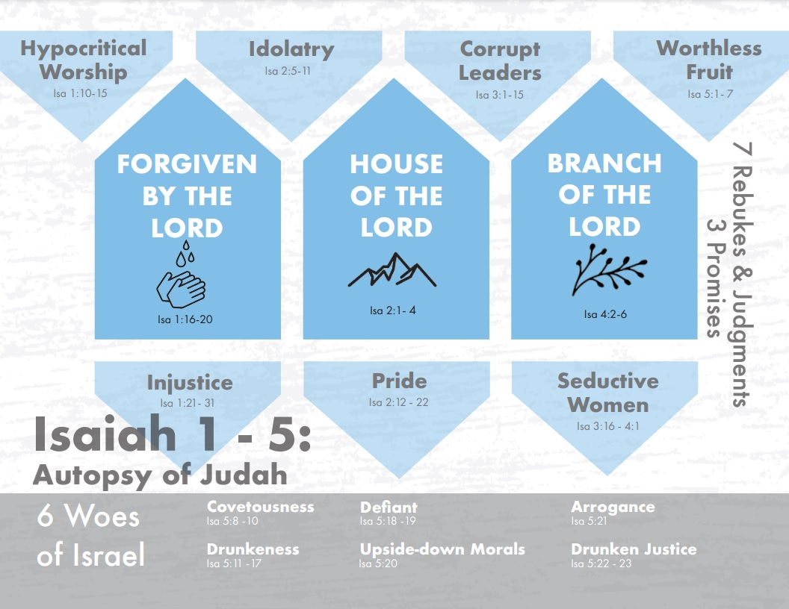
Notes:
In Isaiah chapters 1 – 5, we’re witnessing Isaiah perform a spiritual autopsy on the dead body that Judah has become, and he’s finding 7 specific sins that have just killed them as a nation, and he’s addressing these 7 sins in the form of rebukes and judgments. We’ve observed the first 2 rebukes: hypocritical worship and injustice. This lesson will focus on the next 3 rebukes and judgments: idolatry, pride, and their corrupt leaders. It’s important that we memorize these 7 sins because each of them are going to be revisited time and again, but more importantly, Isaiah is going to show us how he’s going to bring this dead body back to life and turn these sins around into blessings.
Now, in the midst of these rebukes are 3 wonderful promises of better things to come. Thus, we see a pendulum effect throughout these 5 chapters, and in fact throughout the rest of the book, as God’s justice and grace both collide and eventually merge to fulfill the plan He has had for mankind since the beginning of time. The first promise was a promise to forgive them of their sins if they will repent of their sins, though He does not yet reveal who will pay the price for those sins so that forgiveness can be achieved. And the 2nd promise is this wonderful nation that will one day eclipse all nations, the mountain of the house of the Lord in which proper worship and justice will be restored and a grand multitude of people worldwide will flock to.

Slide 2
Rebuke & Judgment 3
Idolatry
Isa 2:5-8 – “⁵Come, house of Jacob, and let us walk in the light of the Lord. ⁶For You have abandoned Your people, the house of Jacob, because they are filled with influences from the east, and they are soothsayers like the Philistines, and they strike bargains with the children of foreigners. ⁷Their land has also been filled with silver and gold and there is no end to their treasures; their land has also been filled with horses and there is no end to their chariots. ⁸Their land has also been filled with idols; they worship the work of their hands, that which their fingers have made.”
Deut 17:16a – “he shall not multiply horses for himself”
Deut 17:17c – “nor shall he greatly increase silver and gold for himself”
Matt 6:24 – “No one can serve two masters; for either he will hate the one and love the other, or he will be devoted to one and despise the other…”
Notes:
Isaiah 2:1-4 leaves you salivating and longing for more, but for now, ideal Jerusalem has to be put on hold. Isaiah has not finished the autopsy, and despite how great things will one day be, these next verses are going to portray the unfortunate reality of present-day Judah – Isa 2:5 – Why? Isa 2:6-8 – So this 3rd rebuke is regarding their gross idolatry. And by beginning the rebuke w/an inspiring call to “come walk in the light of the Lord”. It may be that Isaiah is hoping to provoke them by the Messianic prophecy of the previous 3 verses so they too would want to leave their high places and come to the highest place that there is. We do know that in Rom 11:14, the Apostle Paul hoped to provoke his fellow Jews to jealousy in much the same way, so this may not be far fetched. Because the current situation is that God has abandoned them for allowing them to be influenced by the idolatrous habits of the foreign nations.
Notice the how the word “filled” and “no end” is repeated. This was something explicitly forbidden under the OT.
Deut 17:16a
Deut 17:17c – But this nation has “filled” itself w/idolatry and there is “no end”. Someone might ask, “Well why can’t we have all this stuff and God too?” Because a vessel so “full” of this stuff will not have room for anything else.
Matt 6:24 – And when it came down to God vs. the idols, I think we all know which one became precedence for the people of this day. What a contrast to future Zion, that though nations will one day flow upstream to Zion to hear God’s teaching, right now Jerusalem is taking in all the influences of the very foreigners they should be influencing for good. This is a theme that constantly comes up throughout the book.

Slide 3
Rebuke & Judgment 3
Idolatry
Isa 2:5-8 – “⁵Come, house of Jacob, and let us walk in the light of the Lord. ⁶For You have abandoned Your people, the house of Jacob, because they are filled with influences from the east, and they are soothsayers like the Philistines, and they strike bargains with the children of foreigners. ⁷Their land has also been filled with silver and gold and there is no end to their treasures; their land has also been filled with horses and there is no end to their chariots. ⁸Their land has also been filled with idols; they worship the work of their hands, that which their fingers have made.”
Relational
Financial
Military
Religious
Notes:
Now, when we think about idolatry, our mind typically jumps straight to golden calves and carved images of wood. But that is not the only kind of idolatry; these verses mention 4 different areas of idolatry:
1) Vs. 6 is talking about relational idolatry. They’re “influenced”, they “strike bargains” which some of your translations say “associate”. God’s people were supposed to be a peculiar people, proselytizing foreigners; but foreigners are proselytizing them. Why? Maybe the same reason it happens in our time…to keep the peace, to be polite, to be agreeable. But maintaining these relationships and influences became more of a priority than their God. But we wouldn’t know anything about this, would we? We would never let an earthly relationship come between us and our God! *wink*.
2) The first part of vs. 7 is talks about financial idolatry. Having money is not idolatry, but filling oneself w/it because of greed and covetousness is. Col 3:5 – “Therefore consider the members of your earthly body as dead to immorality, impurity, passion, evil desire, and greed, which amounts to idolatry.” When we’re placing our trust and security in our wealth, it’s robbing us of our trust in God. But we wouldn’t know anything about that in the USA. *wink*
3) The second part of vs. 7 is talking about military idolatry. The reason God didn’t want them multiplying horses and chariots is because He wanted them to look to Him for protection, not to what their heathen neighbors like Egypt and others could provide for them. Because if you’re leading in the arms race, you’ll no longer feel as if you need God. This is idolatry, too.
4) And vs. 8 is talking about religious idolatry. Interesting that He only gets to images after he talks about the other 3 things. And while we may pat ourselves on the back for being too smart to give into religious idolatry in the form of constructing golden calves, I think we’d all admit that as people and as a nation and superpower, we continue to fail in the other 3. Idolatry is an issue of trust. They’re leaning on these things that are fleeting to get them through times of trial and uncertainty, and they’re going to have to be removed in order to get the people to trust God again. This is a theme that will be developed further throughout the book, especially as we get to chapters 40 – 48.

Slide 4
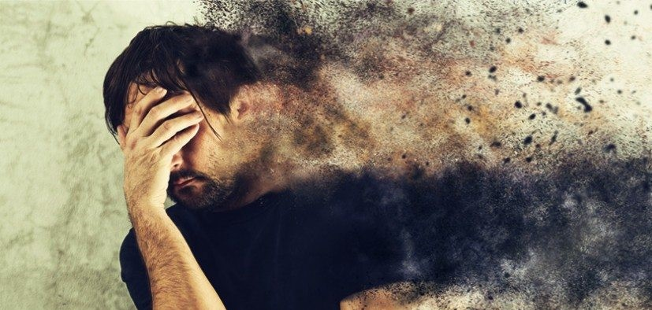
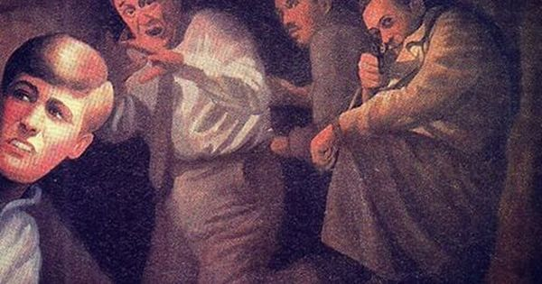
Rebuke & Judgment 3
Judgment
Isa 2:9-11 – “⁹So the common man has been humbled and the man of importance has been abased, but do not forgive them.¹⁰Enter the rock and hide in the dust from the terror of the Lord and from the splendor of His majesty. ¹¹The proud look of man will be abased and the loftiness of man will be humbled, and the Lord alone will be exalted in that day.”
Notes:
Though God had advanced and given them honor above and in the sight of all the other nations, they’ve degraded themselves through the thoughtless pursuit of these other things, and so their judgment is straight forward – Isa 2:9-11 – In other words, every person guilty of this, from the common to the esteemed, will be brought low. And in this way God will be exalted. The phrase “do not forgive them” has given trouble to many bible students. One likely explanation is that rather than Isaiah asking God not to forgive them, he’s merely expressing that for how horrid the sin of idolatry is, “forgiveness is unthinkable”. But perhaps a better temptation is that since God’s judgment is causing them to flee to the rocks and caves, this would imply they are not repentant. And if they are not repenting, there can be no forgiveness. And anyone who puts their trust in the natural will inevitably flee to the natural in order to avoid the supernatural. But one way or another, the prideful spirit will be broken, and God will be honored. The way God is going to correct the problem of idolatry that plagued the nation is really awesome, so stay tuned.

Slide 5
Rebuke & Judgment 4
Pride
Isa 2:12-17 – “¹²For the Lord of hosts will have a day of reckoning against everyone who is proud and lofty and against everyone who is lifted up, that he may be abased. ¹³And it will be against all the cedars of Lebanon that are lofty and lifted up, against all the oaks of Bashan,¹⁴against all the lofty mountains, against all the hills that are lifted up, ¹⁵against every high tower, against every fortified wall, ¹⁶against all the ships of Tarshish and against all the beautiful craft. ¹⁷The pride of man will be humbled and the loftiness of men will be abased; and the Lord alone will be exalted in that day”.
Natural
Cedars
Oaks
Mountains
Hills
Purpose?
Symbols
Security
Abuse
Notes:
Though they had no reason to be prideful over their idolatries, pride infected them nonetheless, and that is the subject of rebuke #4 – Isa 2:12-17 – Isaiah uses several figures to illustrate pride, both of a natural and artificial nature.
The natural illustrations are the cedars, the oaks, the mountains, and the hills. These are word pictures, and there are at least 3 ways of looking at it
1) What they symbolically represent. Cedars of of Lebanon were some of the straightest and stateliest trees, and the oaks of Bashan were the strongest and sturdiest. Both were nature’s “sure things”, and it may be that Isaiah is saying that the pride of man is like, firmly planted and immovable by most storms, looking around at everyone else as if they were mere shrubs. The mountains and hills, as we already have seen from chapter 2, typically represented nations, and anytime a collection of people come together for a common mission and purpose, national pride can follow – remember Babel.
2) False sense of security. Cedars and oaks were cut down and used to build war machines and fortifications and weapons. Cities and mountains were typically where you would build cities because they were much harder to besiege. And so, using both the trees and the natural elevations provided a false sense of security for many nations of this time, which fostered pride
3) Abuse. Cedars and oaks were cut down and crafted into idols. Mountains and hills were the place in which these idols were worshipped. Rom 8:21-22 – “…the creation itself also will be set free from its slavery to corruption into the freedom of the glory of the children of God. For we know that the whole creation groans and suffers the pains of childbirth together until now.” And how could it not groan seeing how it was used for evil? Which of these 3 ways of looking at this is correct? Answer: all of them. That’s the wonderful thing about word pictures in Hebrew poetry (metonymy) – they give us different layers of interpretation. And each of these interpretations will come up again later in Isaiah.

Slide 6
Rebuke & Judgment 4
Pride
Isa 2:12-17 – “¹²For the Lord of hosts will have a day of reckoning against everyone who is proud and lofty and against everyone who is lifted up, that he may be abased. ¹³And it will be against all the cedars of Lebanon that are lofty and lifted up, against all the oaks of Bashan,¹⁴against all the lofty mountains, against all the hills that are lifted up, ¹⁵against every high tower, against every fortified wall, ¹⁶against all the ships of Tarshish and against all the beautiful craft. ¹⁷The pride of man will be humbled and the loftiness of men will be abased; and the Lord alone will be exalted in that day”.
Artificial
Towers
Walls
Ships
Craft
Purpose?
Symbols
Security
Abuse
Notes:
The artificial things are just an extension of the natural, seeing as how the mountains and trees would have contributed to their construction. Towers and walls provided physical security and contributed to national pride because of how they would often be decorated w/national symbols, and the Jews of that day put too much confidence in these things, as we’ll see in greater detail in chapters 17 and 22. The ships of Tarshish contributed to trade and a healthy economy, representing man’s triumph over the natural forces such as the wind and the sea. And as we’ll see in chapter 23, nations like Phoenicia who were adept at sea travel would colonize along their trade routes, extending their reach and their destructive influence, and it cultivated great pride. And it contributed to beautiful craftmanship they would import and export, or that man, in his abilities, would craft from trees and stones.

Slide 7
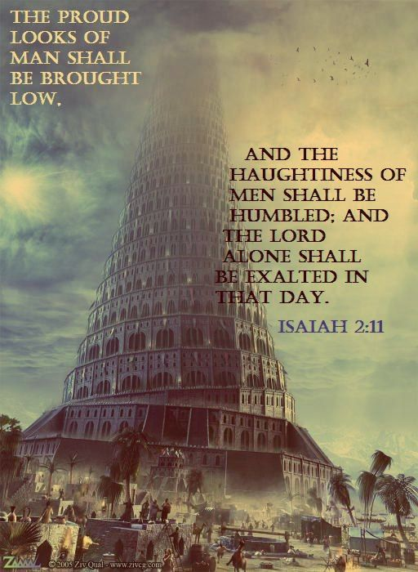
Rebuke & Judgment 4
Judgment
Isa 2:18-22 – “¹⁸But the idols will completely vanish. ¹⁹Men will go into caves of the rocks and into holes of the ground before the terror of the Lord and the splendor of His majesty, when He arises to make the earth tremble. ²⁰In that day men will cast away to the moles and the bats their idols of silver and their idols of gold, which they made for themselves to worship, ²¹in order to go into the caverns of the rocks and the clefts of the cliffs before the terror of the Lord and the splendor of His majesty, when He arises to make the earth tremble. ²²Stop regarding man, whose breath of life is in his nostrils; for why should he be esteemed?”
Notes:
Their judgment? – Isa 2:18-22 – So as we can see, much of their idolatry was directly connected to their pride. And we see the same kind of judgment happening as w/the judgment of idolatry, men fleeing to the natural to avoid the supernatural. The biggest different here, though, is that this judgment would be so fierce, men would cast their idols, in which they once prided themselves in, back to the holes and caves where they came from. And the idols aren’t going to prevent that treatment shown them because they are lifeless and so they can’t secure themselves let alone their worshippers. Even the valuable idols, the ones made of silver and gold, will be abandoned. Why? Because when sinful man can’t be reasoned out of their sin, God has a way of frightening that sin out of us to such a degree that those things we once looked at w/such value and security are thrust back to the earth they came from.

Slide 8
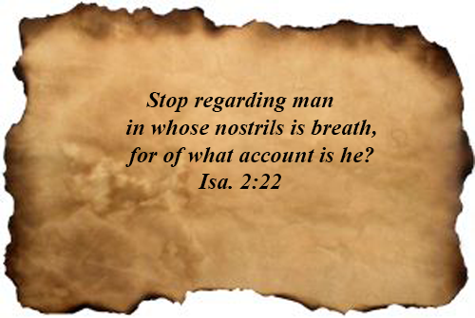
Rebuke & Judgment 4
Notes:
Now, this last verse in chapter 2 is the point that Isaiah attempts to drive throughout this entire book – Isa 2:22 – “Stop regarding man, whose breath of life is in his nostrils; for why should he be esteemed?” Remember, the point of Isaiah is “Trust God”. And we cannot trust God, as long as trust in man. Man is weak, completely dependent on God who gives him the breath of life. Every breath we take is a result of God’s grace. The great irony we will see throughout this book is how often fallen man places all of its hope and confidence in fallen man. And what Isaiah is teaching is to look to God to solve the problems only God can solve. In times of uncertainty, trust God. Not the idols, not your money, not your relationships, and not your weapons. Don’t trust other nations to bail you out of trouble. Don’t trust the nations for answers to your problems. Don’t fear the nations threatening you. These are themes that come up in Isaiah time and again because they are the things that plagued Judah and kept them from being what God wanted them to be. And as we’ve already seen, part of fixing their issue is going to be removing those things that are causing them to stumble, through a purging. And later in the book, He’s going to replace these things with something (someone) far greater to restore their trust and faith in God.

Slide 9
Isa 2:11-21 Inclusios
Isa 2:11-21 – “¹¹The proud look of man will be abased and the loftiness of man will be humbled, and the Lord alone will be exalted in that day. ¹²For the Lord of hosts will have a day of reckoning against everyone who is proud and lofty and against everyone who is lifted up, that he may be abased. ¹³And it will be against all the cedars of Lebanon that are lofty and lifted up, against all the oaks of Bashan,¹⁴against all the lofty mountains, against all the hills that are lifted up, ¹⁵against every high tower, against every fortified wall, ¹⁶against all the ships of Tarshish and against all the beautiful craft. ¹⁷The pride of man will be humbled and the loftiness of men will be abased; and the Lord alone will be exalted in that day. ¹⁸But the idols will completely vanish. ¹⁹Men will go into caves of the rocks and into holes of the ground before the terror of the Lord and the terror of the Lord and the splendor of His majesty, when He arises to make the earth tremble. ²⁰In that day men will cast away to the moles and the bats their idols of silver and their idols of gold, which they made for themselves to worship, ²¹in order to go into the caverns of the rocks and the clefts of the cliffs before the terror of the Lord and the splendor of His majesty, when He arises to make the earth tremble.”
Notes:
One thing that Isaiah often uses throughout his book is a literary device called an “inclusio”. Now this sounds like a Harry Potter spell, but it’s actually just a literary device to emphasis points through repetitions. Think of an inclusion like the chorus of many of the hymns we sing, which we repeat 3 or 4 times throughout a song. An inclusio is where the writer repeats a statement so as to form a bracket or “chorus” so as to emphasize something very important. And we find 2 inclusios in Isa 2:11-21. One is the certainty that man’s pride will be abased and God exalted. The second is the certainty of his punishment, fleeing to the natural from the supernatural. We’ll emphasize as many inclusios as we find in the book, but keep an eye out for them as the purpose of every inclusio is to pound a point home.

Slide 10
Isa 2:10-21 Chiasm
God commands to hide in rocks/caves (10)
B. Man humbled, God exalted (11)
C. Nature instigates man’s pride (13-14)
C’. Man instigates pride by own works (15-16)
B’. Man humbled, God exalted (17)
A’. No one has to tell them to hide (18-22)
Notes:
Another interesting chiasm. Consider all the literary devices we’ve seen so far – chiasms, inclusios, word pictures (metonymy). The reason we want to expose these early is to get us used to reading Hebrew poetry – it is so different then reading straight narrative. And in exposing these to us early on in the book, I’m hoping as you read further, you’ll be able to identify them on your own.

Slide 11
Rebuke & Judgment 5
Corrupt Leaders
Isa 3:14-15 – “¹⁴The Lord enters into judgment with the elders and princes of His people, ‘It is you who have devoured the vineyard; the plunder of the poor is in your houses. ¹⁵What do you mean by crushing My people and grinding the face of the poor?’ Declares the Lord God of hosts.”
Notes:
Rebuke #5 is against the leaders. And Isaiah introduces another literary technique in which he goes in reverse, putting the effect before the cause. Rather than giving the rebuke and then the judgment, as he has done so far, vs. 1-13 is the judgment and vs. 14-15 is the rebuke. If there is a name for this literary technique, I’m unsure what it is, but we do find Isaiah doing this again in places like chapter 14, 18, 40, and 49. So the rebuke is Isa 3:14-15 – The idea is that even the greatest of men in a society, in this case the elder and princes, are not exempt from scrutiny in the court of heaven. In fact, they are given a greater rebuke and judgment considering that their role was to adjudicate the cause of the poor, fatherless, and widow. But these in Judah who were assigned to protect the oppressed had themselves become the oppressors, hoarding in their homes what they gained through this oppression, and Isaiah compares this oppression to taking the poor one by one and grinding their faces as if in a mill and crushing them. And God assures them they will be liable to Him.

Slide 12
Rebuke & Judgment 5
Judgment
Isa 3:1-5 – “¹For behold, the Lord God of hosts is going to remove from Jerusalem and Judah, both supply and support, the whole supply of bread and the whole supply of water; ²the mighty man and the warrior, the judge and the prophet, the diviner and the elder, ³the captain of fifty and the honorable man, the counselor and the expert artisan, and the skillful enchanter. ⁴And I will make mere lads their princes, and capricious children will rule over them, ⁵and the people will be oppressed, each one by another, and each one by his neighbor; the youth will storm against the elder and the inferior against the honorable.”
Supplies taken away
Men of renown judged
Notes:
The section of judgment in vs. 1 – 13 is lengthy, and the reason Isaiah begins w/it in this case may be because it comes fresh off the cuff of Isa 2:22 which warns against esteeming man higher than he needs to be esteemed. Why? Because even the most preeminent of men disappoint, as these in Judah did as well as the ones in our society. And putting our trust in them above God results in nothing but folly and confusion.
Isa 3:1 – Again, we’re starting to see a pattern in these 1st 5 chapters in which all things man trusts in are going to be taken away. Why? So, they’ll learn to lean in God as their only support, a theme developed throughout Isaiah in constant allusions to Him being our solid rock. And since having bread and water is so contingent on having a leadership hierarchy in place, God removing these bad leaders will result in an economic collapse.
What leadership? – Isa 3:2-3 – So the military leaders, political leaders, religious leaders (both legitimate and illegitimate), and skilled craftsmen. All areas in which men are prone to put too much trust. Remember when Nebuchadnezzar came back to Jerusalem to deport a 2nd group of Jews in 2 Kings 24:14? Who did he take? All the skilled people. He upset their infrastructure thinking that would demoralize them into submission. Babylon learned this from Assyria.

Slide 13
Rebuke & Judgment 5
Judgment
Isa 3:1-5 – “¹For behold, the Lord God of hosts is going to remove from Jerusalem and Judah, both supply and support, the whole supply of bread and the whole supply of water; ²the mighty man and the warrior, the judge and the prophet, the diviner and the elder, ³the captain of fifty and the honorable man, the counselor and the expert artisan, and the skillful enchanter. ⁴And I will make mere lads their princes, and capricious children will rule over them, ⁵and the people will be oppressed, each one by another, and each one by his neighbor; the youth will storm against the elder and the inferior against the honorable.”
Supplies taken away
Men of renown judged
Rebellious children rule
Populace oppresses
Notes:
This resulted in anarchy, which quelled possible rebellions, because who will take their place? Isa 3:4 – Children…with all the fickleness and folly they bring. They should be under tutors, but they will storm against the older. We remember Rehoboam in 1 Kings 12, who would not listen to the advice of the elders, but his friends instead. This was in contrast to his father Solomon who recognized in 1 Kings 3:7 the lack of wisdom that came w/his youthfulness. There’s an Arabian writer named Zamaschari who once said, “A blow in the face by an axe is easier to take than the rule of a boy.” And there’s wisdom in God’s judgment here, because by replacing their leadership w/the inept and unqualified, perhaps this would force them to trust in God.
Isa 3:5 – In other words, the populace will now become like the leaders before them, each one oppressing the other because no leader is left to bring order. Before, there was no justice because the leaders were corrupt. Now there is no justice because the leaders have been removed, the infrastructure has been upset, and in the midst of the chaos people are taking advantage of one another to get what they want.

Slide 14
Rebuke & Judgment 5
Judgment
Isa 3:6-13 – “⁶When a man lays hold of his brother in his father’s house, saying, ‘You have a cloak, you shall be our ruler, and these ruins will be under your charge,’ ⁷he will protest on that day, saying, ‘I will not be your healer, for in my house there is neither bread nor cloak; you should not appoint me ruler of the people.’ ⁸For Jerusalem has stumbled and Judah has fallen, because their speech and their actions are against the Lord, to rebel against His glorious presence. ⁹The expression of their faces bears witness against them, and they display their sin like Sodom; they do not even conceal it. Woe to them! For they have brought evil on themselves. ¹⁰Say to the righteous that it will go well with them, for they will eat the fruit of their actions. ¹¹Woe to the wicked! It will go badly with him, for what he deserves will be done to him. ¹²O My people! Their oppressors are children, and women rule over them. O My people! Those who guide you lead you astray and confuse the direction of your paths. The Lord arises to contend, and stands to judge the people.”
No one wants to rule
People emboldened
Judgment Indiscriminate
Notes:
So then here is how desperate they will now become for leadership – Isa 3:6-7 – My, how things have changed. I remember some children of Israel who resented their brother for his coat of many colors. Now they’re so desperate for someone to become leader and to end the chaos, they’ll turn to the first man who seems to don the “dress”. But he’ll turn them down! This is truly a sign of a nation in terrible distress when men don’t even want a seat in its government, wanting neither credit or profit by it, which is generally why men do it in the first place.
Vs. 8 then says Jerusalem has fallen, and they brought it on themselves – Isa 3:8-9 – In other words, the outward fall in leadership was preceded by an internal falling, which is surprising because this is Jerusalem, the city of God, the city of the law and the temple who other nations were supposed to look up to. But she’s fallen so far, she’s not even trying to hide it anymore, a refence back to 1:10 is no longer trying to hide it, displaying her sin like Sodom.
But then in a reference back to 1:9, God assures His people that His judgment will not be indiscriminate – Isa 3:10-11 – Same thing he told Cain in Gen 4:7 – “If you do well, your countenance will be lifted up…if you don’t, sin is crouching at your door.” The wicked are going to get exactly what they deserve. Question, did God spare a righteous remnant from Sodom and Gomorrah? Yes, Lot and his daughters. In Exodus, did God judge Egypt but spare Israel through the plagues? Yes. He will do the same in the coming purge. How? That’s God’s end of the stick.
Isa 3:12 – And he’s going to build on this beginning in 3:16, that not only will children assume roles they are unqualified for, Judah’s women will begin to assume roles never intended for them, and it will lead to further disfunction throughout the nation.

