Slide 1
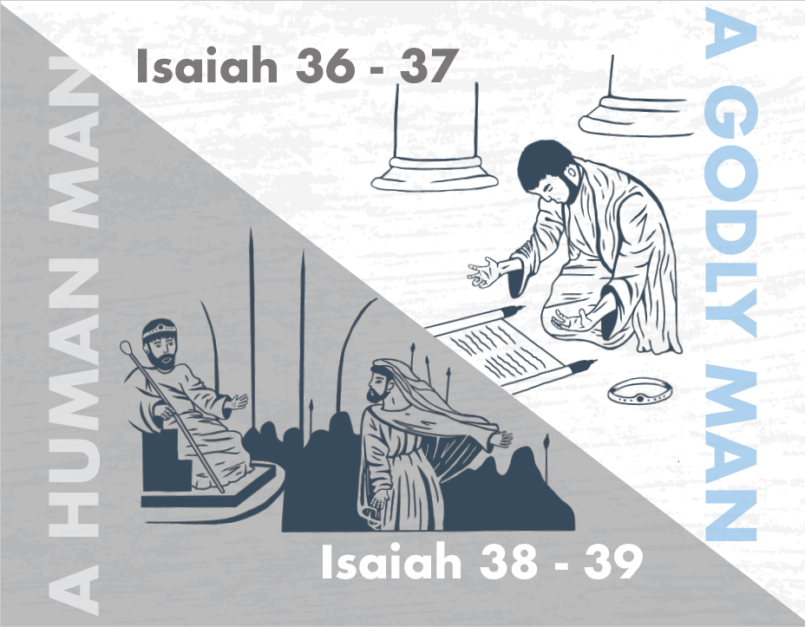
Notes:
Chapter 37 begins at a critical moment in the history of God’s people. Sennacherib, king of Assyria, has decimated the nation of Judah. As he finishes up his siege at Lachish, he has his sights set 20 miles northeast toward Jerusalem. And hoping Jerusalem will surrender w/o a fight, he sends his head trash talker, the Rabshakeh, to wage psychological warfare w/Hezekiah and those guarding the city. And the Rabshakeh said some very intimidating things. So, what will Jerusalem do? Will they discount everything Isaiah has been counseling for decades, in which we have already studied in the first 35 chapters, or will this terror drive them further into the Lord’s embrace? Chapter 37 answers this question, and concludes this massive first section of Isaiah on what God is able to do for those who have unshakable, unwavering trust.

Slide 2
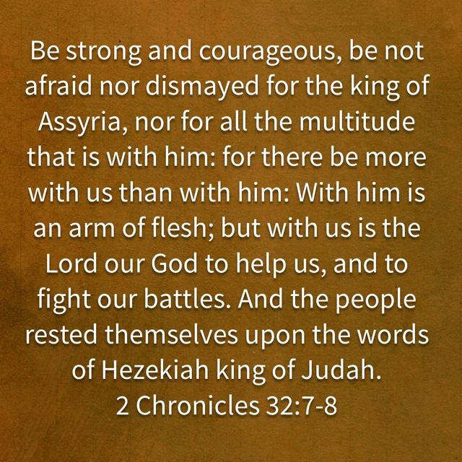
The Grand Finale
Hezekiah Informed
Isa 37:1-4 – “¹And when King Hezekiah heard it, he tore his clothes, covered himself with sackcloth and entered the house of the Lord. ²Then he sent Eliakim who was over the household with Shebna the scribe and the elders of the priests, covered with sackcloth, to Isaiah the prophet, the son of Amoz. ³They said to him, ‘Thus says Hezekiah, “This day is a day of distress, rebuke and rejection; for children have come to birth, and there is no strength to deliver. ⁴Perhaps the Lord your God will hear the words of Rabshakeh, whom his master the king of Assyria has sent to reproach the living God, and will rebuke the words which the Lord your God has heard. Therefore, offer a prayer for the remnant that is left.”’”
Notes:
You’ll recall from the end of chapter 36, that at the conclusion of the Rabshakeh’s first 2 speeches, Hezekiah’s officials tore their clothes in despondency. What will be Hezekiah’s response?
Isa 37:1 – Notice how this news didn’t cause Hezekiah to throw up his hands and give up; he sought out God all the more in his house. We’re starting to see a different caliber of character in Hezekiah than we saw in his father Ahaz. That he tore his clothes is no outward show. Hezekiah now realizes that God is his only resource. Those words of encouragement he had uttered to the people in 2 Chron 32:7-8 are now going to be put to the test.
He next takes action – Isa 37:2 – Remember back in chapter 30 that they had repudiated Isaiah for his harsh words. But here, Hezekiah sees Isaiah as the one who had the answers all along. I wonder if when Shebna’s eyes met Isaiah’s, whether he remembered the rebuke from 22:15-19? Did Eliakim remember Isaiah’s words of being too much weight on an empty peg in 22:25? Regardless, all parties finally appear to be in a penitent state for God to help them.
What was the message to Isaiah? – Isa 37:3-4 – When a birth mother is in the situation described, she has to deliver the baby or they will both die. But how do you deliver that baby if you have no strength left to push? That’s what Hezekiah’s message is to Isaiah – he has no strength left; he’s out of options. Sometimes when we get down, we’ll admit we need some assistance, but we’ll continue to treat ourselves as lords of the situation, only using God as a backup plan. But Hezekiah now recognizes that every human means to get rid of Assyria has failed, which Isaiah already said would happen. And so, notice how he bases his appeal on absolutely nothing other than the hope God will intervene on Jerusalem’s behalf for His sake alone. Notice the phrase “your God” – Hezekiah is recognizing his unworthiness, and so he simply appeals on the basis of God’s honor. And then his second concern is for the remnant, and those remaining in Judah were indeed few, as most were already imprisoned and deported. It’s touching he is concerned for those 2 things rather than himself.

Slide 3
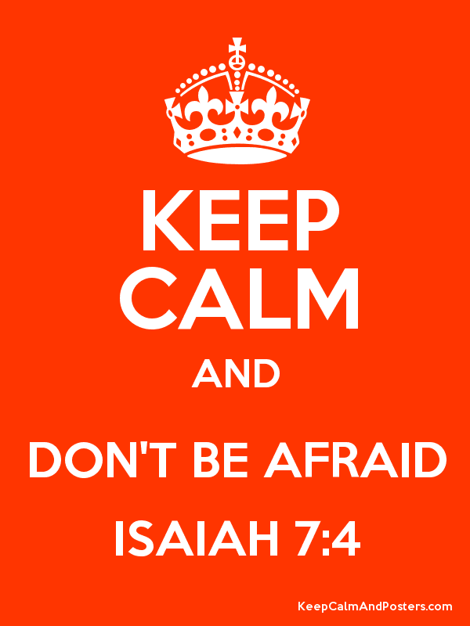
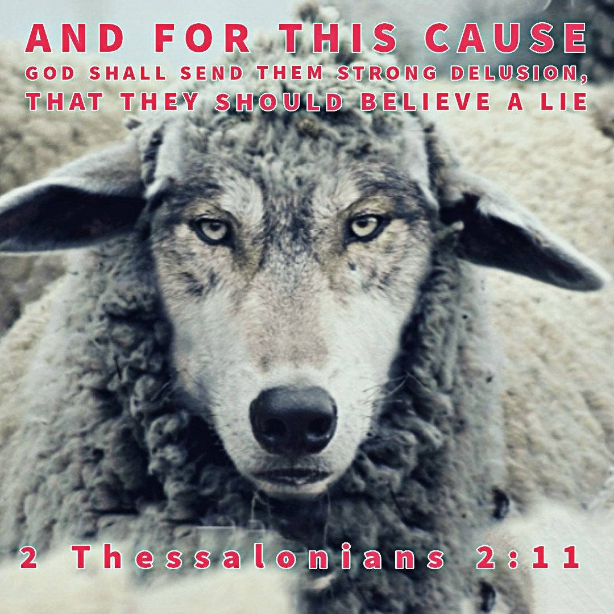
The Grand Finale
Isaiah’s Response
Isa 37:5-7 – “⁵So the servants of King Hezekiah came to Isaiah. ⁶Isaiah said to them, ‘Thus you shall say to your master, “Thus says the Lord, ‘Do not be afraid because of the words that you have heard, with which the servants of the king of Assyria have blasphemed Me. ⁷Behold, I will put a spirit in him so that he will hear a rumor and return to his own land. And I will make him fall by the sword in his own land.’”’”
Notes:
And Isaiah doesn’t repudiate them. He doesn’t say, “Stay here while I go and inquire of the Lord.” The Rabshakeh’s blasphemy had already been heard, and Isaiah had already received a word from God.
Isa 37:5-6 – They were sent to ask for intercession and prayer, but there doesn’t appear to be any. Isaiah seemingly gives no hesitation, simply a message of reassurance and promise of divine action, saying “do not be afraid.” Who had Isaiah also said that to in this book?
Ahaz in 7:4. So, we’ve seen 2 similarities/contrasts between Ahaz and Hezekiah thus far – both times, a message was relayed on the highway by the fuller’s field, and Isaiah’s message to both of them was “do not be afraid”. It’s almost as if God is purposefully trying to call our attention to the similarities and contrasts of these 2 stories. The word “servants” as used here of Assyria’s servants is actually a derogatory term in the Hebrew language, similar to our “flunkies/lackies/underlings/stooges” – errand boys for an overblown ego.
And now God will show just how utterly in control of this situation He is – Isa 37:7 – Now, the rumor is unclear, though it could be what we’ll see referred to in the next verse. But what is clear is that God will predispose him to leave, proving His sovereignty. Those who continue to delude themselves, God furthers the delusion, just as He did w/Pharaoh, because He alone has access to mankind’s psyche.

Slide 4
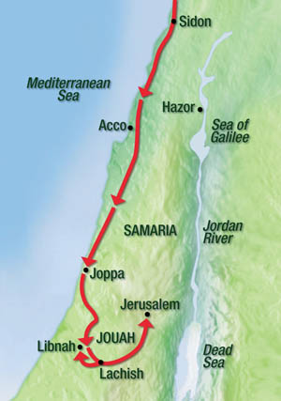
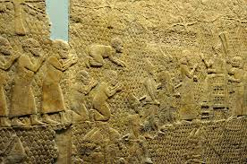
The Grand Finale
Rabshakeh’s Letter
Isa 37:8-13 – “⁸Then Rabshakeh returned and found the king of Assyria fighting against Libnah, for he had heard that the king had left Lachish. ⁹When he heard them say concerning Tirhakah king of Cush, ‘He has come out to fight against you,’ and when he heard it he sent messengers to Hezekiah, saying, ¹⁰‘Thus you shall say to Hezekiah king of Judah, “Do not let your God in whom you trust deceive you, saying, ‘Jerusalem will not be given into the hand of the king of Assyria.’ ¹¹Behold, you have heard what the kings of Assyria have done to all the lands, destroying them completely. So will you be spared? ¹²Did the gods of those nations which my fathers have destroyed deliver them, even Gozan and Haran and Rezeph and the sons of Eden who were in Telassar? ¹³Where is the king of Hamath, the king of Arpad, the king of the city of Sepharvaim, and of Hena and Ivvah?”’”
Notes:
So now we’re going to see a momentary break in the threat.
Isa 37:8-9a – Lachish is the city Assyria was finishing up besieging while the Rabshakeh was bumping gums in Jerusalem, and the relief in the bottom right depicts captives from Lachish bringing tribute and bowing before the Assyrian throne. But what has happened is they’ve “heard” that Ethiopia’s king, who also controls Egypt at this time, has come up to fight against them. We don’t know if this was true, but it would make sense because Assyria is enjoying such a successful campaign in Judah, Egypt knows that if they succeed, there is no more buffer zone. And so, Assyria’s army temporarily withdraws from Lachish toward Libnah ~12 miles northeast.
This seemingly renewed effort by Ethiopia’s king causes Sennacherib to intensify his efforts to convince Hezekiah to give up Jerusalem w/o fight, as he probably would prefer not to wage war on 2 fronts, and so we presumably see the Rabshakeh’s 3rd speech now – Isa 37:9b-13 – Now we saw this tactic from the enemy back in chapter 36. “Not only can you not win, I’ve got proof you can’t win.” But now he’s saying, “And here’s more proof you can’t win!”, by reasserting their invincibility over the nations. But rather than accusing Hezekiah of using faith as a pawn for political survival, he has the audacity to say that God Himself is deceiving the people, reasserting Jerusalem’s inevitable fall. Interestingly, he does refer to Hezekiah as “king” for the first time, perhaps no longer caring to discredit him before the people, but simply to discredit God. But what he doesn’t realize is that counting Jehovah among the gods of the other nations and treating the Davidic king as just another king will be their ultimate undoing.

Slide 5
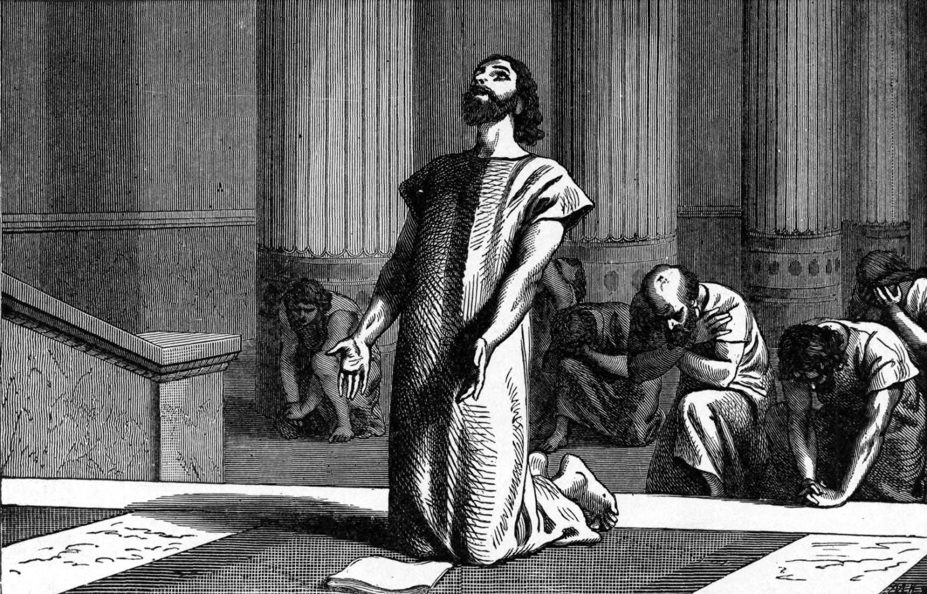
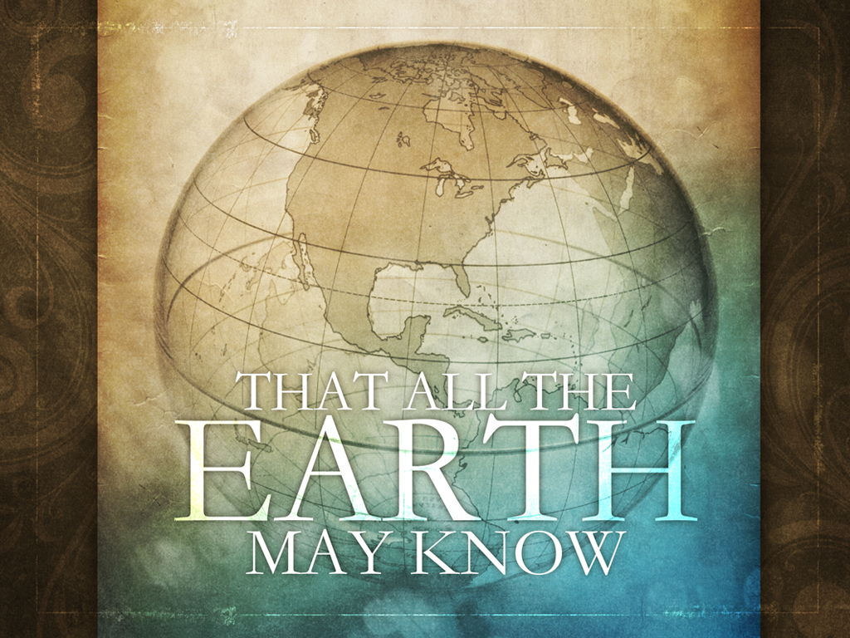
The Grand Finale
Hezekiah’s Prayer
Isa 37:14-20 – “¹⁴Then Hezekiah took the letter from the hand of the messengers and read it, and he went up to the house of the Lord and spread it out before the Lord. ¹⁵Hezekiah prayed to the Lord saying, ‘¹⁶O Lord of hosts, the God of Israel, who is enthroned above the cherubim, You are the God, You alone, of all the kingdoms of the earth. You have made heaven and earth. ¹⁷Incline Your ear, O Lord, and hear; open Your eyes, O Lord, and see; and listen to all the words of Sennacherib, who sent them to reproach the living God. ¹⁸Truly, O Lord, the kings of Assyria have devastated all the countries and their lands, ¹⁹and have cast their gods into the fire, for they were not gods but the work of men’s hands, wood and stone. So they have destroyed them. ²⁰Now, O Lord our God, deliver us from his hand that all the kingdoms of the earth may know that You alone, Lord, are God.’”
Notes:
Now in vs. 1-2, Hezekiah rent his garments and asked Isaiah to pray. But notice that he does his own praying now.
Isa 37:14-15a – The laying of the letter before God is not to tell God something He doesn’t already know. It is an expression of shock and outrage. Hezekiah now puts his faith in God, because as we saw in 28:16, those who do so will not be disturbed. As we read this prayer, notice that it is a prayer not based on Hezekiah’s righteousness, but solely on the character of God
Isa 37:15b-16 – So notice the themes. Hezekiah first acknowledges God’s character, that though enthroned above all, He is present in everyone’s life, which was the theme of chapters 7 – 35. And contrary to Assyria’s pagan view, He is the God, the one and only, implication being He will continue His work by not allowing them to be destroyed by Assyria.
Isa 37:17 – He is praying to a God so unlike the idols because, being “the” living God, He actually does see and hear. This sets Him apart from all other pagan claims of deity. And the living God has been mocked, blasphemed, and dishonored, and this is of sincere concern to Hezekiah who is asking on that basis alone for God to act accordingly.
Isa 37:18-19 – So, notice that Hezekiah acknowledges Sennacherib’s so-called “proof”, the claim of destroying the other nations and their gods. This is a mental challenge for the Jews; the physical evidence was against God helping. Their country appeared small and weak, having lost many battles to Assyria already. But, again, should the one true and living God be numbered among false gods?
Isa 37:20 – In concluding his prayer, it would seem reasonable for Hezekiah to now ask for deliverance because of his personal dependance on God. But in a stunning, selfless twist, he is concerned only for God’s glory. Meaning, what happens to him or what happens to Jerusalem isn’t the most important thing; but what happens to God’s name matters for the world. God is the end, and deliverance would simply be the means to that end.

Slide 6
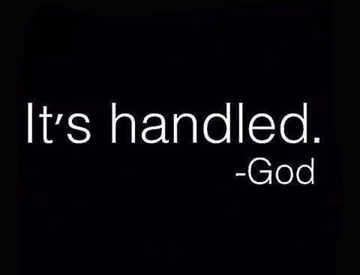
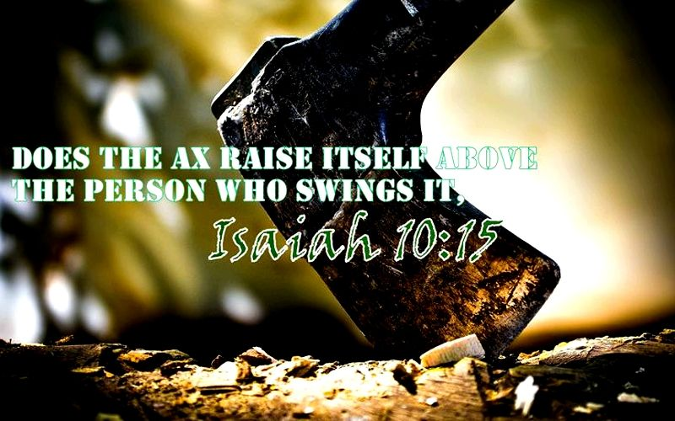
The Grand Finale
God’s reassurance
Isa 37:21-25 – “²¹Then Isaiah the son of Amoz sent word to Hezekiah, saying, ‘Thus says the Lord, the God of Israel, “Because you have prayed to Me about Sennacherib king of Assyria, ²²this is the word that the Lord has spoken against him: ‘She has despised you and mocked you, the virgin daughter of Zion; she has shaken her head behind you, the daughter of Jerusalem! ²³Whom have you reproached and blasphemed? And against whom have you raised your voice and haughtily lifted up your eyes? Against the Holy One of Israel! ²⁴Through your servants you have reproached the Lord, and you have said, “With my many chariots I came up to the heights of the mountains, to the remotest parts of Lebanon; and I cut down its tall cedars and its choice cypresses. And I will go to its highest peak, its thickest forest. ²⁵I dug wells and drank waters, and with the sole of my feet I dried up all the rivers of Egypt.’”
Notes:
The next set of verses are the specific response to the king’s prayer.
Isa 37:21-22a – Meaning, since he approached God personally rather than asking Isaiah to intercede as in vs. 5, the God of Israel (not an idol) responds to his prayer. What if he hadn’t prayed? How many victories, lost souls, etc. are left unclaimed because we did not pray. This is a message sent from Isaiah to Hezekiah; meaning, Isaiah wrote it so God’s response to Assyria’s blasphemy would be preserved.
Isa 37:22b-23a – In other words, God acts for His daughter Zion the same way we would if someone mocked our daughter. “Virgin” is used here in the sense of not having been “defiled” by a conqueror (23:12; 47:1). She has repeatedly rebuffed Assyria’s advances, but Assyria continues to insult her.
And so, God says in essence, “Who do you think you’re talking to!?!?”. Isa 37:23b-24a –Simply by threatening His daughter, Assyria is threatening Him. He has “raised” and “lifted” himself against God, though these are the same verbs used in 6:1 to describe God’s exaltedness. Blasphemy is to act high-handedly. As if Sennacherib were God, he is actually speaking against the one and only true God, not privately, but in open, public defiance. And Sennacherib wasn’t man enough to say those things himself, but had to send his servants to do his dirty work.
Isa 37:24b-25 – By chariots, it’s to mean Assyria is confident in its own material power. She sees her opponents as nothing more than natural hazards to its plans, and no height or jungle barrier will stop him. The highest peaks and thickest forests probably figurative of Jerusalem (Jer 22:6; Ezek 17:3). Assyria’s goal was to conqueror them as well, thinking nothing could stop him. Sennacherib’s own inscriptions use the personal pronoun as often as this verse (10:13-14). He also claims to have had the technology to provide for himself. When water is lacking, he finds it. When water is a barrier to him, his foot is so big he can dry the Nile itself. He’s so confident in his abilities, he believes he can defy nature itself, both the north (Lebanon) and the south (Egypt); truly he is a world conqueror, and it has gone to his head in a big way.

Slide 7
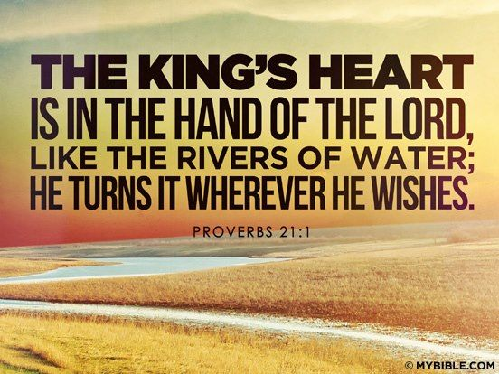
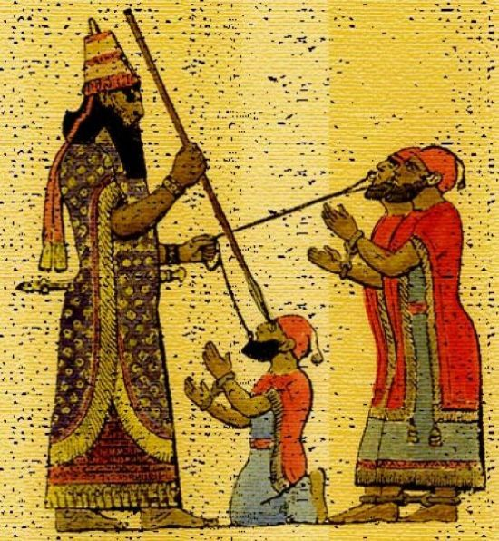
The Grand Finale
God’s reassurance
Isa 37:26-29 – “²⁶Have you not heard? Long ago I did it, from ancient times I planned it. Now I have brought it to pass, that you should turn fortified cities into ruinous heaps. ²⁷Therefore their inhabitants were short of strength, they were dismayed and put to shame; they were as the vegetation of the field and as the green herb, as grass on the housetops is scorched before it is grown up. ²⁸But I know your sitting down and your going out and your coming in and your raging against Me. ²⁹Because of your raging against Me and because your arrogance has come up to My ears, therefore I will put My hook in your nose and My bridle in your lips, and I will turn you back by the way which you came.”
Notes:
But who is the source behind these things?
Isa 37:26-27 – Here is the comical irony of it all – Assyria is nothing more than the victim of the ultimate long con devised by God. God arranged it and brought it to pass exactly as He intended. Even Judah’s humiliation by Assyria was God’s plan, for punishing Zion and purging her of sin. God used this evil king (Prov 21:1,31). He used them to disgrace Judah for trusting in their fortified cities and idols and to remove her strength, all that self-reliance that kept her from seeking God. But Sennacherib mistakenly equated the effect for the cause, causing her to be nothing more than a tool puffed up against the hand that swings it.
Isa 37:28 – That first phrase is a common idiom used in OT for the entirety of one’s activities. Nothing in Sennacherib’s life is hidden from God, in particular His blasphemy. God knows. He is acutely aware of all that we say and do, from the little inconsequential things to the big things.
So, look what God is going to do to them – Isa 37:29 – This is how Assyria cruelly led others to captivity (according to ANEP), hooks through the nose or a ring through the lips. As captives are led by the will of their captor, Sennacherib will return in a similar way purely by the will of God. “You want to act like an unreasoning animal, I’ll treat you like one.” As we’re going to see in chapters 40 – 66, one day, the theocracy would need to be destroyed for its sin to usher in the Redeemer. But because of Hezekiah’s penitent prayer, Sennacherib would not be allowed to do so. Repentance keeps judgment at bay, but only when its lasting repentance.

Slide 8
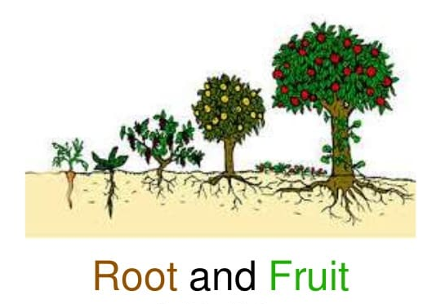
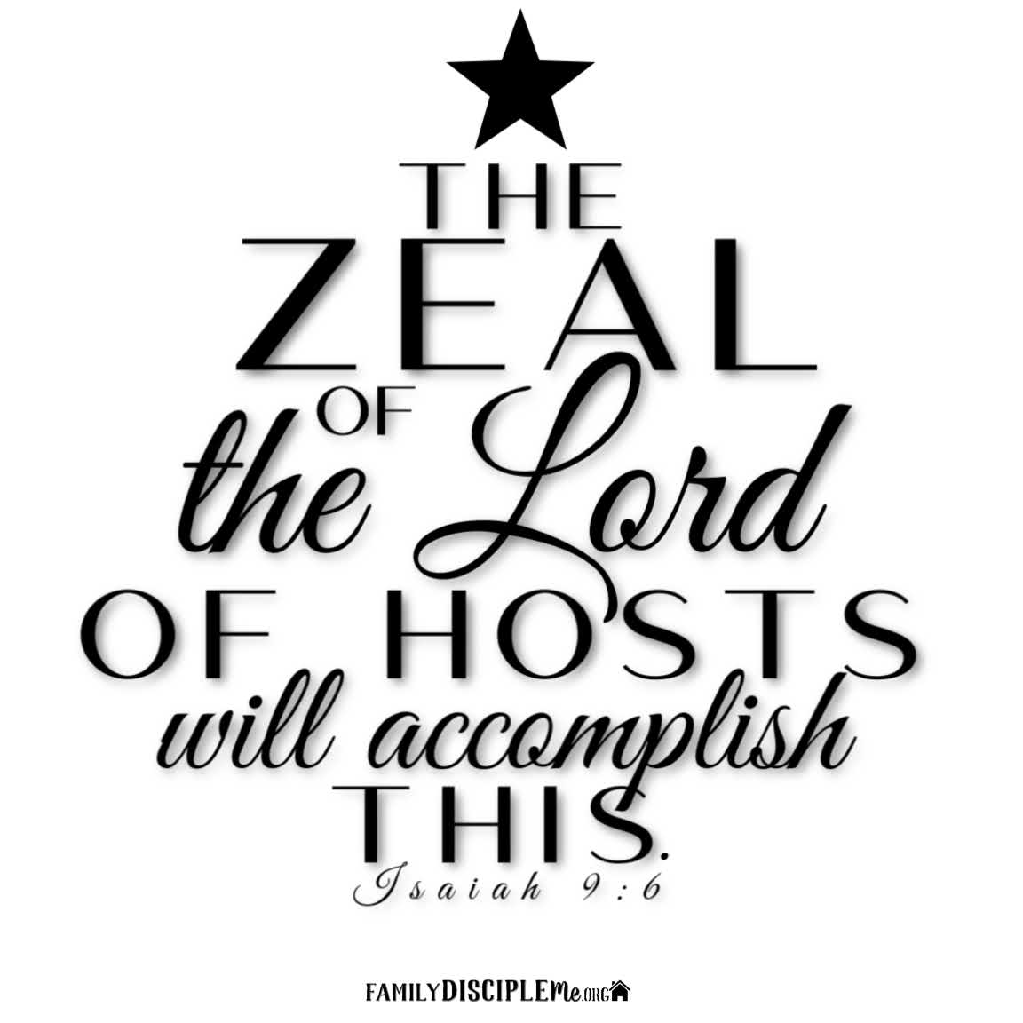
The Grand Finale
The Sign
Isa 37:30-32 – “³⁰Then this shall be the sign for you: you will eat this year what grows of itself, in the second year what springs from the same, and in the third year sow, reap, plant vineyards and eat their fruit. ³¹The surviving remnant of the house of Judah will again take root downward and bear fruit upward. ³²For out of Jerusalem will go forth a remnant and out of Mount Zion survivors. The zeal of the Lord of hosts will perform this.”’”
Notes:
And so that no one will think Assyria’s withdrawal was happenstance, God gives a sign, just as He did for Ahaz in chapter 7.
Isa 37:30 – The significance of this sign is this: Assyria’s invasion would have ordinarily kept them from sowing and reaping because of the desolation of the land. But despite this, God is going to miraculously cause the land to be full of sufficient self-sown crops until in the 3rd year, they’ll return to sowing, not needing to worry whether Assyria would return. This is truly a miracle considering that vineyards require years of patient work before producing.
But more significant is the fruit Judah would bear as a nation – Isa 37:31-32 – As we’ve seen before in Isaiah, the land is figurative for what will happen to the people: security and prosperity. God’s policy is always to preserve a remnant, and so He gives assurance as to how this would happen: His zeal will accomplish it (9:7). This then becomes a type for the coming of the Messiah.

Slide 9
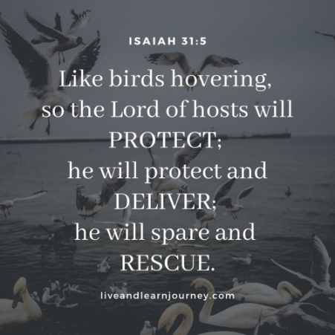
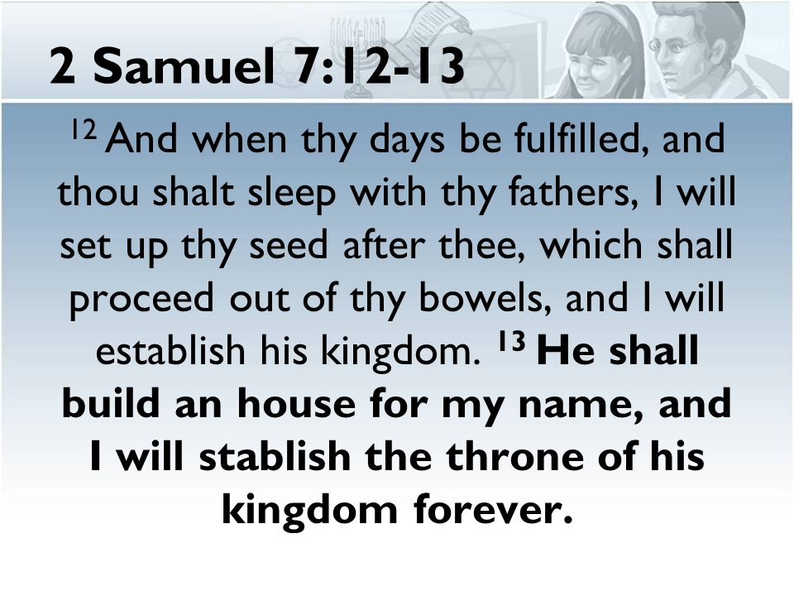
The Grand Finale
God will defend city
Isa 37:33-35 – “³³Therefore, thus says the Lord concerning the king of Assyria, ‘He will not come to this city or shoot an arrow there; and he will not come before it with a shield, or throw up a siege ramp against it. ³⁴By the way that he came, by the same he will return, and he will not come to this city,’ declares the Lord. ³⁵‘For I will defend this city to save it for My own sake and for My servant David’s sake.’””
Notes:
Isa 37:33-34 – The idea is that not only will Jerusalem be delivered, it won’t even be threatened. The Lord is declaring that Assyria is under God’s control. He came w/swagger, but he would limp home. As we discussed last week, even from Sennacherib’s own writings in the Taylor Prism, he makes no mention of having conquered Jerusalem. All he’d be able to boast about was that he “shut up Hezekiah like a bird in a cage”. This proves that what Sennacherib said about God is empty; what matters most is God’s will.
Isa 37:35 – The word “defend” literally means “surround”, same word protect that we’ve already seen in 31:5. He will save them because His name is attached to them (Ezek 36:22) and because of the covenant He made w/David, whose seed He swore to preserve (2 Sam 7:11-16; 2 Kings 18:3). This proves He has every intention of abiding by the seed promise of long ago. Isaiah had assured them of this repeatedly, but as we saw from 29:4, the people had to be brought to their knees to realize it.

Slide 10
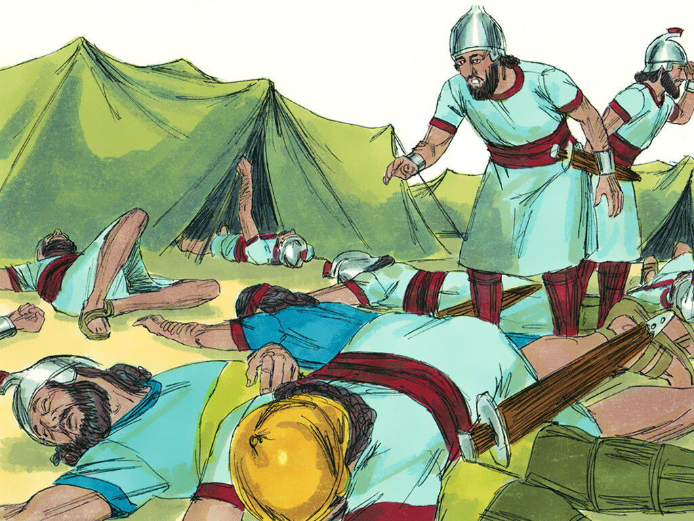
The Grand Finale
Assyria’s army destroyed
Isa 37:36-38 – “³⁶Then the angel of the Lord went out and struck 185,000 in the camp of the Assyrians; and when men arose early in the morning, behold, all of these were dead. ³⁷So Sennacherib king of Assyria departed and returned home and lived at Nineveh. ³⁸It came about as he was worshiping in the house of Nisroch his god, that Adrammelech and Sharezer his sons killed him with the sword; and they escaped into the land of Ararat. And Esarhaddon his son became king in his place.”
Notes:
And now, the grand finale. And surely w/how much text we have on God predicting Assyria’s defeat, His demonstration of this defeat would be equal in verbiage. Not at all.
Isa 37:36 – A simple but powerful statement. God passed over the army of Assyria as He once passed over the firstborn in Egypt. None in the camp knew what happened until it happened. The historian Josephus, Kee gives us further details on the specifics of this. Keep in mind this is extra-biblical record. He said, “When [Sennacherib]] returned to Jerusalem from his war with Egypt, he found there the force under [Rabshakeh] in danger from a plague, for God had visited a pestilential sickness upon his army, and on the first night of the siege one hundred and eighty-five thousand men had perished with their commanders and officers” (Josephus, Ja. 10.17.21).
But regardless of it being extra-biblical testimony, recall Isa 10:18.
Isa 37:37 – But his annals (Taylor prism) claims he was still full of pride. Reigned another 20 years, engaged in other military exploits, but never again in Palestine. God closed that road to him.
Isa 37:38 – Sennacherib was assassinated in 681BC in the temple in which he was praying, the greatest irony of his life. His god couldn’t save him. Praying to Jehovah saved Hezekiah. But when Sennacherib prayed to his god, he was slaughtered by his own flesh and blood. Going into the house of Jehovah saved Hezekiah. Going into the house of his god led to Sennacherib’s death. Great pretensions are no match for God.

Slide 11
Notes:
There is a poem in British literature written by Lord Byron in 1815, which was the same year of the Battle of Waterloo, about the destruction of Sennacherib.
There is also a famous painting called the “Defeat of Sennacherib”, which I would show you, but it contains some of that Renaissance nakedness so I didn’t think it was appropriate to show. Isn’t it interesting that art in western culture used to draw heavily on these biblical themes, because Christianity was so interwoven w/that culture? Things have changed.

