Slide 1
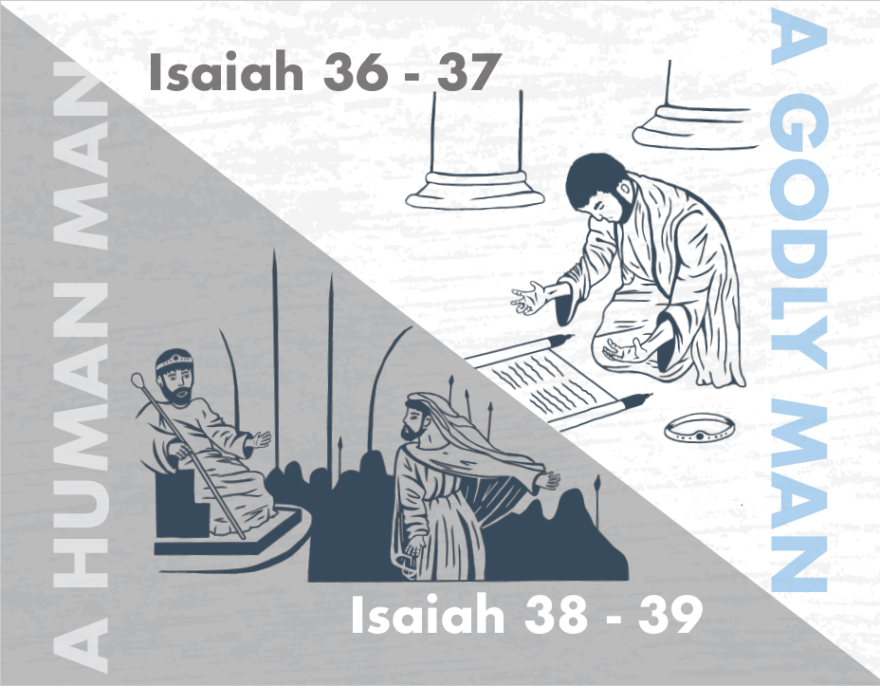
Notes:
Isaiah 36 brings to a head the first 35 chapters of his book. Up until it, it’s been mostly promises and prediction with no real demonstration. But now it is time for the main event. In one corner, full of faith, is the Davidic Ruler, King Hezekiah. In the other corner is the earthly king Sennacherib and his mouthpiece of intimidation, the Rabshakeh, full of nothing but hot air. Who will the victor be?
This is one of the most significant stories in all of the OT. It is the only story that is recorded in 3 separate places in the OT. Consider the fact that the Apostle Paul’s conversion is recorded in 3 separate places in Acts, implying how important his conversion story was for the human racing, even saying such in 1 Tim 1:16 – “I found mercy, so that in me…Jesus Christ might demonstrate His perfect patience as an example for those who would believe in Him for eternal life.” So then consider what the significance of this story in Isaiah 36 – 37 must be that we find it recorded in 3 separate places as well?
Isaiah 36 – 39 is Isaiah’s half time show, and we’re going to see 2 things. In chapters 36 – 37, we’re going to see the triumph of a godly man’s trust in God to deliver him. Remember, that’s the theme we’re working w/in this book – “Trust God”. But in contrast, we’re going to see in chapters 38 – 39 the limits of even the best of men to consistently trust in God, which will once more incite future judgment fro. Both these sections form a lynchpin in this book, chapters 36 – 37 being the conclusion to the first 35 chapters, and chapters 38 – 39 being the reason for chapters 40 – 66.

Slide 2
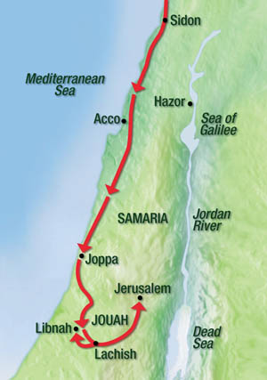
Assyria Threatens Jerusalem
The Setting
Isa 36:1 – “¹Now in the fourteenth year of King Hezekiah, Sennacherib king of Assyria came up against all the fortified cities of Judah and seized them. ²And the king of Assyria sent Rabshakeh from Lachish to Jerusalem to King Hezekiah with a large army. And he stood by the conduit of the upper pool on the highway of the fuller’s field. ³Then Eliakim the son of Hilkiah, who was over the household, and Shebna the scribe, and Joah the son of Asaph, the recorder, came out to him.”
Notes:
Isa 36:1 – Remember from 2 Kings 18:7,13-16 that when Sennacherib King of Assyria started attacking Judah, Hezekiah resubmits to him and pays him off to leave them alone. Well, Sennacherib takes the money and says, “Just kidding” and took up arms anyway. This is the treachery spoken of in 33:1 and this is the point in which Isaiah is beginning his narrative here in chapter 36. So now the earthly king comes face to face w/the Davidic king. Everything up until this point have been predictions of victory; now comes the demonstration of what true trust in God can do in a political crisis. Remember, too, that by this time, Sennacherib had defeated the Tyre and Philistine rebellions. He has reconquered Babylon. He won a monumental battle over Egypt at Eltekeh. And now he has arrived in Judah, and he is conquering city after city and taking Judeans into captivity.

Slide 3
Notes:
This was the claim made in what is called the “Annals of Sennacherib” or the “Taylor Prism”, named after the man who discovered it. It was discovered in Iraq in 1830, among the ruins of Sennacherib’s palace in Nineveh, and it is currently housed in the British Museum. This prism is inscribed w/Sennacherib’s first eight military campaigns from 705–681 BC, and it mentions the conquest of 46 cities in Judah and the deportation of 200,150 citizens. It also states, “Hezekiah the Judahite . . . like a caged bird I shut up in Jerusalem.” And it states, “as for Hezekiah, the awful splendor of my lordship overwhelmed him.” So, this prism is basically Sennacherib bragging about his conquests, and yet, interestingly, what is not mentioned is how the siege ended. He sweeps the best news under the rug. This is incredible because Assyrian annals are known for bragging about their exploits, but it is curiously silent about what happened in Jerusalem. And there’s a reason for this.

Slide 4
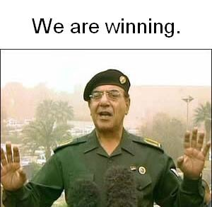
Assyria Threatens Jerusalem
The Setting
Isa 36:1 – “¹Now in the fourteenth year of King Hezekiah, Sennacherib king of Assyria came up against all the fortified cities of Judah and seized them. ²And the king of Assyria sent Rabshakeh from Lachish to Jerusalem to King Hezekiah with a large army. And he stood by the conduit of the upper pool on the highway of the fuller’s field. ³Then Eliakim the son of Hilkiah, who was over the household, and Shebna the scribe, and Joah the son of Asaph, the recorder, came out to him.”
Notes:
Yet Assyria does put the full court press on Jerusalem. And w/Sennacherib occupied w/finishing up a siege 20 miles southwest in Lachish, he sends another man to Jerusalem – the Rabshakeh.
Isa 36:2a – Now, “Rabshakeh” is not the man’s name; and it is not a reggae band – it is His title, and it means “chief of princes” or “chief cup bearer”, and he was Assyria’s 3rd in command. This is not a 9-foot tall Goliath issuing a one-on-one challenge. He has another purpose. The Rabshakeh is the biggest trash talker in the bible, sent to Jerusalem for propaganda.
Remember during the Gulf War that Iraq had a guy who did this, too? His name was Baghdad Bob, and he would always come out and put a crazy spin on what Saddam Hussein was up to, and you always knew he was full of hot air in anything he was saying. Just like Baghdad Bob, the Rabshakeh is sent to Jerusalem for psychological warfare, to muster up all the propaganda that he can in order to convince Jerusalem to surrender the city w/o a fight. Sennacherib sends him to Jerusalem to intimidate and to bully the Jews into submission.
And notice where he is standing – Isa 36:2b – This should be familiar to us because it is the same place Isaiah stood w/his son Shear-jashub in 7:3 when Ahaz was facing invasion by Israel and Syria, and Isaiah urged Ahaz not to fear them, but to put his trust in God. So, what might be the reason for the specificity of the text here? To encourage Hezekiah to succeed in trust where his father failed. See, this story has played out before. How will it play out this time?
Isa 36:3 – We’ve already been introduced to both Eliakim and Shebna in chapter 22, case studies of what Jerusalem had become vs. what God was looking for. What is the difference between that text and here? Eliakim and Shebna have changed offices, just as the Isaiah said they would. So this is evidence of fulfilled prophecy. Another thing worth mentioning is that in 2 Kings 18, we’re told that in addition to the Rabshakeh, Sennacherib sent the Tartan, which means “commander in chief”, and the Rab-saris, which means “chief eunuch”. So, we’ve actually got 3 high officials from Jerusalem facing off against 3 high officials from Assyria, but the Rabshakeh is going to steal the show w/his blustering smack talk.

Slide 5
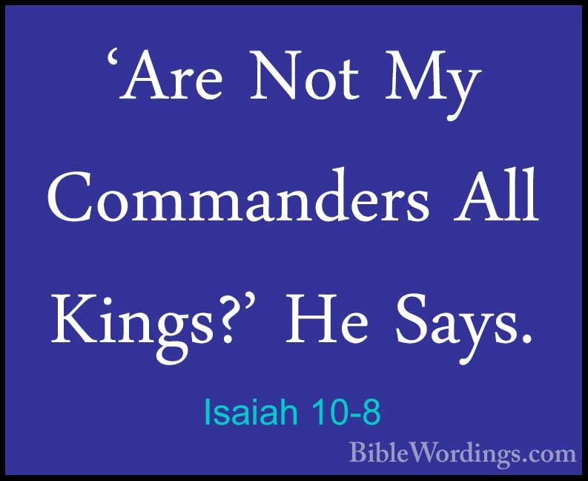
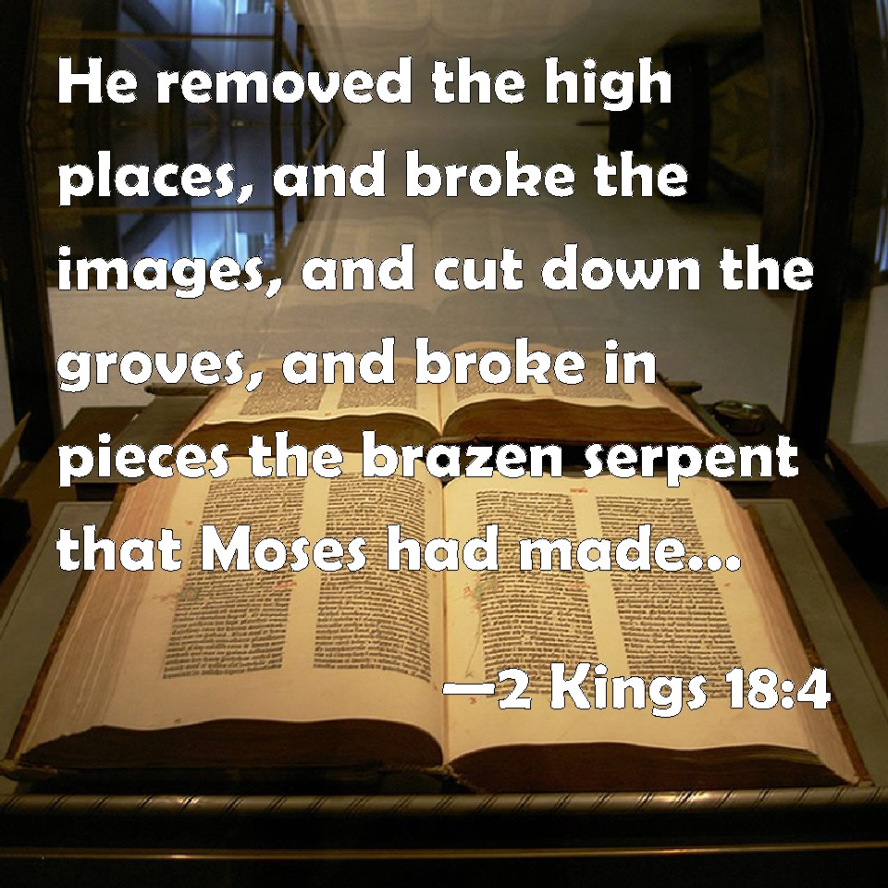
Assyria Threatens Jerusalem
Rabshakeh’s 1st Speech
Isa 36:4-7 – “⁴Then Rabshakeh said to them, ‘Say now to Hezekiah, “Thus says the great king, the king of Assyria, ‘What is this confidence that you have? ⁵I say, “Your counsel and strength for the war are only empty words.” Now on whom do you rely, that you have rebelled against me? ⁶Behold, you rely on the staff of this crushed reed, even on Egypt, on which if a man leans, it will go into his hand and pierce it. So is Pharaoh king of Egypt to all who rely on him. ⁷But if you say to me, “We trust in the Lord our God,” is it not He whose high places and whose altars Hezekiah has taken away and has said to Judah and to Jerusalem, “You shall worship before this altar”?’”
Notes:
So, in chapters 36 and 37, the Rabshakeh is going to make 3 speeches, and all 3 speeches are designed to sow doubt. Think about that – Isaiah has been spending 35 chapters over the course of decades speaking God’s word in order to build trust in the Jews. The Rabshakeh is going to try to destroy, in 3 speeches, what Isaiah has spent years trying to instill. And since this is what the enemy out there is trying to do to us, it would be helpful for us to dissect these speeches so we can understand who we are up against – Isa 36:4-5.
The first thing we notice is no diplomatic courtesy – he refuses to even address Hezekiah as king. If you’ll remember back in chapter 10:8, Assyria thought all of its princes were like kings. They thought Hezekiah’s kingship paled in comparison to Assyrian royalty. And down in vs. 6, he’s even going to refer to Pharaoh as king, as in a show of derision to say, “Now Pharaoh? That’s a king!” But what he doesn’t know is that he is going to be an eternal case study on trusting God.
And then the first thing he basically says is this – “you can’t win”. He claims Hezekiah’s resistance is backed by neither wisdom nor force of arms and that he is simply deceiving himself if he thinks he can actually win. But keep in mind that this isn’t Sennacherib saying this directly. He’s 20 miles southwest in Lachish. He’s sent his stooge to do his dirty work and what this implies is that the enemy is not as close as we think. The Rabshakeh is actually a lot weaker than he is putting on because all he’s doing at this point is talking. And if he’s only talking, he’s got nothing.
And just like the enemy, he mixes in some truth with his lies – Isa 36:6 – Based on what we saw in chapters 28 – 35, is this statement true? Yes, Egypt could not be trusted, and prior nations who had relied on them had paid the price. So, the Rabshakeh is correct in this statement. That’s the interesting thing about the voice of the enemy – sometimes he speaks what is partially true to draw you off balance.
But then he goes right on to show his ignorance – Isa 37:7 – Now, he was up on current events. Hezekiah had indeed reformed Judah. But he’s using pagan logic, that the more places a god is worshipped, the better. Limiting God’s worship to one place, to him, seemed to lessen His power, which is why he’s asserting God wouldn’t help them even if they trusted Him. This is demonic logic, but if the people are not careful, they may believe it. After all, he was right about Egypt! “Could he be right about this, too?” Sometimes the easiest way for the enemy to get a lie in our heart is through the trojan horse of just a little bit of truth.

Slide 6
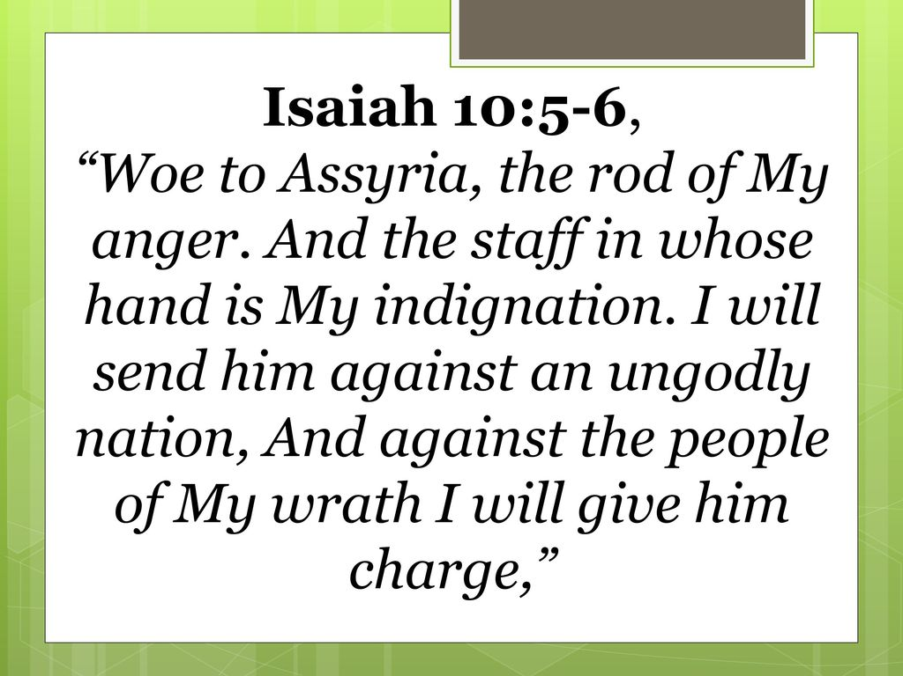
Assyria Threatens Jerusalem
Rabshakeh’s 1st Speech
Isa 36:8-10 – “⁸Now therefore, come make a bargain with my master the king of Assyria, and I will give you two thousand horses, if you are able on your part to set riders on them. ⁹How then can you repulse one official of the least of my master’s servants and rely on Egypt for chariots and for horsemen? ¹⁰Have I now come up without the Lord’s approval against this land to destroy it? The Lord said to me, “Go up against this land and destroy it.”’”
Notes:
Isa 36:8-9 – What Sennacherib is attempting to do is manipulate Hezekiah into bargaining for a quick surrender. But as he does so, he can’t help but to show contempt in Judah’s weakness in numbers should Assyria even give them horses. He’s basically saying, “Even if we gave you these horses, we could still beat you with one hand tied behind our back”.
And then he gives another half-truth – Isa 36:10 – Isn’t this what Isaiah had been prophesying since chapter 5? Assyria was indeed God’s rod of anger used to punish Judah, and the Rabshakeh seems to have some knowledge of this. But, again, his goal is to manipulate Judah into thinking God had forsaken them and that He is on Assyria’s side. And even as he is trying to convince them to make a bargain, he makes his intentions still very clear – “I am going to destroy your land.”

Slide 7
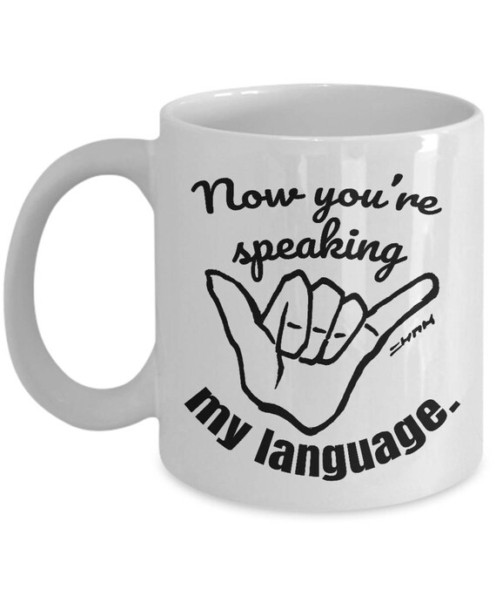
Assyria Threatens Jerusalem
Failed Diplomacy
Isa 36:11-12 – “¹¹Then Eliakim and Shebna and Joah said to Rabshakeh, ‘Speak now to your servants in Aramaic, for we understand it; and do not speak with us in Judean in the hearing of the people who are on the wall.’ ¹²But Rabshakeh said, ‘Has my master sent me only to your master and to you to speak these words, and not to the men who sit on the wall, doomed to eat their own dung and drink their own urine with you?’”
Notes:
Now, what we don’t know up until now is what language the Rabshakeh was speaking in.
Isa 36:11 – Aramaic was the diplomatic language of that day. It allowed negotiations to take place in secret, out of the hearing of the common people. But as we’ve already seen. Assyria, has no interest in integrity or fighting fair, and there was no Geneva Convention of that day or rules for war. The Rabshakeh is trying to destroy moral and cause the citizens of Jerusalem to turn against Hezekiah out of fear. So, as you can see, Hezekiah’s 3 officials are dealing w/a man quite adept at employing psychological warfare, a man who knows how fear can be used to bend the people toward your will.
Isa 36:12 – What he’s doing here is reminding the commoners responsible for defending the city of the harsh conditions of siege warfare: shortage of food and water. This is to magnify their despair and alienate them from their leaders, thinking even if Hezekiah trusted in God, maybe the people won’t.
One thing that is sure about the enemy is that he knows how to “talk our talk”. He knows just how to relate to us and get us to relate to him. Think of how many adulterous relationships started out because “he understands me”. Think of how often we are deceived through flattery. And false teachers are quite adept at ingratiating themselves to us. We must be on guard against those people who would attempt to manipulate us by “speaking our language”.

Slide 8
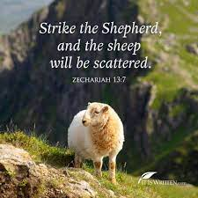
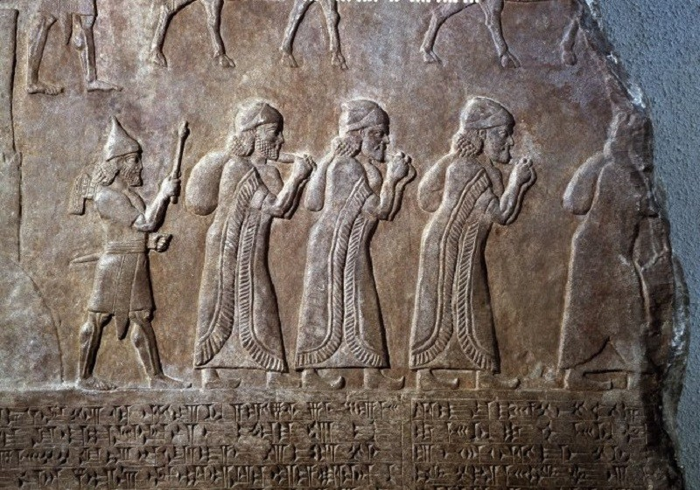
Assyria Threatens Jerusalem
Rabshakeh’s 2nd Speech
Isa 36:13-17 – “¹³Then Rabshakeh stood and cried with a loud voice in Judean and said, ‘Hear the words of the great king, the king of Assyria. ¹⁴Thus says the king, “Do not let Hezekiah deceive you, for he will not be able to deliver you; ¹⁵nor let Hezekiah make you trust in the Lord, saying, ‘The Lord will surely deliver us, this city will not be given into the hand of the king of Assyria.’ ¹⁶Do not listen to Hezekiah,” for thus says the king of Assyria, “Make your peace with me and come out to me, and eat each of his vine and each of his fig tree and drink each of the waters of his own cistern, ¹⁷until I come and take you away to a land like your own land, a land of grain and new wine, a land of bread and vineyards.”’”
Notes:
And so, he becomes even more arrogant and contemptuous and bypasses Hezekiah’s ambassadors, as if they weren’t even present.
Isa 36:13 – Notice how he once again appeals to the greatness of his king as if in contempt of Hezekiah. And the purpose of this tactic is to turn the people against their leader.
Isa 36:14-16a – Here’s another tactic of the enemy, that even they know what Zech 13:7 has been saying for hundreds of years, that if you “strike the shepherd, the sheep will scatter.” And I know that’s a Messianic prophecy, but the enemy knows how widespread the fall out is if leadership crumbles, and that’s why he aims his arrows at those who lead God’s people. If he can remove trust in the leaders, He can then become the authority figure in your life, and that is why leadership is so often targeted and why we need to do everything we can to protect them, short of them sinning themselves. That phrase “nor let Hezekiah make you trust in the Lord” – this is what everything in Isaiah thus far as been boiling down to. Are we going to trust these words of deceit and falsehood that sound so powerful, so intimidating, or are we going to trust what God has been saying through Isaiah?
Isa 36:16b-17 – Now he offers something far better than the dung and urine he claims awaits them. He’s appealing to the blessings of plenty as opposed to the famine of siege. The only downside is they will be carted away to a different land. But he definitely tries to soften the idea of captivity and make surrender an attractive option. This is another tactic of the enemy, to promise slavery disguised as blessing. as a wise man once said, “[it] will take you farther than you want to go, keep you longer than you want to stay, and cost you more than you want to pay.” How many drug addicts, started out experimenting, only to spend the rest of their life trying to chase that first high? How many people started out by drinking w/their friends, or just drinking away sorrow after a hard day’s work, only to become alcoholics? Sin always promises great things, but “[it] will take you farther than you want to go, keep you longer than you want to stay, and cost you more than you want to pay.” Assyria forced resettlement not to offer something better, but to break spirits, repatriate, and discourage rebellion. Docile people would in turn be brought in to settle in their land.

Slide 9
Assyria Threatens Jerusalem
Rabshakeh’s 2nd Speech
Isa 36:18-20 – “¹⁸Beware that Hezekiah does not mislead you, saying, ‘The Lord will deliver us.’ Has any one of the gods of the nations delivered his land from the hand of the king of Assyria? ¹⁹Where are the gods of Hamath and Arpad? Where are the gods of Sepharvaim? And when have they delivered Samaria from my hand? ²⁰Who among all the gods of these lands have delivered their land from my hand, that the Lord would deliver Jerusalem from my hand?”’”
Notes:
Bu here is the Rabshakeh’s biggest mistake.
Isa 36:18 – Big mistake. Trash talking God’s people, God’s king, is one thing. But now he’s made this a contest between Assyria and Jehovah. He’s comparing Jehovah to nothing more than an idol, just another god like all the others Assyria had beaten. And anyone in Jerusalem w/spiritual insight, after hearing this blasphemy, could have gone ahead and started planning the victory party. The Rabshakeh has overstepped his bounds. Hezekiah is not the one seducing the people. Assyria is seduced by its own borrowed power, and they have just made a fatal mistake.
Isa 36:19-20 – Sargon II had settled captives in these places (2 Kings 17:24). And so, the Rabshakeh’s argument here is, “Since these cities couldn’t be saved by their god, what makes you think Jerusalem can be saved by Jehovah?” This is another strategy of the enemy, to not just say “you can’t win”, but to also come w/his supposed “proof” for why we can’t win. But in spite of Rabshakeh’s knowledge of Judean religion, he doesn’t know Jehovah, and they’re going to find out that they were simply God’s tool that will be discarded as such when God sees fit. It’s the hand of God vs. the hand of Assyria.

Slide 10
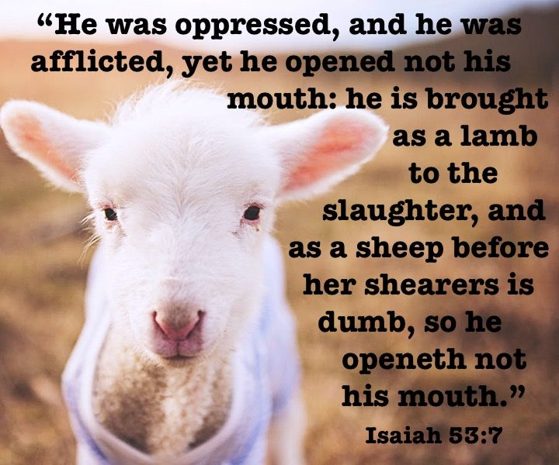
Assyria Threatens Jerusalem
Aftermath
Isa 36:21-22 – “²¹But they were silent and answered him not a word; for the king’s commandment was, ‘Do not answer him.’ ²²Then Eliakim the son of Hilkiah, who was over the household, and Shebna the scribe and Joah the son of Asaph, the recorder, came to Hezekiah with their clothes torn and told him the words of Rabshakeh.”
Notes:
Now, how do you handle this kind of trash talk? What do you say?
Isa 36:21 – Isaiah’s message had apparently struck a chord w/some. Though God was blasphemed and they were told to capitulate or die, the people held their tongues. Sometimes the best response to blasphemy is a disdainful silence, as any reproof would have fallen flat w/the Rabshakeh.
And our Lord Jesus Christ is our greatest example. When he stood before Pilate as the Jews hurled their abuse, Mark 15:5 says He “answered nothing”. When Jesus stood before Herod, and Herod lobbied him for a trick, and questioned him at length, Luke 23:9 says “He answered Him nothing.” And when He hung from the cross as they hurled abuse after abuse at him, Isa 53:7 says, “like a sheep that is silent before its shearers, He was silent, so He did not open His mouth.” Don’t misunderstand. There is a time to give a defense, a time to speak up and speak out. But when it’s this kind of trash talk and divisiveness, determined to destroy our trust in God, we don’t need to talk to the enemy, we need to talk to God.
Though silent, they were still deeply affected – Isa 36:22 – Indicates disgrace, grief, and sorrow, the horror of such blasphemy. This doesn’t necessarily mean they were faithless – 2 Cor 4:8-9. So, it doesn’t mean they were faithless. But the entirety of God’s nation has just been insulted by one single man, and up to this point, there is no indication whether God will act because all we’ve seen thus far is prediction w/little demonstration. But that is all about to change in chapter 37.

