Slide 1
Notes:
This study will conclude the section in Isaiah 28 – 35, in which Isaiah is contrasting alliance w/man vs. reliance in God. These 8 chapters are divided up into an inclusio of 6 woes. The first 5 woes are applied specifically to Judah, warning them that if they continue to supplant trust in God for trust in Egypt, it’s their funeral. But at the same time, He assures them that He, not Egypt, will ultimately save them from the Assyrian threat. The 6th woe, however, is not against Judah, but rather against what 33:1 refers to as the treacherous “destroyer”, which though never named, contextually refers to Assyria. And there’s a tone of repentance in chapter 33, suggesting that God’s people are starting to see the error of their ways. And so now God is applying “woe” to any nation that would dare touch his people. And as we saw in chapter 33, just when Assyria thought it would conquer Jerusalem, God would then arise from His throne to save Jerusalem at the 11th hour, and sinners in Zion who see the Lord’s power on display will be terrified.
As we conclude the 6th woe in chapters 34 – 35 , we are quickly approaching Isaiah’s halftime show. But before we do, God is going to have some final words of judgment and redemption that need to be heeded before He demonstrates what He’s been predicting throughout this entire book. What we’re going to see in chapters 34 and 35 is a stark contrast between a productive land turned into a desert, and a desert land turning into a garden, and these 2 chapters conclude God’s teaching in the first part of the book on His sovereignty over the nations.

Slide 2
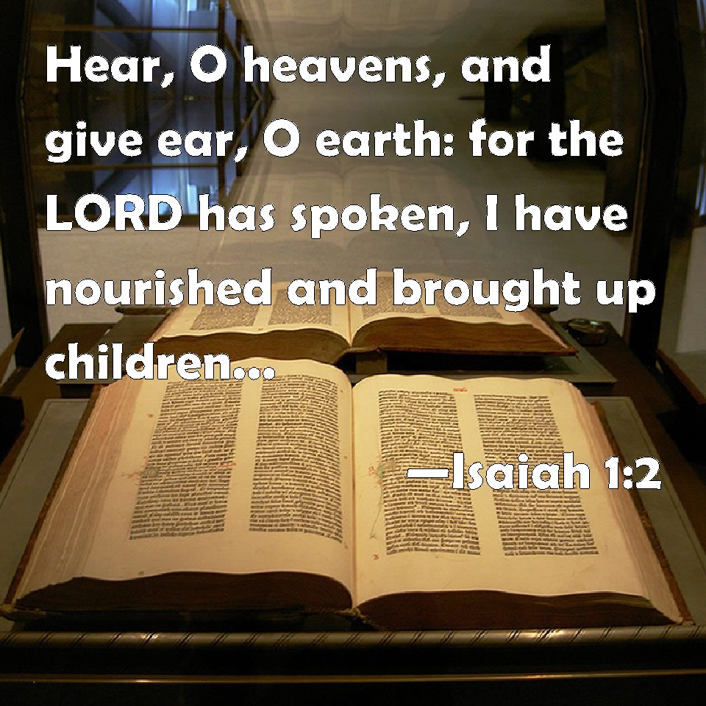
Judgment & Redemption
Divine judgment
Isa 34:1 – “¹Draw near, O nations, to hear; and listen, O peoples! Let the earth and all it contains hear, and the world and all that springs from it.”
Notes:
Notice how in Isa 34, Isaiah expands the message against Assyria from chapter 33 to even beyond Assyria.
Isa 34:1 – In other words, God wants all nations throughout the world to take note of what He is about to do to Assyria. No longer is Assyria, Egypt, or the rebelliousness of Judah alone under consideration. In a similar function to chapter 24, chapter 34 is a foreshadow of how all nations will face the universal judgment of the indignant God of this universe who holds their destiny in His hand like no other, and they need to give Him their full attention (1:2). Chapters 34 & 35 summarize what Isaiah has been saying for the first 33 chapters – it is a double theme of judgment and salvation, judgment being the theme of chapter 34 and salvation the theme of chapter 35. I hope no one ate a big meal before this study – there’s a lot of blood in this text.

Slide 3
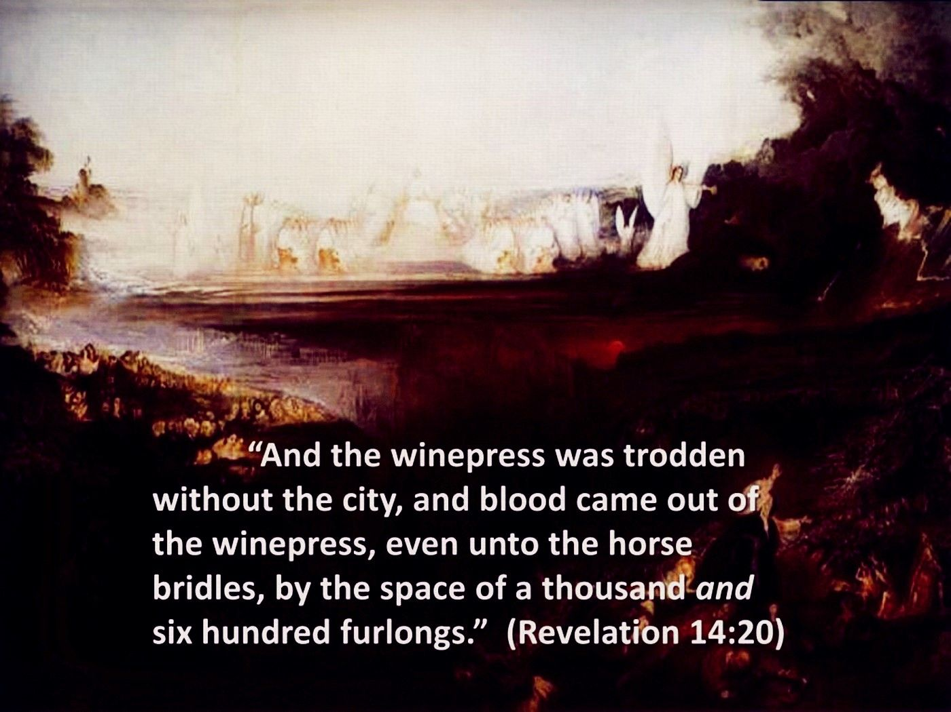
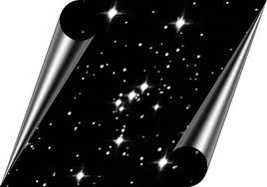
Judgment & Redemption
Divine judgment
Isa 34:2-4 – “²For the Lord’s indignation is against all the nations, and His wrath against all their armies; He has utterly destroyed them, He has given them over to slaughter. ³So their slain will be thrown out, and their corpses will give off their stench, and the mountains will be drenched with their blood. ⁴And all the host of heaven will wear away, and the sky will be rolled up like a scroll; all their hosts will also wither away as a leaf withers from the vine, or as one withers from the fig tree.”
Notes:
This is some of the strongest language of judgment we have seen since chapter 24. What does He want the nations to know?
Isa 34:2-3 – God’s point is this: any nation that is hostile to God’s people are done for. And so certain is this, notice in the 2nd half of vs. 2 how Isaiah speaks of it as already occurring. This is called the “prophetic perfect”, which suggests that whatever God’s word has determined will be, it’s as good as done. And Isaiah is using strong hyperbole here. Corpses thrown into the field w/o proper burial and left to rot would normally be a disgrace in any situation. But it is a fitting judgment for God’s enemies, because when you put your trust in flesh, the corruptibleness of your flesh will be exposed. This is likely a foreshadowing of what we’re going to see at the end of chapter 37. That the mountains will be “drenched” probably implies that as heavy rain erodes soil, the flow of the blood of these corpses will be so strong, it will corrupt nature in their deaths, an idea we also see in Rev 14:20. And so, what good does it do to put one’s trust in man, in flesh?
Vs. 4 is quoted in the gospels and in Revelation – Isa 34:4 – We also saw this at the end of chapter 24. The entirety of the universe has gotten caught up in sin, and so accounts in heaven will have to be settled, too. Their internal corruption will then precede an external corruption. Think of that phrase “Like a scroll” as meaning that God determines when man’s story comes to an end, when to “close the books” on the heathen nations, settling all accounts. And so, the heavens are no more permanent than the earth. When God says the word, they’ll wither away as easily as the leaf from the vine.

Slide 4
Judgment & Redemption
Divine judgment
Isa 34:5-7 – “⁵For My sword is satiated in heaven, behold it shall descend for judgment upon Edom and upon the people whom I have devoted to destruction. ⁶The sword of the Lord is filled with blood, it is sated with fat, with the blood of lambs and goats, with the fat of the kidneys of rams. For the Lord has a sacrifice in Bozrah and a great slaughter in the land or Edom. ⁷Wild oxen will also fall with them and young bulls with strong ones; thus their land will be soaked with blood, and their dust become greasy with fat.”
Notes:
And now he’s going to address a specific nation:
Isa 34:5 – Why is Edom being called out specifically? Don’t just think of literal Edom; think about what they historically represented. We’ve already seen this same idea done w/nations like Babylon and Moab. In this chapter, Edom is being used as a type, because, historically, they were the antithesis of God’s people. So, Isaiah is using them here metaphorical representation of the profane enemies of God’s people. This is a tie-in to woe #3, where in 29:22, Isaiah used Jacob as a model for the ultimate fulfillment of His promises. He is doing the same thing here, using Edom as a contrasting model of overthrow. The prophet Obadiah uses Edom in a very similar way. After rebuking literal Edom for their treatment of Judah, Obadiah transitions in vs. 15 from judging literal Edom to all those nations like them.
So, the idea is this. Any nation or person who refuses to devote Himself to God and His people, like Edom, is devoting Himself to destruction, as God’s sword is ready to strike from heaven itself. The phrase “devoted to destruction” is the same word we see in Josh 6 pertaining to Jericho’s spoil, where God told Israel it was under a ban. This is a Hebrew word used for places/things so wicked that nothing is to be taken because it’s reserved as a burnt offering to God.
What is God’s sword satiated with? – Isa 34:6 – The idea is that just as the blood and the fat of the Levitical sacrifices belonged exclusively to God (Lev 3:16-17; 7:23-27), the Lord’s right to judge “Edom” is His alone. Bozrah was Edom’s capital, and this is where God will “offer sacrifices” out of the Edomites. What happens when there is no more sacrifice to atone for our sins? We ourselves will become the sacrifice. It’s the idea that all sin must end in sacrifice, either in a Day of Atonement or a Day of Vengeance as we’ll see in vs. 8. To continue sinning is to forfeit one’s life into the hands of God as a sacrifice.
Isa 34:7 – This is interesting because wild oxen were never allowed as a sacrifice in the Levitical system. The point behind it being a sacrifice is that it had to cost you something. So why is it being allowed here? Who do all animals belong to? God – and so He can sacrifice them. And the idea is that when He sacrifices Edom, nothing will be spared. This verse starts w/small animals in vs. 6 and proceeds to the larger animals, which probably means from the smallest (common) to the greatest (leaders) of “Edom”, all of them will fall.

Slide 5
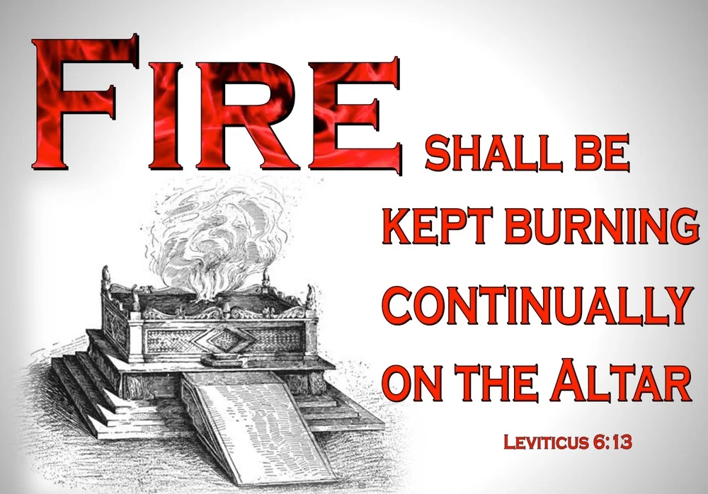
Judgment & Redemption
Divine judgment
Isa 34:8-10 – “⁸For the Lord has a day of vengeance, a year of recompense for the cause of Zion. ⁹Its streams will be turned into pitch, and its loose earth into brimstone, and its land will become burning pitch. ¹⁰It will not be quenched night or day; its smoke will go up forever. From generation to generation it will be desolate; none will pass through it forever and ever.”
Notes:
Since no substitutionary atonement can be made for Edom, there is no Day of Atonement, only a Day of Vengeance.
Isa 34:8 – Notice the recurring theme. Edom is not judged just for their sin, but also for the cause of Zion, in God’s defense of His people – Psa 132:13. God will keep is promises to not only judge the nations, but to ultimately protect His own. Now, interestingly, Jesus used this same expression “Day of Vengeance” in Luke 21:22, but whose fall is under consideration in Luke 21? Not Edom, but Jerusalem’s eventual fall to the Romans. This shows again that literal Edom is not under consideration, and no one was more hostile to God’s people than the physical residents of Jerusalem during the Apostolic Age before 70AD.
Isa 34:9-10 – This is very similar language to Sodom and Gomorrah, which ironically happened to be on the very northern end of Edom on the south side of the Dead Sea. Sin is the cause of such ecological disaster, the ultimate environmental threat that always leaves lasting pollution in its wake. And when God brings this judgment, “Edom” will not be built again, which should be a constant reminder to onlookers of the consequence of rejecting the spiritual life for the fleshly. And like the fire on God’s altar (Lev 6:13), it is to be kept burning continually, likely alluding to the 2nd death called hell.

Slide 6
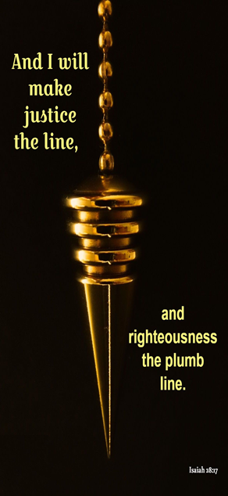
Judgment & Redemption
Perpetual desolation
Isa 34:11-15 – “¹¹But pelican and hedgehog will possess it, and owl and raven will dwell in it; and He will stretch over it the line of desolation and the plumb line of emptiness. ¹²Its nobles—there is no one there whom they may proclaim king—and all its princes will be be nothing. ¹³Thorns will come up in its fortified towers, nettles and thistles in its fortified cities; it will also be a haunt of jackals and an abode of ostriches. ¹⁴The desert creatures will meet with the wolves, the hairy goat also will cry to its kind; yes, the night monster will settle there and will find herself a resting place. ¹⁵The tree snake will make its nest and lay eggs there, and it will hatch and gather them under its protection. Yes, the hawks will be gathered there, every one with its kind.”
Notes:
And this description of desolation continues in vs. 11:
Isa 34:11 – Notice the contrasts: the disappearance of man, the reappearance of beasts, all unclean. In 28:17, Zion’s cornerstone was to be measured with justice and righteousness, but for Edom will be measured by the line of desolation and the plumb line of emptiness. It’s the idea that God’s judgment is thorough and precise.
Isa 34:12-13 – If you read the Chronology of Esau’s descendants in Gen 36, you’ll see that a point of pride was its rulers. But when God gets done with it, there will be no kingdom left for such nobility. Towers and fortresses that once challenged the enemy and protected inhabitants of the land are no more. The cries of jackals and ostriches were known to sound mournful, and this is fitting to the setting. Thistles and thorns are the most useless vegetation there is, evidence of the fall of man, and that’s what will be found there.
And in place of a once festive gathering, there will be meetings of another kind – Isa 34:14-15 – That the wild animals have mates and broods suggest permanency and undisturbed security. They’re untamed and unrestrained. And, of course, the list wouldn’t be complete w/o mentioning a serpent. True to form, a life committed to Satan and his evils leaves behind a life of emptiness and confusion, a place of uncleanness and loathing. There is just nothing pleasant in this chapter for “Edom” to look forward to.

Slide 7
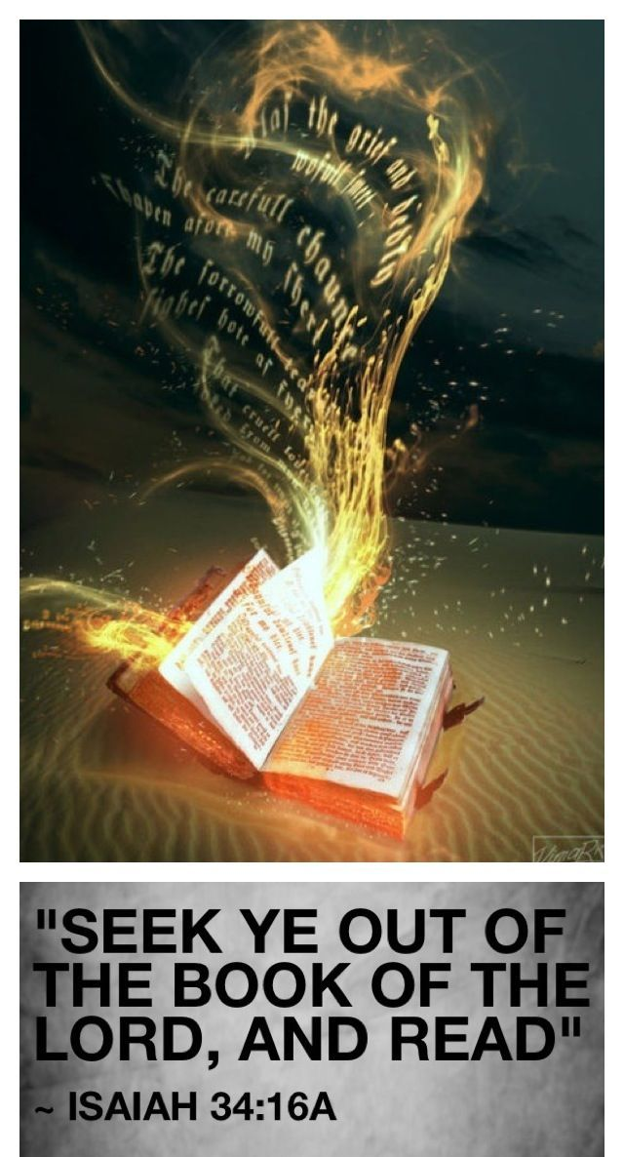
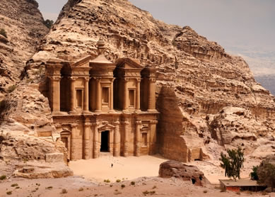
Judgment & Redemption
Future generations encouraged
Isa 34:16-17 – “¹⁶Seek from the book of the Lord, and read: not one of these will be missing; none will lack its mate. For His mouth has commanded, and His Spirit has gathered them. ¹⁷He has cast the lot for them, and His hand has divided it to them by line. They shall possess it forever; from generation to generation they will dwell in it.”
Notes:
And so, there is a returning plea similar to vs. 1.
Isa 34:16-17 – Meaning, every detail of which God has spoken down to the birds and thistles will be accomplished through the power of His Spirit. All one must do is wait for Edom to become a wasteland, then compare it to what God recorded long before. As the land was partitioned for the Israelites in Canaan by lot (Josh 12 – 19), Edom would be partitioned for the wild animals. This is a permanent arrangement, and for 2000 years, these creatures have dwelt in literal Edom, which today is nothing but desert and ruins. Since the nations have nullified the dominion God gave mankind, the animals are divinely allotted the land.
This picture on the bottom right is the archeological site of Edom’s ancient capital Petra. No one lives here anymore. Edom to this day continues to be an uninhabited desert, a perpetual reminder for those who would become like them.

Slide 8
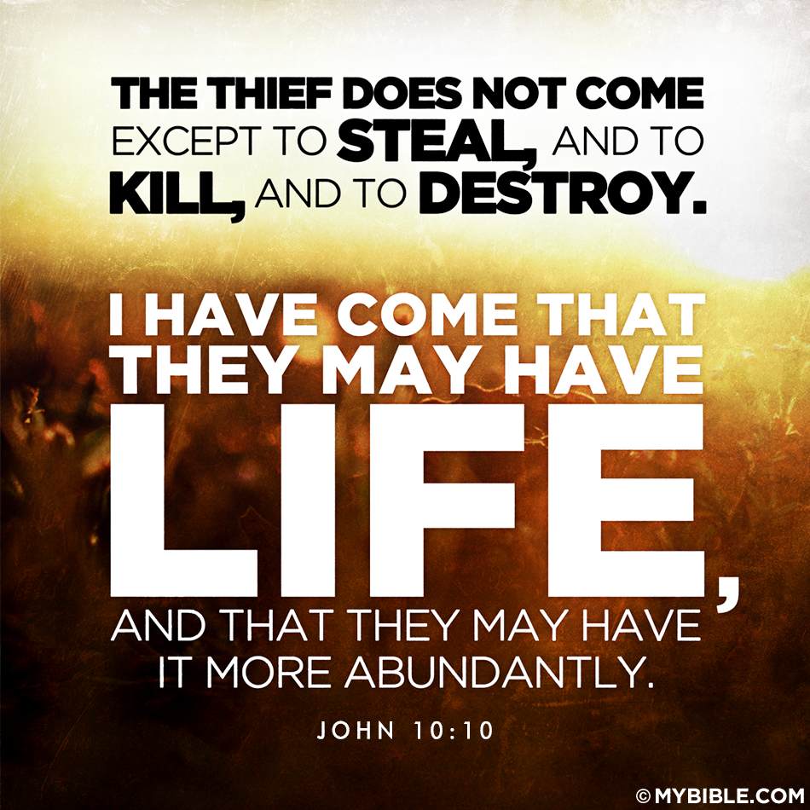
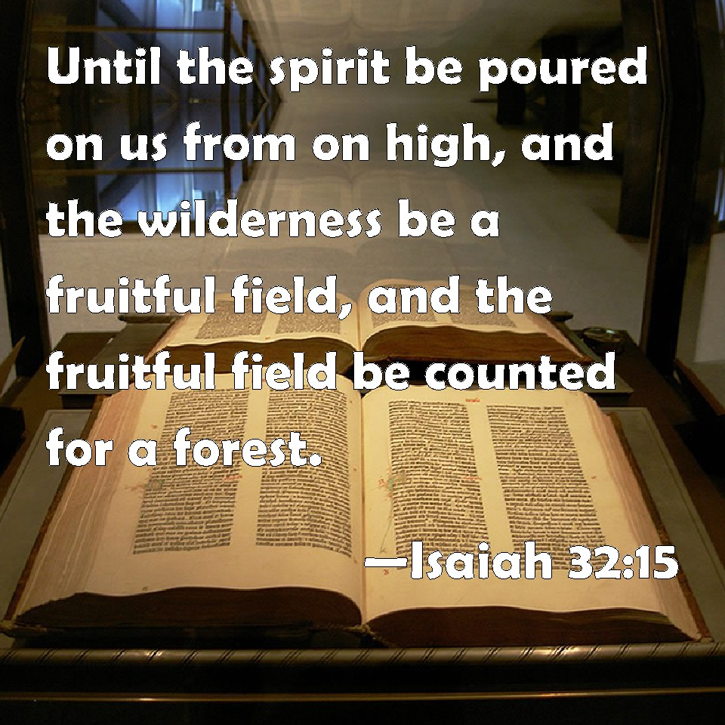
Judgment & Redemption
Zion encouraged to stiffen resolve
Isa 35:1-2 – “The wilderness and the desert will be glad, and the Arabah will rejoice and blossom; like the crocus ²it will blossom profusely and rejoice with rejoicing and shout of joy. The glory of Lebanon will be given to it, the majesty of Carmel and Sharon. They will see the glory of the Lord, the majesty of our God.”
Notes:
And now we arrive at the climax of the final woe, Isaiah 35, which is one of the most magnificent Messianic passages in the bible, rich w/meaning, highly symbolic. In contrast to the vivid judgment scene of chapter 34, this chapter begins by declaring a spontaneous transformation and reversal.
Isa 35:1-2a – This reads a lot like a reversal of the Lord’s curse on Creation from Gen 3, but in reality, Isaiah is using word pictures to show what will happen to the emptiness of the sinner’s life wrecked by human arrogance. People once dead in sin will spring forth w/spiritual life and fertility.
This is what Jesus was referring to in John 10:10b – “I came that they may have life, and have it abundantly”. So, not a literal desert, rather a life once made a sterile wasteland by the true enemy “sin” that has now become a fruitful life, as we read in 32:15.
Isa 35:2b – Lebanon was known for its beautiful, stately cedars; Carmel was known for its great oak trees; and Sharon was full of beautiful roses. These places were wonderful demonstrations of the beauty of God’s creation, but even they would marvel at the glorious transformation that will occur when people formerly destroyed by their sin begin to bear fruit.

Slide 9
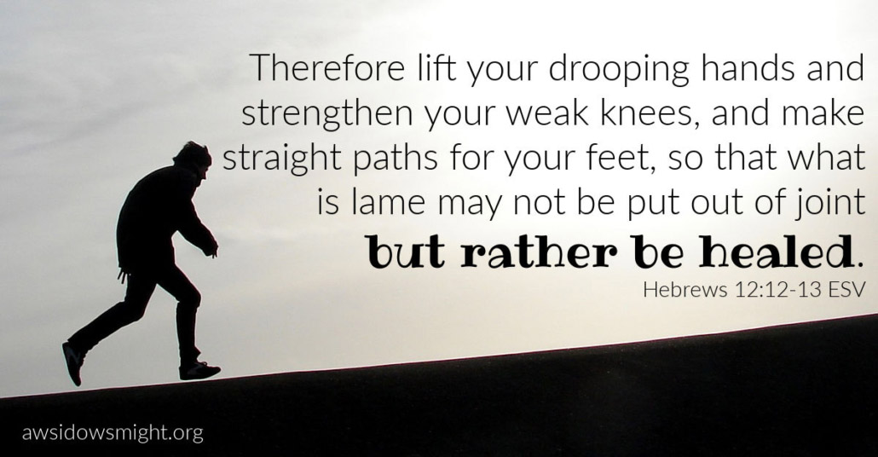
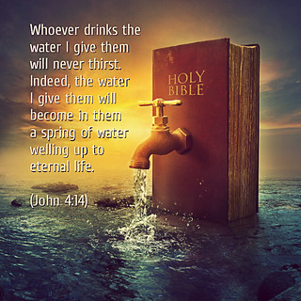
Judgment & Redemption
Zion encouraged to stiffen resolve
Isa 35:3-7 – “³Encourage the exhausted, and strengthen the feeble. ⁴Say to those with anxious heart, ‘Take courage, fear not. Behold, your God will come with vengeance; the recompense of God will come, but He will save you.’ ⁵Then the eyes of the blind will be opened and the ears of the deaf will be unstopped. ⁶Then the lame will leap like a deer, and the tongue of the mute will shout for joy. For waters will break forth in the wilderness and streams in the Arabah. ⁷The scorched land will become a pool and the thirsty ground springs of water; in the haunt of jackals, its resting place, grass becomes reeds and rushes.”
Notes:
And this news that should excite encouragement:
Isa 35:3-4 – Another “sin is disease” verse, quoted in Heb 12, the first part of which talks about the importance of having endurance, and then about coming to terms w/God’s discipline toward us, that though it doesn’t seem joyful at the time, it will yield the peaceful fruit of righteousness. Then immediately afterwards in Heb 12:12, he tells us to strengthen the hands that are weak and the knees that are feeble. At this point in Isaiah, God’s people are still in a period of waiting, undergoing discipline, and they need encouragement in the area of hands/exhausted (action), knees (stability), and hearts (conviction). God is still there despite their sinfulness. He will make everything right. He comes to save His people; full deliverance. That He comes means they wouldn’t have to worry about reaching Him because He’s far away; He will reach them.
Isa 35:5-6a – This is very messianic. In Luke 7, when John the Baptist sent his disciples to find out whether Jesus was truly the Christ, Jesus quotes part of this verse – “Go and report to John what you have seen and heard: the blind receive sight, the lame walk, the lepers are cleansed, and the deaf hear”. And while this did involve physical healing to an extent, the real goal was an opening of the eyes of understanding. When Jesus healed the blind man in John 9, and he came to gradually realize Jesus was the Christ, this caused him to see more than the Pharisees who were spiritually blind. And so, when Christ came, those who couldn’t hear would comprehend. Those who were lame, having learned the truth, will be energized. Those who were paralyzed w/silence will be emboldened to ring out the message. In other words, the wilderness and desert will be glad, rejoice, and blossom. This is a radical departure to the blindness and deafness told Isaiah when he was originally commissioned.
Isa 35:6b-7 – This is similar to what Jesus told the Samaritan woman in John 4:14 – What was once so dry and useless can now, through Christ, become well-watered and fruitful, provoking great joy in all who receive Him. Only God can take a completely inhospitable life, inhabited by desert creatures, and through Jesus, reverse that curse from Gen 3 by transforming our lives into a paradise.

Slide 10
Judgment & Redemption
Highway of Holiness
Isa 35:8-10 – “⁸A highway will be there, a roadway, and it will be called the Highway of Holiness. The unclean will not travel on it, but it will be for him who walks that way, and fools will not wander on it. ⁹No lion will be there, nor will any vicious beast go up on it; these will not be found there. But the redeemed will walk there. ¹⁰And the ransomed of the Lord will return and come with joyful shouting to Zion, with everlasting joy upon their heads. They will find gladness and joy, and sorrow and sighing will flee away.”
A Prepared Road
Standard of Holiness
Notes:
And that leads us to vs. 8, where God tells us how He’d accomplish this in the desert that is our lives – Isa 35:8-10. The Highway of Holiness is the path God has created to redeem His people can get them home, and it has several awesome features.
1) A prepared road – Not some ordinary path or mere track in the soil. This is a new way, a prepared, raised roadway, carefully constructed for the easiest and safest travel. Before we come to Christ, the paths we walked were old, worn-out roads full of potholes that cause more damage to our vehicles than we have the means to pay. But the Highway of Holiness is a prepared road, a new way of living life that God has prepared for us to travel. Isa 35 shows us that it’s a life that bears fruit, a new thing, a new way He has prepared for us.
2) Standard of Holiness – Meaning, there is a standard for our travel. It is a “high” way. Some of you that are older might remember a time before interstates existed, and travel was a lot harder. But then someone got the bright idea to take a bunch of dirt and gravel and build up a road, pitch it for drainage, and then all the sudden long-distance travel got a lot easier. A highway, by definition, is higher ground, which we sing – “I’m pressing on, the upward way, new heights I’m gaining every day”. Every highway has standards – lines, speed limits, access points, and medians, all designed to make travel easier and more efficient. And God’s highway has a standard, too – holiness. Hence, the Highway of Holiness. Phil 3:14 – “I press on toward the goal for the prize of the upward call of God in Christ Jesus.” And that upward call is holiness – the “high” way of holiness. A life of holiness is a high life. “I want to live above the world, where Satan’s darts at me are hurled” – That’s the goal, that’s the standard.

Slide 11
Judgment & Redemption
Highway of Holiness
Isa 35:8-10 – “⁸A highway will be there, a roadway, and it will be called the Highway of Holiness. The unclean will not travel on it, but it will be for him who walks that way, and fools will not wander on it. ⁹No lion will be there, nor will any vicious beast go up on it; these will not be found there. But the redeemed will walk there. ¹⁰And the ransomed of the Lord will return and come with joyful shouting to Zion, with everlasting joy upon their heads. They will find gladness and joy, and sorrow and sighing will flee away.”
A Prepared Road
Standard of Holiness
Toll Booth
Guard Rails
Notes:
3) Toll Booth – Vs. 8 says “it will be for him who walks that way”. Vs. 9 says “the redeemed will walk there”. And vs. 10 says, “the ransomed of the Lord will return”. That’s who this highway is for. The ransomed, the redeemed, and for him who walks that way. In contrast, look again in vs. 8 at who is not allowed on the Highway of Holiness? “The unclean will not travel on it.” And how could they? This is the highway of holiness. In other words, this highway has a tollbooth. And at a toll booth, a price has to be paid for travel. Most are privately owned and funded, and so is the Highway of Holiness. The ultimate price was the blood of Christ – 1 Cor 6:20a – “For you have been bought with a price”, and that price is the blood of Jesus Christ. But that is not where it ends, look again at 1 Cor 6:20 – “For you have been bought with a price: therefore glorify God in your body.” The blood of Christ pays the way, and that’s implied by it being for the ransomed and redeemed. But it’s also for “him who walks that way”, and we cannot walk this way unclean. We have to repent, and live lives that glorify God. Those who don’t repent are not allowed on this highway. This highway is for those whose desire is to leave the dry, hopeless, barren, and unfruitful wasteland living that this world embraces. It is not for those who continue to stubbornly embrace that lifestyle.
4) Guard Rails – “And fools will not wander on it.” This is the NASB, but that is not best translation of this verse; it makes it out to be as if these are the wicked fools we read about in Proverbs, as if it is saying something similar to “the unclean will not travel on it”. But the ESV, KJV, and NKJV has the correct rendering – Isa 35:8 (ESV) – “even if they are fools, they shall not go astray.” That’s the right idea. When we first come to Christ, we bring w/us a certain degree of innocence, yet naivety. We’re inexperienced in the way. We can be gullible. Sometimes we’re so enthusiastic, we’re like an unguided missile and in our zealousness we end up causing damage due to a lack of wisdom. God knew that would be the case, and He prepared His highway for just that thing, placing sufficient guard rails along the way. Isa 42:16 – “I will lead the blind by a way they do not know, in paths they do not know I will guide them. I will make darkness into light before them and rugged places into plains. These are the things I will do, and I will not leave them undone.” As our GPS, God knows our exact position on the road, and He knows how to keep us from running off of it when we’re clueless on how to get where we’re going (Psa 19:7b; Prov 27:17; Col 1:9).

Slide 12
Judgment & Redemption
Highway of Holiness
Isa 35:8-10 – “⁸A highway will be there, a roadway, and it will be called the Highway of Holiness. The unclean will not travel on it, but it will be for him who walks that way, and fools will not wander on it. ⁹No lion will be there, nor will any vicious beast go up on it; these will not be found there. But the redeemed will walk there. ¹⁰And the ransomed of the Lord will return and come with joyful shouting to Zion, with everlasting joy upon their heads. They will find gladness and joy, and sorrow and sighing will flee away.”
A Prepared Road
Standard of Holiness
Toll Booth
Guard Rails
Safety
Joyful Shouting
Notes:
5) Safety – “No lion will be there, nor will any vicious beast go up on it; these will not be found there.” Traveling in ancient times could be a dangerous endeavor. You might recall the story of the Good Samaritan, and Paul talked about the dangers of his travels in 2 Cor 11. This was a reality of the ancient world, that when you set out to travel, it was not a given that you’d reach your destination in one piece. And robbers weren’t the only concern. Lions, leopards, and bears were just a few of the animals that used to lurk around Palestine, especially in the wilderness of Judea. But what is probably under consideration in Isa 35 is the greatest wild beast that there is, Satan himself – 1 Pet 5:8 – But if we stay on the Highway of Holiness, God won’t let Satan get to us. Satan only lurks off the exits and in the scenic routes, but He is not allowed on the Highway of Holiness. Satan has been muzzled – 1 Cor 10:13 – This means Satan can roar at us from the offramp all he wants. He can intimidate us from the shoulder. But if you and I stay on the Highway of Holiness, fixated on the goal, Satan can’t touch us.
6) Joyful Shouting – Isa 35:10 – “[They will] come with joyful shouting to Zion, with everlasting joy upon their heads. They will find gladness and joy, and sorrow and sighing will flee away.” Joy is the emotion of salvation, and it is the predominant attitude for all who would travel the Highway of Holiness. There’s an interesting catch 22 in this verse. It says we will find gladness and joy in Zion, and that sorrow and sighing will flee away, but then it says before we even get there, we’ll come w/joyful shouting. So how is it that we find joy in Zion if that same joy is already present on this journey? Why do we rejoice before that joy can be fully realized in Zion? Well, just look again at the things God has done to get us there. He took my dry and barren life and made it fruitful. I came to God as a simple, foolish person: blind, deaf, and crippled. But then Jesus Christ paid a price so that I could be forgiven and made whole, setting set me on a path to bring me home. He’s muzzled the beast, He’s installed guard rails so in my foolishness from time to time, I won’t wander off. God has promised that if I stay on the highway, He will be there w/me and His promise is certain. And so, I am free. Brethren, we are so free, we can live our lives down here as if we’re already there. That’s why we rejoice now. He gave me a song.

