Slide 1
Notes:
This study as well as the next one will deal with the last of the 6 woes from chapters 28 – 35. The first 5 woes were primarily directed toward Judah, suggesting that as long as they continue to put their trust in nations, it’s their funeral. But this 6th woe is not addressed to Judah, but rather Assyria. And chapter 33 seems to indicate a radical change of heart on the part of God’s people, leaving some to speculate that this chapter is the response to a wave of repentance that began once it became clear that despite trying to pay Assyria off to leave them alone, they intended to attack Jerusalem anyway. And so, whereas the first 5 woes were addressed to a stubborn Judah putting their trust in the nation of Egypt, once they start to put their trust in God, it’s as if the “woe” gets applied to those who lay their hands on God’s people (Assyria).
These next 3 chapters are the precursor to the event of 36 – 37, and it parallels chapter 10 in which after advising trust, He promises to eventually remove the rod of His anger. If you remember from 2 studies ago, the main thrust of the 3rd woe in 29:15-24 was transforming them from a contriving, plotting people to a fertile people, first Zion, then the world. We’re going to see the application of this principle in the 6th woe, first emphasizing Zion’s redemption which then becomes a universal message around vs. 12, w/that thought extending through the end of chapter 35. The idea is this: when God is treated like nothing more than a good luck charm, judgment follows. When He is treated like the Sovereign King that He is, there is redemption.
And so, we’re going to see 3 things in this 3rd woe – God will arise, He will destroy the destroyer, and then He will transform Zion.

Slide 2
Judgment & Redemption
The Lord defends His people
Isa 33:1 – “¹Woe to you, O destroyer, while you were not destroyed; and he who is treacherous, while others did not deal treacherously with him. As soon as you finish destroying, you will be destroyed; as soon as you cease to deal treacherously, others will deal treacherously with you.”
2 Chron 28:20-21 – “²⁰So Tilgath-pileser king of Assyria came against him and afflicted him instead of strengthening him. ²¹Although Ahaz took a portion out of the house of the Lord and out of the palace of the king and of the princes, and gave it to the king of Assyria, it did not help him.
2 Kings 18:13-17a – “¹³Now in the fourteenth year of King Hezekiah, Sennacherib king of Assyria came up against all the fortified cities of Judah and seized them. ¹⁴Then Hezekiah king of Judah sent to the king of Assyria at Lachish, saying, ‘I have done wrong. Withdraw from me; whatever you impose on me I will bear.’ So the king of Assyria required of Hezekiah king of Judah three hundred talents of silver and thirty talents of gold. ¹⁵Hezekiah gave him all the silver which was found in the house of the Lord, and in the treasuries of the king’s house. ¹⁶At that time Hezekiah cut off the gold from the doors of the temple of the Lord, and from the doorposts which Hezekiah king of Judah had overlaid, and gave it to the king of Assyria. ¹⁷Then the king of Assyria sent Tartan and Rab-saris and Rabshakeh from Lachish to King Hezekiah with a large army to Jerusalem.
Notes:
Interestingly, Assyria is not named in this chapter; there is simply an allusion to a “destroyer”. But the context all but assures us that they are the ones under consideration.
Isa 33:1 – Now, why would Assyria be referred to as treacherous? Well, remember what happened when Ahaz hired them to protect Judah in the Syro-Ephraimite war? Tiglath-Pileser III did conquer Israel and Syria, but then he came back and afflicted Judah.
2 Chron 28:20-21.
And this wouldn’t be the last time. Much later into Hezekiah’s reign, notice what happened when Sennacherib started invading Judah – 2 Kings 18:13-17a. And so, Sennacherib gladly took the money, but he continued the siege. And Assyria got away w/this treachery for a time, but Isaiah is assuring the Jews that Assyria’s punishment will be according to their crime. And by saying, “as soon as you finish destroying, you will be destroyed”, he could be referring to any number of events from Assyria’s defeat by the angel in Jerusalem, or Sennacherib eventually being killed by his own sons, or by Assyria’s complete destruction at the hands of Babylon in 612 BC. Either way, they will get a taste of their own medicine.

Slide 3
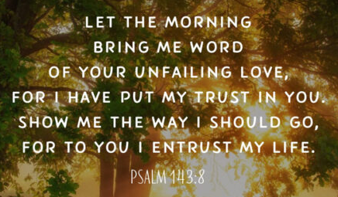
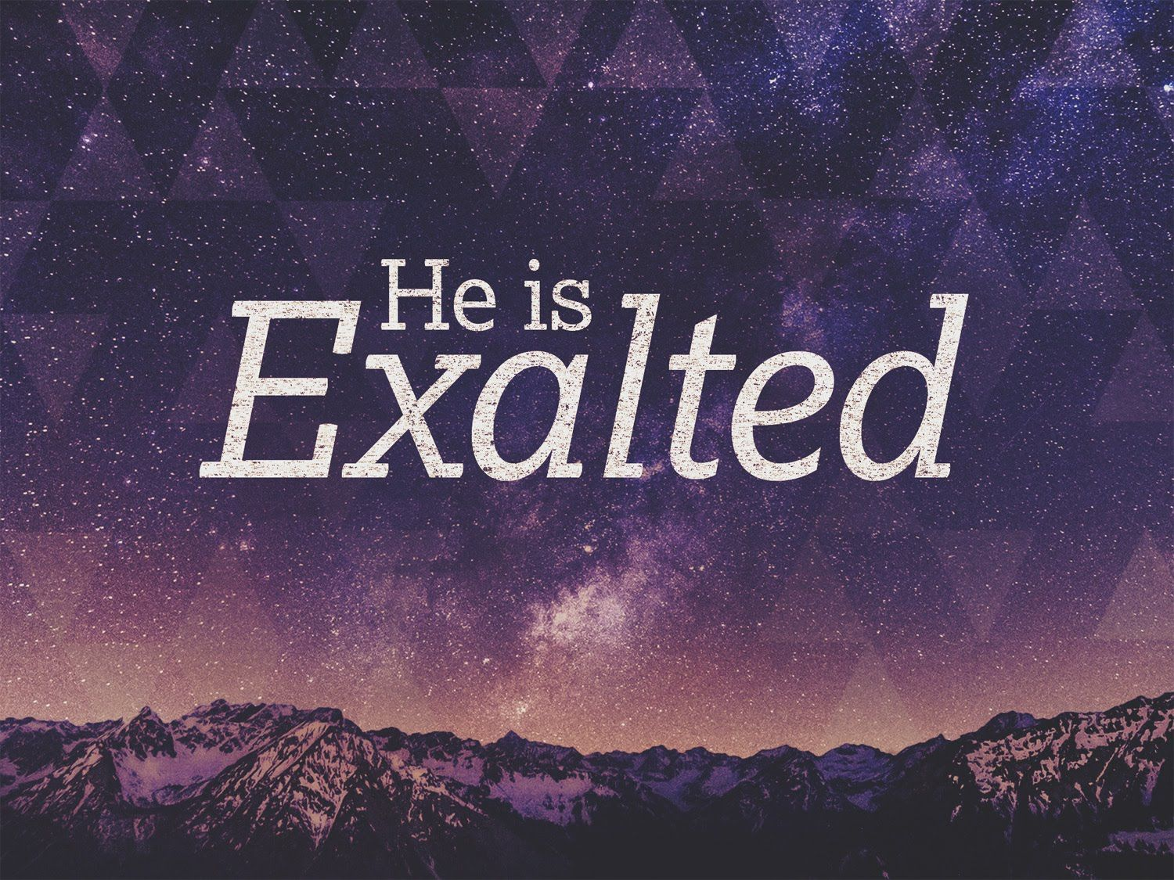
Judgment & Redemption
The Lord defends His people
Isa 33:2-6 – “²O Lord, be gracious to us; we have waited for You. Be their strength every morning, our salvation also in the time of distress. ³At the sound of the tumult peoples flee; at the lifting up of Yourself nations disperse. ⁴Your spoil is gathered as the caterpillar gathers; as locusts rushing about men rush about on it. ⁵The Lord is exalted, for He dwells on high; He has filled Zion with justice and righteousness. ⁶And He will be the stability of your times, a wealth of salvation, wisdom and knowledge; the fear of the Lord is his treasure.”
Notes:
In the meantime, though, notice this prayer by Isaiah that seems to allude to the fact that the people in Jerusalem were beginning to see the error of their ways.
Isa 33:2 – It’s as if the people are starting to learn that waiting on God w/confident expectation is going to pay off. They’re learning that neither allying w/Egypt nor paying off Assyria will fix their problem; only God’s grace can. Why does He need to be their strength “every” morning? Because doesn’t every morning, every new day, present unique distresses that require God’s strength? This is a continuous need, and it is also our first tie-in to woe #3, where we see in 29:15-16 their self-reliance, saying, “Who sees us? Who knows us?”, underplaying God’s sovereignty. Now they’ve learned their lesson.
And now the answer to his prayer – Isa 33:3-4 – This is the key to victory – simply waiting on the Lord to “lift up Himself” from His throne. Just a simple manifestation of God’s power is all it takes to disperse Assyria and every other enemy who threaten God’s people. This makes the battle over before it even begins, and as we see from vs, 4, the spoil will be numerous. As locusts leap from plant to plant, Judah will leap upon the spoil Assyria leaves behind.
And what does God “lifting Himself up” prove? – Isa 33:5-6 – That’s what it proves; and never will Assyria have experienced such a “god” as what they’re going to experience at the end of chapter 37. This may be remarkable for a people who are just now recognizing it, but the truth is, it merely expresses what has always been true about God. But unfortunately, we often must be brought low to see just how high He is. This exaltation leads to a permeation of His just and righteous character throughout the land, an increase of wisdom and knowledge. Vs. 6 contrasts the times of distress of vs. 2…
…because rather than being merely their “salvation” from vs. 2, when He rises, He will be a “wealth” of salvation. And what is the key to this wealth? The fear of the Lord, in which we begin to take God seriously. In other words, that is true treasure to God. Not the treasure they used to pay off Assyria, but the fear of the Lord, taking Him seriously. That’s a much wiser investment.

Slide 4
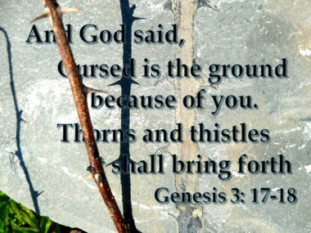
Judgment & Redemption
The Lord defends His people
Isa 33:7-9 – “⁷Behold, their brave men cry in the streets, the ambassadors of peace weep bitterly. ⁸The highways are desolate, the traveler has ceased, he has broken the covenant, he has despised the cities, he has no regard for man. ⁹The land mourns and pines away, Lebanon is shamed and withers; Sharon is like a desert plain, and Bashan and Carmel lose their foliage.”
Notes:
Now, in a classic Isaiah pendulum swing, the scene now appears to shift back to the reaction of the unfaithful toward Assyria’s treachery.
Isa 33:7 – Meaning, upon seeing Assyria’s treachery, the unfaithful of Judah realize they have nowhere to turn. Its brave men are brave no more. Its ambassadors realize there will be no peace despite the high price they paid to get Sennacherib out of their land. All of Judah’s self-reliant efforts are exhausted and they’re unable to conceal their distress.
Isa 33:8 – Meaning, because Assyria did not honor the agreement w/Hezekiah, and their invasion continues, ordinary activities have grinded to a halt. One thing to notice here is that Isaiah loves the “highway” imagery, and it is typically used to depict the ease at which people would come to God. But right now, while there is judgment, the highways are desolate because their path to God is restricted by their self-reliance and lack of trust. Keep an eye on how this is all going to change, though, once we get to chapter 35.
Isa 33:9 – Meaning, what started w/thorny ground in Gen 3:18 has turned into a withered world. “Lebanon” = “permanent”. “Sharon” = “beautiful”. “Bashan” and “Carmel” = fertile. The land reflects the spirit of the people, cold and lifelessness. Barrenness is the result of self-reliance; fruitfulness is the result of reliance on God, and again, we’re going to see this imagery again when we get to chapter 35. And remember from chapter 32 that one of the things God was going to do to force the complacent women into repentance was to take away those sure things they had depended on from the production of the land. That time has now come.

Slide 5
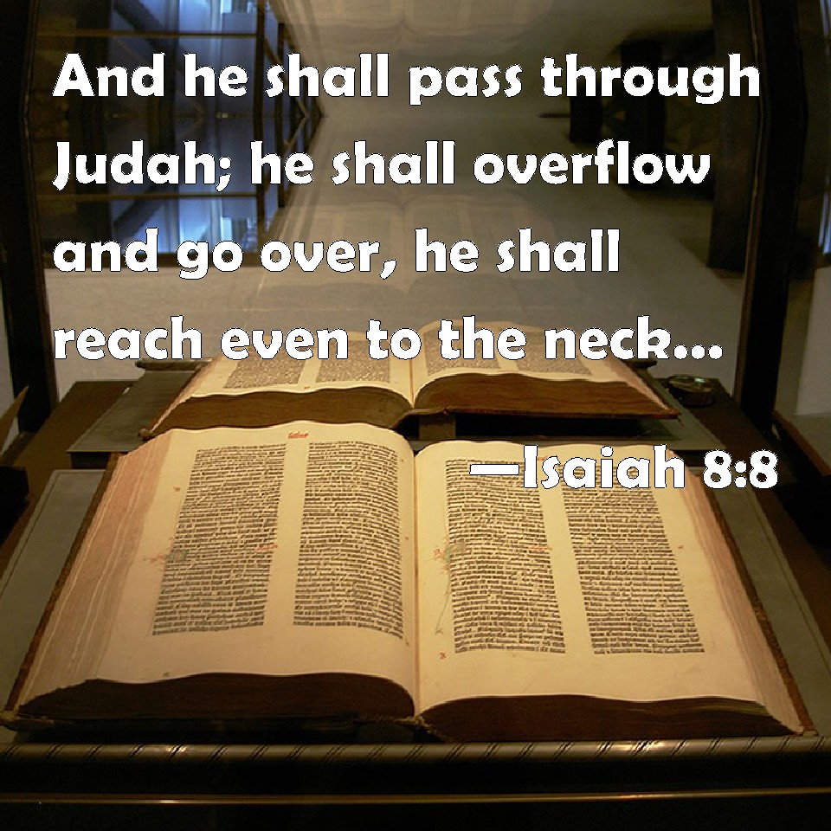
Judgment & Redemption
The Lord defends His people
Isa 33:10-12 – “¹⁰‘Now I will arise,’ says the Lord, ‘Now I will be exalted, now I will be lifted up. ¹¹You have conceived chaff, you will give birth to stubble; My breath will consume you like a fire. ¹²The peoples will be burned to lime, like cut thorns which are burned in the fire.”
Notes:
But while the so-called brave men and ambassadors cry out and weep, the next few verses indicates how God will respond to the threat at the 11th hour. And this is powerful imagery:
Isa 33:10 – Remember chapter 8:8, that Assyria’s conquests will reach to Judah’s neck, almost drowning them. But they won’t succeed because “God is with us”. But why “now”? Why wait until Assyria “reaches even to the neck”? Why wait until the 11th hour when it seems like all hope is lost? Because of our sin. The only way that some people are going to get it is to run completely out of any other option, to have to confront the most dire situation imaginable. It’s much like what had to happen to the prodigal son in that only when he had gotten so low that he would have gladly eaten the pods that the swine were eating was he finally able to see the error of his ways. There is a method to God’s judgment and redemption, and often it requires those who are most faithful to wait. And when He does rise, is it for our glory or His? Not ours, we are sinners. It’s so He will be lifted up.
And here is what He will do once He does – Isa 33:11-12 – Meaning, when God acts, man reaps what he sows. Assyria was pregnant w/grandiose visions, but they come to naught. As we’re going to see in chapter 36, Sennacherib’s chief trash talker, the Rabshakeh, is going to say a lot of intimidating things. But in the end, it was all empty. God’s “talk” will consume them w/fire (30:28,33). The phrase “to lime” indicates the intensity of the heat; it emphasizes the completeness of the destruction This is an external agent acting on Assyria – God Himself. This is another tie-in to woe #3 – in 29:23, He mentions that Judah’s redemption would be the work of His hands. God will be the one to defeat Assyria, not Egypt and not Judah, but God.

Slide 6
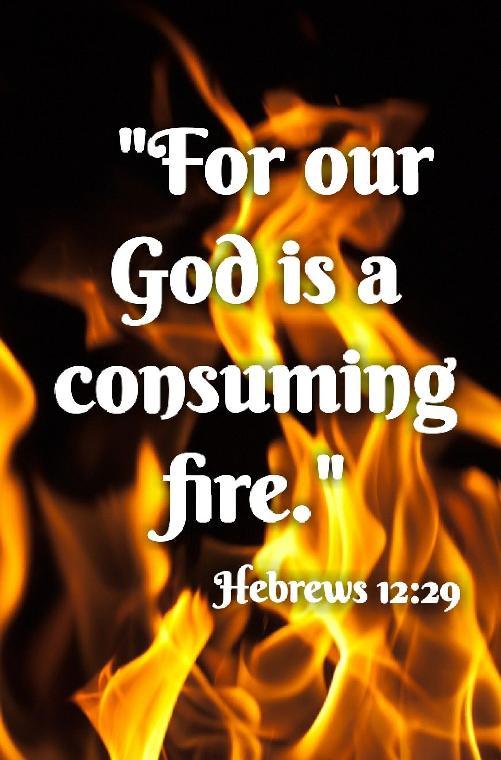
Judgment & Redemption
The New Zion
Isa 33:13-16 – “¹³You who are far away, hear what I have done; and you who are near, acknowledge My might.’ ¹⁴Sinners in Zion are terrified; trembling has seized the godless. ‘Who among us can live with the consuming fire? Who among us can live with continual burning?’ ¹⁵He who walks righteously and speaks with sincerity, he who rejects unjust gain and shakes his hands so that they hold no bribe; he who stops his ears from hearing about bloodshed and shuts his eyes from looking upon evil; ¹⁶he will dwell on the heights, his refuge will be the impregnable rock; his bread will be given him, his water will be sure.”
Notes:
He now shifts gears toward the new Zion.
Isa 33:13 – Those “far away” and “near” expresses totality. Similar to what Isaiah already taught in chapters 13 – 27, what the Lord does for Judah has worldwide implications. What He does to Assyria can be done to anyone. And hearing what God has done is the basis of faith.
But look at the reaction of the sinners within Zion – Isa 33:14 – So, the sinners who are “near”, having seen w/their eyes what God can do, they are terrified. This is because God’s holiness is the supreme threat to the godless, and they cannot survive in God’s presence. This was the same dread Isaiah faced in chapter 6 when he stood before God w/all his sin in plain view. And yet, the implication from vs. 10 of this chapter is that “God is with us”. What a paradox. Sinners in Zion realize they in no way can endure God’s fire anymore than Assyria could. And if one can’t endure God’s temporal fire, how will he endure the eternal fire? This is a tie in to 29:23, in which we read that those who witness God’s redemption, they “stand in awe”.
Who can live among the consuming fire? The answer – Isa 33:15 – To receive forgiveness demands accepting a lifestyle of righteous living previously unattained. Righteous conduct, upright speech, purity of heart, honesty, and ears attuned to righteousness. This is not to confuse the result of salvation w/the method, simply to suggest that there will be fruit born in the one who sincerely comes to God. And that’s the person who the fire of God’s furnace will not consume, but will purify, as we learn in 1 Pet 1:7.
Isa 33:16 – More Exodus themes. As we saw from vs. 5, to dwell on the heights is to be w/the Lord. There we will find security and provision, not destruction by fire. God’s character has infiltrated this person to such an extent that He will be in serenity regardless of earthly circumstances. This is the new Zion.

Slide 7
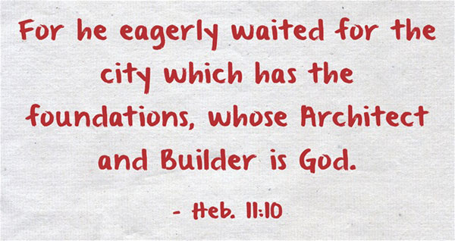
Judgment & Redemption
The New Zion
Isa 33:17-20 – “¹⁷Your eyes will see the King in His beauty; they will behold a far-distant land. ¹⁸Your heart will meditate on terror: ‘Where is he who counts? Where is he who weighs? Where is he who counts the towers?’ ¹⁹You will no longer see a fierce people, a people of unintelligible speech which no one comprehends, of a stammering tongue which no one understands. ²⁰Look upon Zion, the city of our appointed feasts; your eyes will see Jerusalem, an undisturbed habitation, a tent which will not be folded; its stakes will never be pulled up, nor any of its cords be torn apart.”
Notes:
Remember in woe #3 (29:18) how God promised that the deaf would one day hear and the blind would one day see? Here is that principle applied:
Isa 33:17 – That’s what will produce spiritual insight; not just because God beats the blindness out of them – that, by itself, hasn’t worked. It’s when they see the King in His beauty, causing them to realize that true beauty entails the spiritual, not the physical. And to “behold a far-distant land” means we’re preparing for that day w/thoughts of fellowship w/Him, just as Abraham was looking for a city w/foundations (Heb 11:10). The day will come when they will not longer be the “Valley of Vision”, they will see from afar as if on a mountain, not down in a valley where their vision is limited.
And having said what the “eyes” will see, he next addresses what the thoughts of the “heart” will be – Isa 33:18-19 – Likely refers the people who once took an inventory of their weaponry – they’re no longer found. And God’s people will look back on the days when they were so afraid of Assyria and remember how silly it was to dwell on that terror in light of Who was watching over them. It would have been degrading to hear a harsh, unintelligible language in the streets of the holy city from a boasting, foreign conqueror. But what Assyria did to Samaria will not happen to Jerusalem. So, in a play on words, by seeing the King, they will no longer see Assyria.
Rather…Isa 33:20 – Zion is the city of religious privilege and fellowship, one of peace and security. The tent (another Exodus theme) that was used in the wilderness was regularly taken up and moved around. Not so here. While true that Assyria would not take them captive, this alludes to a spiritual Jerusalem in which the pilgrimage would be over. It will not suffer decay because the earthly tabernacle was only a model of heavenly realities.

Slide 8
Judgment & Redemption
The New Zion
Isa 33:21-22 – “²¹But there the majestic One, the Lord, will be for us a place of rivers and wide canals on which no boat with oars will go, and on which no mighty ship will pass—²²For the Lord is our judge, the Lord is our lawgiver, the Lord is our king; He will save us—”
Notes:
And who is dwelling in the midst of this permanent tent? God.
Isa 33:21 – This figure could mean a couple things. It could mean that Zion will be so self-sufficient, there will be no need for shipping, because God will supply them w/everything they need. However, world cities were also protected by rivers, so this could be a play on their alliance w/Egypt, suggesting that whatever protection the Nile afforded Egypt, God’s river protecting Zion will be infinitely superior. Either way, Zion’s protection will be from God, giving all its inhabitants the benefits of rivers w/o its liabilities. And why is God doing this Zion? Did you know notice the phrase “for us”? Immanuel – God is with us.
And who is the Lord? – Isa 33:22 – This answers the question of the entire book, “Can we trust God to save us?” Yes. He is supremely gifted in leadership, judgment, and defense (John 5:22), fair in legislating (Heb 8:6; 12:24), and delivering and uniting all tribes from every nation (Rev 17:14). This verse is so weighty, the founding fathers of our nation used it as the basis for designing our government w/the checks and balances we currently see: “judge” being the judicial branch, “lawgiver” being the legislative branch, and “king” being the executive branch.

Slide 9
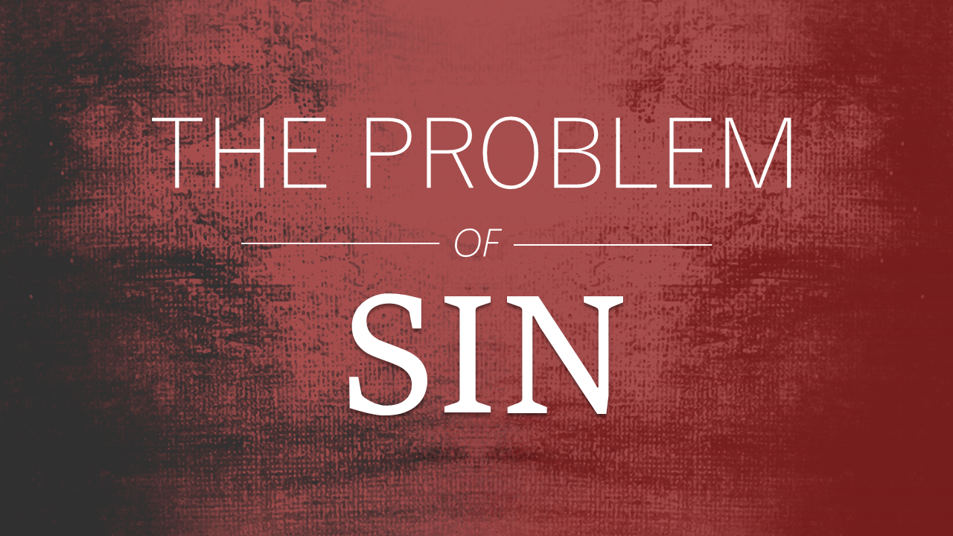
Judgment & Redemption
The New Zion
Isa 33:23-24 – “²³Your tackle hangs slack; it cannot hold the base of its mast firmly, nor spread out the sail. Then the prey of an abundant spoil will be divided; the lame will take the plunder. ²⁴And no resident will say, ‘I am sick’; the people who dwell there will be forgiven their iniquity.”
Notes:
Isa 33:23 – In other words, current Zion can be compared to a ship that is crippled, whose the rigging is loose, mast unset, and sails not hoisted. Yet in spite of its poor condition, they still take the spoil. This seems to simply further illustrate that their victory will not be from themselves – it will be achieved by Another. And so abundant will be the spoil, even the lame, who would typically not have the faculties to get any of the spoil, will have plenty to take because of the abundance of the spoil.
This concluding verse is the heart of the whole matter – Isa 33:24 – The real problem is not physical oppression – that is only the symptom. The root problem is a broken relationship w/God. The sickness of sin will not exist in the new Zion. This leads to a restoring of strength, a healing of their sin-sickness. And as we get closer to chapters 40 – 66, we’re going to see more of this type of language start to pop up. This is God foreshadowing for us what the real issue behind the present distress is. It’s not nations or people; it’s sin. If the problem of sin can be fixed, that’s what will usher in ultimate blessing.

