Slide 1
Notes:
As we continue working our way through chapters 28 – 35, let’s review what Isaiah is teaching us in this section. He’s gone from dealing w/the worldwide implications of the future Messianic kingdom right back to talking about a local crisis as he had done in chapters 7 – 12. But this time, it is Hezekiah as king, Assyria is the threat, Egypt is the temptation, and the message of trust from these chapters is leading up to the grand finale in chapter 37 where we will see the demonstration of God’s predictive word.
There are 3 main objectives from these chapters. 1) Judah will be both judged as well as saved from the current threat. 2) Egypt, that old abusive boyfriend, will not be the one to come to Judah’s rescue. 3) When it is time for Assyria to be destroyed, God will be the one to do it.
Isaiah divides these chapters into 6 “woes”; the first 3 develop the principles of the current crisis, and the last 3 apply those principles. As was the case in chapters 13 – 27, there are repeated themes across the companion woes. Meaning, the 5th woe in chapters 31 – 32 are going to apply the principles of the 2nd woe in 29:1-14.
Back in 29:1-8, the point was made that though the destroyer seems fierce, God has them on a short leash. He will never leave the last word to them, even if divine intervention may appear to come at the 11th hour. And now in this 5th woe, the first 5 verses of chapter 31 will show how God will apply this principle specifically to Assyria.
Back in 29:9-15, it was mentioned the need for Judah to be transformed, to have a change of heart, something the Lord was going to help facilitate by allowing their hardness of heart for a time so that He could destroy their so-called wisdom. And that is the subject of 31:6 – 32:20, as we’re going to see exactly how God will do this through the coming of a new King and a new Spirit that will bring about that very transformation.

Slide 2
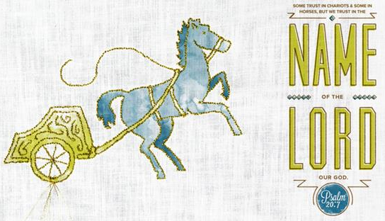
Deliverance & Renewal
Folly of relying on Egypt
Isa 31:1-3 – “¹Woe to those who go down to Egypt for help and rely on horses, and trust in chariots because they are many and in horsemen because they are very strong, but they do not look to the Holy One of Israel, nor seek the Lord! ²Yet He also is wise and will bring disaster and does not retract His words, but will arise against the house of evildoers and against the help of the workers of iniquity. ³Now the Egyptians are men and not God, and their horses are flesh and not spirit; so the Lord will stretch out His hand, and he who helps will stumble and he who is helped will fall, and all of them will come to an end together.”
Notes:
The 5th woe does complete the thoughts of the 2nd woe, but it also continues the thought of the previous woe in chapter 30 by exposing the folly of depending on Egypt, a sin so acutely sinful, it necessitates a repeated warning.
Isa 31:1 – So, why was Egypt such a temptation to God’s people? Because they had the best weaponry. Horses and chariots were Egyptian strengths and Judah wants Egypt’s strength to be their strength also….
…both in quantity (“many”) and quality (“strong”). The phrase “those who go down” is a participle in the Hebrew that indicates that this isn’t the first time they’ve done this. And the words “rely” and “trust” denote a settled attitude. But as if utterly perplexed, Isaiah says, “You’re not looking to God, who not only rescued your forefathers from Egyptian slavery, but laid the smackdown on them in the process.”
This is such a far cry from King David’s attitude in Psa 20:7 – “Some boast in chariots and some in horses, but we will boast in the name of the Lord, our God.” – the apple has truly fallen far from the tree.
Isa 31:2 – That word “also” denotes heavy sarcasm, as if to say, “You know, God knows a little something, too”. In fact, He knows so much, He is going to bring every single one of their plans to disaster, and all the “Egypts” in the world wouldn’t be able to stop Him. And as we see at the end of the verse, not only will He judge the wrongdoers, but those who aid them in their sin. The so-called “wise” men behind the political alliance w/Egypt were in fact not wise at all, and this is the first tie-in we see to woe #2, where in 29:14 he tells them the wisdom of their wise men will perish.
Because here is the reality they seem to have forgotten – Isa 31:3 – However mighty the Egyptians may have been, they were still men. And their horses were less than men, being flesh w/no spirit. But the Lord is powerful, all He has to do is stretch out His hand and flick them over like pawns on a chessboard.
And here is our first reference back to the book of Exodus. In fact, God doesn’t have to stretch out His own hand, but merely tell one of His servants to do so, as we see in Ex 14:26-27. The Egyptians are those who “help” and the wise men are the “helped”, and both will fall together. But as we’re going to see later in Isa 40, it is God’s word that endures forever.

Slide 3
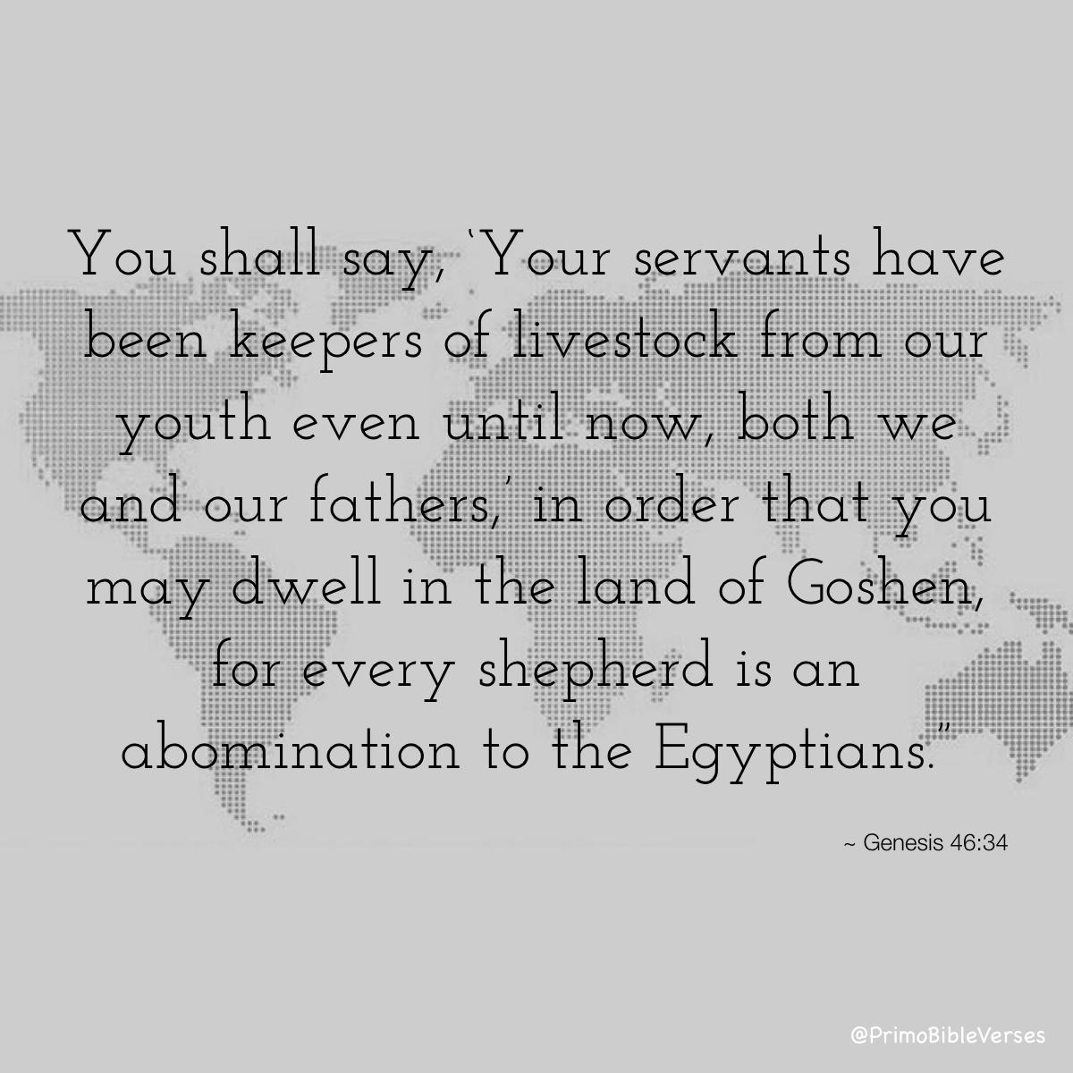
Deliverance & Renewal
How God rescues
Isa 31:4-5 – “⁴For thus says the Lord to me, ‘As the lion or the young lion growls over his prey, against which a band of shepherds is called out, and he will not be terrified at their voice nor disturbed at their noise, so will the Lord of hosts come down to wage war on Mount Zion and on its hill.’ ⁵Like flying birds so the Lord of hosts will protect Jerusalem. He will protect and deliver it; He will pass over and rescue it.”
Notes:
Isaiah is now going to present us w/2 pictures of God’s persistence in the face of the enemy.
Isa 31:4 –The first picture is of His fierce might. As a lion, God will seize Mt. Zion as His prized captor, eliminating those enemies within it who move people away from God. And in this image, He is depicting Egypt as shepherds. What is the irony in that? From what we read in Gen 43:32; 46:34; Ex 8:26, the Egyptians despised shepherds; they wouldn’t even eat w/them. But here, they are depicted as an ineffectual aid to help Judah because while the wise men “go down” to Egypt, (here’s an inclusio) God will “come down” to wage war on Mt. Zion for His people even when they weren’t asking for it. This is also another tie-in to woe #2 and Jerusalem’s identity as “Ariel”, which can mean 2 things: a “lion” or an “altar hearth”. We’re going to see both of these figures used in this chapter.
But here’s the 2nd picture – Isa 31:5 – So while the 1st picture is of his fierce might, this 2nd picture is of His passionate attachment. In Ex 19:4, God bore Israel on eagles’ wings. God is like a gentle, mother bird protecting her young. He will “pass over” them in protection, in another allusion to Exodus, and it is the exact same word used of the Passover in Ex 12:13,23,27. So, these 2 pictures show us that while God will fight against Zion’s enemies, He will also protect its faithful in the process. God will defend and protect them, not Egypt.

Slide 4
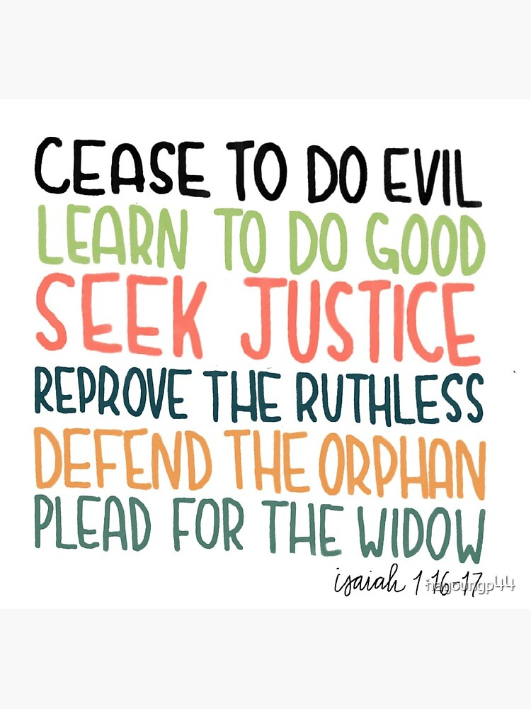
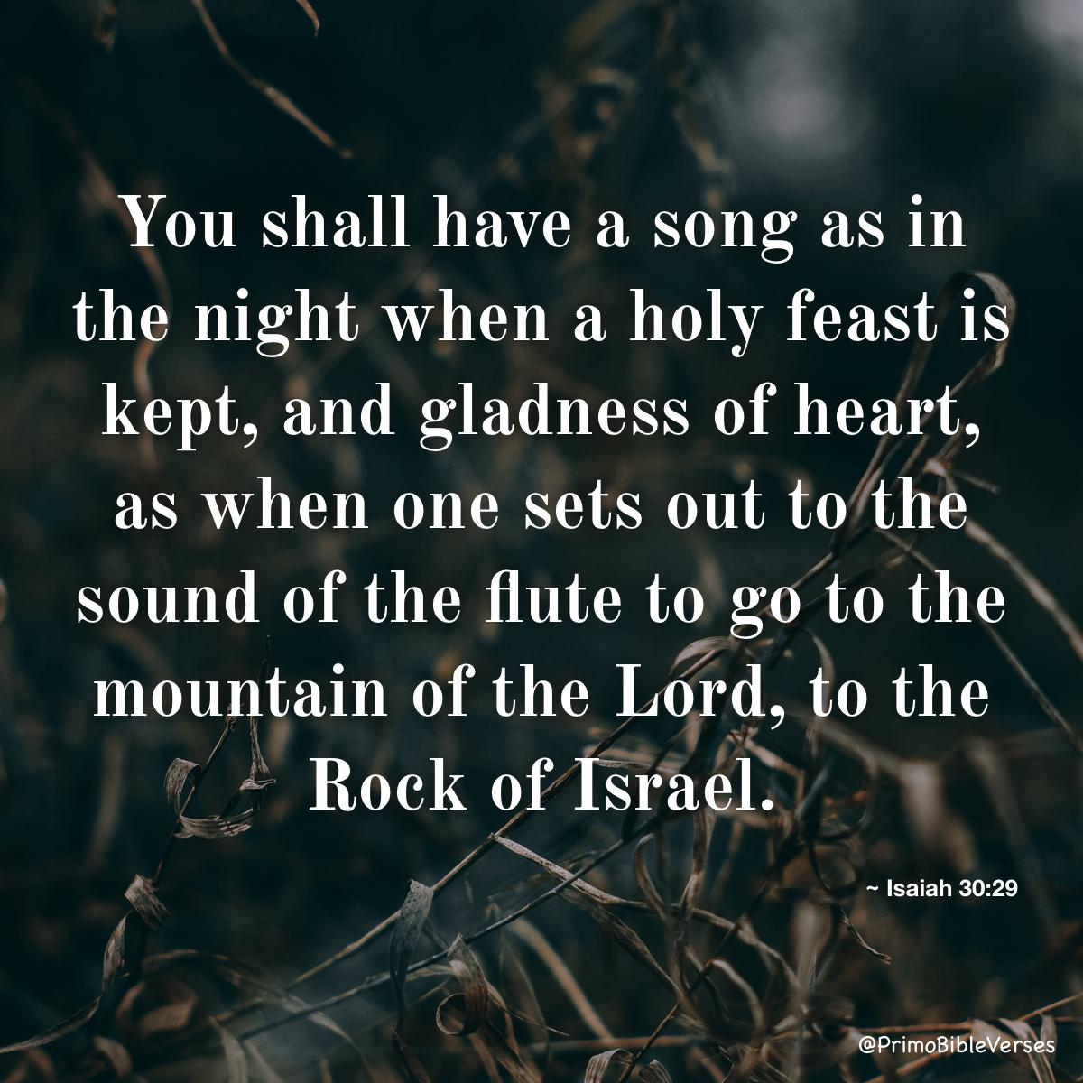
Deliverance & Renewal
Invitation & Promise
Isa 31:6-9 – “⁶Return to Him from whom you have deeply defected, O sons of Israel. ⁷For in that day every man will cast away his silver idols and his gold idols, which your sinful hands have made for you as a sin. ⁸And the Assyrian will fall by a sword not of man, and a sword not of man will devour him. So he will not escape the sword, and his young men will become forced laborers. ‘⁹His rock will pass away because of panic, and his princes will be terrified at the standard,’ declares the Lord, whose fire is in Zion and whose furnace is in Jerusalem.”
Notes:
So, given this assurance, what must they do now?
Isa 31:6-7 – “Return” is “repentance”, and “repentance” is reorienting one’s life from self back to God. It’s a change of action and attitude, what we saw in Isa 1:16-17. They have so deeply defected to the dark places, as we saw in 29:15, that they have a desperate need to return. Because there is a certainty about the day of the Lord – when God reveals His grace, the helplessness of the idols will also be revealed, and when that happens, they don’t want to be found on the losing side. “But gold and silver is a lot of money” – but see, while true repentance may require counting the cost, it never asks for a price. God already showed His supremacy to the Egyptian idols in Ex 12:12, the question is whose side will they be on when He shows that supremacy again.
Also in that day, He’s going to take care of the Assyrians – Isa 31:8-9 – This is what we’re going to see fulfilled in just 6 more chapters, so stay tuned. But just like the fall of Jericho, Assyria’s ultimate defeat in their current campaign will have nothing to do w/men. This is going to be all God. And eventually Babylon would finish the job in 612BC, and Assyria would then get a taste of what they had done to other nations. The word “rock” in vs. 9 appears to be synonymous w/”princes” in the same verse, representing Assyria’s “sure thing”. But as we’ve already seen in Isa 30:29, Judah has a much bigger Rock, and as that Rock will “pass over” in deliverance, Assyria will “pass away” into history. And notice how God’s “hearth/furnace” reappears here, another tie-in to oracle #2. And since His “hearth” is in Judah, He will ultimately protect it – Assyria is done for.

Slide 5
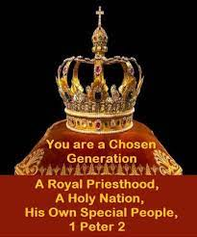
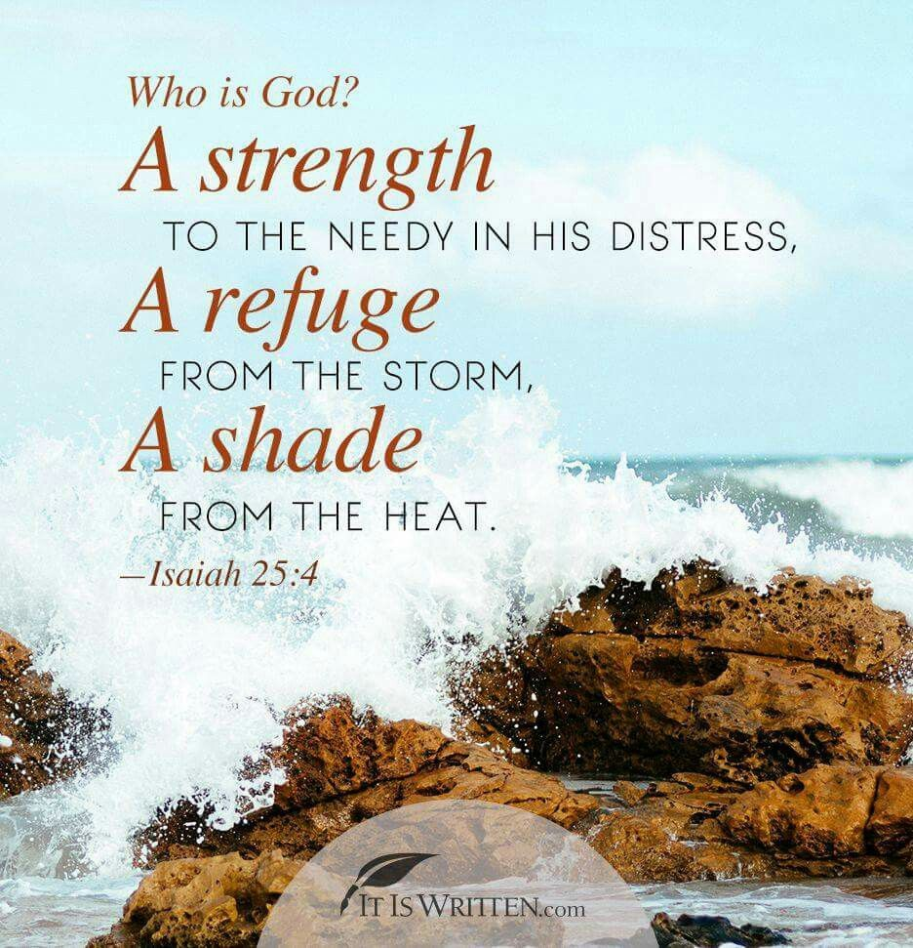
Deliverance & Renewal
Coming of a new society
Isa 32:1-2 – “¹Behold, a king will reign righteously and princes will rule justly. ²Each will be like a refuge from the wind and a shelter from the storm, like streams of water in a dry country, like the shade of a huge rock in a parched land.”
Notes:
However, as we begin chapter 32, the 5th woe continues w/the theme of Assyria’s defeat by showing a contrast between Assyria’s government and a new government that God will one day usher in. Meaning, while Assyria’ “rock” passes away and their princes are terrified, look at what God’s people get to look forward to:
Isa 32:1 – What king? The same one we saw in 9:7, whose throne would be established and upheld w/justice and righteousness. The same one we studied in 11:4 who w/righteousness would judge the poor. The same cornerstone we saw in 28:16 in which justice would be the measuring line and righteousness the plumb line. There has been hardly a mention of the Messiah thus far in Isaiah in which justice and righteousness are the not predominant themes of His rule. This was the exact opposite of the governments of that day and was meant to inspire them toward a more illustrious future.
Who are the “princes” of this verse? Likely Christians, those who 1 Pet 2:9 calls a “royal priesthood” alluding to the fact that in a sense, we rule w/Him, proclaiming and practicing these very qualities of character.
Hence vs. 2 – Isa 32:2 – The idea being, that the princes will take on the qualities of the King, and Isaiah gives us 4 word-pictures from nature to describe them, all of which refer to protection, provision, and refreshment – every beneficial care. This is a stark contrast to the former leaders’ ruthless behavior that we saw in 29:20-21. The Messiah and His followers will not be like this – they will be true servants
And this is similar to the metaphors used of God in 25:4 in which we’re told God would be a “defense for the helpless, a defense for the needy in his distress, a refuge from the storm, a shade from the heat.” The princes will be like the king they serve.

Slide 6
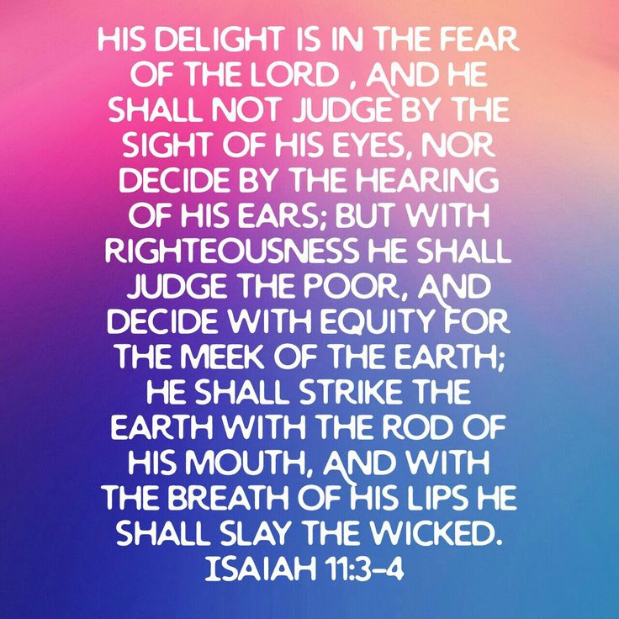
Deliverance & Renewal
Coming of a new society
Isa 32:3-5 – “³Then the eyes of those who see will not be blinded, and the ears of those who hear will listen. ⁴The mind of the hasty will discern the truth, and the tongue of the stammerers will hasten to speak clearly. ⁵No longer will the fool be called noble, or the rogue be spoken of as generous.”
4 Areas of Spiritual Transformation
Eyes (perception)
Ears (reception)
Mind/heart (grasping)
Tongue (communicate truth)
Notes:
And there are going to be reciprocal effects of His coming on many of those who were once so very blind.
Isa 32:3-4
So, notice how spiritual renewal leads to four areas of transformation: eyes (perception), ears (reception), mind/heart (grasping), and tongue (communication of truth). All that judicial blindness/deafness of from 6:11 and 29:9-12 will be reversed! Even those who rush forward too hastily will show restraint and those previously incapacitated will not delay to speak truth w/clarity. This King truly must be something. God couldn’t beat the blindness out of them no matter how hard He tried. But there is something about this coming King whose very nature will inspire transformation. Who is this King? Stay tuned.
Isa 32:5 –A “fool” is one who lacks moral sensitivity; it is the same word for “nabal” in 1 Sam 25. A “rogue/scoundrel” is one who is into self-advantage at the expense of others. And worldly societies have always accorded fame/honors to people like this who are unworthy. But now that the coming King has ushered in clarity of eyes, ears, heart, and tongue, true character will be discerned. As we saw in 11:3, the Messiah will not judge by what His eyes see and ears hear; He will be able to see through to the truth of a matter.

Slide 7
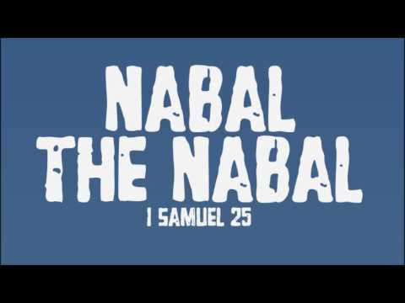
Deliverance & Renewal
Coming of a new society
Isa 32:6-8 – “⁶For a fool speaks nonsense, and his heart inclines toward wickedness: to practice ungodliness and to speak error against the Lord, to keep the hungry person unsatisfied and to withhold drink from the thirsty. ⁷As for a rogue, his weapons are evil; he devises wicked schemes to destroy the afflicted with slander, even though the needy one speaks what is right. ⁸But the noble man devises noble plans; and by noble plans he stands.”
Notes:
Isa 32:6-7 – Why the exhaustive description? It’s almost as if this is designed for the King’s princes, who like the King want to discern and understand the motives that drive evil doers. The fool speaks and acts in this way because of his heart, which we know from Jas 3:3 gives the tongue a voice. This attitude toward God breeds an attitude of contempt toward man, just as that fool Nabal had toward David. Fools are dangerous because they set out to accomplish evil; they are dedicated to iniquity. The rogue is one who has to have his way no matter the cost. He knows how to manipulate the legal process, how to use slander to turn others against his opponent, how to get rich through deceit, and he has the “weapons” (leverage) to do so, though his opponent is clearly in the right. If it weren’t for the King’s reign, the fool and rogue would likely continue unhindered, never exposed.
In contrast – Isa 32:8 – On the contrary, the noble will be exposed for his nobility. Knowing God supplies all his needs, he can afford to be generous toward God and other people. And this is because he is the King’s prince.

Slide 8
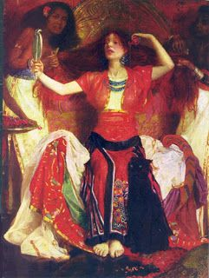
Deliverance & Renewal
Purging of old society
Isa 32:9-14 – “⁹Rise up, you women who are at ease, and hear my voice; give ear to my word, you complacent daughters. ¹⁰Within a year and a few days you will be troubled, O complacent daughters; for the vintage is ended, and the fruit gathering will not come. ¹¹Tremble, you women who are at ease; be troubled, you complacent daughters; strip, undress and put sackcloth on your waist, ¹²beat your breasts for the pleasant fields, for the fruitful vine, ¹³for the land of my people in which thorns and briars shall come up; yea, for all the joyful houses and for the jubilant city. ¹⁴Because the palace has been abandoned, the populated city forsaken. Hill and watch-tower have become caves forever, a delight for wild donkeys, a pasture for flocks;”
Notes:
Now, keep in mind the pendulum swings we see in Isaiah. Because part of what needs to happen before this purging takes is there must be judgment. And this judgment is also going to be extended toward Judah’s women. And we did see an issue w/the women of that day back in chapter 3, vain women who were contributing to Judah’s downfall.
Isa 32:9-10 – The women of my grandparents’ generation were more impoverished and there was little ease because they had to scratch and claw their way through life, and it was hard. But they developed the virtuous character that comes w/that lifestyle. But these women lived indulgent, self-focused lives, w/no thoughts beyond their wardrobe, and who are at ease because of prosperity. And this has lulled them into apathy toward the dangers at hand, and so they need a shot in the arm. God is going to take away those sure things they came to expect from their crops and their fruit gathering, and its design is to shake them out of their complacency.
Isa 32:11-13 – All this is related to Sennacherib’s siege in 701BC, which we’re going to see in chapters 36-37. As a result of Assyria’s ransacking o Judean cities, the land became desolate and unproductive. And in view of this inevitability, God is calling on Judah’s women to swap out their fancy clothing for clothes of mourning to express the repentant heart He is looking for. He is trying to wake Judah up before the tough times arrive because it is always better to repent out of principle rather than compulsion.
Isa 32:14 – In other words, previous fortified structures intended to house and defend the people, such as those Uzziah and Jotham had developed, will now be populated by animals. This transition is the price of Judah’s sin. Point: the Messianic kingdom Isaiah is foreshadowing simply can’t come until this unrighteousness is first purged.

Slide 9
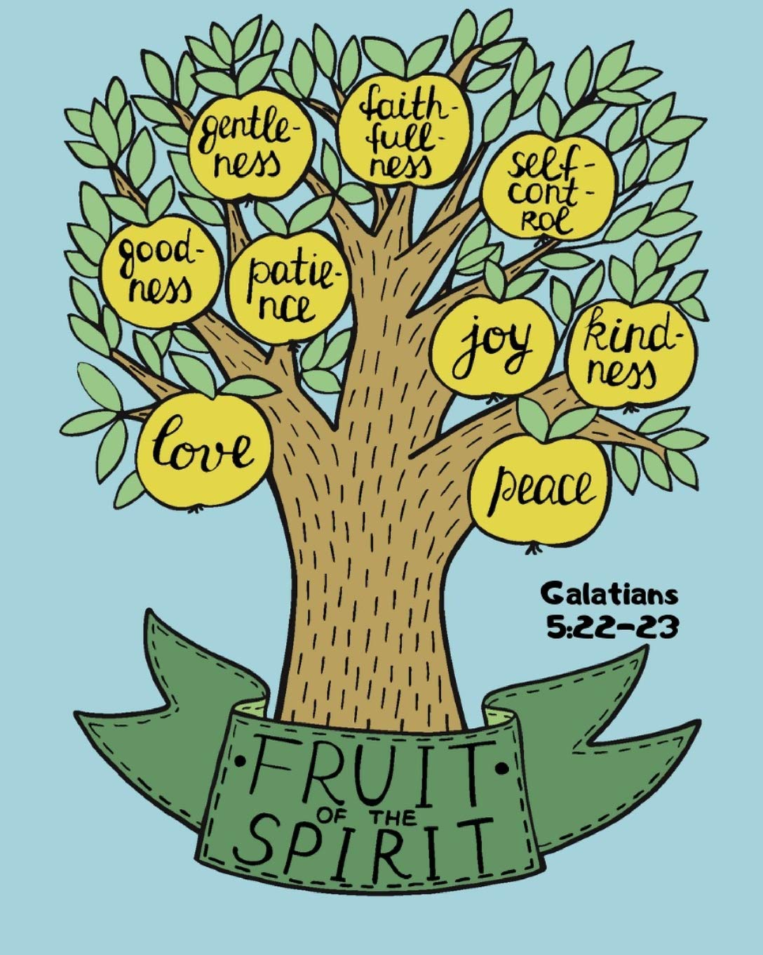
Deliverance & Renewal
Holy Spirit is the source
Isa 32:15-18 – “¹⁵Until the Spirit is poured out upon us from on high, and the wilderness becomes a fertile field, and the fertile field is considered as a forest. ¹⁶Then justice will dwell in the wilderness and righteousness will abide in the fertile field. ¹⁷And the work of righteousness will be peace, and the service of righteousness, quietness and confidence forever. ¹⁸Then my people will live in a peaceful habitation, and in secure dwellings and in undisturbed resting places;”
Notes:
But fortunately, that word “forever” from vs. 14 is actually given an end.
Isa 32:15 – In other words, this judgment is to precede this eventual outpouring of the Holy Spirit; not a scattering of just a few drops; He would pour it out. Not from men, but from on high. This is another tie-in to woe #2, where in 29:10 he mentioned the need to “pour over you a spirit of deep sleep”; meaning, they were so hard-headed, they were going to need to sleep this thing off. But once judgment has served its purpose, He will “awaken” them w/a pouring out of the Holy Spirit. This will cause the land to bear fruit, a reversal of vs. 13-14. But that was talking about physical fruit. What kind of fruit will this be?
The fruit of the Spirit – Gal 5:22-23. The Holy Spirit is the ultimate fertilizer; only it can restore what the sin of man destroys. Don’t miss this symbolism of the wilderness becoming a fertile field, because we’re going to start to see this a lot in upcoming chapters.
And what are those 2 virtues we keep seeing over and over again when Messianic principles are at play? Those 2 twin virtues, Justice and righteousness – Isa 32:16-17 – Remember, “righteousness” is a conformity to God’s holy standard (the measuring lie) and justice is what upholds these standards (the plumb line). The idea, as we saw in vs. 1, is that the presence of God’s unique people will lead to other people being honored and treated fairly. Justice and righteousness is what will drive these fruits of the Spirit.
And in contrast to the careless ease and false peace of vs. 9 – Isa 32:18 – Meaning, the comfort and complacency of vs. 9 will not only be interrupted, but replaced w/a true security that only God can offer. As we saw in chapter 11, no ravenous animal will enter God’s pasture to destroy His flock. They’ll either conform to a new standard, or they’ll be destroyed.

Slide 10
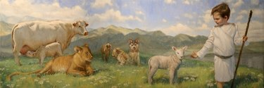
Deliverance & Renewal
Epilogue
Isa 32:19-20 – “¹⁹And it will hail when the forest comes down, and the city will be utterly laid low. ²⁰How blessed will you be, you who sow beside all waters, who let out freely the ox and the donkey.”
Notes:
These last verses are the epilogue, summarizing the abrupt transition from disaster to blessing with which the woe began in 31:1.
Isa 32:19 – I take this to mean that sinful Judah is going to have to be laid very, very low. Only judgment and glory remain. The idea is, which will they choose?
Isa 32:20 – Meaning, when this happens, those of God’s people who remain will pursue productive occupations in the Lord, devoted to the production of good – 2:4. They stay near to the source (living water), and let the “animals” roam free w/o worrying that what they consume will be missed.

