Slide 1
Notes:
There were 2 climactic points in chapters 13 – 27 where Isaiah prophesied that both Egypt and Assyria would be brought into full membership w/the Lord’s people.
Isa 19:24-25 – “In that day Israel will be the third party with Egypt and Assyria, a blessing in the midst of the earth, whom the Lord of hosts has blessed, saying, ‘Blessed is Egypt My people, and Assyria the work of My hands, and Israel My inheritance.’”
Isa 27:13 – “It will come about also in that day that a great trumpet will be blown, and those who were perishing in the land of Assyria and who were scattered in the land of Egypt will come and worship the Lord in the holy mountain at Jerusalem.”
To the Jews, this would have seemed strange, unlikely, and offensive – enemies becoming friends? Imperial powers submitting? But what may have seemed marvelous to the Jews would be demonstrated before their very eyes, according to God’s sovereign will, and that is the subject of chapters 28 – 35.
After looking at a worldwide picture in chapters 13 – 27, Isaiah comes back to the political climate of Judah, this time during the days of Hezekiah, in which God’s people are facing the threat of a hostile Assyrian takeover. It appears as though Judah’s foreign policy makers are considering an alliance w/Egypt to prevent it, and there is evidence that Judah is already committed to trusting in Egypt above God. Remember that Hezekiah’s father Ahaz had tried to ally w/Assyria against Israel and Syria, and it came back to bite him in a big way. In this section, God is not only going to reveal Egypt as utterly untrustworthy and ineffective in helping Judah, He will also assure them that while He is using Assyria, they will ultimately not succeed in taking down Jerusalem. And so, will they ally w/Egypt, or rely on God? Hence, the theme, “Alliance vs. Reliance”.
These chapters are wonderfully constructed around a mosaic of 6 “woes”, to suggest that if Judah persists in committing herself to fickle Egypt, “its your funeral”. These “woes” are divided into 2 sections of 3. The first three “woes” are found in chapters 28 – 29 in which Isaiah expounds upon the principles of the situation, contrasting false vs. true foundations, revealing Judah’s blindness vs. how He will use that blindness to illuminate them, and their contrivance vs. their transformation. In the 2nd set of 3 “woes” He applies the principles to Egypt and Assyria by name, explaining how Judah will go from obstinance to prominence, be delivered and renewed, and will contrast His judgments toward them all vs. redemption. Just as we saw in chapters 13 – 27, there are common themes found in the parallel “woes” (woe #1 w/woe #4, etc.).

Slide 2
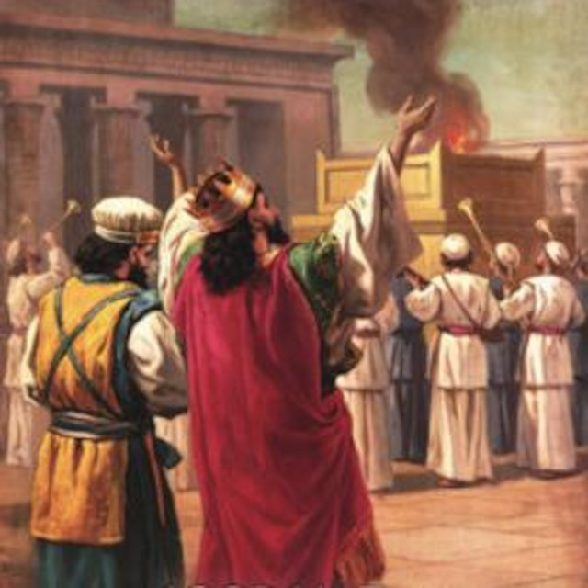
Background
Hezekiah
Reversed Ahaz’s Apostasy
Reopened temple service
Reinstituted Passover
Sennacherib invades Judah
Trust in Egypt?
Notes:
Back in Isa 14:28, we read of the death of Ahaz. His son Hezekiah then began reigning at 25 years old. We believe that most of the oracles in chapters 13-23 were probably written during Hezekiah’s early years as king. What else was happening in these early years?
Both 2 Kings 18 and 2 Chron 29 tell us that Hezekiah immediately began reversing the heinous practices of his father. Hezekiah could clearly see that the reason Judah was struggling was due to their unfaithfulness. So, he took it upon himself to reopen the temple and he consecrated the priests to the service. He reinstituted the Passover, even inviting Israelites from the northern kingdom; and some of them actually came! And so inspired were they by their participation in this Passover that when the feast was over, they went all throughout the cities of Judah and Israel tearing down idols and removing the high places. Hezekiah was such a faithful man who exercised tremendous influence over the people.
It was 5 years into his reign that Samaria fell to Assyria and its king Shalmaneser V. Shalmanesar died that same year and was replaced by Sargon II who reigned 17 years. As we’ve already discussed, Sargon II spent a large part of his reign quelling rebellions, particularly in Babylon. And when he died in 705BC, he was replaced by his son Sennacherib who finished the job. With Babylon successfully tamed, Sennacherib then set his sights on Judah and made it his goal to conqueror them. Much of the message of chapters 28 – 35 were likely delivered during Hezekiah’s first 14 years leading up to the climatic event w/Assyria in chapter 37. From the very beginning, Hezekiah adopted an anti-Assyrian foreign policy, refusing tribute. But when Sennacherib started invading them, Hezekiah tried to pay them off both from his personal treasury as well as the temple treasury. Sennacherib took the money and continued his invasion, hence the term “treacherous one”. Hezekiah also strengthened the walls, and cut off access to the Gihon springs.
The biggest temptation during this time, and the predominant them of Isaiah’s message in chapters 28 – 35, was the temptation to get help from Egypt. And this was definitely happening somewhere in the administration, but there’s a debate over whether this came from Hezekiah himself or from others. It would seem strange that one of Hezekiah’s first moves when becoming king would be to observe the feast that reminded them of God’s sovereignty over Egypt. However, Hezekiah was to be wishy-washy, as we’ll see in chapters 36 – 39. So, others suggest while he was encouraging faithfulness to God, foreign policy makes behind the seen were holding talks w/Egypt. Regardless, Egypt was a temptation, but as we’ve already seen, they couldn’t be trusted. Our trust must solely be in God.

Slide 3
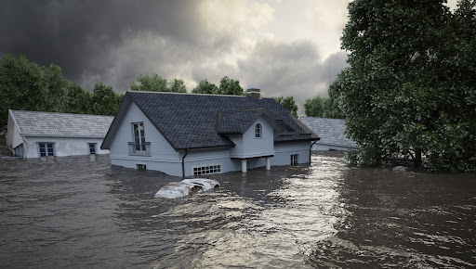
False & True Foundations
Israel must “die” to bear fruit
Isa 28:1-2 – “¹Woe to the proud crown of the drunkards of Ephraim, and to the fading flower of its glorious beauty, which is at the head of the fertile valley of those who are overcome with wine! ²Behold, the Lord has a strong and mighty agent; as a storm of hail, a tempest of destruction, like a storm of mighty overflowing waters, He has cast it down to the earth with His hand.”
Notes:
The first few verses is going to focus on Samaria. Keep in mind that Samaria did not fall to Assyria until Hezekiah’s 6th year. And so, he has a very short message for them that will quickly Segway into a message to Judah.
Isa 28:1 – The subject of this first “woe” is the contrasting of false vs. true foundations. The people of Ephraim, which is just a stand-in for the northern kingdom of Israel, had a pride about them that led them into complacent revelry and drunkenness. Even today, much of the self-hatred and self-despising that drinkers feel is rooted in self-absorption. But the flower of the “garland” is fading, meaning the party is almost over. The word “overcome” literally means “to beat down, to hammer”. In other words, they’re hammered! This is what one does to himself when given over to alcohol, and it led to poor judgment by Ephraim’s leadership.
Attention is now directed to what God is going to do about Ephraim – Isa 28:2 – Meaning, if the drunkard is powerless to stop his drinking, God is able to make him stop, and He does so through Assyria. But rather than mentioning Assyria by name as Isaiah had done before, the emphasis is simply on Israel’s sin. This destruction will be controlled by the hand of God (10:5) and it will resemble a hailstorm, tempest, and overflowing waters (8:7).

Slide 4
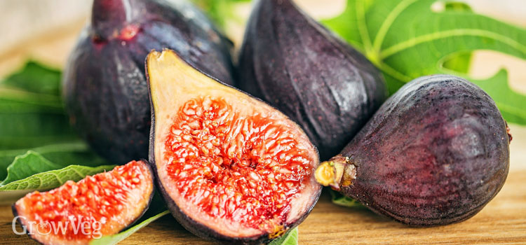
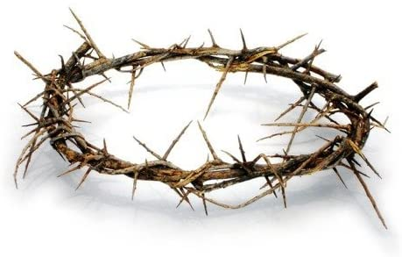
False & True Foundations
Israel must “die” to bear fruit
Isa 28:3-6 – “³The proud crown of the drunkards of Ephraim is trodden under foot. ⁴And the fading flower of its glorious beauty, which is at the head of the fertile valley, will be like the first-ripe fig prior to summer, which one sees, and as soon as it is in his hand, he swallows it. ⁵In that day the Lord of hosts will become a beautiful crown and a glorious diadem to the remnant of His people; ⁶a spirit of justice for him who sits in judgment, a strength to those who repel the onslaught at the gate.”
Notes:
Isa 28:3-4 – Vs. 2 ended w/God’s “hand” and vs. 3 begins w/God’s “foot”. The idea is that God’s judgment upon Samaria will be all encompassing in that what the hand of God casts down, the feet of soldiers will trample. And what will Ephraim’s fading flower be comparable to? The great prized figs as they first ripen, eaten quickly until they’re gone. This is what the fertile valley of Samaria would be like when God gets through w/it, no sooner seen than eaten. All the pride of Samaria, whose building-up took so long, would be toppled over very quickly, and though the siege lasted 3 years, its destruction was but a moment compared to the time it took to build it.
But remember from chapter 9 and chapter 17 that He would spare a remnant – Isa 28:5-6 – The idea is that when the wreckage of sin completely unglorifies us and we at last see its folly and failure, the remnant that remains can then recognize God’s glory. But physical indulgence must first lose its appeal before the Messiah becomes our true crown (4:2). The lack of judgment displayed by the drunken leaders will be found once again in the Messiah. He will become an impregnable defense against the enemy, in which the remnant, through His power, will turn the enemy back from the gate.

Slide 5
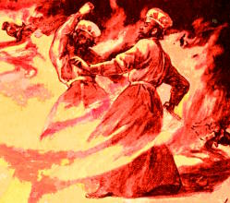
False & True Foundations
Judah has copied Israel
Isa 28:7-8 – “⁷And these also reel with wine and stagger from strong drink: the priest and the prophet reel with strong drink, they are confused by wine, they stagger from strong drink; they reel while having visions, they totter when rendering judgment. ⁸For all the tables are full of filthy vomit, without a single clean place.”
Notes:
Now, beginning in vs. 7, it appears as if Isaiah shifts gears – Isa 28:7-8 – The object of rebuke appears to change from Israel to Judah. Though he doesn’t mention Jerusalem by name until vs. 14, the word “also” as well as the focus being on the prophets and priests seems to imply a shift of audience. Why the sudden shift? Likely because Ephraim influenced Judah, and their behavior is equally repugnant. Drunkenness always leads to error, and Judah is following in Israel’s footsteps. The prophet is supposed to communicate visions and the priests are supposed to render judgments. But their private indulgences are carrying over to their ministry in that all they can do is stagger and stumble. This is likely what happened to Nadab and Abihu in Lev 10 since the instruction immediately following their death prohibited the priesthood from drinking wine. The self-indulgent always claim they are in control, only for unrestrained passion to then rule due to its unrelenting demand for greater satisfaction. And it always ends in the most degrading manner as vs. 8 illustrates, in that the “table” from which they were to serve spiritual food was filthy, lacking anything spiritually wholesome.

Slide 6
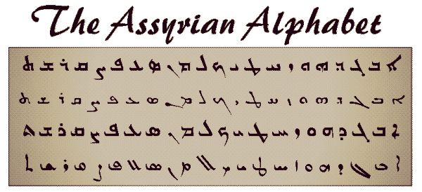
False & True Foundations
Judah has copied Israel
Isa 28:9-13 – “⁹To whom would He teach knowledge, and to whom would He interpret the message? Those just weaned from milk? Those just taken from the breast? ¹⁰For He says, ‘Order on order, order on order, line on line, line on line, a little here, a little there.’ ¹¹Indeed, He will speak to this people through stammering lips and a foreign tongue, ¹²He who said to them, ‘Here is rest, give rest to the weary,’ and, ‘Here is repose,’ but they would not listen. ¹³So the word of the Lord to them will be, ‘Order on order, order on order, line on line, line on line, a little here, a little there,’ that they may go and stumble backward, be broken, snared and taken captive.”
Notes:
This naturally led them to mocking the teaching of a very sober Isaiah:
Isa 28:9-10 – In other words, ”stop talking to us like we’re babies”. They’re either thinking he can’t add to their supposed knowledge or that his teaching is so elementary as to be dismissed. In their pride, the drunken prophets and priests assume themselves above Isaiah’s reproof. They accuse him of treating them like toddlers, of just trying to boss him around. But in reality, they’re just refusing godly correction. The phrase in vs. 10 sounds strange to our ears, but all it does is reflect the patience of a teacher building up the pupil’s knowledge bit by bit, watching for growth points, so he can add a little more to what has already been established. And they’re mocking this approach, mocking what Isaiah was actually aiming to achieve. The worthiest goal of a preacher is sharing the message in its simplest form, systemic edification. But they rejected it, mocking Isaiah’s simple approach in drunken song.
So now Isaiah is going to say, “Ok, you don’t like my orders? Wait ‘til you have to listen to Assyria” – Isa 28:11-13 – Meaning, if you don’t understand the ABCs of Isaiah’s message, wait until you hear the Assyrian language. When God’s simple word is refused, all that follows is the unintelligible. This is not the first time that God has confused the tongue for those who don’t obey His word (Gen 11). They could have found rest through faithfulness and obedience, but they choose to mock instead, which means they’re going to have to learn at the end of a whip. “Judgment” is unfortunately the only language some people will hear and understand. God already told Isaiah they wouldn’t listen (6:9-10). Some people must unfortunately be allowed to suffer the consequences of their actions.

Slide 7
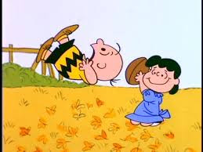
False & True Foundations
Judah has copied Israel
Isa 28:14-15 – “¹⁴Therefore, hear the word of the Lord, O scoffers, who rule this people who are in Jerusalem, ¹⁵because you have said, “We have made a covenant with death, and with Sheol we have made a pact. The overwhelming scourge will not reach us when it passes by, for we have made falsehood our refuge and we have concealed ourselves with deception.’”
Notes:
Isa 28:14 – What is a scoffer? Those who are spiritually cynical, self-assured (Prov 1:22), beyond correction (Prov 13:1), arrogant (Prov 21:24), scornful of spiritual realities (Psa 1:1; Prov 14:9), and who don’t just choose the wrong way, but mock the right way. And they’re living as such in Jerusalem, the very city of faith! Yet there are none so mature or advanced in the word who should not heed God’s word. But a recurrent theme in scripture is God attempting to instruct people who will not listen.
Isa 28:15 – This is reminiscent of Isa 22:12-14. God offers security to them but the security they have chosen is signing their own death warrants because all that remains outside of trusting God is death. There is no alternative salvation. The overwhelming scourge is Assyria (8:7-8) which they boast of avoiding, once again showing their arrogant self-confidence, perhaps due to performing an alliance w/Egypt. But political treaties based on lies “plays both ends against the middle” and makes for a very poor refuge under which to hide from trouble. Egypt was like Lucy holding the football for Charlie Brown. As soon as a nation began to trust her, she pulled the football. They never told the truth.

Slide 8
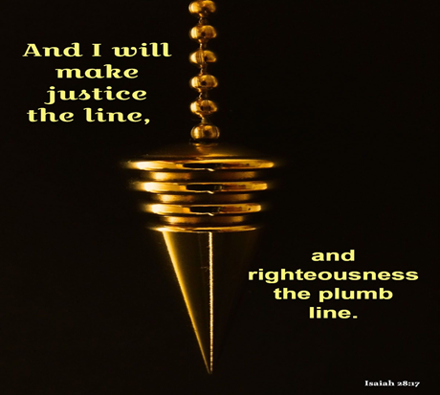
False & True Foundations
Judah has copied Israel
Isa 28:16-17a – “¹⁶Therefore thus says the Lord God, ‘Behold, I am laying in Zion a stone, a tested stone, a costly cornerstone for the, firmly placed. He who believes in it will not be disturbed. ¹⁷I will make justice the measuring line and righteousness the level;”
Notes:
Hence the next verse – Isa 28:16 – This is a construction metaphor, and it means that in contrast to the refuge of falsehood and deception, God has given us a solid foundation for our lives: Jesus Christ, who Peter identifies as this very cornerstone in 1 Pet 2:6. This is the rock referred to by Jesus in Matt 7:24-27 in which we must build our house. Anything not built w/Jesus as the foundation will fall. This includes Egypt. Remember in 19:13 that even Egypt’s “cornerstones” led her own people astray. But for the person who put their trust in God, there is serenity and security. The rest/repose God offers in vs. 12 is conditioned on believing in it.
Now exactly what are the horizontal and vertical measurements of this stone? – Isa 28:17a – The better translation is that justice is the “line” and righteousness the “plumb line”. The cornerstone of a building is the first block laid, and it determines the axes of every other block that is laid, both horizontal and vertical – it determines the direction they go. Justice and righteousness are tests of the horizontal and vertical exactitude, complementary measuring lines, justice being the rule (line), and righteousness being the standard of that rule (plumb line). Every life built on the rock, Jesus the cornerstone, will be a life of justice, and the thing that determines true justice is the righteousness of God.

Slide 9
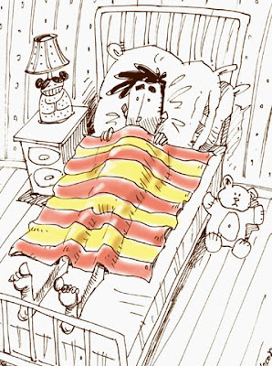
False & True Foundations
Judah has copied Israel
Isa 28:17b-20 – “Then hail will sweep away the refuge of lies and the waters will overflow the secret place. ¹⁸Your covenant with death will be canceled, and your pact with Sheol will not stand; when the overwhelming scourge passes through, then you become its trampling place. ¹⁹As often as it passes through, it will seize you; for morning after morning it will pass through, anytime during the day or night, and it will be sheer terror to understand what it means. ²⁰The bed is too short on which to stretch out, and the blanket is too small to wrap oneself in.”
Notes:
What about those who “build their house on the sand”?
Isa 28:17b – All the deception and secret sins will be cast away; there will be nowhere to hide. These measuring lines will devastate the people’s supposed security. Ezekiel would later call them walls plastered w/whitewash (Ezek 13:8-16).
Isa 28:18 – God’s plans will always supersede human plans. The word “pass through” is illustrious, because this is a “Passover” that they did not want, in which all their secret agreements and covenants w/Egypt would prove useless. They will be beaten flat like a grain field in which a flood has overrun.
Isa 28:19-20 – In other words, it won’t just come once and be over, but again and again, wave after wave. The Assyrian annals even report numerous returns to the same area. There is a contrast w/vs. 9 in which they previously mocked Isaiah for assuming they don’t understand. Now we’re told they will understand, but that understanding will be terrifying to them. Ever slept under a blanket that was too short? Either your upper body is warm and your feet are cold or your feet are warm and your upper body cold. The “bed” that they’ve made is that all their “agreements” were too short and too narrow to protect them. Promises are easy to make, but difficult to keep.

Slide 10
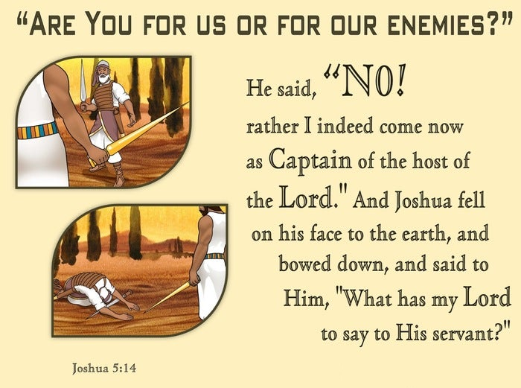
False & True Foundations
Judah has copied Israel
Isa 28:21-22 – “²¹For the Lord will rise up as at Mount Perazim, He will be stirred up as in the valley of Gibeon, to do His task, His unusual task, and to work His work, His extraordinary work. ²²And now do not carry on as scoffers, or your fetters will be made stronger; for I have heard from the Lord God of hosts of decisive destruction on all the earth.”
Notes:
Isa 28:21 – This is likely alluding to when God rescued Israel from Philistia at Mt. Perazim and Gibeon in 2 Sam 5. Gibeon likely refers to Joshua and Israel’s victory in Josh 10, in which vs. 17 says more people were killed by hail than the sword. Interestingly, both victories were stepping “stones” (vs. 16) to Zion’s security. But why would He consider the work “unusual”? Because it is carried out against His people who have become His foes. He’s saying, “I’m going to do to you what I did to the Canaanites and Philistines”, which is not the way it was supposed to be. But this is an indictment against Judah’s sinfulness.
This is an important thing to remember, because in Josh 5:13, when Joshua and Israel were first coming into Canaan’s land, they were met by a man with a sword drawn – Josh 5:13-14a – “Now it came about when Joshua was by Jericho, that he lifted up his eyes and looked, and behold, a man was standing opposite him with his sword drawn in his hand, and Joshua went to him and said to him, ‘Are you for us or for our adversaries?” He said, ‘No; rather I indeed come now as captain of the host of the Lord.’” God indeed had a righteous plan for Judah, but when they sinned, they would be judged just as all the other nations.
Isa 29:22 – Isaiah’s call for reformation is based on what he knows is coming. The only way to flee from God is to flee to Him. Scoffers are already in bondage, but unless they stop, their chains will become so tight that nothing can break them. The destruction to the theocracy would extend to all the earth, a universal judgment (24 – 27), but also universal redemption.

Slide 11
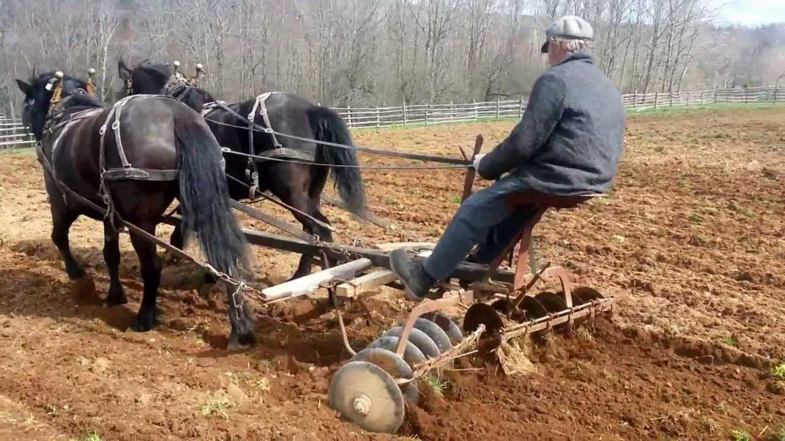
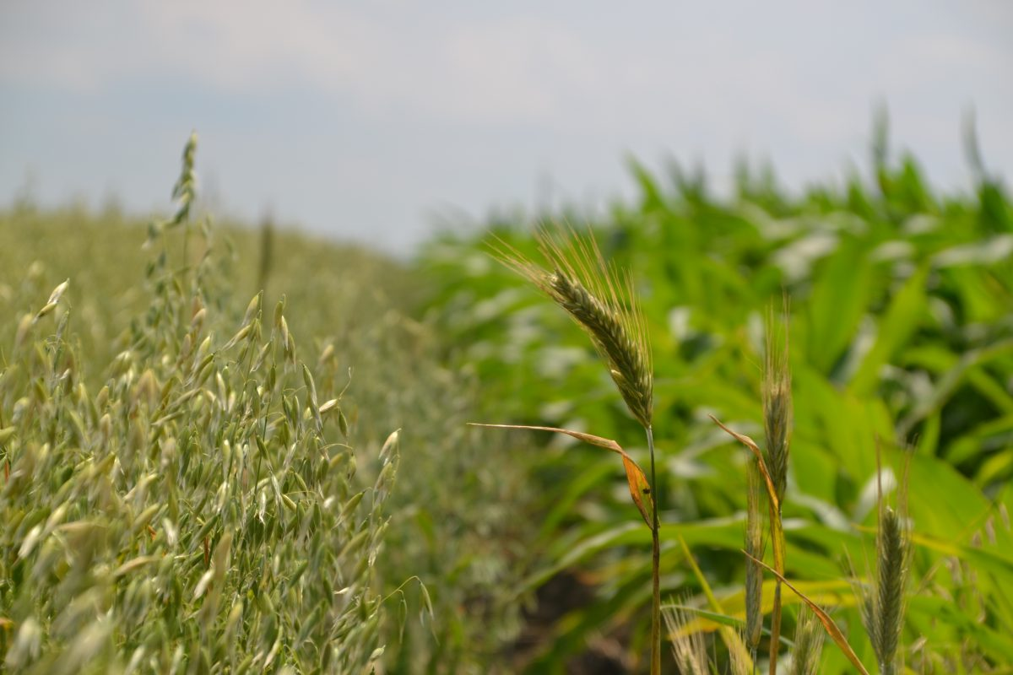
False & True Foundations
Agricultural metaphor
Isa 28:23-26 – “²³Give ear and hear my voice, listen and hear my words. ²⁴Does the farmer plow continually to plant seed? Does he continually turn and harrow the ground? ²⁵Does he not level its surface and sow dill and scatter cumin and plant wheat in rows, barley in its place and rye within its area? ²⁶For his God instructs and teaches him properly.”
Notes:
Now we come to a call for Judah to learn from this.
Isa 28:23-25 – This is about sowing. The husbandman plows, harrows to break up the clod, but only until the ground is sufficiently prepared for planting. The harshness of the harrowing is wedded to the purpose. His aim has always been to sow, and so He will one day cease the harsh preparatory work. Once done, there is planned, purposeful action. Each seed is sown discriminately. He knows what needs to be sown where. Where did he learn this from?
Isa 28:26 – The idea is if they were wiling to listen to what God has set up in Creation to yield agriculture, why will they not listen to His spiritual instruction? Creation has an order about it, both physically and spiritually. And so, to a people that were wrapped up in the physical, Isaiah is reverting to the physical realm to teach spiritual principle.

Slide 12
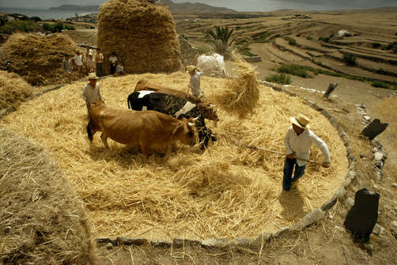
False & True Foundations
Agricultural metaphor
Isa 28:27-29 – “²⁷For dill is not threshed with a threshing sledge, nor is the cartwheel driven over cummin; but dill is beaten out with a rod, and cummin with a club. ²⁸Grain for bread is crushed, indeed, he does not continue to thresh it forever. Because the wheel of his cart and his horses eventually damage it, he does not thresh it longer. ²⁹This also comes from the Lord of hosts, Who has made His counsel wonderful and His wisdom great.”
Notes:
And now He speaks about threshing.
Isa 28:27 – The differences between dill and cumin require being able to adapt to different threshing techniques in order to reap instead of destroy.
And notice what else the farmer knows – Isa 28:28 – Just as the husbandman knows just the right amount of threshing of the grain, separating the kernel from the husk, so as not to crush it and make it unfit for bread and consumption, in the same way, God renders just the right amount of judgment, not too much, not too little. He considers the condition of His people, employing what will best carry out His will.
Isa 28:29 – The words “counsel” and “wonderful” are the same words used to describe the Messiah in 9:6. Perfect timing and wisdom. It is “from” the Lord and “of” the Lord. He always acts according to His infinite wisdom and the counsel of His divine will – Rom11:33. The point of these scriptures is this: if the farmer accepts the physical laws in order to benefit physically, why would they scoff at spiritual counsel? Judah is trying to rig the system by allying w/other nations, but that won’t work – it’s not reality. Reality is that you plant, you cultivate, you harvest. That’s the order. How life works is that you reap what you sow.

