Slide 1
Notes:
The purpose of Isaiah 24 – 27 is to expand upon the oracles of judgment of chapters 13 – 23, to show how the principles taught to those specific nations actually apply to all of earth’s civilizations. Isaiah is inviting us to picture the “world city”, that is all organized human societies, whether nation or city, in which rebellion is spread beyond repair, and the world city is the nemesis of salvation. Chapter 24 teaches a pattern for how God deals w/these nations – all wickedness is judged, regardless of class, in which a remnant remains who then give glory to God. But even from the remnant comes more wickedness, leading to more judgment until that final day of judgment we saw at the end of the chapter. That is the point of chapter 24.
In chapter 25, we’re introduced to a contrasting city which is specifically named, Zion, and their response to the destruction of the “world city”.
In chapter 26, and the tone is going to change to what is to be enjoyed in the future, to the steadfast trusted needed by God’s people in the present. In order for God’s people to experience the victory and the feast of chapters 24-25, there is waiting involved. And throughout this waiting, the Lord’s people recognize that they already enjoy the security of a strong city, which Heb 11:10 tells us the builder and architect is God.

Slide 2
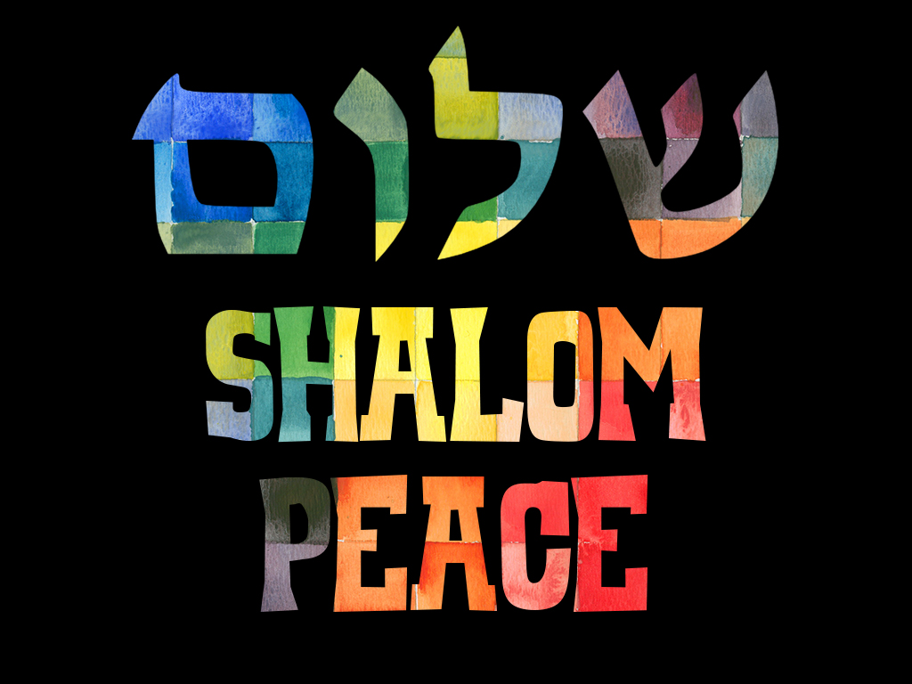
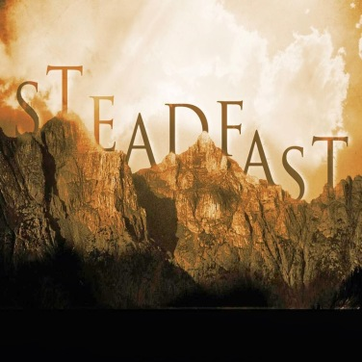
Song of Trust
Security through peace
Isa 26:1-4 – “¹In that day this song will be sung in the land of Judah: ‘We have a strong city; He sets up walls and ramparts for security. ²Open the gates, that the righteous nation may enter, the one that remains faithful. ³The steadfast of mind You will keep in perfect peace, because he trusts in You. ⁴Trust in the Lord forever, for in God the Lord, we have an everlasting Rock.”
Notes:
So, chapter 26 is giving us a glimpse into the thoughts of God’s people as they wait.
Isa 26:1 – Those saved by God no longer desire “world cities” to protect them. These cities were undeservedly praised, but could not ultimately protect them. Rather, they’ve come to terms that God is all they need and they’re content w/His city because it is impregnable w/God as its strength.
Isa 26:2 – Who can enter? The righteous. And who are the righteous? Those who remain faithful. Meaning, no one can take advantage of the protection of God’s city unless godliness is the passion of their lives.
Isa 26:3-4 – The phrase “perfect peace” in Hebrew is “shalom shalom”, a repetition of the word “peace”. This is saying that those who replace their trust in physical security for God’s security won’t just enjoy a pseudo-peace, but a perfect peace that could only come from the Prince of Peace.
Why? Because as vs. 4 says, God is the only true “Rock” that there is. So, notice the connection between the “steadfast of mind” of vs. 3 and God the “Rock” from vs. 4. The idea is that trusting in God’s unchanging, steady nature will likewise give us an undeviating frame of mind in which all anxieties take a back seat to confidence in God’s protection.

Slide 3
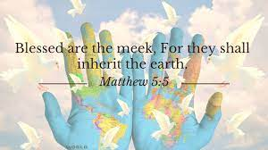
Song of Trust
Unassailable city brought to dust
Isa 26:5-6 – “⁵For He has brought low those who dwell on high, the unassailable city; He lays it low, He lays it low to the ground, He casts it to the dust. ⁶The foot will trample it, the feet of the afflicted, the steps of the helpless.”
Notes:
What’s the incentive?
Isa 26:5-6 – Mankind creates these “cities” of power and prestige w/o any thought of God, building them on the backs of the weak/poor. But when God brings it low, the weak/poor will tread it down. And it’s the Lord’s battle, meaning they don’t fight, but merely trample on what God leaves behind. So, it’s better to be among those who are weak/poor than the mighty, because there will eventually be a complete reversal of position.
This is a NT concept – Matt 5:5 – This is a concept that we’re going to see expanded on in a big way once we get to the last 9 chapters of this book, a role reversal between the haughty and the weak.

Slide 4
Song of Trust
God smooths the way
Isa 26:7-9 – “⁷The way of the righteous is smooth; O Upright One, make the path of the righteous level. ⁸Indeed, while following the way of Your judgments, O Lord, we have waited for You eagerly; Your name, even Your memory, is the desire of our souls. ⁹At night my soul longs for You, indeed, my spirit within me seeks You diligently; for when the earth experiences Your judgments the inhabitants of the world learn righteousness.”
Notes:
This builds on the previous verse.
Isa 26:7 – The purpose of God leveling the “world city” to the ground is to flatten it out for the righteous to walk upright. So, while one reason for God judging the “world city” of wickedness, it is also because their wickedness prevents God’s people from coming to Him. It’s a poetic way of saying that the way of the wicked is crooked, but through judgment, God smooths out the way that the righteous must journey. Theme alert.
Isa 26:8 – In other words, while the goal for God’s people is God’s “way”, the goal of God’s “way” is God – a fuller experience w/Him. And by waiting on Him, we’re acknowledging that we are not the solution to our problems. The solution is God’s name, the rock-like consistency of His character. When that becomes the desire of our soul, we find contentment in His timing rather than our own.
What is this waiting like? – Isa 26:9a – All hours of the day and night; all circumstances. And because we’ve been redeemed from the very trouble we ourselves caused, we can’t help but long for Him.
And what else is God’s judgment designed for? – Isa 26:9b – Meaning, some will only learn righteousness through God’s judgment. But learn they will. Again, we often don’t like God’s judgment and we prefer to default to His love. But God’s love doesn’t save everybody. For some, it’s God’s punishing hand – Psa 78:34-34.

Slide 5
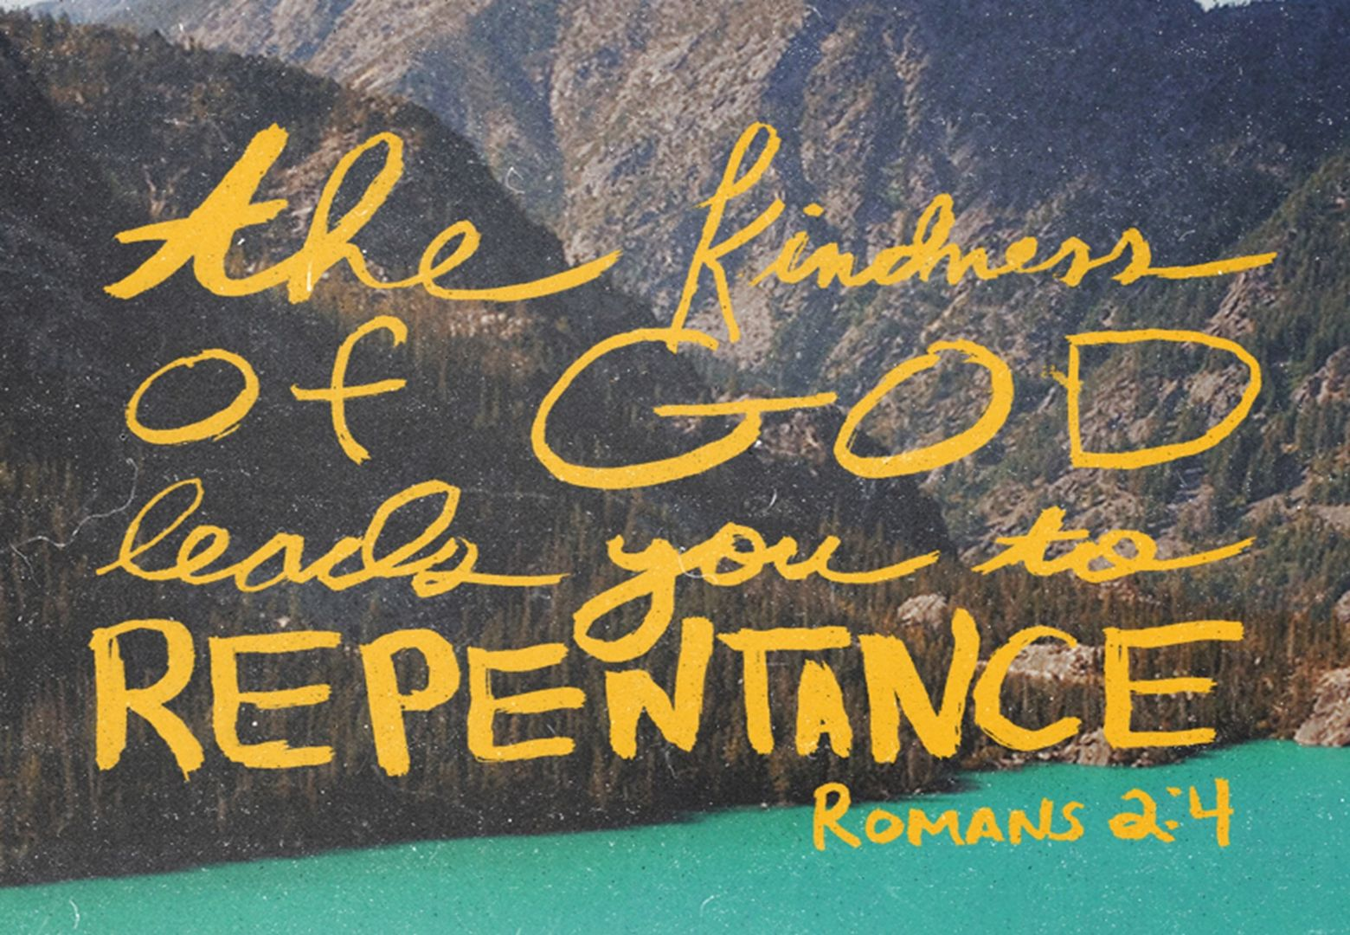
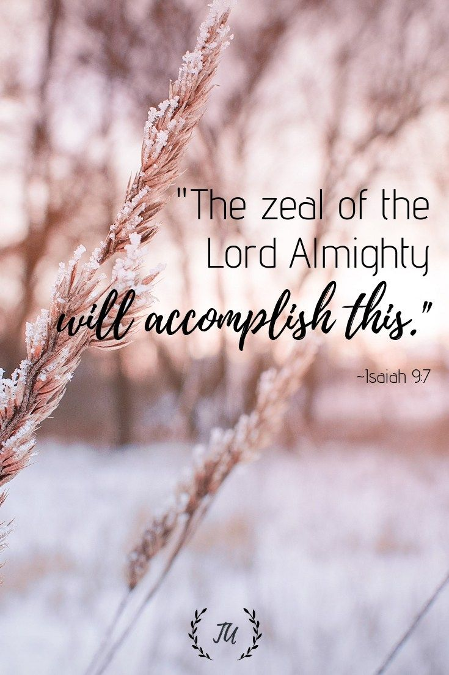
Song of Trust
Impenetrable blindness
Isa 26:10-11 – “¹⁰Though the wicked is shown favor, He does not learn righteousness; He deals unjustly in the land of uprightness, and does not perceive the majesty of the Lord. ¹¹O Lord, Your hand is lifted up yet they do not see it. They see Your zeal for the people and are put to shame; indeed, fire will devour Your enemies.”
Notes:
And vs. 10 exemplifies this.
Isa 26:10 – God allows the wicked to live in His land for a time – Rom 2:4. But though God pours grace and favor on them, many are ungrateful and blind to Him. This is sad because He refers to their land as a “land of uprightness”, implying that their land should be one in which there is no compelling temptation for men to do wrong. But perpetual prosperity turns away many hearts from the majesty of God.
For some, it’s only when their pride receives its just reward that they are finally able to see – Isa 26:11 – The image of God’s hand lifted up is that He’s about to strike them. But that inevitability is not what leads them to see their error. What does is when He also manifests His zeal for His people, and then they will realize they were on the wrong side when the fire of God’s judgment destroys them. Theme alert.

Slide 6
Song of Trust
God brings peace and increase
Isa 26:12-15 – “¹²Lord, You will establish peace for us, since You have also performed for us all our works.¹³O Lord our God, other masters besides You have ruled us; but through You alone we confess Your name. ¹⁴The dead will not live, the departed spirits will not rise; therefore You have punished and destroyed them, and You have wiped out all remembrance of them.¹⁵You have increased the nation, O Lord, You have increased the nation, You are glorified; You have extended all the borders of the land.”
Notes:
Isa 26:12-13 – In other words, man can do nothing of himself w/o God. And since God has performed all our works, He will be the one to establish peace. But what about all the nations who once ruled Israel? Egypt, Philistia, Midian, etc. Well, remember vs. 9. Those “rulers” were never truly sovereign; He merely used them to punish Israel for their sins. And then He provided them help in their time of need.
In fact, God went further in His judgment against those who oppressed His people – Isa 26:14 – Meaning, those former mortal rulers are now dead, shadows never again to rise to harm God’s people, whereas God is the Rock. As we saw in chapter 14, death is the ultimate mocker of human pride, and it alone will wipe away the memory of so many who oppress. We don’t even know the name of the Pharaoh in Exodus, nor do we care.
In contrast… - Isa 26:15 – This is God’s covenant purpose toward Abraham’s descendants. He destroys the oppressors while continuing to add to His own people. He therefore must “extend” the borders to accommodate them all (9:3). This is for His glory rather than a result of their merit, so this is too is God’s “work” from vs. 12.

Slide 7
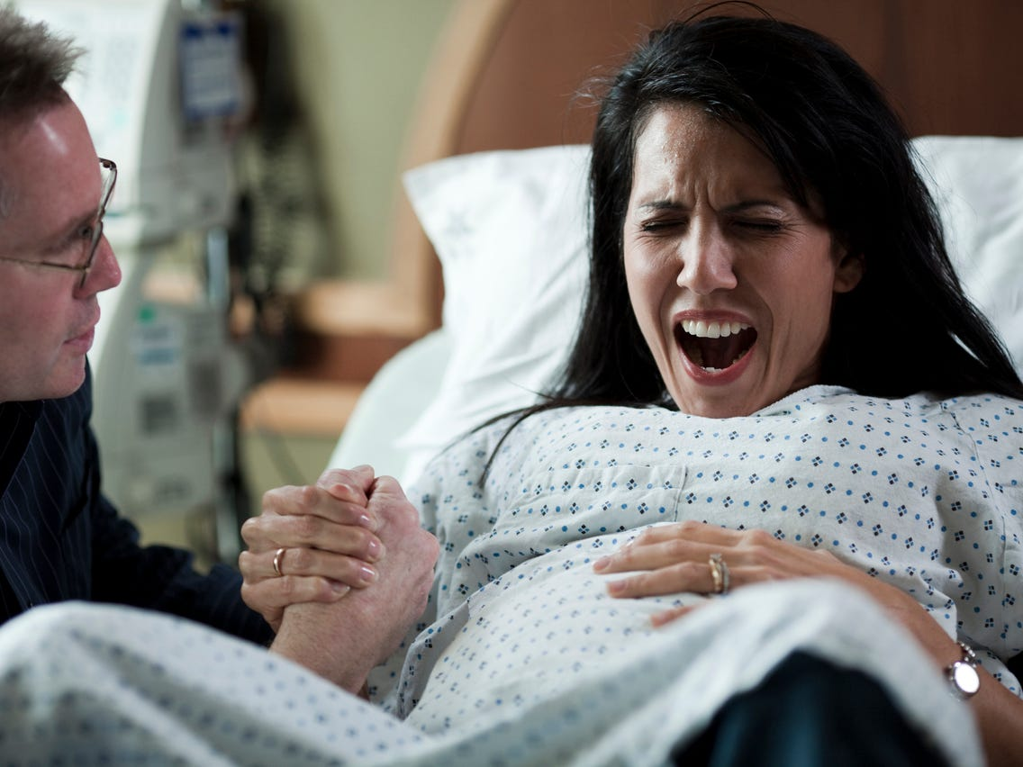
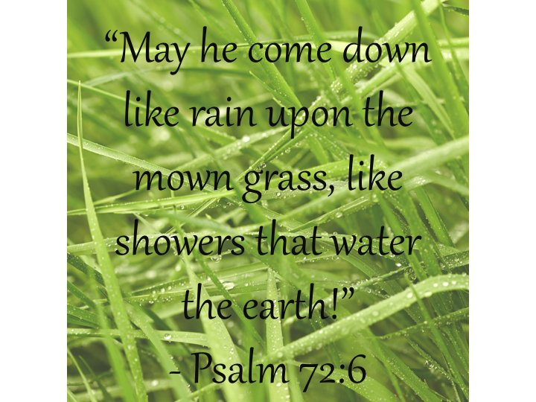
Song of Trust
Out of the dust
Isa 26:16-19 – “¹⁶O Lord, they sought You in distress; they could only whisper a prayer, Your chastening was upon them. ¹⁷As the pregnant woman approaches the time to give birth, she writhes and cries out in her labor pains, thus were we before You, O Lord. ¹⁸We were pregnant, we writhed in labor, we gave birth, as it seems, only to wind. We could not accomplish deliverance for the earth, nor were inhabitants of the world born. ¹⁹Your dead will live; their corpses will rise. You who lie in the dust, awake and shout for joy, for your dew is as the dew of the dawn, and the earth will give birth to the departed spirits.”
Notes:
Isa 26:16 – Meaning, under God’s heavy hand of judgment, God’s people sought Him in quiet prayer. Rather than God’s chastening driving them away from Him, it drove them to Him. And the intensity of their prayer was such that it could barely be vocalized, and that God instead heard the yearning of the heart.
Isa 26:17-18 – This describes the worldly, strenuous efforts God’s people used to rid themselves of the issues brought on by their sin – the alliances, the payoffs, it was all in vain. Isaiah compares those rigors to going through child-birth w/o the comfort of a living child. Israel just couldn’t bring the nations to God because of their individual unfaithfulness. Human effort apart from God was not capable of bruising the head of the serpent. Something more was needed. Theme alert
Isa 26:19 – This is a confident expectation of a spiritual resurrection for the Lord’s people. The idea is that since Israel could not be the positive influence to “deliver” the world to righteousness, and many died as a result, God will have to do His “work”. The dew is the refreshing grace of God (Psa 72:6), bringing newness of life and vigor to an otherwise helpless situation. People ruin the world seemingly beyond repair, but God can bring “life” from the “dead”, and in so doing, they will shout for joy.

Slide 8
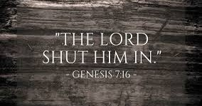
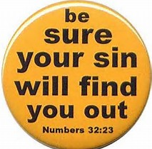
Song of Trust
Secure from wrath
Isa 26:20-21 – “²⁰Come, my people, enter into your rooms and close your doors behind you; hide for a little while until indignation runs its course. ²¹For behold, the Lord is about to come out from His place to punish the inhabitants of the earth for their iniquity; and the earth will reveal her bloodshed and will no longer cover her slain.”
Notes:
And so, what must God’s people do while waiting for this judgment to come?
Isa 26:20 – The previous call from vs. 2 was to “open the gates”. Now now it is for them to “close your doors”. This calls to mind events like the flood where we’re told in Gen 7:16 that God shut Noah and his family in while judgment ran its course. We saw the same thing during the Passover where they were to close their doors while God did His work on Egypt. This is a call for God’s faithful to find refuge in Him while God’s judgment runs its course. What are the secure chambers of God’s people? The “everlasting Rock” (vs. 4). Only when we are “in Him” will we find refuge.
What about for those not in Him? – Isa 26:21 – All the iniquity of the earth will be revisited. All the blood shed by the wicked they tried to cover up will be uncovered. Earth’s crime will be cleverly exposed and the penalties executed. Ultimately alludes to the fact that our sins will be found out (Num 32:23).

Slide 9
Israel/Judah: Reliance in Cities (Lust of the Eyes)
Isa 17 (Israel) | Isa 22 (Judah) | Isa 26 (Secure in God)
Israel (17:3) | Judah (22:8-9)
“World city” cannot save (17:1-3,9) | “World city” cannot save (22:5-8)
Depended on Damascus (17:1-3) | Depended on weapons, walls, water (22:8-11)
Sickness, incurable pain (17:11) | “Until you die” (22:14)
Did not remember Rock of refuge (17:10) | Attempts to find rest in physical rock (22:16)
Enemies will not overcome (17:12-14) | Enemies will overcome (22:5-8a)
Learn from judgment (17:7-8) | Don’t learn from judgment (22:12-14)
“Eyes” (17:7-8) | “Vision” (22:1,4-5,9)
“O Lord” (evoked 7 times)
Strong, unassailable city (26:1,5)
All in vain (26:17-18a)
Dead will live (26:19)
Everlasting Rock (26:4)
Righteous overcome
through God (26:7-9)
Mixed reaction to
judgment (26:9-10)
“Perception” (26:10-11)
Notes:
The fourth set of companion oracles is about God’s own people looking for help from sources other than Him, and can be summed up as the “lust of the eyes”. Chapter 17 refers to Israel, chapter 22 to Judah, and in chapter 26, we see the phrase “O Lord” 7 times.
The focus in 17 and 22 is that fortified cities, world-cities, cannot save. Only the “strong, unassailable city” from chapter 26 can save.
We see Israel depending on Damascus in 17, Judah depending on weapons, walls, and water in 22, and chapter 26 compares relying on these things to a pregnant woman giving birth to wind, not delivering what she set out to accomplish.
Chapter 17 mentions bringing sickness and incurable pain, chapter 22 mentions certain death, but in chapter 26 we see a resurrection of the faithful.
Chapter 17 rebuked Israel for not remembering the rock of their refuge, chapter 22 mentioned Shebna seeking to find rest in a physical rock, and 26:4 mentions the Everlasting Rock.
In both 17 and 22, there is an assurance that the enemy will overcome Israel and Judah. But in chapter 26, we see the promise that the righteous will overcome through God.
In chapter 17, we read that Israel will learn from her judgment. In chapter 22, God mentions some in Judah will not learn from their judgment. Then in 26, we see a mixed reaction to the judgment.
And then in chapter 17, we see the repetitive use of the words “eyes” and “look”. In chapter 22, Judah is referred to sarcastically as the “valley of vision”, and in chapter 26 we see the importance of perceiving the majesty of God. And so, Isa 26 completes the companion oracles by suggesting that God’s true people finally come to terms with the futility of self-reliance, ultimately concluding only God can save.

Slide 10
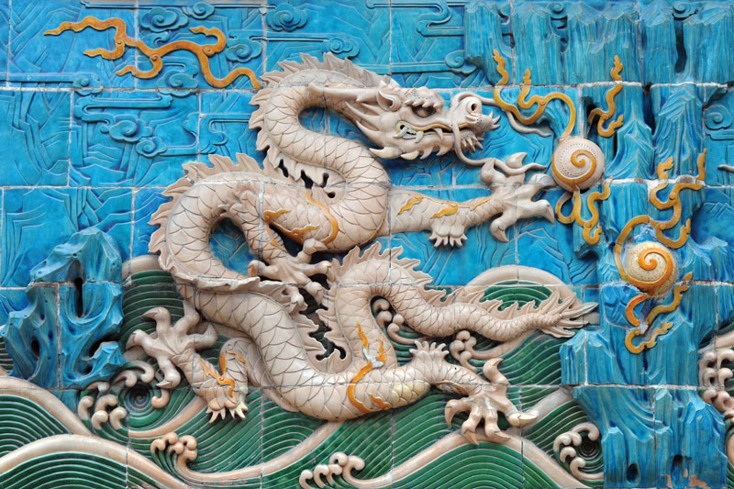
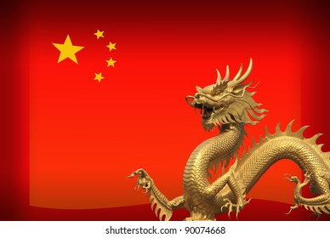
Deliverance of Israel
Leviathan & the dragon
Isa 27:1 – “¹In that day the Lord will punish Leviathan the fleeing serpent, with His fierce and great and mighty sword, even Leviathan the twisted serpent; and He will kill the dragon who lives in the sea.”
Notes:
Lev 27:1 – This is a very symbolic passage requiring some “rightly dividing” to understand.
Nations are often symbolized by animals: America = bald eagle, China = dragon, Greece = Phoenix. This was also the case in antiquity. Psa 74:14 refers to Egypt as Leviathan, and since the Leviathan is a twisting serpent w/many arms/tendrils, this may signify the Nile and its winding cataracts. We also read of a dragon who lives in the sea, which some suggest is still referring to Egypt because the Nile is sometimes referred to as a “sea”. However, if we follow the pattern of companion oracles we’ve looked at so far, this would put chapter 27 in line with chapter 19 about Egypt and chapter 23 about Tyre. The Egyptian oracle makes sense because of Leviathan, but why could Tyre be referred to as the dragon of the sea? Because we know from chapter 23 that Tyre exerted worldwide influence w/its sea trade. This view is strengthened further if you remember that there are 2 beasts referred to in Revelation; the beast of the earth and the beast of the sea. The beast of the earth from Rev 13 represents false religion, and given Egypt’s rampant idolatry, this fits. The beast of the sea in Rev 13 represents world power, which fits Tyre perfectly. Point: Isaiah is giving us a picture of 2 mythological creatures infesting the entirety of creation, land and sea, w/their harmful influence. But the Lord’s sword, His word, described as fierce, great, and mighty, will be sufficient enough to strike them both down (Heb 4:12).

Slide 11
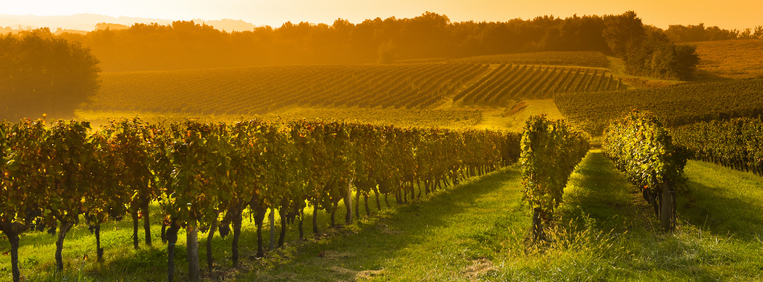
Deliverance of Israel
The Lord’s true vineyard
Isa 27:2-6 – “²In that day, ‘A vineyard of wine, sing of it! ³I, the Lord, am its keeper; I water it every moment. So that no one will damage it, I guard it night and day. ⁴I have no wrath. Should someone give Me briars and thorns in battle, then I would step on them, I would burn them completely. ⁵Or let him rely on My protection, let him make peace with Me, let him make peace with Me.’ ⁶In the days to come Jacob will take root, Israel will blossom and sprout, and they will fill the whole world with fruit.”
Notes:
But in contrast to the worldwide, negative influence of these 2 beasts, God has a different influence in mind for Zion.
Isa 27:2-3 – In other words, the Lord will plant a new vineyard w/a different result from that of chapter 5. This vineyard results in spontaneous praise for its rich production of grapes. And God will no longer delegate its care to hirelings, but guard it Himself w/o break or interruption. In 5:6, the clouds were charged not to rain on it. Now He causes it to drink w/o ceasing. This is similar to what Jesus said in John 10:11-13.
But what if people attack it? – Isa 27:4-5 – God has such zeal for this vineyard that He longs to show how much He cares. Like a young suitor, He’s almost begging for someone to attack His beloved just so He can show the level of protection He’ll offer. No enemy is too great – “Bring it”. Yet He wants this vineyard is open for all, even one-time enemies. He’s more than willing to be reconciled w/one-time enemies as long as they make peace on His terms.
And now the purpose of this planting – Isa 27:6 – The purpose is that the whole world would be full of the fruit not of Egypt and Tyre’s harmful influence, but of a spiritual Israel. God’s vine will spread all throughout the earth and everyone who comes in contact, friend or foe, Jew or Gentile, will have an opportunity to join it.

Slide 12
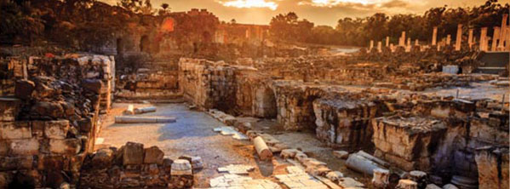
Deliverance of Israel
Restitution vs. desolation
Isa 27:7-11 – “⁷Like the striking of Him who has struck them, has He struck them? Or like the slaughter of His slain, have they been slain? ⁸You contended with them by banishing them, by driving them away. With His fierce wind He has expelled them on the day of the east wind. ⁹Therefore through this Jacob’s iniquity will be forgiven; and this will be the full price of the pardoning of his sin: when he makes all the altar stones like pulverized chalk stones; when Asherim and incense altars will not stand. ¹⁰For the fortified city is isolated, a homestead forlorn and forsaken like the desert; there the calf will graze, and there it will lie down and feed on its branches. ¹¹When its limbs are dry, they are broken off; women come and make a fire with them, for they are not a people of discernment, therefore their Maker will not have compassion on them. And their Creator will not be gracious to them.”
Notes:
Isa 27:7-8 – Meaning, God was never as harsh w/His people as He had been w/its foes – there was divine restraint. This comparison would serve well for those who contend God had treated them unfairly, and a reminder that God’s punishments are sometimes merely purifications. Rather, His method of judgment was exile. The east wind, though severe, is a temporary wind. Against Israel, it was measured judgment.
Isa 27:9 – What are the terms of their forgiveness? Repentance. As we discussed when studying chapter 17, Asherim were symbols of male and female fertility gods of Canaan. This idolatry would never again be a problem for Israel after the return from captivity. The fruit of repentance is both the cause and effect of sin’s removal. The sins that hold us back must not be hidden or stored away, but completely destroyed.
Isa 27:10-11 – Meaning, no hope should be placed in the world-system. It’s not secure and it never will be. It will be so devastated, it will become an open pasturage only fit for cattle to graze in. That it becomes isolated and forsaken suggests those not forcibly removed will themselves flee it, now seeing that it cannot offer the security and hope they once thought it could be. Even what branches the cattle fed from will become so dry that they will only become suitable for fire. This is all the “harvest” it produces. Isaiah then exposes the hearts of its remaining inhabitants: no discernment, which invokes the heart of God toward them; no compassion, which then leads to no grace. This causes them to suffer the consequences of their folly.

Slide 13
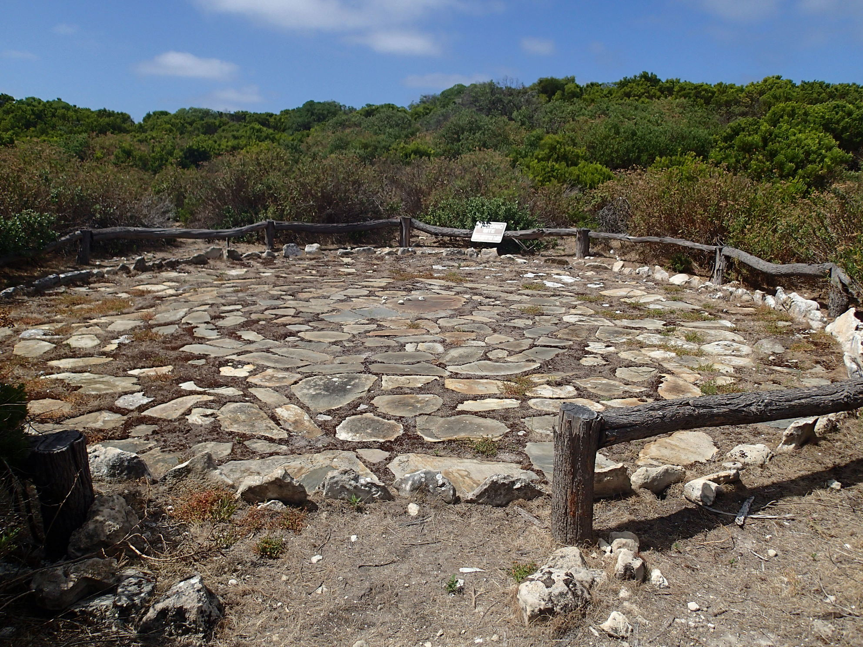
Deliverance of Israel
The ingathering
Isa 27:12-13 – “¹²In that day the Lord will start His threshing from the flowing stream of the Euphrates to the brook of Egypt, and you will be gathered up one by one, O sons of Israel. ¹³It will come about also in that day that a great trumpet will be blown, and those who were perishing in the land of Assyria and who were scattered in the land of Egypt will come and worship the Lord in the holy mountain at Jerusalem.”
Notes:
And now, divine harvesting:
Isa 27:12 – We’ve seen this harvest language at the end of every major segment so far. The Euphrates and the brook/Wadi of Egypt were traditional boundaries of the promised land. And so, He is first gathering His remnant from the Jews, doing so “one by one” which likely denotes the tender care God shows each individual member of His kingdom.
And then he turns His attention to the Gentiles – Isa 27:13 – This is an ingathering of Gentiles who become full participants of the “strong city”.

Slide 14
Egypt/Tyre: Reliance on Harvest (Lust of the Flesh)
Isa 18 – 19 (Egypt/Ethiopia) | Isa 23 (Tyre) | Isa 27 (Lord’s Vineyard)
Ethiopia/Egypt controls Nile | Tyre controls sea
Failed attempt to federalize (18:5-6) | Influence filled known earth (23:3,7-8)
Harvest depleted (19:5-10) | Harvest depleted (23:3)
Ingathering of Gentiles (19:23-25) | Ingathering of wages (23:18)
Leviathan (Nile) & Dragon (Sea) (27:1)
Vineyard fills whole earth (27:6)
Harvest depleted (27:10-11)
Ingathering of Jews &
Gentiles (27:12-13)
Notes:
The fifth set of companion oracles seem to focus on the lust of the flesh. In chapter 18-9, Egypt/Ethiopia controls the Nile and in chapter 23 Tyre controls the sea. Then in chapter 27, he appears to symbolically represent them as monsters whose influence spreads throughout the entire world.
Chapter 18 tells us about Ethiopia’s attempt to federalize, while chapter 23 shows how Tyre’s influence filled the earth. But in chapter 27, God will make Zion like a vineyard whose influence will fill the earth.
In all 3 chapters, we see the harvest of the enemy being depleted.
And in we see 3 sets of ingatherings. In chapter 19, an ingathering of the Gentiles in chapter 3 and ingathering of the wages, and in chapter 27 and ingathering of the Gentiles.
And so, Isa 27 completes the companion oracles by suggesting that in place of the negative world influence brought on by the materialism of Egypt and Tyre, God’s people will fill the earth like a vineyard bearing fruit.

