Slide 1
Notes:
For those joining us for the new semester, we’ve already been well underway in Isaiah, so you may feel a bit lost – hang in there. I’m going to try to do some review at the beginning of each class, and in the beginning of November, we’re going to take an entire class to go back through chapters 1 - 37 before preceding on w/the remainder of the book to ensure we don’t lose the forest from the trees.
In chapters 7 – 12, Judah was dealing w/a local crisis, the Syro-Ephramaite war in which a coalition between Syria and Israel intended to capture Jerusalem and set up a king more favorable to its cause to resist Assyrian expansion in the region. But God’s message in those chapters is that Judah didn’t need to worry about Syria, Israel, or ultimately Assyria because He has future plans to bring a child into the world who will one day reign. And in order for that to happen, neither Israel nor Syria nor Assyria’s plans would be allowed to continue unfettered. This promise was to instill trust in God’s people during that day.
We just finished chapters 13 – 23 where we made the point that those same lessons taught in chapters 7 – 12 apply not just to Syria and Israel, but to all nations. Any nation that threatens God’s people will be judged. None of these nations should be looked to for help against Assyria because one day these nations would stream to Mt. Zion. And so, all we see Isaiah doing in chapters 13 – 23 is expanding the theology of chapters 7 – 12 to a more global perspective.
Chapters 24 – 27 is going to do the same thing, but its going to suggest that a nation-by-nation judgment just won’t suffice. Isaiah now invites us to look at the scene of God’s worldwide judgment that expands to the entire earth, a word repeated 17 times in this chapter, and beyond the earth. Scholars have referred to this section as “The Apocalypse of Isaiah”, but I believe that is misleading in some ways. The central theme of these 4 chapters is a contrast between 2 cities. The first “city” is not identified by name or location because it is metaphorical, and is intended to show what God will do to all “cities” of man who take on the ungodly attributes enumerated through chapters 13 – 23, in order to show God’s lordship isn’t just over individual nations, but over all the earth. And be on the lookout for the adjectives to describe this city: chaos, desolation, ruined, fortified, ruthless, etc. This “city” and all like it will be destroyed. However, in contrast is a “city” whose name and location is given – Zion, and it will be established. And it is described as a mountain, strong, unassailable, and upright. And this represents the collection of God’s people who resist the temptation of worldly living and who swim upstream toward heavenly heights. We’re also going to see contrasts in song. We’re going to see the song of drunken revelry silenced in the city of man while the song of the city of God will continue all throughout eternity. These four chapters are a fitting finale to chapters 13 – 23.
In this study, we’ll consider chapters 24 and 25, which deal w/2 themes: we’re going to see the overthrow of the metaphorical city of man and the response by God’s people to that overthrow.

Slide 2
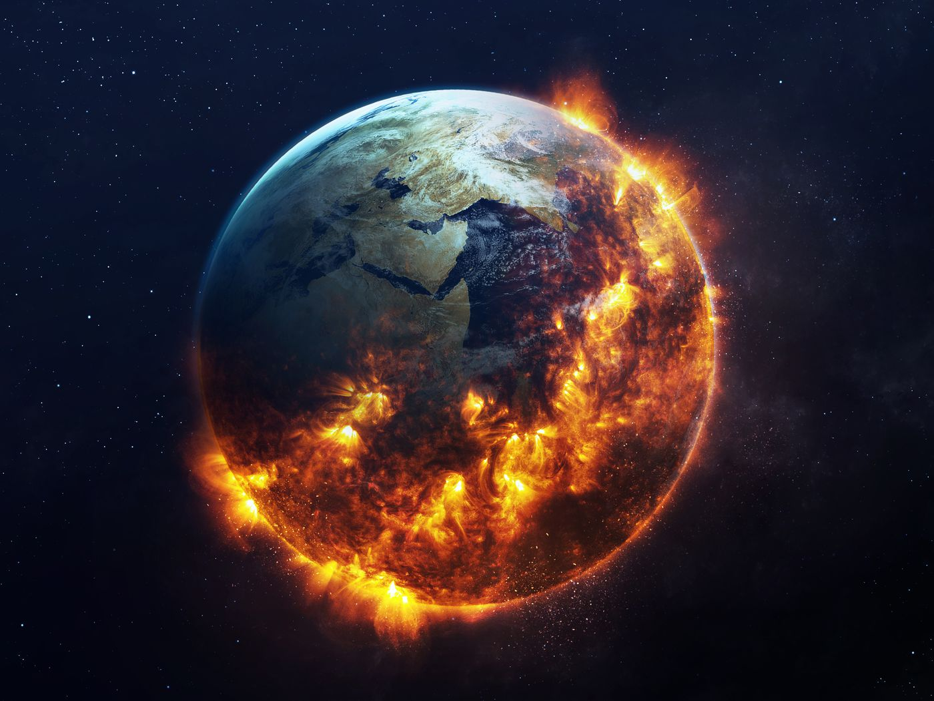
World
Worldwide judgment
Isa 24:1-3 – “¹Behold, the Lord lays the earth waste, devastates it, distorts its surface and scatters its inhabitants. ²And the people will be like the priest, the servant like his master, the maid like her mistress, the buyer like the seller, the lender like the borrower, the creditor like the debtor. ³The earth will be completely laid waste and completely despoiled, for the Lord has spoken this word.”
Notes:
Isa 24:1-3.
We first see something similar to what we saw in chapter 13, an emptying of the world, which is the opposite of God’s creative purpose. Man is the greatest environmental threat that there is, constantly abusing God’s creative gift, and so we’re reading here that He will take it back. Similar to the flood, the face of the Earth will be devastated and changed. Similar to Babel, the people will scatter.
In vs. 2, we see God saying, “Except for you Mr. President. And this won’t apply to you Madam speaker. And you billionaires? Your high-priced lawyers are just too good, so you’re exempt too.” No, vs. 2 tells us that that a high station in life will not protect you like it does here on Earth. And a low station in life will also not be shown partiality. God’s judgment will be complete in scope; all social distinctions, from religious to domestic to commercial, will be removed and turned on their head.
And in vs. 3 we see the certainty of this. Why? Because the Lord has spoken. Just as His word brought Creation into existence, He can bring it to an end anytime He wants. He leaves no doubt at all as to what’s eventually coming for all mankind.

Slide 3
World
The Cause
Isa 24:4-6 – “⁴The earth mourns and withers, the world fades and withers, the exalted of the people of the earth fade away. ⁵The earth is also polluted by its inhabitants, for they transgressed laws, violated statutes, broke the everlasting covenant. ⁶Therefore, a curse devours the earth, and those who live in it are held guilty. Therefore, the inhabitants of the earth are burned, and few men are left.”
Rom 8:19-22 – “¹⁹For the anxious longing of the creation waits eagerly for the revealing of the sons of God. ²⁰For the creation was subjected to futility, not willingly, but because of Him who subjected it, in hope ²¹that the creation itself also will be set free from its slavery to corruption into the freedom of the glory of the children of God. ²²For we know that the whole creation groans and suffers the pains of childbirth together until now.
How Sin Pollutes The Earth
Transgressed laws
Violate/change statutes
Break everlasting laws
Notes:
Isa 24:4 – The reason the earth is in mourning is because the sin brought on by Adam has reached full expression. And through sin’s disease, the earth fades and withers away like a flower. As we see in vs. 2, even the highest of the earth are affected. This shows that righteous living by Creation’s inhabitants is more important to God than even His creation.
And now we learn the cause – Isa 25:5 – The reason creation itself suffers is because of mankind’s sins (Rom 8). The earth has always been morally sensitive. Ever since sin came into the world and God cursed the ground because of man, the earth has suffered the consequences – Rom 8:19-22. Why? Because everything we touch becomes polluted. That’s why when God would later send the Jews into captivity, He spoke of their punishment has an opportunity to give the land rest so that it would enjoy its sabbaths (Lev 26:34; 2 Chron 36:21).
There are 3 categories of sinfulness listed in vs. 5 to show how sin pollutes the earth.
1) Transgressed laws – To transgress literally means to “cross a line”. The word “Law” is the Jewish word “Torah”, divine revelation given by God. The idea is that those under God’s special covenant did not keep it.
2) Violated statutes – Some of your translations say “changed” instead of “violated” and that seems to be the better sense of the word. This is a step further than simply not keeping God’s law. This is trying to alter God’s law to make it say something else. And the word “statute” means “to carve, to engrave”, which suggests that law is binding and perpetual. So, the idea is that long-standing laws are being nullified and repealed by those who no longer wish to be bound by them.
3) Broke the everlasting covenant – To “break” is to nullify, and “everlasting law” is the implicit covenant between creature and Creator, basic law and order as in the days of Noah. So, this goes even further than the prior 2 because now the moral laws of nature, not engraved in stone, but engraved on the conscience, even those are being violated.
And to break God’s laws is to break ourselves upon them – Isa 25:6 – This is no arbitrary judgment; it is a natural consequence to mankind’s sin. God made the laws, and so He is within His right to pronounce curses and hold accountable parties guilty. This God’s way of saying “Enough is enough!”. But rather than total destruction, He allows a remnant to remain as in the days of Noah. There will be gleanings, which we’ll see further in vs. 13.

Slide 4
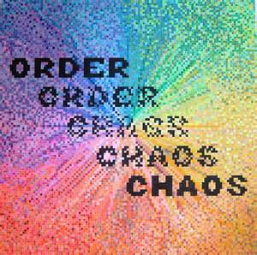
World
The city of chaos
Isa 24:7-12 – “⁷The new wine mourns, the vine decays, all the merry-hearted sigh. ⁸The gaiety of tambourines ceases, the noise of revelers stops, the gaiety of the harp ceases. ⁹They do not drink wine with song; strong drink is bitter to those who drink it. ¹⁰The city of chaos is broken down; every house is shut up so that none may enter. ¹¹There is an outcry in the streets concerning the wine; all joy turns to gloom. The gaiety of the earth is banished. ¹²Desolation is left in the city and the gate is battered to ruins.”
Notes:
Isa 24:7-12 – In other words, the party’s over.
In vs. 7-8, we read that the normal social activities of an agricultural community are brought to an end, as we see the same words used as in vs. 4. Oh, how quickly the music will cease. And for the person who merely looks forward to the physical joys of life, he’ll be left sighing.
In vs. 9, we see what happens to those who always need stimulates to fill the void inside of them. Without it, life is bitter because only in their drink are they able to find pleasure. But when judgment comes and the music stops, even their stimulates bring them no joy.
And in vs. 10, we’re now introduced to the word “city”, and as mentioned, there is a play on this word throughout this entire unit. The city is never named, rather it is to be looked at as any conglomeration of people, nation or otherwise, who mutually infect one another w/sin, becoming physically what it already was spiritually. And it is chaos. Life in this “city” is lonely and fearful. Because that is what sin does. God’s law creates order, sin creates chaos. 1 John 2:17a – “The world is passing away, and also its lusts”. But before the world w/its lusts passes away the city which personifies it must go.
In vs. 11, why the outcry? Because of the lack of their failed remedies. Those who have developed a dependency on stimulates are in trouble now; their sources of joy were attached to that which is fleeting and can be taken away rather than the joy which endures.
And after mentioning everything that has been taken away, one thing remains: desolation and battered city gates. The gates are the most important part of the city, so w/it gone, the destruction is complete. Because who will want to enter a “city” left so defenseless?

Slide 5
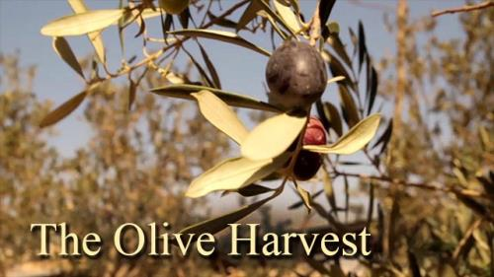
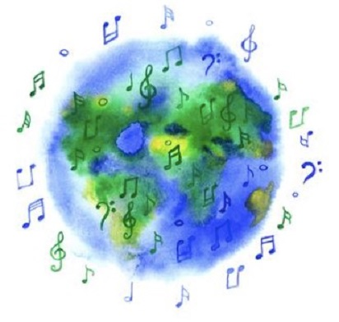
World
Remnant singing
Isa 24:13-16a – “¹³For thus it will be in the midst of the earth among the peoples, as the shaking of an olive tree, as the gleanings when the grape harvest is over. ¹⁴They raise their voices, they shout for joy; they cry out from the west concerning the majesty of the Lord. ¹⁵Therefore glorify the Lord in the east, the name of the Lord, the God of Israel, in the coastlands of the sea. ¹⁶From the ends of the earth we hear songs, ‘Glory to the Righteous One,’”
Notes:
Now, as we saw repeatedly in chapters 13 – 23, as well as in vs. 6 of this chapter, when God brings earthly judgment, He spares a remnant. Notice the similar language we’ve seen so far – Isa 24:13 – Meaning, the judgment will not be complete, because like bare olive trees and grape vines stripped of everything, a few stray clusters or a handful of olives will be left – a remnant. This shows that though God’s judgments are catastrophic, this is not final judgment in any sense, because people are left on the earth.
And how will they respond? – Isa 24:14-15 – The remnant will praise Him w/gratitude, having been so blessed. They shout loud enough so as to be heard by those far away, knowing how important it is that others know of God’s majesty, perhaps to spare them from the calamity in which they themselves had been spared. Calling for matching songs in the east, the desire is for this praise to become worldwide (Gentiles) because the remnant has finally begun to see the Lord’s hand in world affairs. That the west and east are singing to one another matches the image Isaiah saw from heaven in 6:3. This shows that the result of righteous judgment is always the universal praise of God by those who remain. The word “east” literally means “dawning light”, and if you’re reading the KJV it uses the word “fires”. The Hebrew word contains the word “Urim” as in the “Urim and Thummim” of the priest’s attire, which is interesting.
The command for worldwide praise sees its culmination – Isa 24:16a – That God is Righteousness is recognition that His judgment is just. And notice that Isaiah identifies Himself w/them using the word “we”.

Slide 6
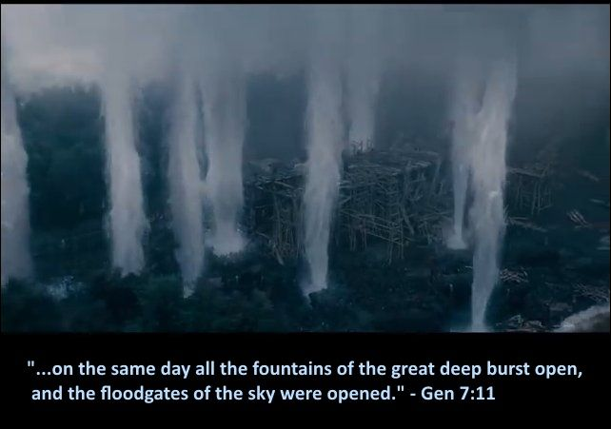
World
Return of sin, more judgment
Isa 24:16b-20 – “But I say, ‘Woe to me! Woe to me! Alas for me! The treacherous deal treacherously, and the treacherous deal very treacherously.” ¹⁷Terror and pit and snare confront you, O inhabitant of the earth. ¹⁸Then it will be that he who flees the report of disaster will fall into the pit, and he who climbs out of the pit will be caught in the snare; for the windows above are opened, and the foundations of the earth shake. ¹⁹The earth is broken asunder, the earth is split through, the earth is shaken violently. ²⁰The earth reels to and fro like a drunkard and it totters like a shack, for its transgression is heavy upon it, and it will fall, never to rise again.”
Notes:
But this rejoicing is only a momentary break in the clouds.
Isa 24:16b – Meaning, Isaiah knows more judgment is coming. He goes into shock and awe like in 21:3-4. He adds woe to himself as he did in 6:5, feeling the condemnation upon others as he did upon himself because the immoral world continues unchanged. Despite rejoicing, there appears to be no real conversion as the wicked continue to prey on everyone that they can.
Isa 24:17-18 – Point being that God’s judgment is inescapable. This is a frequent theme in scripture. God’s judgment has enough backup plans to thwart our attempts to escape it. There is nothing more terrible than for one to breathe a sigh of relief that he has escaped one pitfall only to find himself in another from which there is no escape. Judgment comes from every direction imaginable. Those whom God judges will inevitably be trapped like animals. Day 2 of Creation was the waters above and below separating. This judgment language is the reverse of that – decreation.
Isa 24:19-20a - There was a previous judgment on the earth that this language is very similar to: the Genesis flood. There is an ascending gradation of destruction. The earth was created for humanity for fruitfulness and abundance and enjoyment. But our sin has ruined a good thing. And if the earth is to become such, why put so much trust in it and what it provides?
And what is the cause of this destruction? – Isa 24:20b – Sin has become so heavy on the earth that it cannot bear the weight. God can tolerate this no longer. Whether the earth is destroyed by man’s weapons or man’s sins, the earth is done for. And when this comes, do we lean on that which is drunk and tottering, or do we lean on that which is everlasting? One will fall, the other will stand.

Slide 7
Overthrow of Babylonian Worldview
Isa 13-14:27 (Babylon/World) | Isa 21:1-10 (Babylon) | Isa 24:1-22 (World)
National/Worldview Overthrow | National Overthrow
Object of judgment goes from Babylon to Earth (13:9,11,13) | Babylon judged (21:9)
False boasting (14:13-14) | Treacherous ones (21:2)
For Israel’s sake (14:1-2) | For Israel’s sake (21:10)
Joy over destruction (14:7b) | Lament over destruction (21:10)
Earth Overthrow (24:1,3-4,19-20)
“City” judged (24:10,12)
Treacherous ones (24:16cd)
For remnant’s sake (24:13-16)
Joy over destruction (24:13-16)
Notes:
Now, as we’ve come to the end of the first set of companion oracles, let’s fill in the blanks.
In chapters 13 and 14, an overthrow of national Babylon teased an overthrow of its worldview. Chapter 21 dealt specifically w/the nation itself, and chapter 24 focused solely on the earth, implying that “Babylon” is an ideology and worldview that would infect many cities.
This becomes clearer when we see the national judgment become focused on a figurative “city of chaos” that must be judged, a city being a collection of people coming together who mutually infect one another.
We saw the false boasting of Babylon in chapter 14, learned of the treachery of Assyria in chapter 21, and then see this pop up again in chapter 24 to imply that even our of a remnant, more treachery will arise, just in another nation.
At the beginning of chapter 14, we learned that Babylon’s overthrow would be for Israel’s sake. We learned in chapter 21 it would also be for Israel’s sake, but in a different way. They were hoping Babylon would be the one to take Assyria down, but God had no intention of that happening in this instance. And then in chapter 24, we see that judgment against the city of chaos is solely for the remnant of God’s people, that they’d glorify the Lord and not the “city of chaos”.
We also see contrasting reactions. There was joy over Babylon’s destruction in chapter 14 when they were in the position of oppressor. There was lamentation over their destruction in chapter 21 when they were in the potential position of liberator. And then in chapter 24, there is rejoicing once again as the remnant learns not to put its trust in any nation because God is the source of salvation.

Slide 8
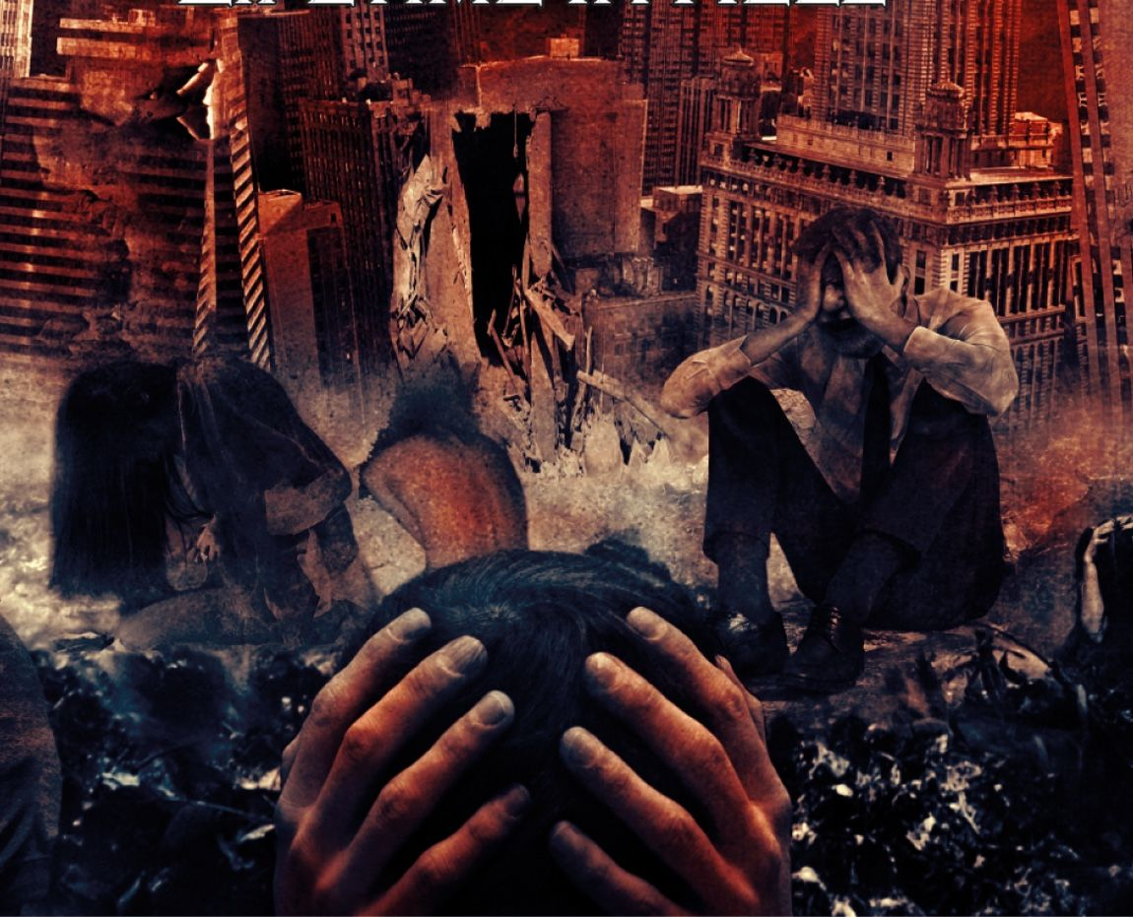
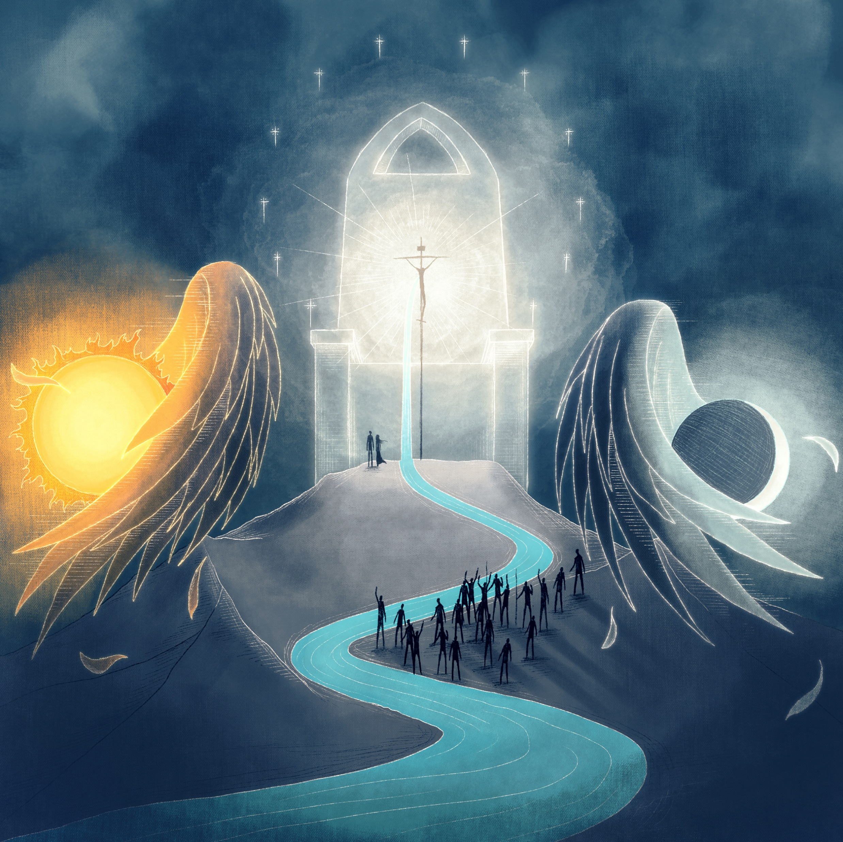
Zion’s King
Last judgment, reign of the king
Isa 24:21-23 – “²¹So it will happen in that day, that the Lord will punish the host of heaven on high, and the kings of the earth on earth. ²²They will be gathered together like prisoners in the dungeon, and will be confined in prison; and after many days they will be punished. ²³Then the moon will be abashed and the sun ashamed, for the Lord of hosts will reign on Mount Zion and in Jerusalem, and his glory will be before His elders.”
Notes:
Now, since God’s earthly judgments don’t seem to permanently fix the problem, there must be a final judgment, and the end of chapter 24 is going to give us a peak into what that judgment will look like.
Isa 24:21 – Who are the “host of heaven on high” who will be judged? Likely what Eph 3:10 refers to as “the rulers and authorities in heavenly places”, or what Eph 6:12 calls the “spiritual forces of wickedness in the heavenly places”. Kings on earth sin, but involved in their fall are these wicked spiritual forces, and they will be judged “on high”, in their own sphere and at their most powerful. And no high-priced lawyer or bribed politician will help them escape God’s judgment.
Isa 24:22 – Regardless of stature, both earthly powers and heavenly powers will be herded and confined together to the same prison. This theme develops later in 2 Pet 2:4; Jude 6; Rev 12:7-10; 20:1-6. This is ”Sheol” or “Hades”, the temporary home of the dead until the final judgment comes.
Isa 24:23 – I believe the idea here is that though the sun and moon, in their brightness, are poor by comparison to the Lord’s glory, He will not allow their brightness to detract from His own. God will reign before the elders as He did at Mt. Sinai in Ex 24, and as we see occurring in Rev 4. They only saw His feet in Ex 24, but now they will see His glory. The Lord’s throne on Mt. Zion in Jerusalem is the goal of the worldwide pilgrimage described in 24:13-16; 2:4. This promise provides certainty to those saints who see delay.

Slide 9
Looking Forward To Reign of Zion’s King
Isa 14:28-32 (Philistia) | Isa 21:11-12 (Edom) | Isa 24:21-23 (Judgment Day)
Philistine glee: think they understand times (14:29) | Edomite gloom: don’t understand times (21:11)
Offer of aid/refuge from Philistia (14:32) | Impatient asking (21:11)
Coming supremacy of David (14:32) | Uncertainty of coming light (21:12)
God knows times; judges proud (24:21)
Patience rewarded (in that day) (24:21-23)
Day/night transcended by the Lord (24:23)
Notes:
Filling in the 2nd set of companion oracles – “Looking forward to the reign of Zion’s king.”
In the oracle to Philistia, there was glee because they thought they understood the times. In the oracle to Edom, there was gloom because they didn’t understand the times. And now we see in 24:21 the phrase “in that day”, meaning God knows the time. And in His time, the proud will be judged.
Also, Philistia was frantically hustling about trying to make alliances. Edom was impatiently asking, “Watchman, how far gone is the night?” But in chapter 24, patience for those who wait on the Lord is rewarded.
And then in the Philistine oracle, Isaiah reminds them of the coming supremacy of David. But to Edom, there is uncertainty about the coming light. And in 24:23, we see both day and night being transcended by the Lord, as the sun and moon are no more, a theme developed more fully in chapter 60.

Slide 10
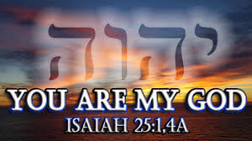
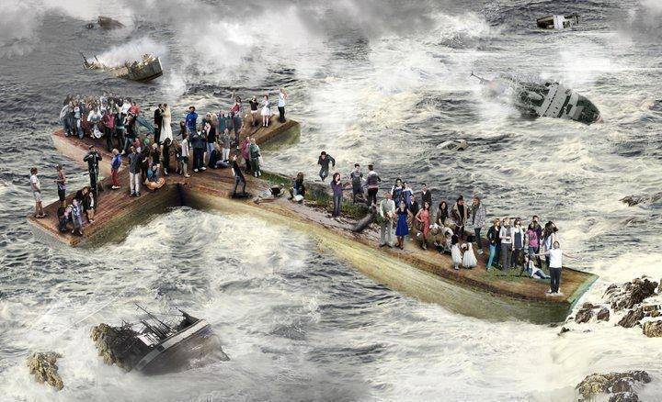
Hymns of Praise
Thanksgiving of victory
Isa 25:1-5 – “¹O Lord, You are my God; I will exalt You, I will give thanks to Your name; for You have worked wonders, plans formed long ago, with perfect faithfulness. ²For You have made a city into a heap, a fortified city into a ruin; a palace of strangers is a city no more, it will never be rebuilt. ³Therefore a strong people will glorify You; cities of ruthless nations will revere You. ⁴For You have been a defense for the helpless, a defense for the needy in his distress, a refuge from the storm, a shade from the heat; for the breath of the ruthless is like a rain storm against a wall. ⁵Like heat in drought, You subdue the uproar of aliens; like heat by the shadow of a cloud, the song of the ruthless is silenced.”
Notes:
Chapter 25 is the response to the destruction of the “city of chaos”. It is a hymn of thanksgiving consisting of 3 stanzas, describing God’s faithfulness in delivering His people. Stanza 1 of the hymn is as follows – Isa 25:1-5.
So, as the pilgrimage of the remnant moves through a ruined world toward Zion, their response is to burst forth in song over the marvel of their rescue and the power of God. Notice the pronouns used – Isaiah feels a personal attachment to God due to his redemption. This suggests that our response to redemption is just as important as the process that gets us there. If we’ve been saved, and we’re not praising, exalting, and giving thanks, have we truly responded to God’s grace? The word “wonders” is the same word used in 9:6, and the word “planned” is the same word as “Counselor” in 9:6. Meaning, this was not off the cuff, but planned from eternity, and God has been perfectly faithful to pull it off despite our sin.
Vs. 2 explains the reason for rejoicing – Isa 25:2-3 – The “world city” of chapter 24, here called the “fortified city”, is the nemesis of salvation, an organized human society in which rebellion is spread beyond repair. And no matter how well organized, fortified, or beautified, God makes folly every monument to human pride. And the power behind God’s judgment will convince even the most ruthless that He is Lord, and they will revere Him. This doesn’t suggest they are saved; it simply means they now acknowledge His might. Unfortunately, there are some who are so focused on self, they will only recognize power.
Vs. 4 is an allusion to God’s care for the socially and religiously ostracized – Isa 25:4 – While God destroys the “ world city”, which is a refuge for the strong/wicked, He Himself becomes a refuge for His people. This verse suggests that while God is opposed to the proud by way of principle, He is also opposed to it because of what it does to others. The storm of the wicked is like rain against a brick wall, ineffectual against God.
How is He a refuge? Vs. 5 tells us that when the enemy “brings the heat”, God brings His cloud – Isa 25:5 – When the enemy brings rage, God brings a wall against them. Here we see that the unsaved have their song, too. But God brings to silence their tumultuous noise.

Slide 11
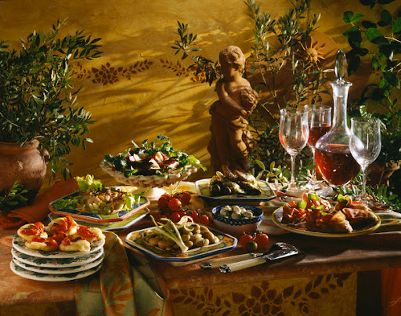
Hymns of Praise
Feast for the redeemed
Isa 25:6-8 – “⁶The Lord of hosts will prepare a lavish banquet for all peoples on this mountain; a banquet of aged wine, choice pieces with marrow, and refined, aged wine. ⁷And on this mountain He will swallow up the covering which is over all peoples, even the veil which is stretched over all nations. ⁸He will swallow up death for all time, and the Lord God will wipe tears away from all faces, and He will remove the reproach of His people from all the earth; for the Lord has spoken.”
Notes:
The 2nd stanza of the hymn begins in vs. 6, showing us more of what will happen on that mountain of the house of the Lord: the marriage supper of the Lamb – Isa 25:6-8.
In the bible, it is very common after a coronation to celebrate a sacrificial meal (1 Sam 11:15; 1 Kings 1:9, 19, 25), the people providing the meal. But God provides this banquet for His own coronation, and He does so w/the choicest food and drink man has to offer. This is a victory banquet, an “awards” ceremony. The phrase “lavish banquet” literally means “feast of fat things”. See, in the Levitical system, the fat of the sacrifices always belonged to God. But now He gives us what is rightfully His. Aged wine is the best wine, the red grapes that have high tannin levels and high acid levels that make them too bitter when pressed, but when cooled over a long period of time falls out of the wine and turns into the most quality beverage you could drink. Marrow literally refers to the high protein substance inside the bone, a delicacy in many countries. The image is God providing us with the richest, choicest food for His coronation meal.
In vs. 7, the veil represents a blindness that prevents us from seeing things from a kingdom perspective, what had infected the nations of that age. But ultimately it represents the effect of that blindness: death; and before people can experience the joy of God’s great feast, something must be done about the universal cause. And so, at this meal, as a tender father comforts His child, God wipes away the “effect” that death and mourning bring. He is so touched by our hurt, He’s going to put an end to it all even though we were the cause. All the shame and reproach that led to so much loss will be made up for. This is guaranteed for God has spoken it. BTW, this is the first explicate mention of a resurrection in the OT.

Slide 12
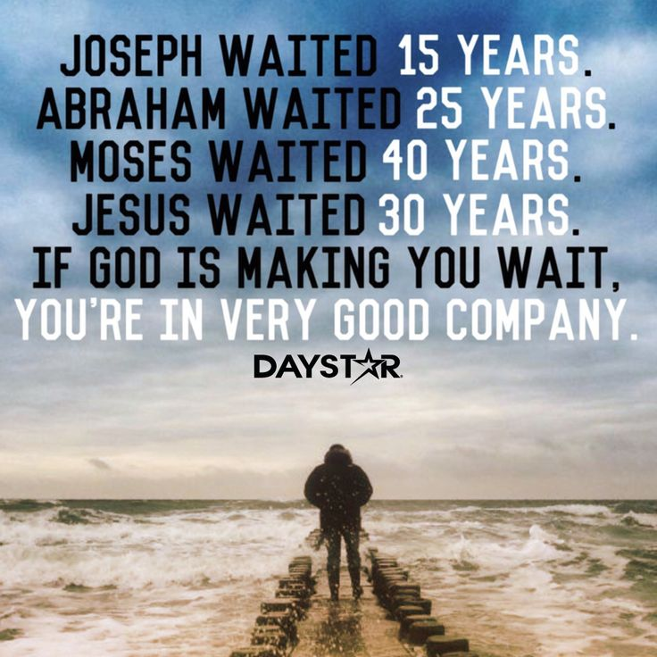
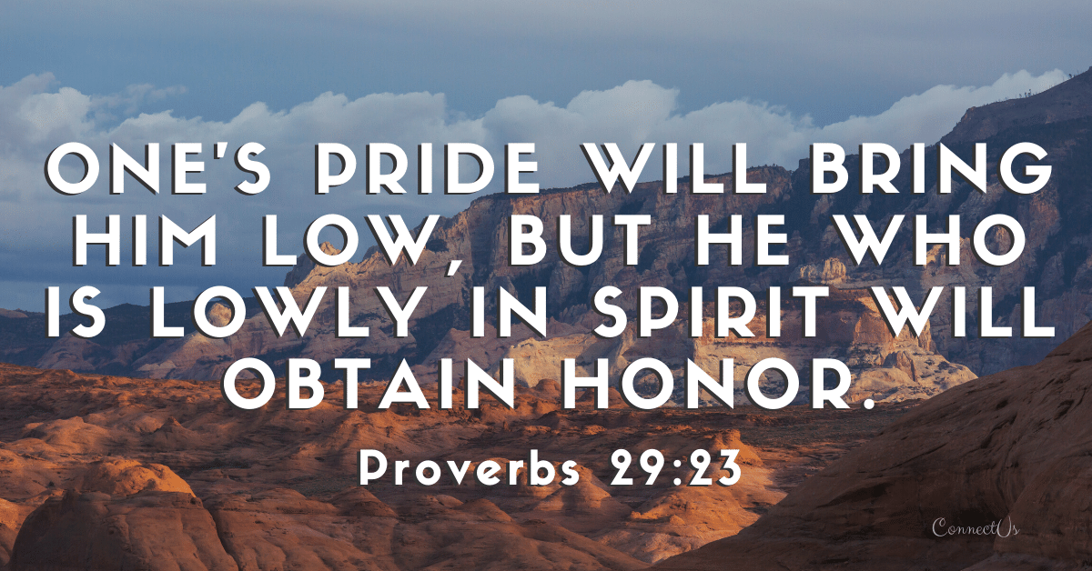
Hymns of Praise
Contrasting judgments
Isa 25:9-12 – “⁹And it will be said in that day, ‘Behold, this is our God for whom we have waited that He might save us. This is the Lord for whom we have waited; let us rejoice and be glad in His salvation.’ ¹⁰For the hand of the Lord will rest on this mountain, and Moab will be trodden down in his place as straw is trodden down in the water of a manure pile. ¹¹And he will spread out his hands in the middle of it as a swimmer spreads out his hands to swim, but the Lord will lay low his pride together with the trickery of his hands. ¹²The unassailable fortifications of your walls He will bring down, lay low and cast to the ground, even to the dust.”
Notes:
The 3rd stanza begins the same as the 1st verse.
Isa 25:9 – In other words, those who wait on God will realize the object of their expectation, that He will save us. These are people unafraid to confess Jesus before men. This is a trust that contrasts the instant gratification sought after by the world from chapter 24. And notice it is “His” salvation, not ours. No contribution on our part was needed, only waiting in confidence. And when salvation comes, rejoicing follows.
But while there is peace and blessing on Mt. Zion, there is another mountain across the Jordan: Moab – Isa 25:10 – Don’t think literal Moab, think of it as a word picture. What was Moab’s issue from chapter 16? Pride, even in the midst of suffering. And while God’s hand rests on Zion, His foot presses “Moab” underneath Him. Moab had been proud, but she chose the cesspool over the banquet, so now she will be abased. Israel had been despised and looked down upon, now she will be exalted.
And the next verse shows why such judgment is necessary – Isa 25:11 – In other words, since Moab sought security through its own self-reliance and self-effort, it was going to attempt to swim out of the cesspool it found itself in. But God does not admire this “go it alone” attitude. The cunning and skill she used to escape judgment will not succeed. The same pride that held back Moab from seeking physical security due to divine promise in an earthly crisis (15 – 16) will keep her from partaking of heavenly promises.
Isa 25:12 – In other words, Moab is just another “city of chaos” who thinks its walls are unshakable. But not even the ruins and rubble of their forts will remain, only level ground and dust.

Slide 13
Reliance on Self (Pride of Life)
Isa 15 – 16 (Moab) | Isa 21:13-17 (Arabia) | Isa 25 (Trust Fulfilled)
Many cities affected | Many cities affected
Encouraged to send tribute lamb (16:1) | Barest of necessities (21:14)
Fleeing from strangers (16:4,8) | Hiding from strangers (21:13)
No treader of grapes (16:10) | Only water available (21:14)
Self-reliance (16:6-7,12) | Peer-reliance (21:14)
Only a remnant spared (16:14) | Only a remnant spared (21:17)
“World city” destroyed (25:2-3,12)
Lavish banquet (25:6)
Strangers destroyed;
fear God (25:2c)
Aged refined wine (25:6)
Continue self-reliance after discipline (25:10-11)
Helpless and needy spared (25:4)
Notes:
This companion oracle to Moab and Arabia contrasts a Gentile world in trouble and on the run, yet held back from Zion by its pride.
In both Moab and Arabia’s oracles, we saw many cities affected. In chapter 25, we see the world-city destroyed, being any city who takes on the pride and rebellion of Moab.
Moab was encouraged to send the tribute lamb in chapter 16. Arabia was encouraged to provide the barest of necessities. But on Zion, a lavish banquet is waiting.
Both Moab and Arabia were fleeing from and hiding from strangers. But in 25:2, we read “a palace of strangers is a city no more”.
Moab lost its wine, and Arabia only had water available. But in Zion, there would be aged wine.
We saw self-reliance in Moab, peer-reliance in Arabia, and in chapter 25, they continued in self-reliance even after judgment, only for those on Zion to rely on the Lord.
And we also see the commonality of a remnant spared in all 3 oracles, but it would only be those who see themselves as truly helpless and in need of God who will make it to God’s banquet. The summary of these 3 oracles is reliance of self, the pride of life.

