Slide 1
Notes:
This study will finish up chapters 13 – 23 on oracles to individual nations w/an oracle to Tyre. This oracle toward Tyre might seem rather strangely placed. There was history between Tyre and the Jews, but what would an oracle to Tyre have to do w/the present Assyrian distress that God’s people need to know? Well, if you’ll recall from 22:3, when the leaders in Jerusalem saw that the Assyrian invasion of Judah was inevitable, some would try to flee, though vs. 3 says they’d be caught. If you wanted to escape Assyria, where would you go? God has already predicted Assyrian take downs of Egypt in the south, Philistia in the west, Edom in the southeast, Moab and Arabia in the west, Israel in the north, Syria in the further north, and Babylon in the northeast. Where will you go? Well, during the present distress, if you wanted to get as far away from Assyria as possible, you were going to need get on a ship and sail away, and given Tyre’s maritime enterprise, that would be the place I’d go. But guess what? Assyria is going to take them down too. And so, this oracle seems well placed as God has dealt a blow to virtually every nation within Israel and Judah’s sphere of influence, which leaves only one person they can truly put their trust in for help – God, and God alone.
The oracle to Tyre consists of 2 parts. Verses 1 – 14 talks about Tyre’s eventual fall, and then vs. 15 – 18 predicts their reviving as well as their ultimate allegiance to the Lord’s cause.

Slide 2
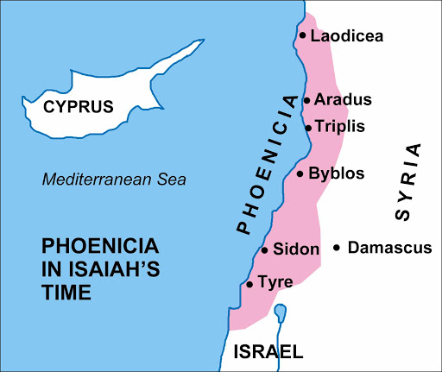
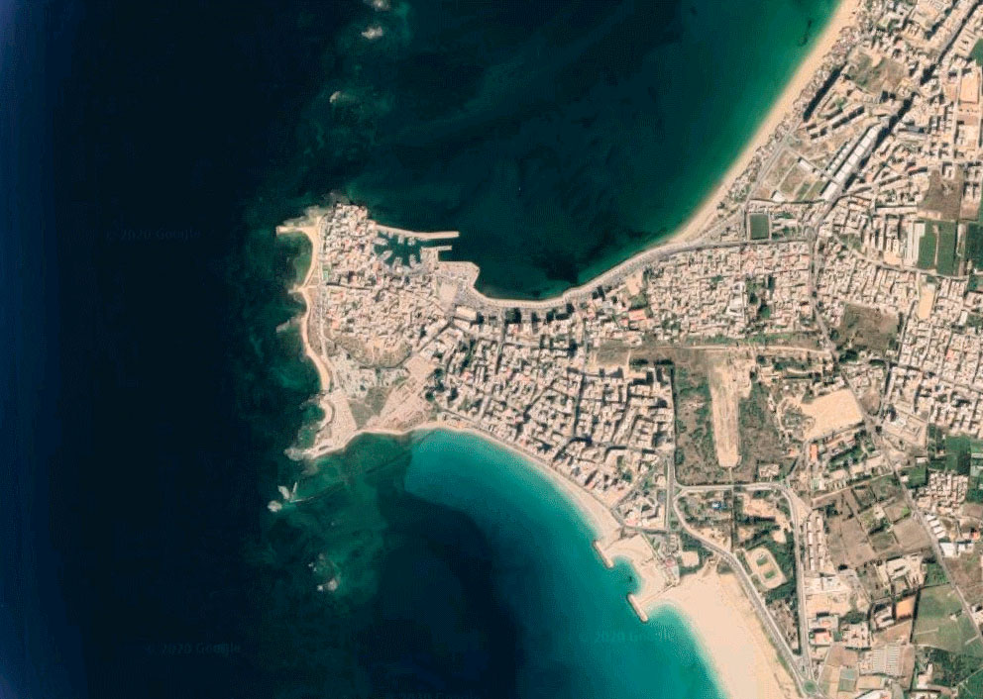
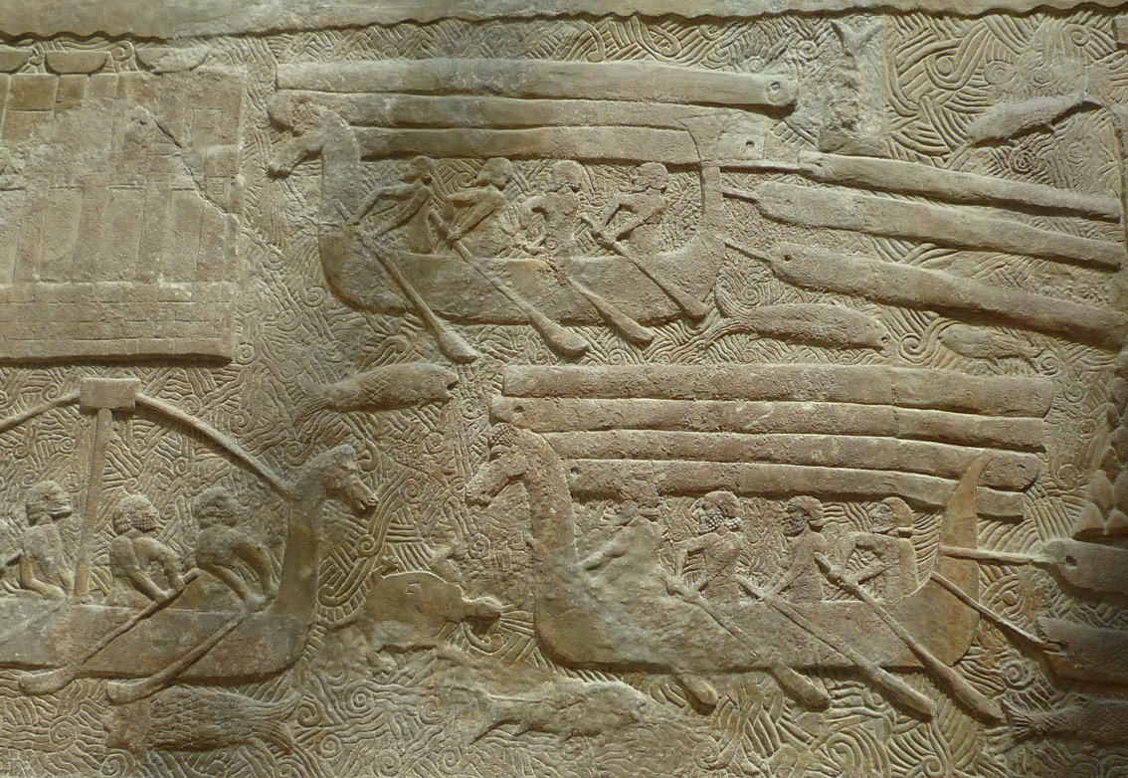
Lebanon/Phoenicia
Notes:
Background: Tyre was the main city of Lebanon, and they were direct descendants of the Canaanites, as Gen 10:15 tells us Canaan had a son named Sidon who the other main city of Lebanon was named after. The Greeks later renamed the region “Phoenicia”, which means “purple people”, because they were known for their extraction of purple dye from shellfish. But Phoenicia was most famous for its maritime trade, which led to colonization, which in turn led to a worldwide influence, and the most prominent city of Phoenicia in Isaiah’s time was Tyre, and it was made up of two parts. There was the maritime capital on the mainland, which was a rocky fortress, and then there was also an island about a ½ mile from the coast. However, today the mainland and the island are connected. Why?
Because in the 4th century, Alexander the Great, seeking to do what no one else had ever done, besieged the island of Tyre. He did so by first taking out the mainland of Tyre and then he used its rubble to build a causeway to the island, which from the beginning of the construction to its conquest only took 7 months. The picture in the upper right is what it looks like today. Israel and Phoenicia had both good connections and bad connections. The good connection was that David and Solomon had an alliance w/Tyre’s king Hiram, who supplied the material to build the temple. However, King Omri of Israel unfortunately made an alliance with the King of Sidon by allowing his son Ahab to marry his daughter Jezebel which had lasting negative affects on both Israel and Judah.
What was the relationship between Tyre and Assyria? There were many times that Tyre and Assyria were nominal allies, because Tyre’s policy was to generally pay tribute rather than go to war. The relief on the bottom right, which can be seen in the Louvre, depicts Phoenician ships transporting cedar logs off the coast of Lebanon for Sargon II. And in return, Sargon II offered Tyre troops for help in fending off pirates and to help Tyre regain control of Cyprus. But where things went downhill for Tyre was that while Assyria was dealing w/the rebellions of Egypt and Philistia, they outlawed Tyre from exporting and trading any goods w/those nations, and trade w/Egypt was a huge part Tyre’s economy. And so, when Sargon II died and was replaced by his son Sennacherib, Tyre was one of those several places that rebelled and stopped paying tribute. And so, Sennacherib besieged Tyre for 5 years, capturing the mainland of Tyre and forcing its king to flee to Cyprus, replacing him w/a local vassal.

Slide 3
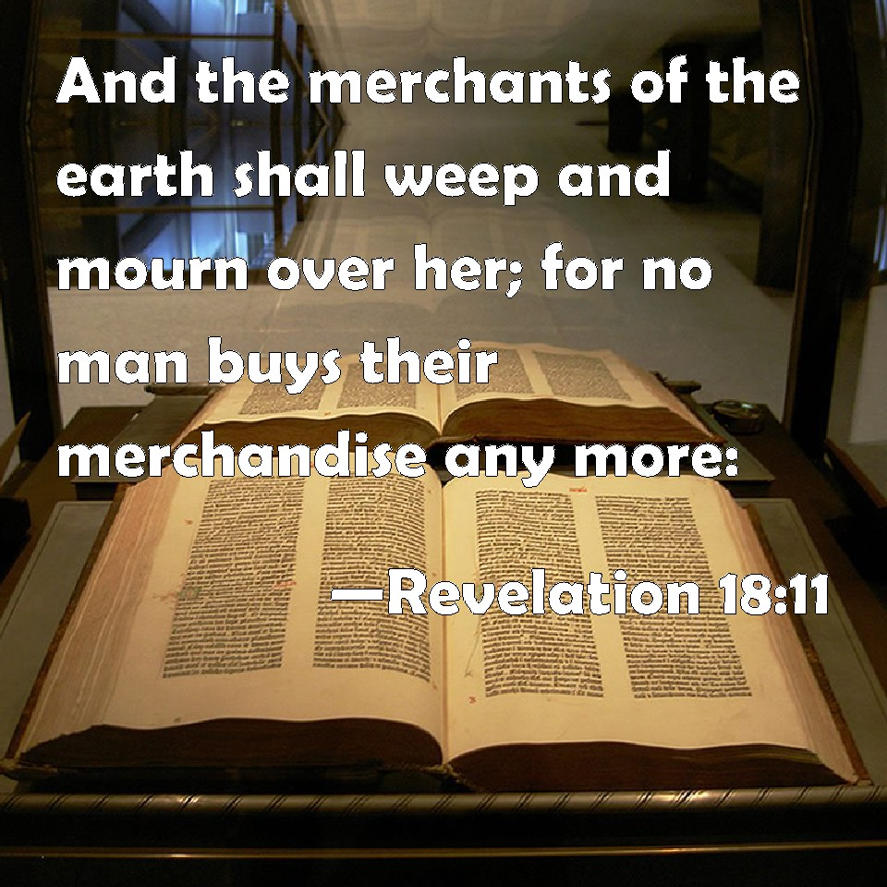
Tyre
What happened
Isa 23:1-3 – “The oracle concerning Tyre. Wail, O ships of Tarshish, for Tyre is destroyed, without house or harbor; it is reported to them from the land of Cyprus. ²Be silent, you inhabitants of the coastland, you merchants of Sidon; your messengers crossed the sea ³and were on many waters. The grain of the Nile, the harvest of the River was her revenue; and she was the market of nations.”
Notes:
What happened? – Isa 23:1 – What we’re being called to picture are sailors from Tyre at port in Cyprus hearing the news of the fall of mainland Tyre. And the ships from Tarshish (south Spain), who were the merchantmen responsible for carrying Tyre’s goods throughout the world, they hear about it too. One of the things unique about Isa 23 is its many use of imperatives, and we see the first one in verse 1 in how these sailors and merchants are to respond: wail.
Isa 23:2-3 – The second imperative is to “be silent”. Why? Because Sidon’s merchants were sent out on the sea, and while they’re gone, they get word that there is no Tyre to return to. And while we saw from chapter 19 how much Egypt’s livelihood depended on the Nile, it also on trade w/Tyre. But now that is gone. So, the idea is that everyone who benefited from Tyre’s commercial success is going to be horrified over what happens to them.
Notice the end of vs. 3 – “she was the market of nations”. Tyre was so successful in trading that nations didn’t just buy Tyre’s merchandise; they were buying Tyre. Tyre herself became the trade, which is so typical when there is a monopoly on a product. Who is the premier social media app of our time? Facebook. And if you want to be on it, you have to play by their rules, don’t you? Such was the case w/Tyre. The nations that traded w/it were inevitably influenced by it. In fact, in Rev 18:11-24, though it identifies the nation symbolically as “Babylon”, there is very similar language to what we see in Isa 23, suggesting that this oracle represents a larger worldview – the evil that can come about due to commercial wealth and materialism. And there does come a point where we have to tell the “evil” in our culture “I’m no longer going to ‘buy’ what you’re trying to sell me.”

Slide 4
Tyre
What happened
Isa 23:4-5 – “⁴Be ashamed, O Sidon; for the sea speaks, the stronghold of the sea, saying, ‘I have neither travailed nor given birth, I have neither brought up young men nor reared virgins.’ ⁵When the report reaches Egypt, they will be in anguish at the report of Tyre.”
Notes:
Isa 23:4 – What’s happening here is that the sea is being personified, speaking for Tyre who is the stronghold of the sea. The idea is that despite their historical, commercial success, she has ultimately provided nothing of a lasting nature. As Jesus said in Matt 6:19-21, wealth is what moth and rust destroys. It is “as if” she did everything she could do to satisfy and solidify a legacy and name for herself, but it was all for nothing.
Isa 23:5 – Rumor travels fast. And since Egypt’s economy also depended on Tyre’s, this report meant an inevitable collapse of commerce and that whatever took Tyre down could take them down too. Sin has ripple effects.

Slide 5
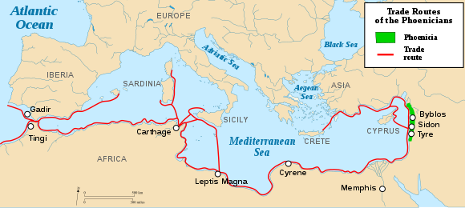
Tyre
What happened
Isa 23:6-7 – “⁶Pass over to Tarshish; wail, O inhabitants of the coastland. ⁷Is this your jubilant city, whose origin is from antiquity, whose feet used to carry her to colonize distant places?”
Notes:
Isa 23:6 – In other words, evacuees and refugees who fled the destruction to Tarshish would wail over their former homeland.
Isa 23:7 – How old was Tyre? We have evidence that it was inhabited from early in the 3rd millennium BC. So, this is an ancient, long-established city whose pursuit of trade led to colonizing other places. “Tyre” was always being planted somewhere. Where did they colonize? Too many to name, but none was more famous than Carthage in North Africa, who became so mighty that they eventually cut ties with Tyre and declared its independence. But Tyre’s antiquity gave it vitality and a sense of permanence so that when they are finally judged, the world just cannot believe it. But just because it’s always been this way does not mean it always will be. Nothing on this earth lasts and that is unsettling to many.

Slide 6
Tyre
Who caused it
Isa 23:8-11 – “⁸Who has planned this against Tyre, the bestower of crowns, whose merchants were princes, whose traders were the honored of the earth? ⁹The Lord of hosts has planned it, to defile the pride of all beauty, to despise all the honored of the earth. ¹⁰Overflow your land like the Nile, O daughter of Tarshish, there is no more restraint. ¹¹He has stretched His hand out over the sea, He has made the kingdoms tremble; the Lord has given a command concerning Canaan to demolish its strongholds.”
Notes:
Beginning in vs. 8, the tone now changes from what happened to why it happened
Isa 23:8 – That’s some resume. The most ancient of cities, who crowned kings through colonization, whose merchants were seen as princes and honored in all the earth. When Tyre founded colonies, they were ruled by kings that Tyre appointed, not through military conquest, but through economic and commercial conquest. This would place them in Tyre’s services, increasing her power and influence. Who is mighty enough to take away that kind of power?
Isa 23:9 – All that power gave them feelings of pride and supremacy and self-glory. And so, the Lord planned this against them. This was His design, to demonstrate the foolishness of human pride. And if Tyre was going to join the other nations in streaming to the mountain of the house of the Lord to learn of His ways, they too, like all the other nations discussed so far, were going to have to be humbled.
Isa 23:10 – Daughters of Tarshish likely represents all the colonies established by Tyre. They can now pass freely through their land w/o restraint.
Isa 23:11 –The sea was the source of Tyre’s livelihood, their sure thing, but God will see to it that Tyre would no longer hold nations hostage to her commerce and crowns. God will stretch out his hand, an allusion to the Exodus against Egypt, and shake them as He shakes all nations. They are just another Canaanite nation that needs judging for the terrible influence it had on the world.

Slide 7
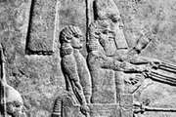
Tyre
Who caused it
Isa 23:12-14 – “¹²He has said, ‘You shall exult no more, O crushed virgin daughter of Sidon. Arise, pass over to Cyprus; even there you will find no rest.’ ¹³Behold, the land of the Chaldeans—this is the people which was not; Assyria appointed it for desert creatures—they erected their siege towers, they stripped its palaces, they made it a ruin. ¹⁴Wail, O ships of Tarshish, for your stronghold is destroyed.”
Notes:
Isa 23:12a – The idea from this statement is that Tyre had for a long time been “untouched”, but they would now fall and there would be no more exultation.
Isa 23:12b – Cyprus was a natural refuge of escape as it was just a short hop across the sea. But even there, they would find no rest. As mentioned earlier, Tyre and Sidon took a cue from Babylon and likewise rebelled against Assyria. But when Sennacherib reconquered Babylon, before heading to Jerusalem for the grand finale, he captured Phoenicia and its king, a man name Luli, actually had to flee to Cyprus to escape. The bottom right picture is a relief of Luli.
Isa 23:13-14 – As if to say, “If Assyria can destroy Babylon, think hard about what it can do to you.” All this in view, Isaiah closes the section by calling on them once again to wail. The ships are so named because that was their strength and now had no more place to go to harbor. Their financial security is no more.

Slide 8
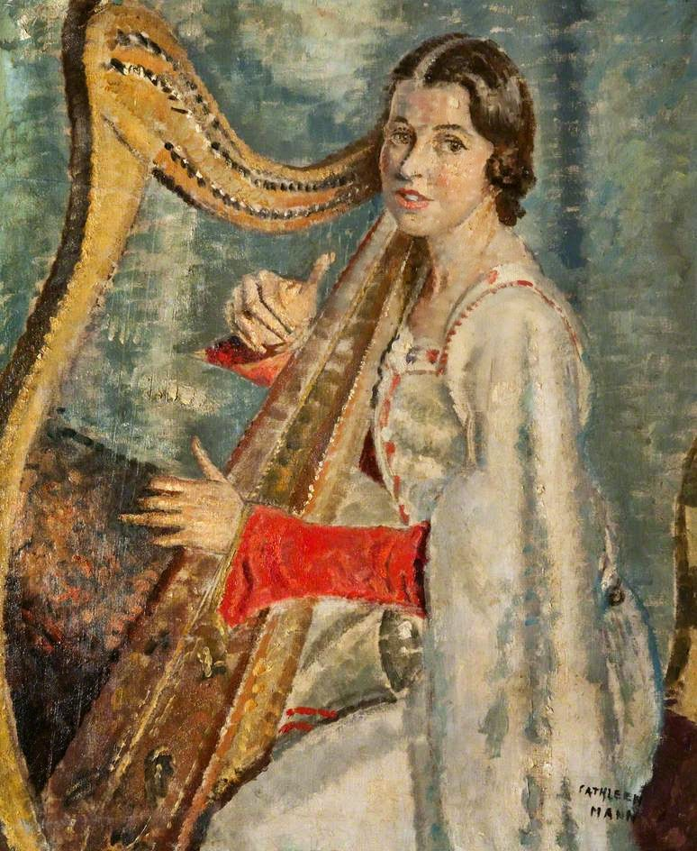
Tyre
The judgment
Isa 23:15-16 – “¹⁵Now in that day Tyre will be forgotten for seventy years like the days of one king. At the end of seventy years it will happen to Tyre as in the song of the harlot: ¹⁶take your harp, walk about the city, O forgotten harlot; pluck the strings skillfully, sing many songs, that you may be remembered.”
Notes:
Verses 15 – 16 give us details into Tyre’s specific judgment.
Isa 23:15a – There would be 70 years of judgment like the days of a king. This is similar to language we saw in 16:14 and 21:16, the phrase “as a hired man”, to denote a specific time, and it matches well between the time of Sennacherib’s campaign in 701BC to Assyria’s decline in 630BC. Either way, this would be just enough time for Tyre not to be remembered in order that God can be remembered.
At that point, Phoenicia’s trade would then be compared to an old harlot – Isa 23:15b-16 – The idea is that when these 70 years are complete, Tyre would be compared to an old harlot going about the streets and taverns trying to drum up old clientele w/song. However, her ability to entice is hindered because she doesn’t have the goods like she once did. She has to play many songs. She has to go to them rather than them coming to her. And so this seems to suggest that God’s judgment worked for a time, but only for a time.

Slide 9
Tyre
The future
Isa 23:17-18 – “¹⁷It will come about at the end of seventy years that the Lord will visit Tyre. Then she will go back to her harlot’s wages and will play the harlot with all the kingdoms on the face of the earth. ¹⁸Her gain and her harlot’s wages will be set apart to the Lord; it will not be stored up or hoarded, but her gain will become sufficient food and choice attire for those who dwell in the presence of the Lord.”
Ezra 3:7 – Then they gave money to the masons and carpenters, and food, drink and oil to the Sidonians and to the Tyrians, to bring cedar wood from Lebanon to the sea at Joppa, according to the permission they had from Cyrus king of Persia.
Notes:
Because notice what happens when the 70 years is complete.
Isa 23:17 – So, when the 70 years is complete, God will revisit Tyre in order to lift the judgment, but she will go right back to her old harlotry ways w/the kingdoms of the world. The lesson learned did not last. So, then what good is she?
Isa 23:18 – The wages she gains won’t be hoarded up as they had done in the past. It would be used to benefit the Lord’s people. The idea is that just as Tyre helped build Solomon’s temple but never committed itself to Solomon’s God, Tyre’s commerce would benefit God’s people in some way even if her character was not reformed. It’s as if Tyre will only be redeemed simply so it’s resources can be used by the Lord for His purposes. “That sounds like God is going to use people’s evil to accomplish His purposes.” Has He ever done that? – Gen 50:20 – The main point is this: Judah needs to stay true to her Husband rather than playing the harlot w/Tyre, because what Tyre possesses will ultimately be enjoyed by God’s people, consecrated to His purposes.
When was this fulfilled? There was a short term and a longer-term fulfillment. In the short term, who funded the rebuilding of the temple after the return from Captivity? – Ezra 3:7. In the longer-term, we know there were Christians in Phoenicia, but it was a primary port used by Paul and others to take the gospel to the nations.

Slide 10
Notes:
As was mentioned when we started chapter 13, not only do the vertical columns of this outline contain themes, but also the horizontal. I first became aware of this from a commentary by Motyer in which he suggested there were themes but didn’t really elaborate on them very much. And I thought some of what he did elaborate on was a bit of a stretch. However, as I studied these oracles, I couldn’t deny that there were things that popped up time again across what I’m going to call the companion oracles. And I want to present what we can see from the first two vertical columns in order to give you some things to look out for as we begin chapters 24 – 27.

Slide 11
Overthrow of Babylonian Worldview
Isa 13-14:27 (Babylon/World) | Isa 21:1-10 (Babylon) | Isa 24:1-22 (World)
National/Worldview Overthrow | National Overthrow
Judgment goes from Babylon to Earth (13:9,11,13) | Babylon judged (21:9)
False boasting (14:13-14) | Treacherous ones (21:2)
For Israel’s sake (14:1-2) | For Israel’s sake (21:10)
Joy over destruction (14:7b) | Lament over destruction (21:10)
Notes:
The first companion oracles obviously have Babylon as the central figure. Chapters 13-14 deal w/a national overthrow of literal Babylon, in which the doom of its kings and armies are vividly and graphically detailed. However, we saw the language toggle back and forth from literal Babylon to a more global “Babylon”, suggesting an influential worldview that must be judged. And the tone from God’s people is excitement over their fall.
However, Chapter 21 focuses specifically on their national overthrow and if my theory is correct, this is dealing w/Babylon’s destruction in 703/702 BC by Assyria. And as we discussed, God’s people seemed to be rooting Babylon on against Assyria despite how utterly evil and corrupt Babylon is.
So, as you’re reading through and studying 24:1-22, we’re going to see this influential worldview revisited through the idea of a “city”, in what commentators often refer to as a “tale of two cities”. The idea is that no matter what benefits may come from “city life”, the negative influences of an ungodly worldview far outweigh the positive benefits, and what chapter 24 refers to as “the city of chaos” must ultimately go down if God’s people are to be saved. Due to its negative influence upon the earth, any nation or city on this earth whose worldview introduces ungodliness must fall and fall hard. And as you’re studying chapter 24, see if you can fill in the blanks.

Slide 12
Looking Forward To Reign of Zion’s King
Isa 14:28-32 (Philistia) | Isa 21:11-12 (Edom) | Isa 24:21-23 (Judgment Day)
Philistine glee: think they understand times (14:29) | Edomite gloom: don’t understand times (21:11)
Offer of aid/refuge from Philistia (14:32) | Impatient asking (21:11)
Coming supremacy of David (14:32) | Uncertainty of coming light (21:12)
Notes:
The second companion oracles deal w/the future coming of the Davidic King. Isaiah reminds the Philistines of the inevitability and that they don’t understand the times as well as they think, and that ultimately where things are headed is a king reigning in Zion. But then in the oracle to Edom, the scene has become even darker and there is greater uncertainty for where things are headed, and so there is impatient inquiries by the Edomites.
When we study 24:21-23 in the next class, we’re going to get an actual glimpse into the reign of the king, but because it is in the future it will require patience. But when it occurs, the Lord’s reign in Zion will be the central point of the worldwide pilgrimage of God’s people and everything that was wrong will be made right.

Slide 13
Reliance on Self (Pride of Life)
Isa 15 – 16 (Moab) | Isa 21:13-17 (Arabia) | Isa 25 (Trust Fulfilled)
Many cities affected | Many cities affected
Encouraged to send tribute lamb (16:1) | Barest of necessities (21:14)
Fleeing from strangers (16:4,8) | Hiding from strangers (21:13)
No treader of grapes (16:10) | Only water available (21:14)
Self-reliance (16:6-7,12) | Peer-reliance (21:14)
Only a remnant spared (16:14) | Only a remnant spared (21:17)
Notes:
The third companion oracles centers on Gentile nations on the run and needing help, in fact seeking it. Isa 15-16 speaks of Moab who is looking to Zion for help, but when it realizes this requires submitting to Zion’s King, pride prevents her from doing so. In the Arabian oracle, Arabia sought help through mutual aid within its borders, but it would ultimately prove insufficient and temporary because the world cannot solve its own problems. In each oracle, we’re told that few would be saved.
But when we get to Isa 25, we’re going to see how in God’s city, He meets every single need that self-reliance and collective alliance could never provide, sadly excluding those who continue in “Moabite pride”. I’m suggesting the main theme in these companion oracles is the “pride of life” and its insufficiency to ultimately help us, and how the fulfillment of our trust will be found on the wonderful mountain of the house of the Lord.

Slide 14
Reliance in Cities (Lust of the Eyes)
Isa 17 (Israel) | Isa 22 (Judah) | Isa 26 (Secure in God)
“World city” cannot save (17:1-3,9) | “World city” cannot save (22:5-8)
Depended on Damascus (17:1-3) | Depended on weapons, walls, water (22:8-11)
Sickness, incurable pain (17:11) | “Until you die” (22:14)
Did not remember Rock of refuge (17:10) | Attempts to find rest in physical rock (22:16)
Enemies will not overcome (17:12-14) | Enemies will overcome (22:5-8a)
Learn from judgment (17:7-8) | Don’t learn from judgment (22:12-14)
“Eyes” (17:7-8) | “Vision” (22:1,4-5,9)
Notes:
The fourth companion oracles concerns God’s own people looking for help from material sources other than Him. That they come fourth in each cycle may indicate how surrounded by the world, it too seeks worldly solutions, and therefore subject to following their path of faithlessness. However their position also makes them central to the Lord’s work. Isa 17 concerns Israel’s coalition w/Syria and how it abandoned trust in God for an alliance w/a Gentile city. Isa 22 concern’s Judah abandoning trust in God for the seemingly unassailable strength of its own city, its weapons, walls, and water.
However, Isa 26 speaks of what a true “strong city” is: it’s God, the Everlasting God, and Isaiah encourages God’s people to find refuge within His “walls”, not material walls. It suggests God’s true people finally come to terms with the futility of the things of this earth, ultimately concluding only God can save. So I would suggest that these companion oracles seem to surround the theme of the “lust of the eyes.”

Slide 15
Reliance on Harvest (Lust of the Flesh)
Isa 18 – 19 (Egypt/Ethiopia) | Isa 23 (Tyre) | Isa 27 (Lord’s Vineyard)
Ethiopia/Egypt controls Nile | Tyre controls sea
Failed attempt to federalize (18:5-6) | Influence filled known earth (23:3,7-8)
Harvest depleted (19:5-10) | Harvest depleted (23:3)
Ingathering of Gentiles (19:23-25) | Ingathering of wages (23:18)
Notes:
The fifth companion oracles concerns Egypt and Tyre’ s well known commercial enterprises. Egypt benefited materially in large part due to the Nile and its cataracts while Tyre benefited from its sea trade. This, however, led to large scale corruption, pride, materialism, and idolatry rather than recognizing God as the ultimate provider of their position. Each nation exerted negative influence throughout the world. Egypt was promising aid to those who rebelled against Assyria but did not follow through. Tyre’s international trade led to colonization throughout its travel routes, but in the end gave birth to nothing but wind. Each would be judged by God, in which there will be an ingathering of the faithful of Egypt and an ingathering of the wages of Tyre that would eventually go toward benefitting the Lord’s people.
But in chapter 27, Isaiah brings it all together by suggesting that the ultimate harvest will be seen in the Lord’s vineyard which will one day fill the earth, and that rather than people relying on “goods” they’ll rely on he fruit borne from God’s people. And so I believe the predominant theme revolves around the “lust of the flesh”.

