Slide 1
Notes:
God has given us Christians some pretty magnificent promises, and yet as we wait on those promises to reach their full fruition, we’re called to live in a corruptible world that is falling apart, and things can look so bleak. It’s not that the uncertainties of life negate the promise, but the anxiety and fear of trying to make it to the end can sometimes challenge us in our trust can it not? This is how I’d recommend we view the oracles in chapters 13 – 23. In chapters 13 – 19, it dealt w/the certainty of trusting God, in which God relays definitive promises surrounding Zion’s everlasting security and the certainty of its coming Davidic king. Chapters 21 – 23 present a bleaker picture in which as a result of Assyria’s inevitable defeat of Babylon and its approaching march on Jerusalem, things look more uncertain. Things look darker. And when things are dark, people look to the watchman to tell them what’s going to happen, as we saw in chapter 21. But despite how things may feel, how they may look, the promises are not negated. And when God finally visits His people, the uncertainties that seemed so severe will vanish like smoke.
Now, in all these oracles against other nations, why would Jerusalem be found amongst the collection? We’re going to discuss that in the very next slide. But why does it appear at this point in the section on God’s worldview to the nations? Well, if the theory is correct that these oracles share themes horizontally, as depicted in the outline, that would line it up w/Israel, another nation of God’s people surrounded by worldly nations. And I hope you’ve been looking out for common themes because on Wed, I am only planning to spend half the class on Tyre, and the remainder of the class is going to be spent breaking down some of the parallels between the first 2 vertical columns.
Chapter 22 is another obscure oracle, though it is not as difficult as chapter 21. I will do my best to explain the verses relative to what I understand to be the history of the times, as I believe chapters 21 – 23 are connect to one another historically.

Slide 2
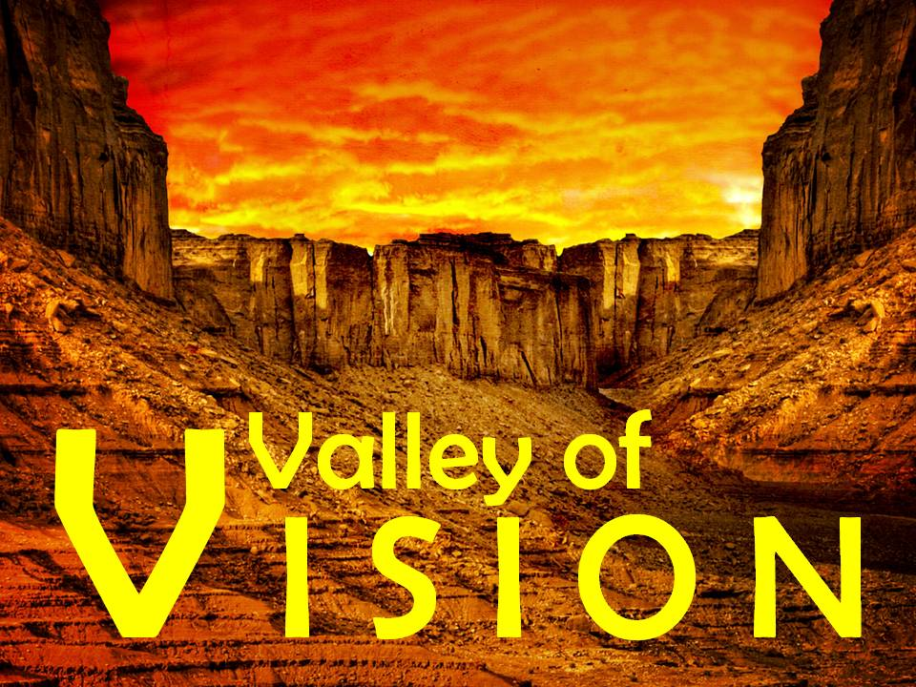
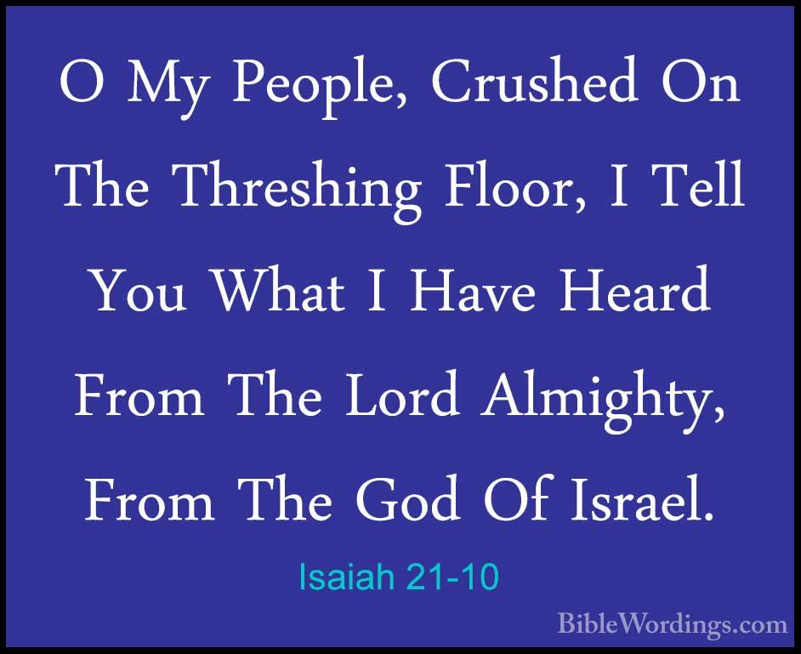
Jerusalem
Celebration short-lived
Isa 22:1-3 – “¹The oracle concerning the valley of vision. What is the matter with you now, that you have all gone up to the housetops? ²You who were full of noise, you boisterous town, you exultant city; your slain were not slain with the sword, nor did they die in battle. ³All your rulers have fled together, and have been captured without the bow; all of you who were found were taken captive together, though they had fled far away.”
Notes:
Isa 22:1a – Another enigmatic title, though we know from vs. 9-10 that he is talking about Jerusalem. So, what does “valley of vision” imply? Well, if you want good vision, where do you go, up on a mountain or down in a valley? You go up on a mountain. This title for Jerusalem is derisive, an expansion upon Isa 6:9 – “keep on looking, but do not understand”. It’s a sarcastic way of saying that they have a lack of spiritual vision, which earns them an oracle of judgment right along side those of the world, seeing as they identify with them more than they do the Holy One of Israel.
Isa 22:1b-2 – The scene paints a picture of a city who at one point was celebrating something, but that celebration has ended and now they’re climbing to the tops of their houses to be on the lookout for something. We did learn from chapter 21 that though Babylon was having some success against Assyria, that success was short lived. Assyria would take them out and head right back to Judah to afflict it. If this oracle was written around the same time, Isaiah could be describing the joy Jerusalem experienced at Babylon’s apparent victory over Assyria only for Isaiah to give them a gut punch – “If you could see what I see coming, you wouldn’t rejoice”.
We already saw this idea after Isaiah announced Babylon’s fall in Isa 21:10 – “O my threshed people, and my afflicted of the threshing floor! What I have heard from the Lord of hosts, the God of Israel, I make known to you.” It’s as if they were once excited over Babylon’s temporary success against Assyria, which forestalled judgment against Jerusalem, but now Isaiah sees a future in which the people are dying not by the sword, but by pestilence and hunger due to a coming siege.
And when that happens, notice what the leaders do – Isa 22:3 – Meaning, instead of their leaders defending the city, they were caught fleeing. The Jerusalem of this time is a city in which there is no vision. When Assyria wraps up at Babylon and comes knocking on Jerusalem’s door, that rejoicing and confidence they once displayed will be no more.

Slide 3
Jerusalem
Isaiah’s vision
Isa 22:4-8a – “⁴Therefore I say, ‘Turn your eyes away from me, let me weep bitterly, do not try to comfort me concerning the destruction of the daughter of my people.’ ⁵For the Lord God of hosts has a day of panic, subjugation and confusion in the valley of vision, a breaking down of walls and a crying to the mountain. ⁶Elam took up the quiver with the chariots, infantry and horsemen; and Kir uncovered the shield. ⁷Then your choicest valleys were full of chariots, and the horsemen took up fixed positions at the gate. ⁸And He removed the defense of Judah.”
Deut 28:20a –”The Lord will send upon you curses, confusion, and rebuke, in all you undertake to do…”
1 Kings 8:33-34 – “When Your people Israel are defeated before an enemy, because they have sinned against You, if they turn to You again and confess Your name and pray and make supplication to You in this house, then hear in heaven, and forgive the sin of Your people Israel, and bring them back to the land which You gave to their fathers.”
Notes:
What is Isaiah’s response? – Isa 22:4 – We saw Isaiah grieve over Moab in chapters 15 and 16, Babylon’s inevitable destruction in chapter 21, and now he grieves over Jerusalem’s future, and he doesn’t want anyone comforting him. He either wants to be left alone to grieve in peace or he doesn’t want the sympathy of a people who are so out of touch w/reality.
Isa 22:5 – God has fixed a day in which there will be disorientation and cries for help because of the besieging of their city. Moses prophesied this in Deut 28:20. The mountain they’re crying to is probably the one where the temple was located.
1 Kings 8:33-34 – “When Your people Israel are defeated before an enemy, because they have sinned against You, if they turn to You again and confess Your name and pray and make supplication to You in this house, then hear in heaven, and forgive the sin of Your people Israel, and bring them back to the land which You gave to their fathers.” This is what they’re doing – crying to the mountain in which rested the Lord’s house.
Isa 22:6-7 – Remember in chapter 21 that there appeared to be a war cry for the Elamites to get ready for battle. The Elamites were in league with the Babylonians at this time so I suspect this alludes to that final battle between Babylon’s Merodach-baladan and his Elamite allies. This is probably Isaiah saying, “They’re going to try to keep Assyria out of Babylon, but it won’t work. Assyria will win and when they do, they’ll come marching right back to Judah and completely overrun its valleys. Vs. 2 says Jerusalem was once “full” of noise, but now in vs. 7 they are “full” of chariots.
Nothing they devised would work because who is behind the removing of Judah’s defenses? – Isa 28:a – All of this that is happening is according to God’s sovereign will.

Slide 4
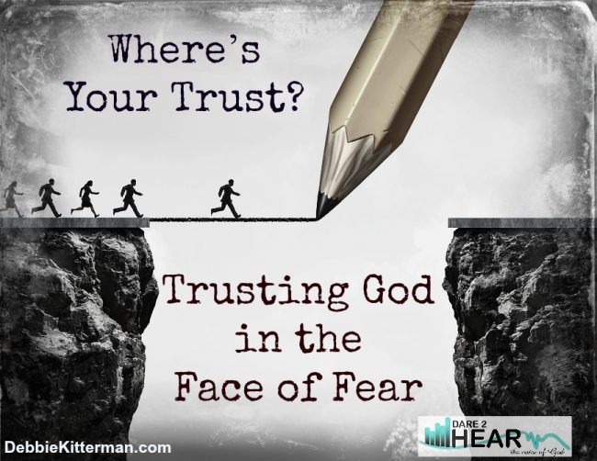
Jerusalem
Self-reliance
Isa 22:8b-11 – “In that day you depended on the weapons of the house of the forest, ⁹and you saw that the breaches in the wall of the city of David were many; and you collected the waters of the lower pool. ¹⁰Then you counted the houses of Jerusalem and tore down houses to fortify the wall. ¹¹And you made a reservoir between the two walls for the waters of the old pool. But you did not depend on Him who made it, nor did you take into consideration Him who planned it long ago.”
Reliance
Weapons (vs. 8)
Walls (vs. 9a,10)
Water (vs. 9b,11a)
Notes:
Now, vs. 8 – 11 is going to paint a picture of Jerusalem’s self-reliance, and there 3 things they depended on.
Isa 22:8b – First, they relied on a material means of defense, the armory built by Solomon. We read about this armory in 1 Kings 7, where it was called the “house of Lebanon’, and in 1 Kings 10:17 we read that he stored weapons there.
Isa 22:9a,10 – They also relied on their walls. Now, according to this verse, the walls were in disarray. So, what did they do to fortify them? They took an inventory of the houses in the city, likely to determine which were expendable enough to provide building materials to repair breaches in walls, and Jeremiah also alludes to this taking place when Babylon was the threat (Jer 33:4)
Isa 22:9b,11a – The waters of the lower pool came from the underground conduit supplied from the Gihon Spring. Hezekiah would conceal this outside the city and divert its water to the Pool of Siloam. More on that in the next slide. Vs. 11 tells us they also built a reservoirs, water storage tanks, in the city for easier access to water.
And while they were putting their confidence in weapons, water, and walls, who were they not putting their confidence in? – Isa 22:11b – This statement is the theological key to the context of this oracle against Jerusalem. They trusted in the material, but not in God. And why bother w/faith when you have weapons, walls, and water? Because God made it all. He also knows its vulnerability and determined their destruction should they turn from Him. Looking to defenses is not wrong in and of itself, only when it is a higher priority than looking to God.

Slide 5
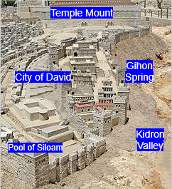
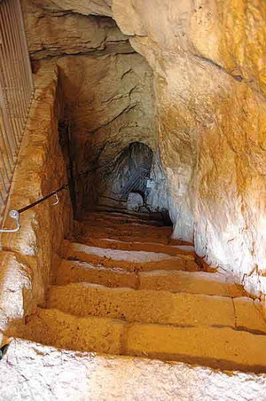
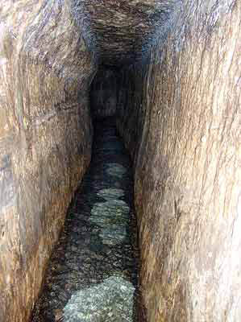
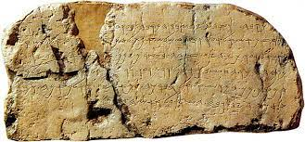
Hezekiah’s Tunnel
2 Chron 32:1-4 – “¹After these acts of faithfulness Sennacherib king of Assyria came and invaded Judah and besieged the fortified cities, and thought to break into them for himself. ²Now when Hezekiah saw that Sennacherib had come and that he intended to make war on Jerusalem, ³he decided with his officers and his warriors to cut off the supply of water from the springs which were outside the city, and they helped him. ⁴So many people assembled and stopped up all the springs and the stream which flowed through the region, saying, ‘Why should the kings of Assyria come and find abundant water?’”
Notes:
Now, when Isa 22:9 talks about how they collected the waters of the lower pool, what’s being referred to is what Hezekiah did in 2 Chron 32:1-4 – The Gihon Spring was just outside the southeastern part of Jerusalem in the Kidron Valley, and it was one of the main water sources for those who lived both inside and outside of the city. In fact, there was so much traffic by this spring, when David sent Nathan and others to take Solomon on his mule to Gihon to be anointed king, presumably because there were always people there collecting water. But when Sennacherib began invading Judah, Hezekiah came up w/a way to deny the Assyrians water while also providing water to the people shut in the city.
Hezekiah created a pool in the southern part of Jerusalem called the “Pool of Siloam”, and a set of engineers started digging underground from that pool while another set of engineers started from the Gihon Spring, and they met in the middle. How did they pool this off w/o the technology we have today? We have no idea, and there is actually a section in the tunnel where you could tell they started going the wrong direction for a bit and had to cut back. The tunnel is about 1/3 mile long. Once they completed it, they permanently closed off the Gihon Spring outside, and began collecting the water in the city at the Pool of Siloam.
These bottom 2 pictures show what it looks like today. The first picture is the entrance to the tunnel at the Gihon Spring, and the second is inside which you can still walk through today if you’re not claustrophobic.
The picture in the bottom right is called the Siloam inscription. It was cut out of the side of the wall in the tunnel and taken to the Istanbul Archeological Museum. Some of the ancient Hebrew is undecipherable, but it read ins part, "…and the waters began flowing from the source toward the reservoir for 1200 cubits….“. This is the context behind vs. 9 and 11.

Slide 6
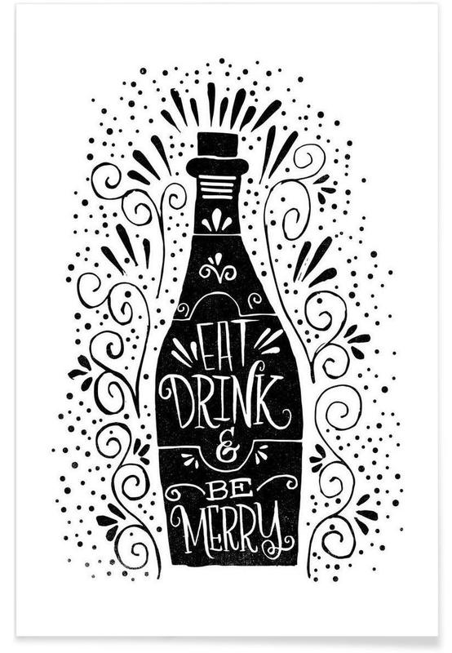
Jerusalem
God’s judgment
Isa 22:12-14 – “¹²Therefore in that day the Lord God of hosts called you to weeping, to wailing, to shaving the head and to wearing sackcloth. ¹³Instead, there is gaiety and gladness, killing of cattle and slaughtering of sheep, eating of meat and drinking of wine: ‘Let us eat and drink, for tomorrow we may die.’ ¹⁴But the Lord of hosts revealed Himself to me, ‘Surely this iniquity shall not be forgiven you until you die,’ says the Lord God of hosts.”
Notes:
So, w/an impending siege, the Lord was looking for one thing in the people, but got another:
Isa 22:12-13 – They should have turned their heart to humble repenting before God, expressed through the typical mourning rites mentioned. And the fact that God “called” them to this suggests they were privileged to have been divinely called to repentance at a specific time. But what happened instead was careless, carefree rejoicing, unconcerned w/the nation’s grim condition. This is likely why Isaiah found their joy from vs. 2 so offensive. They were contradicting God’s will and trusting in human endeavors. Here’s the irony – even Assyria mourned its own fate at the preaching of Jonah (Jon 3:6-9). But Jerusalem preferred to resign themselves to their fate and make the most out of life while they still had life. So resigned to their fate, they didn’t even ration their animals as would be typical in a siege. Rather, they were consumed w/seeking immediate gratification as opposed to waiting on the Lord in faith and hope. When the material things in which they trusted collapsed, it just gave rise to revelry and dissipation.
And it’s for this reason God takes the stance in Isa 22:14 – Isaiah is explicitly told by God that they had crossed a point of no return, and that this was an unforgivable sin. Why unforgivable? Because they’re willing to ignore God even unto death, fulfilling 6:9-10. They could not bring themselves to the kind of humility Isaiah himself expressed in chapter 6, so Isaiah mourns.

Slide 7
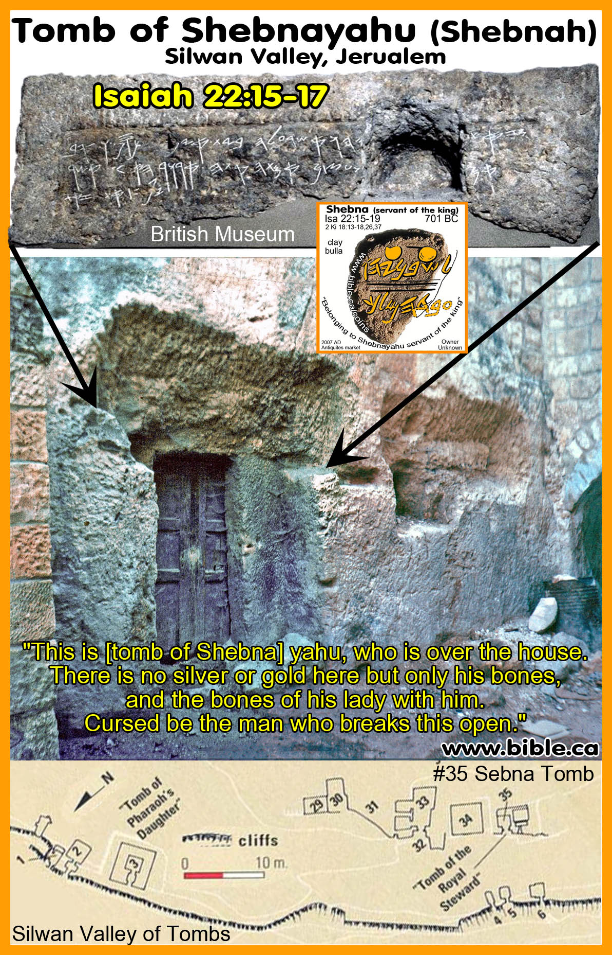
Jerusalem
Shebna
Isa 22:15-19 – “¹⁵Thus says the Lord God of hosts, ‘Come, go to this steward, to Shebna, who is in charge of the royal household, ¹⁶‘What right do you have here, and whom do you have here, that you have hewn a tomb for yourself here, you who hew a tomb on the height, you who carve a resting place for yourself in the rock? ¹⁷‘Behold, the Lord is about to hurl you headlong, O man. And He is about to grasp you firmly ¹⁸and roll you tightly like a ball, to be cast into a vast country; there you will die and there your splendid chariots will be, you shame of your master’s house.’ ¹⁹I will depose you from your office, and I will pull you down from your station.”
“This is [the tomb of Shebna] -yahu who is over the house. There is no silver and gold here but [his bones] and the bones of his slave-wife with him. Cursed be the man who will open this.”
Notes:
The remainder of chapter 22 deals w/two separate characters on Hezekiah’s kingly staff: Shebna and Eliakim the son of Hilkiah. These two individuals represent individual case studies on what pleases and displeases God.
Isa 22:15 – Shebna is identified as Hezekiah’s steward, which means he would have been in charge of the royal household. Interestingly, his father is not named as Eliakim’s is, which is a typical thing amongst the Jews. This has led some to conclude that he was a foreigner who, by virtue of this, would not have held the theocracy in as high a view as someone else would. And God so disdains his character that He refers to Shebna as “this” steward. What’s the issue?
Isa 22:16 – In other words, “Who do you think you are?” Here is Jerusalem facing potential ruin, and Shebna, being in a high government position, is supposed to be trying to fix the problem, but what is he doing? He’s an example of what we just saw in vs. 13, a person resigned to his fate. He is making sure that when he dies, he has a nice luxurious place to be laid to rest in among the heights, which is typically where kings were laid to rest, so that his name would be preserved. This is the epitome of self-centeredness. Shebna is a personification of the nation at that time is prioritizing everything he shouldn’t be. In God’s response to this is, “Who do you think you are?”
And so, God renders a judgement on him – Isa 22:17-19 – And so he’s going to be removed from his office, which we’re going to see in 36:2 and 37:2 did in fact happen. But his ultimate fate would be that rather than being laid to rest w/honor in Jerusalem, he would die in a distant land lacking the very dignity and honor that he sought. Isaiah said in vs. 3 that their leaders would be captured fleeing, but Shebna believed he would die right there in Jerusalem. “Man proposes, God disposes”. The royal house should have never been put in the charge of such a man as this. But he personifies the self-serving attitude of Jerusalem that we read in vs. 13.
An inscription was discovered in the 1870 at the entrance of an old tomb on a cliff in the Kidron Valley where persons of rank and high distinction were typically buried. The inscription reads – “This is [the tomb of Shebna] -yahu who is over the house. There is no silver and gold here but [his bones] and the bones of his slave-wife with him. Cursed be the man who will open this.” Archeologists now believe this was referring to Shebna. So, was he actually laid to rest there? According to God, he would not be. But at the very least, he had finished construction.

Slide 8
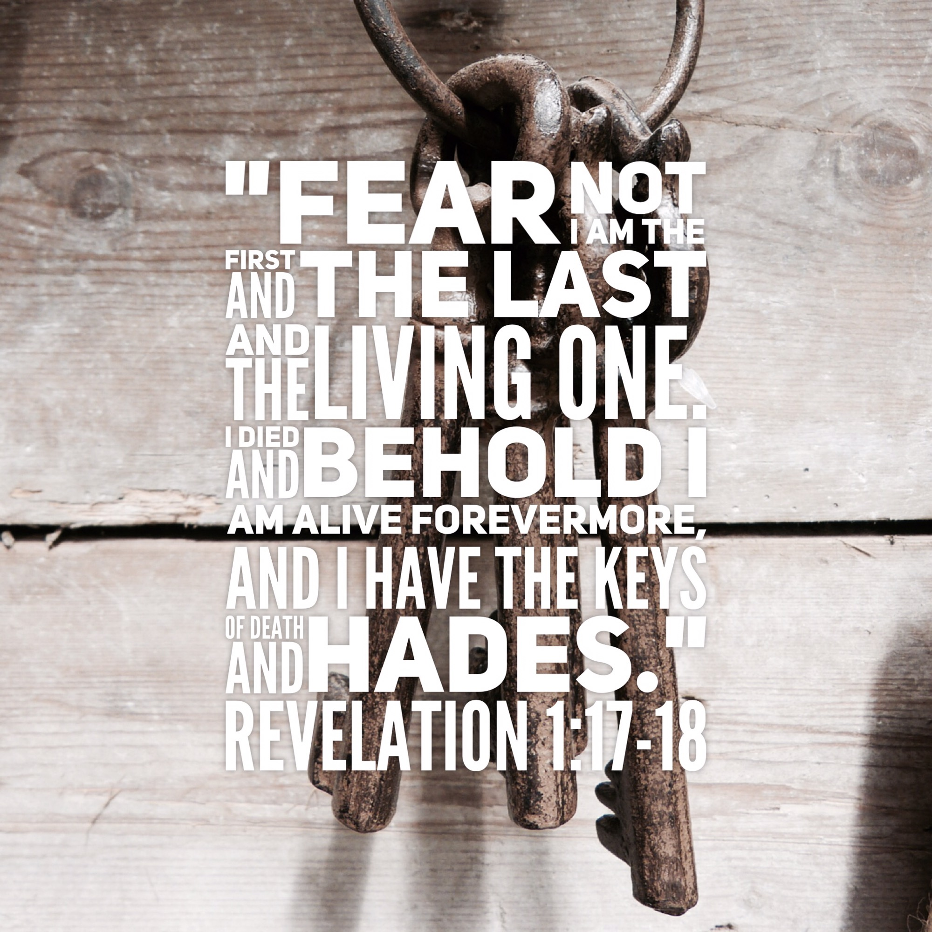
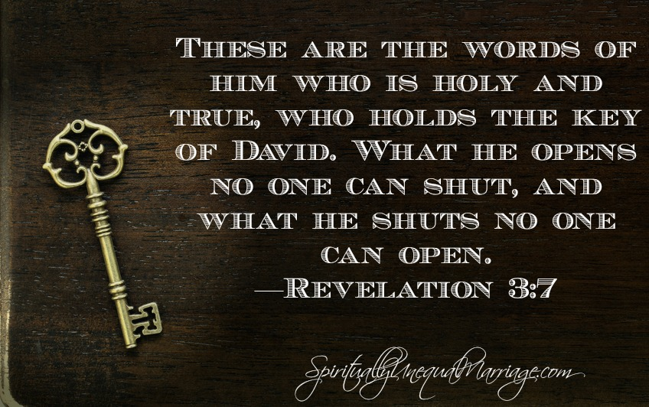
Jerusalem
Eliakim
Isa 22:20-22 – “²⁰Then it will come about in that day, that I will summon My servant Eliakim the son of Hilkiah, ²¹and I will clothe him with your tunic and tie your sash securely about him. I will entrust him with your authority, and he will become a father to the inhabitants of Jerusalem and to the house of Judah. ²²Then I will set the key of the house of David on his shoulder, when he opens no one will shut, when he shuts no one will open.”
Notes:
On the contrary, we’re given the portrait of a man who does garner God’s respect – Eliakim.
Isa 22:20-21 – So while Shebna was serving his own interests, Eliakim was serving God’s interests. When God refers to someone as “My servant”, He’s attributing a high honor to that man. That he is referred to as “son of Hilkiah” suggests that in every respect he may legitimately serve, as opposed to Shebna whose father we do not know. So, the office of authority would go from Shebna to Eliakim. This language points out what a proper steward should be, He will wear badges of honor to carry out the proper functions of a steward, as Joseph once did (Gen 41:41-44; 45:8). He will genuinely care for the people rather than serving simply for the perks. Prophets laid blame time and again on bad leaders who did not have the people’s interests at heart. But Eliakim will serve the people fully.
Isa 22:22 – This denotes authority to make conclusive decisions and either grant or forbid access to the king, exclusively. Why would a man be given this authority? Wouldn’t it be a threat to the king? Not if the king had unwavering trust in him. Now, if Shebna is a personification, a “type” of a self-centered person, who would Eliakim be a type and personification of?
Ultimately Jesus. In fact, because the Father has unwavering trust in Jesus, He can likewise give Him these key – Rev 1:18; 3:7. And Jesus Himself delegates this authority as it pleases Him – Matt 16:19.

Slide 9
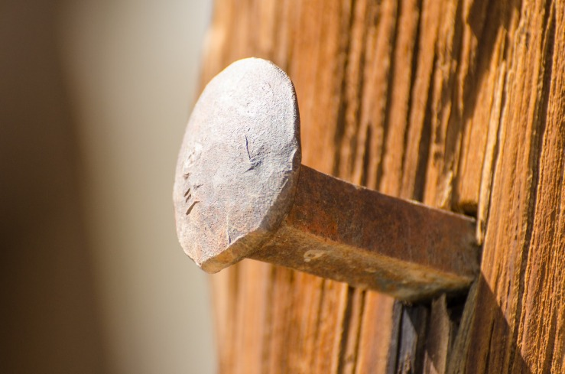
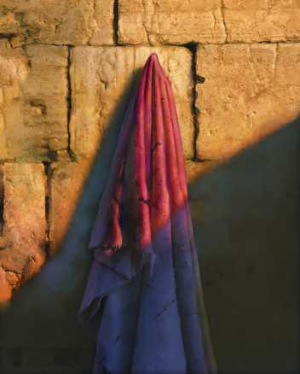
Jerusalem
Eliakim
Isa 22:23-24 – “²³I will drive him like a peg in a firm place, and he will become a throne of glory to his father’s house. ²⁴So they will hang on him all the glory of his father’s house, offspring and issue, all the least of vessels, from bowls to all the jars.”
Notes:
Isa 22:23-24 – In ancient Israel, pegs were driven in walls to secure and hold items. If something is on its peg, it is safe and secure. And so, because the Lord established Eliakim’s authority, it is secure. It cannot be easily removed. By Eliakim himself becoming the throne for others to sit on, he became a means through which others could be honored, find support, and be lifted up. All souls will depend on him from the least to the greatest. The safety in these items is not in their size or quality, but in how securely they are attached to the peg. “Issue” = “offshoot”, something that is an outcast thing. But by making use of him, all who attach themselves will be lifted up.
Back in chapter 9, we studied about how out of their frustration over bad leaders came a longing for the Messiah. In fact, 22:20-22 contains many similarities to 9:6-7 – “the government will rest on his shoulders”…”Eternal Father”…”On the throne of David and over His kingdom”. Eliakim is a glimmer of that kind of rule that would eventually come, and he likely represents a type of Jesus due to the similar language in Revelation and Isaiah 9.

Slide 10
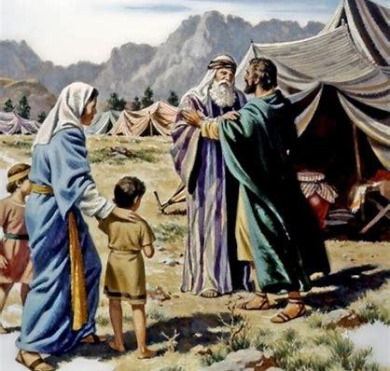
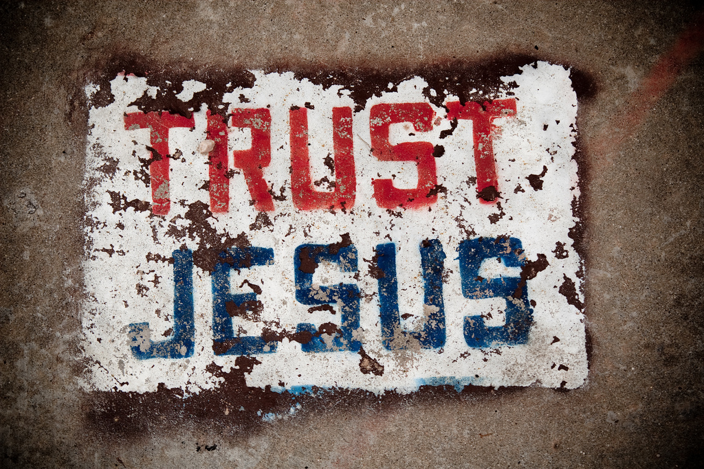
Jerusalem
Eliakim
Isa 22:25 – “²⁵‘In that day,’ declares the Lord of hosts, ‘the peg driven in a firm place will give way; it will even break off and fall, and the load hanging on it will be cut off, for the Lord has spoken.’”
Notes:
But there’s an issue – Isa 22:25 – The main issue is the internal weakness of the peg. When you find a good man, the tendency is to put everything on him, but you can’t do that too much to a man or you’ll ruin him. While Eliakim is trustworthy, he is still a man, w/all the weaknesses and frailties that exemplify men. And so, when he falls, he brings everyone else down with him.
In Ex 18, Jethro told Moses he was putting too much on himself and that he needed to delegate the judging to worthy men, which he did, but then in Num 20, Moses had enough of the people and it led him to sinning. The idea in this text is that they’re putting everything on Eliakim and it’s just too much. No matter how righteous the man, he is still a man. And the best of men fail. So, if we put our whole trust in man, when they fall, we’ll fall too.
So, then who can trust? Our only hope is in Jesus Christ, hence, the need for the seed. This is foreshadowing to a major theme in Isaiah that we’re going to see when we get to chapter 39.

