Slide 1
Notes:
Before we begin chapter 20, it’s important that we understand the primary purpose behind the first set of oracles in chapters 13 – 19, which as the heading shows, we’re labeling as the “certainty of trust”. With every oracle in this first section, we are being shown the certainty that God will take care of His people. So, for example, Babylon was a stumbling block to people coming to God, so they will be removed. To Philistia, God’s promise of a future Davidic king will be kept. To Moab, He assures them shelter in Zion is secure should they overcome their pride. To Israel, he tells them their reliance on human works will have to be removed so that they’ll learn to trust in God. To Ethiopia, he reminds them Zion doesn’t need their help, they need Zion’s help. And to Egypt, the Lord will use judgment against them to unite all 3 world powers together in Him: Egypt, Assyria, and Judah. Every oracle’s purpose is to show the certainty that God will be w/Zion, and that not only shouldn’t Zion seek help from them, one day they would seek help from Zion.
But in chapters 21 – 23, the scene is going to get darker, which we’ll explain in just a bit. But before that, chapter 20 is going to serve as the Segway. In order to conclude the purpose of showing the certainty of trusting in God, God is going to have Isaiah perform a sign to provide this certainty.

Slide 2
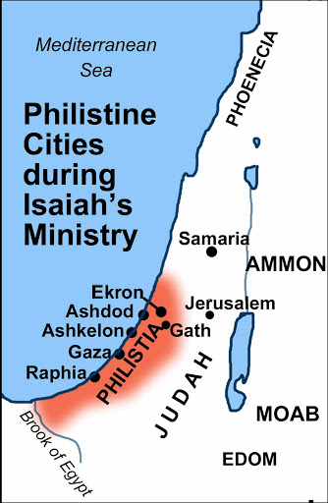
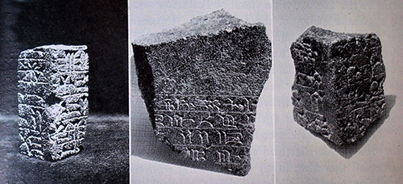
Isaiah’s Sign
The Ashdod Rebellion
Isa 20:1 – “¹In the year that the commander came to Ashdod, when Sargon the king of Assyria sent him and he fought against Ashdod and captured it.”
Notes:
The first verse provides us historical context behind the sign that will help us to understand it’s purpose – Isa 20:1 – The event being referred to here is historically known as the Ashdod Rebellion, Ashdod being one of the five main Philistine cities. Here’s the background.
When Shalmaneser V of Assyria died, Sargon II became king and he made the Philistine city of Ashdod a vassal nation, setting up his brother as king over it. However, when an Assyrian king died and a new one rose to power, vassal nations would typically use this transfer of power as an opportunity to revolt. Of all the nations under Assyria’s rule, the most prominent nation to revolt was Babylon w/its king Merodach-Baladin, which we’ll discuss more in chapter 21, and this occupied a lot of Sargon II’s time. And it was while Sargon II was dealing w/Babylon’s rebellion that Ashdod overthrew his brother and appointed one of its commanders in his place, a man named Yamani. Now, what gave Ashdod the courage and resolve to do this? Remember chapter 18; when Egypt’s new Ethiopian ruler Piankhi was sending envoys all throughout Palestine promising aid against Assyria should any choose to rebel, Ashdod took them up on it, forming a coalition w/Edom, Moab, and possibly even Judah, and this was probably also the context behind the Philistine oracle in chapter 14. Well, when Sargon II finished taking care of business in Babylon, he came back to Ashdod in 711BC and reconquered it. He deported Ashdod’s royal family, its gods, its people, and all its gold and silver to Assyria, and Ashdod was once again made an Assyrian province. And the most important thing you need to remember about the history is this: Egypt, true to form, reneged on its promise to provide assistance. And when Ashdod’s king Yamani fled to Egypt, in order to keep Assyria out of there, Egypt handed him right back over to the Assyrians.
The picture on the right is a stele that was discovered in Tel Ashdod in 1963, written in ancient cuneiform signs, and commemorates Sargon’s victories, including his conquest at Ashdod, confirming the biblical record. What does this event have to do w/Isa 20?

Slide 3
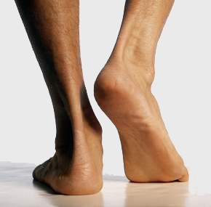
Isaiah’s Sign
Naked & Barefoot
Isa 20:2-6 – “²at that time the Lord spoke through Isaiah the son of Amoz, saying, ‘Go and loosen the sackcloth from your hips and take your shoes off your feet.’ And he did so, going naked and barefoot. ³And the Lord said, ‘Even as My servant Isaiah has gone naked and barefoot three years as a sign and token against Egypt and Cush, ⁴so the king of Assyria will lead away the captives of Egypt and the exiles of Cush, young and old, naked and barefoot with buttocks uncovered, to the shame of Egypt. ⁵Then they will be dismayed and ashamed because of Cush their hope and Egypt their boast. ⁶So the inhabitants of this coastland will say in that day, “Behold, such is our hope, where we fled for help to be delivered from the king of Assyria; and we, how shall we escape?”’”
Notes:
Isa 20:2 – Notice the phrase “at that time” – the events of the Ashdod rebellion is the purpose behind God giving Isaiah this sign. Signs were often performed by prophets to awaken peoples’ minds to more serious consideration to the message. We’re used to seeing Ezekiel doing these kinds of things, but this is the only symbolic act recorded in Isaiah. And notice from vs. 2 that he is blindly obeying, not having been told first why he is to go about naked and barefoot. Now, there’s a question over whether Isaiah was completely naked or partially naked. There is no way to be sure either way. The most important thing to glean form this is that he was to be an object of attention and demoralization, and whether completely or partially naked, he would’ve been doing something out of the ordinary, capturing the attention of Judah in the process.
What was the point of this? – Isa 20:3-4 – This tells us the entire purpose behind the sign. While Ashdod was the one who rebelled against Assyria, who was the fomenter behind it all? Egypt. And so, God is concerning Himself w/the cause of Ashdod’s defeat rather than the symptom. As mentioned before, this is likely to set up the primary message of chapters 28 – 35 that we’ll soon get into, which is “don’t trust Egypt; trust God.” Now, how was this eventually fulfilled? While there were many intermittent wars between Egypt and Assyria, the decisive blow occurred in 663BC when Assyria’s king Ashurbanipal sacked Thebes and leveled most of Egypt, taking many Egyptians into captivity. And how did Assyria typically lead people away into captivity? Not just with fishhooks, but naked, barefoot, buttocks uncovered, completely shaven, in utter and complete shame, and they showed no discrimination between young and old. Isaiah is being commanded by God to about in this manner for 3 years as a sign against what will happen to Egypt and Cush (Ethiopia).
And who besides Egypt needs to heed this message? – Isa 20:5-6 – In other words, this was for those in the levant region to see how utterly foolish it is to look to heathen nations like Egypt for help. And notice in vs. 6 that to show the futility of it, Isaiah employs the peoples’ own words. When Egypt is taken into captivity, they’ll realize Egypt had only been on borrowed time. Egypt was not a nation worthy of placing one’s hope in. So why look to Egypt’s fading beauty when they could look to God? Trusting in flesh to protect us leads to nothing but disillusionment, and God needed His people to understand that.

Slide 4
Notes:
Now, while chapter 20 provides somewhat immediate ground for the certainty of trusting in God through a physical sign, it does also end on a note of uncertainty. It seems as if Judah had assumed that God might deliver them from Assyria by allowing another nation to defeat them, because this was a typical action of God. But as the assurance of judgment against these potential allies grows, especially the most powerful nation of that region, Egypt, the number of nations Judah can turn to for help against Assyria are growing slim.
And so, while chapters 13 – 19 are to teach the certainty of trusting in God, the 2nd set of oracles is to teach trust in times of uncertainty. And what Isaiah does is project the themes of chapter 13 – 19 to the future. While all the oracles of the prior chapters were given to specific nations, 4 of the 5 oracles in chapters 21 – 23 are given enigmatic titles, though we are able to determine who is being addressed. Add to this the fact that most of these oracles are the obscurest of all the oracles in this section, and we’re going to be doing some guess work regarding the context. But the overall point of this next section is this: in the midst of a coming darkness in which the result can’t be determined, will I still trust in God even then?

Slide 5
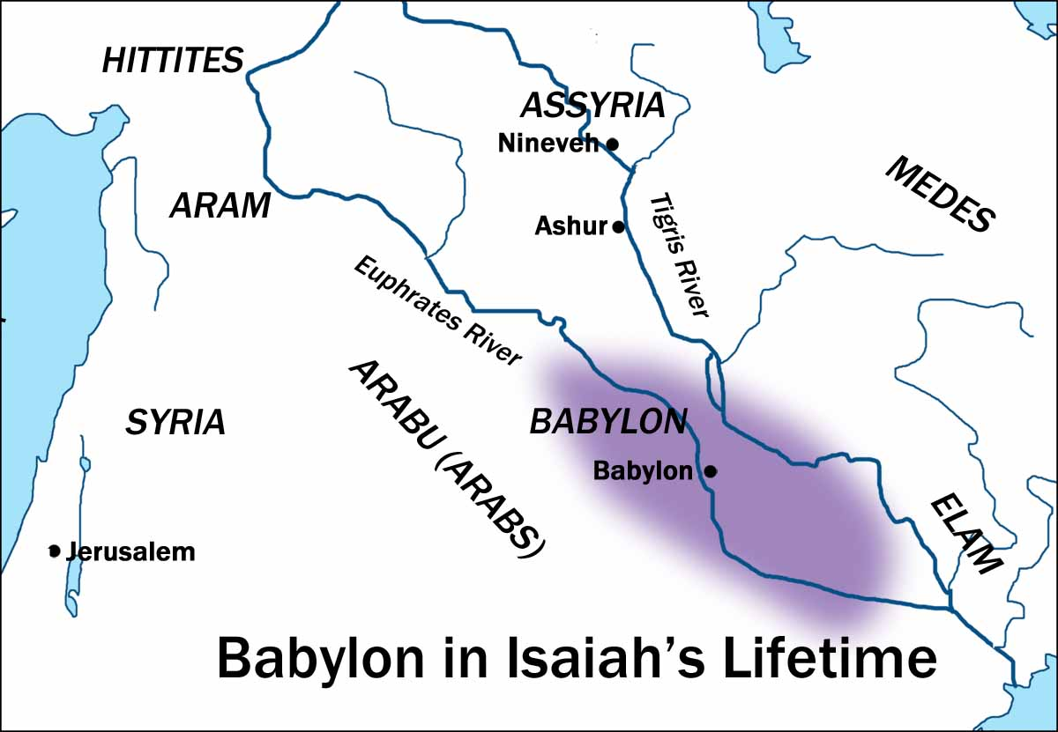
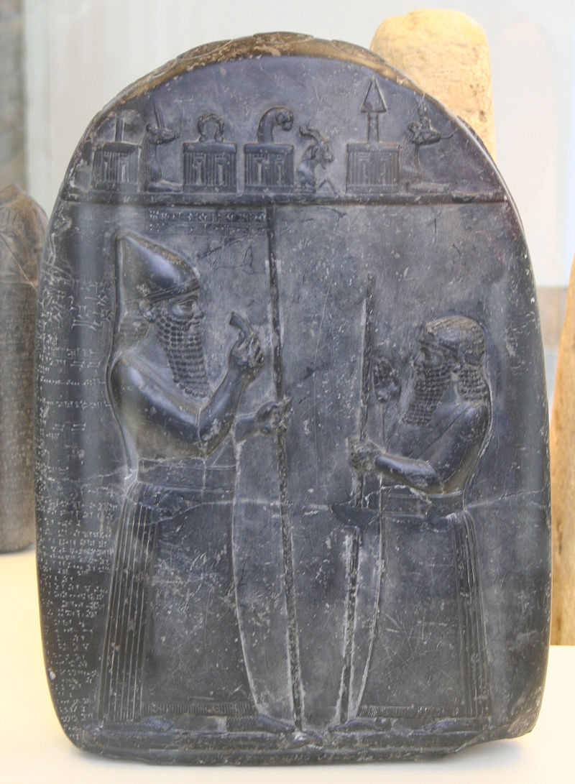
Babylon Background
Timeline
732BC – Tiglath Pileser III conquers Syria
729BC – Tiglath Pileser III conquers Babylon
722BC – Shalmaneser V conquers Samaria
722BC – Merodach-baladan retakes Babylon
715BC – Sargon II invades Moab
711BC – Sargon II conquers Ashdod
710BC – Sargon II conquers Babylon
703BC - Merodach-baladan retakes Babylon
702BC – Sennacherib conquers Babylon
701BC – Sennacherib besieges Jerusalem
Notes:
Now, we’ve spent a lot of time on what has been happening in the south w/Egypt, and how that affected God’s people. But what about in the northeast w/Babylon? They are once again the subject in chapter 21, and it is the obscurest of all the oracles. There are so many speakers in this chapter, it’s hard to know who is saying what to who. When you first read it, it “seems” as if it is referring to the fall of Babylon at the hands of the Medo-Persian empire in 539BC, which we alluded to in that first oracle about Babylon in chapter 13 and 14. Some take that interpretation because of the allusion to the Medes in vs. 2 and because vs. 5 reminds us of the drunken feast of Belshazzar in Dan 5. But I’m going to propose that the evidence is stronger that this a Babylonian fall that occurs in Isaiah’s time.
Background. As previously discussed, Tiglath Pileser III conquered Syria in 732BC and at the same time took out the northern part of the northern kingdom of Israel. He then goes to Mesopotamia and conquers Babylon in 729BC. It was shortly after this that Israel’s king Hoshea started playing footsy w/Egypt and stopped paying tribute. When Tiglath Pileser finds out, he returns to Israel and begins a 3-year siege of Samaria, but he dies before conquering it, and his son becomes the new king, Shalmaneser V, who finishes taking out Samaria in 722BC.
As mentioned, whenever an Assyrian king died, former vassal nations used that as an opportunity to revolt. The one that did so most often, and who was the biggest thorn in Assyria’s side, was Babylon. After Shalmaneser V became king, and he was finishing up his sieging at Samaria, a man named Merodach-baladan regained the throne at Babylon in 722BC, and he was somehow able to keep Babylon out of the hands of Assyria for 12 years.
How was he able to hold Babylon for so long? Because Assyria still had to deal w/the rest of the anti-Assyrian coalition in the Levant region and its Egyptian sponsors. But Shalmaneser V’s reign wasn’t long, and when Sargon II took over, he invaded Moab in 715BC, conquered Ashdod in 711BC, and then went back to Mesopotamia and conquered Babylon again, forcing Merodach-baladan to flee to Elam.
But then when Sargon II died, Merodach-baladan came back to Babylon and took it back out of Assyrian hands again in 703BC only to then lose it again 9 months later to Assyria’s new king Sennacherib, who then declared himself king of Babylon. Sennacherib eventually had enough of Babylonian revolt and officially sacked them in 696BC after a 9-month siege. Then 20 years later in 676BC, Esarhaddon rebuilt Babylon.
Now, what is all of this rebellion leading up to? It’s leading up to that climactic moment in 701BC when Sennacherib comes back to Judah to finish the job.
This picture is a relief in which Merodach-baladan brags about having taken Babylon from Assyria. But it was excavated in Assyria. Why would we find in the midst of Assyrian ruins a relief chronicling the defeat of Assyria? Assyria was known for only chronicling its victories, not its defeats – they were such braggarts. Well, when Sargon II took Babylon back in 710BC, he probably took this relief back with him as a way of saying, “See what they said? And now see what I just did?” Babylon was a huge thorn in Assyria’s side, but ultimately couldn’t stop Assyria during Isaiah’s days, and I believe that this is the background of the prophecy in chapter 21.

Slide 6
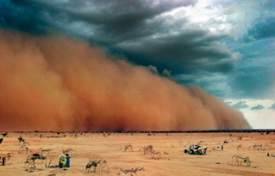
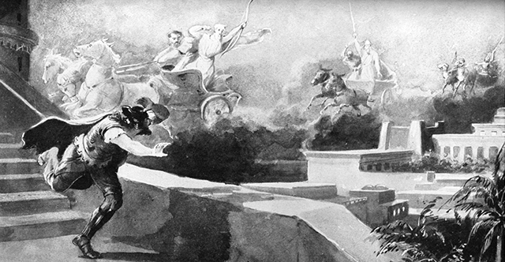
Babylon
Isaiah’s reaction to Babylon’s fate
Isa 21:1-5 – “¹The oracle concerning the wilderness of the sea. As windstorms in the Negev sweep on, it comes from the wilderness, from a terrifying land. ²A harsh vision has been shown to me; the treacherous one still deals treacherously, and the destroyer still destroys. Go up, Elam, lay siege, Media; I have made an end of all the groaning she has caused. ³For this reason my loins are full of anguish; pains have seized me like the pains of a woman in labor. I am so bewildered I cannot hear, so terrified I cannot see. ⁴My mind reels, horror overwhelms me; the twilight I longed for has been turned for me into trembling. ⁵They set the table, they spread out the cloth, they eat, they drink; ‘Rise up, captains, oil the shields,’”
Notes:
Isa 21:1a – This is an enigmatic title, but we know it is referring to Babylon because of vs. 9. So why is it referred to as the “wilderness of the sea?” “Wilderness” and “sea” are different categories. Merodach-baladan’s country was referred to in Assyrian annals as the “sea land”, so this could be a play on the fact that the land of the sea would become the wilderness of the sea. Or it could be because Babylon was indeed once a desert, but it was recovered by an intricate system of irrigation using the water from the Euphrates which allowed the land to be divided up into a large collection of lakes and marshes, overflowing the whole land like a “sea”. Jeremiah also referred to them as such. So by Isaiah referring to it as the “wilderness of the sea”, it may be that he’s prophesying Babylon’s return to uninhabited, desert status (14:23).
Either way, this oracle came w/fierceness – Isa 21:1b-2a – Windstorms of the Negev were known for coming w/great force, and when they came, they came w/little warning, and they were harsh. And that is how Isaiah describes this oracle, which is shocking considering the first oracle against Babylon in chapters 13 – 14 in which God’s people would applaud. Why is this oracle about Babylon’s defeat so harsh to Isaiah?
Isa 21:2b – Who is the destroyer and the treacherous one? This is a title given to both Assyria and Babylon in Isaiah, but I will suggest it most likely refers here to Assyria, as Isaiah is seeing that despite Babylon’s successful revolts, Assyria continues doing what it does best. At first glance, it seems as if Elam and Media are being called to attack Babylon. This would fit the fall of Babylon in 539BC, but not the time of Isaiah as the history is very clear that Babylon was united w/the Elamites and Medes and Elam was the home to Merodach-baladan when he was in exile. And one of the reasons why Babylon was able to defeat Sargon II the first time was because the Elamites joined Babylon in battle against them. And so some suggest this could be a war cry by Merodach-baladan to his Elamite country men for they and the Medes to rally the troops and get ready to take out Assyria, to end all the groaning/sighing Assyria has caused.
But it seems as if Isaiah has already been told that Babylon would not be he one to end the present Assyrian threat, and notice the effect it had on him – Isa 21:3-4 – Why would this be such a disappointment to Isaiah? Because when Merodach-baladan successfully revolted against Assyria, he’s the first one to do so and to hold out for so long. And after being assured that Egypt would not save them, Babylon was looked at by many as Judah’s last earthly hope to intervene against Assyria. But now he’s being told, “Nope, Babylon’s success is short-term, they’re going down too”, and so it’s as if he’s beside himself. Twilight would normally be a time when one could finally rest, but this new revelation has turned his twilight into trembling. Babylon’s rebellions kept Assyria in balance and occupied in Mesopotamia and therefore far away from Judah. But Babylon’s defeat meant a stronger more expansive Assyria. That Babylon will not end the current Assyrian threat leads to added uncertainty that leads to personal fear, anxiety, and dread on Isaiah’s part, as he realizes Judah would have to face the full terror of Assyrian assault.
In contrast to Isaiah’s agitation is the carefree attitude of Babylon – Isa 21:5 –They are making preparations for a lavish banquet, but not for war. Then the tone changes – the call is made for those partaking to prepare for battle against Assyria. Shields are oiled so arrows slide off of it instead of piercing it.

Slide 7
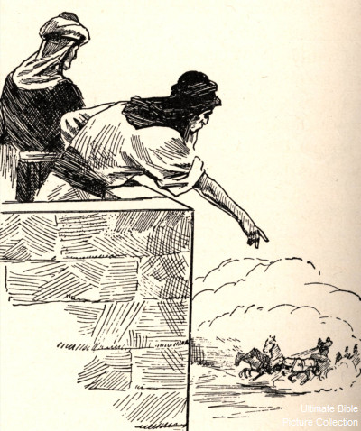
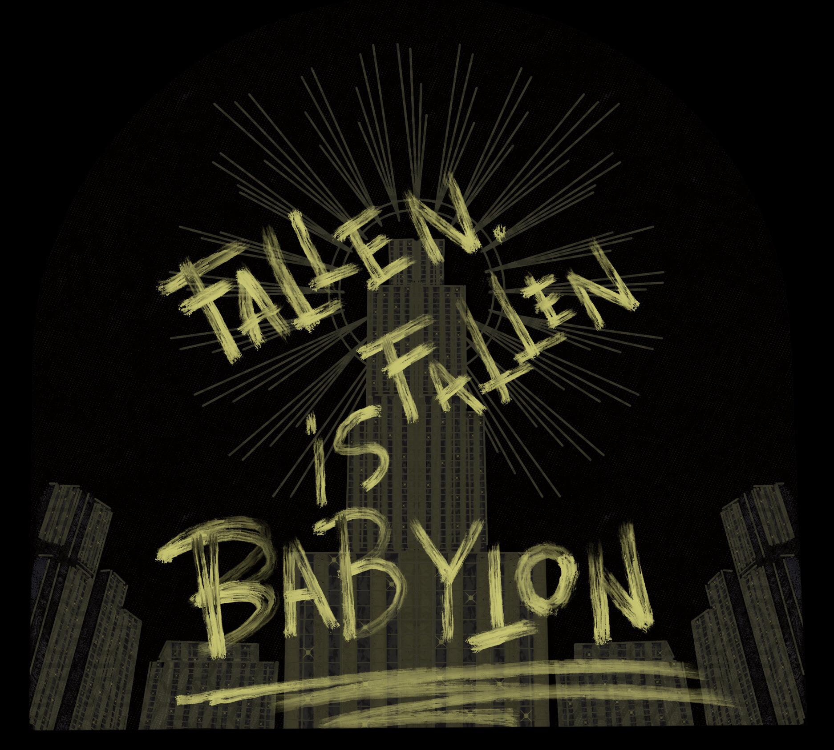
Babylon
Watchman’s report, Isaiah’s remorse
Isa 21:6-10 – “⁶For thus the Lord says to me, ‘Go, station the lookout, let him report what he sees. When he sees rider, horsemen in pairs, a train of donkeys, a train of camels, let him pay close attention, very close attention.’ ⁸Then the lookout called, ‘O Lord, I stand continually by day on the watchtower, and I am stationed every night at my guard post. ⁹Now behold, here comes a troop of riders, horsemen in pairs.’ And one said, ‘Fallen, fallen is Babylon; and all the images of her gods are shattered on the ground.’ ¹⁰O my threshed people, and my afflicted of the threshing floor! What I have heard from the Lord of hosts, the God of Israel, I make known to you.”
Notes:
But how will this all turn out? – Isa 21:6-9 – So Isaiah is told to post a watchman, who is to look for very specific signs, a specific formation of animals, that will tell them whether Babylon has fallen. And in vs. 8, he’s so far seen nothing. But he is vigilant and persevering in doing so, with perhaps a smudge of impatience. This is likely to heighten the suspense between vs. 7 and 9. Then suddenly, the sign to watch out for in vs. 7 comes into view. The watchman’s patience and perseverance has paid off. Another reason why I don’t think this is referring to the fall in 539BC is because Cyrus didn’t destroy idols. He wasn’t an iconoclast. He restored all the idols to the nations. But in this fall of Babylon, the idols are shattered.
And now Isaiah appears to be relaying what to him is unfortunate news for the people of Judah – Isa 21:10 – This is a lamentation over the seemingly dire fate that Babylon’s fall to Assyria meant for Judah, at least from an earthly standpoint. Judah’s temporary reprieve is over – Assyria would be coming. In fact, 2 Kings 18 tells us that at some point in the first 14 years of Hezekiah’s reign, he stopped paying tribute to Assyria, which was a bold move, but not a surprising one given Babylon’s short-term success against Assyria. But now w/Assyria’s victory at Babylon, it all but assures that Assyria’s “threshing” of God’s people will continue. As we saw in chapter 8, it will only be after Judah is threshed and winnowed that God will bring about victory over Judah’s enemies. And this revelation that Babylon was not going to be able to restrain Assyria forms the backdrop of chapter 22 for next week.

Slide 8
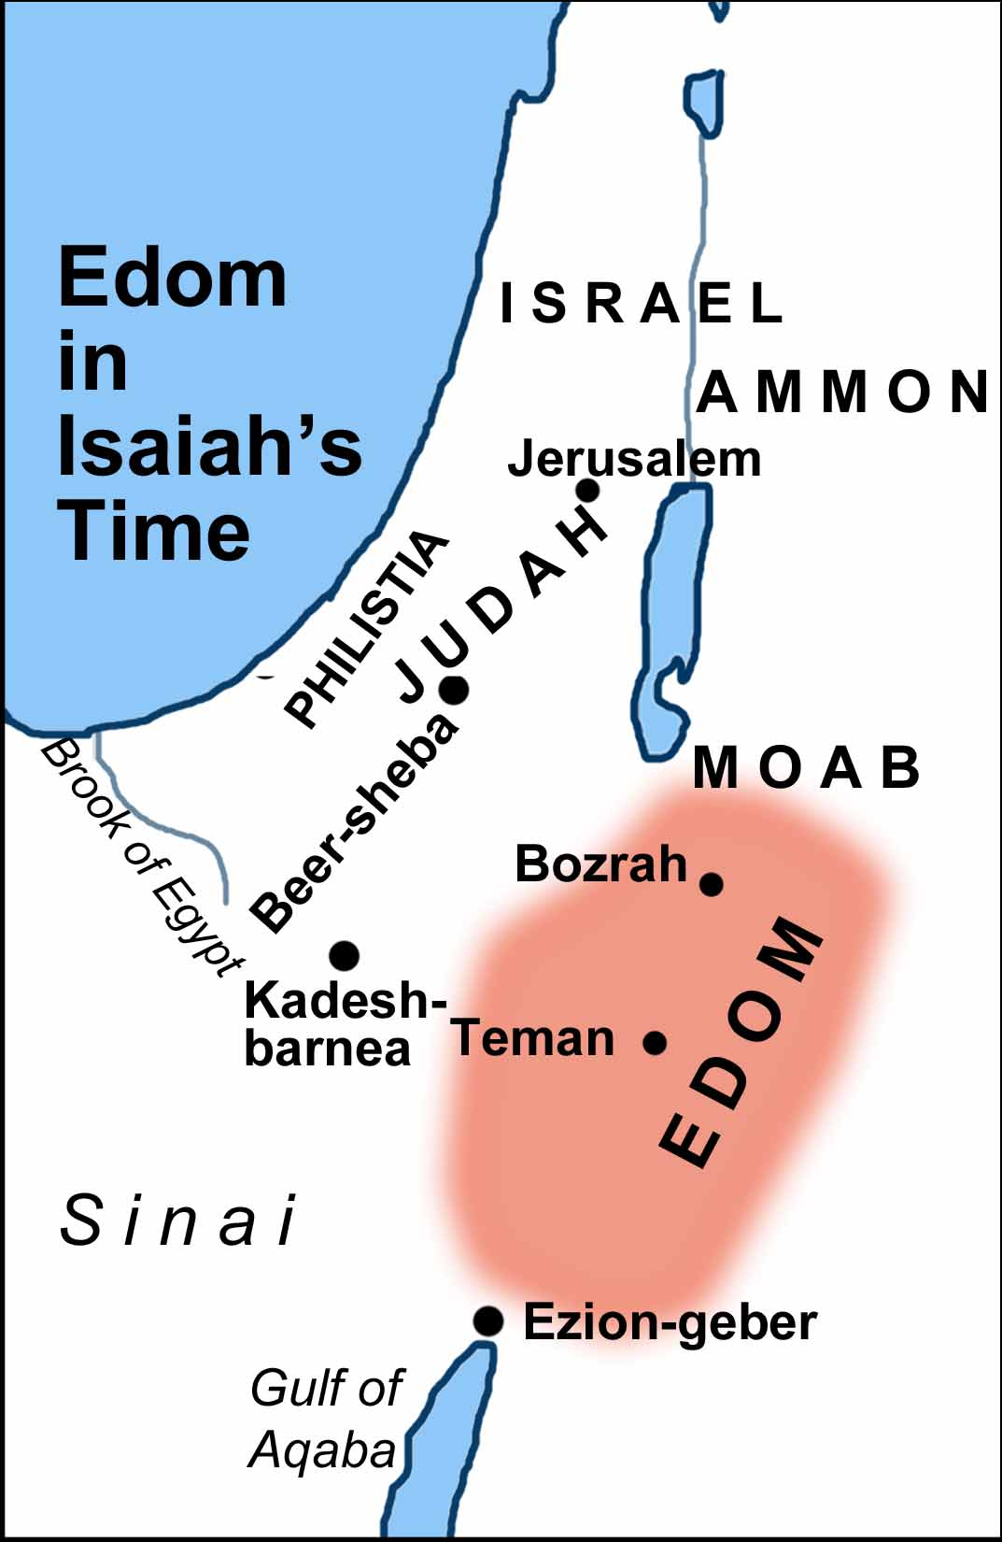
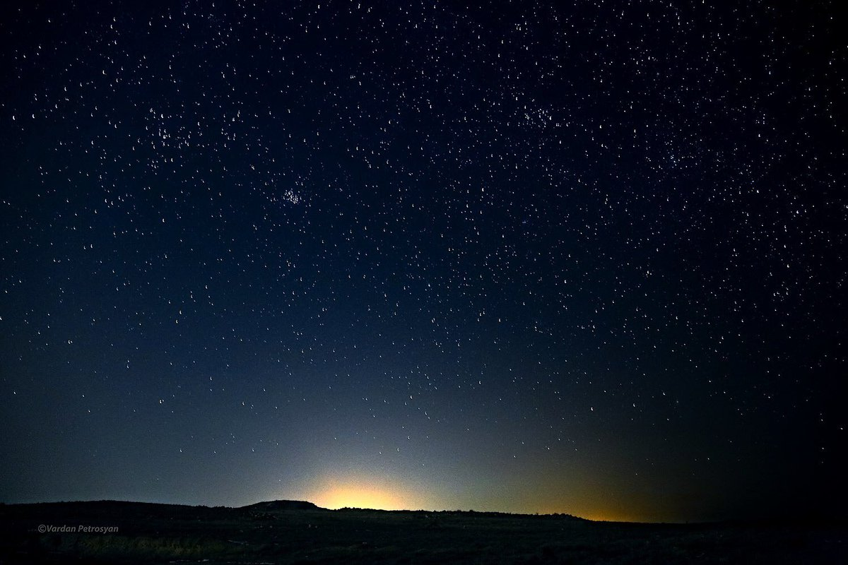
Edom
Watchman’s silence
Isa 21:11-12 – “¹¹The oracle concerning Edom. One keeps calling to me from Seir, ‘Watchman, how far gone is the night? Watchman, how far gone is the night?’ ¹²The watchman says, ‘Morning comes but also night. If you would inquire, inquire; come back again.’”
Notes:
Now, Judah was not the only nation wondering what was going to become of the fight between Babylon and Assyria?. Edom was Judah’s next-door neighbor, and notice their response.
Isa 21:11 – Instead of “Edom”, some of your translations say “Dumah”. Dumah was a son of Ishmael, and in an obvious play on words, it means “silence”. Remember that those in ancient times had no indicators to inform them of when dawn was about to break. There were no watches or alarm clocks. Only the watchman could see the first greying on the horizon. So, the question to Judah’s watchman, which is likely Isaiah, is, “How much of the night has passed and how much more uncertainty must we endure before morning comes?” The idea is that the uncertainty of the Assyrian flood also caused Edom anxiety, and they’re actually seeking answers from God’s prophet as to their fate in this uncertainty. And so anxious is Edom, they ask twice.
The answer? – Isa 21:12 – In other words, even Isaiah cannot give Edom any certainty of hope. Morning would come, but there would be a long night. Meaning, there is hope, but there will be a lot of gloom beforehand and he doesn’t yet know the specifics, implied by his suggestion to inquire again later. This fits vs. 6 – 9 in which while Isaiah knows Assyria will defeat Babylon, he does not know how or when it will happen. All they can do is wait, and waiting is bitter medicine. Edom can’t provide help to Judah; they’re just as anxious and helpless as the other nations.

Slide 9
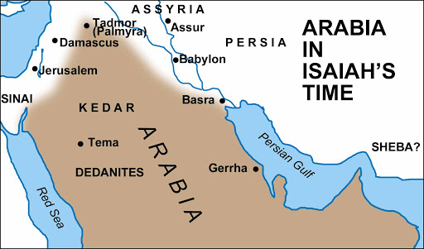
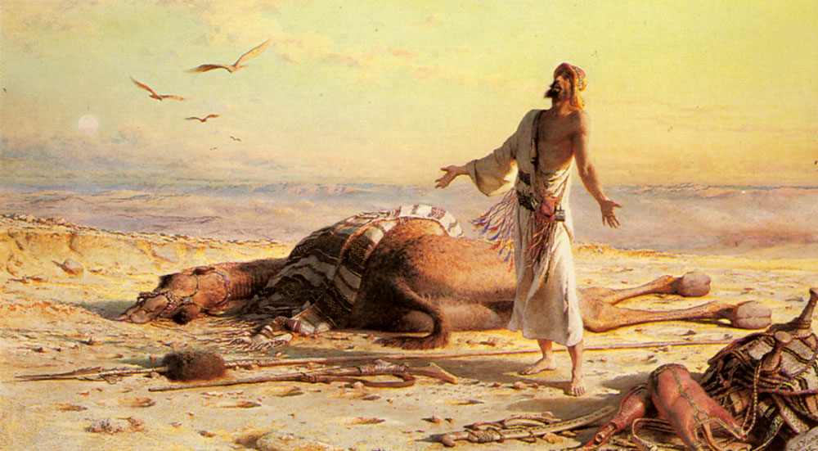
Arabia
Needs, but no solutions
Isa 21:13-17 – “¹³The oracle about Arabia. In the thickets of Arabia you must spend the night, O caravans of Dedanites. ¹⁴Bring water for the thirsty, O inhabitants of the land of Tema, meet the fugitive with bread. ¹⁵For they have fled from the swords, from the drawn sword, and from the bent bow and from the press of battle. ¹⁶For thus the Lord said to me, ‘In a year, as a hired man would count it, all the splendor of Kedar will terminate; ¹⁷and the remainder of the number of bowmen, the mighty men of the sons of Kedar, will be few; for the Lord God of Israel has spoken.’”
Notes:
And in the last oracle of chapter 21, we learn that the night creeping over Edom would even extend toward Arabia.
Isa 21:13-15 – Arabian thickets were ravines w/thick, brushy vegetation where animals would typically hide. But now fugitives, refugees, and caravan traders are hiding in them to escape Assyrian invasion because the road and the usual resting places are now too dangerous. Tema was a major western city, situated on an oasis, and home to the worship of the moon goddess. Isaiah is encouraging them toward a rescue operation, to assist those fleeing from war. This is a Gentile world in trouble who is being encouraged to provide help within its own borders, those fleeing from the sword of Assyria.
Isa 21:16-17 – We saw this language about hirelings in the oracle to Moab (16:14). Hirelings diligently observe and wait for the end of the year when they are to receive their wages. This shows the Lord was behind this difficulty for Arabia and has set the time for their judgment. Kedar, being the 3rd Arabian city mentioned, shows how widespread this would be, just like w/the oracle to Moab. Another similarity to Moab’s oracle is regarding a “remnant” (16:19). Kedar was a northern Arabian tribe known for being a force to be reckoned with, but now they would be significantly depleted. That God has spoken this should not be lost on us. If it were not for this divine intervention, men would completely destroy one another.

