Slide 1
Notes:
As we’ve gotten into this next section, chapters 13 – 27, Isaiah takes the themes from chapters 6 – 12 and broadens it beyond a local crisis to the entire world. Meaning, just as Israel and Syria were not going to take down Judah, this applies to all nations who would threaten Judah. And just as Judah didn’t need to be allying w/Assyria, they didn’t need to be allying w/anyone because not only would all these nations be judged, but as we saw in chapter 2, Zion would be the future rallying point for all nations. In other words, Zion doesn’t need to put their trust in these nations. All these nations would eventually need to put their trust in Zion’s God.
The oracle against Egypt in chapter 19 is setting the stage for chapters 28 – 35, in which during the reign of Hezekiah, one of the greatest sources of temptations for God’s people was to put their trust in Egypt for help against the Assyrian flood. Just as Isaiah’s done so far in the oracles to Philistia, Moab, and Ethiopia, he shows that it is folly to trust in men – they needed to trust in God. But how much more should they not trust in a nation like Egypt in which God has already shown His supremacy so vividly in the book of Exodus?

Slide 2
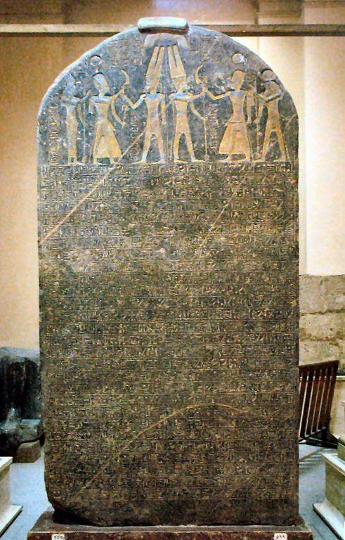
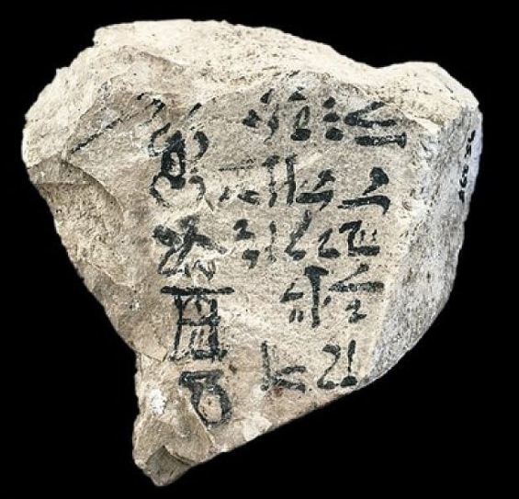
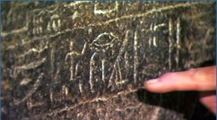
Egypt’s Background
Notes:
Before we look at the oracle itself, a little background on the nation of Egypt.
Egypt was descended from the 2nd oldest son of Ham - Mizraim (Gen 10:6; Psa 105:23). This was the original name given to Egypt in the Hebrew OT. The top picture is the Hebrew interlinear translation of Gen 12:10, and you can see that Egypt is literally pronounced “mis-ray-mah”. The name “Egypt” actually came later from the Greek word “Aegyptos”. They are one and the same. As we know, there were many run-ins between God’s people and Egypt. Besides Abraham fleeing there in Gen 12, Hagar was an Egyptian, and its possible Abraham had acquired her from there. Their son Ishmael married an Egyptian. Joseph went from being sold as a slave in Egypt to being 2nd in command, causing the rest of his family to settle there and explode to around 2 million people by the time Moses led them out of Egypt. And as we know from Exodus, despite how powerful the nation of Egypt was at this time, they were no match for God’s power, and He made Himself known to them in a very visible way. But though God rescued them from their cruel, Egyptian slavery, they would often look back during their wilderness wanderings to their time as Egyptian slaves w/fondness, preferring it to the supposed hardship of being led by God in the wilderness. And this is a theme throughout the rest of the OT. Though God had demonstrated His supremacy over them, Egypt became a great temptation to God’s people, as we’ll see further in chapters 28 – 35.
Now skeptics will argue that w/all the Egyptian artifacts uncovered, that it is strange how the Hebrews never appeared in any of their history outside the bible. This is not exactly true. This first picture on the left is called the Merneptah Stele, also known as the Israel Stele, and dates to the early days of the Judges (1206BC). It is a victory stele of Pharaoh Merneptah, the son of Ramesses II, mentioning a list of peoples and city-states in Canaan, and among them are the Israelites. And it's interesting that the other ethnic groups are described as nascent states, but the Israelites are described as "a people”, implying they had not yet reached a level of state organization (no king).
The picture on the right is an inscribed piece of limestone discovered in 1995 in a tomb along the west bank of the Nile at Luxor. It is dated to 1450BC, which was the time of Moses. It contains an ancient version of the Semitic alphabet in ABC order. They believe it was used by Egyptian scribes as a mnemonic device to remember the letter orders of not one, but two forms of early Semitic alphabets. This is another blow to skeptics who claim there was no written language at that time and that Moses would have supposedly written the first 5 books of the bible. But more importantly, it shows the Egyptians absolutely had history w/the Israelites.

Slide 3
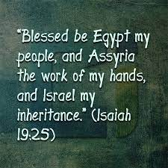
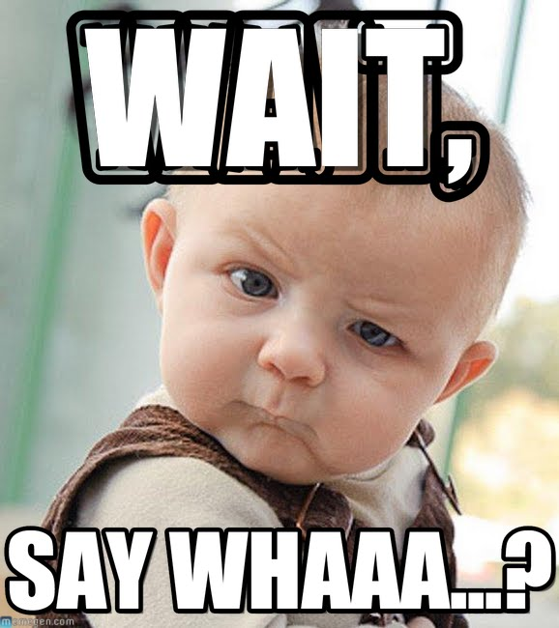
Notes:
I want to do something a little different with the oracle to Egypt by first looking at the very last verse of the chapter, because it is one of the most shocking verses in the entire book – Isa 23:25.
Say what? That can’t be. How can Egypt be “My people”? What did Moses first say to Pharaoh in Ex 5:1? “Let My people go…”, and He was referring to Israel, not Egypt. And Assyria is, “the work of My hands”? Jonah would have had a heart attack; this is something Israel is referred to time and again in the OT, not the pagan terrorists Assyria. Now in hindsight, this makes sense to us. If Gentile nations are going to eventually stream up to the mountain of the house of the Lord, this could certainly include Egyptians and Assyrians. But put yourselves in the sandals of the Jews hearing this statement for the very first time – this would have been a difficult thing to swallow for many Jews, but Isaiah 19 shows why it shouldn’t be.

Slide 4
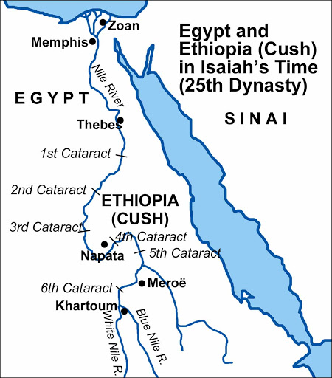
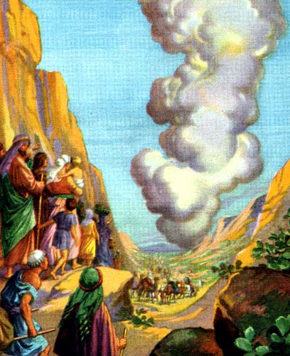
Smiting of Egypt
God returns to Egypt
Isa 19:1 – “¹The oracle concerning Egypt. Behold, the Lord is riding on a swift cloud and is about to come to Egypt; the idols of Egypt will tremble at His presence, and the heart of the Egyptians will melt within them.”
Exodus Contrasts
On a cloud (Ex 13:21)
Idols judged (Ex 12:12)
Hearts melt (Ex 14:17)
Notes:
Isa 19:1 – As this oracle begins, there are 3 contrasts w/what occurred in the Exodus.
1) The last time God left Egypt, He was leading the Israelites out in a cloud by day and a fire by night. But now He’s coming back on a cloud, in an obvious scene of judgment, almost as if to finish what He started back in Exodus. And there are multiple verses scatter throughout the bible that speak of God riding on the clouds having Messianic connotations of judgment (Psa 104:3; Dan 7:13; Rev 1:7; Matt 26:64).
2) Notice in Ex 12 what one of God’s purposes was for judging Egypt – Ex 12:12 – “For I will go through the land of Egypt on that night, and will strike down all the firstborn in the land of Egypt, both man and beast; and against all the gods of Egypt I will execute judgments—I am the Lord.” Now as He returns, the idols tremble, as if they remember how God had made a fool of them the last time and will surely do so again.
3) The hearts of the Egyptians will melt. Back in Exodus, someone had a hard heart – Pharaoh. And in Ex 14, all the Egyptians were referred to as having hard hearts. But maybe the point of this statement is that no matter how hard one’s heart may be, no heart is so hard that it won’t melt when it meets the fire of God’s judgment.

Slide 5
Smiting of Egypt
Social collapse
Isa 19:2-4 – “²‘So I will incite Egyptians against Egyptians; and they will each fight against his brother and each against his neighbor, city against city and kingdom against kingdom. ³Then the spirit of the Egyptians will be demoralized within them; and I will confound their strategy, so that they will resort to idols and ghosts of the dead and to mediums and spiritists. ⁴Moreover, I will deliver the Egyptians into the hand of a cruel master, and a mighty king will rule over them,’ declares the Lord God of hosts.”
Social Collapse
Division
Demoralization
Divination
Dictatorship
Notes:
So in vs. 2 – 15, Isaiah is going to describe 3 different types of collapses that will occur. The first is in vs. 2 – 4, four levels of social collapse, and notice how God speaks in the first person.
Division – Isa 19:2 – God pronounces a civil way. This was often a way for God to indirectly defeat another nation (Judg 7:22). And historically, we know this occurred around the time of this prophecy, as Egypt was divided into 12 kingdoms in which many wars followed. Anytime a nation of people don’t think beyond themselves, social division follows, which is why we’re seeing it today in our own nation.
Demoralization – Isa 19:3a – With hearts melting, the spirit will inevitably fail. God is known for thwarting the counsel of wise men in order to hasten judgment, as he did w/Ahithophel when he sided w/Absalom. (2 Sam 17:44). Even Egypt, who was know for their wise men (1 Kings 4:30), would not succeed. God would frustrate every one of their proposals for national recovery.
Divination – Isa 19:3b – In desperation and spiritual failing, they will put pathetic trust in mediums and spirits.
Dictatorship – Isa 19:4 – Once a cruel master themselves, the tables will be turned. And part of confounding their strategy may have been replacing competent leadership w/cruel, oppressive leaders.
Now before we move on, notice how many times the word “Egypt” or “Egyptians” is used in vs. 1 – 4: 8 times. You might be tempted to think Isaiah is being redundant – “Ok, I get it, you’re talking about Egypt”. But repetition almost always means God is trying to emphasize something. Why might Isaiah feel the need to make sure we understand He is talking about Egypt? Well, look how similar things were happening to the Jews in chapters 1 – 12. In 9:19-21, brother was against brother. In 8:19, the nation of Judah was resorting to mediums and spiritists rather than putting its fear and trust in God, in which God said, “To the law and to the testimony.” And did God hand the Jews over to a cruel master? Yes, the Assyrians. What’s the point? If one were unfamiliar w/the Davidic promise, the Immanuel promise, but simply judged the nations by their character, Egypt, Israel, and Judah would not have looked that much different. This was going to be an important point God’s people needed to understand if they were ever going to defeat the idol of nationalism and accept the stream of Gentiles who would eventually come to Zion.

Slide 6
Smiting of Egypt
Economic collapse
Isa 19:5-10 – “⁵The waters from the sea will dry up, and the river will be parched and dry.⁶The canals will emit a stench, the streams of Egypt will thin out and dry up; the reeds and rushes will rot away. ⁷The bulrushes by the Nile, by the edge of the Nile and all the sown fields by the Nile will become dry, be driven away, and be no more. ⁸And the fishermen will lament, and all those who cast a line into the Nile will mourn, and those who spread nets on the waters will pine away. ⁹Moreover, the manufacturers of linen made from combed flax and the weavers of white cloth will be utterly dejected. ¹⁰And the pillars of Egypt will be crushed; all the hired laborers will be grieved in soul.”
Economic Collapse
Vegetation/grain
Fish
Industry
Employment
Notes:
The next 6 verses focus on economic collapse, and there is another word that gets repeated and referred to multiple times. – Isa 19:5-10.
Which verse gets repeated? The Nile – the lifeline of Egypt’s economy. When the Nile flooded, they could irrigate it and would have lots of grain. But a drought would devastate them. And so, Egypt’s very existence depended on the Nile. And because it functioned on a predictable cycle that Egypt depended on, this contributed to Egypt’s self-confidence. Yet God’s ability to control water is recurrent in the OT. And so, their dependance on the Nile was conditioned on their commitment to Him.
But notice the degradation in these verses. The arms of the Nile were the canals and streams, the irrigation channels for when the Nile flooded. But as the Nile dries up, so would its canals and streams, which leads to the vegetation it was supposed to feed rotting, leaving a stench. So first the Nile, then the canals, then the grass, and finally the meadows due to soil erosion. Egypt was a great exporter of grain throughout the world, so this is a big deal.
And w/o the Nile or its canals, the fishing industry takes a hit, which was another major industry for Egypt, depicted on many Egyptian monuments. They will mourn over the death of what once brought so much life.
And when the plants can’t grow, the manufacturing and clothing industry take a hit, and having no clothes = shame. This is a harsh reminder that all he productivity they were so used to enjoying ultimately depended on God’s grace.
And vs. 10 suggests that all of Egyptian society from the high (pillars) to the low (hired laborers) will be impacted by God’s actions against the Nile. There will be a failure of morale among enterprisers along w/the working class they employ.

Slide 7
Smiting of Egypt
Political collapse
Isa 19:11-15 – “¹¹The princes of Zoan are mere fools; the advice of Pharaoh’s wisest advisers has become stupid. How can you men say to Pharaoh, ‘I am a son of the wise, a son of ancient kings’? ¹²Well then, where are your wise men? Please let them tell you, and let them understand what the Lord of hosts has purposed against Egypt. ¹³The princes of Zoan have acted foolishly, the princes of Memphis are deluded; those who are the cornerstone of her tribes have led Egypt astray. ¹⁴The Lord has mixed within her a spirit of distortion; they have led Egypt astray in all that it does, as a drunken man staggers in his vomit. ¹⁵There will be no work for Egypt which its head or tail, its palm branch or bulrush, may do.
Political Collapse
Stupid & foolish
Don’t understand times
Deluded
Distorted & drunken
Notes:
And then thirdly there is political collapse, an expansion on what we read in vs. 3.
Isa 19:11 – Zoan is the same as Tanis, the capital of the delta region, and its wise men were renowned. But the ones who would be looked to w/the wisdom and intelligence to get them out of this mess are rendered foolish. And being descended from wise men wouldn’t help either, as none were able to read the signs of the times. So why should Judah trust in Egypt?
Isa 19:12 – Meaning, if they’re so wise, let’s see if they can guess what the true God is planning to do. The fact that Isaiah asks where they are seems to imply that they have no true wise men, because true wisdom is only found in the Lord of hosts.
Isa 19:13 – These are is the answers to the questions from vs. 11 and 12. The “cornerstones” were the strong leaders of the people, but they have led them astray rather than directing them properly. And as we’re going to see in chapter 28:16, which begins God’s exhortation not to rely on the strength of Egypt, the only true cornerstone is Jesus Christ.
Isa 19:14 – The reason they are foolish is because the Lord rendered them as such, just as He did at Babel to their language. They now have absolutely no direction as they stagger about – Ex 14:24b-25a – “[He] brought the army of the Egyptians into confusion. He caused their chariot wheels to swerve, and He made them drive with difficulty”.
And then expanding on vs. 10, Isa 19:15 – All levels of society are affected, just as we read about Israel in 9:14-15. The work Egypt needed to do to support its daily life would cease. And think of how we trust in the same things today that Egypt did then.

Slide 8
Smiting Vs. Healing
Trembling – 19:1
Division/Infighting – 19:2
Trembling/Dread – 19:16-17
One language – 19:18
Isa 19:16-18 – “¹⁶In that day the Egyptians will become like women, and they will tremble and be in dread because of the waving of the hand of the Lord of hosts, which He is going to wave over them. ¹⁷The land of Judah will become a terror to Egypt; everyone to whom it is mentioned will be in dread of it, because of the purpose of the Lord of hosts which He is purposing against them. ¹⁸In that day five cities in the land of Egypt will be speaking the language of Canaan and swearing allegiance to the Lord of hosts; one will be called the City of Destruction.”
Notes:
Now, as we get to vs. 16, the tone is going to shift from smiting to healing. And each of the main themes addressed in vs. 1-15 are now going to be reversed. In these last 10 verses, there are 5 inclusios of “in that day” that for the most part make up the comparisons/contrasts.
For example, in vs. 1, we read that Egypt would be in dread because the Lord will visit them in judgment – Isa 19:16-17 – So this trembling and dread is not so much what God has done to Egypt in judgment, but what they observe that He would be doing through Judah. In bygone days, Egypt didn’t hesitate to take the fight to Judah. But now the very mention of Judah terrifies them, likely because they’re remembering how they’ve treated them in the past and now they can clearly see “God is with us”. And so, we see the Lord’s hand again in vs. 16, and he compares Egypt’s dread to that of women, which may not be PC in our times, but is used elsewhere (Nah 3:13; Jer 50:37; 51:30) and simply means they will become soft and timid. And so, this is a dread of a people who now realize they have been on the wrong side the entire time, and they have a decision to make. Continue to fight against God’s chosen people, securing their inevitable destruction, or join them?
Back in vs. 2, we learned there would be infighting, but notice in vs. 18 that “in that day”, 5 of their cities will speak the same language, that of Canaan – Isa 19:18 – And so, these five cities will identify more w/the Lord than they will w/Egypt. This is astonishing given their angst towards Hebrews in the past (Gen 43:32). See why would there need to be judgment first? Because those who are crushed by sin are more likely to seek out a Redeemer. And not surprisingly, God had been waiting for them to return the whole time. Some of your translations say, “City of Destruction” and others say, “City of the Sun”. There is only one letter which makes the difference, but contextually, “City of the Sun” makes more sense because this would have been the god Ra’s city, suggesting that Ra’s own city would turn to Jehovah.

Slide 9
Smiting Vs. Healing
Trembling – 19:1
Division/Infighting – 19:2
Consulting idols – 19:1c,3c
Cruel ruler/dictator – 19:4
Trembling/Dread – 19:16-17
One language – 19:18
Consulting God – 19:19-21
Healing God – 19:22
Isa 19:19-22 – “¹⁹In that day there will be an altar to the Lord in the midst of the land of Egypt, and a pillar to the Lord near its border. ²⁰It will become a sign and a witness to the Lord of hosts in the land of Egypt; for they will cry to the Lord because of oppressors, and He will send them a Savior and a Champion, and He will deliver them. ²¹Thus the Lord will make Himself known to Egypt, and the Egyptians will know the Lord in that day. They will even worship with sacrifice and offering, and will make a vow to the Lord and perform it. ²²The Lord will strike Egypt, striking but healing; so they will return to the Lord, and He will respond to them and will heal them.”
Notes:
Now they go from consulting idols to consulting God – Isa 19:19 – Meaning, the physical presence of Jehovah would be established in Egypt. The altar referred to here is likely an expression of gratitude and allegiance, as what we saw Abraham, Isaac, and Jacob build. The true religion will be found in Egypt and the true God worshipped there. That it’s at its border seems to imply that as one leaves Judah and enters Egypt, He comes into a land that is also the Lord’s.
Isa 19:20 – Quite a change from when Israel cried out to God in Ex 2 because Egypt was oppressing them. Now as this cruel task master from vs. 4 oppresses Egypt, and they cry out, He sends a Savior, proving He is the Savior of all the world. “Savior and Champion” is a similar phrase as used in Judg 1:34; 2:18, so it may or may not have Messianic implications.
Isa 19:21 – To “know” denotes personal relationship. How? Through teaching and instruction. They will not only sacrifice, but will live it out. Previous knowledge of the Lord came through bitter defeat, as we saw in Exodus. This new knowledge will come through gratitude and they will be zealous to complete their vows, having come to a full realization of who God is and who they are, just as Isaiah did in Isa 6.
Isa 19:22 – He struck them in Exodus for destruction; He now strikes them for healing. God’s judgment was intended to bring healing through repentance. If the Lord relieved them of plague after plague when Moses entreated them on behalf of Pharaoh’s plea, how much more will He respond to those Egyptians who completely turn to Him?

Slide 10
Smiting Vs. Healing
Trembling – 19:1
Division/Infighting – 19:2
Consulting idols – 19:1c,3c
Cruel ruler/dictator – 19:4
Nile dried up – 19:5-6
Confusion/distortion – 19:14
Trembling/Dread – 19:16-17
One language – 19:18
Consulting God – 19:19-21
Healing God – 19:22
Highway for unity – 19:23
Harmony – 19:24-25
Isa 19:23-25 – “²³In that day there will be a highway from Egypt to Assyria, and the Assyrians will come into Egypt and the Egyptians into Assyria, and the Egyptians will worship with the Assyrians. ²⁴In that day Israel will be the third party with Egypt and Assyria, a blessing in the midst of the earth, ²⁵whom the Lord of hosts has blessed, saying, ‘Blessed is Egypt My people, and Assyria the work of My hands, and Israel My inheritance.’”
Notes:
And in contrast to a dried up Nile, there will be a highway – Isa 19:23 – So notice the 3 stages of the kingdom. 1st, just a few cities in 19:18. Then in 19:19, an entire country. Now the whole world. A highway had already been spoken of for the Jewish remnant from Assyria in 11:16. Now Assyria and Egypt will travel on a highway through Judah to worship together, having been reconciled in a common faith. As much as these 2 nations had been at war with one another, this is an amazing statement. But true religion heals wounds between people. They accept one another because the Lord has accepted them.
Isa 19:24 – Judah had been a pawn between the two, militarily speaking. And in chapter 7, we learned they would be a staging ground for war between the two. Then they were a dread in 19:17. Now they are a uniting factor between the two, a source of blessing. Israel, in their nationalism, would not have liked this verse.
Which brings us to the last verse we began with – Isa 19:25 – Again, these statements used of Egypt and Assyria had previously been exclusively applied to Israel. But now the nation to whom it was said “let my people go” (Ex 5:1) are called “my people”. Point: if Judah turns to these nations for help, she will prostitute her ministry to them. Rather, she is to be the Segway in which they can turn to her and become partners in the faith, enjoying the same blessings.

