Slide 1
Notes:
The previous 2 oracles dealt with Judah’s southern neighbors, Philistia and Moab. As we come to the 4th oracle in chapter 17, their 2 northern neighbors are going to be addressed, Israel and Syria. It’s interesting that in a section obviously dedicated to judgment against the surrounding nations that God would include Israel here in chapter 17 and Jerusalem in chapter 22. Yet look at some of the sins being judged such as trusting in alliances over God and pride. Had God’s people been any different? No, despite His purpose for them on Mt. Sinai, they proved to be just like them in almost every way. So perhaps this next oracle and the one in chapter 22 is God’s way of saying, “If you’re going to act like them, you are going to be included in the judgments against them.” And perhaps it is to also suggest that just as the nations are going to need to turn themselves around if they’re ever going to stream up to the mountain of the house of the Lord, Israel and Judah would need to turn themselves around, too.

Slide 2
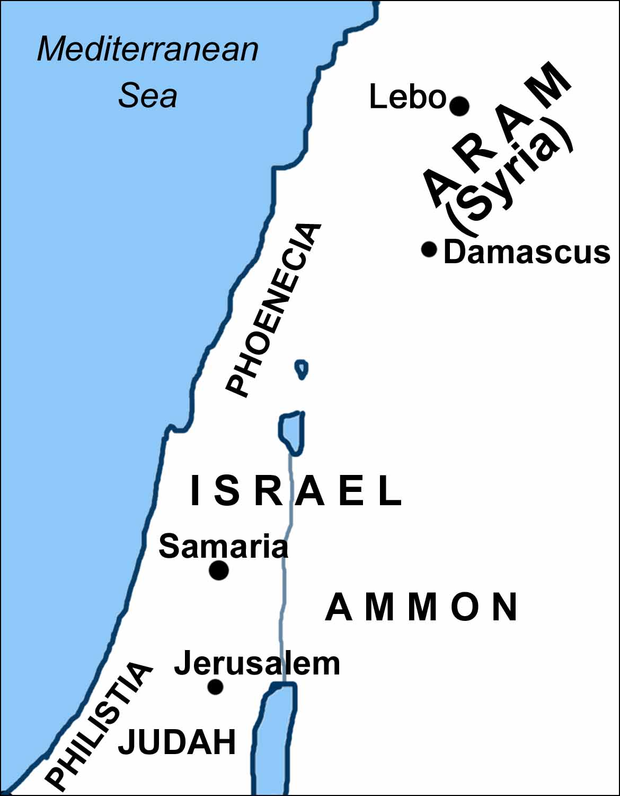
Syria/Israel
Coalition fails
Isa 17:1-3 – “¹The oracle concerning Damascus. ‘Behold, Damascus is about to be removed from being a city and will become a fallen ruin. ²The cities of Aroer are forsaken; they will be for flocks to lie down in, and there will be no one to frighten them. ³The fortified city will disappear from Ephraim, and sovereignty from Damascus and the remnant of Aram; they will be like the glory of the sons of Israel,’ declares the Lord of hosts.”
Notes:
Isa 17:1 – Damascus was the ancient capital of Syria, and it was known to be one of the most beautiful cities of antiquity. And it was a strategic city on the route between Mesopotamia and Egypt, meaning it exercised a lot of influence. But in vs. 1, we read it would be removed as a city and would fall into ruin. This has already been alluded to in chapters 7, 8, and 10 where it was only partially destroyed by Tiglath-Pileser III, but he rebuilt it into an Assyrian province.
Isa 17:2 – We have no idea where Aroer is. There was a city by that name in Gad as well as in Moab, but archeology has yet to uncover anything in the Aramean region w/a city by that name. In a similar vein to those cities in Moab we can’t locate, perhaps its because Isaiah said the city would be forsaken. By claiming it will be a place for flocks to lie down, Isaiah is not picturing pastoral bliss, but a landscape emptied of mankind and devoid of any evidence it ever even existed.
Now notice how the text quickly segways from Syria to Israel – Isa 17:3 – Why is He now making Israel the source of judgment? Because they had been in cahoots. Israel and Syria were so closely aligned, Isaiah is tying their fates together in this oracle. He’s reminding God’s people that they cannot be ultimately made secure by fortresses and worldly powers. And yet, just as a remnant from Israel would be spared, so will a remnant from Syria. But first, they’re going to have to learn to find their security in the sovereign God, which means Israel must lose the security of her “fortresses” and Syria must lose her sovereignty.

Slide 3
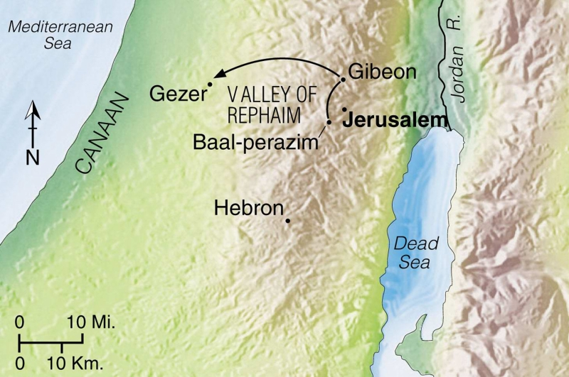
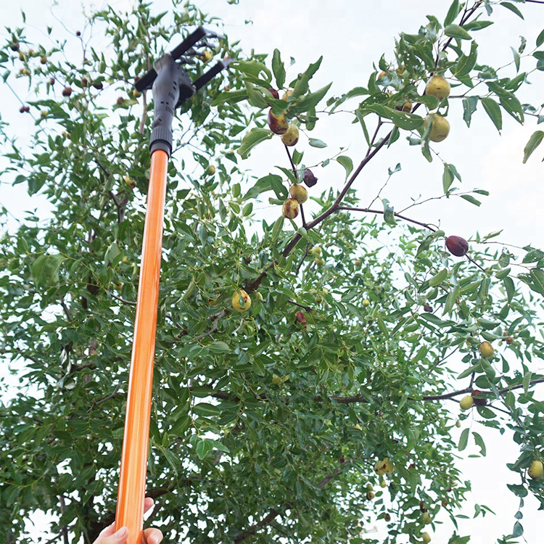
Syria/Israel
From glory to gleanings
Isa 17:4-6 – “⁴Now in that day the glory of Jacob will fade, and the fatness of his flesh will become lean. ⁵It will be even like the reaper gathering the standing grain, as his arm harvests the ears, or it will be like one gleaning ears of grain in the valley of Rephaim. ⁶Yet gleanings will be left in it like the shaking of an olive tree, two or three olives on the topmost bough, four or five on the branches of a fruitful tree, declares the Lord, the God of Israel.”
Notes:
There is an inclusio that appears in this chapter 3 times, the phrase “in that day”, in verses 4, 7, and 9.
Isa 17:4 – What is the glory of Jacob? It could be her alliance w/Syria. It could be all the wealth she had gained under Jeroboam II. Doesn’t really matter, because not only was Damascus no more, but all the economic advancement Israel had enjoyed would turn lean, because the false glory of worldly power and status that Israel had achieved was nothing by a fraud.
Isa 17:5 – Now the agent of justice comes into view in this image of the reaper. Because of Israel’s sin, she is now ripe for the sickle. The phrase “as his arm” denotes personal action, and what will be left to glean? Very little. The Valley of Rephaim, which was west of Jerusalem, is where the poor would often go to glean, so this adds a vivid picture to the judgment scene. By the time God was done w/Israel, they would be just like that valley.
But there’s a light at the end of the tunnel – Isa 17:6 – So, the fatness of Israel’s flesh will become lean, all that will be left of the land would be for gleaning, and it’d be like a bare olive tree w/just 2 or 3 olives at the top. All 3 descriptions are to show that only bits and pieces of Syria and Israel will be left when God has finished w/them. So, as we read in vs. 3, God is declaring there would be a remaining remnant, but getting to that point isn’t going to be pretty.

Slide 4
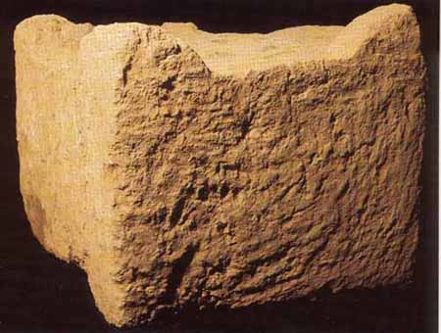
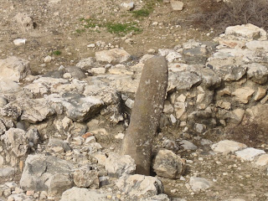
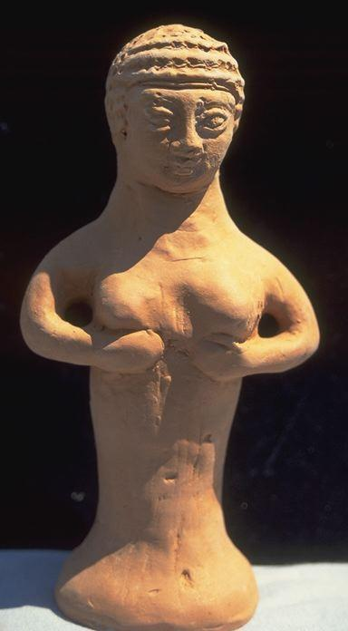
Syria/Israel
Restoration
Isa 17:7-8 – “⁷In that day man will have regard for his Maker and his eyes will look to the Holy One of Israel. ⁸He will not have regard for the altars, the work of his hands, nor will he look to that which his fingers have made, even the Asherim and incense stands.”
Notes:
Isa 17:7-8 – This is a picture of an altar that was uncovered in excavations at the site of Tel Dan. It was likely a massive four-horned altar and they also found massive amounts of animal-bone concentrations that suggest intense sacrificial offerings.
The picture in the middle is an Asherah pole archeologists uncovered at Hazor, but they believe many of them were carved like the picture on the bottom right. See, the Asherim was the goddess of fertility and temple prostitution was associated with its worship. Israel had created all these things to supplant their Creator, but all idolatry and false religion is, at its best, is self-reliance. The most significant thing man has “made” is an utter mess of things. But the impetus of vs. 7-8 is that God’s judgment would cause the remnant of Israel to do away w/these idols and recognize Him alone as their sole object of religious devotion, the true Giver and Sustainer of life.

Slide 5
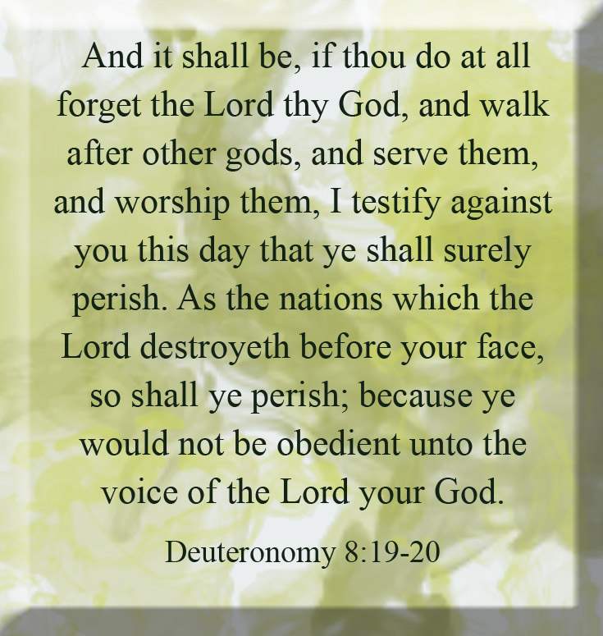
Syria/Israel
Explanation of destruction
Isa 17:9-11 – “⁹In that day their strong cities will be like forsaken places in the forest, or like branches which they abandoned before the sons of Israel; and the land will be a desolation. ¹⁰For you have forgotten the God of your salvation and have not remembered the rock of your refuge. Therefore you plant delightful plants and set them with vine slips of a strange god. ¹¹In the day that you plant it you carefully fence it in, and in the morning you bring your seed to blossom; but the harvest will be a heap in a day of sickliness and incurable pain.”
Notes:
But in order for Israel to get there, there must be judgment – Isa 17:9 – Remember in chapter 2, when we were talking about Judah’s problem w/idolatry, that the idea of idolatry spanned broader than “images” to even artificial, manmade structures that man puts confidence in. Israel’s fortresses were just as much an idol to her as the Asherim. Trusting in creation, whether images or abstract things like power, always equates to idolatry. God would remove this idol as well to teach Israel not to put her trust in them. And God is comparing it to how He originally gave them land. The irony was that God was the one who led Israel to defeating the pagan nations that inhabited Canaan and they populated their cities. But now God is having to “defeat” Israel for the same reason. God needs to re-remind them of what He previously reminded them of in the days of Joshua.
Isa 17:10a – They had known God but had forgotten. The true refuge, fortress, and strength is found in the Rock. To forget God is to forget that only He is our true salvation. Satan doesn’t have to turn us into murderers and thieves. If he can simply get us to forget about God and His works, he can hurt us – Deut 8:19-20.
Isa 17:10b-11 – In other words, no gardener who plants thistles should expect roses. No matter how refined their gardening technique, God will see to it that the harvest is a bitter disappointment, because we will always reap what we sow. That they expected such quick germination implies they had lost their ability to wait in faith. This is a precursor to sin, taking short cuts, wanting a quick harvest in life rather than waiting on the Lord, learning to trust that He makes all things beautiful in His time.

Slide 6
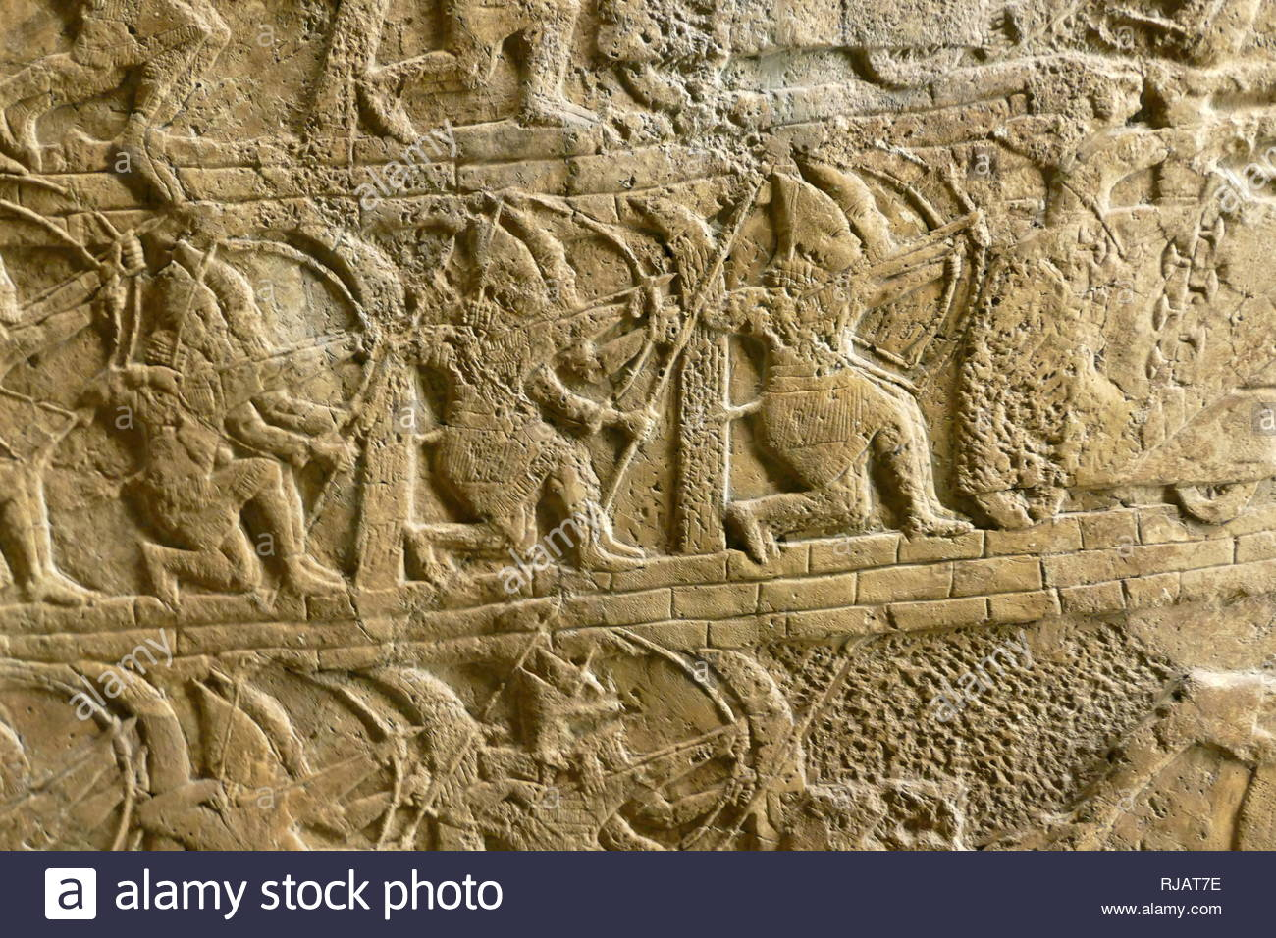
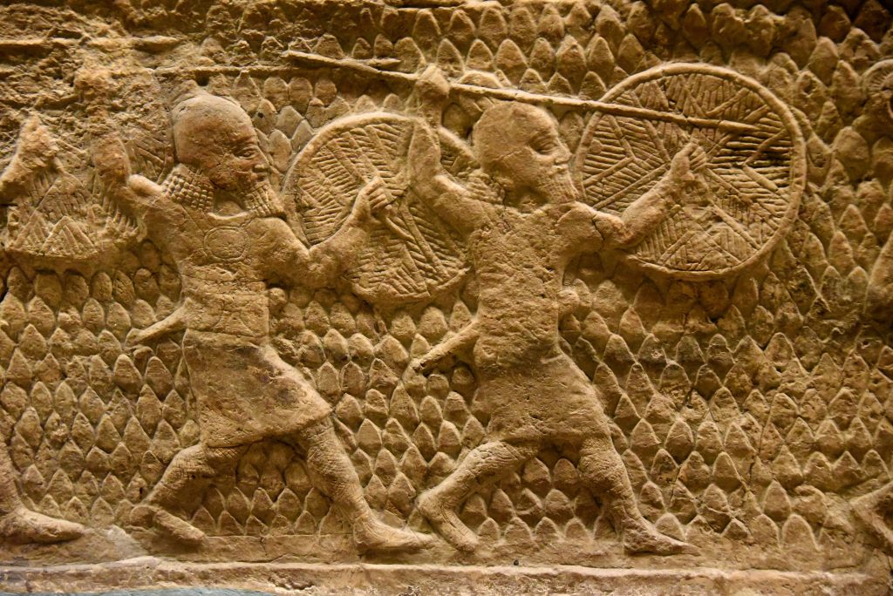
Syria/Israel
Sudden dispersal of international threat
Isa 17:12-14 – “¹²Alas, the uproar of many peoples who roar like the roaring of the seas, and the rumbling of nations who rush on like the rumbling of mighty waters! ¹³The nations rumble on like the rumbling of many waters, but He will rebuke them and they will flee far away, and be chased like chaff in the mountains before the wind, or like whirling dust before a gale. ¹⁴At evening time, behold, there is terror! Before morning they are no more. Such will be the portion of those who plunder us and the lot of those who pillage us.”
Notes:
But just as after pronouncing judgment against Judah and Israel in chapters 7 – 10, He then pronounces judgment against the rod of His anger, Assyria, He does so again – Isa 17:12-13 – As we read in chapter 8, Assyria would come upon Israel and Syria like a flash flood that can’t be stopped. Like a roaring sea, it would be overpowering, restless, and hostile toward them. And there is nothing any of them could do about it. But God would not allow the Assyrian flood to prevail in any final sense. God would take the roaring waves of Assyria and reduce them to chaff and dust. The key is to look at these events from God’s perspective. When He is for you, the power of those nations is rendered insignificant. They only run unchecked until God accomplishes His purposes. He uses sinners to punish other sinners, then he punishes the sinner. See, from our point of view, nations look powerful and unstoppable. From God’s point of view, they are like dust in the wind.
Isa 17:14 – What does this sound like? It fits Sennacherib’s invasion in Isa 36 and 37 perfectly, as one day they were causing terror, then the next morning they were reduced to dead bodies. The Assyrian judgment could have been worse than it was, but even after earthly judgment, mercy is found. The bottom two reliefs depict Assyria’s invasion against Lachish, which was going on at the same time Sennacherib sent the Rabshakeh to Jerusalem to intimidate them into giving up. This invasion did not turn out as well as these reliefs depict.

Slide 7
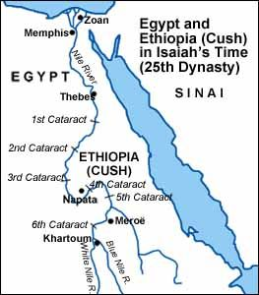
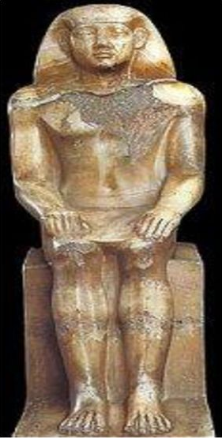
Ethiopia
Piankhi
Notes:
In chapter 18, God has a message for Ethiopia, but unlike His messages to the other countries, this one is not a message of judgment. It’s not even really an oracle. In fact, even though the actions being taken by Ethiopia in this chapter are the basis for Isaiah’s message, Isaiah looks at the situation through a wider lens, quickly expanding the message from Ethiopia to the entire world.
The background of this message is the following. Around 715BC, Egypt had been ruled by a Libyan dynasty, but there was a bunch of squabbling amongst its leaders. Ethiopia took advantage of this internal strife and took control of Egypt, and a series of Ethiopian rulers became the 25th dynasty. The first Ethiopian Pharaoh was named Piankhi, and he ruled for 31 years. This image on the right is a rendering of him. It’s very possible that he is the same individual we read about in 37:9, “Tirhakah”, who came up against Assyria while they were fighting in Libnah, because there is an Egyptian stele that equates the two as one and the same.

Slide 8
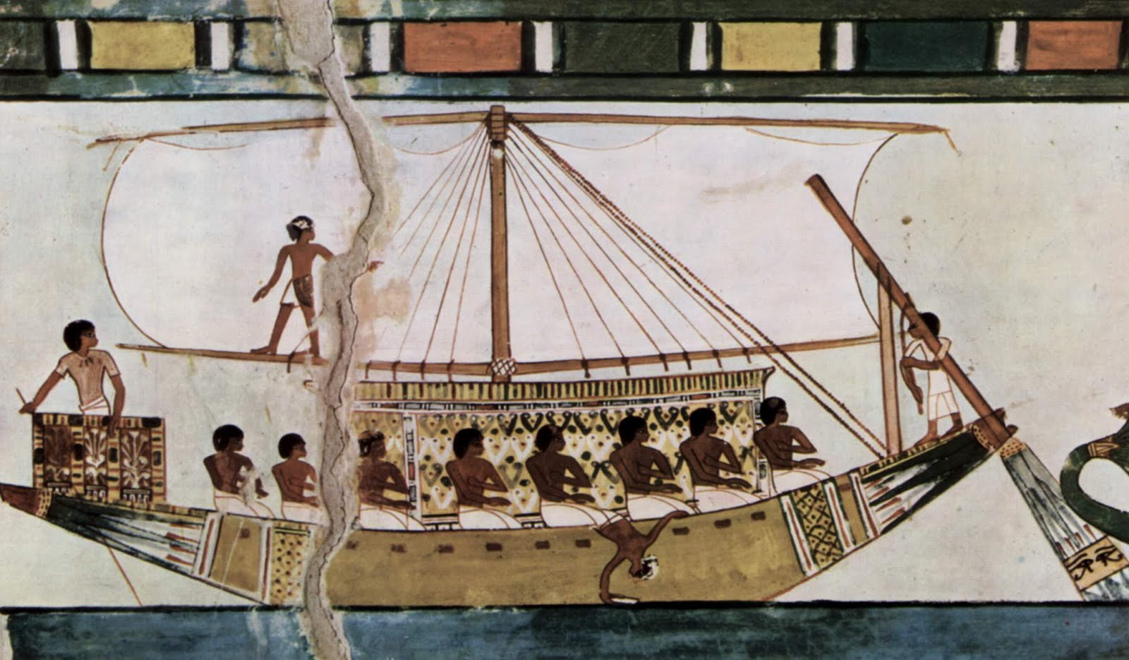
Ethiopia
Futile attempt to federalize
Isa 18:1-2ab – “¹Alas, oh land of whirring wings which lies beyond the rivers of Cush, ²which sends envoys by the sea, even in papyrus vessels on the surface of the waters. Go, swift messengers, to a nation tall and smooth, to a people feared far and wide, a powerful and oppressive nation whose land the rivers divide.””
v
v
v
Notes:
Isa 18:1-2ab – The dating of this message gets very difficult because there are Egyptian steles and Assyrian annals that conflict, but here is what we believe was happening. Piankhi not only sought to play a part on the world stage, but they desperately wanted to protect their dynasty in Egypt. So, the scene appears to be Ethiopians sending ambassadors all over Palestine to make alliances, promising aid for any nations that would join them in rebellion against Assyria. And some of these envoys are headed to Judah. You’ll remember in 7:18 that Isaiah compared Assyria to the bee and Egypt to the fly because those two “pests” were known in those respective countries. Well, in the same way, the Nile Valley was famous for its many whirring insects.
But it appears Isaiah tells Judah to send their own messengers to Ethiopia – Isa 18:2cdef – The “nation tall and smooth” are Ethiopians, as they were considered proverbially tall in the ancient world with a dark bronze skin tone. And the Ethiopian dynasty in this time were a powerful and oppressive nation. “Whose land the rivers divide” is definitely Ethiopia because as you can see from the map, Ethiopia benefited from several cataracts of the Nile River.

Slide 9
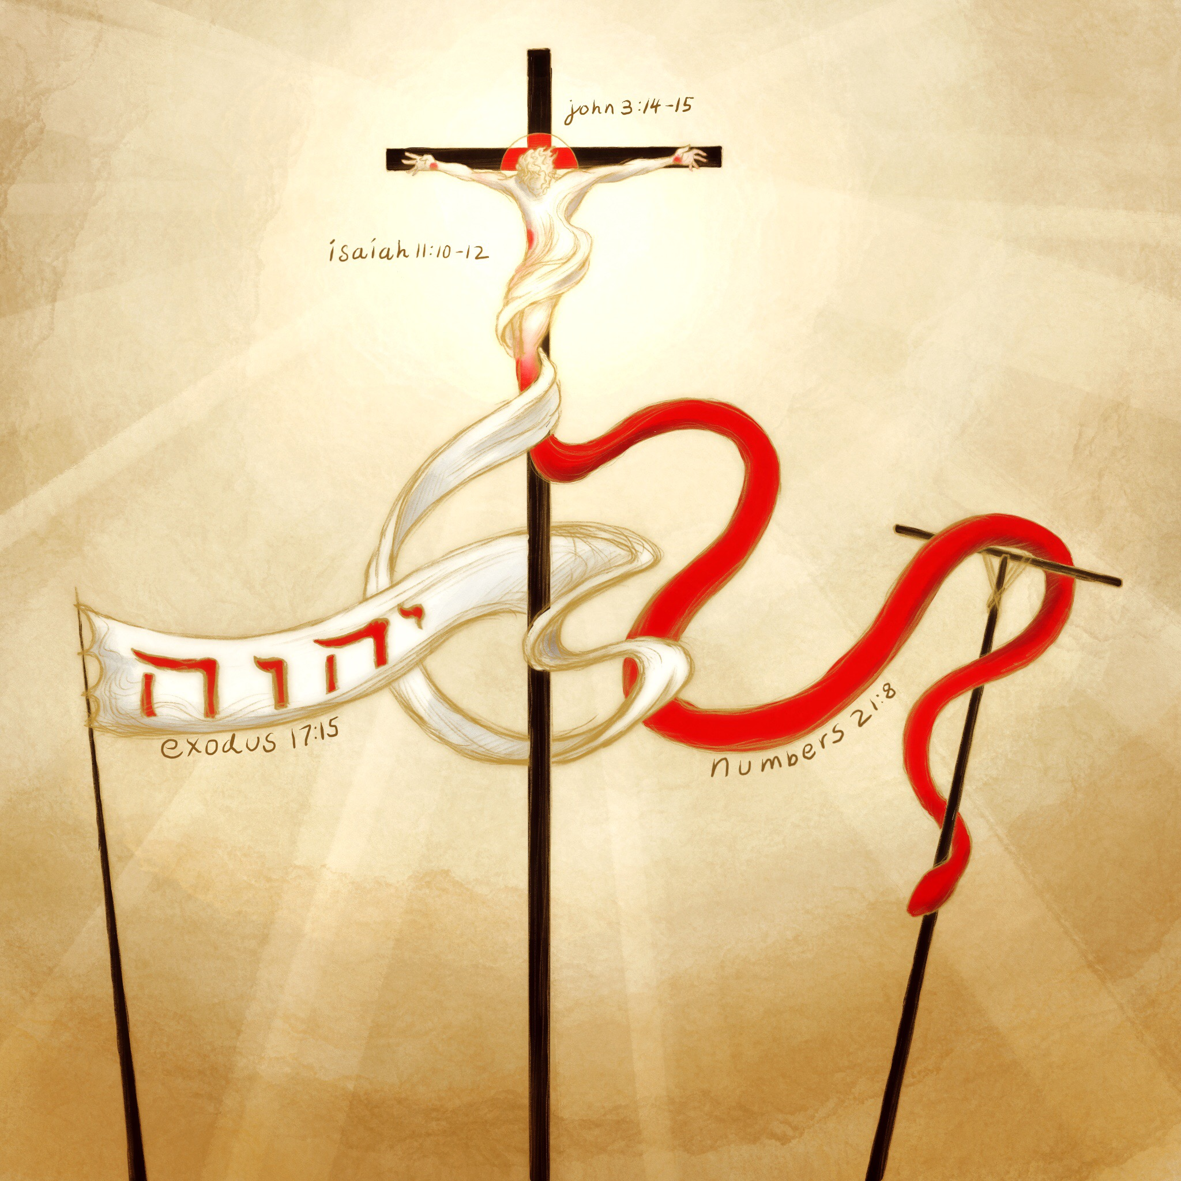
Ethiopia
Message expanded to entire world
Isa 18:3-6 – “³All you inhabitants of the world and dwellers on earth, as soon as a standard is raised on the mountains, you will see it, and as soon as the trumpet is blown, you will hear it. ⁴For thus the Lord has told me, ‘I will look from My dwelling place quietly like dazzling heat in the sunshine, like a cloud of dew in the heat of harvest.’ ⁵For before the harvest, as soon as the bud blossoms and the flower becomes a ripening grape, then He will cut off the sprigs with pruning knives and remove and cut away the spreading branches. ⁶They will be left together for mountain birds of prey, and for the beasts of the earth; and the birds of prey will spend the summer feeding on them, and all the beasts of the earth will spend harvest time on them.”
Isa 11:10 – “Then in that day the nations will resort to the root of Jesse, who will stand as a signal for the peoples; and His resting His resting place will be glorious.”
Isa 11:12 – “And He will lift up a standard for the nations and assemble the banished ones of Israel, and will gather the dispersed of Judah from the four corners of the earth.”
Notes:
But rather than this simply being a message specifically to Ethiopia, Isaiah says, “this message I’m sending to them needs to be said to the entire world”.
Isa 18:3 – This alludes back to what we studied in chapter 11. A banner would be raised…what is the banner in Isa 11? The root of Jesse. It will be raised on the mountains for all to see, and like a trumpet blown, all will hear. And when this occurs, all nations on the Earth, Ethiopia or otherwise, must be ready to perceive the message. Because when God decides to act, it will not only be a rallying point to those who wish to come to come to Him, but a sign of judgment for those who wish to reject Him.
Now, while all the nations are trying to figure out what to do about Assyria, Ethiopia is scurrying about trying to make alliances, and Judah is frantically trying to figure out what to do and who to put their trust in, notice God’s disposition from His throne – Isa 18:4 – There is stark contrast between all the chaos occurring on earth, and the tranquility of God in heaven. What’s up w/that? It is to remind us that God “sitting and looking quietly” is far more powerful than all the deliberations of the nations combined. In spite of all the political alliances and diplomatic bruhaha, God works w/o fanfare. And just as the heat of the sun and dew gradually ripens the harvest, God is allowing the time of judgment to mature for when He finally makes His presence known.
And just when Assyria thinks it’s going to win…Isa 18:5 – This is an agricultural reference Judah would have understood. He’s comparing the nations schemes and plans to a ripening harvest, and just as their plans are about to reach fruition, God’s hand cuts off their harvest. Agriculturally, this would be devastating to farmers and vine dressers, to see all that hard work come to nothing right when its time to harvest. Perfect illustration of Sennacherib’s invasion of Judah. Assyria’s growth is an exercise of futility. God will only allow their threat to grow so far.
When He’s finished w/them…Isa 18:6 – Meaning, the carcasses of the army of Assyria will literally become food for the birds of prey when God was done w/them. This would be such a feast for the animals, there won’t be enough men to deter the animals from doing so. This was a victory no man could have achieved. Any nation’s attempt to run the world, like Assyria and its imperialism, or Ethiopia and its quest for collective strength, will ultimately collapse. One might ask why God would allow Assyria to get so strong to begin with. Perhaps so people will understand the true power of the Lord of hosts, and that one of the reason so many will be drawn to the mountain of the house of the Lord is because there is truly no one like Him.

Slide 10
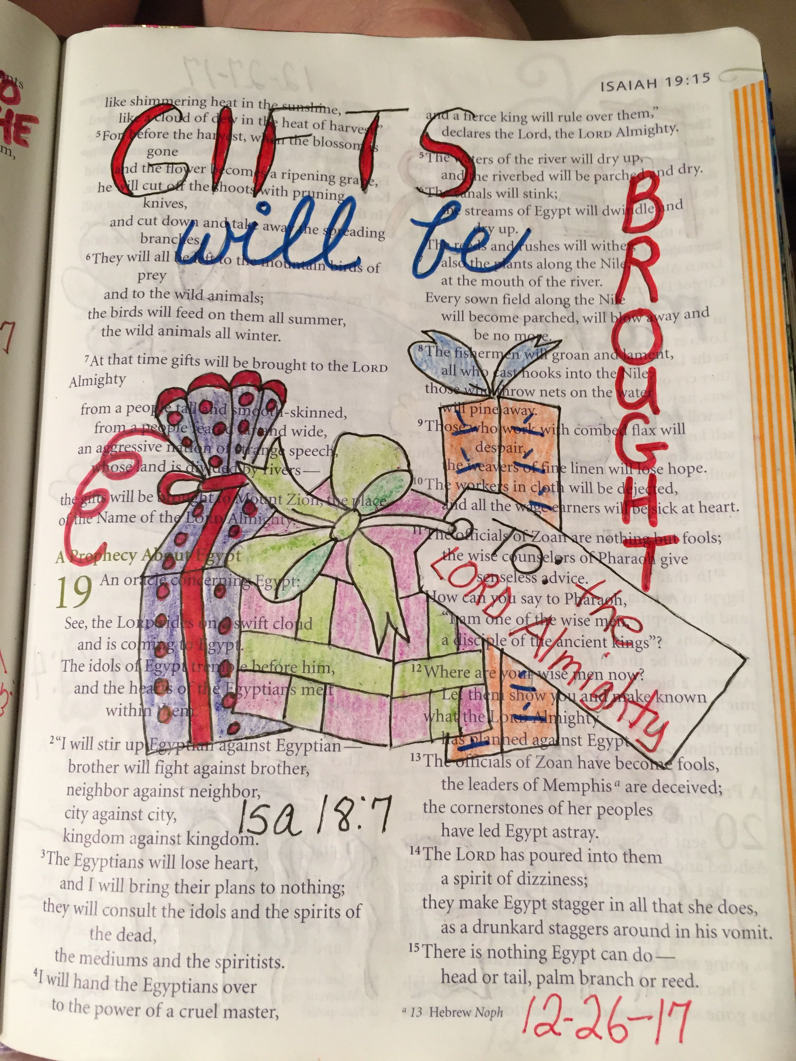
Ethiopia
Ethiopia to be drawn to Zion
Isa 18:7 – “⁷At that time a gift of homage will be brought to the Lord of hosts from a people tall and smooth, even from a people feared far and wide, a powerful and oppressive nation, whose land the rivers divide—to the place of the name of the Lord of hosts, even Mount Zion.”
Notes:
And so, the message to Ethiopia is repeated from vs. 2, w/a twist, but in an ironical sense – Isa 18:7 – Here’s the point: Ethiopia’s message to Judah in vs. 2 was nowhere near as important as Judah’s message should be to Ethiopia. In vs. 2, Isaiah seems to want Judah to send their own messengers back to Ethiopia informing them that Ethiopia has it backwards. Judah would not be soliciting help from Ethiopia. Rather, Ethiopia would eventually need to get help from Judah if it were to ultimately be saved. God’s people don’t need Ethiopia’s help, they need God’s help. And when they eventually figure that out, their messengers will be bringing gifts of homage to Mount Zion. In fact, what Ethiopia was doing only made matters worse. Because of their actions, Philistia listened to Ethiopia, prompting Sargon II to take action against the Philistine city of Ashdod, what’s called the Ashdod rebellion, referred to in 20:1. More on that later.
How did this happen in the NT? Cyrus funded the temple from the Persian treasury. Magi brought gifts to baby Jesus. Ethiopian Eunuch. Paul’s collection from Gentile churches to Jewish churches – Rom 15; Rev 21-22 – nations come and bring what they have into the city. A big part of the coming Messianic age would be the ingathering of the Gentiles and the tribute they bring w/them.

