Slide 1
Notes:
This study will conclude chapters 7 – 12, the book of Immanuel, and it is going to end on a high note as the pendulum swings from judgment back to more promises. The hope of Immanuel that was introduced in chapter 7 and amplified in chapter 9 now reaches full flower in chapter 11. In time when Judah’s failure to trust God brough on Assyrian judgment, and Assyrian pride brought on God’s judgment, God is giving a glimpse of a new, better kind of leadership. Chapter 11 envisions a time when those in authority no longer see themselves as privileged, but as responsible for those they lead. This section introduces the Messiah as a servant ruler, and He’s not a servant because He is too weak to rule, He’s a Servant because He’s so powerful, He need not dominate through force. In other words, He completes the picture of the incarnate children we’ve seen time and again in these chapters, and that through weakness there is true strength.
As we consider chapters 11 – 12, pay attention to the contrasts between the kingdoms of old and this new kingdom God would bring.

Slide 2
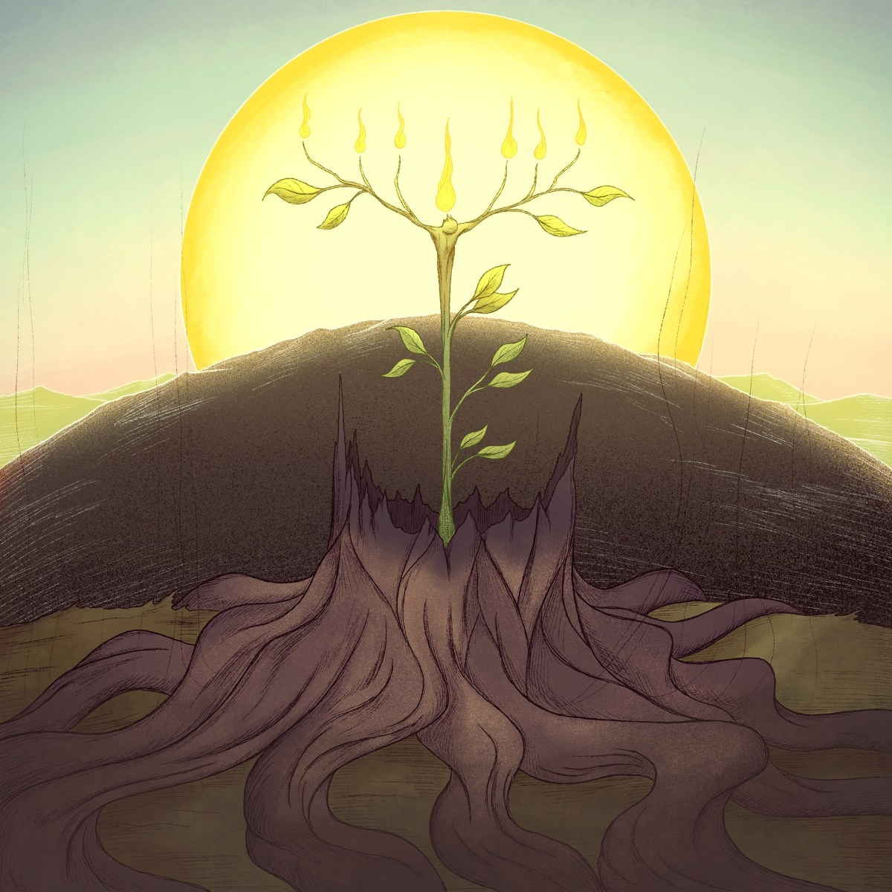
David Stump: Nature/Character
Isa 11:1-5 – “¹Then a shoot will spring from the stem of Jesse, and a branch from his roots will bear fruit. ²The Spirit of the Lord will rest on Him, the spirit of wisdom and understanding, the spirit of counsel and strength, the spirit of knowledge and the fear of the Lord. ³And He will delight in the fear of the Lord, and He will not judge by what His eyes see, nor make a decision by what His ears hear; ⁴but with righteousness He will judge the poor, and decide with fairness for the afflicted of the earth; and He will strike the earth with the rod of His mouth, and with the breath of His lips He will slay the wicked. ⁵Also righteousness will be the belt about His loins, and faithfulness the belt about His waist.”
Judicial/Governmental
Strategy/Military
Relational/Piety
Notes:
The end of chapter 10 presented a picture of Go cutting down the forest that us Assyria. In contrast…Isa 11:1 – When Babylon destroyed Assyria in 609BC, nothing arose from its stumps. But we saw in Isa 6:13 that something holy would arise from a stump in Judah. Why the partiality? “God is with us”. When all seemed lost for Judah, and all signs of vitality were seemingly gone, a little shoot would pop up out of a stump from a family tree that had lay dormant for over 600 years, bearing fruit. And this salvation would not come from royal spectacle, but from a descendant of the peasant family of Jesse.
And despite His humble lineage He’d far exceed expectations – Isa 11:2 – So His awesome abilities would not come from human power; He’d be energized by God Himself. This shoot may look barely alive, but He’d be full of the Spirit of God. And John 3:34 tells us that Jesus received the Spirit “without measure”. This endowed Him w/ 3 pairs of abilities:
1) Wisdom and understanding – This is in contrast to 10:13, where Assyria boasted in its so-called “wisdom” and “understanding”, as if it came from them and not God. But the Branch would receive these things from God in full recognition of that fact. Wisdom and understanding are judicial and governmental attributes which speak to the fact that He’ll have insight that looks past the surface to the true heart of an issue.
2) Counsel and strength – these are the attributes of strategy and of military strength, the ability to devise a right course of action together w/the physical and mental proficiency to see it through. We’ve already seen in 9:6 that He would be called “Wonderful Counselor”, and this would only be possible because of the wisdom and understanding He’d be given.
3) Knowledge and fear – this word “knowledge” actually means to conform to another individual. It’s the same word used in Gen 4:1 where it says the man “knew” His wife Eve. Don’t get caught up in the sexual aspect of this, rather the intimacy. Because when applied to God, it’s about conforming to Him religiously and morally. And fear is a moral concern that motivates obedience and fosters ethical conduct.

Slide 3
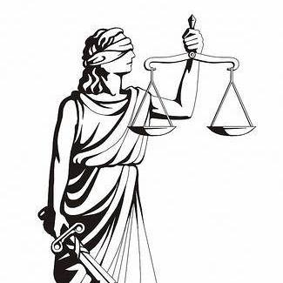
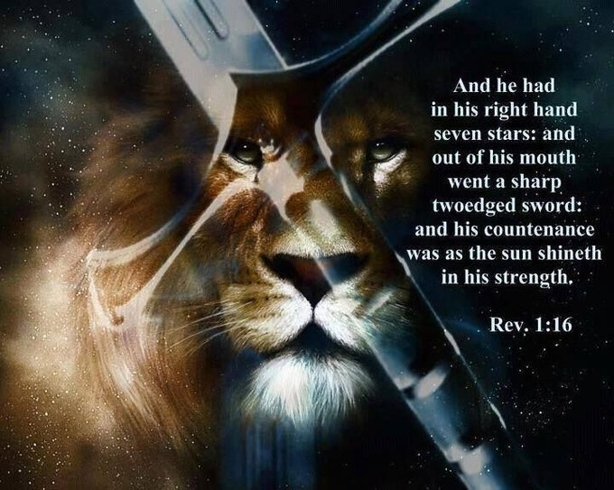
David Stump: Nature/Character
Isa 11:1-5 – “¹Then a shoot will spring from the stem of Jesse, and a branch from his roots will bear fruit. ²The Spirit of the Lord will rest on Him, the spirit of wisdom and understanding, the spirit of counsel and strength, the spirit of knowledge and the fear of the Lord. ³And He will delight in the fear of the Lord, and He will not judge by what His eyes see, nor make a decision by what His ears hear; ⁴but with righteousness He will judge the poor, and decide with fairness for the afflicted of the earth; and He will strike the earth with the rod of His mouth, and with the breath of His lips He will slay the wicked. ⁵Also righteousness will be the belt about His loins, and faithfulness the belt about His waist.”
Notes:
Sometimes Christians look at the fear of the Lord as a bad thing. How would Jesus feel about this? – Isa 11:3a – That word “delight” is the same word used in Gen 8:21 when after Noah got off the ark and offered sacrifices, it says the Lord “smelled” the soothing aroma – same word. Fear wasn’t something Jesus avoided; He delighted in it because it delighted Him to do the Father’s will.
Isa 11:3bc – In other words, Jesus would not be tricked into by false testimony that can easily deceive the eyes and ears. So, lady justice needs to be blind, so as to avoid partiality, a human judge can only use his natural faculties to render judgments. But our heavenly Judge will be able to distinguish appearance from reality. After all, He’ll have perfect knowledge, and w/perfect knowledge comes perfect judgment.
Isa 11:4ab – This doesn’t mean that poverty and oppression won’t exist in the Messianic Age, simply that they will be of special concern to Him when others try to take advantage. There will be absolute fairness w/the Judge, straight and equitable justice.
Isa 11:4cd – This is in contrast w/the “rod of His anger” in 10:5. The rod of His mouth is the word of God, and it will be so powerful, it alone will bring justice. And the NT shows the power of Jesus’ words to do so many great things. To the storm, He said, “Peace, be still.” To the paralytic, He said, “Your sins are forgiven”. To a 4-day old decaying body, He said, “Lazarus, come forth.” That rod is infinitely more powerful than Assyria.
Isa 11:5 – We often look at the belt in the armor of God of Eph 6 as representing “readiness”, hence the phrase “gird up your loins” in which the person would take their cloak and wad it up and stick behind them beneath their belt for better movement. But the word “belt” as used here means “waistcloth”, referring to the undergarment. So, the idea would be that if you strip away everything external form the Messiah, what’s left? Righteousness and faithfulness. Deep inside, He has all the qualities we’re looking for, in contrast w/kings who look kingly on the outside, but not inside.

Slide 4
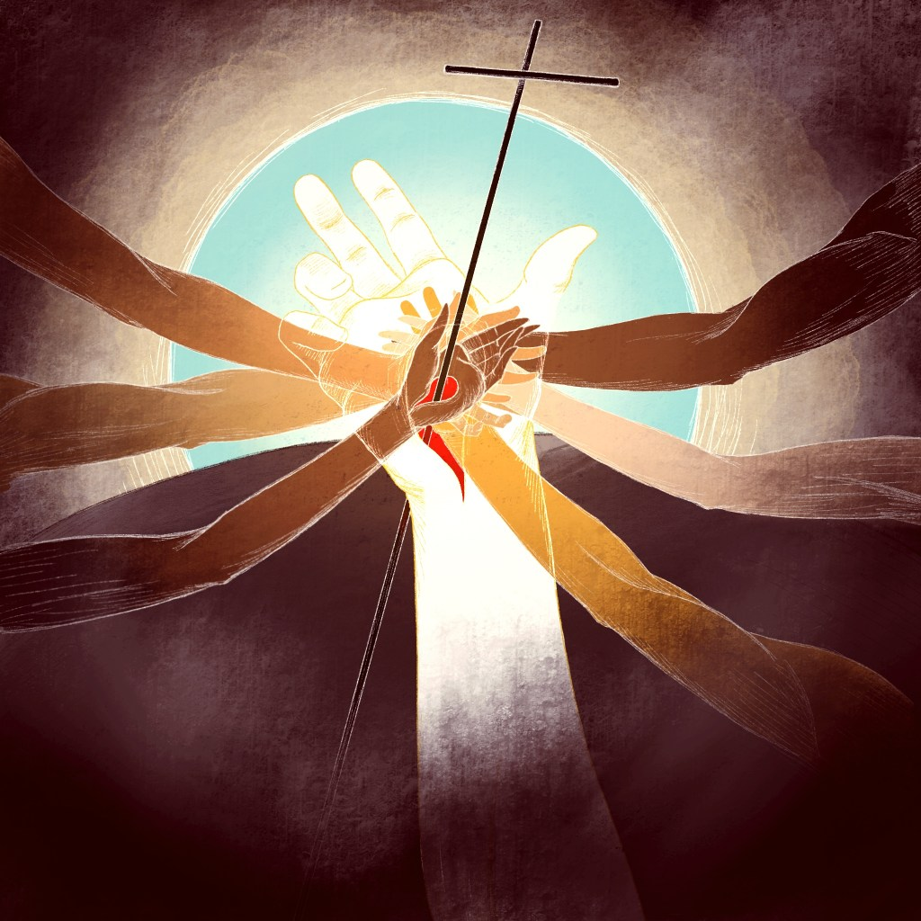
Davidic Stump: Character of Subjects
Isa 11:6-10 – “⁶And the wolf will dwell with the lamb, and the leopard will lie down with the young goat, and the calf and the young lion and the fatling together; and a little boy will lead them. ⁷Also the cow and the bear will graze, their young will lie down together, and the lion will eat straw like the ox. ⁸The nursing child will play by the hole of the cobra, and the weaned child will put his hand on the viper’s den. ⁹They will not hurt or destroy in all My holy mountain, for the earth will be full of the knowledge of the Lord as the waters cover the sea. ¹⁰Then in that day the nations will resort to the root of Jesse, who will stand as a signal for the peoples; and His resting His resting place will be glorious.”
Clean & Unclean
Notes:
What about those in His kingdom? – Isa 11:6-8 – If a Jehovah’s Witness visits you, they’ll hand you literature from the Watchtower Society that depicts a lamb next to a lion and a little kid playing w/them unharmed, and that this is supposed to be this new millennial earth that comes after Judgment Day. That is a gross misinterpretation of the text. This is referring to the kingdom of God, the Lord’s church, and as we’ve already seen in Isa 2, the Lord’s church will be a kingdom of peace. In vs. 6 and 7, animals are listed in pairs, and like the cities we’ve seen, there is a patterns. There are at least 3 ways to interrupt them.
1) Each pair contains a clean and an unclean animal dwelling together in harmony. In fact, a lion is eating straw like an ox would, something not normally part of its diet. What might this allude to in the kingdom? Jew and Gentile uniting. The wolf will “dwell” with the lamb, and in Acts 10:48, after Peter baptized Cornelius and his household, he stayed with them a few days. “the lion will eat straw like the ox” – “In Gal 2 they were known to eat together, though Peter backtracked from his previous experience w/Cornelius. The kingdom of heaven will find Jew and Gentile eating and dwelling together.

Slide 5
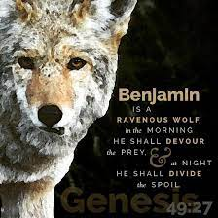
Davidic Stump: Character of Subjects
Isa 11:6-10 – “⁶And the wolf will dwell with the lamb, and the leopard will lie down with the young goat, and the calf and the young lion and the fatling together; and a little boy will lead them. ⁷Also the cow and the bear will graze, their young will lie down together, and the lion will eat straw like the ox. ⁸The nursing child will play by the hole of the cobra, and the weaned child will put his hand on the viper’s den. ⁹They will not hurt or destroy in all My holy mountain, for the earth will be full of the knowledge of the Lord as the waters cover the sea. ¹⁰Then in that day the nations will resort to the root of Jesse, who will stand as a signal for the peoples; and His resting His resting place will be glorious.”
Clean & Unclean
Predator & Prey
Notes:
2) Each pair also represents predator and prey. A wolf doesn’t typically dwell with the lamb; it eats it. When Saul of Tarsus began persecuting the church, Acts 8:3 says he began “ravaging” the church. And interestingly, that’s exactly what Jacob said about his tribe of Benjamin way back in Gen 49:27 – “Benjamin is a ravenous wolf; in the morning he devours the prey, and in the evening, he divides the spoil.” But when Jesus appeared to Saul on the road to Damascus, and Saul became a Christian, that wolf started dwelling w/lambs. That’s just one example of how the kingdom of God will be full of people and cultures and religions once hostile to one another who now dwell together in unity, and this is a theme that will be further developed in Isaiah.

Slide 6
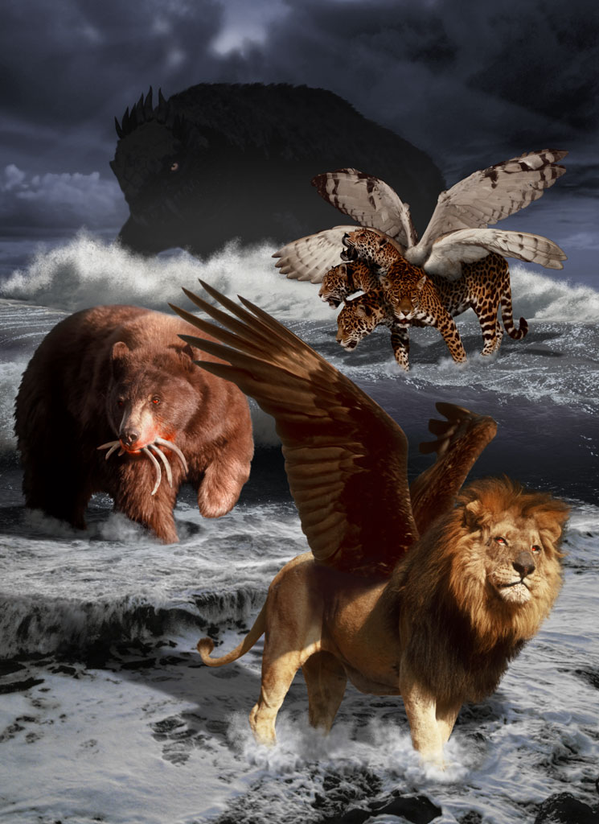
Davidic Stump: Character of Subjects
Isa 11:6-10 – “⁶And the wolf will dwell with the lamb, and the leopard will lie down with the young goat, and the calf and the young lion and the fatling together; and a little boy will lead them. ⁷Also the cow and the bear will graze, their young will lie down together, and the lion will eat straw like the ox. ⁸The nursing child will play by the hole of the cobra, and the weaned child will put his hand on the viper’s den. ⁹They will not hurt or destroy in all My holy mountain, for the earth will be full of the knowledge of the Lord as the waters cover the sea. ¹⁰Then in that day the nations will resort to the root of Jesse, who will stand as a signal for the peoples; and His resting His resting place will be glorious.”
Clean & Unclean
Predator & Prey
Wild & Domestic
Notes:
3) Each pair also represents wild and domestic animals. In Isa 5:29, Assyria referred to as a young lion. In Dan 7, how all these same animals are referred to, Babylon is a lion, Medo-Persia is a bear, Greece is the leopard. The Babylonian and Medo-Persian nations were wild animals threatening all the domesticate nations around them through physical conquest, and Greece threatened them through philosophical conquest. But in the kingdom of God, they’d all be reeducated in God’s word and would be at peace with one another. And there might not be a better NT verse that fully encapsulates Isa 11:6-8 than 2 Cor 5:17 – “Therefore if anyone is in Christ, he is a new creature; the old things passed away; behold, new things have come.” And Christians scattered throughout the nations are to see each other like this even if the nations themselves don’t.
Also notice the emphasis on children once again – “a little boy will lead them”; “The nursing child will play by the hole of the cobra, and the weaned child will put his hand on the viper’s den.” What’s this all about? Matt 18:3 – “Truly I say to you, unless you are converted and become like children, you will not enter the kingdom of heaven.” Meaning, w/all the emphasis on children in this section, strength in seeming weakness, the ultimate goal is for us to take on that childlike disposition and use it to lead others to Jesus Christ. Just as His humility brings people to the cross, our childlike humility can bring others to Him. In vs. 8, he’s not saying we can allow our kids to go out and play w/a serpent’s pit. I believe he’s saying that the enmity that has plagued us for so long, death, will finally be removed by the suppressing of that most ancient of enmities, the serpent. 1 Cor 15:55 – “O death, where is your victory? O death, where is your sting?” This is symbolic of the curse being removed from those of us born again in Christ Jesus, who take on that childlike spirit so necessary to inherit the kingdom of God. As 1 Cor 10:13 teaches, the serpent is not gone, but his power has been greatly limited.

Slide 7
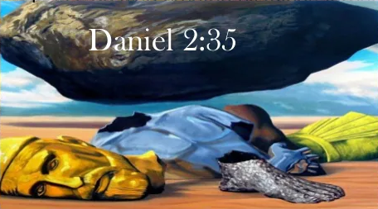
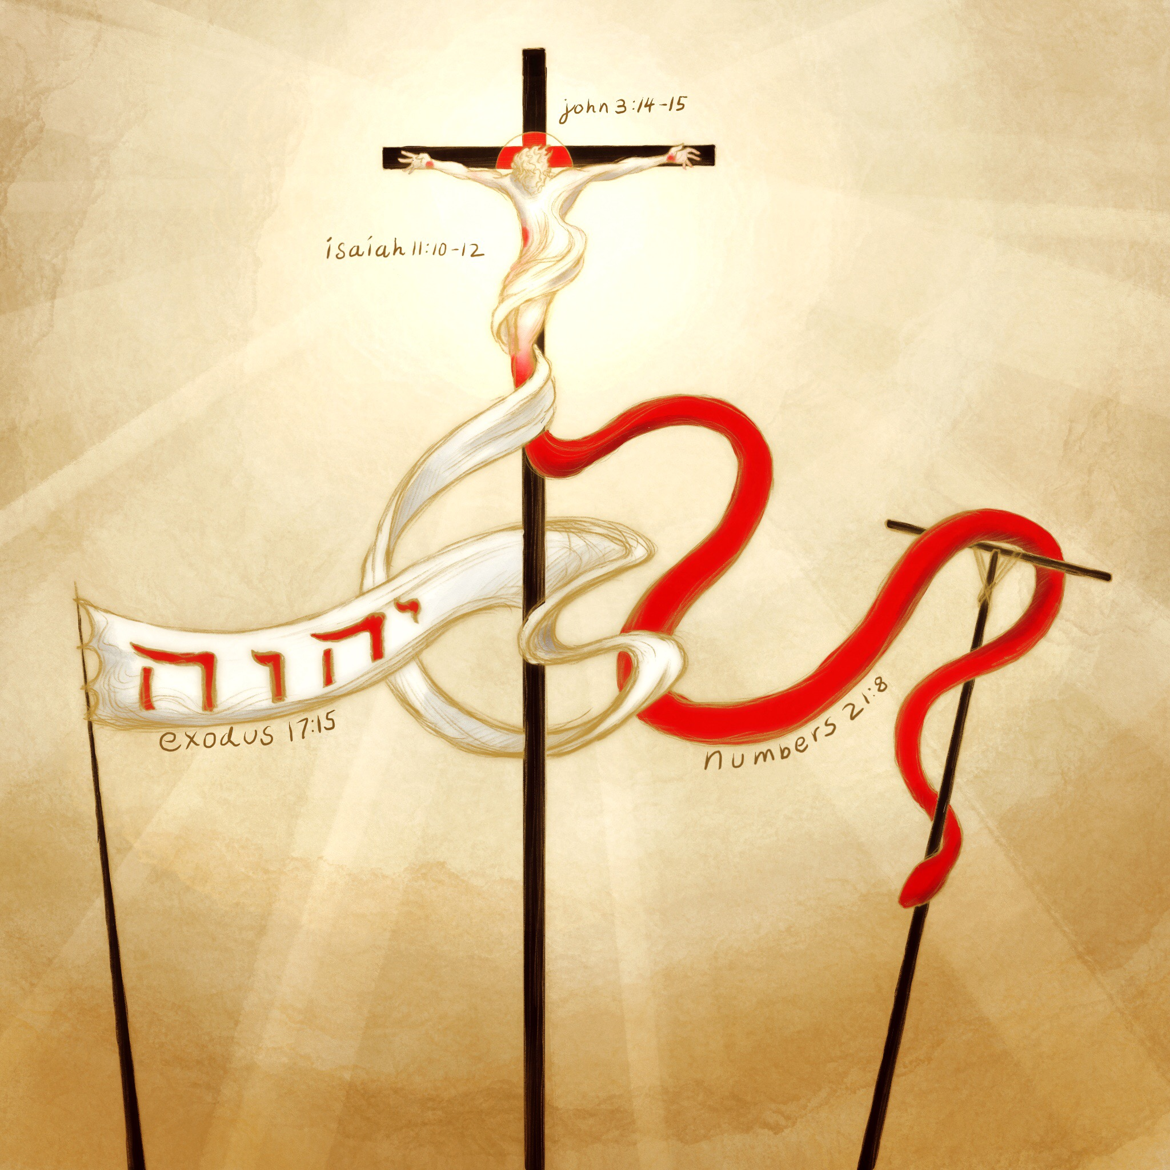
Davidic Stump: Character of Subjects
Isa 11:6-10 – “⁶And the wolf will dwell with the lamb, and the leopard will lie down with the young goat, and the calf and the young lion and the fatling together; and a little boy will lead them. ⁷Also the cow and the bear will graze, their young will lie down together, and the lion will eat straw like the ox. ⁸The nursing child will play by the hole of the cobra, and the weaned child will put his hand on the viper’s den. ⁹They will not hurt or destroy in all My holy mountain, for the earth will be full of the knowledge of the Lord as the waters cover the sea. ¹⁰Then in that day the nations will resort to the root of Jesse, who will stand as a signal for the peoples; and His resting His resting place will be glorious.”
Notes:
Vs. 9 contains both the summary and the explanation – Isa 11:9 – The summary is that those who come into the kingdom will no longer hurt or destroy one another. The explanation for why is because the earth will be full of the knowledge of the Lord as the waters cover the sea. This is similar to a prophecy in Dan 2:35, regarding the stone that struck Nebuchadnezzar's statue – “the stone that struck the statue became a great mountain and filled the whole earth.”
Isa 11:10 – More contrasts. In 5:26, a banner was raised to draw Assyria to Judah for judgment. Now a banner is raised from Judah that draws Gentiles to find rest in the Messiah, and Paul quotes this verse in Rom 15:12 as reason for why the Jews and Gentiles need to get along – this was always God’s plan and they were to respect that plan. What signal? The root of Jesse, which, though once underground and invisible, has now shot up to such a height, it attracts people who once were not God’s people. There is a contrast – in vs. 1, He’d come from the stem of Jesse, in this verse He is the “root of Jesse”, implying Jesse sprang from Him! Psa 110:1 – “The Lord says to my Lord: ‘Sit at My right hand until I make Your enemies a footstool for Your feet.’” Being of the stem of Jesse speaks of His humanity, being the root of Jesse speaks of His divinity; He’s the divine source of everyone. How did the Jews miss this? Jesus challenges them on this very point in Matt 22:41-44.

Slide 8
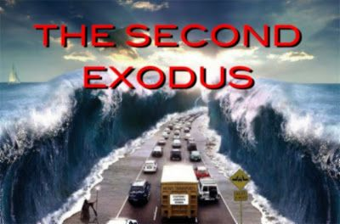
A 2nd Exodus
Isa 11:11-13 – “¹¹Then it will happen on that day that the Lord will again recover the second time with His hand the remnant of His people, who will remain, from Assyria, Egypt, Pathros, Cush, Elam, Shinar, Hamath, and from the islands of the sea. ¹²And He will lift up a standard for the nations and assemble the banished ones of Israel, and will gather the dispersed of Judah from the four corners of the earth. ¹³Then the jealousy of Ephraim will depart, and those who harass Judah will be cut off; Ephraim will not be jealous of Judah, and Judah will not harass Ephraim.”
Escape (vs. 11)
Assembly (vs. 12)
Goodwill (vs. 13)
Notes:
The remainder of chapter 11 describes a 2nd Exodus that will occur.
Isa 11:11-12 – Remember in the promise of chapter 9, in which we were told a child would be born who be called Wonderful Counselor, Mighty God, Eternal Father, Prince of Peace, establishing justice and righteousness forevermore, it begged the question, “How”? And 9:7 said, “the zeal of the Lord of hosts will accomplish this.” That’s how. The Lord’s hand, that we’ve seen so often stretched out in anger and judgment, that same hand is now being used to deliver the Jews from captivity.
Vs. 12 is really synonymous w/vs. 11, which tells us that His hand is a standard, and from vs. 10 we learned that the standard is the root of Jesse. So, in what way is God calling His people from the scattered nations which He told Isaiah in chapter 6 they’d be scattered? Through the Christ, the holy seed. Don’t get bogged down by the list of nations in vs. 11, they’re a pattern, a metaphor for what vs. 12 says are the ‘”4 corners of the earth”, Assyria, Elam, and Shinar being in the east, Egypt, Pathros, and Cush being in the south, Hamath in the north, and the Mediterranean Islands in the west.
So first there is escape, then there is an assembling, and now we read of the goodwill that will exist – Isa 11:13 – this is direct contrast to 9:19-21, in which we learned that part of Israel’s judgment was in how they treated each other – “no man spares his brother”. But not only will there be peace between Jew and Gentile, as we learned earlier in this chapter, there will be goodwill between the Jews. The divided kingdoms will once again be united.

Slide 9
A 2nd Exodus
Isa 11:14-16 – “¹⁴They will swoop down on the slopes of the Philistines on the west; together they will plunder the sons of the east; they will possess Edom and Moab, and the sons of Ammon will be subject to them. ¹⁵And the Lord will utterly destroy the tongue of the Sea of Egypt; and He will wave His hand over the River with His scorching wind; and He will strike it into seven streams and make men walk over dry-shod. ¹⁶And there will be a highway from Assyria for the remnant of His people who will be left, just as there was for Israel in the day that they came up out of the land of Egypt.”
Escape (vs. 11)
Assembly (vs. 12)
Goodwill (vs. 13)
Evangelize (vs. 14)
Remove Obstacles (vs. 15-16)
Notes:
Isa 11:14 – Again, he is speaking metaphorically. All of these nations had been traditional enemies of Israel. And if you study David’s conquests as king, from 2 Sam 5 – 13, each of these nations are listed as being conquered by David. But in this 2nd Exodus, the stem of Jesse is going to conqueror them a different way – through the rod of His mouth, the sword of the Spirit. Assyria had swooped down on all these nations and plundered them and subjected them, now the gospel will bring them into subjection, and the plunder/spoil will be the saved souls from these formerly hostile nations.
Isa 11:15-16 – These represented boundaries of Immanuel’s land, the Red Sea was the southern boundary and the Euphrates the northern boundary – Ex 23:31a – “I will fix your boundary from the Red Sea to the sea of the Philistines, and from the wilderness to the River Euphrates…”. But now these former boundaries will be removed, metaphorically. Nothing in Creation will prevent God’s new creation from rallying to His holy mountain. All obstacles will be eliminated just as God formerly made a path through the Red Sea in the 1st Exodus. It’s no longer Israel that is benefiting from redemption, but for all the earth who rally toward His cause. Like the banner/signal imagery, Isaiah loves to use highway imagery because it alludes to a path opened up for people to come to God, whosoever will.

Slide 10
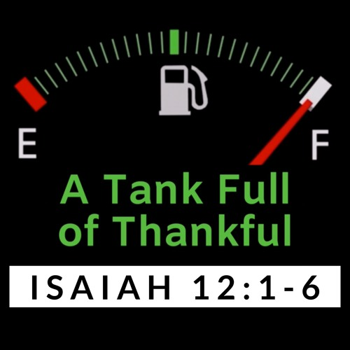
Song of Thanksgiving
Isa 12:1-3 – “¹Then you will say on that day, ‘I will give thanks to You, O Lord; for although You were angry with me, Your anger is turned away, and You comfort me. ²Behold, God is my salvation, I will trust and not be afraid; for the Lord God is my strength and song, and He has become my salvation.’ ³Therefore you will joyously draw water from the springs of salvation.”
From Anger to Comfort
Attitude Change
New Perspective On Trial
Notes:
Now, at the beginning of Ex 15, there was a song of thanksgiving after escaping the Red Sea, called the Song of Moses and the Song of Miraim. And the 2nd Exodus has a song of thanksgiving too – Isa 12:1 – interestingly, the “I” is feminine, as if this is Miriam singing again.
Remember how in chapters 9 and 10, His anger was not turned away? But in “that day”, the Messianic Age, it will be. And the text doesn’t tell us how, but if you are a Jew and you know how God’s anger over sin was propitiated under the Law, surely that must be on your mind. We’re going to learn how God’s wrath is satisfied once we get to chapter 53. Without benefit of hindsight, though, all we know is that somehow God’s anger is turned away, and the icing on the cake is He now comforts.
Isa 12:2 – Who did Judah used to put their trust in? Men – Isa 2:22 – “Stop regarding man…why should he be esteemed?” Who did they used to fear? Armies – Isa 7:2b – “[Ahaz’s] heart and the hearts of his people shook as the trees of the forest shake with the wind.” Not anymore. Something about the Messianic Age will cause men to trust God and to no longer be afraid. According to this verse, who is the source of salvation? God and God alone. This concept is so important, the verse says it twice. We didn’t ask Him to send Jesus. And if He had waited for us to ask Him before He sent Him, He never would have come. He is the one who made the first move, who reached out to us. So, why should we not trust Him? Why would we be afraid? This should reflect the attitude of every blood-bought Christian.
Isa 12:3 – Did God provide water for Israel in the wilderness after the first Exodus? Yes, twice before they got to Mt. Sinai, and He’ll do so again. This contrasts Isa 8:6-7 where we learned that Israel rejected the gently flowing waters of Shiloah for the mighty Euphrates. The Christian journey often looks like a barren wilderness, but springs of salvation are made available by God to draw from w/joy as Paul did while in his barren wilderness of prison, and repeatedly encourages us Christians to do the same in Philippians.

Slide 11
Song of Thanksgiving
Isa 12:4-6 – “And in that day you will say, ‘Give thanks to the Lord, call on His name. Make known His deeds among the peoples; make them remember that His name is exalted.’ ⁵Praise the Lord in song, for He has done excellent things; let this be known throughout the earth. ⁶Cry aloud and shout for joy, O inhabitant of Zion, for great in your midst is the Holy One of Israel.”
From Anger to Comfort
Attitude Change
New Perspective On Trial
Encourage Others
Notes:
The singular now changes to the plural – Isa 12:4-6 – In vs. 2, He was the song of the saved. But praising God is just too big a job for us alone. Now it becomes the song for whoever will listen so that they may have opportunity to be saved. So excellent are the things He has done, they cannot be selfishly hoarded by the one saved. And this praise is the primary means which men will learn about the Messiah. What does “He is in our midst” sound like? “God is with us.” What a contrast to what Isaiah initially experienced in chapter 6, to remember that the one whose train fills the temple, which would have kept Him out of the temple, that now He is “in our midst” – Immanuel.

