Slide 1
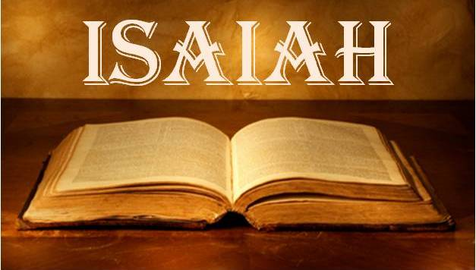
Notes:
The book of Isaiah is the most theologically dense books in all of scripture. IMHO, no book can match its splendor and its design. And this may be one of the reasons why it is the most quoted prophet in the NT, and along with Psalms and Deuteronomy is one of the most frequently quoted. This 66-chapter book is a collection of oracles, prophecies, and a few historical narratives here and there. But the main literary type used is Hebrew poetry. Isaiah uses Hebrew parallelisms w/word pictures and emblems. And so, the majority of it cannot be read as a narrative, which can present some challenges, ones we’ll attempt to overcome the next 6 months.
It takes its name from its writer, which means “God saves”. But there is one common theme throughout the entire book: “Trust God.” I know that sounds very simplistic for such a large book, and maybe you were expecting something deeper. But if it’ll make you feel better, just remember that trusting God is a challenge that we humans face throughout out entire life, and our life is a lot longer than 66 chapters. This is the point of the book – “Trust God”, and it is the biggest challenge God’s people faced in Isaiah’s days and the days beyond.

Slide 2
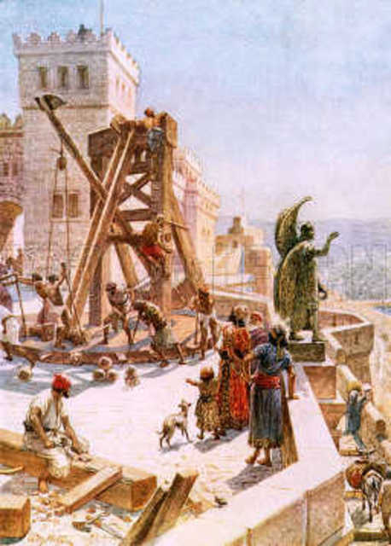
Background
Uzziah & Jotham
Good Kings
Nation Prospered
People Corrupt
Uzziah’s Pride
God Losing Patience
Notes:
A little background (2 Chron 26; 2 Kings 15):
Around 791BC, a 16-year-old kid named Uzziah became king, and he would reign for 52 years. Uzziah was one of the best kings to reign since David. God allowed the nation of Judah to become immensely strong under Uzziah. All the surrounding nations were subjugated to Uzziah and he fortified Judah more than any other king before him. 2 Chron 26:5 – “as long as he sought the Lord, God prospered him.” And when his son Jotham became king in his place, he was also a good man, reigning 16 years – 2 Chron 27:6 – “So Jotham became mighty because he ordered his ways before the Lord his God.” And Jotham would continue fortifying Judah and subduing the surrounding nations. So, both of these kings were 2 of the best kings Judah had seen.
But what about the people they ruled? Under Uzziah, where were the people at, spiritually speaking? – 2 Kings 15:4 – “Only the high places were not taken away; the people still sacrificed and burned incense on the high places.” What about under Jotham? – 2 Chron 27:2c – “But the people continued acting corruptly.”
And even Uzziah made a terrible mistake in the latter years of his reign – 2 Chron 26:16 – “But when he became strong, his heart was so proud that he acted corruptly, and he was unfaithful to the Lord his God, for he entered the temple of the Lord to burn incense on the altar of incense.” And if you keep reading, God struck Uzziah with leprosy, and he had to live out the remainder of his days in a separate house, and that’s when Jotham took over as coregent to his father.
It was this last year before Uzziah died, that we’re told in Isa 6 that Isaiah received his commission from God to prophesy to the people. Why? Because while Israel and Judah both enjoyed peace and economic prosperity, it lulled the people into spiritual complacency and sin, and that sin even infected one of Judah’s best kings.
And so, God is starting to lose patience. They’re not listening to His word, they’re not listening to His prophets, and the sin of the people is so infectious that it’s starting to infect Judah’s most righteous kings. Something has got to be done to fix the problem of sin.

Slide 3
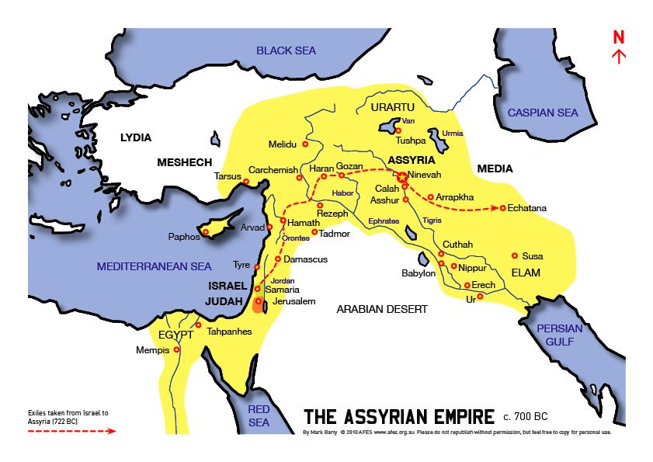
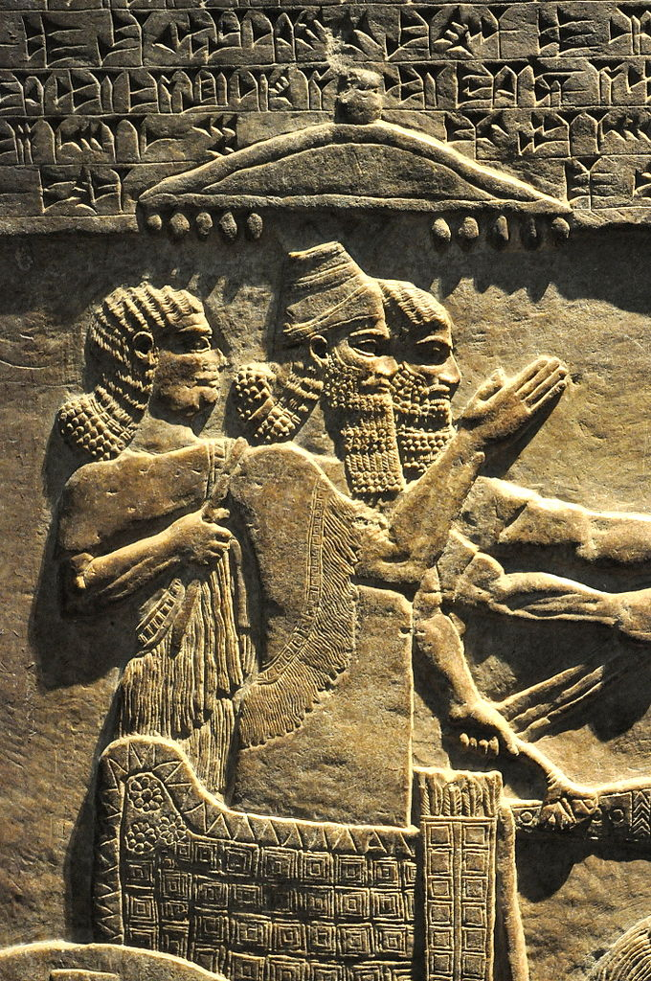
Notes:
And so, in the first part of Isaiah, God announces a purging that He is going to bring upon both Israel and Judah, and He’s going to do so by raising up a very powerful, intimidating nation called the Assyrian empire, who He refers to in Isa 10:5 as “the rod of My anger.” It’s king, Tiglath-Pileser III, was the very epitome of an Assyrian king – ruthless, powerful, intelligent, energetic, and decisive. He was unmerciful, decorating their palaces w/the flayed skin of its victims. And under his reign, Assyria was beginning to conquer a large portion of the fertile crescent and was posing a threat to every nation in its path.
And in view of the uncertainties created by this fast-changing international scene, rather than turning back to God as He had hoped they would, the Jews begin turning to other forms of “security”. They turned to rampant idolatry, they turned to coalitions w/other nations, they turned to bribery, and when none of these things worked and their destruction seemed inevitable, many would just resolve themselves toward reckless self-indulgence w/the mindset “Let’s eat and drink and be merry for tomorrow we’ll die”.
But there was a remnant of faithful people, like Isaiah, who were concerned about their spiritual lot in life. And they were asking questions like, “What will become of the promises of God? How will the theocracy survive? And must the righteous remnant of the nation also suffer w/the wicked?” These were the challenges facing both the faithful and unfaithful of Judah, and Isaiah’s message, for all it’s depth, its length, and its profundity, constantly comes back to this point – “Trust God.” And he proves why we can trust Him.

Slide 4
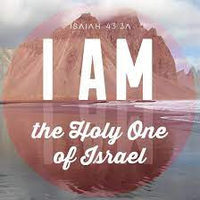
Isaiah’s Pendulum Swing
Isa 6:5 – “Woe is me, for I am ruined! Because I am a man of unclean lips, and I live among a people of unclean lips; for my eyes have seen the King, the Lord of hosts.”
Notes:
Now, as you read Isaiah, you’re going to notice something a little unsettling – a pendulum effect. Isaiah, w/very little warning, goes from hope and salvation to catastrophe and judgment right back to hope and salvation only to pronounce more judgment. Reading this book will give you whiplash. What’s he doing, just messing with us? No, the reason for this pendulum effect, is because of a phrase that appears 31 times in the OT, but 26 of those times are this one book – “The Holy One of Israel”. What is the significance of this phrase?
Well, that God is holy is an expression of His magnitude, His worth, His transcendence, perfect purity, the ultimate goodness, the summation of all qualities that make Him divine. When the bible refers to God’s holiness, it means His “otherness” or “apartness”. And as we’re going to see when we get to Isa 6, when Isaiah himself stands before this God to whom the angels are crying out “holy, holy, holy”, He says in Isa 6:5 – “Woe is me, for I am ruined! Because I am a man of unclean lips, and I live among a people of unclean lips; for my eyes have seen the King, the Lord of hosts.” In other words, it’s not God’s holiness that keeps one from being able to be in His presence, it’s our sin. Hab 1:13 – “Your eyes are too pure to approve evil, and You can not look on wickedness with favor.” And in Isaiah, the adjective “holy” is used more times in this book than all the OT taken together.

Slide 5
Isaiah’s Pendulum Swing
Gen 28:14 – “Your descendants will also be like the dust of the earth, and you will spread out to the west and to the east and to the north and to the south; and in you and in your descendants shall all the families of the earth be blessed. ”
Notes:
But then there is the phrase “of Israel”, and that means He has committed Himself to them by promise and by covenant. He made a promise to Abraham in Gen 12:3 that through Abraham’s seed, all nations of the earth would be blessed, and that promise got repeated to Abraham’s son Isaac and then to Isaac’s son Jacob in Gen 28:14. This is referring to the coming of Jesus Christ, who at the time Isaiah’s writing has not yet come. Now when this promise was repeated to Jacob, was he a righteous, a faithful man like his grandfather Abraham? No, Jacob was a deceiver and he had to learn to trust in God the hard way. And the big turning point in Jacob’s life is in Gen 32 when He is on his way back home after being away for 20 years, only to find out that his twin brother Esau is coming to meet him w/400 men. They didn’t exactly leave on good terms, and so knowing that there was no conniving he could do to get out of this pickle, he turns to God. An angel of God then visits him that night and they wrestle together and Jacob refuses to let him go until he gives him a blessing. And he does, changing Jacob’s name to what? Israel, which means “strives w/God” or “contends w/God”.
What is the point of the phrase “Holy One of Israel”? It is that Israel has been sinful and repeatedly violated their covenant w/God, and they deserve to die because they’ve offended a holy, holy, holy God. Yet God has committed Himself to them. He made an unconditional promise, and His holiness requires He keep it. This is what explains the pendulum effect of Isaiah. He’s angry and there is going to be judgment, but His judgment cannot be the last word and so He promises greater things in the future, a magnificent solution to the problem that continues to plague them. And in the meantime, Israel needs to trust Him and live up to their forefather’s name and continue to strive and contend w/Him rather than the nations and their idols. This is the reason behind the pendulum swinging in the book.

Slide 6
Judean Kings
Assyrian Kings
Notable Events
Isaiah
Jerusalem Besieged
Jotham
Hezekiah
Uzziah
Ahaz
791BC
681BC
752BC
736BC
687BC
740BC
732BC
725BC
716BC
744BC
727BC
722BC
705BC
Tiglath-Pileser III
Sargon II
Sennacherib
Shalmaneser V
Damascus Falls
Israel Falls
Isaiah’s Ministry
Notes:
Here is a very crude outline of the kings and the major events of Isaiah’s era. We’ve already discussed Judah’s kings Uzziah and Jotham. Once we get to Isaiah 7, we’ll be introduced to Jotham’s son Ahaz. And then later on his son, Hezekiah.
We mentioned the very powerful Assyrian King Tiglath-Pileser III, but he would eventually die and be replaced by Shalmaneser V, then Sargon II, and then Sennacherib who was the major threat during Hezekiah's reign.
And then there are 3 major events that take place during Isaiah’s time. The first of which is the fall of Syria’s capital Damascus in 732 BC, which we’ll talk about once we get to Isa 7 – 8. The 2nd big event is in 722BC, and it is a major biblical event: the fall of the northern kingdom of Israel. We’ll discuss this a good bit during Isaiah 7 – 8 as well. The 3rd major event that we won’t look at in detail until we get to Isaiah 36 took place in 701BC, and it is the besieging of the city of Jerusalem by Assyria’s King Sennacherib.

Slide 7
Facts About Isaiah
Written for us – Isa 30:8; Rom 15:4
Contemporary of Amos, Hosea, and Micah
Sawn in 2 by Manasseh? – Heb 11:37
Notes:
A few facts about Isaiah:
Isaiah may be in the OT, but it was written for us. Isa 30:8 – “Now go, write it on a tablet before them and inscribe it on a scroll, that it may serve in the time to come as a witness forever.” And given how often the NT writers, including Jesus Himself, quoted from this book, it is a study worth our most sincere efforts.
Isaiah was a contemporary of the prophets Amos, Hosea and Micah. However, while Amos and Hosea were primarily prophets to the northern kingdom of Israel, Isaiah was primarily a prophet to the southern kingdom of Judah, though he did have plenty to say to Israel as well. Micah was also a prophet to Judah, and his message is very similar. Some even go so far as to call Micah the “mini-Isaiah”, comparable to Isaiah the way Galatians is to Romans.
There is an interesting tradition about Isaiah that is extra biblical – Heb 11:37 – “They were stoned, they were sawn in two…”. Some biblical scholars claim that the Hebrew writer was referring to Isaiah being sawn in half by Hezekiah’s son Manasseh, because there are unsubstantiated Jewish traditions suggesting such and there is also a pseudepigrapha called “The Ascension of Isaiah” that states it. This is extra-biblical testimony, keep that in mind.

Slide 8
Facts About Isaiah
Written for us – Isa 30:8; Rom 15:4
Contemporary of Amos, Hosea, and Micah
Sawn in 2 by Manasseh? – Heb 11:37
Most quoted prophet in NT
2nd most quoted book in NT next to Psalms
Frequented royal circles
Richest of all Hebrew poetry
Notes:
4) Isaiah is the most quoted prophet in the NT
5) It is the 2nd most quoted OT book next to Psalms, but if you count the number of repeated quotes as well as the number of times we believe it was alluded to, it would be the most quoted book in the NT by far.
6) We know Isaiah frequented royal circles (Isa 7:3; 8:2; 36:1-38:8; 38:21-39:8; 2 Kings 18:1 – 20:19). Some have suggested that the reason was because he was a member of the royal family. Another Jewish tradition states that Isaiah’s father Amoz was the brother of Uzziah’s father, King Amaziah. This would make Isaiah royal blood and a first cousin to Uzziah. It would also explain how he could get away w/speaking w/such pointedness to the kings. But again, this an extra-biblical theory and tradition, and won’t make more of it than that.
7) Isaiah’s use of poetry is rich and varied. He makes use of sarcasm, word plays that are lost in translation because we can’t read Hebrew. He uses inclusios to outline his messages, which we’ll talk more about in the coming weeks. And then are mixed metaphors, alliterations, assonance, inversion. He uses a much larger vocabulary of Hebrew words than any other OT writer, which has given translators fits on how to translate correctly. In fact, there are a few dozen verses that are radically different across some of our popular translations. We’ll make note of the more pertinent ones as we get to them and then there are others that I wouldn’t waste my time worrying over too much.

Slide 9
Facts About Isaiah
Written for us – Isa 30:8; Rom 15:4
Contemporary of Amos, Hosea, and Micah
Sawn in 2 by Manasseh? – Heb 11:37
Most quoted prophet in NT
2nd most quoted book in NT next to Psalms
Frequented royal circles
Richest of all Hebrew poetry
Drops hints of coming themes
2/3 different authors?
Notes:
8) Now, one thing Isaiah loves to do while he’s developing a point is to drop hints of upcoming themes that will be further developed. Now, if you’re unfamiliar with the book, you won’t catch it at first. But if you’ve read it a few times and are familiar w/major themes in the latter half, you’ll be really impressed w/how subtly he introduces themes in order to wet your appetite and build suspense, and this is especially apparent in the few chapters leading up to the very famous Isaiah 53.
9) Some recent liberal theologians have suggested that Isaiah was actually written by 2 different authors, and others suggest 3 different authors. The reason why they suggest this is because when you get to the 2nd section of the book in chapters 40 – 66, Isaiah makes some pretty powerful and specific predictions that he could not have known at the time. And so, some will say a 2nd guy came a long a couple hundred years later and made it look like he was prophesying future events when in fact he wasn’t. 3 things on this: first, one of the main purposes of chapters 40 – 48 is to show why God is the one true God, and one of the qualifications repeatedly mentioned is that He predicts future events. The whole point of chapters 40 – 48 is moot if it wasn’t written prior to those events happening (more on that later). But secondly, in John 12:38-49, John’s gospel quotes 2 different verses from Isaiah, the first in John 12:38 is from Isaiah 53:1 and the second in John 12:40 is from Isaiah 6:10. So one is from the first section of Isaiah, the other is from the 2nd. Who was in a better position to know who wrote this book, the Apostle John or the liberal scholar 2700 years removed? And third, the expression "the Holy One of Israel” occurs 12 times in chapters 1 - 39 and 14 times in chapters 40 - 66. Outside Isaiah it appears in the OT only 6 other times. This is evidence Isaiah was the author of both sections. It is one book. Some will claim “But the style of writing is different”. Well, go back and read articles I wrote just 20 years ago and compare them to ones I’ve written recently and tell me if they look like the same author.

Slide 10
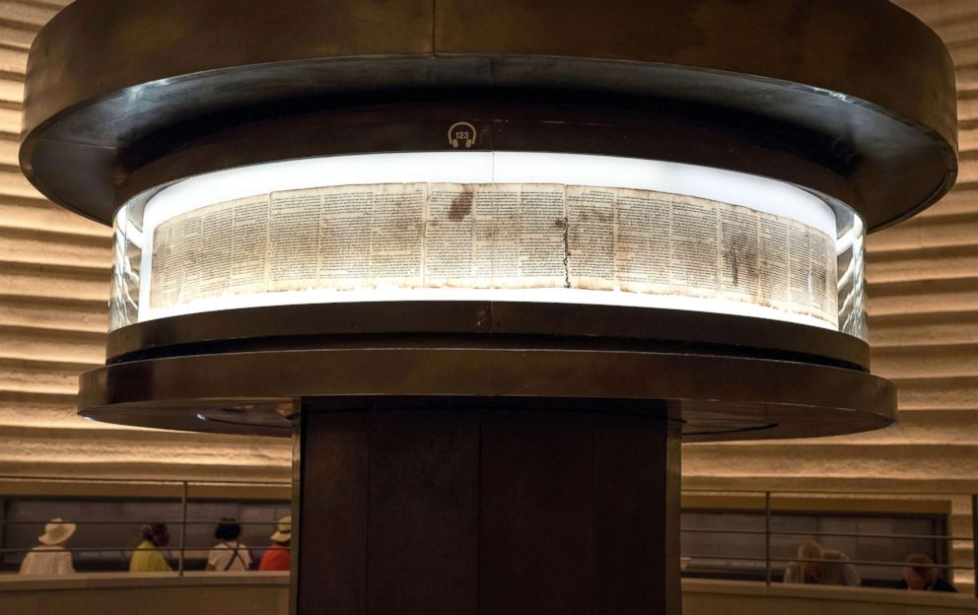
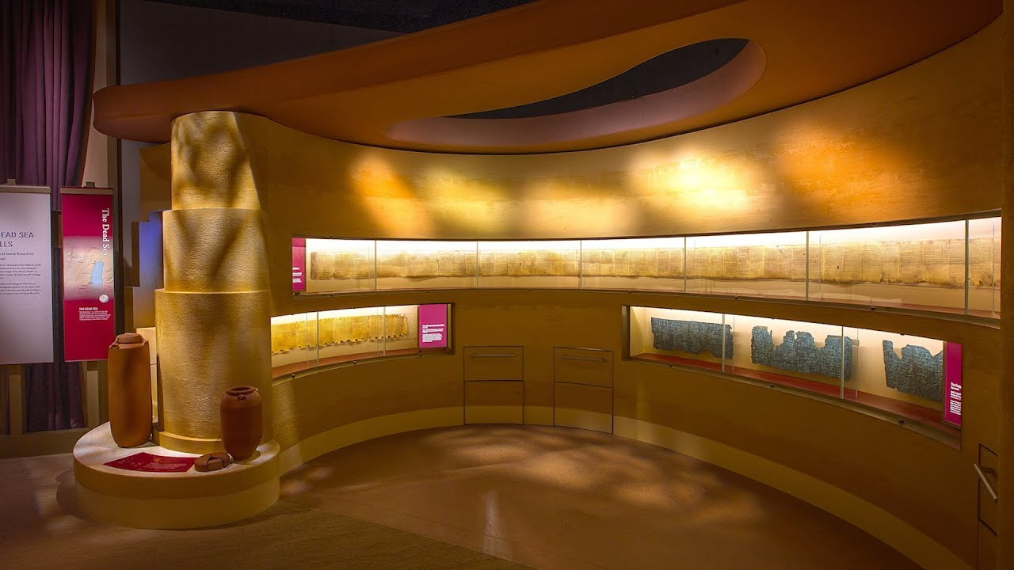
Dead Sea Scrolls
Isaiah Scroll
Discovered in 1947
2 complete copies
Dated to ~150BC
Authenticates Jesus
Notes:
But here’s one of the coolest facts about Isaiah. When the dead sea scrolls were discovered in the caves of Qumran in 1947, the most famous of all the scrolls were 2 complete copies of Isaiah dating to ~150BC. So astonishing was the discovery, Jerusalem did everything it could to preserve it in its already fragile state, initially keeping it stored underground in a temperature-controlled vault under lock and key for the first 40 years after its discovery. They then brought it out to be displayed for the first time in 2008 for a few months. The first picture is the display in Jerusalem, and the second picture is a copy of it that you can see at the Museum of the Bible in Washington, DC.
What is significant about this discovery? Well, it disproved the skeptic’s theory that Isaiah was put together many years after Jesus’ death to make Him look like the Messiah. This scroll is dated to 150 years before His birth and Isaiah contains more prophecies about Jesus Christ than any other book of the bible.

Slide 11
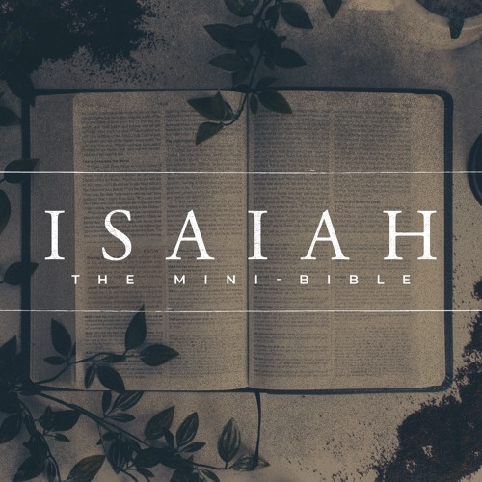
Notes:
One neat thing about Isaiah is that sometimes it is referred to as the “mini bible”. It has the same number of chapters as the bible does books (66). But many of its chapters appear to line up w/themes in the books of the bible.
For example, Isaiah 1 alludes to Sodom and Gomorrah just as we’re introduced to those cities in the book of Genesis. Isaiah 2 is going to get into idolatry, mentioning gods of silver and gold, and we know that was a prominent them in Exodus. Then in Isa 40, which would line up w/Matthew, Isa 40:3 – “A voice is calling, ‘Clear the way for the Lord in the wilderness; make smooth in the desert a highway for our God.” This is quoted as referring to John the Baptist in Matt 3:3, which is the 40th book of the bible. And then in Isa 66, we read about the new heavens and new earth, and the 66th book of the bible is Revelation which also talks a lot about the new heavens and the new earth.
Now it’s important we don’t make too much out of this because the bible didn’t get its chapters and verses until the 16th century, but it’s very interesting. But some are so convinced it was part of God’s providential plan, they’ve tried to make something in every chapter of Isaiah match up w/a theme from the matching book of the bible. And while some are very interesting, others are a little bit of a stretch.

Slide 12
Outline
1 – 5: Autopsy of Judah
6: Isaiah’s Commission
Notes:
Now, since Isaiah such a large book, it is helpful to know what the pieces are. Before climbing Mt. Everest, you would first pull out the map and study the pieces of it thoroughly in order to gain a “forest from the trees” view of it. And we’re going to make sure we’re spending sufficient time throughout the next 6 months understanding the forest from the trees. The following is how I outline the book. There are probably other ways of outlining it, but this is what makes most sense to me:
1) Isaiah 1 – 5: I mentioned earlier that during Uzziah and Jotham’s reigns, while they were good kings, the people were spiritually complacent and given over to a variety of sins. The purpose of chapters 1 – 5 is to introduce us to Judah’s issues by performing an autopsy of Judah as a spiritual body and see what is going wrong. We see 7 rebukes, 7 judgments, followed by 6 woes in chapter 5, and intermingled throughout are 3 wonderful promises. The pendulum effect is in full force in these 5 chapters so prepare yourself for some whiplash.
2) Isaiah 6: In Isaiah 6, Isaiah receives his commission from God. Some believe this should be the first chapter and not the 6th. But theologically, it is exactly where I needs to be, and I’ll explain why when we get there. But while the first 5 chapters show us Judah’s problem, Isaiah 6 is going to reveal God’s solution to the problem.

Slide 13
Outline
1 – 5: Autopsy of Judah
6: Isaiah’s Commission
7 – 12: Book of Immanuel
13 – 27: Three Cycles of Oracles
28 – 35: Alliance Vs. Reliance
Notes:
3) Isaiah 7 – 12: In chapters 7 – 12, Ahaz is now king, and he is facing a crisis. The northern kingdom of Israel along w/Syria have formed a coalition against him because he wouldn’t join them in fighting against the rising Assyrian empire. This is the section of scripture in which we read about that famous Messianic promise that a child will be born, “Immanuel”, which means God is with us. That phrase is the dominate theme of these 6 chapters, hence why scholars refer to these chapters as “The Book of Immanuel”. God assures His people that He will take down both Syria and the northern kingdom of Israel, and Judah will also be punished for her sins, but ultimately saved. Why? Because “God is with us”.
4) Isaiah 13 – 27: Then in 13 – 27, God shows us that protecting Judah from Israel, Syria, and Assyria is not some one-off exercise. What He’ll do to those nations that threaten His plan w/Judah is going to happen to every nation. And in chapters 13 – 23, the lesson is, “Stop leaning on these nations to bail you put of trouble. Stop submitting to human authority. Because one day they’re going to be coming to you to learn more about Jesus. You don’t need them, they need you. God is with us.” And chapters 24 – 27 broaden that idea to a worldwide, universal scale.
5) Isaiah 28 – 35: In these chapters, Hezekiah is now king, and the problem hasn’t gone away, only Assyria is now the dominate threat, and Egypt is the nation tempting to aid Judah. Chapters 28 – 35 are divided up between an inclusio of 6 woes dealing w/the issues of that time while counseling trust in God.

Slide 14
Outline
1 – 5: Autopsy of Judah
6: Isaiah’s Commission
7 – 12: Book of Immanuel
13 – 27: Three Cycles of Oracles
28 – 35: Alliance Vs. Reliance
36 – 37: Prediction To Demonstration
38 – 39: The Real Problem: Sin
Notes:
6) Isaiah 36 – 37: These chapters are the grand finale of the first section of Isaiah, and what some refer to as Isaiah’s halftime show. God has made prediction after prediction of what He would do to any who tried to take down His people. And now Assyria is knocking on Jerusalem’s doors and God demonstrates the very power He had been predicting through Isaiah for decades by sending an angel to kill 185,000 Assyrian troops. And they tuck tail and go home.
7) Isaiah 38 – 39: This great victory through Hezekiah’s faith was a high point for God’s people. Maybe everything will be fine going forward. Syria’s gone, the northern kingdom is gone, Assyria has run back home. Could Hezekiah be the promised Savior of Judah? Not quite. Because despite God saving Jerusalem, and also saving Hezekiah’s physical life when he got sick, Hezekiah gives into pride. This is when we really start to see that the threat of physical captivity was never really the problem; sin is the real problem that needs to be addressed; not the threat of nations but the threat of sin. And God was eventually going to have to send Judah into captivity to get them to see this point.

Slide 15
Outline
1 – 5: Autopsy of Judah
6: Isaiah’s Commission
7 – 12: Book of Immanuel
13 – 27: Three Cycles of Oracles
28 – 35: Alliance Vs. Reliance
36 – 37: Prediction To Demonstration
38 – 39: The Real Problem: Sin
40 – 48: Rescue From Physical Captivity
49 – 57: Rescue From Spiritual Captivity
58 – 66: The Anointed Conqueror
Notes:
8) Isaiah 40 – 48: The fall of Jerusalem and Judah’s captivity by Babylon would not take place for over a hundred years after this event, but in chapters 40 – 48, Isaiah assumes the destruction of Judah and proceeds to predict the restoration of the people from captivity. Why did captivity happen? Is it because the idols overpowered God and defeated Him? Is Babylon stronger than God? No, the true God’s power is beyond compare. He allowed it to happen and used this opportunity to tell beforehand the destruction of the idols, the return of Israel from captivity, and personally naming Cyrus as their deliverer long before he was even born.
9) Isaiah 49 – 57: But delivering from physical captivity still wouldn’t fix the real problem. Their captivity was merely a symptom of the problem. How would God ultimately help them, how would He ultimately bear His arm in power to rescue them? Through His Servant, the Messiah. Their immediate problem was captivity, but it was only a symptom of a greater of problem which led them into captivity in the first place. And God, as our Physician, has always wanted to fix the root of the issue. But why beat around the bush? Why not start chapter 40 w/dealing w/the real issue? Because God is going to use their “physical captivity” as a visual framework for their spiritual captivity. If only the Jews could be more concerned about the slavery of their sin rather than the physical slavery they were enduring, they would be ready to receive Jesus when the fullness of time came.
10) Isaiah 58 – 66: In the meantime, what are they do to, especially as they find themselves amongst people who don’t share their faith? They are to wait for the Anointed One, with hopeful expectation, whose work will solve the problem of sin they hadn’t been able to solve themselves. And when He comes, He will deal w/every opposition. In the meantime, they are to pray and hold on to the promises yet to be fulfilled.
This is the overall message of the book. It is beautiful and well organized, and we’re going to work really hard to that as we get into the trees, we don’t forget the forest. But since this is such a large book, the more you put into it, the more you’re going to get out of it.

Slide 16
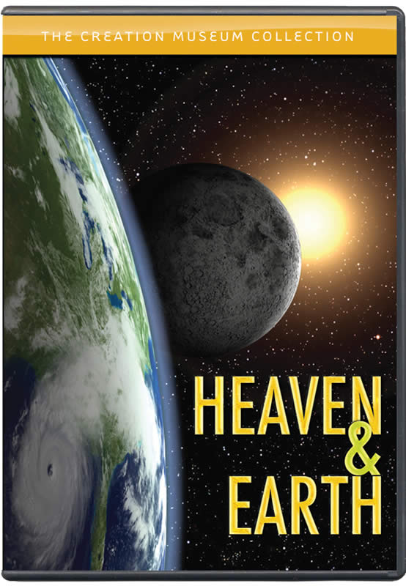
Assessing Judah’s Sins
Judah on trial
Isa 1:2a – “Listen, O heavens, and hear, O earth; for the Lord speaks; ‘Sons I have reared and brought up, but they have revolted against Me.’”
Deut 4:26 – “I call heaven and earth to witness against you today, that you will surely perish quickly from the land where you are going over the Jordan to possess it. You shall not live long on it, but will be utterly destroyed.”
Deut 31:28 – “Assemble to me all the elders of your tribes and your officers, that I may speak these words in their hearing and call the heavens and the earth to witness against them.”
Deut 32:1 – “Give ear, O heavens, and let me speak; and let the earth hear the words of my mouth.”
Notes:
If Isaiah 1 – 5 is the introduction to the book, Isaiah 1:1-8 is the introduction to the introduction. Isaiah begins by giving an overall assessment of Judah’s situation:
Isa 1:2a – Now, in the book of Deuteronomy, which was the book of the covenant, God called on heaven and earth as a witness to the covenant, both at the beginning and end of the book. Deut 4:26 – “I call heaven and earth to witness against you today, that you will surely perish quickly from the land where you are going over the Jordan to possess it. You shall not live long on it, but will be utterly destroyed.” – “Thanks for the vote of confidence, Moses, appreciate the optimism!” And yet hundreds of years later, the heavens and earth can give witness to their fall. What makes them such great witnesses? Because while the people are not constant, the heavens and earth are. They are made by God, and ironically do a better job of obeying God’s will than we do. So, this is a trial scene. Judah is the defendant, whom the charges are made against. God, with whom the nation had made a covenant is the plaintiff, the heavens and the earth, though inanimate objects of creation, are summoned to jury duty to hear the evidence, and Isaiah himself serves as the attorney to prosecute the case. God brought them up as children, blessed them as children, and they’ve completely rebelled against Him.

Slide 17
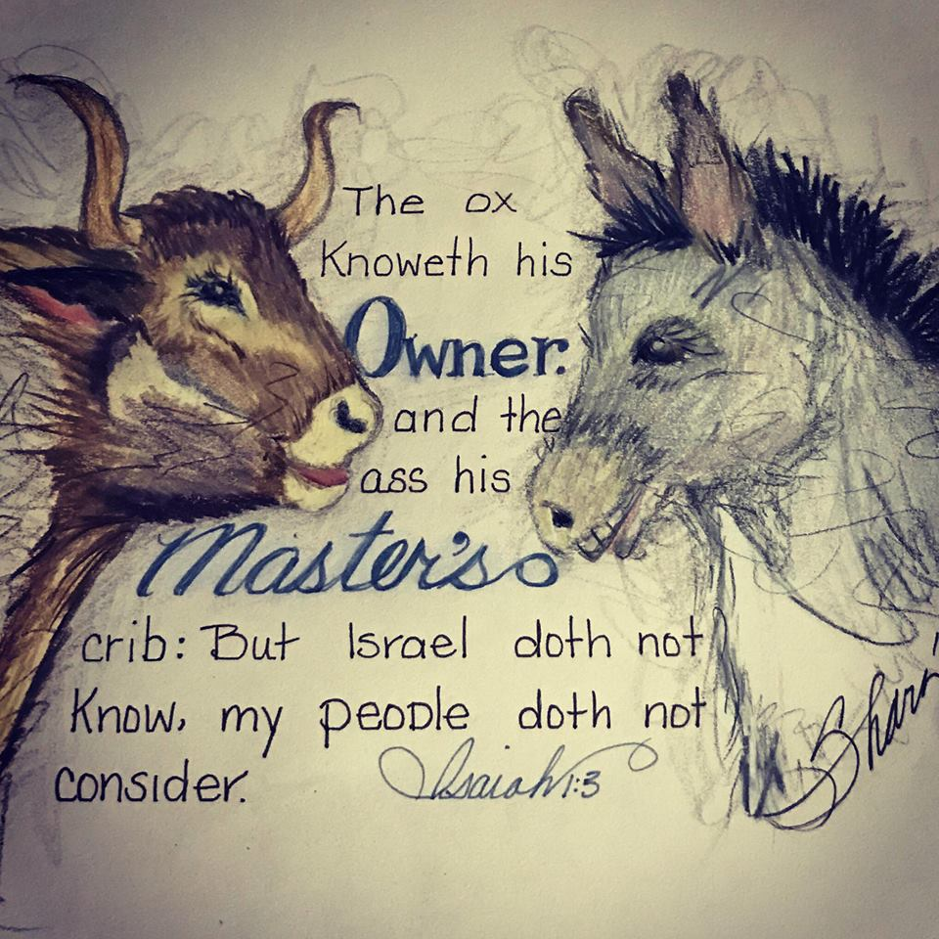
Assessing Judah’s Sins
Judah on trial
Isa 1:2a – “Listen, O heavens, and hear, O earth; for the Lord speaks; ‘Sons I have reared and brought up, but they have revolted against Me.’”
Deut 4:26 – “I call heaven and earth to witness against you today, that you will surely perish quickly from the land where you are going over the Jordan to possess it. You shall not live long on it, but will be utterly destroyed.”
Deut 31:28 – “Assemble to me all the elders of your tribes and your officers, that I may speak these words in their hearing and call the heavens and the earth to witness against them.”
Deut 32:1 – “Give ear, O heavens, and let me speak; and let the earth hear the words of my mouth.”
Dumber than the ox/donkey
Isa 1:3 – “An ox knows its owner, and a donkey its master’s manger, but Israel does not know, My people do not understand.”
Notes:
How far gone were they? Isa 1:3 – Even in the animal kingdom, an ox and a donkey are not exactly known for their intelligence; but they at least know their owner and where they bed. But Israel, who rather than being some random nation, is called by God “My people”, they don’t know God. All their supposed knowledge and understanding is put to the shame by ignorant animals, who God has loved far lesser than He has loved them. Remember Balaam’s donkey?

Slide 18
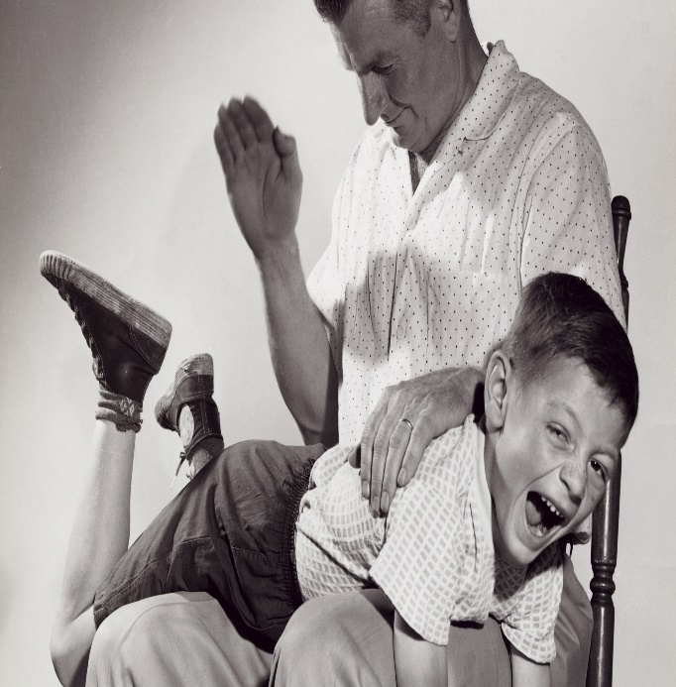
Assessing Judah’s Sins
Exasperation
Isa 1:4-5b – “Alas, sinful nation, people weighed down with iniquity, offspring of evildoers, sons who act corruptly! They have abandoned the Lord, they have despised the Holy One of Israel, they have turned away from Him. Where will you be stricken again, as you continue in your rebellion?
Sick From head to toe
Isa 5c-6 – “The whole head is sick and the whole heart is faint. From the sole of the foot even to the head there is nothing sound in it, only bruises, welts and raw wounds, not pressed out or bandaged, nor softened with oil.”
Notes:
Isa 1:4-5b – their plate is so full of sin, they can’t move – weighed down w/it. Bred by evil-doers, meaning they’ve been influenced. They deal corruptly. They’ve turned their back on God and have lightly esteemed Him, and here is the first time we see that phrase “the Holy One of Israel”. They’ve turned their back on the purest, noblest, and highest character that there is, who despite their sins and iniquities, has been there for them time and again because He promised He would be. They’re like a family who acts anything like a family. And then he follows it up w/”Where will you be stricken again?” In other words, what more can you do to discipline a rebellious child when you’ve spanked him over and over again, but it doesn’t work? The idea is that every disciplinary tactic God had tried so far w/Judah was not working.
Why? Isa 5:c-6 – Why? Because this has gone beyond mere spiritual sickness. It’s an epidemic. Diseases of the head and the heart are always the most serious. And anytime we’re not giving God our “head”, the seat of our mind, or our “heart”, the seat of our affections, our sickness will be clearly visible to the naked eye, as verse 6 so graphically describes. Some have suggested by saying “from the sole of the foot even to the head”, it means from the common man all the way up the chain of leadership. Either way, the degree of the problem is evident. Such sickness doesn’t get better w/time; this is going to require radical surgery. Notice how these are visible wounds. We typically band-aid a wound. If a young lady gets a black eye from a volleyball, she’ll cover it w/makeup. Not these people. Everything is visible, they’re unashamed of it, and are doing nothing to help their condition.

Slide 19
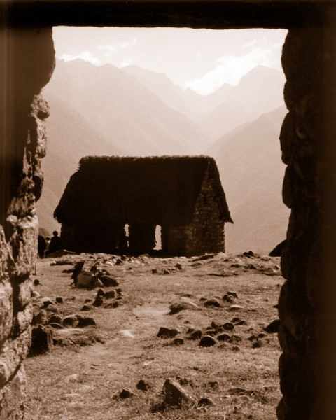
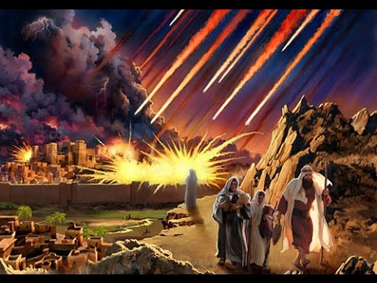
Assessing Judah’s Sins
Result? Desolation
Isa 1:7-9 – “Your land is desolate, your cities are burned with fire, your fields—strangers are devouring them in your presence; it is desolation, as overthrown by strangers. The daughter of Zion is left like a shelter in a vineyard, like a watchman’s hut in a cucumber field, like a besieged city. Unless the Lord of hosts had left us a few survivors, we would be like Sodom, we would be like Gomorrah.”
Notes:
The result? Complete desolation in their land – Isa 1:7-8 – now, during the days of Ahaz, this became a reality. We’re told in 2 Chron 28:5 that Syria had invaded Judah and taken away captives. Vs. 17 – 18 of the same chapter show us that Edom and Philistia had done the same. So instead of being a well protected stronghold as it was during Uzziah and Jotham’s reigns, Judah has been reduced to a shelter in a vineyard and a watchman’s hut, symbolizing fear of further attacks and utter helplessness.
And as verse 9 goes on to say, had there not been divine intervention to spare a remnant, God would have laid them waste just as He had done to Sodom and Gomorrah in Gen 19. But if they’re like Sodom and Gomorrah, but haven’t suffered the fate of Sodom and Gomorrah, why? This is a theme he is going to develop, so watch out for it. But here’s a hint: did God spare a remnant from Sodom and Gomorrah? Yes, Lot and his family. And as we read in Gen 18, he would have spared the city for 10 righteous souls.
This passage is an example of Isaiah using what is called the “prophetic perfect”. While it is true some of this was starting to be realized by the point of this writing, it is likely still in the future. The point of the prophetic perfect is that if God has spoken it, it is so, even if it is still yet to come. It is to illustrate the inevitability of God’s word. Isaiah does this often throughout the book.
And Paul quotes Isaiah 1:9 in Rom 9:29. What’s the point there? He declares that because of Israel’s sinfulness, nothing is left of them to spare but the Messiah. Isaiah concurs.

