Slide 1
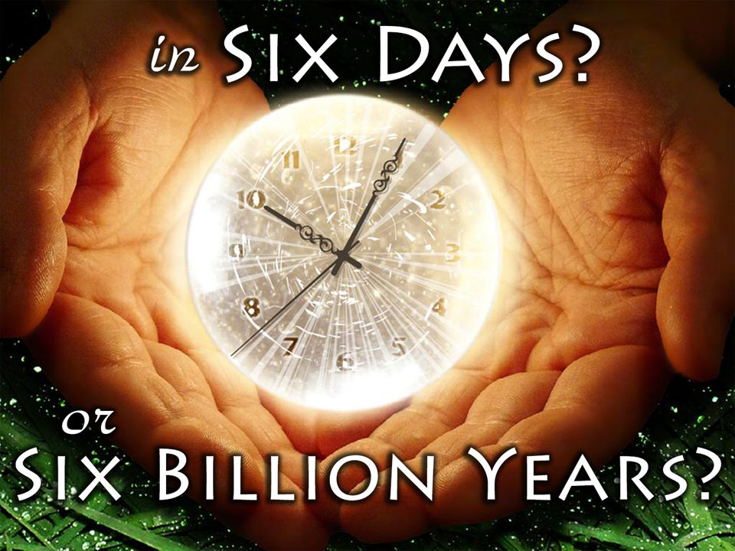
Notes:
In 1 Kings 18, Elijah issues a challenge to Ahab and Jezebel to gather the prophets of Baal on Mt. Carmel where it would be decided before a multitude of divided people which God was the true God – Baal or Jehovah? And as the multitudes assembled there, we read the following:
1 Kings 18:21 – “Elijah came near to all the people and said, “How long will you hesitate between two opinions? If the Lord is God, follow Him; but if Baal, follow him.”
There may not be a more prevalent verse to consider as we begin considering issues related to the age of the earth. Christians who think the creation/evolution conflict is a mere conflict over biblical interpretation and the “voice” of science need to think again. It is the work of Satan through and through:
1 Cor 4:4 – “In whose case the god of this world has blinded the minds of the unbelieving so that they might not see the light of the gospel of the glory of Christ, who is the image of God.”
How far does this blindness reach?
1 John 5:19b – “…the whole world lies in the power of the evil one.”
So when Christians find themselves on crossroads in regard to the ideas of this world, the question is not what we can do to make Christianity relevant to the world, rather can we harness the courage to stand for what God has plainly revealed in the bible?
Eph 4:14 – “As a result, we are no longer to be children, tossed here and there by waves and carried about by every wind of doctrine, by the trickery of men, by craftiness in deceitful scheming”
My purpose in this lesson is to show you that there is no biblical or scientific reason to be ashamed of believing in a six-day creation or a young Earth. And we should not allow scientists to dictating a proper interpretation of scripture.

Slide 2
Why Do Some Not Believe?
Dr. Gleason Archer – “From a superficial reading of Genesis 1, the impression would seem to be that the entire creative process took place in six twenty-four-hour days. If this was the true intent of the Hebrew author…this seems to run counter to modern scientific research, which indicates that the planet Earth was created several billion years ago.” (A Survey of Old Testament Introduction (Chicago: Moody, 1994, rev. ed.), p. 196.)
Dr. James Montgomery Boice – “We have to admit here that the exegetical basis of the creationists is strong…In spite of the careful biblical and scientific research that has accumulated in support of the creationists’ view, there are problems that make the theory wrong to most (including many evangelical) scientists…Data from various disciplines point to a very old earth and an even older universe.” (Genesis, An Expositional Commentary (Grand Rapids: Zondervan, 1982), Vol. 1, pp. 57–62.)
Notes:
Terry Mortensen, a Creationist who writes for AnswersInGenesis, wrote an article with some quotes from some of the most staunch defenders of scripture who do not believe that the days in Genesis were literal 24-hour days. Why do they believe this?
Dr. Gleason Archer (Old Testament professor) – “From a superficial reading of Genesis 1, the impression would seem to be that the entire creative process took place in six twenty-four-hour days. If this was the true intent of the Hebrew author…this seems to run counter to modern scientific research, which indicates that the planet Earth was created several billion years ago.”
He later noted that Genesis 1 “reads like perfectly straightforward history”, but he doesn’t interpret as such. Why? Because he is putting his authority on the interpretation of scientists.
Dr. James Montgomery Boice (pastor and Bible scholar) rejected theistic evolution, but he also rejected the Flood as the cause of most of the fossil record. He had doubts about some of the theories theistic evolutions came up with to explain away Genesis. But, he himself was not sure how to harmonize the Bible with millions of years. He stated – “We have to admit here that the exegetical basis of the creationists is strong…In spite of the careful biblical and scientific research that has accumulated in support of the creationists’ view, there are problems that make the theory wrong to most (including many evangelical) scientists…Data from various disciplines point to a very old earth and an even older universe.”

Slide 3
Why Do Some Not Believe?
Dr. Meredith Kline – “In this article I have advocated an interpretation of biblical cosmogony according to which Scripture is open to the current scientific view of a very old universe and, in that respect, does not discountenance the theory of the evolutionary origin of man. But while I regard the widespread insistence on a young earth to be a deplorable disservice to the cause of biblical truth, I at the same time deem commitment to the authority of scriptural teaching to involve the acceptance of Adam as an historical individual, the covenantal head and ancestral fount of the rest of mankind, and the recognition that it was the one and same divine act that constituted him the first man, Adam the son of God (Luke 3:38), that also imparted to him life (Gen. 2:7).” (“Space and Time in the Genesis Cosmogony,” Perspectives on Science and Christian Faith, 48 (1996), 15, fn. 47.)
Dr. Gordon Lewis & Dr. Bruce Demarest – “At first reading the creation account seems to indicate that these six days of creative activity were twenty-four hours each…ultimately, responsible geology must determine the length of the Genesis days.” (Integrative Theology (Grand Rapids: Zondervan, 1996), vol. 2, pp 29 & 43)
Notes:
Dr. Meredith Kline (Old Testament professor), advocate of the “framework hypothesis,” who believes Adam was a historical person but rejects the literal history of Genesis 1 and Genesis 6–9, even entertaining the possibility that Adam evolved from some ape-like creature:
“In this article I have advocated an interpretation of biblical cosmogony according to which Scripture is open to the current scientific view of a very old universe and, in that respect, does not discountenance the theory of the evolutionary origin of man. But while I regard the widespread insistence on a young earth to be a deplorable disservice to the cause of biblical truth, I at the same time deem commitment to the authority of scriptural teaching to involve the acceptance of Adam as an historical individual, the covenantal head and ancestral fount of the rest of mankind, and the recognition that it was the one and same divine act that constituted him the first man, Adam the son of God (Luke 3:38), that also imparted to him life (Gen. 2:7).”
Dr. Gordon Lewis (theology professor) and Dr. Bruce Demarest (theology professor), apparently favor the day-age view. They admit – “At first reading the creation account seems to indicate that these six days of creative activity were twenty-four hours each.” Nevertheless, they conclude that – “ultimately, responsible geology must determine the length of the Genesis days.”
Many, many more at https://answersingenesis.org/genesis/why-dont-many-christian-leaders-and-scholars-believe-genesis/
They all say basically the same thing in different words, that science is the final authority in determining the correct interpretation of some or all of Genesis 1–11, or at least that science is the final authority in determining that the young-earth view must be wrong. But in their discussions on this topic, they consistently refer to “science” or “findings” or “data” or “research” or “evidence” or “facts.” These men would be quick to assert the impossibility of interpretive neutrality when it comes to exegesis of the rest of Scripture and to the development of theology. But none of them seems to understand that what they are using to help them interpret the Bible are not scientific “facts” or “data”, but rather evolutionary “interpretations” of “some” of the facts or data, and that those interpretations are based on anti-Biblical philosophical “presuppositions” or “assumptions”.
These men believe we should have more faith in pop science than in the bible, yet none of the 12 theologians/evangelicals agree on every point. They all have different ways of explaining away the 24-hour days of Creation.

Slide 4
Overturned Scientific Hypotheses
Sun revolves around the Earth (1600)
Fire is caused by “phlogiston” (1750)
Sick people treated by bleeding them (1800)
Inheritance transmitted by gemules (1859)
Women & African races inferior to white men (1860)
Lobotomies performed to treat the mentally ill (1940)
“Steady State Theory” replaced with “Big Bang Theory” (1960)
Autism caused by childhood vaccines (retracted in 2010)
Notes:
But here’s the real issue - scientists are often wrong. Hypotheses are derived and overturned ever single year and for hundreds of years.
Scientists once said that the sun revolved around the earth and millions of people died believing this was the truth. Scientists once said that fire is caused by the release of a substance called phlogiston. Scientists once treated the sick by bleeding them and that is how George Washington died. Lamarckian science of the 19th century said that inheritance was transmitted by gemules. We know now they are transmitted by genes. Charles Darwin believed that both women and the African races were evolutionary and intellectually inferior to white men. In 1940, they performed lobotomies to treat the mentally ill. In the 1960s, the steady state theory of the origin of the universe was replaced by the big bang theory. And for over a decade, scientists said that autism was caused by childhood vaccines until it was retracted in 2010.
And the list is longer. But what people have tried to do for the last 200 years is replace the authority of the bible with the authority of scientists. They’ve decided to put their trust in what fallible scientists says, seeing them as the all-knowing, and reinterpret the text of Gen 1 around them.
Brethren scientists have been getting things wrong for years. And they’ll continue to do so because they’re fallible men. And they don’t live in some neutral nebulas, they interpret their data with biases and presuppositions just like everyone else. So what we need to be doing is interpreting science based on scripture because science changes as new evidence is considered but God does not change – He is always right. Scientists are proven wrong and hypotheses are overturned every single year, but God’s word can never be proven wrong. God is all knowing, not the guy wearing the white lab coat.

Slide 5
Notes:
Interestingly, before the 1800s, there was no question of whether Genesis should be interpreted literally, and a plethora of quotes from early bible scholars will attest to this. But in the 1800s, the rise of a theory called “uniformitarianism” caused certain fence-sitting, bible-believing scientists to start reevaluating how the early chapters of Genesis should be interpreted. Uniformitarianism is the idea that if all the sediment in the world were gathered by slow, gradual processes, as we can measure them today, it would have taken billions of years for the earth to form. Scientists of 1800s did not bother to consider how catastrophic events like Noah’s flood or other minor catastrophes such as volcanic eruptions played a roll in speeding up the process because the men espousing this theory were anti-bible, naturalistic thinking men who resented the concept of God and a young earth. And this thinking unfortunately infiltrated universities, and Christians were going to have to decide whether they were going to stand up and fight it, to fall away completely, or to earn some credibility by suggesting that maybe Gen 1 shouldn’t be taken so literally. And many Christians went that direction.

Slide 6
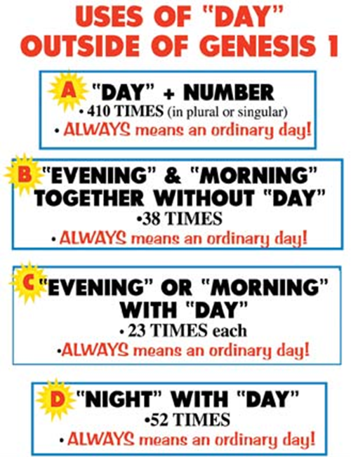
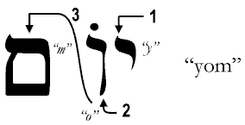
“yom”
Notes:
But Genesis 1 states in no uncertain terms that God created the Earth in 6 literal days.
The word “day” is translated from the Hebrew word “yom” and this word is used about 2400 times in the OT. And you might be surprised to hear me say that there are times in the OT when this “yom” does not refer to a 24 hour period. However, when it is used that way, it is always heavily apparent in the context.
Outside of Genesis, there are 410 times when this word “yom” is used with a number, and it always refers to a day. 38 times when the words “morning” and “evening”, are used without the word “day” and 23 times when the words “morning” and “evening” are used with the word “day” always refers to an ordinary day. And 52 times this word “day” is used with the word “night”, and it refers to an ordinary day.

Slide 7
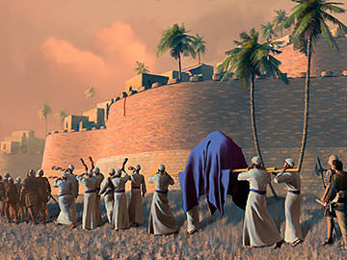
Jonah 1:17 – “And the Lord appointed a great fish to swallow Jonah, and Jonah was in the stomach of the fish three days and three nights.”
Josh 6:3 – “You shall march around the city, all the men of war circling the city once. You shall do so for six days.”
Notes:
In the book of Jonah, when we’re told that he was in the belly of the whale for 3 days, no reads that wondering whether it was a 3 24-hour periods or 12 billion years. No one questions that. And when Joshua and the nation of Israel marched around Jericho for 6 days and then on the 7th day marched around it 7 times, no one says, “Well, it’s possible that was 6 million years you know”. You never hear that. There is no theological dispute here.

Slide 8
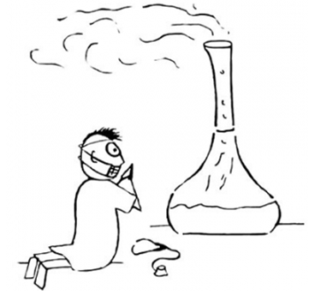
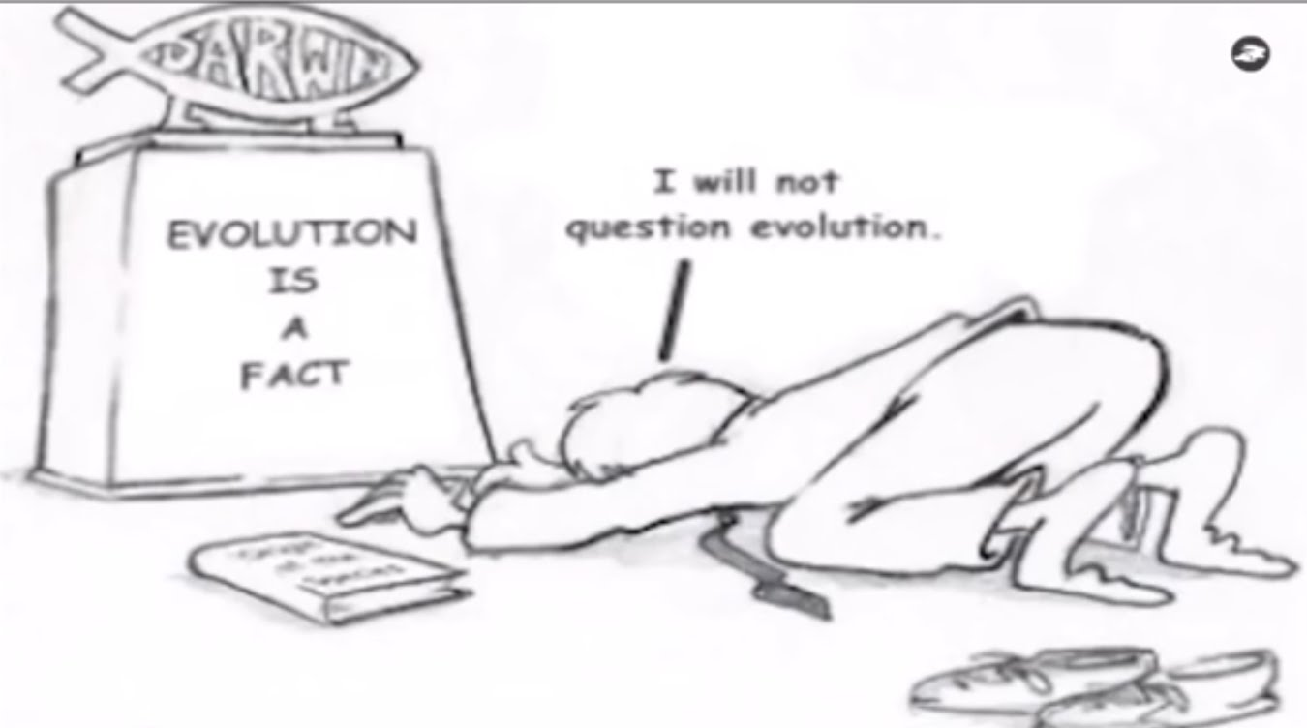
“Scientists have discovered that people will believe anything when you claim scientists have discovered it."
Notes:
But Gen 1 in regards to the 6 days of Creation is somehow becomes an exception. Because in the western world, what many people think is that science is the pinnacle of all knowledge, that all we have to do is put it in the test tube and prove it. You can’t do that. Scientists are fallible human beings and they are wrong all the time and have been proven to be wrong on a variety of subjects for hundreds of years. But naturalistic scientists want you to believe that their findings are incontrovertible. Listen, the biggest thing scientists have discovered is that people will believe anything when you claim scientists have discovered it.
Our challenge as Christians who have made that great confession, “I believe that Jesus Christ is the Son of God” is to stand by that confession, and no longer bow the knee to fallible, biased, men, but to put our faith in the great I AM who was, who is, and who is to come. Science will forever change, God’s word will stand when this world is on fire.

Slide 9
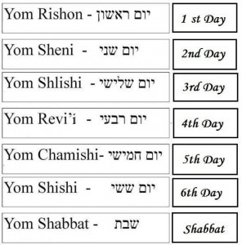
1st Day
¹In the beginning God created the heavens and the earth. ²The earth was formless and void, and darkness was over the surface of the deep, and the Spirit of God was moving over the surface of the waters. ³Then God said, “Let there be light”; and there was light. ⁴God saw that the light was good; and God separated the light from the darkness. ⁵God called the light day, and the darkness He called night. And there was evening and there was morning, one day.

Slide 10
2nd Day
⁶Then God said, “Let there be an expanse in the midst of the waters, and let it separate the waters from the waters.” ⁷God made the expanse, and separated the waters which were below the expanse from the waters which were above the expanse; and it was so. ⁸God called the expanse heaven. And there was evening and there was morning, a second day.

Slide 11
3rd Day
⁹Then God said, “Let the waters below the heavens be gathered into one place, and let the dry land appear”; and it was so. ¹⁰God called the dry land earth, and the gathering of the waters He called seas; and God saw that it was good. ¹¹Then God said, “Let the earth sprout vegetation, plants yielding seed, and fruit trees on the earth bearing fruit after their kind with seed in them”; and it was so. ¹²The earth brought forth vegetation, plants yielding seed after their kind, and trees bearing fruit with seed in them, after their kind; and God saw that it was good. ¹³There was evening and there was morning, a third day.

Slide 12
4th Day
¹⁴Then God said, “Let there be lights in the expanse of the heavens to separate the day from the night, and let them be for signs and for seasons and for days and years; ¹⁵and let them be for lights in the expanse of the heavens to give light on the earth”; and it was so. ¹⁶God made the two great lights, the greater light to govern the day, and the lesser light to govern the night; He made the stars also. ¹⁷God placed them in the expanse of the heavens to give light on the earth, ¹⁸and to govern the day and the night, and to separate the light from the darkness; and God saw that it was good. There was evening and there was morning, a fourth day.

Slide 13
5th Day
²⁰Then God said, “Let the waters teem with swarms of living creatures, and let birds fly above the earth in the open expanse of the heavens.” ²¹God created the great sea monsters and every living creature that moves, with which the waters swarmed after their kind, and every winged bird after its kind; and God saw that it was good. ²²God blessed them, saying, “Be fruitful and multiply, and fill the waters in the seas, and let birds multiply on the earth.” ²³There was evening and there was morning, a fifth day.

Slide 14
6th Day
²⁴Then God said, “Let the earth bring forth living creatures after their kind: cattle and creeping things and beasts of the earth after their kind”; and it was so. ²⁵God made the beasts of the earth after their kind, and the cattle after their kind, and everything that creeps on the ground after its kind; and God saw that it was good.

Slide 15
6th Day
²⁶Then God said, “Let Us make man in Our image, according to Our likeness; and let them rule over the fish of the sea and over the birds of the sky and over the cattle and over all the earth, and over every creeping thing that creeps on the earth.” ²⁷God created man in His own image, in the image of God He created him; male and female He created them. ²⁸God blessed them; and God said to them, “Be fruitful and multiply, and fill the earth, and subdue it; and rule over the fish of the sea and over the birds of the sky and over every living thing that moves on the earth.”

Slide 16
6th Day
²⁹Then God said, “Behold, I have given you every plant yielding seed that is on the surface of all the earth, and every tree which has fruit yielding seed; it shall be food for you; ³⁰and to every beast of the earth and to every bird of the sky and to every thing that moves on the earth which has life, I have given every green plant for food”; and it was so. God saw all that He had made, and behold, it was very good. And there was evening and there was morning, the sixth day.

Slide 17
7th Day
¹Thus the heavens and the earth were completed, and all their hosts. ²By the seventh day God completed His work which He had done, and He rested on the seventh day from all His work which He had done. ³Then God blessed the seventh day and sanctified it, because in it He rested from all His work which God had created and made. ⁴This is the account of the heavens and the earth when they were created, in the day that the Lord God made earth and heaven.
Notes:
Do you see the repetition? Evening, morning, day, night….ever wonder why the repetition is there? Could God be hinting at something? What could God have said to make the meaning any clearer than He already made it?
Did you know that outside the biblical text, there is no basis for a 7 day week? It is so deeply rooted in human experience and so natural physiologically that we seldom think about its significance. All the other important time markers in human life are clearly based on astronomical and terrestrial constants. The “day”, for example, is the duration of one rotation of the earth on its axis; the “year” is the duration of one orbital revolution of the earth about the sun; the “month” is the approximate interval between new moons; the “seasons” are even marked by the equinoxes and solstices. But the “week” has no astronomical basis whatever! Yet we order our lives around a seven-day cycle.
How could such a system ever have originated? From Gen 1. This is where we get our week from. But if each Genesis day were really billions of years in length, would we even have a basis? Its very existence can only be explained by the reality of a six-day completed creation!

Slide 18
Literal or Allegorical?
Ex 20:8-11 – “⁸Remember the Sabbath day, to keep it holy. ⁹Six days you shall labor and do all your work, ¹⁰but the seventh day is a Sabbath of the Lord your God; in it you shall not do any work, you or your son or your daughter, your male or your female servant or your cattle or your sojourner who stays with you. ¹¹For in six days the Lord made the heavens and the earth, the sea and all that is in them, and rested on the seventh day; therefore the Lord blessed the Sabbath day and made it holy.”
Ex 31:16-17 – “¹⁶So the sons of Israel shall observe the Sabbath, to celebrate the Sabbath throughout their generations as a perpetual covenant.’ ¹⁷It is a sign between Me and the sons of Israel forever; for in six days the Lord made heaven and earth, but on the seventh day He ceased from labor, and was refreshed.”
Ex 31:14-15 – “¹⁴Therefore you are to observe the Sabbath, for it is holy to you. Everyone who profanes it shall surely be put to death; for whoever does any work on it, that person shall be cut off from among his people. ¹⁵For six days work may be done, but on the seventh day there is a Sabbath of complete rest, holy to the Lord; whoever does any work on the Sabbath day shall surely be put to death.”
Notes:
So how do those Christians who do not believe these were literal days (who are called “theistic evolutionists”) get around this? Well, sometimes theistic evolutionists will suggest that Gen 1 should not be taken literally, but that it is simply an allegory. An allegory is a literary device in which a story, with its characters and events, only symbolize ideas and concepts rather than being literal.
Now you don’t prove something that something considered literal for thousands of years is an allegory simply by suggesting it, but by proving it. And the way we prove it or not prove it is by allowing the biblical text to interpret itself.
Who penned the book of Genesis? Moses. And in Ex 20, Moses provides for us a commentary on what he wrote about Gen 1.
In Ex 20:8-11, Moses recites commandment #4 of the 10 commandments. Ex 20:8-11 – “Remember the Sabbath day, to keep it holy. Six days you shall labor and do all your work, but the seventh day is a Sabbath of the Lord your God; in it you shall not do any work, you or your son or your daughter, your male or your female servant or your cattle or your sojourner who stays with you. For in six days the Lord made the heavens and the earth, the sea and all that is in them, and rested on the seventh day; therefore the Lord blessed the Sabbath day and made it holy.”
Why did the Jews have a 6 day work week and 1 day of rest? Because of the model that Gen 1 provides. In 6 days God created the heavens and the earth and on the 7th day he rested.
Ex 31:16-17 – “So the sons of Israel shall observe the Sabbath, to celebrate the Sabbath throughout their generations as a perpetual covenant.’ It is a sign between Me and the sons of Israel forever; for in six days the Lord made heaven and earth, but on the seventh day He ceased from labor, and was refreshed.”
Now, do those “days” sound like literal days or allegorical days? Did the Israelites work for several millions of years and then rest for a million years? Is that how they understood it? Of course not. So if it is plain in this context what a day is, and Moses used the Creation days to substantiate it, would that not also mean that the days of Gen 1 are to be taken literally?
Another way to prove it was literal is to consider the consequences of not honoring the Sabbath Day.
Ex 31:14-15 – “Therefore you are to observe the Sabbath, for it is holy to you. Everyone who profanes it shall surely be put to death; for whoever does any work on it, that person shall be cut off from among his people. For six days work may be done, but on the seventh day there is a Sabbath of complete rest, holy to the Lord; whoever does any work on the Sabbath day shall surely be put to death.”
If God was willing to put someone to death for something, wouldn’t He want to make sure the law pertaining to it was something that was clear? Was the “day” something that was clear or unclear to the Jew? Can you imagine a Jew saying, “I know God said to rest on the 7th day, but how do we know these are really 24 hour days? I think we should rest for a million years and then go to work for another 6 million years.” These texts in Exodus make it clear these were literal 24 hour days.

Slide 19
Literal or Allegorical?
Num 12:6-8 – “⁶Hear now My words: if there is a prophet among you, I, the Lord, shall make Myself known to him in a vision. I shall speak with him in a dream. ⁷Not so, with My servant Moses, He is faithful in all My household; ⁸With him I speak mouth to mouth, even openly, and not in dark sayings, and he beholds the form of the Lord. Why then were you not afraid to speak against My servant, against Moses?”
Ex 24:4a – “Moses wrote down all the words of the Lord...”
Josh 1:7 – “ Only be strong and very courageous; be careful to do according to all the law which Moses My servant commanded you; do not turn from it to the right or to the left, so that you may have success wherever you go.”
Josh 23:6 – “Be very firm, then, to keep and do all that is written in the book of the law of Moses, so that you may not turn aside from it to the right hand or to the left.”
Notes:
Some will say, “Well, God only spoke to Moses using hidden symbols.” No, not according to God Himself. In Num 12, God makes it clear how He chose to communicate with His servant Moses.
Num 12:6-8 – “Hear now My words: if there is a prophet among you, I, the Lord, shall make Myself known to him in a vision. I shall speak with him in a dream. Not so, with My servant Moses, He is faithful in all My household; With him I speak mouth to mouth, even openly, and not in dark sayings, and he beholds the form of the Lord. Why then were you not afraid to speak against My servant, against Moses?”
Notice that that God spoke to Moses “clearly, and not in riddles.” Ex 24:4 tells us that Moses wrote down these words. These words were authenticated on Mt. Sinai by great powers and miracles intended to produce godly fear in the Israelite recipients (Ex 20:18-21). Even Joshua was told not to turn from these words “to the right or to the left” (Josh 1:6) and later encouraged the Israelites in the same (Josh 23:6). That being said, while the bible does indeed contain different genres of literature, the Creation account was never intended to be a mysterious, symbolic description of obscure events. It was intended to be a straight-forward, historical narrative to produce faith.
So when He told Moses that He created the heavens and earth in 6 days and rested on the seventh day, these are literal days. Else, why would the words “morning” and “evening” accompany these days? Why are the numbers 1st, 2nd, 3rd, 4th, 5th, 6th, and 7th used with these days?

Slide 20
Literal or Allegorical?
Notes:
(Mark 10) Before we talk about this verse, let’s be sure we remember what Evolution teaches. Evolution teaches that the world came into existence from a tiny spot smaller than a period at the end of sentence 13.8 billion years ago. Hubble discovered that the universe is expanding, which we do know is true. But he tried to claim that where that came from was a big bang 13.8 million years ago. But then 4.5 billion years ago, the Earth was supposedly created and then 3.8 billion years ago life appeared on Earth. This is what Evolutionists say.
Now, if this is true, it would mean that Adam came towards the end of all this because according to Evolutionists, it took 10 of the 13.8 billions of years between the time the universe was created and the earth was created plus another couple billion years before man came into being. But this is what Jesus said in Mark 10:6.
Mark 10:6 – “But from the beginning of creation, God made them male and female.”
He is talking about Adam and Eve here. In other words, Jesus Himself acknowledged that from the beginning when God started creating things, man existed there on day 6. Jesus is not affirming that billions of years passed before man was created, but that it happened in the beginning on day 6, not 10 billion years after creation, but 120 hours after creation.

Slide 21
Consequences
“Unscientific” Virgin Birth of Jesus?
“Unscientific” Resurrection of Jesus?
“Unscientific” 10 Plagues of Egypt?
“Unscientific” Parting of the Red Sea?
“Unscientific” Miracles of the Bible?
Notes:
Some will say, “I believe the bible, but when it comes to this, there is just too much science.”
Then what will you do with the unscientific, virgin birth of Jesus? What will you do with the unscientific resurrection of Jesus? What will you do with the unscientific 10 plagues, parting of the Red Sea, and all the other miracles we see throughout scripture?
Psa 11:3 – “If the foundations are destroyed, what can the righteous do?”
This is one of the reasons why this is so important. If we’re willing to let the opinions and interpretations of humanistic scientists supersede scripture when it comes to Creation, we have no basis to believe any of God’s supernatural workings in scripture after that fact. Because all it will take to shatter your faith in those things is for the next humanistic scientist to publish a new hypothesis in a paper/article with well sounding words, based entirely off biased conjecture.

Slide 22
Consequences
John MacArthur – “In other words, if you reject the creation account in Genesis, you have no basis for believing the Bible at all.”
“If you doubt or explain away the Bible’s account of the six days of creation, where do you put the reins on your skepticism? Do you start with Genesis 3, which explains the origin of sin, and believe everything from chapter 3 on? Or maybe you do not sign on until sometime after chapter 6, because the Flood is invariably questioned by scientists, too. Or perhaps you find the Tower of Babel too hard to reconcile with the linguists’ theories about how languages originated and evolved. So maybe you start taking the Bible as literal history beginning with the life of Abraham. But when you get to Moses’ plagues against Egypt, will you deny those, too? What about the miracles of the NT? Is there any reason to regard any of the supernatural elements of biblical history as anything but poetic symbolism? ”
Notes:
John MacArthur said just as much.
John MacArthur – “In other words, if you reject the creation account in Genesis, you have no basis for believing the Bible at all”.
Now let’s understand what he is saying and what he is not saying. He is not saying that if you don’t believe they are literal days that you don’t believe the bible. He is saying you don’t have a basis. You don’t have a foundation for interpreting the rest of the bible as literal.
Further he says, “If you doubt or explain away the Bible’s account of the six days of creation, where do you put the reins on your skepticism? Do you start with Genesis 3, which explains the origin of sin, and believe everything from chapter 3 on? Or maybe you do not sign on until sometime after chapter 6, because the Flood is invariably questioned by scientists, too. Or perhaps you find the Tower of Babel too hard to reconcile with the linguists’ theories about how languages originated and evolved. So maybe you start taking the Bible as literal history beginning with the life of Abraham. But when you get to Moses’ plagues against Egypt, will you deny those, too? What about the miracles of the NT? Is there any reason to regard any of the supernatural elements of biblical history as anything but poetic symbolism?”
See the point? Listen, if we’re worried about appearing unscientific in the eyes of naturalists, we’re going to have to reject a lot more than Gen 1. Because naturalistic scientists believe the resurrection of Jesus Christ is just as ridicules as the 6 days of Creation. So if you just cannot live with yourself unless you condone scientists’ views, what then about Eugenics? What then about Embryotic Stem Cell research? What then about homosexuality, because after all, scientists suggest people are born that way and so its not their fault. What about Euthanasia? What about Pop Psychology that condones fornication, adultery, extra-marital affairs, abandoning your family for the sake of “happiness”, unscriptural divorces and remarriages?

Slide 23
Notes:
Genesis is designed to be the beginning of our belief, not the beginning of our unbelief. And as long we insist on reinterpreting the 24-hour days in Genesis 1 to accommodate popular science, we’re no longer bowing before God; we’re bowing before the guy in the white lab coat. And this reveals our heart:
1 Cor 2:14 – “But a natural man does not accept the things of the Spirit of God, for they are foolishness to him; and he cannot understand them, because they are spiritually appraised.”
If we cannot trust the bible when it talks about earthly things, how will we ever trust it when it talks about heavenly things? That is why it is so important to be ready to give an answer to the faith that we have.

Slide 24
Notes:
The truth will win out in the end. And my encouragement to all is stand on the side of God, and not give in to nodding of the Dr. Know-It-All in the white lab coat.
1 Pet 3:15 – “But sanctify Christ as Lord in your hearts, always being ready to make a defense to everyone who asks you to give an account for the hope that is in you, yet with gentleness and reverence”

