Slide 1
Topics
Introduction: A Ready Defense Against Evolution
Why Do So Many Believe In Evolution?
Animal Kinds
Evolution’s Weaknesses
Famous Evolutionary Hoaxes
Misconceptions of Evolution
July 4th, 11th – Societal & Spiritual Consequences of Evolution
July 25th, Aug 1st – Examining The Fossil Record
Aug 15th, Sep 12th – Uniformitarianism vs. Catastrophism
Sep 19th, 26th – Evidence For The Global Flood
Oct 3rd – Day-Age Controversy or When Did Dinosaurs Live?
Notes:
“Social & Spiritual Consequences of Evolution” – We’ll look at how evolution, as a worldview, as shaped our society for the worst and destroyed the spirituality of so many. I can guarantee I’ll have a few of you crying during this study.
“Examining The Fossil” – In this lesson, we’ll look at what is actually present in the geologic column and whether what is there supports the Evolutionary or Creationist worldview? We’ll also examine the “bait and switch” tactic Evolutionists like to use whenever the fossil record enters the discussion and how we can call them on that tactic.
“Uniformitarianism vs. Catastrophism” – In this lesson, we’ll take the Evolutionist’s technique of measuring the age of the Earth (uniformitarianism) and show why it is wrong as well as give evidence for catastrophism.
“Scientific Evidence For The Biblical Flood” – The biblical flood was such a magnificent event that it would have had to have left evidence. We see the fingerprints of this catastrophe all over our planet and we’ll look at some lines of evidence for it.
“The Day-Age Controversy” – In this lesson, we’ll study whether the Genesis account was intended to be a literal explanation of our origins or an allegorical one which would open the door for pushing any interpretation we so desire
“Why Did The Dinosaurs Live?” – This is an evolutionists favorite tool, the dinosaurs. Why do they go to the dinosaurs so much to try to prove an old earth? We’ll make this one fall on its head and we’ll present some evidence that shows man and dinosaurs walked the earth together
If there are other topics you would like to hit on, see me after class. Buckle up, it’s going to be a fun ride!

Slide 2
Social Darwinism:
Spiritual & Societal
Consequences
Notes:
Most people believe that evolution has impacted only the scientific theater and is only isolated to scientific theory. The theory of evolution, though, is far from neutral in its effect on society. In fact, it is as religious as Christianity, it has impacted every area of life, and it is the foundation of many evils that we as Christians are attempting to remove.
So what we will do in this lesson is bring to light the plethora of moral and spiritual damage that Darwinian Evolution brings upon society and how it is destroying the faith of so many people. The theory that led Darwin to discard the Bible and reject the existence of God has had a profound effect on millions of other people and will continue to do so lest we engage it head on decide we’re going to be a force in this world for good.
A fair warning about this particular lesson. We are going to be dealing with very sensitive topics – death, genocide, racism, sexism, and other issues which are extremely sensitive topics in our day and time, especially in the political climate, and I’m going to attempt to handle these subjects with as much sensitivity as possible. It is important, however, to discuss them so we can know just how important of a battle this really is.

Slide 3
2 Cor 10:3-4 – “For though we walk in the flesh, we do not war according to the flesh, for the weapons of our warfare are not of the flesh, but divinely powerful for the destruction of fortresses.”
2 Cor 10:5 – “We are destroying speculations and every lofty thing raised up against the knowledge of God, and we are taking every thought captive to the obedience of Christ”
Notes:
As Christians, one thing we always need to be reminded of is that there is a proper and improper way to confront heretical views.
2 Cor 10:3-4 – “For though we walk in the flesh, we do not war according to the flesh, for the weapons of our warfare are not of the flesh, but divinely powerful for the destruction of fortresses.”
In other words, by contending against Darwinian Evolution, we’re not trying to physically hurt Evolutionists. They’re people. We’re not going to take their books and burn them because we haven’t been called to be arsonists. We’re going to use spiritual weapons because that is the way in which we will be victorious, which we will win more souls, and God will be glorified.
2 Cor 10:5 – “We are destroying speculations and every lofty thing raised up against the knowledge of God, and we are taking every thought captive to the obedience of Christ”.
That’s what we’re trying to do: take captive people’s thoughts and hearts. We want to challenge people to think, to put aside their biases, and be honest with the evidence that is there. Because, as Creationists, we are confident that the evidence for the Creationist worldview is unequivocally heavier than the Darwinian Evolutionary worldview.

Slide 4
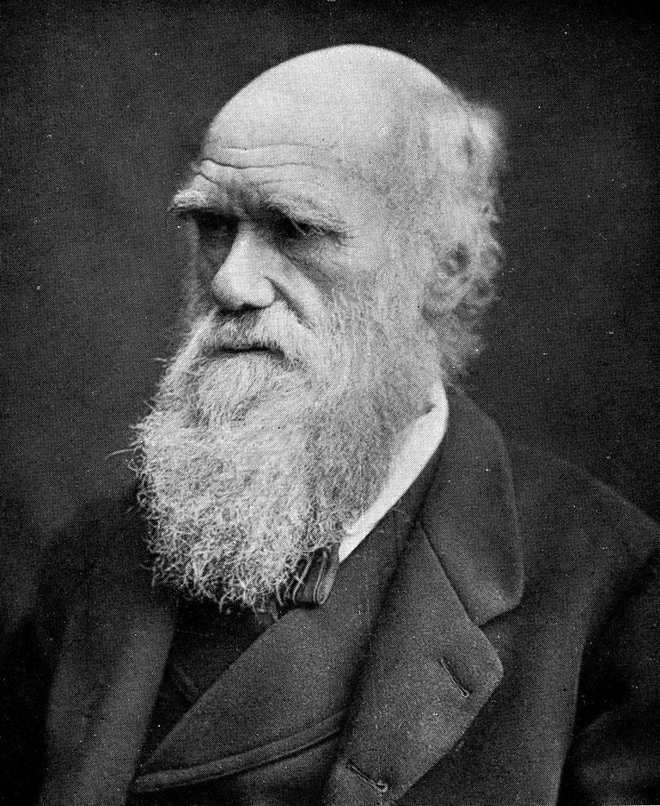
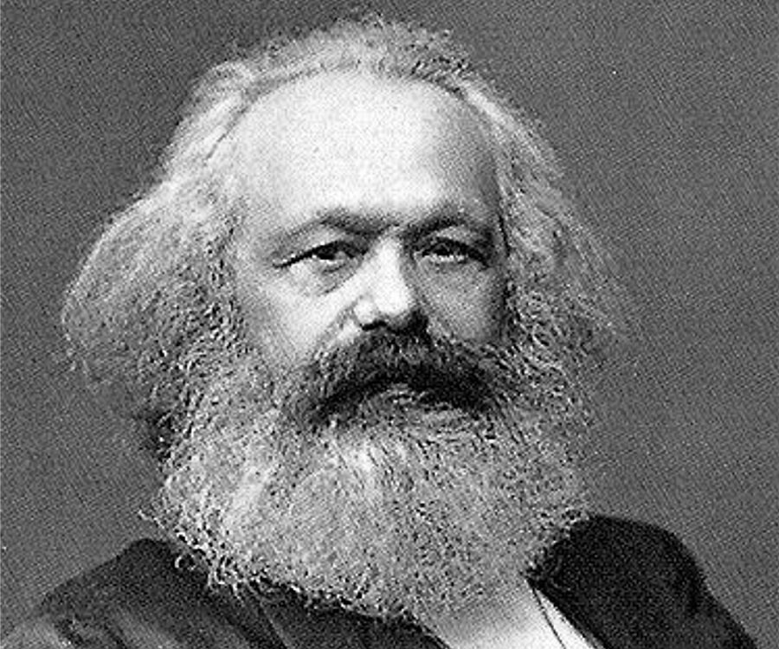
Charles Darwin – “You will really believe how much interested I am in observing that you apply to moral and social questions analogous views to those which I have used in regard to the modification of species. It did not occur to me formerly that my views could be extended to such widely different and most important subjects.” (The Life and Letters of Charles Darwin, edited by Francis Darwin, D. Appleton and Company, 1896, vol. 2, p. 294).
Karl Marx – “Although developed in the crude English fashion, [Darwin’s Origin of Species] is the book which in the field of natural history, provides the basis for our views.” (to Engels, 19 Dec 1860)
“[Darwin’s work] suits my purpose in that it provides a basis in natural science for the historical class struggle” (Janet Browne, Charles Darwin: The Power of Place, 2002, p. 188).
Notes:
Interestingly enough, Darwin himself seemed to approve of the application of his evolutionary ideas to moral and social issues. In a letter to H. Thiel in 1869, Darwin said:
“You will really believe how much interested I am in observing that you apply to moral and social questions analogous views to those which I have used in regard to the modification of species. It did not occur to me formerly that my views could be extended to such widely different and most important subjects.”
So we see here that Darwin expressed interest in how his views on Evolution could reshape morality and societal views of morality, and he views this as an important thing.
And so apparent was the potential for Darwinian Evolution to change morality within society that Karl Marx, the father of communism, out of gratitude to Darwin, sent him Das Kapital, his principal book on communism. Writing to his communist colleague Friedrich Engels, Marx wrote, “Although developed in the crude English fashion, [Darwin’s Origin of Species] is the book which in the field of natural history, provides the basis for our views.”
To another person he wrote that “[Darwin’s work] suits my purpose in that it provides a basis in natural science for the historical class struggle.”
And it was this evolutionary backing that eventually helped establish the philosophical and government framework for the twin scourges of communism and atheism in nations like Russia, China, Eastern Europe, Cambodia, North Korea and many other nations.
Remember, this happened barely a generation ago in what were considered to be the most advanced and enlightened nations. It could happen again, especially in a world in which so many have adopted a belief in moral relativism and a survival-of-the-fittest outlook.

Slide 5
1 Cor 15:32b – “If the dead are not raised, let us eat and drink, for tomorrow we die.”
Notes:
1 Cor 15:32b – “If the dead are not raised, let us eat and drink, for tomorrow we die.”
In other words, if we’re not here because of God, but rather because of molecules to man natural selection, and if we’re not to be raised and if there is not going to be a judgment, it really doesn’t matter what we do. There are no morals and there are no ethics, as we’ll look at in detail later
If we’re descended from animals, why don’t we just act like animals? And this is exactly what some of have concluded, and has led to many of the perverse activities and viewpoints that plague our society today.
So let’s get into the meat of the lesson. Some of the points I’m going to share with you are vehemently denied by some atheists and evolutionists, but in making these points I’m also going to share with you quotes from Evolutionists themselves to substantiate the very points I’ll be making.

Slide 6
We Are An Accident
Notes:
Point #1 – We are nothing but a cosmic accident.
And this means that preaching Jesus Christ would be utterly senseless and without meaning. They’d be just empty words designed to make people feel guilty who already have enough problems to deal with as it is.
Having faith in Christ would be completely useless. Even baptism would be pointless because it speaks to and symbolizes an event that never took place.
Every single witness from the 1st century to every preacher who followed would be liars. And not just liars, but the so-called witnesses would be fools for dying for a cause in which they claimed to be eye-witnesses yet knew to be false.
No one is redeemed from their sins and all those who have lived in former times believing such a lie have perished and we will never again see our loved ones who died in faith before us.
There is no judgment which means there is no justice in the world. Those who lived with impunity toward the Lord will never experience any divine justice and those who suffered trying to do what is right will never see any reward.
So let’s be real; if Creation is nothing but an accident, we Christians are the most pitiful people to have ever walked this earth because we rested our hope on that which is vain. In other words, look at us silly people and how we waste our time coming to these assemblies and putting such heart and effort into such a vain occasion.

Slide 7
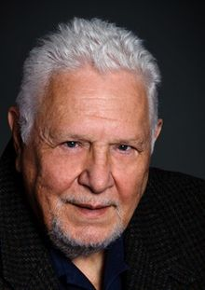
We Are An Accident
Richard E. Leakey – “In many ways we are a biological accident, the product of countless propitious circumstances.” (Co-author with American science writer Roger Amos Lewin, 1946, Origins: What New Discoveries Reveal about the Emergence of our Species and its Possible Future, 1977, 256)
Victor Stenger – “Physicists are now claiming that the hundreds of billions of stars and galaxies, including the earth and humanity, are not conscious creations but an accident.” (1987, Free Inquiry, Summer, Vol. 7, No. 3, pp. 26-27)
Stephen Jay Gould – “Many paleontologists, myself included, now view Homo sapiens as a tiny and unpredictable twig on a richly ramifying tree of life—a happy accident of the last geological moment.” (Modified Grandeur, Natural History, vol. 102, March 1993, pp. 14-20. p 20)
Notes:
Now Darwinism itself was rejected in the early part of the 20th century and so they had to come up with a new idea. So they stole a Creationist’s idea. A scientist named Mendel, who discovered genetics and was a Creationist, had his idea blended with Darwinism and they called it “The Modern Synthesis” (1930s). This is the brand of macroevolution accepted by the majority of Evolutionists today, what is called Neo-Darwinism.
Neo-Darwinism teaches that we are nothing but worthless, random, unplanned cosmic accidents – every single one of us.
Here are quotes from some of the most well-known Evolutionists of the 20th century:
Richard E. Leakey – “In many ways we are a biological accident, the product of countless propitious circumstances.”
Victor Stenger – “Physicists are now claiming that the hundreds of billions of stars and galaxies, including the earth and humanity, are not conscious creations but an accident.”
This guy thinks this should be taught in schools. Imagine the consequences of telling children, “You have no purpose, you’re just an accident.” What might some children then do with that knowledge? I’m going to show you in just a few minutes what some children have chosen to do with that knowledge.
Stephen Jay Gould – “Many paleontologists, myself included, now view Homo sapiens as a tiny and unpredictable twig on a richly ramifying tree of life—a happy accident of the last geological moment.”
These are the so-called experts saying we are nothing more than an accident. And again, when this is what children are taught, think about the potential ramifications of such information when acted upon.

Slide 8
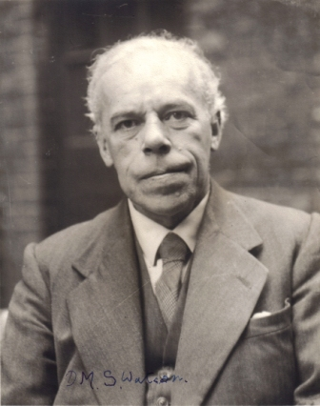
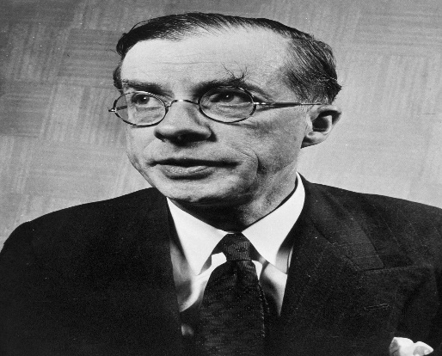
Macroevolution Alternative
D. M. S. Watson – “The theory of evolution itself, a theory universally accepted not because it can be proved by logically coherent evidence to be true but because the only alternative, special creation, is clearly incredible.” (1929 article, “Adaptation”)
Julian Huxley – “Our faith in the idea of evolution depends on our reluctance to accept the antagonistic doctrine of special creation” (Dogma of Evolution, p. 304).
Notes:
Point #2 – Macroevolution destroys the Christian faith because it offers a perceived alternative to Creation.
Now there are some Christians who will deny this. Some Christians are attempting to find a way to merge the Creation story with Darwinism and hold to the view that is called “Theistic Evolution”. I am going to deal with this specific subject in future lessons. But to support this premise, let’s again listen to the Darwinian experts:
D. M. S. Watson – “the theory of evolution itself, a theory universally accepted not because it can be proved by logically coherent evidence to be true but because the only alternative, special creation, is clearly incredible.”
In other words, “We don’t want to believe in Creation so we need to come up with a new idea”, right? Even the ancient Greek philosophers were trying to come up with evolution in order to do away with God and Creationism.
Julian Huxley – “Our faith in the idea of evolution depends on our reluctance to accept the antagonistic doctrine of special creation”
These are the experts, men that lived during Darwin’s time. And they believed that Darwinian Evolution should destroy mankind’s faith in God. Many will say “no”, but my argument is that it does and these quotes from famous Evolutionists are incredibly revealing.
Atheist, A. J. Mattel – “Evolution thus becomes the most potent weapon for destroying the Christian faith.” Do you want to destroy the Christians faith, Mattel says all we have to do is keep teaching naturalistic, macroevolution.

Slide 9
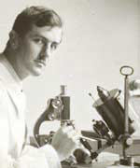
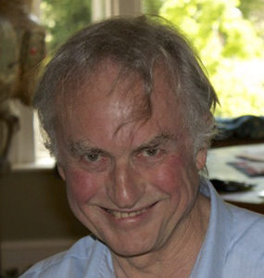
Macroevolution Alternative
Stephen Jay Gould – “We are here because one odd group of fishes had a peculiar fin anatomy that could transform into legs…We may yearn for a ‘higher answer’– but none exists.” (Who’s Who In Hell, p. 450)
C. Darlington – “Here is a theory that released thinking men from the spell of superstition…we owe to the Origin of Species the overthrow of the myth of creation” (C. Darlington, Origin of Evolution, Scientific American, May, 1959, p. 60)
Richard Dawkins – “Although atheism might have been logically tenable before Darwin, Darwin made it possible to be an intellectually fulfilled atheist”. (Berlinski, David, 1996, The Deniable Darwin. Commentary 101, 6, Jun)
Julian Huxley – “In the evolutionary pattern of thought there is no longer either need or room for the supernatural. The earth was not created: it evolved. So did all the animals and plants that inhabit it, including our human selves, mind and soul as well as brain and body. So did religion.” (Essays of a Humanist, p. 82–83, Penguin Books, 1964)
Notes:
Stephen Jay Gould – “We are here because one odd group of fishes had a peculiar fin anatomy that could transform into legs…We may yearn for a ‘higher answer’– but none exists.”
And our children get a heavy dose of this stuff and so will students in Auburn university who take biology classes.
C. Darlington – “Here is a theory that released thinking men from the spell of superstition…we owe to the Origin of Species the overthrow of the myth of creation”
Richard Dawkins – “Although atheism might have been logically tenable before Darwin, Darwin made it possible to be an intellectually fulfilled atheist”.
In other words, while 200 years ago atheists were laughed at for believing in something that had no naturalistic backing, they now believe that Darwinian Evolution provides the intellectual reason to believe there is no God.
Julian Huxley again – “In the evolutionary pattern of thought there is no longer either need or room for the supernatural. The earth was not created: it evolved. So did all the animals and plants that inhabit it, including our human selves, mind and soul as well as brain and body. So did religion.”
Imagine young impressionable minds being taught this – these are things that will shake someone’s faith.

Slide 10
No Sanctity For Human Life
Notes:
Point #3 – It causes society to disregard the sanctity for human life, that man was indeed made in God’s image.
Jeffrey Dahmer, said the following after his arrest, about what contributed to his complete regard for sanctity of human life – “If a person doesn’t think there is a God to be accountable to, then—then what’s the point of trying to modify your behavior to keep it within acceptable ranges? That’s how I thought anyway. I always believed the theory of evolution as truth, that we all just came from the slime. When we, when we died, you know, that was it, there is nothing…”

Slide 11
No Sanctity For Human Life
“He doesn't deserve the jaw evolution gave him. Look for his jaw. It won't be on his body.”
“Let natural selection take its course. All the fat, ugly, retarded, crippled, ___ in the world would die…maybe then the human race can actually be proud of itself.”
Barry Arrington – “I read through every single page of Eric Harris’s journals; I listened to all of the audio tapes and watched the videotapes…it became evident to me that Harris consciously saw his actions as logically arising from what he had learnt about evolution. Darwinism served as his personal intellectual rationale for what he did. There cannot be the slightest doubt that Harris was a worshipper of Darwin and saw himself as acting on Darwinian principles.” (The Political Gene: How Darwin’s Ideas Changed Politics)
Notes:
This is Eric Harris, the Columbine Shooter in Littleton CO. Does anyone know what he had underneath his trench coat written on his tee shirt? “Natural Selection”…which was Darwin’s mechanism for MacroEvolution. Harris and Klebold, before the shooting, made a video in which referring to a football player said, “He doesn't deserve the jaw evolution gave him. Look for his jaw. It won't be on his body.” He said further that he wished there were no vaccines, or even warning labels on dangerous goods, but “let natural selection take its course. All the fat, ugly, retarded, crippled __________ (deleted for foul language) in the world would die…maybe then the human race can actually be proud of itself.”
The attorney for the families of six of the students killed at Columbine, Denver lawyer Barry Arrington, said, “I read through every single page of Eric Harris’s journals; I listened to all of the audio tapes and watched the videotapes…it became evident to me that Harris consciously saw his actions as logically arising from what he had learnt about evolution. Darwinism served as his personal intellectual rationale for what he did. There cannot be the slightest doubt that Harris was a worshipper of Darwin and saw himself as acting on Darwinian principles.”
Now, disclaimer: I’m not going to stand here and tell you if it wasn’t for Evolution, these men wouldn’t have done what they had done because that would be foolish on my part. They had mental problems. But they certainly tried using it to justify their actions. Why? Because Evolution teaches that we’re an accident and that over the course of millions of years, the strongest had to weed out the weakest.

Slide 12
No Sanctity For Human Life
Richard Dawkins – “I think ‘nature red in tooth and claw’ sums up our modern understanding of natural selection admirably.” (The Selfish Gene, 1976)
Stephen Jay Gould – “The price of perfect design is messy relentless slaughter.” (Darwin and Paley Meet the Invisible Hand, Natural History, Nov 1990)
Notes:
Richard Dawkins, in his book “The Selfish Gene”, said – “I think “nature red in tooth and claw” sums up our modern understanding of natural selection admirably.”
Stephen Jay Gould – “The price of perfect design is messy relentless slaughter.”
Imagine your children being taught this, that this is where we come from? Can you see why some might want to take this to the next level, why some might conclude that we are not doing enough as the so-called stronger of the species to weed out the weak?

Slide 13
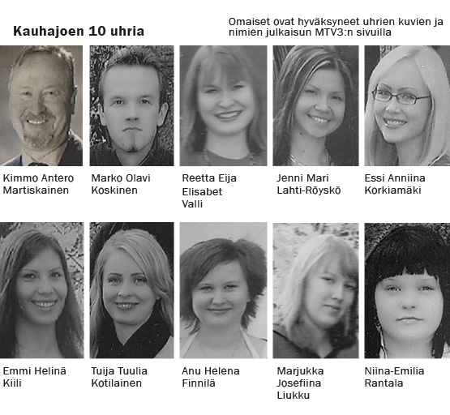
No Sanctity For Human Life
Matti Juhani Saari – “I, as natural selector, will eliminate those whom I see unfit, disgraces of human race and failures of natural selection.”
Prov 23:7a – “For as he thinks within himself, so he is.”
Notes:
The Kauhajoki school shooting occurred on Sept 23rd, 2008, at a University of Applied Sciences in the former province of Western Finland. The gunman, 22-year-old student Matti Juhani Saari, shot and killed ten people with a semi-automatic pistol, before shooting himself in the head. He was a staunch evolutionist. Here is what he wrote beforehand:
“I, as natural selector, will eliminate those whom I see unfit, disgraces of human race and failures of natural selection.”
When our children are taught that life is an accident, there are no absolutes, life has no meaning, people are just animals, there is no God, should another Darwinian-inspired school shooting surprise us?
Prov 23:7a – “For as he thinks within himself, so he is.”

Slide 14
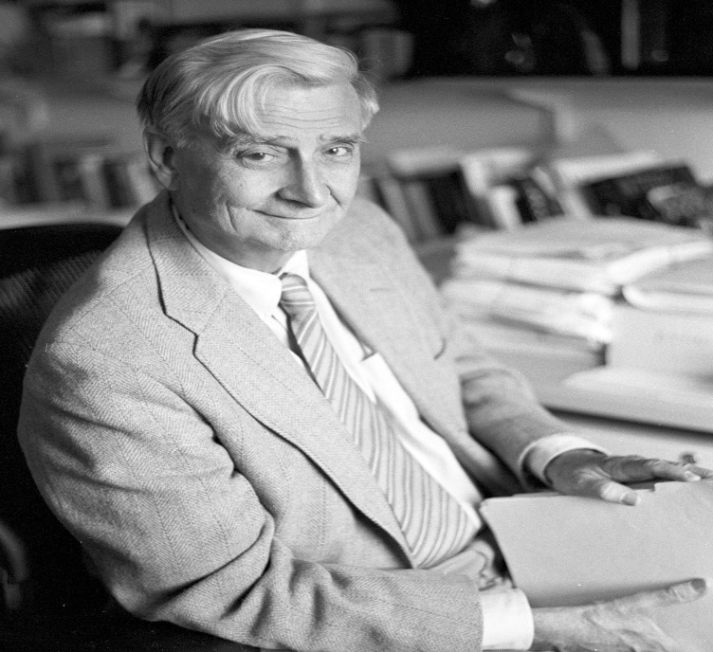
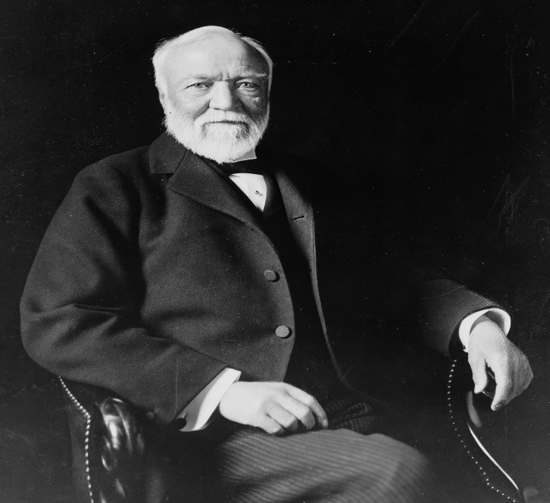
Evolution Begets Atheism
E. O. Wilson – “As were many persons from Alabama, I was a born-again Christian. When I was fifteen, I entered the Southern Baptist Church with great fervor and interest in the fundamentalist religion, I left at seventeen when I got to the University of Alabama and heard about evolutionary theory.” (E.O. Wilson, Toward a Humanistic Biology; The Humanist, September/October, 1982; p. 40).
Andrew Carnegie – “I remember that light came in like a flood and all was clear. Not only had I got rid of theology and the supernatural, but I had found the truth of evolution.” (1920. Autobiography of Andrew Carnegie, ed. John C. Van Dyke. 1986; reprint, Boston: Northeastern University Press.)
Notes:
Point #4 – The evolutionary lie causes people to completely abandon faith in God.
E. O. Wilson, an Alabama native, is a 2-time Pulitzer prize winner and knows the single most about ants than any person alive today.
"As were many persons from Alabama, I was a born-again Christian. When I was fifteen, I entered the Southern Baptist Church with great fervor and interest in the fundamentalist religion, I left at seventeen when I got to the University of Alabama and heard about evolutionary theory.”
Andrew Carnegie – “I remember that light came in like a flood and all was clear. Not only had I got rid of theology and the supernatural, but I had found the truth of evolution.”
The Carnegie foundation sponsored “The National Center For Science Education” which is an antiChristian organization. This is Eugenie Scott’s organization. Eugenie Scott’s life work has been to prevent creationism or intelligent design from being taught in public schools.

Slide 15
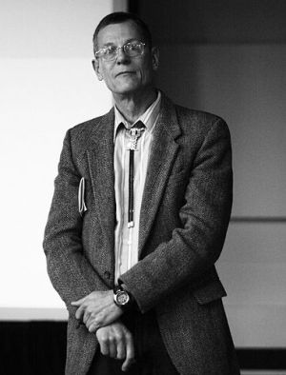
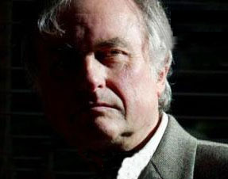
Evolution Begets Atheism
William Provine – “[B]elief in modern evolution makes atheists of people. One can have a religious view that is compatible with evolution only if the religious view is indistinguishable from atheism.” (“No Free Will”, in Catching Up with the Vision, Ed. by Margaret W. Rossiter, Chicago: University of Chicago Press, 1999, p. S123.)
Richard Dawkins – “I became increasingly aware that Darwinian evolution was a powerfully available alternative to my creator god as an explanation of the beauty and apparent design of life…I went through a period of doubting the power of natural selection to do the job required of it. But eventually a friend… persuaded me of the full force of Darwin’s brilliant idea and I shed the last vestige of theistic credulity, probably at the age of about sixteen. It wasn’t long then before I became strongly and militantly atheistic.” (An Appetite for Wonder: The Making of a Scientist, New York: Harper-Collins, 2013, p. 142)
Notes:
William Provine was a brilliant mind and used to be a Christian when he grew up in Tennessee. Then he went to UT and learned about Evolution and decided to become an atheist.
“[B]elief in modern evolution makes atheists of people. One can have a religious view that is compatible with evolution only if the religious view is indistinguishable from atheism.”
He is shown in the movie “Expelled”, a movie that provides a glimpse as to how teachers and professors are being persecuted as well as introduce you to the Intelligent Design movement.
Few people know this, but Richard Dawkins, arguably one of the most famous Atheists, grew up in the Anglican church as a believer in the bible and Jesus Christ. In one of his memoirs, he writes that his first doubts about Christianity came when his mother told him (at age 9) that there were many different religions and that they contradicted one another. As he grew into his teen years and early adulthood, he gradually lost faith in any version of a creator God. Dawkins states that, once he encountered Darwin’s views, he shed his last vestige of theistic credulity.
“I became increasingly aware that Darwinian evolution was a powerfully available alternative to my creator god as an explanation of the beauty and apparent design of life…I went through a period of doubting the power of natural selection to do the job required of it. But eventually a friend…persuaded me of the full force of Darwin’s brilliant idea and I shed the last vestige of theistic credulity, probably at the age of about sixteen. It wasn’t long then before I became strongly and militantly atheistic.”
He is now one of the most adamant, outspoken atheists in the world.
Now, does the fact that these “smart guys” abandoned faith in Jesus Christ for Evolution mean that Evolution is correct? Of course not…what else could it mean about these men?

Slide 16
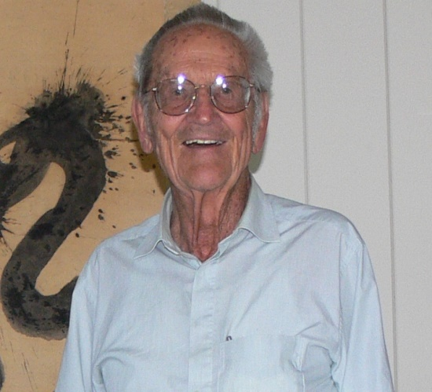
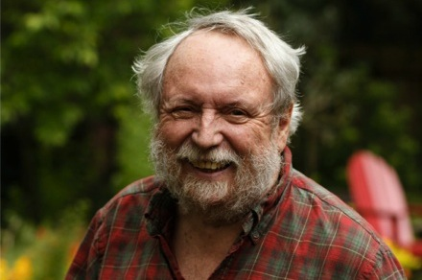
Evolution Negates Ethics
Lloyd Morain – “Morality needs no supernatural sanctions or motivations. It is not heaven-sent; it is human-evolved…In the coming planetary civilization of a world-embracing humanism, those ‘religions’ that obstruct social advance must be subordinated.” (The Humanist, vol. 48, p. 33-34)
Michael Ruse – “We humans are modified monkeys, not the favoured miraculous creation of a good god some 6000 years ago” (Intelligence & Evolutionary Biology, p. 13)
“As evolutionists, we see that no [ethical] justification of the traditional kind is possible. Morality, or more strictly our belief in morality, is merely an adaptation put in place to further our reproductive ends. Hence the basis of ethics does not lie in God’s will….In an important sense, ethics as we understand it is an illusion fobbed off on us by our genes to get us to cooperate. It is without external grounding. (“The Evolution of Ethics,” 1991)”
Notes:
Point #5 – Evolution destroys morality.
Some atheists will deny this, saying there is morality and ethics. But this is nonsensical. Because if there is no God, how can there be such a thing as ethics?
Lloyd Morain – “Morality needs no supernatural sanctions or motivations. It is not heaven-sent; it is human-evolved. In the coming planetary civilization of a world-embracing humanism, those 'religions' that obstruct social advance must be subordinated.”
This is now happening in Canada where it is illegal to speak out against homosexuality.
Michael Ruse – “We humans are modified monkeys, not the favoured miraculous creation of a good god some six-thousand years ago”
“As evolutionists, we see that no [ethical] justification of the traditional kind is possible. Morality, or more strictly our belief in morality, is merely an adaptation put in place to further our reproductive ends. Hence the basis of ethics does not lie in God’s will….In an important sense, ethics as we understand it is an illusion fobbed off on us by our genes to get us to cooperate. It is without external grounding.
So some Evolutionists will deny it, but these guys are at the very least honest about natural implication of Evolutionary thinking. If we’re nothing but a random accident from particles, there is no purpose or standard and therefore no basis for a right and wrong. Without ethics, we can do whatever we want to whoever we want without any regard for them whatsoever. Survival of the fittest.

Slide 17
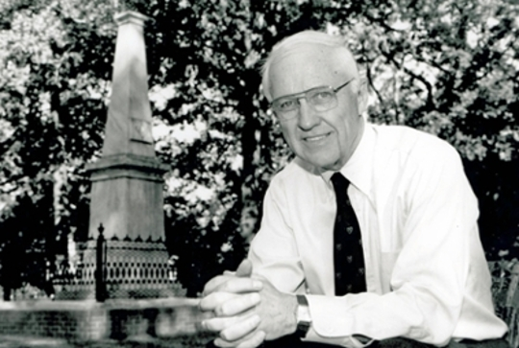
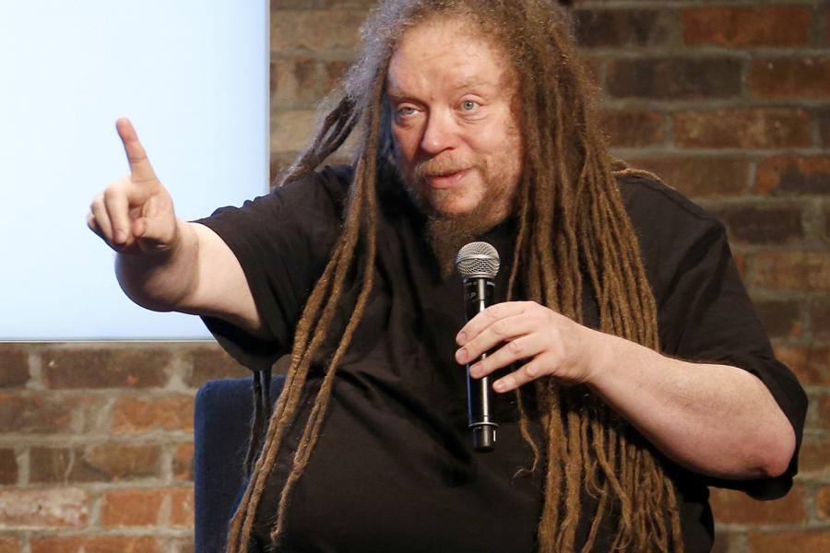
Evolution Negates Ethics
W. H. Murdy – “Unbridled self-indulgence on the part of one generation without regard to future ones is the modus operandi of biological evolution and may be regarded as rational behavior.” (Anthopocentrism, a Modern Version, Science 187, Mar 28, 1975, p. 1169)
Jaron Lanier – “There’s a large group of people who simply are uncomfortable with accepting evolution because it leads to what they perceive as a moral vacuum, in which their best impulses have no basis in nature.”
Richard Dawkins – “All I can say is, That’s just tough. We have to face up to the truth.” (‘Evolution: The dissent of Darwin,’ Psychology Today , 30(1):62, Jan-Feb 1997.)
Notes:
W. H. Murdy - “Unbridled self-indulgence on the part of one generation without regard to future ones is the modus operandi of biological evolution and may be regarded as rational behavior.”
Jaron Lanier, an atheist, debated Richard Dawkins, also an atheist, and Lanier was trying to explain to Dawkins that, “If you keep telling people there are no ethics, they’re not going to like atheism.”
Jaron Lanier: “There’s a large group of people who simply are uncomfortable with accepting evolution because it leads to what they perceive as a moral vacuum, in which their best impulses have no basis in nature.”
Richard Dawkins: “All I can say is, That’s just tough. We have to face up to the truth.”

Slide 18
Evolution Negates Ethics
Eddie N. Colanter – “The philosophical implications of ND not only have no reference for objective morality, but also have nothing ethically to say about whether past or future holocausts are right or wrong…If philosophical naturalism is correct, then human beings are reduced to pieces of impersonal matter…There is no truth, good or bad ideas, worthy or unworthy arguments, or love, but only determined chemical processes and the firing of neurons in brains. Science itself ends up a meaningless endeavor with no one left to share in its alleged benefits.” (“Philosophical Implications of Neo-Darwinism and Intelligent Design.” In Intelligent Design 101, Ed. H. Wayne House, 2008)
Notes:
Eddie Colanter – “The philosophical implications of ND not only have no reference for objective morality, but also have nothing ethically to say about whether past or future holocausts are right or wrong…If philosophical naturalism is correct, then human beings are reduced to pieces of impersonal matter…There is no truth, good or bad ideas, worthy or unworthy arguments, or love, but only determined chemical processes and the firing of neurons in brains. Science itself ends up a meaningless endeavor with no one left to share in its alleged benefits.”

Slide 19
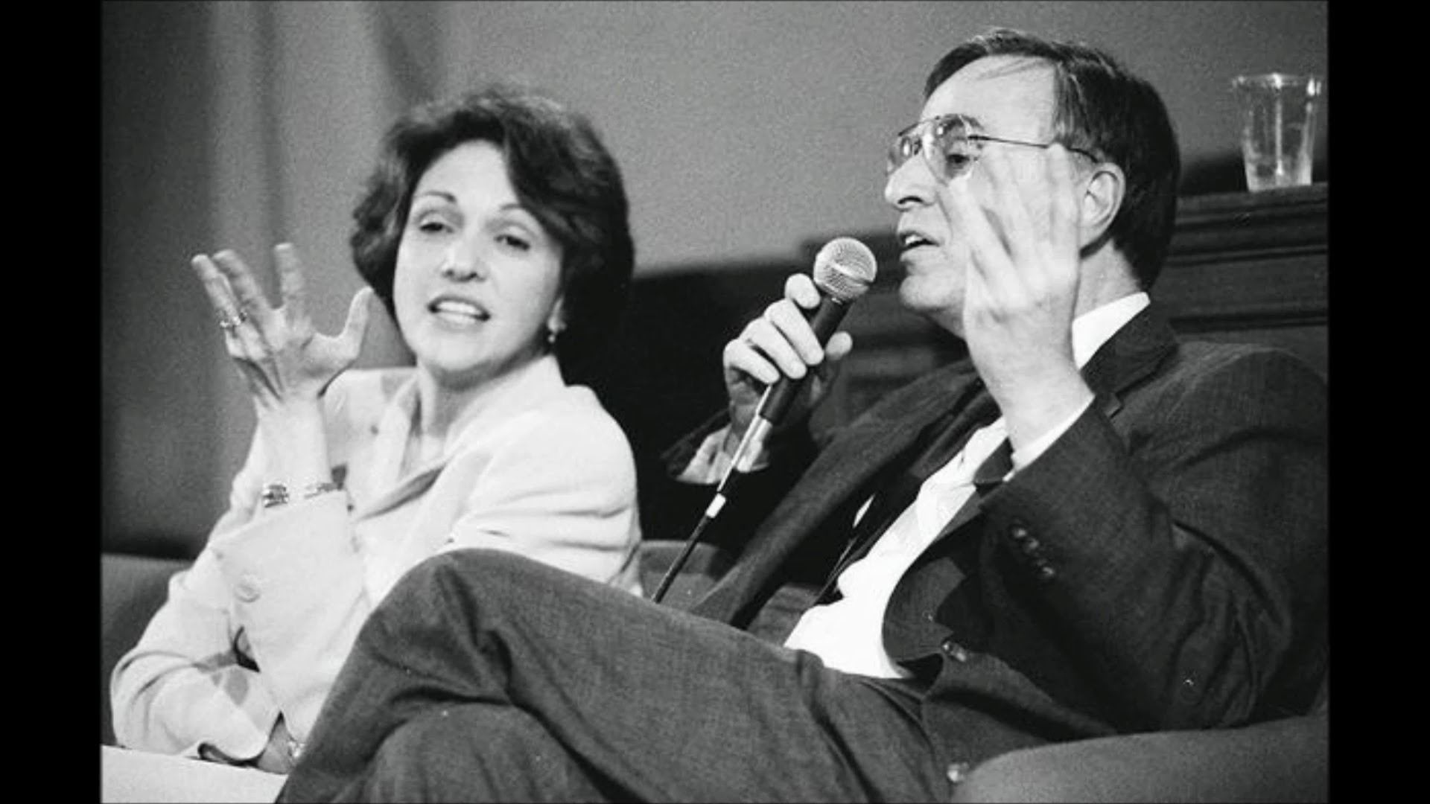
Abortion
Carl Sagan & Ann Druyan – “By the third week…it looks a little like a segmented worm. By the end of the fourth week…it's recognizable as a vertebrate, its tube-shaped heart is beginning to beat, something like the gill arches of a fish or an amphibian have become conspicuous, and there is a pronounced tail. It looks something like a newt or a tadpole...By the sixth week…the eyes are still on the side of the head, as in most animals, and the reptilian face has connected slits where the mouth and nose eventually will be...By the end of the eighth week the face resembles a primate's but is still not quite human.” (Parade Magazine, Apr 22, 1990)
Notes:
The next few of points are going to be a lot heavier and more sensitive than the previous. I’m going to try to be as careful as I can in saying certain things, but you’ll understand what I’m talking about as we progress.
Point #6 – Evolutionary teaching promotes abortion, euthanasia, and genocide. How is that the case? Well, logically, if we’re nothing more than animals, why can’t we treat one another the way that animals are treated?
In April 1990, Carl Sagan and his wife Ann Druyan, in a piece for the weekly magazine “Parade”, contended for the ethical permissibility of human abortion on the ground that the fetus, growing within a woman’s body for several months following conception, is not a human being. The conclusion drawn, therefore, was that the killing of this tiny creature is not murder, and they based their assertion by subtly suggesting the concept of embryonic recapitulation, which is another name for “animal homology” which we talked about a few weeks ago.
“By the third week…it looks a little like a segmented worm. By the and of the fourth week…it's recognizable as a vertebrate, its tube-shaped heart is beginning to beat, something like the gill arches of a fish or an amphibian have become conspicuous, and there is a pronounced tail. It looks something like a newt or a tadpole...By the sixth week…the eyes are still on the side of the head, as in most animals, and the reptilian face has connected slits where the mouth and nose eventually will be...By the end of the eighth week the face resembles a primate's but is still not quite human.”
Although Sagan doesn't mention Ernst Haeckel, this article, which is cleverly written, he clearly uses Haeckel's discredited recapitulation theory to justify abortion! Any person who had been taught recapitulation at school or college would immediately think that Sagan is promoting Haeckel's ideas. How sad that many thousands of people (many of them young women), will have read this article thinking that what they read from this “smart” scientist must be trustworthy. Many may even abort a baby on the basis of this misleading information.
Though this argument has long been discredited, it graphically reveals the thought process of humanists who disregard the sanctity of human life.

Slide 20
Abortion
Peter Singer – “The notion that human life is sacred just because it is human life is medieval…To give preference to the life of a being simply because that being is a member of our species would put us in the same position as racists who give preference to those who are members of their race…The animals themselves are incapable of demanding their own liberation, or of protesting against their condition with votes, demonstrations, or bombs…Why [..] should the boundary of sacrosanct life match the boundary of our species?” (The Dangerous Philosopher, New Yorker Magazine, Sept 1999)
Peter Singer – “Human babies are not born self-aware, or capable of grasping that they exist over time. They are not persons…the life of a newborn is of less value than the life of a pig, a dog, or a chimpanzee…a period of 28 days after birth might be allowed before an infant is accepted as having the same right to live as others.” (Practical Ethics, 1st edition, Cambridge: Cambridge University Press, 1979, 122–23.)
Notes:
Dr. Peter Singer is, ironically, a professor of bio-ethics at Princeton, but it should be bio-inethics. He is a fierce Evolutionist and an ardent, militant animal activist. He began that movement in the 1970s where people would throw paint on women who wear furs; his followers would bomb certain facilities to let animals loose.
This story would be humorously ironic if it wasn’t so sad, but a few years back, he and his group broke into a Mink farm and let a bunch of the Minks go. But it was next to a major highway and they all ended up getting run over. But he is someone who teaches that animals and humans should have the same rights, because according to evolution, we are equal to animals.
“The notion that human life is sacred just because it is human life is medieval…To give preference to the life of a being simply because that being is a member of our species would put us in the same position as racists who give preference to those who are members of their race…The animals themselves are incapable of demanding their own liberation, or of protesting against their condition with votes, demonstrations, or bombs.”
Meaning, we have to do that for them.
“Why [..] should the boundary of sacrosanct life match the boundary of our species?”
Meaning, why are we the only ones who are special? What about all the other animals?
What is the conclusion, then, if we’re to treat humans just like animals? Here is his response regarding abortion, in which he is one of the leading advocates in the country for expanding:
“Human babies are not born self-aware, or capable of grasping that they exist over time. They are not persons…the life of a newborn is of less value than the life of a pig, a dog, or a chimpanzee…a period of 28 days after birth might be allowed before an infant is accepted as having the same right to live as others.”
In other words, we should get 4 weeks to decide whether or not we want to kill a baby.

Slide 21
Euthanasia
Notes:
Now some Evolutionists will claim this is ridicules, that they would never advocate killing babies. The problem is, Evolutionists already do.
Here is a list of countries where it is not only legal, but regularly practiced. The Netherlands is especially atrocious. Every year, they euthanize 4800 people and 650 of these are babies. When the babies are born, the parents are allowed to decide over a period of time what they want to do. If the baby is born blind, deaf, without a limb, or with down syndrome, they can legally have the baby euthanized.
A 2005 study in Netherlands found that depression increased the likelihood of assisted suicide by 410%. I wonder how many of those 4800 people, if they were treated for their depression, would still be alive today.
Belgium kills about 2000 people a year. And according to a study in 2010, 33% of the euthanasia done in Belgium are done without patient consent. That’s just plain murder. These are people with dementia, those in old folks homes, or old folks with no family. That is very scary to think about, and I cringe thinking how close we may be to that in this country.

Slide 22
Euthanasia
Notes:
Now in the US, euthanasia, physicians killing their patients, is illegal. But physician-assisted dying has been legal since 1997, called the “Death With Dignity” Act in the state of Oregon. When this was passed, people flocked to Oregon from all across the country just to end their lives.
The other states that have legalized it are Vermont, Washington, and a county in Albuquerque, NM. Montana has decriminalized it in the sense that a doctor can be arrested for it, but if it gets to the DA, he won’t prosecute it.
In Oregon, state medical assistance will not cover your cancer treatment if doctors deem you have a 5% or less chance of living. But they will cover the cost of you killing yourself. Let that sink in.
This is Jeanette Hall. She is from Oregon and was dying from cancer. Doctors told her that she had 6 – 12 months to live. She asked her doctor 3 times for assistance to kill herself and he denied her 3 times. When he talked her out of it the 3rd time, he asked her, “What would your son think?” and then convinced her to try chemotherapy despite her low chance of living. Well guess what? 15 years later, Jeanette Hall is still alive, she’s happy, and is now one of the major advocates in Oregon against their Physician-assisted suicide.

Slide 23
Euthanasia
Rom 5:3-4 – “And not only this, but we also exult in our tribulations, knowing that tribulation brings about perseverance; and perseverance, proven character; and proven character, hope”
Jas 1:2-4 – “Consider it all joy, my brethren, when you encounter various trials, knowing that the testing of your faith produces endurance. And let endurance have its perfect result, so that you may be perfect and complete, lacking in nothing.”
1 Pet 1:6-7 – “In this you greatly rejoice, even though now for a little while, if necessary, you have been distressed by various trials, so that the proof of your faith, being more precious than gold which is perishable, even though tested by fire, may be found to result in praise and glory and honor at the revelation of Jesus Christ”
Gen 9:6 – “Whoever sheds man’s blood, by man his blood shall be shed, for in the image of God He made man.”
Notes:
What does the bible say about this? Think about all the people who chose to endure pain rather than to end their lives prematurely. And one reason for this is because there is value in suffering:
Rom 5:3-4 – “And not only this, but we also exult in our tribulations, knowing that tribulation brings about perseverance; and perseverance, proven character; and proven character, hope”
Jas 1:2-4 – “Consider it all joy, my brethren, when you encounter various trials, knowing that the testing of your faith produces endurance. And let endurance have its perfect result, so that you may be perfect and complete, lacking in nothing.”
1 Pet 1:6-7 – “In this you greatly rejoice, even though now for a little while, if necessary, you have been distressed by various trials, so that the proof of your faith, being more precious than gold which is perishable, even though tested by fire, may be found to result in praise and glory and honor at the revelation of Jesus Christ”
But even more importantly, perhaps, is what we read in Gen 9:
Gen 9:6 – “Whoever sheds man’s blood, by man his blood shall be shed, for in the image of God He made man.”
This is what establishes the differences between humans and animals, the fact that we are made in the image/likeness of God.

Slide 24
Euthanasia
Notes:
Many people in the bible preferred to endure suffering rather than end their life.

Slide 25
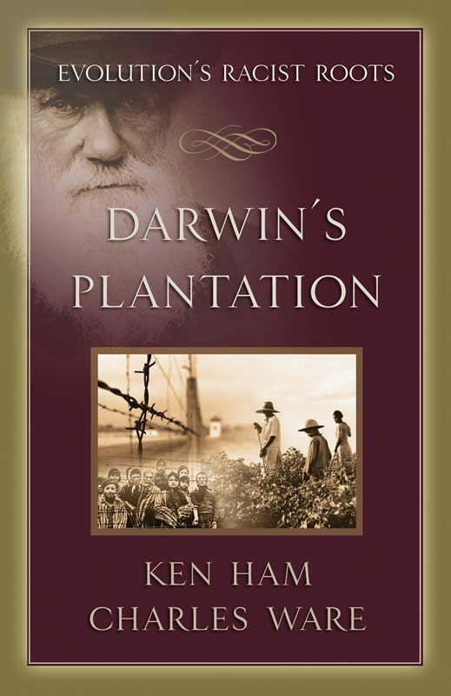
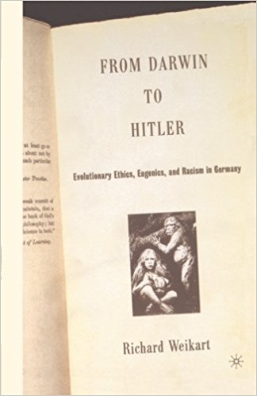
Genocide
“Lebensunwertes Leben”
“Life Unworthy of Living”
Notes:
And if Evolution is right, why stop at euthanizing the elderly or terminating unwanted pregnancies? If you’re willing to do that, why not add the mentally impaired, the sick, the blind, the handicapped, the physically and emotionally disabled? That’s logical right? If you go back to the 1930s, who do we know that took this practical conclusion of Evolution to the next level? Hitler did, and it is detailed in many books:
“Darwin's Plantation: Evolution's Racist Roots”
“From Darwin to Hitler: Evolutionary Ethics, Eugenics and Racism in Germany”
This is what Hitler did. He considered the mentally ill in institutions as, in German, “Lebensunwertes Leben”, which means “life unworthy of living”.

Slide 26
Genocide
Notes:
Here are some children with down syndrome in Schönbrunn Psychiatric Hospital, taken on Feb 16, 1934, all of which were likely euthanized.
If you’ve studied holocaust history, you’ve likely also heard of “Action 14f13” sometimes called “Code 14f13”. Nazi physicians conducted experiments on concentration camp prisoners deemed too ill to work using Zyklon B (hydrocyanic acid) and killed 15k – 20k people. These gas chambers were installed in several cities across Germany.

Slide 27
Genocide
Notes:
This is an old Nazi propaganda poster that basically says that it costs 60,000 marks (German dollars) to take care of a genetically ill person. The purpose of the article is to strongly imply how much of a waste of money that is and how it would be better spent elsewhere. And it was around the time of the Great Depression where people were hurting anyway, so the idea was, “Why not get rid of these people that are a drain on society?”
This 2nd picture depicts what the Nazis viewed as the blessings of sterilization – I believe it says, “Who would want to be responsible for this?”
This 3rd picture is similar to the 1st, saying that a genetically ill person costs the state, on average, 50,000 marks over 60 years.
These were German propaganda posters pushing genocide.

Slide 28
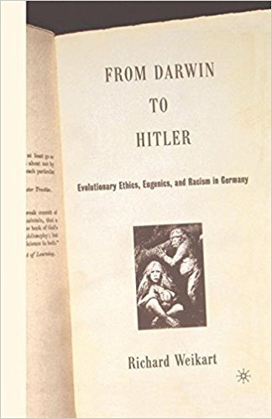
Genocide
Peter Hoffman – “Hitler believed in struggle as a Darwinian principle of human life that forced every people to try to dominate all others” (Hitler’s Personal Security, Oxford, UK: Pergamon Press, 1979, p. 264)
Richard Weikert – “Darwinism delivered a death-blow to the prevailing Judeo-Christian ethics…Darwinism by itself did not produce the Holocaust, but without Darwinism... neither Hitler nor his Nazi followers would have had the necessary scientific underpinnings to convince themselves and their collaborators that one of the worlds greatest atrocities was really morally praiseworthy.” (From Darwin to Hitler: Evolutionary Ethics, Eugenics, and Racism in Germany, New York, NY: Palgrave-Macmillan, 2004, p. 230)
Notes:
Now if you ask an Evolutionist if he is aware of the connection between Darwin and Hitler, the conversation will turn volatile very quickly. Evolutionists will almost always angrily deny it, engaging in Ad Hominum attacks. But let’s listen to the experts:
Peter Hoffman, who was a professor at McGill University, wrote a book called “Hitler’s Personal Security”, in which he said, “Hitler believed in struggle as a Darwinian principle of human life that forced every people to try to dominate all others”.
A historian at California State University, Richard Weikert, said, “Darwinism delivered a death-blow to the prevailing Judeo-Christian ethics…Darwinism by itself did not produce the Holocaust, but without Darwinism... neither Hitler nor his Nazi followers would have had the necessary scientific underpinnings to convince themselves and their collaborators that one of the worlds greatest atrocities was really morally praiseworthy.”

Slide 29
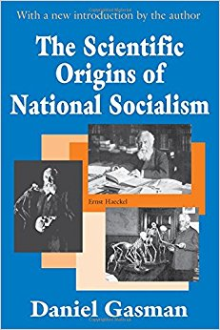
Genocide
Daniel Gasman – “Hitler stressed and singled out the idea of biological evolution as the most foremost weapon against traditional religion and he repeatedly condemned Christianity for its opposition to the teaching of evolution...For Hitler, evolution was the hallmark of modern science and culture.” (The Scientific Origins of National Socialism: Social Darwinism in Earnest Haeckel and the German Monist League, New York: American Elsevier Press, 1971, p. 168)
Dr. Jerry Bergman – “A review of the writings of Hitler and contemporary German biologists finds that Darwin’s theory and writings had a major influence on Nazi policies…In the formation of his racial policies, [Hitler] relied heavily upon the Darwinian evolution model, especially the elaborations by Spencer and Haeckel. They culminated in the ‘final solution’, the extermination of approximately six million Jews and four million other people who belonged to what German scientists judged were ‘inferior races’.” (Eugenics and the Development of Nazi Race Policy, Perspectives on Science and Christian Faith, vol. 44, June 1992, p. 109)
Notes:
Daniel Gasman, who was a historian at City University in New York, said the following in his book “The Scientific Origins of National Socialism”: “Hitler stressed and singled out the idea of biological evolution as the most foremost weapon against traditional religion and he repeatedly condemned Christianity for its opposition to the teaching of evolution... For Hitler, evolution was the hallmark of modern science and culture.”
Dr. Jerry Bergman, a professor of science at Northwest Technical College, said “A review of the writings of Hitler and contemporary German biologists finds that Darwin’s theory and writings had a major influence on Nazi policies…. In the formation of his racial policies, [Hitler] relied heavily upon the Darwinian evolution model, especially the elaborations by Spencer and Haeckel. They culminated in the “final solution,” the extermination of approximately six million Jews and four million other people who belonged to what German scientists judged were ‘inferior races’.”

Slide 30
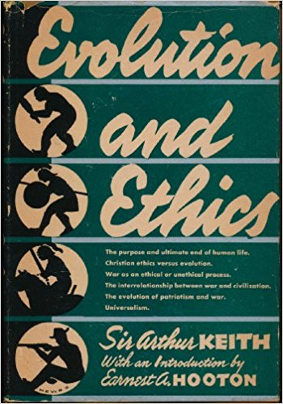
Genocide
Sir Arthur Keith – “We see Hitler devoutly convinced that evolution provides the only real basis for a national policy…The means he adopted to secure the destiny of his race and people were organized slaughter, which has drenched Europe in blood…Germany has reverted to the tribal past, and is demonstrating to the world, in their naked ferocity, the methods of evolution…The German Fuhrer, as I have consistently maintained, is an evolutionist; he has consciously sought to make the practice of Germany conform to the theory of evolution.” (Evolution and Ethics, Putnam, NY, USA, pp. 28–30, 230, 1947)
Notes:
Sir Arthur Keith, one of the architects and master minds behind ape to man evolution myth. He is an Evolutionist, yet makes the connection between Hitler and Darwin.
“We see Hitler devoutly convinced that evolution provides the only real basis for a national policy…The means he adopted to secure the destiny of his race and people were organized slaughter, which has drenched Europe in blood…. Germany has reverted to the tribal past, and is demonstrating to the world, in their naked ferocity, the methods of evolution…. The German Fuhrer, as I have consistently maintained, is an evolutionist; he has consciously sought to make the practice of Germany conform to the theory of evolution.”
Still, a lot of Evolutionists will deny this.

Slide 31
Genocide
Adolf Hitler – “The Germans were the higher race, destined for a glorious evolutionary future. For this reason it was essential that the Jews should be segregated…otherwise mixed marriages would take place. Were this to happen, all nature’s efforts 'to establish an evolutionary higher stage of being may thus be rendered futile.” (Clark, Ref. 12, p. 115.)
Adolf Hitler – “Thus there results the subjection of a number of people under the will, often of only a few persons, a subjection based simply upon the right of the stronger, a right which, as we see in Nature, can be regarded as the sole conceivable right, because it is founded on reason.” (The Einsatzgruppen Case, MILITARY TRIBUNAL II, Case No. 9, p. 32)
Notes:
So let’s now look at the Fuhrer’s own words:
In a speech in Germany in 1933 – “The Germans were the higher race, destined for a glorious evolutionary future. For this reason it was essential that the Jews should be segregated…”
He is referring to what was done to the Jews prior to them being killed, that they were taken out of their homes and moved into ghettos where they could be quarantined off.
“…otherwise mixed marriages would take place. Were this to happen, all nature’s efforts 'to establish an evolutionary higher stage of being may thus be rendered futile‘”
Hitler himself – “Thus there results the subjection of a number of people under the will, often of only a few persons, a subjection based simply upon the right of the stronger, a right which, as we see in Nature, can be regarded as the sole conceivable right, because it is founded on reason.”

Slide 32
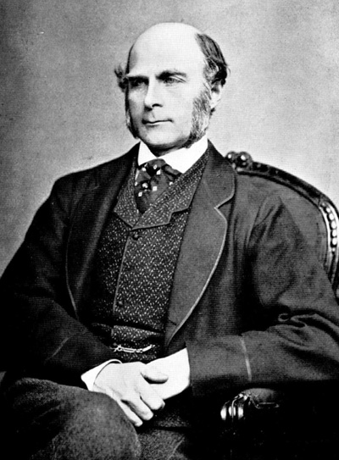
Genocide
Martin Brookes – “Since Darwin’s death, all has not been rosy in the evolutionary garden. The theories of the Great Bearded One have been hijacked by cranks, politicians, social reformers—and scientists—to support racist and bigoted views. A direct line runs from Darwin, through the founder of the eugenics movement—Darwin's cousin, Francis Galton—to the extermination camps of Nazi Europe.” (‘Ripe old age,’ New Scientist 161(2171):41, 1999)
Francis Galton – “There is perhaps some connection between this obscure action and the disappearance of most savage races when brought into contact with high civilization…But while most barbarous races disappear, some, like the negro, do not…What nature does blindly, slowly, and ruthlessly, man may do providently, quickly, and kindly. As it lies within his power, so it becomes his duty to work in that direction.” (Eugenics – Its Definition, Scope, and Aims, 1904)
Notes:
Martin Brookes, an evolutionist and no friend of creationists – “Since Darwin’s death…The theories of the Great Bearded One have been hijacked…to support racist and bigoted views.”
In other words, he does not think Darwin was a racist or a bigot, which we will address in a minute.
“A direct line runs from Darwin, through the founder of the eugenics movement—Darwin’s cousin, Francis Galton—to the extermination camps of Nazi Europe.”
The eugenics movement began as an effort to rid the world of genetically inferior people, the idea that people should only be allowed to procreate if they have superior, genetic makeup.
Notice what Darwin’s cousin, Francis Galton, said, and I’m going to go ahead and warn you that what is said is exceptionally racist, but they are connected to Darwin though you will never hear it taught by Evolutionists or biologists teaching evolution in public schools.
Francis Galton – “There is perhaps some connection between this obscure action and the disappearance of most savage races when brought into contact with high civilization”
For background, this was during a time when Englishmen were traveling all over the world exploiting different countries, and often when they would go in, they would wipe out entire tribes of people. And Darwin supported and backed this idea in a time when this practice was actually beginning to wane. But Darwin lent credence to the idea that these people were not fully human, rather that they were an evolutionary missing link between animals and humans, which we’ll substantiate with some quotes in a moment.
“But while most barbarous races disappear, some, like the negro, do not.”
“What nature does blindly, slowly, and ruthlessly, man may do providently, quickly, and kindly. As it lies within his power, so it becomes his duty to work in that direction.”
And this was going on all over Africa by the English, the French, the Dutch, and other Western European nations. It’s a fact and can be found on the internet or in any library.

Slide 33
Notes:
Nazi propaganda movie that Hitler put out in 1937: “Victims of the Past”. (https://www.youtube.com/watch?v=LiO_c5-6_Hw&bpctr=1517548783)
“All weak living things will inevitably perish in nature. In the last few decades, mankind has sinned frightfully against the law of natural selection. We haven’t just maintained life unworthy of life, we have even allowed it to multiply! The descendants of these sick people look like this!”

Slide 34
Genocide
Larry Taunton – “As we speak of this shifting [time], how are we to determine who is right? If we do not acknowledge some sort of external [standard], what is to prevent us from saying that the Muslim [extremists] aren’t right?”
Richard Dawkins – “Yes, absolutely fascinating. What’s to prevent us from saying Hitler wasn’t right? I mean, that is a genuinely difficult question.” (Richard Dawkins, the Atheist Evangelist, by Larry Taunton, byFaith, 18 December 2007)
Stephen J Gould – “Biological arguments for racism may have been common before 1850, but they increased by orders of magnitude following the acceptance of evolutionary theory.” (Ontogeny and Phylogeny, Belknap-Harvard Press, p. 127, 1977)
Notes:
The most outspoken atheist and support of evolution is of course Richard Dawkins. In an interview he did with Larry Taunton, who asked…
“As we speak of this shifting [time], how are we to determine who is right? If we do not acknowledge some sort of external [standard], what is to prevent us from saying that the Muslim [extremists] aren’t right?”
In other words, if we don’t believe in God, what standard is there to tell you what is right and what is wrong? Here is Dawkins’ answer (and at least he is honest)…
“Yes, absolutely fascinating. What’s to prevent us from saying Hitler wasn’t right? I mean, that is a genuinely difficult question.”
Really? It is? Well for an Evolutionist and an Atheist it is because if we’re animals, why not just act like animals?
Stephen J Gould admitted that Darwinism increased racism – “Biological arguments for racism may have been common before 1850, but they increased by orders of magnitude following the acceptance of evolutionary theory.”

Slide 35
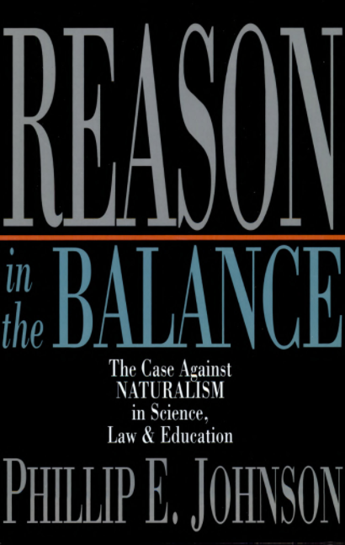
Genocide
Phillip Johnson – “Genocide, of course, is merely a shocking name for the process of natural selection by which one gene pool replaces another. Darwin himself explained this in The Descent of Man, when he had to deal with the absence of ‘missing links’ between ape and human. Such gaps were to be expected, he wrote, in view of the extinctions that necessarily accompany evolution. He coolly predicted that evolution would make the gaps wider in the future, because the most civilized (that is, European) humans would soon exterminate the rest of the human species and go on from there to kill off our nearest kin in the ape world. Modern Darwinists do not call attention to such passages, which make vivid how easily the picture of amoral nature inherent in evolutionary naturalism can be converted into a plan of action” (Reason in the Balance: The Case Against Naturalism in Science, Law & Education, 1995. p.144)
Notes:
“Genocide, of course,” writes Phillip Johnson, “is merely a shocking name for the process of natural selection by which one gene pool replaces another.”
“Darwin himself explained this in The Descent of Man, when he had to deal with the absence of ‘missing links’ between ape and human. Such gaps were to be expected, he wrote, in view of the extinctions that necessarily accompany evolution.”
“He coolly predicted that evolution would make the gaps wider in the future, because the most civilized (that is, European) humans would soon exterminate the rest of the human species and go on from there to kill off our nearest kin in the ape world. Modern Darwinists do not call attention to such passages, which make vivid how easily the picture of amoral nature inherent in evolutionary naturalism can be converted into a plan of action”

Slide 36
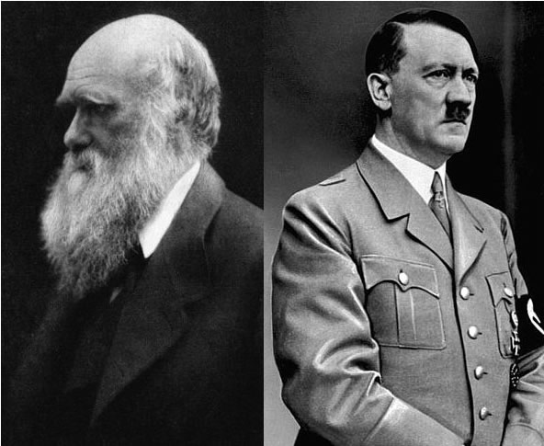
Genocide
Notes:
Later Adolf Hitler indeed applied the Darwinian concept of the “survival of the fittest” to the human race. During World War II the Nazis forcibly sterilized more than 2 million people and began systematically exterminating people whom Hitler considered to be inferior. The Nazis justified their atrocities by rationalizing that they were doing mankind a service with “genetic cleansing” to improve the races.
As long as evolution—with its implications of amorality and the survival-of-the-fittest mentality among “superior” and “inferior” races —is accepted and believed, genocide, as sporadic ethnic cleansings in various parts of the globe show, will have a scientific justification, even though most believers in Darwinian theory would object to this conclusion.

Slide 37
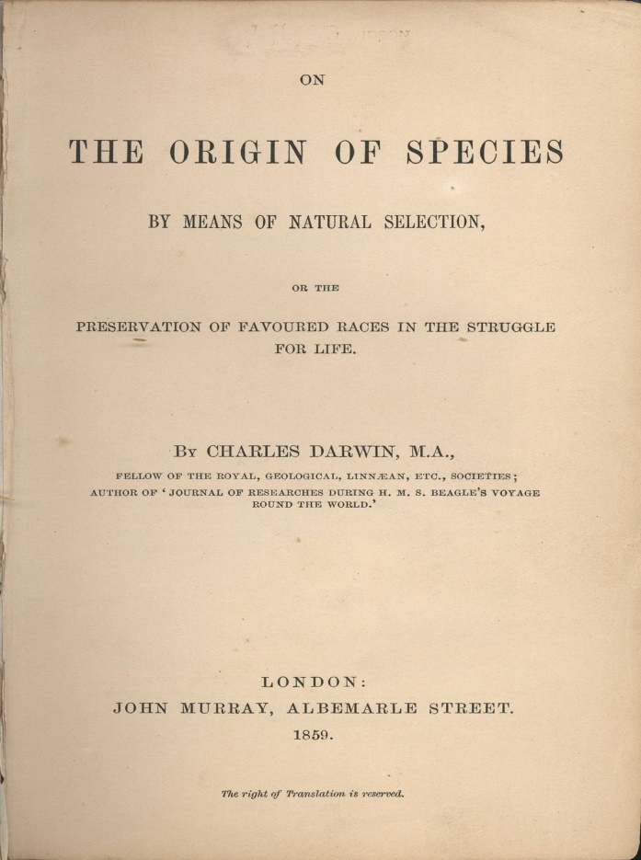
Racism
Charles Darwin – “Looking to the world at no very distant date, what an endless number of the lower races will have been eliminated by the higher civilized races throughout the world.” (Darwin's letter to W. Graham, The Life & Letters of Charles Darwin, Volume 1, p.316)
Charles Darwin – “At some future period, not very distant as measured by centuries, the civilised races of man will almost certainly exterminate and replace throughout the world the savage races…At the same time the anthropomorphous apes…will no doubt be exterminated.” (Darwin, Descent of Man, 1871, vol. I, p. 201)
Notes:
What about racism? Here is what Darwin said – “At some future period, not very distant as measured by centuries, the civilised races of man will almost certainly exterminate and replace throughout the world the savage races.”
I would suggest that Darwin was not only a racist, but also a murder. And I’m going to show you some evidence of that in a few minutes.
“At the same time the anthropomorphous apes…will no doubt be exterminated.”
What is anthropomorphism? That is when you attribute human qualities to something that is not human. In other words, he’s saying, “We refer to these people as human, but they’re really not human.”
Some will refuse to believe that Darwin was a racist or that he wanted to wipe out other races.
Well, we know Darwin’s first book was entitled, “On the Origin of Species” then “By Means of Natural Selection” But what did he subtitle it? “Or The Preservation Of Favored Races In The Struggle For Life.” So he doesn’t just talk about in this book about evolution, but also about how some races should be eliminated and some should be preserved.
Notice what he said in a letter to a friend – “Looking to the world at no very distant date, what an endless number of the lower races will have been eliminated by the higher civilized races throughout the world.”

Slide 38
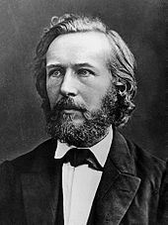
Racism
“I consider the negro to be a lower species of man and cannot make up my mind to look upon him as ‘a man and a brother,’ for the gorilla would then also have to be admitted into the family.” (The History of Creation, or the development of the Earth and its inhabitants by the action of natural causes: A popular exposition of the doctrine of evolution in general, and that of Darwin, Goethe, and Lamarck in particular, vol II, English edition translated from the 8th German Edition by Prof. Ray Lankester, Fellow of Exeter College, Oxford, pp. 412–413, 1909)
Notes:
Darwin’s biggest supporter in Germany was Ernst Haeckel, and men like Haeckel would do battle with the religious clergy of the day, evangelicals who opposed Darwin. Haeckel was nicknamed the “Apostle of Darwin”. Notice what Haeckel quotes in his book “The History of Creation” (I apologize for the offensive language)
“I consider the negro to be a lower species of man and cannot make up my mind to look upon him as ‘a man and a brother,’ for the gorilla would then also have to be admitted into the family.”
And he said similar things about American Indians, Asians, Mongols, and other races he deemed inferior. This is a guy that is praised in the Evolutionary community. Evolutionists love Haeckel, but you’ll never see this quote mentioned in their circles or taught in public schools.

Slide 39
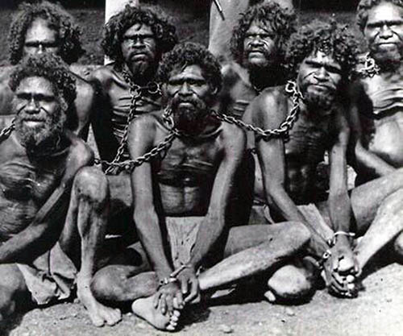
Racism
Notes:
Now, as a result of these teachings by these men, the Evolutionists were being pressed by Evangelicals to provide evidence for how we evolved. And so Evolutionists traveled all over the world looking for the missing link. And they believed they found this missing link in the Australian Aborigines. We have published documents that show that >10,000 Aborigine remains were shipped to British museums. The Smithsonian still holds the remains >15,000 Aborigines. The above is one of the many pictures you can find of them being rounded up for extermination or study.
I mentioned earlier that Darwin was not just a racist, but a murderer. When there were only 4 remaining Aborigines on the island of Tasmania, Darwin requested their skulls provided that the request did not “upset” their feelings. Shortly after that, the remaining Aborigines were wiped off the island. Many museums wanted skins of specimens, or freshly killed specimens to be stuffed and put into museums. These were people.
Edward Ramsey, curator of an Australian museum, actually published a book on how to plug up bullet wounds in freshly killed specimens. He also requested the skulls of a small African tribe called the Bungee Blacks. 4 weeks later, a scientist sent him 2 corpses, proudly proclaiming the last of their tribe.

Slide 40
Racism
Phillip Bradford & Harvey Blume – “They chased him about the grounds all day, howling, jeering, and yelling. Some of them poked him in the ribs, others tripped him up, all laughed at him…There was always a crowd before the cage, most of the time roaring with laughter, and from almost every corner of the garden could be heard the question ‘Where is the Pygmy?’ and the answer was, ‘in the monkey house’”. (Ota Benga: The Pygmy in the Zoo, St Martins, 1992, 269)
Notes:
This is Ota Benga, of the Pigmy tribe in the Congo in 1881. Murderous, government thugs from Belgium came into the Congo in 1904 and wiped out many of his tribe including Ota Benga’s wife and family. Ota Benga was taken as a slave and sold to a slave trader named Samuel Verner. In the 1904 World’s Fair in St. Louis, operating on Darwinian theory about races, Verner put him on display as an emblematic savage. They also put on display some American Indians in an attempt to show they weren’t really human, but rather missing links. They ran experiments on them and tortured them to see how they responded to pain. When they compared the brain of one, they were surprised that it was larger than the statesman Daniel Webster. After this, Africans were put in zoos all over the world and treated like animals.
Verner then transferred Ota Benga to the Bronx Zoo where he was put on display with the Apes to try to prove that he was really just an advanced ape and not a human.
On Sept 15 1906, 40,000 people from New York came to the zoo to see Ota Benga. He was pummeled with rocks and always in danger of being grabbed and yanked and pulled to pieces by the mob. This is what the New York Times said – “They chased him about the grounds all day, howling, jeering, and yelling. Some of them poked him in the ribs, others tripped him up, all laughed at him…There was always a crowd before the cage, most of the time roaring with laughter, and from almost every corner of the garden could be heard the question 'Where is the Pygmy?" and the answer was, 'in the monkey house'”
The only people that would come to Ota Benga’s defense were some African American ministers. They published a letter denouncing the treatment, claiming he was a human they were treating like an animal. Here is what the New York Times replied – “the reverend colored brother should be told that evolution ... is now taught in the textbooks of all the schools, and that it is no more debatable than the multiplication table"
On Mar 20 1916, Ota Benga got hold of a revolver, pressed it to his chest, and pulled the trigger. Not surprising.
Richard Dawkins was asked later how he could support Charles Darwin when he was such a bigot and such a racist? Dawkins very dishonestly replied that all Victorian men of that era were racist. Well, what we know and what even Dawkins knew when he spouted this lie was that there were men at that time, hundreds if not thousands, who were risking their lives to bring bibles and the message of Jesus Christ to African and Aboriginal tribes all over the world. Not all Englishmen were racist like Charles Darwin was.

Slide 41
Male Chauvinism
1 Cor 11:11-12 – “However, in the Lord, neither is woman independent of man, nor is man independent of woman. For as the woman originates from the man, so also the man has his birth through the woman; and all things originate from God.”
Notes:
Finally, Darwinism promotes male chauvinism and exploitation of females.
If you study the culture of the NT in the first century, Jesus bestowed honor upon women, which was unusual for Jewish men of that era as they did not generally hold women in high regard. But Jesus healed Peter’s mother-in-law, resurrected the 12 year old girl, giving comfort and forgiveness to prostitutes, the gospel writers records multitudes of women mourning his suffering, He befriended an adulteress, Samaritan woman, showed mercy to the adulterous woman in John 8, and He honored His mother while hanging on the cross.
The bible teaches that while woman is distinct in her work, she is the same in her personhood – 1 Cor 11:11-12 – “However, in the Lord, neither is woman independent of man, nor is man independent of woman. For as the woman originates from the man, so also the man has his birth through the woman; and all things originate from God.” The bible teaches love and respected toward men, especially husbands towards wives as Paul spends 3 times as many verses in Eph 5 teaching the man how to love the woman vs. the woman toward the man.

Slide 42
Male Chauvinism
Eveleen Richards – “In a period when women were beginning to demand the suffrage, higher education and entrance to middle-class professions, it was comforting to know that women could never outstrip men; the new Darwinism scientifically guaranteed it…an evolutionary reconstruction that centers on the aggressive, territorial, hunting male and relegates the female to submissive domesticity and the periphery of the evolutionary process.” (New Scientist, Vol. 100, Dec 22/29, 1983, p. 887.)
Notes:
Well around the time Darwin wrote his books, the women’s rights movement was kicking off, where women were wanting to have some of the common rights of men. For example, at this time women were not allowed to divorce their husband for any reason. He could have been an adulterous, womanizing husband and the wife had no recourse in that society.
This is what Eveleen Richards said – “In a period when women were beginning to demand the suffrage, higher education and entrance to middle-class professions, it was comforting to know that women could never outstrip men; the new Darwinism scientifically guaranteed it.” She went on in the article to say, “ … an evolutionary reconstruction that centers on the aggressive, territorial, hunting male and relegates the female to submissive domesticity and the periphery of the evolutionary process.”

Slide 43
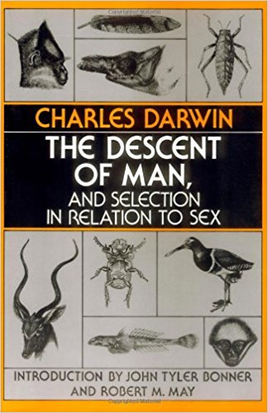
Male Chauvinism
Charles Darwin – “It is generally admitted that with woman the powers of intuition, of rapid perception, and perhaps of imitation, are more strongly marked than in man; but some, at least, of these faculties are characteristic of the lower races, and therefore of a past and lower state of civilization…The chief distinction in the intellectual powers of the two sexes is shewn by man's attaining to a higher eminence, in whatever he takes up, than can woman…if men are capable of a decided pre-eminence over women in many subjects, the average of mental power in man must be above that of woman” (The Descent Of Man, p. 269)
Notes:
What did Darwin say that was male chauvinist? In his second book, “The Descent of Man”, he said:
“It is generally admitted that with woman the powers of intuition, of rapid perception, and perhaps of imitation, are more strongly marked than in man; but some, at least, of these faculties are characteristic of the lower races, and therefore of a past and lower state of civilization.”
Now in this second book, he taught that women were less evolutionarily advanced than men. So keep that in mind with this next quote – “The chief distinction in the intellectual powers of the two sexes is shewn by man's attaining to a higher eminence, in whatever he takes up, than can woman”. Well, in Victorian society of that day women were not allowed to take up anything.
They always tell you in school that the title of Darwin’s 2nd book was “The Descent of Man”, but they never tell you what it was subtitled – “And Selection In Relation To Sex”…the book teaches that women are inferior to men.
Darwin goes on to say, “if men are capable of a decided pre-eminence over women in many subjects, the average of mental power in man must be above that of woman”.

