Slide 1
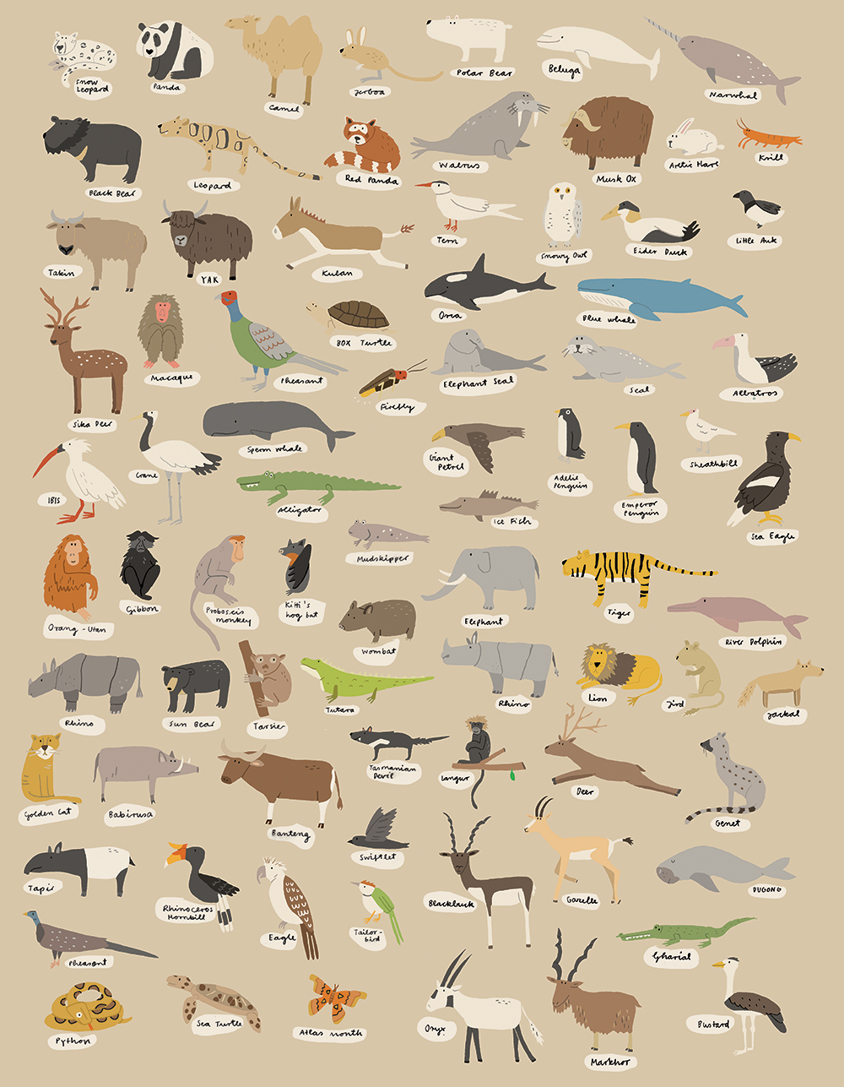
Animal
Kinds
Notes:
In this lesson, we are going to talk about animal kinds. Sometimes people believe the word “species” is the same thing as the word “kind” but that is not necessarily the case. The word “species” is a man-made term used in the modern classification system we’ll look at in just a bit. And frankly, the word “species” is difficult to define regardless of which worldview to which you hold. In fact, one of the most popular books on “Speciation” written by Jerry Coyne, an Evolutionist to Evolutionists, lists 9 different definitions for a species.
But I have 2 objectives in mind for this lesson:
First, what we observe in nature is that animals are fixed by kind and therefore unable to reproduce outside of its kind. And so this fixing of animal kinds actually disqualifies Darwinian Evolution as a theory
Second, the similarities we see in the created animal kinds actually reflect an intelligent designer rather than natural selection.

Slide 2
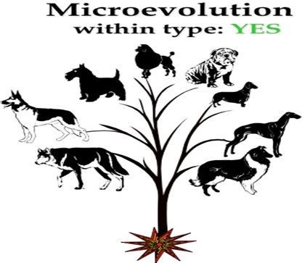
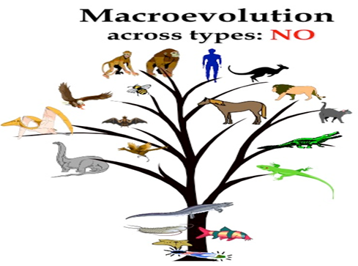
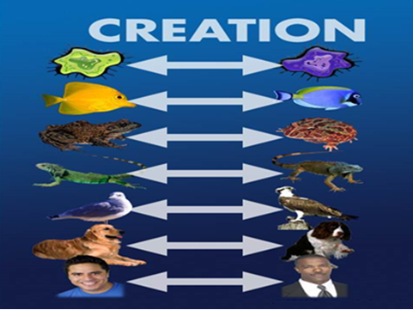
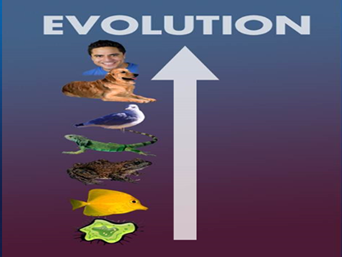
Notes:
First, what do we mean by saying that the fixing of animal kinds disqualifies Darwinian Evolution?
What we observe in nature is that animals have been created in fixed, biogenetic boundaries which cannot be crossed. We can certainly see animals change within their kinds, but we cannot see them change outside their kind. Meaning, we see changes within the “cat” kind, within the “dog” kind, within the “fish”, etc. But we don’t observe fish changing into cats, and we don’t observe dogs changing into fish.
Changes within animal kinds is what we call “Microevolution”. We can observe this in nature, small changes within a kind over a short period of time. But, Darwinian Evolution teaches what is called “Macroevolution”, that mankind descended from a single microscopic organism and we do not see that in nature. It can’t be observed, it can’t be tested, it can’t be produced; those types of changes fail every single level of the Scientific Method. All we see happening in nature is Microevolution, changes within kinds.

Slide 3
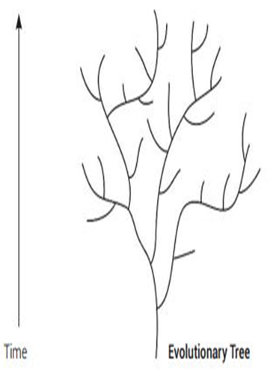
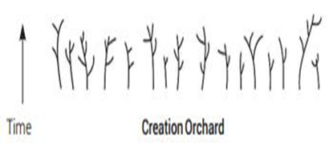
Gen 1:21 – “God created the great sea monsters and every living creature that moves, with which the waters swarmed after their kind, and every winged bird after its kind; and God saw that it was good.”
Gen 1:24-25 – “Then God said, ‘Let the earth bring forth living creatures after their kind: cattle and creeping things and beasts of the earth after their kind’; and it was so. God made the beasts of the earth after their kind, and the cattle after their kind, and everything that creeps on the ground after its kind; and God saw that it was good.”
Notes:
And what we see in nature is exactly what the bible teaches:
Gen 1:21 – “God created the great sea monsters and every living creature that moves, with which the waters swarmed after their kind, and every winged bird after its kind; and God saw that it was good.”
Gen 1:24-25 – “Then God said, ‘Let the earth bring forth living creatures after their kind: cattle and creeping things and beasts of the earth after their kind’; and it was so. God made the beasts of the earth after their kind, and the cattle after their kind, and everything that creeps on the ground after its kind; and God saw that it was good.”
And so the bible teaches that God made each living creature after its kind and nature confirms that animals only reproduce after their kind and not according to another kind. And so if I understand this correctly, that would preclude animals being able to breed with another kind.
So, in this top right diagram, Darwinian evolution teaches that everything started like a tree trunk and then branches formed into different kinds/species. But this bottom diagram shows what Genesis teaches, that kinds were created distinct from other kinds, with them producing only after their kind, and nature shows us that changes only occurring within the kind. So in this diagram, each little branch in the tree might be a different kind of cat, a different kind of dog, a different kind of fish, and so on.

Slide 4
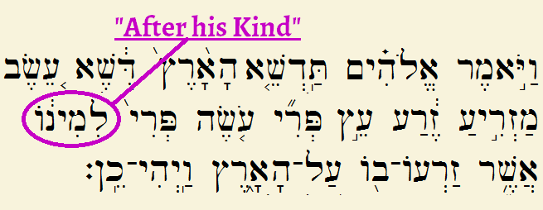
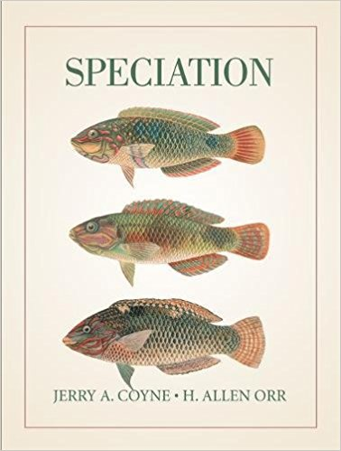
Gen 2:19-20a – “¹⁹Out of the ground the Lord God formed every beast of the field and every bird of the sky, and brought them to the man to see what he would call them; and whatever the man called a living creature, that was its name. ²⁰The man gave names to all the cattle, and to the birds of the sky, and to every beast of the field…”
Notes:
So this begs a question: how do we know what an actual “kind” is? You’ll remember that in Gen 1, that God himself called the light “day” and the darkness “night”. God called the expanse “heaven” and the dry land “earth”. But then He stops naming things Himself when He created the animal kinds, deciding apparently to let Adam share that power, which would seem to indicate that it is important in God’s plan that man has personal knowledge about the animal kinds.
Gen 2:19-20a – “Out of the ground the Lord God formed every beast of the field and every bird of the sky, and brought them to the man to see what he would call them; and whatever the man called a living creature, that was its name. The man gave names to all the cattle, and to the birds of the sky, and to every beast of the field…”
What this also suggests is that kinds are generally intuitive to our senses. In the book I mentioned earlier, Speciation, there is a fascinating story about the people of Papa New Guinea. Ernst Mayr, a popular Evolutionist who was an Ornithologist (he liked to study birds), went into Papa New Guinea and studied the birds there and started classifying them into species based on what he observed in their looks, their songs, and their breeding. When he was finished, he came up with 137 bird species of that area. Guess how many names for the different birds the natives of Papa New Guinea had previously come up with? 136. These natives didn’t have the scientific training that Ernst Mayr had, they merely did what we humans do – they observed the world around them, specifically these birds, and gave names for what they saw and we do the same thing to native plants and animals we see in our own lovely city of Auburn.
So what this suggests is that people today can do the same thing that Adam did. We can you use the five senses God gave us, make observations from the living things we see, and not only give them names but recognize what separates one kind from another – because species/kinds are intuitively obvious.

Slide 5
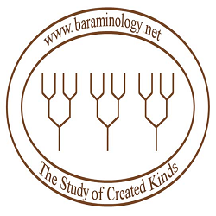
Notes:
But there is a branch of science today that goes beyond what is intuitively obvious and attempts to determine what actually composes an animal kind, and that field is called Baraminology. “Bara min” means “created kinds”, which was first suggested in 1941 by Frank Marsh. So Baraminology is a Creationists’ taxonomical study attempting to identify those created kinds mentioned in Gen 1, even if they might look different today, post flood.

Slide 6
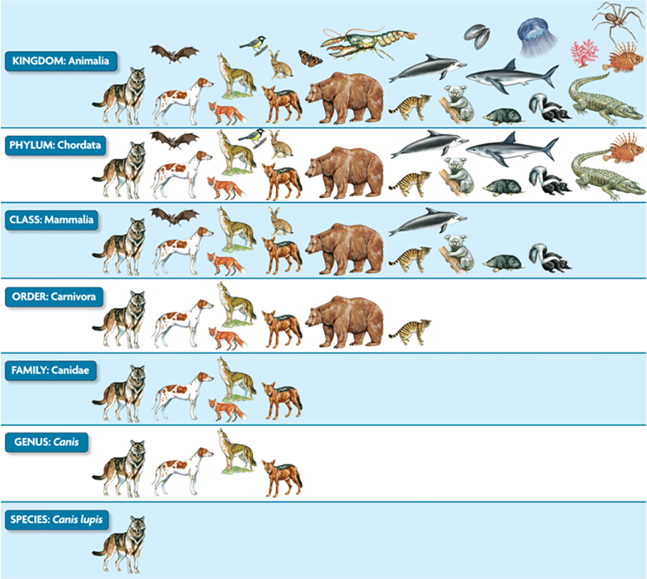
Notes:
Now when we look at the entirety the animal kingdom, you’ll recall that in the 18th century, this 7-tier scientific classification of animals was constructed – kingdom, phylum, class, order, family, genus, species. And the guy who came up with this, Carl Linnaeus, was actually a Creationist, a believer in God’s word.
Baraminologists of today believe that the “kinds” that the bible refer to fall somewhere around the “family” level. Why might we think that? In the family level on this chart, we see some animals rom the “Canidae” family: a coyote, wolf, jackal, dog, and a fox. So did Noah have to put all 5 of these animals in the ark, or could he have just put a common ancestor in there that diverged and created the different kinds? Because we see the family “canidae” and the genus “canis” and then the species “canis lupis”, and yet all 5 of these animals can breed with one another which may mean they are all the same kind.

Slide 7
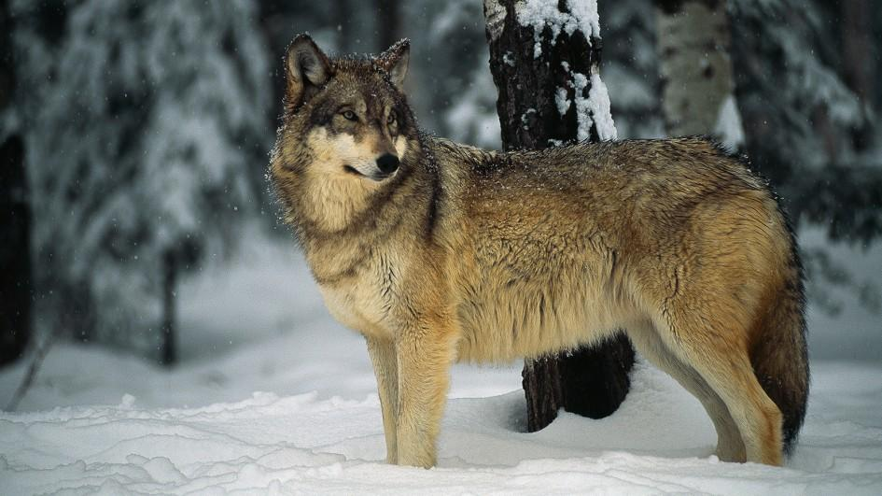
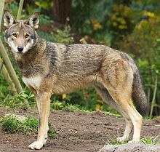
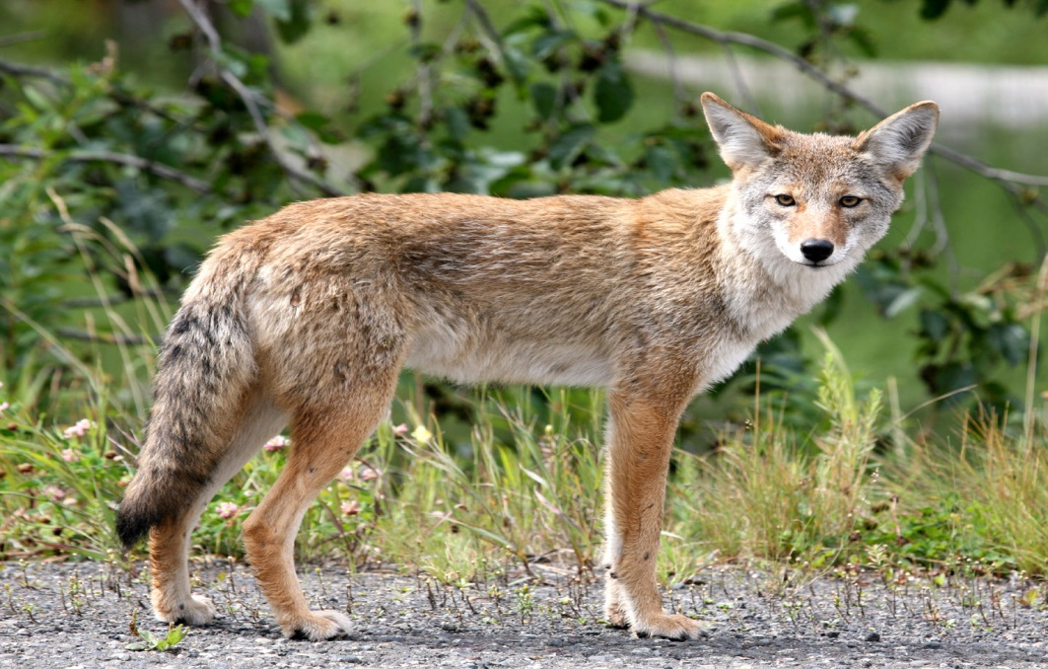
Notes:
So using this “canidae” family as an example, you can breed together a coyote and a wolf. Anyone know what that is called? You get what’s called a coy wolf, a canine hybrid descended from coyotes and gray wolves.

Slide 8
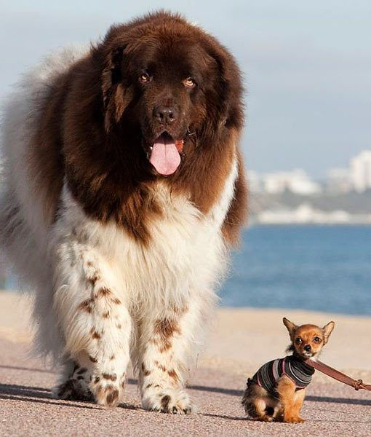
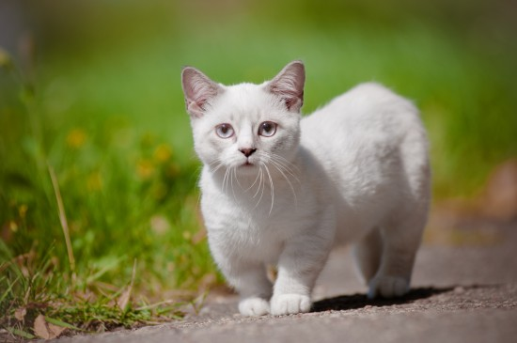
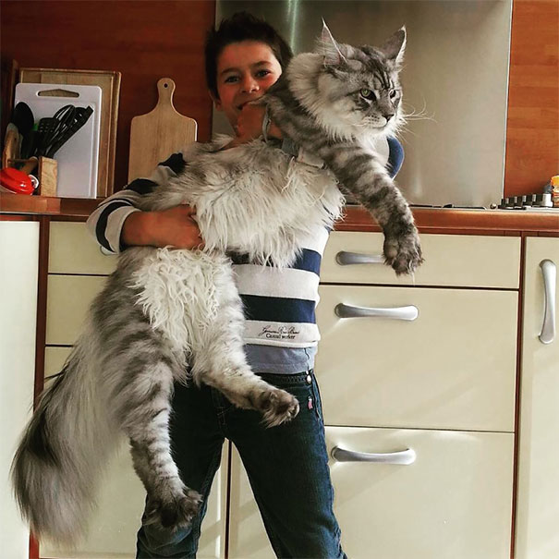
Notes:
Sometimes you’ll people say, “Well I just don’t believe that God wouldn’t have created the coyote, wolf, jackal, dog, and fox just as we see them today.”
Well, than what about these two animals – here is the 3lb Chihuahua and the 100 pound Saint Bernard. Both come from the same ancestor and we know it. This will blow your mind if you don’t already know it, but back in the 1600s, there were only a handful of breeds of dogs. But today we have hundreds of varieties, all bred from the original dogs. Do you see the variety in this kind, between the St. Bernard and the Chihuahua?
What about cats? This top right picture is a full grown munchkin cat and the bottom is a maine coon. These 2 cats are so different in so many ways, not just size. And yet we know they both share a common ancestor.
So what does this prove? Does it prove that Darwinian Evolution is true? No. Because out of the millions of dogs that have been bred since the 1600s, what do we get? We get dogs, nothing but dogs. Of the millions of cats that have been bred since time, we never see them changing into any other type of animal. They’re just cats. We see a variety of dogs and a variety of cats, but in the end they are cats and dogs.
And so in nature, we observe Microevolution, but we don’t observe Macroevolution.

Slide 9
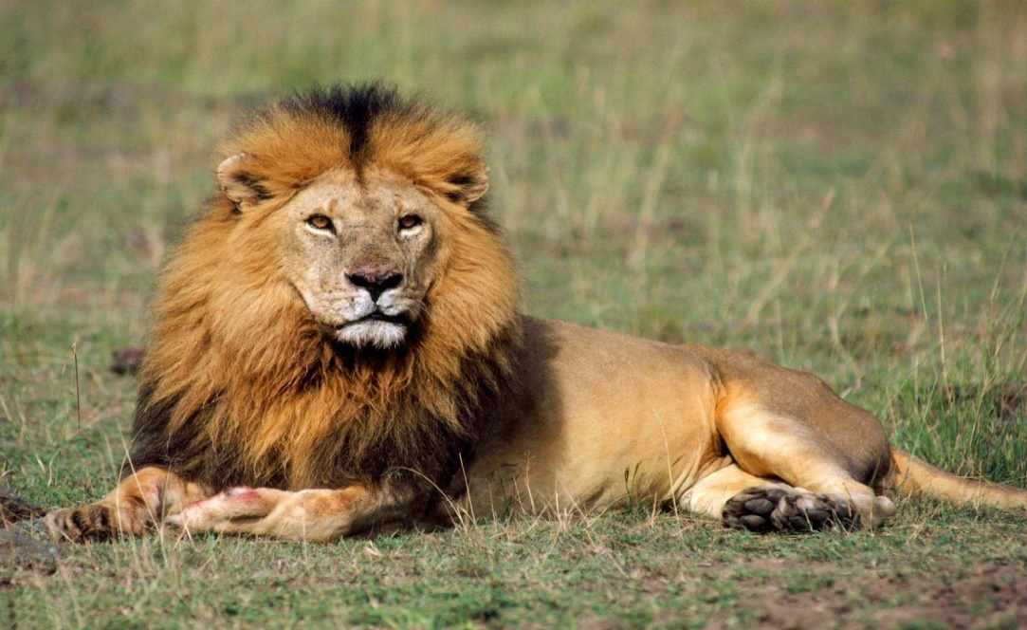
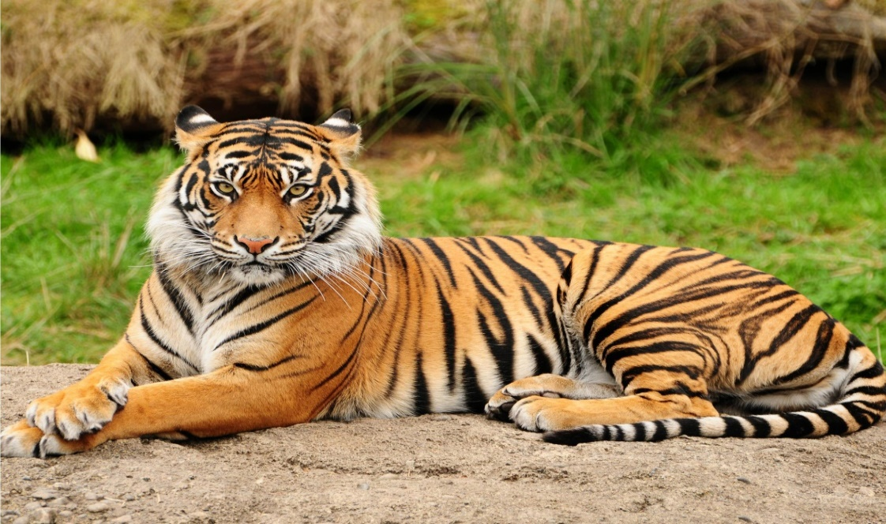
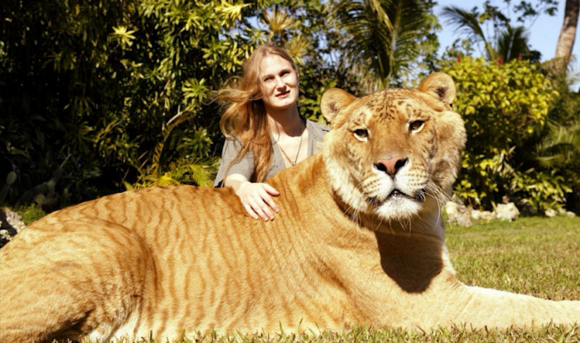
Notes:
What about the lion and the tiger? Did God create them separately or not? Evidence appears to suggest that they were originally of one kind, but through geographical diversity their genetics changed and they were able to speciate. In fact, we know we can create species. In 35 generations, you can speciate a fruit fly that is then unable to interbreed with another. And all speciation proves is that animals are unable to breed, but they are still the same kind.
So why would we think that the lion and tiger are the same kind? Because they can both breed, and the largest cat known to man comes from the breeding of a male lion and a female tiger, which is called a liger. This is the liger Hercules, the largest cat in the world at almost 1000 pounds, half a ton. There’s a really cute YouTube video out there about him if you’re interested in checking him out.

Slide 10
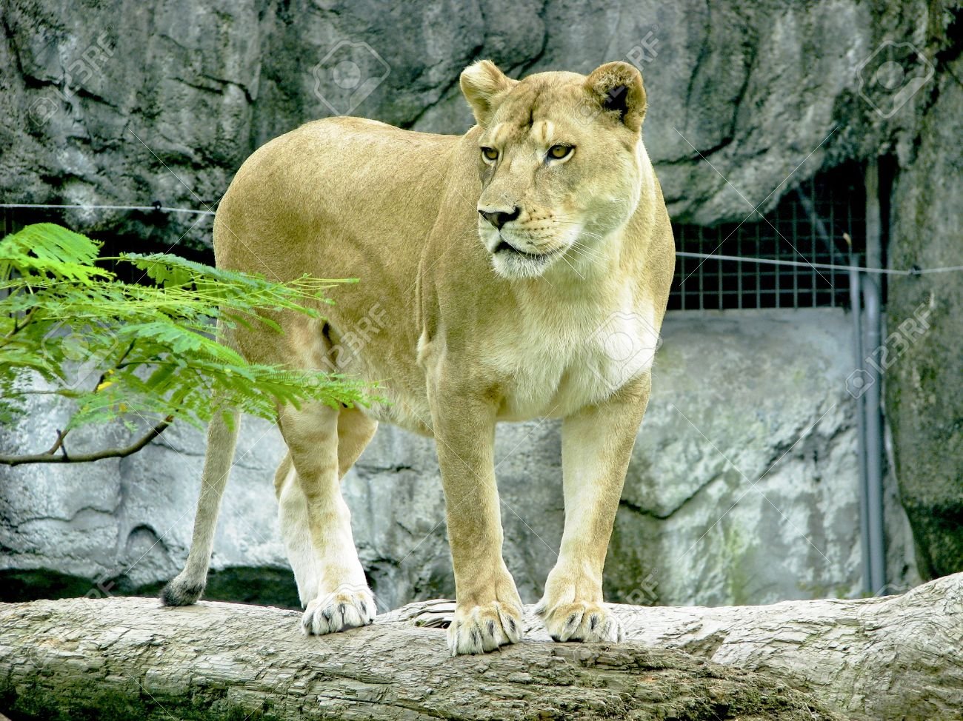
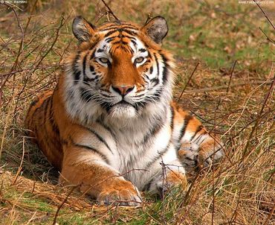
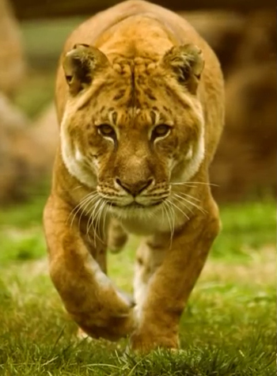
Notes:
This is a female lion and a male tiger, and when you breed them together you get what is called a tigon. Most tigons are born prematurely and almost all of them have health problems that prevent them from living a full life, though some of have been known to live up to 10 years. But this is what we see consistently occurring in nature regarding mutations. Non-beneficial mutations that create problems in the offspring rather than adding genetic information – the tigon actually loses genetic information in this breeding and it suffers health consequences as a result.

Slide 11
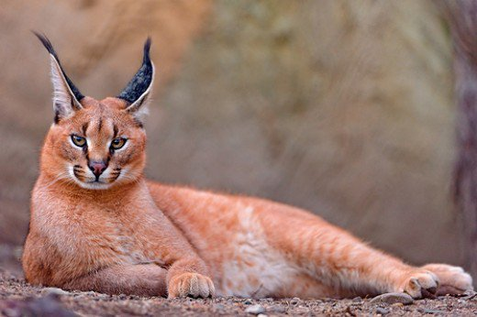
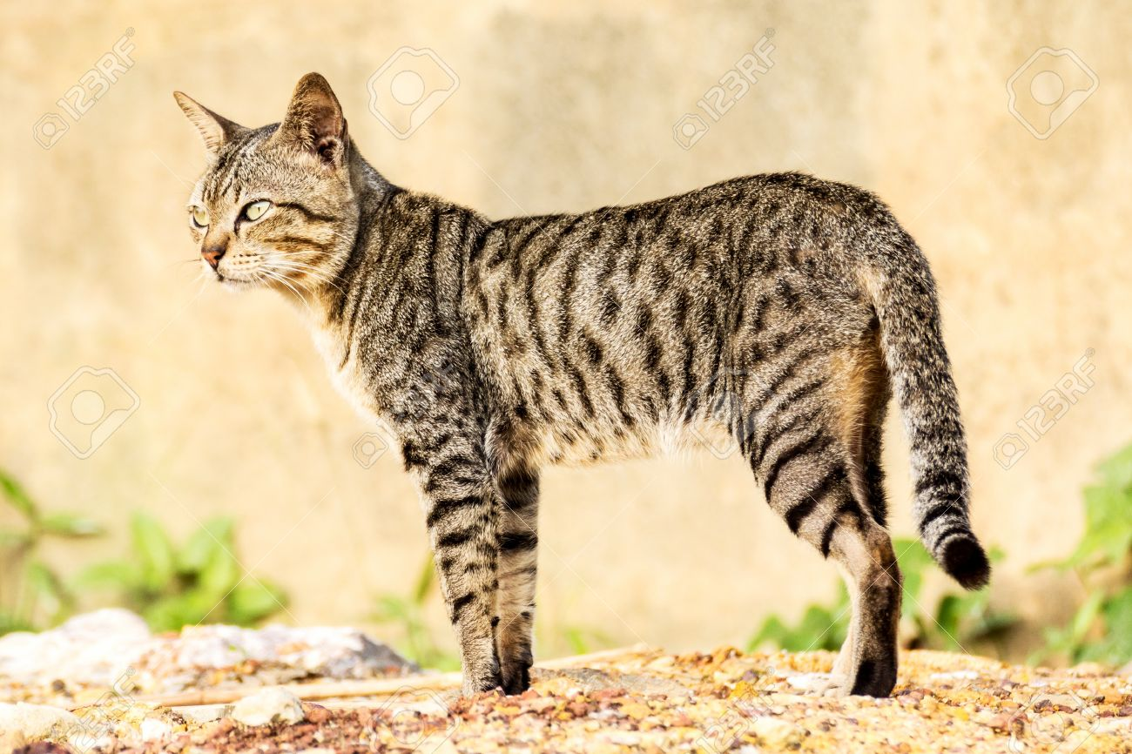
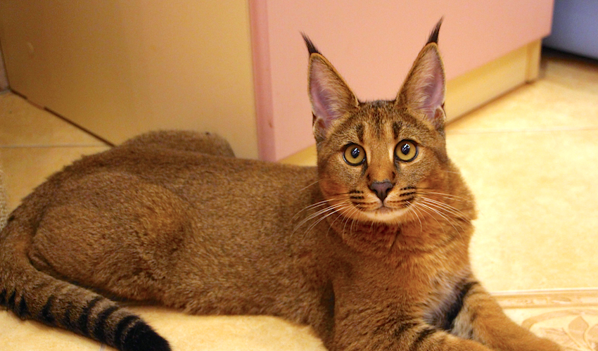
Notes:
Domestic cats can breed with a wide variety of wild cats in the world. This is the caracal, a wild cat that lives in the Middle East, Africa, and Western Asia. Jennifer and I saw a couple of them in a game reserve in South Africa a few years ago.
In 1998, a stray domestic cat wandered into the pen of a caracal in a Moscow zoo and they bred and it resulted in this: – the caracat.
Now, I don’t know if all cats come from the same original kind. It could be that God created the small cat and the large cat, just as I’m sure he created the large bird such as the ostrich and then the small bird such as the hummingbird into two different kinds. Yet scientists who have studied the large cats and the small cats see similarities, so it could be that they descended from a common ancestor. But, again, that fact doesn’t prove evolution, it proves creationism – that they are all the same kind.

Slide 12
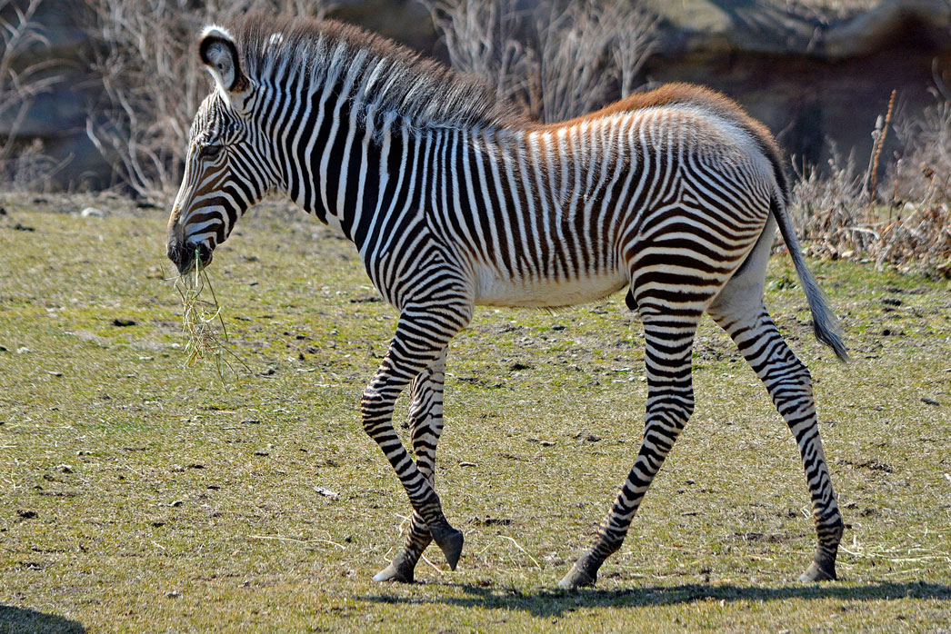
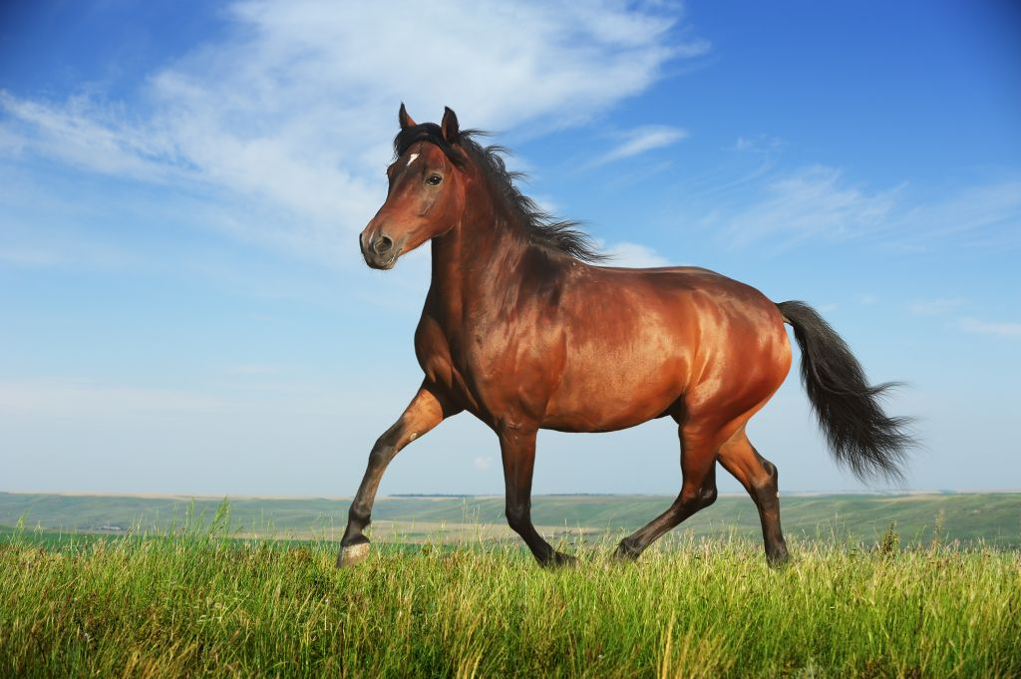
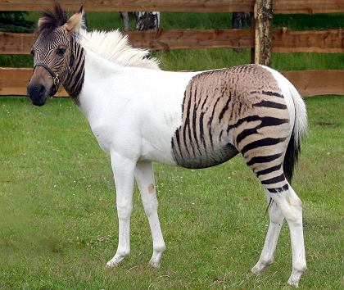
Notes:
Zebras and horses can breed, and this is a picture of its offspring, what is called a Zebroid.

Slide 13
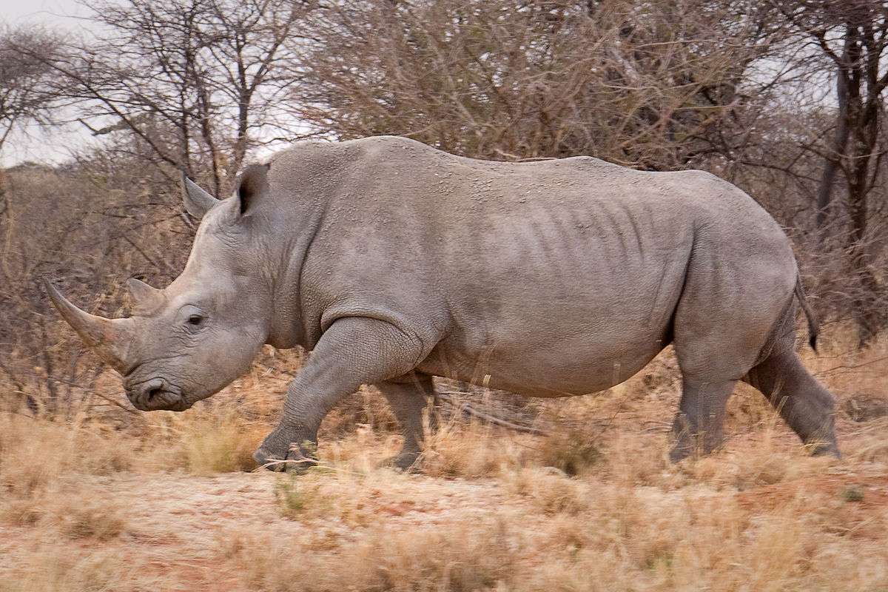
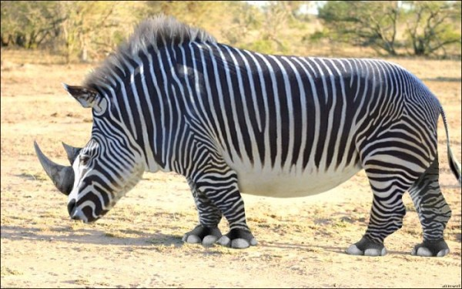
Notes:
But here is an example of what we don’t observe in nature; we don’t see different kinds of animals coming together.
We don’t see a Rhinoceros and a zebra coming together to form a “zebracerus or “rhinebra”. This bottom picture is fake. But evolutionists would have to argue that their theory necessitates something like this even though we don’t see anything like this happening in nature.

Slide 14
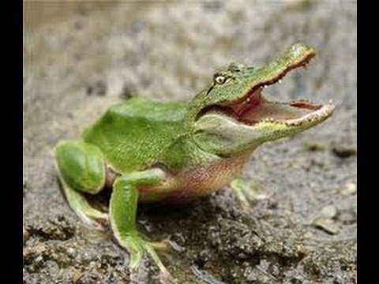
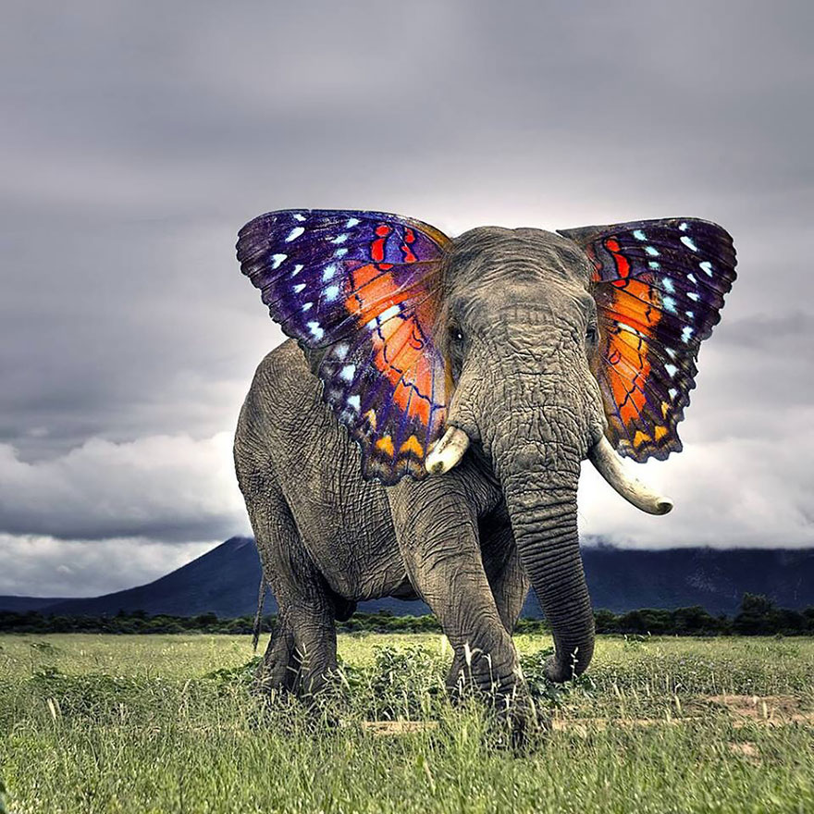
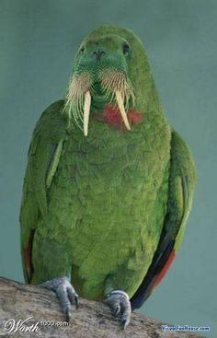
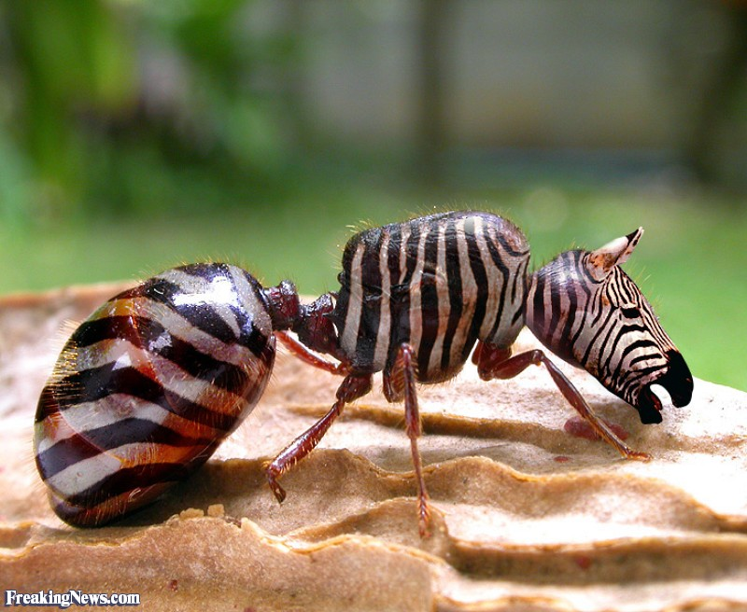
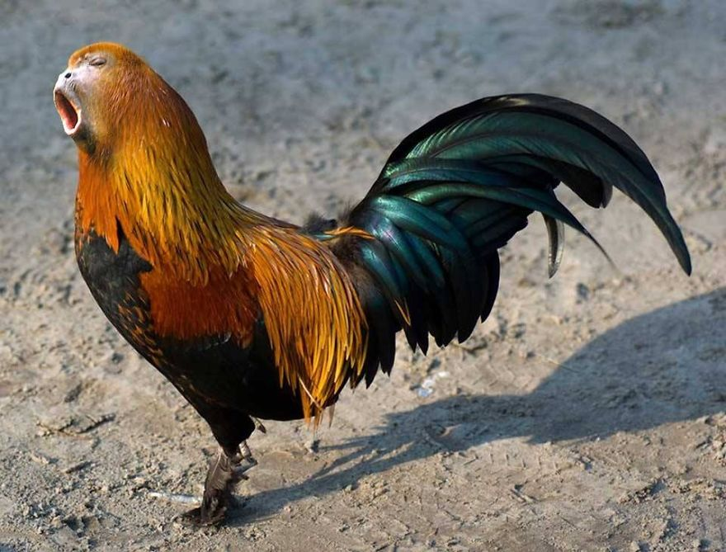
Notes:
We don’t see different kinds of animals coming together. We don’t see an “aligrog”, or the graceful, majestic “butterphant”, or the “walrut”, or a “zant”. Or as much I wish we did, we don’t see a “rooskey/monkster”. Evolutionists might say I’m crossing a line, but if they’re honest, they’d have to say that such breeding is possible if they are really going to take the position of molecules to man evolution. And yet such breeding, even genetically, is impossible.
Evolutionists will claim, “We don’t say that. We say that animals evolve over time through gene mutations.” Well, for the last 50 years, gene-based evolutionary mechanisms have pretty much been debunked. There are a few hanging their hopes by a thread hoping some evidence presents itself to say otherwise, but some of the biggest names in evolution are on record as saying they believe this theory is dead. We don’t find any gene-based mutations that create evolution.
And so other hypotheses are being suggested, such as the one by Lynn Margulis, a professor at the University of Massachusetts Amherst who used to be married to Carl Sagan. She suggests something called, “Sembiogenetic Reorganization”, where she suggests two animals of different kinds can indeed get together and breed, though it may only happen 1 every 3,000,000 tries. Why did she come up with this? Because she couldn’t prove evolution by gene-based mutations. And she can’t prove this hypothesis either. It’s a hypothesis – she’s just grasping for whatever she can.
We need to remember that when it comes to evidence, we’re not interested in what is possible. I can come up with as many possibilities as my imagination allows. I’m not interested in what is possible; I am interested in what is plausible.

Slide 15
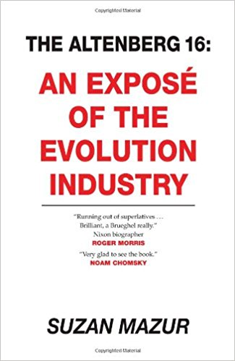
“While the Altenberg 16 have roots in neo-Darwinian theory, they recognize the need to challenge the prevailing Modern Synthesis, because there’s too much it doesn’t explain.” (p. 7)
“The Altenberg 16…recognize that the theory of evolution which most practicing biologists accept and which is taught in classrooms today, is inadequate in explaining our existence.” (p. 19)
“A wave of scientists now questions natural selection’s role, though fewer will publicly admit it.” (p. 20)
Notes:
There is a book out there called “The Altenberg 16”, written by an evolutionist. It was an by-invitation-only symposium attended by 16 evolutionary scientists in Austria in 2008. The Evolutionists tried to keep this meeting quiet. However, details about the meeting leaked to the press and it came out in Science Magazine. Basically 16 of the world’s greatest Geneticists and Scientists got together to say, “We do not have a valid explanation for Evolution anymore. The gene-based mutation theory no longer works so we need to come up with a new idea.”
“While the Altenberg 16 have roots in neo-Darwinian theory, they recognize the need to challenge the prevailing Modern Synthesis, because there’s too much it doesn’t explain ” (p. vii).
“The Altenberg 16…recognize that the theory of evolution which most practicing biologists accept and which is taught in classrooms today, is inadequate in explaining our existence” (p. 19).
“A wave of scientists now questions natural selection’s role, though fewer will publicly admit it” (p. 20).

Slide 16
“Evolutionary science is as much about the posturing, salesmanship, stonewalling and bullying that goes on as it is about actual scientific theory. It is a social discourse involving hypotheses of staggering complexity with scientists, recipients of the biggest grants of any intellectuals, assuming the power of politicians while engaged in Animal House pie-throwing and name-calling: ‘ham-fisted’, ‘looney Marxist hangover’, ‘secular creationist’, ‘philosopher’ (a scientist who can’t get grants anymore), ‘quack’, ‘crackpot’… (p. 5)
Notes:
“Evolutionary science is as much about the posturing, salesmanship, stonewalling and bullying that goes on as it is about actual scientific theory. It is a social discourse involving hypotheses of staggering complexity with scientists, recipients of the biggest grants of any intellectuals, assuming the power of politicians while engaged in Animal House pie-throwing and name-calling: ‘ham-fisted’, ‘looney Marxist hangover’, ‘secular creationist’, ‘philosopher’ (a scientist who can’t get grants anymore), ‘quack’, ‘crackpot’…

Slide 17
“In short, it’s a modern day quest for the holy grail, but with few knights. At a time that calls for scientific vision, scientific inquiry’s been hijacked by an industry of greed, with evolution books hyped like snake oil at a carnival…”
“Perhaps the most egregious display of commercial dishonesty is this year’s celebration of Charles Darwin’s On the Origin of Species—the so-called theory of evolution by natural selection, i.e., survival of the fittest, a brand foisted on us 150 years ago.”
“Scientists agree that natural selection can occur. But the scientific community also knows that natural selection has little to do with long-term changes in populations” (p. 5).
Notes:
“In short, it’s a modern day quest for the holy grail, but with few knights. At a time that calls for scientific vision, scientific inquiry’s been hijacked by an industry of greed, with evolution books hyped like snake oil at a carnival…”
“Perhaps the most egregious display of commercial dishonesty is this year’s celebration of Charles Darwin’s On the Origin of Species—the so-called theory of evolution by natural selection, i.e., survival of the fittest, a brand foisted on us 150 years ago.”
“Scientists agree that natural selection can occur. But the scientific community also knows that natural selection has little to do with long-term changes in populations” (p. v).
Now Susan Mazur is an evolutionist, but she is clearly a serious reporter, committed to the reporter’s creed of excluding her own views. The book is careful reportage throughout. She asks pointed questions of many evolutionary scientists, and gives lengthy transcripts of their responses, along with biographies, and observations about their appearance, manner, habits, and hobbies. It’s unlikely a creationist reporter could have gotten these same evolutionists to open up that much.
But what I want you to get out of this is that top Evolutionists admit that Neo-Darwinism is dead. They just don’t want to admit that Evolution itself is also dead. They’re going to continue to try to find a way to hypothesize it to death because what is the only other viable alternative? Creationism

Slide 18
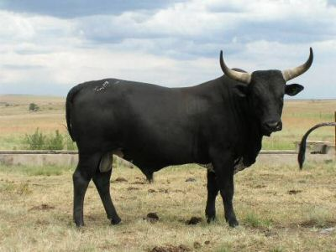
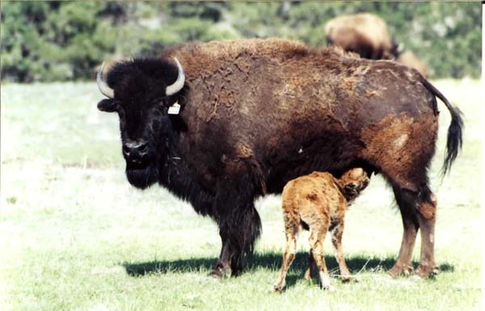
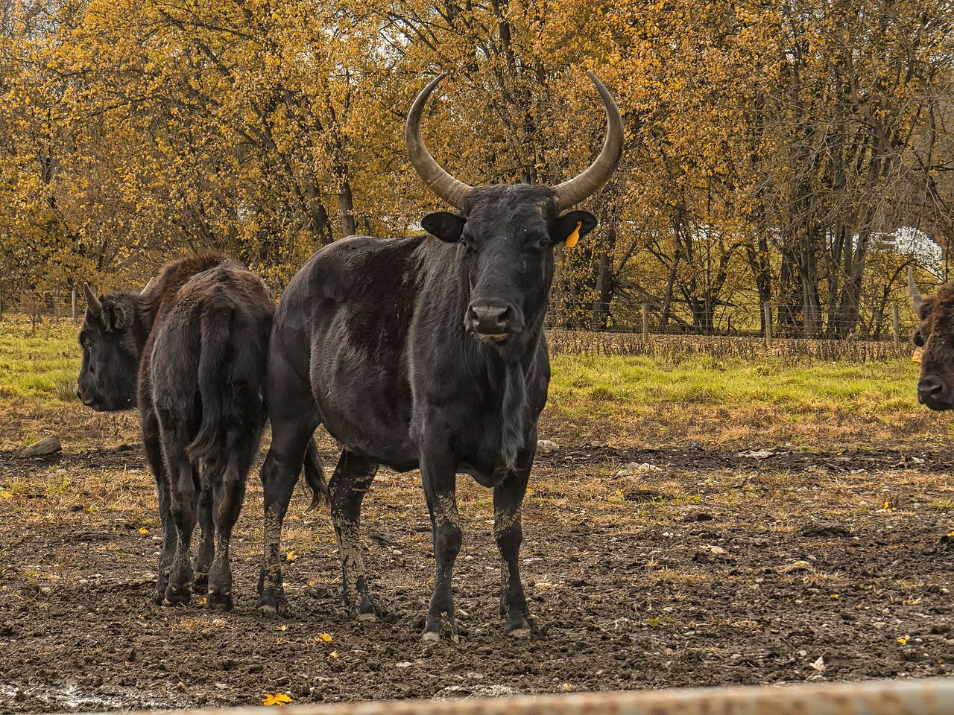
Notes:
Well, what about other genre? In the family called “bovidae”, you have the genus “bison” and the genus “bos”. These are not the same genus much less the same species. So you have the domesticated cattle, with over 800 breeds, and the bison and they can all breed together! And what this suggests is that they come from the same common ancestor because the offspring of the domesticated cattle and bison is what is called a “beefalo”. And there are some that are different species that can breed together.

Slide 19
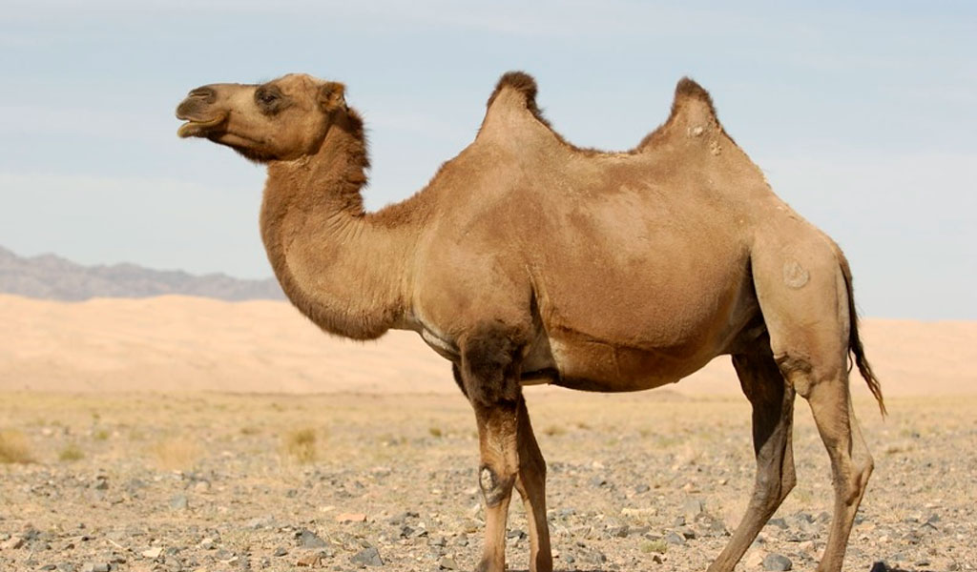
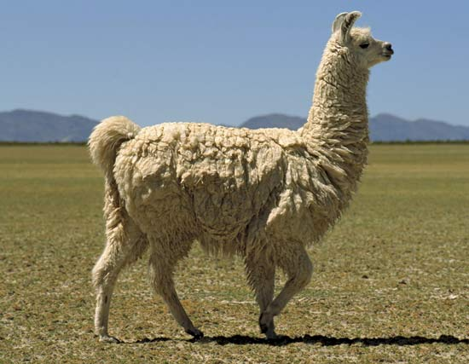
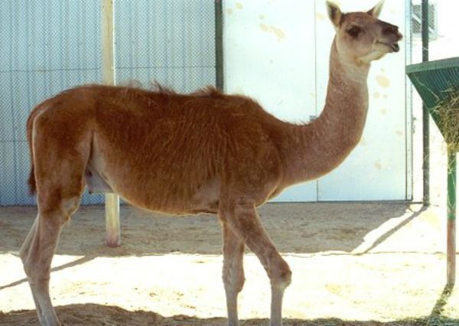
Notes:
Camels and llamas come from completely different genuses, but they can breed into what is called a “cama”.

Slide 20
Gen 1:21 – “God created the great sea monsters and every living creature that moves, with which the waters swarmed after their kind, and every winged bird after its kind; and God saw that it was good.”
Gen 1:24-25 – “Then God said, ‘Let the earth bring forth living creatures after their kind: cattle and creeping things and beasts of the earth after their kind’; and it was so. God made the beasts of the earth after their kind, and the cattle after their kind, and everything that creeps on the ground after its kind; and God saw that it was good.”
Arbitrary
Notes:
Now if this is the case, than what exactly does science base the 7-tier scientific classification of animals on? If some species can and can’t interbreed and if some genus’ can and can’t interbreed, where’d they come up with this? Here’s the answer: it’s arbitrary. It’s an arbitrary classification system which even Darwinian biologists of today cannot agree on.
Gen 1:21 – “God created the great sea monsters and every living creature that moves, with which the waters swarmed after their kind, and every winged bird after its kind; and God saw that it was good.”
Gen 1:24-25 – “Then God said, ‘Let the earth bring forth living creatures after their kind: cattle and creeping things and beasts of the earth after their kind’; and it was so. God made the beasts of the earth after their kind, and the cattle after their kind, and everything that creeps on the ground after its kind; and God saw that it was good.”
We see the bird kind, snake kind, turtle kind, bat kind, rat kind, dog kind, cat kind, pig kind, monkey kind, man kind. We don’t see any kinds changing outside their kind.
And so, when change occurs it is within its kind, what is called “Micro Evolution” or “Horizontal Evolution”. This is important to distinguish because in most of our conservations with Evolutionists, they will try to prove Darwinian Evolution by showing how animals within kinds. Creationists believe that too, because that is what Gen 1 teaches. But that doesn’t mean they can change outside their kind. And that is the evidence that Darwinian Evolutionists need to produce that they haven’t been able to produce.

Slide 21
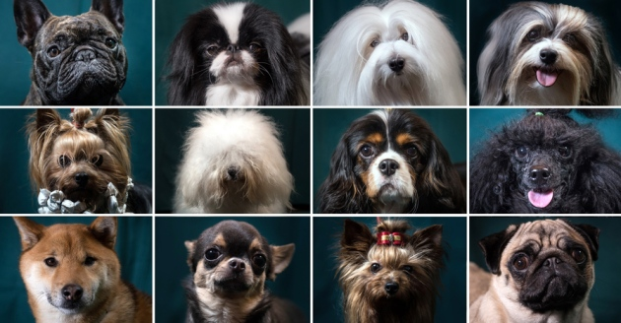
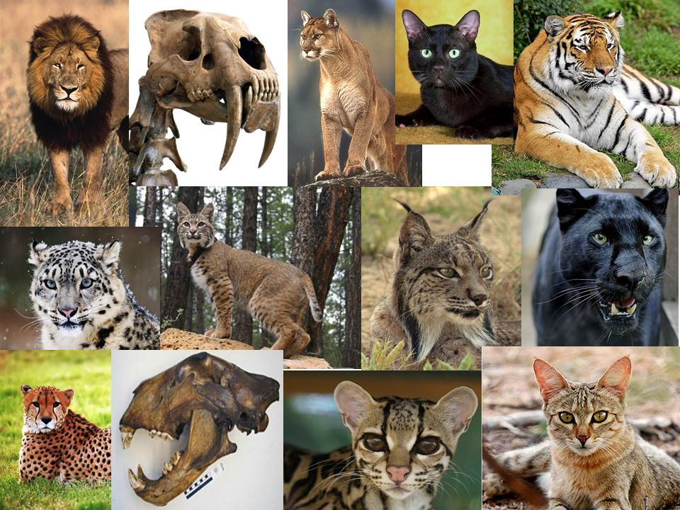
Number of atoms in the universe: 1 x 10⁸⁰
Chance of 2 humans having the same genetics: 1 x 10²⁰¹⁷
Notes:
See, in schools, Biology teachers who hold evolutionary views will look at the monkey and show you all the different classifications that come from the monkey according to geographical diversification and have all these different characteristics. And if we can understand the principle of “kinds” as the bible presents it, all we have to answer that teacher is, “That’s because they are all the same kind. Of course they can interbreed, that’s how God made them”.
And we would expect God to create animals with genetic diversity so that they could adapt to any environment on the planet whether they are living at the equator or the north pole. Dogs at the equator don’t have long shaggy coats like huskies and dogs at the north pole are not going to look like Chihuahuas with hardly any hair. No, their genetics within their kind absolutely can cause them to adapt and we’ve been able to see this.
In fact, its estimated that there are ~1 x 10⁸⁰ atoms in the universe. Do you know what the chances are of two humans having the same genetic disposition? 1 x 10²⁰¹⁷. That’s a 1 followed by 2017 zeros. That’s many more than even the number of atoms in the universe. So, do you see the incredible variability that God put into our genetic makeup?

Slide 22
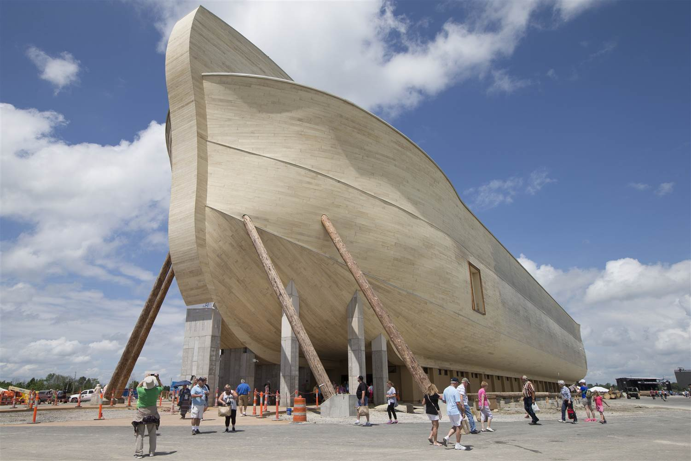
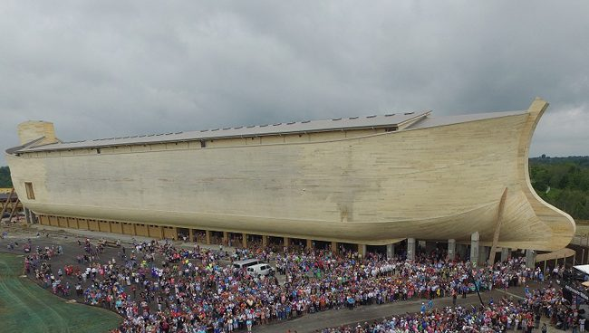
Gen 6:15 – “This is how you shall make it: the length of the ark three hundred cubits, its breadth fifty cubits, and its height thirty cubits.”
510 x 85 x 51 feet = 2.21 million ft³
Notes:
If we can understand this, it will bring clarity to the question of how Noah fit all those animals on the ark.
Based on current findings from Baraminology, the study of animal kinds, Creationists can divide all of animal kinds on the Earth into 8000 different animal genera. And if that is true, there would have been no more 16,000 animals on the ark because the 7 pairs of clean animals would have only been a modest amount. If you consider that horses, zebras, and donkeys are probably descended from the horse-like “kind,” Noah did not have to carry two sets of each such animal. Also, dogs, wolves, and coyotes are probably from a single canine “kind,” so hundreds of different dogs were not needed.
So roughly, ~16,000 animals. How big was Noah’s ark? According to Gen 6:15, the Ark measured 300 x 50 x 30 cubits, which is about 510 x 85 x 51 feet, with a volume of about 2.21 million cubic feet. This calculates to an equivalent volume of over 500 semitrailers of space, which if you divide that. Can you get 32 animals on a semitrailer? Absolutely. If you look at it by the entire volume, though, the 16,000-plus animals would have occupied much less than half the space in the Ark (even allowing them some moving-around space).

Slide 23
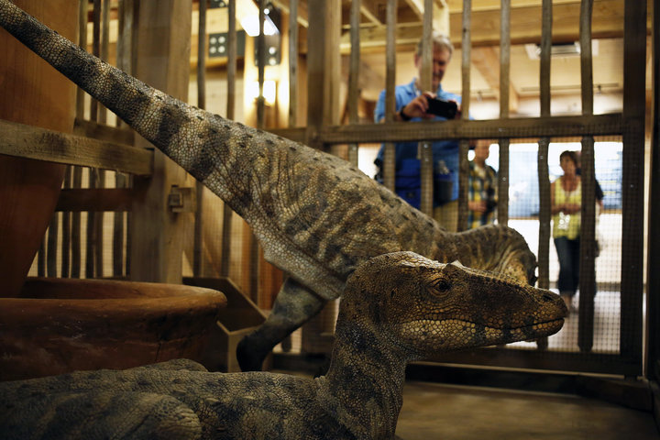
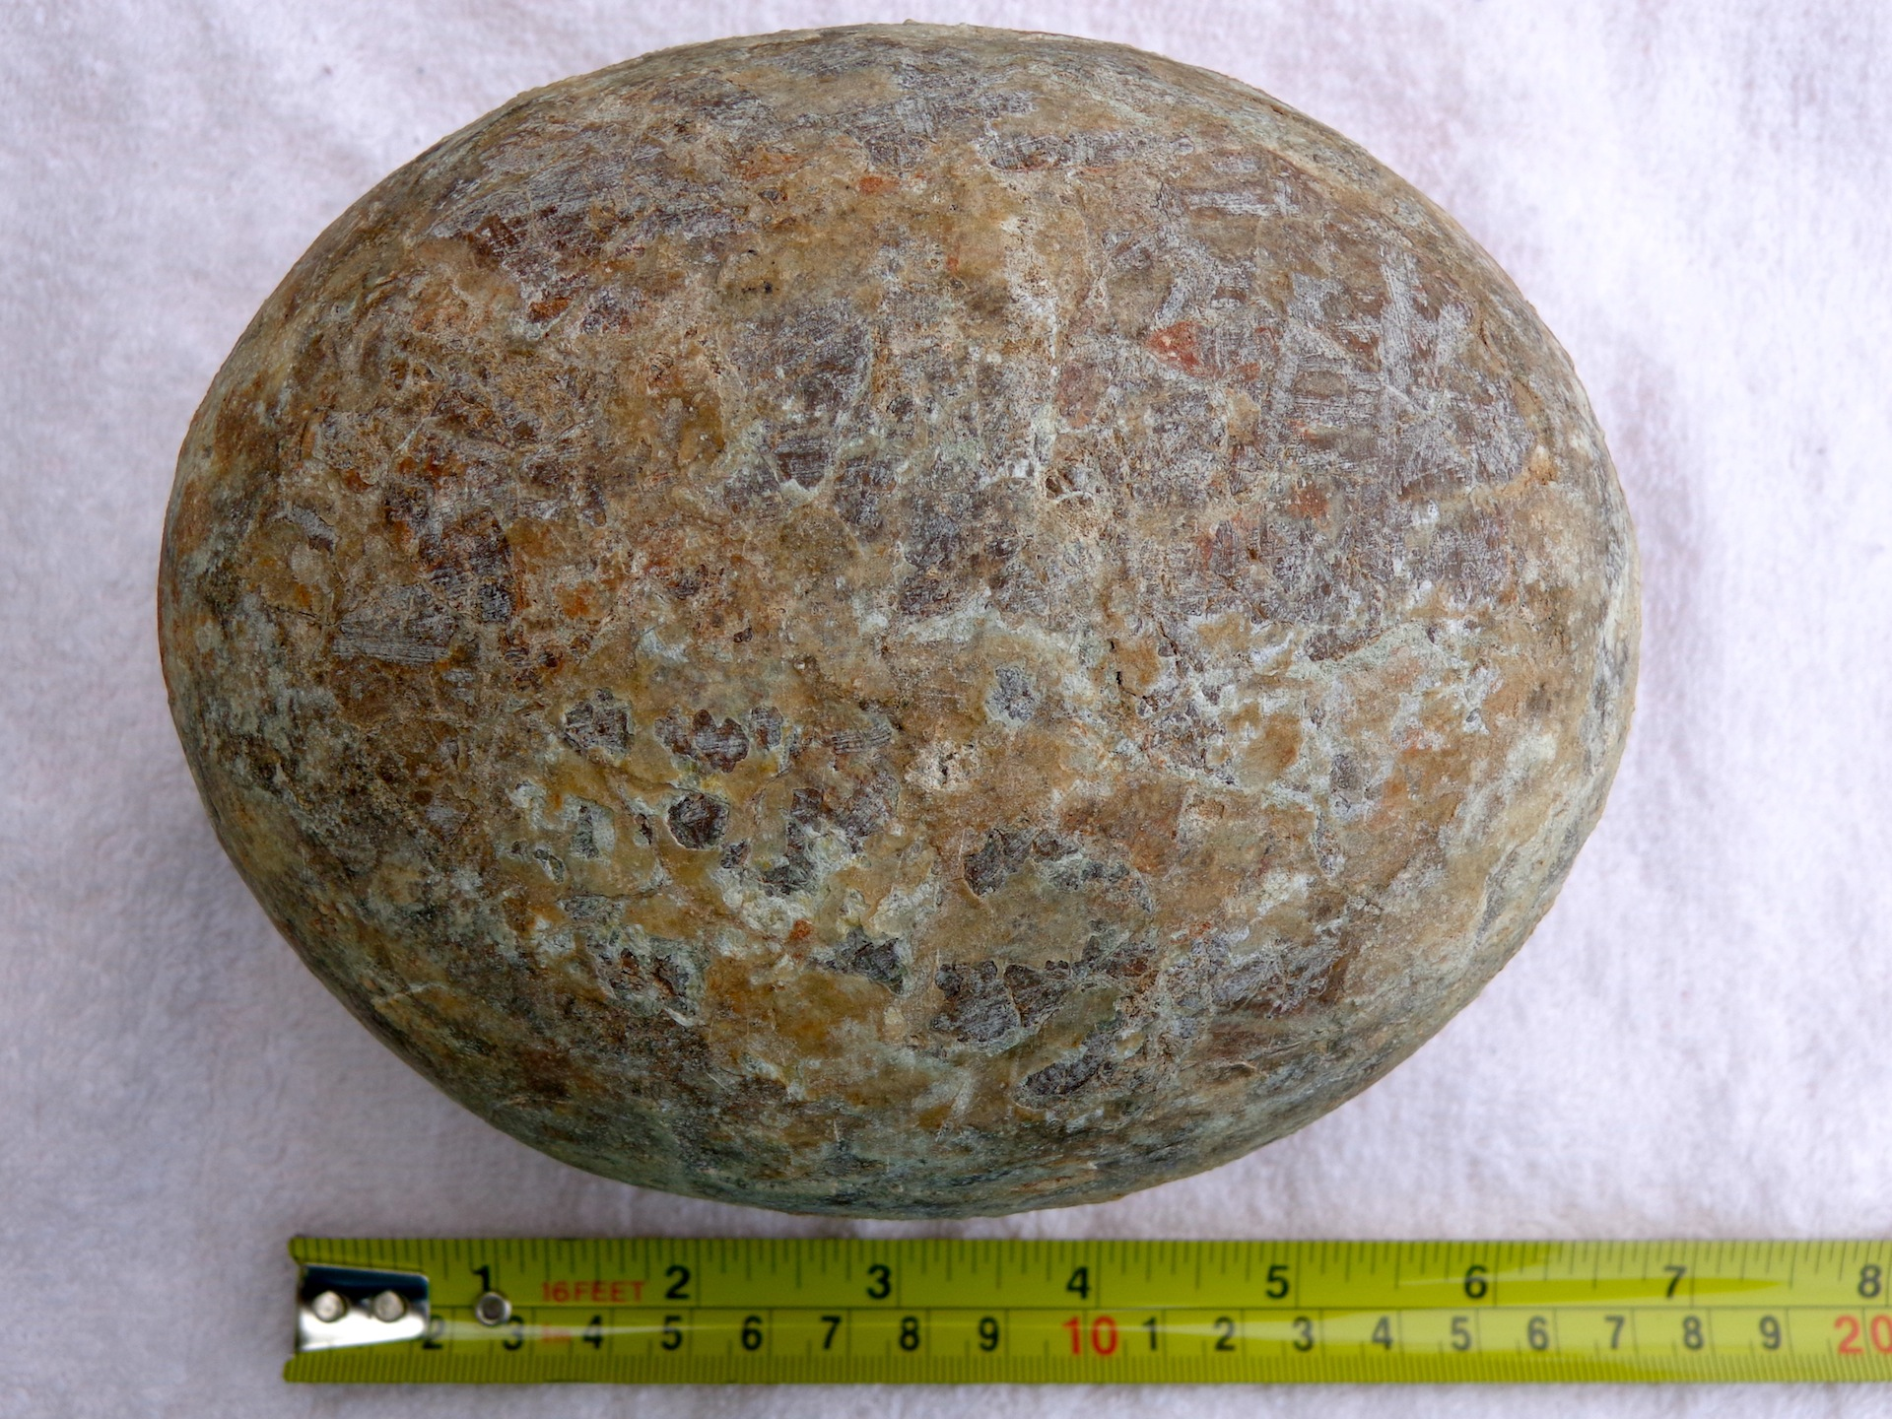
Notes:
What about the dinosaurs? How did they fit? Well, according to present, the largest dinosaur egg was about the size of a football. Maybe they only took the egg? Maybe they only took baby dinosaurs? We don’t know. But if you separate dinosaurs into their kinds, Baraminologists suggest that there were only 55 kinds. And they were unclean creatures so Noah would have only needed to have taken 2 each. So that’s only 110 dinosaurs on the Ark. And even if he didn’t take eggs, the average dinosaur was only about the size of a bison.

Slide 24
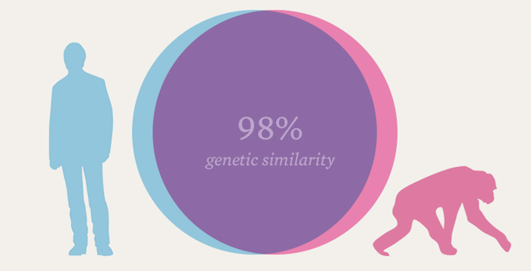
Notes:
Let’s play devil’s advocate now:
For years, Evolutionists have been arguing about similarities between Chimpanzee DNA and human DNA. They claim the Chimpanzee may be our oldest living relative because, supposedly, up to 98.4% of our DNA is analogous. And so Evolutionists say this proves we are 98.4% Chimpanzee. So to Evolutionists, this proves Charles Darwin was right. So what’s the deal with this?
First, Evolutionists put out this estimate before they actually knew the full genome sequence of chimpanzees. They had already had the full genome sequence of humans since 2001, but they didn’t have the full genome of chimpanzees. Then in 2005, they claimed to have a rough draft of it and the similarity dropped down to 96%. Interestingly, Evolutionists lauded it as a great victory even though they doubled the percent difference from what they originally estimated. Another 2% difference amounts to 35 million differences. There are 40 – 45 million genes in humans that are not in the chimp and there are 40 – 45 million genes in the chimp that are not in the human. This is not insignificant. When Evolutionists try to use percentages when it comes to DNA comparisons, it actually skews the magnitude of differences. There are many other differences between chimpanzee and human genomes that are not quantifiable as percentages. This is a logical fallacy called the “Texas Sharp Shooter” wherein they move the target in order to make their shots look more accurate than it really was. But now, recent findings suggest the number can’t be greater than 70%. We also know that if we use the same percentage-based comparative processes that Evolutionists originally used for the human and chimpanzee, it makes us look more related to the mouse than the chimpanzee.
Secondly, why does shared DNA similarity have to mean Evolution? Why can’t it be explained as the result of a common Creator? All houses have a roof, walls, doors, some exterior, etc. Yet despite all the similarities showing common design, houses also show a lot of differences. It is not far-fetched to assume God had the same idea in mind unless you have already decided you’re not going to believe in God. If you’re already biased toward evolution, you’ll interpret the percentages within that worldview.
It would be really surprising if every living thing had completely different sequences for each protein—especially ones that carried out the same function. Organisms that have highly similar functionality and physiological needs would be expected to have a degree of DNA similarity. We’ll go into more about this when we start discussing animal homology in future lessons.
With this debate, you’ll find that Evolutionists only want to talk about the similarities and not the differences because the differences cannot be easily explained through an Evolutionary worldview. Creationists don’t mind talking about the similarities and the differences because we would actually expect both to exist.
https://answersingenesis.org/genetics/dna-similarities/what-about-the-similarity-between-human-and-chimp-dna/
http://nazaroo.blogspot.com/2013/02/

Slide 25
Evolutionists: Chimp to Human Evolution ~300,000 generations
Avg human generation: 20 years
Bacteria:
New generation 7 – 20 minutes. 300k generations in ~11 years
How many changes or beneficial mutations? 0
Notes:
But lets look at it like this: since we now have the complete genome sequences of both humans and chimpanzees, we’ve discovered that there are about 40 million genes in humans that are not in chimps. That means for a chimp to become a human, how many beneficial, persistent mutations would have to occur? 40 million. But they have been trying to get beneficial, persistent mutations out of the fruit fly for decades and they haven’t been able to produce even one. Fruit flies reproduce a lot quicker than chimps, but they can’t get a single beneficial mutation. But they’re going to get 40 million out of a chimpanzee? See the issue?
Furthermore, do you know how many generations it took for these beneficial, persistent mutations to cause the chimpanzee to become a human? They say it only happened in 300,000 generations. If you consider a human generation as being 20 years, this would be ~6 million years, which is where they get that # from. But scientists will about that, “Well, we can’t see Darwinian evolution today because it takes so long!”
Scientists have actually discovered a way to breed 300,000 generations today. How do they do it? We have certain bacterium that can multiply into a new generation in just 20 minutes. Some research that’s been done has shown an even shorter time at 17 – 18 minutes, and other experiments have produced a new generation as fast as 7 minutes under optimal conditions. But if we go w/the bacterium that creates new generations every 20 minutes, we can go through 300,000 generations in just a little over 11 years. That’s the same number of generations that Evolutionists say took chimpanzees to evolve into humans. Do you know how many beneficial, persistent mutations they see taking place in these bacterium? None.
“How do you know that? You don’t have bacterium from long ago!”
We have bacterium from the year 1840 discovered in humans that were found buried in the Artic, and they were found with antibiotic resistance before the actual antibiotics were invented, proving that antibiotic resistance is not an evolutionary process – the genes were there the entire time and they always have been.

Slide 26
Notes:
Finally, chimps and humans are supposed to be so closely related because Evolutionists say they share a common ancestor that came after the gorilla. But guess what was found when they compared chimps, humans, and gorillas? They found that 18 – 29% of human DNA are more similar to gorillas than they were to chimps. In other words, the humans and the chimps had a common ancestor AFTER the gorillas. Yet, somehow the gorillas DNA genetic markers got into the human. You see? Its not a successive evolutionary process, which we’ll see further when we look at animal homology in an upcoming lesson. This is evidence for intelligent design. It’s a mix and match intelligent designer creating a mosaic – a little piece here, a little piece there, and He mixes it up and makes something new.
You won’t find a bigger conundrum for evolutionists than the duckbill platypus. How do you explain how an animal can look like a duck, a marsupial, and a mammal that lays eggs, all these different animals at the same time. Evolutionists have nothing on this animal – to them, it just *poof* appears out of nowhere as if someone with a cosmic sense of humor took all these different pieces and created a different kind of creature. We see the same thing with the red panda, which you can observe in the San Diego zoo, as well as the human and octopus eye, which are identical. Humans and octopuses, supposedly, have no common ancestor yet just happened to evolve the same type of eye. More on that later.
So common ancestor or common designer? I believe the evidence is far stronger for a common designer. Our common designer is called Jehovah.

