Slide 1
Uniformitarianism
Or
Catastrophism?
Notes:
In a couple of weeks, we’re going to look at some global evidence for the flood. These lines of evidence are incredible, immense, and faith building. Acts 14:17a – “He did not leave Himself without witness”. Truly, the more we dig and study and use reason, the more we can come to the same conclusion as David in Psa 19 who said “the heavens are telling of the glory of God.” But the truth is, so does the earth.
But before we , we look at this evidence, need to first look at some the of great debate uniformitarianism vs. catastrophism.

Slide 2
Notes:
Uniformitarianism is the scientific, geological philosophy going back 200 years that says if all the sediment in the world were gathered together by slow, gradual processes, it would have taken billions of years.
Catastrophism, on the other hand, is what we Christians have believed for centuries, that Noah’s flood was a cataclysm that rapidly created all the sediments in the world, that carved out all the immense canyons, and is responsible for the explosion of fossils we find in the Cambrian layer of the geologic column.

Slide 3
Gen 1:6-9 – “Then God said, ‘Let there be an expanse in the midst of the waters, and let it separate the waters from the waters.’ God made the expanse, and separated the waters which were below the expanse from the waters which were above the expanse; and it was so. God called the expanse heaven. And there was evening and there was morning, a second day. Then God said, ‘Let the waters below the heavens be gathered into one place, and let the dry land appear’; and it was so.”
Pangea
Notes:
Now in the Creationism model, there are 2 biblical catastrophic events that are very important.
Catastrophic Event #1 is the creation of the world itself – Gen 1:6-9 – “Then God said, ‘Let there be an expanse in the midst of the waters, and let it separate the waters from the waters.’ God made the expanse, and separated the waters which were below the expanse from the waters which were above the expanse; and it was so. God called the expanse heaven. And there was evening and there was morning, a second day. Then God said, ‘Let the waters below the heavens be gathered into one place, and let the dry land appear’; and it was so.”
So imagine this great movement of water and molten rock. And then God gathered the waters into one place. What does that suggest? I think it suggests what we now know is a Pangea, that all the continents were at one time together in one place. In fact, the continental drift was first predicted in 1859 by a Creationist, which was a terrible time to be making this prediction because it was the same year Darwin’s first book was released. And not until around 1960, a hundred years later, did Evolutionists finally catch up to Creationists and agree that there was indeed a Pangea at one time. And in a couple weeks, I’m going to try to show you that this Pangea had to have existed before Noah’s flood and the continental drift was the result of Noah’s flood.

Slide 4
Gen 7:11 – “In the six hundredth year of Noah’s life, in the second month, on the seventeenth day of the month, on the same day all the fountains of the great deep burst open, and the floodgates of the sky were opened.”
Gen 7:19 – “The water prevailed more and more upon the earth, so that all the high mountains everywhere under the heavens were covered.”
Psa 104:5-9 – “He established the earth upon its foundations, so that it will not totter forever and ever. You covered it with the deep as with a garment; the waters were standing above the mountains. At Your rebuke they fled, at the sound of Your thunder they hurried away. The mountains rose; the valleys sank down to the place which You established for them. You set a boundary that they may not pass over, so that they will not return to cover the earth.”
Notes:
Catastrophic Event #2 was about 1700 years after the creation of the world; Noah’s flood of Gen 7:11 – “In the six hundredth year of Noah’s life, in the second month, on the seventeenth day of the month, on the same day all the fountains of the great deep burst open, and the floodgates of the sky were opened.” So the first thing that happened was all the fountains of the deep burst open. Then the 2nd thing that happened was the floodgates of the sky burst open (meaning, it rained). How much did the water prevail? – Gen 7:19 – “The water prevailed more and more upon the earth, so that all the high mountains everywhere under the heavens were covered.”
Psa 104:5-9 – “He established the earth upon its foundations, so that it will not totter forever and ever. You covered it with the deep as with a garment; the waters were standing above the mountains. At Your rebuke they fled, at the sound of Your thunder they hurried away. The mountains rose; the valleys sank down to the place which You established for them. You set a boundary that they may not pass over, o that they will not return to cover the earth.”
This is exactly the model we see with the Pangea and the continental drift. Since the earth’s crust is so dense and because of the mantle, the only way we can create mountain ranges is if something else in the earth goes down. So in the ocean floor, we see the salt that has gone down allowing the mountains then to come up, which we’ll look at more in a couple weeks.
And until the year 1800, all geological formations on the planet were interpreted in light of these two catastrophic events, even in all major universities in the world. Then around the year 1800, the so-called Age of Enlightenment ushered in this mad rush to discredit the bible as humanism began to rise. Then scientists started interpreting geological formations by uniformitarianism. They had to find a way to work the millions of years into geology in order to make macroevolution work and so they had to get rid of the bible to do so

Slide 5
1 Tim 6:20 (KJV) – “O Timothy, keep that which is committed to thy trust, avoiding profane and vain babblings, and oppositions of science falsely so called”
Notes:
When did this come to a head? We have to go back a few centuries and understand the nature of science in the western world. Many are unaware of this, but in the western world science is actually premised by Christianity. Most of the great developments in science came from folks who believed in God, understood biblical principles, and understood the world in which we live operates under laws given to us by a Designer and not as a result of random chance. If it’s a random chance universe we live in, we can’t study science. But we know its not because God put certain laws in order. Men like Galileo, Francis Bacon who came up with the Scientific Method, Kepler, and others, were all believers and considered themselves young earth Creationists. And they founded their science on an understanding of God’s creation.
But then all the western universities started incorporating another type of science, calling them the “Natural Sciences”. Science, at that time, simply meant “knowledge” and it is in fact used in the KJV in 1 Tim 6:20 and it simply means “knowledge”. But now the universities added what they called “Natural Science” to supplement biblical science and required students to take both. But then over time they started to put more faith in the natural sciences over the biblical sciences and the bible started to be pushed out. Therefore theism began to be replaced by scientism, which is where we are today.

Slide 6
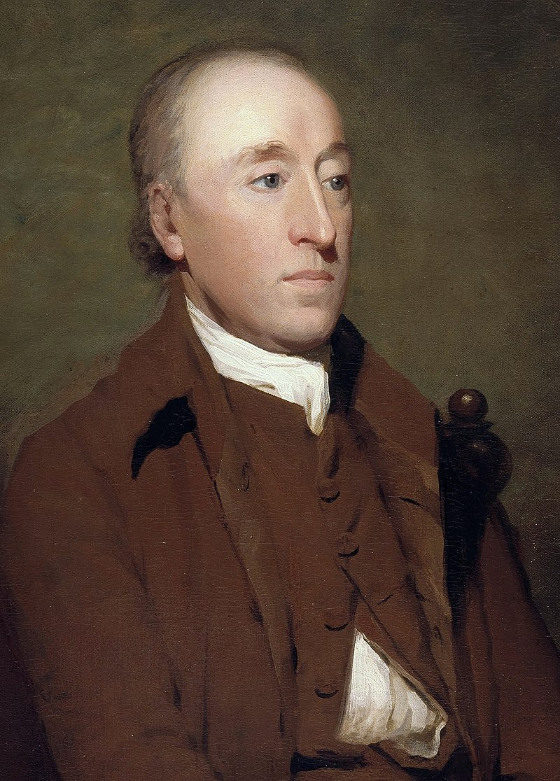
James Hutton – “The past history of our globe must be explained by what can be seen to be happening now. No powers are to be employed that are not natural to the globe, no action to be admitted except those of which we know the principle.” (Theory of the Earth Paper, published in Transactions of the Royal Society of Edinburgh in 1785)
Notes:
So geology, like all the other sciences, got pulled away from biblical theology and dragged into the natural sciences and while many were involved in this, there were 2 majors players worth mentioning:
James Hutton was a Scottish physician and he saw the world as not developing catastrophically but instead he thought it developed gradually over many centuries. He rejected Noah’s flood, rejected biblical accuracy/authority, and said this – “The past history of our globe must be explained by what can be seen to be happening now. No powers are to be employed that are not natural to the globe, no action to be admitted except those of which we know the principle.”
In other words, Hutton believed that the only way we could know how the layers of the geologic column formed was to look at streams, rivers, and mountains of today – then whatever processes we see happening now, that’s what happened in the past. So if, at todays erosion rates, it takes a 1000 years to develop an inch of sediment, than that is how he proposed it developed in the past. Hutton is known as the Father of Geology, but he actually kicked our Father out of geology. Go figure. But James Hutton was no doubt one of the biggest players in getting this uniformitarianism theory moving.
It should be noted, however, that his hypothesis did not come from the rock layers and from geology, it came from a rejection of God’s word.
Well, he published in 1785 but at that time the western world was still accepting the biblical interpretation: catastrophism. So Hutton was largely rejected for the next few decades because he was considered heretical. But…

Slide 7
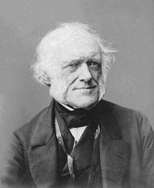
Charles Lyell – “…all theories are rejected which involve the assumption of sudden and violent catastrophes and revolutions of the whole earth, and its inhabitants.” (Scientific Papers, The Harvard Classics, 1909–14, p 94)
“I trust I shall make my sketch of the progress of geology popular. Old [Rev. John] Fleming is frightened and thinks the age will not stand my anti-Mosaical conclusions and at least that the subject will for a time become unpopular and awkward for the clergy…I shall out with the whole but in as conciliatory a manner as possible.” (From Mortenson, T., The Great Turning Point: The Church’s Catastrophic Mistake on Geology—Before Darwin, Master Books, Inc., P.O. Box 726, Green Forest, AR 72638, USA, 2004, pp. 225–226, citing Brooke, J., “The Natural Theology of the Geologists: Some Theological Strata”, in Jordanova, L. and Porter, R., Images of the Earth, British Society for the History of Science, Monograph 1, 1979), p. 45.)
“I am sure you may get into Q.R. [Quarterly Review] what will free the science from Moses, for if treated seriously, the [church] party are quite prepared for it….They see at last the mischief and scandal brought on them by Mosaic systems…”(From Mortenson, T., The Great Turning Point: The Church’s Catastrophic Mistake on Geology—Before Darwin, Master Books, Inc., P.O. Box 726, Green Forest, AR 72638, USA, 2004, pp. 226–227, citing Lyell, Katherine (Lyell’s sister-in-law), Life, Letters and Journals of Sir Charles Lyell, Bart. (London: Murray, 1881), I:p. 268–271.)
Notes:
…then in 1835, an English attorney named Charles Lyell applied the tools of his trade to push Hutton’s views. Lyell was not a geologist, but he was an admirer of Hutton’s work and wanted to make Hutton’s work go mainstream, and he did it in a crafty manner. Lyell was the man who coined the term “uniformitarianism”, the idea that the sediments accumulated uniformly and not rapidly. He said:
“…all theories are rejected which involve the assumption of sudden and violent catastrophes and revolutions of the whole earth, and its inhabitants.”
And what is he referring to? The flood. This guy reshaped geology for the next 150 years, doing more than any one individual to destroy faith in the literal interpretation of the book of Genesis. He did it in the book he published in 1830 called “The Principles of Geology”.
Now there were some private things going on behind the scenes, which we now know from letters he wrote. In one letter to Roger Merchasent, he said – “I trust I shall make my sketch of the progress of geology popular. Old [Rev. John] Fleming is frightened and thinks the age will not stand my anti-Mosaical conclusions and at least that the subject will for a time become unpopular and awkward for the clergy, but I am not afraid. I shall out with the whole but in as conciliatory a manner as possible.”
In other words, he didn’t want to upset the public, but he definitely wanted to convince them of his idea. This is what Lyell wrote in 1830 a letter to George Scrope:
“I am sure you may get into Q.R. [Quarterly Review] what will free the science from Moses, for if treated seriously, the [church] party are quite prepared for it….They see at last the mischief and scandal brought on them by Mosaic systems…”
In other words, his goal was to replace the biblical account of the flood with a purely naturalistic explanation.

Slide 8
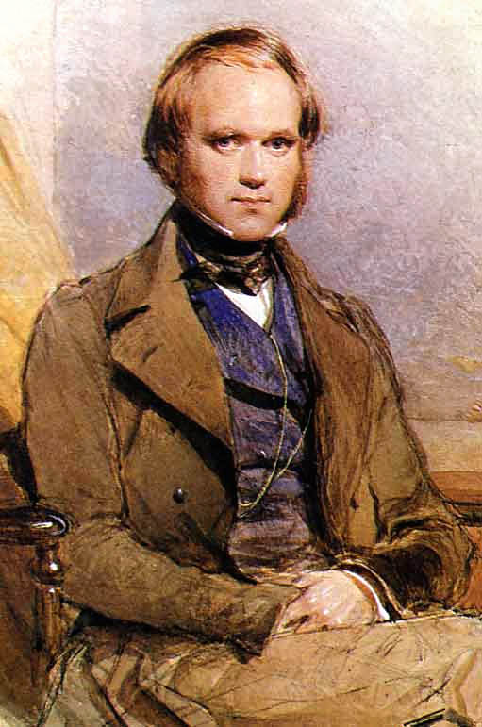
Charles Darwin – “I liked the thought of being a country clergyman. Accordingly I read with care…books on divinity; and as I did not then in the least doubt the strict and literal truth of every word in the Bible.” (Darwin 1958, pp. 57–67)
“I had gradually come by this time…to see that the Old Testament…was no more to be trusted than the sacred books of the Hindus, or the beliefs of any barbarian.” (The Life and Letters of Charles Darwin, Volume I, p. 132)
Notes:
Here is a man who was greatly influenced by Charles Lyell. This is a young Charles Darwin. Darwin, when he was young, was actually a man of great faith. Before he went on his great voyage around the world where he came up with his naturalistic ideas, he was a fervent member of the church of England. So what caused him to lose his faith? In his writings, when he recounts this period, he talks about the fact he had faith. In fact, he went to school to be a preacher and came out with a degree in theology (he did not have a degree in science):
“I liked the thought of being a country clergyman. Accordingly I read with care…books on divinity; and as I did not then in the least doubt the strict and literal truth of every word in the Bible”.
This guy had so much faith, when he first went on board the HMS Beagle, the other people on board thought it very amusing that Darwin would defend his moral convictions by quoting scripture. In fact, when they got to Argentina before they began to explore, Darwin requested from the chaplain on board that they serve communion.
So when did Darwin lose his faith? This is what happened: on the voyage, he brought along a book that he admits in the journals he wrote while on board had the biggest impact on his evolutionary though process. It was Charles Lyell’s “Principles of Geology”. This is what Darwin said in one of his journals around the end of the voyage:
“I had gradually come by this time…to see that the Old Testament…was no more to be trusted than the sacred books of the Hindus, or the beliefs of any barbarian.”
Remember what Charles Lyell said he wanted to do? He did exactly what he set out to do – destroy people’s faith. And he did it with a young Charles Darwin.

Slide 9
2 Pet 3:3-6 – “Know this first of all, that in the last days mockers will come with their mocking, following after their own lusts, and saying, ‘Where is the promise of His coming? For ever since the fathers fell asleep, all continues just as it was from the beginning of creation.’ For when they maintain this, it escapes their notice that by the word of God the heavens existed long ago and the earth was formed out of water and by water, through which the world at that time was destroyed, being flooded with water.”
Notes:
2 Pet 3:3-6 – “Know this first of all, that in the last days mockers will come with their mocking, following after their own lusts, and saying, ‘Where is the promise of His coming? For ever since the fathers fell asleep, all continues just as it was from the beginning of creation.’ For when they maintain this, it escapes their notice that by the word of God the heavens existed long ago and the earth was formed out of water and by water, through which the world at that time was destroyed, being flooded with water.”
And so Lyell succeeded in doing exactly what he set out to do. Because no longer was the geological column primarily interpreted by rapid sedimentation because of a worldwide flood, but rather assumed to develop gradually over a long period of time. And that’s how we get the millions of years in the geologic column that we have today.
Creationists have been saying for the last 220 years that the geologic column was not formed gradually, but catastrophically. But the theists were kicked out of universities 200 years ago so they weren’t listened to then.

Slide 10
Notes:
We know, though, that literally billions of bones have been buried in flood deposits all over the global. When you go around the world and observe the geologic column, over 90% of it is oceanic sedimentation. It’s a flood deposit all over the world with the same strata in different parts of the world matching up. In other words, the flood wasn’t localized. It was global.
These pictures are oceanic fossils discovered in parts of the world where they do not belong. The bottom left picture are of marine fossils found in limestone beds high up in the Himalayan mountains. How in the world did they get there?
So was Lyell right or wrong?

Slide 11
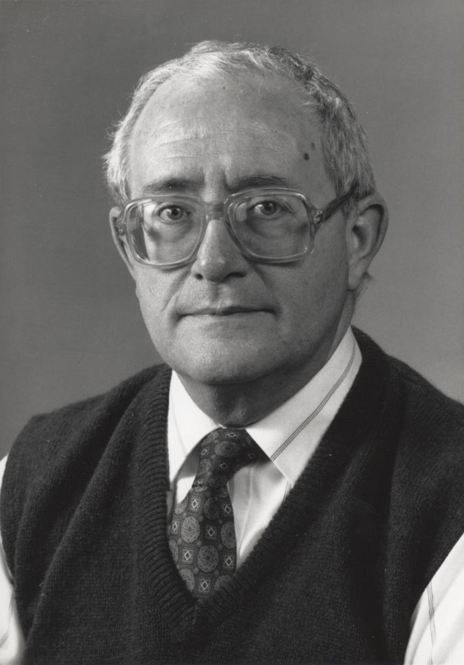
Dr. James Shea – “If the creationists could mount a successful attack on the validity of uniformitarianism, they would succeed in their effort to discredit modern geology.” (“Creationism, Uniformitarianism, Geology and Science”, Journal of Geological Education, 31[2]:105-110, 1983)
Notes:
Let’s look at what some naturalistic geologists have said:
In 1983, Dr. James Shea, a very well-known geologist, said – “If the creationists could mount a successful attack on the validity of uniformitarianism, they would succeed in their effort to discredit modern geology.”
Well, Creationists don’t want to discredit modern geology. What we want to do is return geology to the place it was before Lyell got his talons on it.
So what has happened? Evolutionists are now starting to admit that Creationists were right. They didn’t want to listen to Creationists for the last 200 years, but now they’re finally admitting that Hutton, Lyell, and uniformitarianism are wrong

Slide 12
Warren Allmon – “Lyell also sold geology some snake oil. He convinced geologists that … all past processes acted at essentially their current rates (that is, those observed in historical time). This extreme gradualism has led to numerous unfortunate consequences, including the rejection of sudden or catastrophic events in the face of positive evidence for them, for no reason other than that they were not gradual.” (Post Gradualism, Science 262, p. 122, October 1, 1993)
R. H. Dott – “Finally, it even means that catastrophism, in the sense of not straining the intensities of processes, was a better premise than Lyell’s uniformitarianism” (What is unique about geological reasoning? GSA Today, 8(10):15-18)
Notes:
Here are some quotes from Evolutionists admitting this very thing:
Warren Allmon, from Cornell University, said this – “Lyell also sold geology some snake oil. He convinced geologists that…all past processes acted at essentially their current rates (that is, those observed in historical time). This extreme gradualism has led to numerous unfortunate consequences, including the rejection of sudden or catastrophic events in the face of positive evidence for them, for no reason other than that they were not gradual.”
Remember what Lyell wanted to do? He wanted to free geology from Moses. He wanted to push on the public his anti-mosaic conclusions.
R. H. Dott, a popular geologist of the 21st century, said in 1998 – “Finally, it even means that catastrophism, in the sense of not straining the intensities of processes, was a better premise than Lyell’s uniformitarianism”
These are Evolutionists admitting that after 200 years, they have been wrong. The Creationists were right.

Slide 13
Derek Ager – “Paleontologists cannot live by uniformitarianism alone. This may be termed the Phenomenon of the Fallibility of the Fossil Record.” (1993, The Nature of the Stratigraphical Record, London: MacMillan)
Ken Hsu – “Catastrophism is enjoying a renaissance in geology. For the last 180 years, geologists have applied consistently a uniformitarian approach to their studies that has stressed slow gradual changes as defined by Lamarck, Lyell, and Darwin. Now, many of us are accepting that unusual catastrophic events have occurred repeatedly during the course of Earth’s history. ” (Rare Events in Geology Discussed at meeting, Geotimes, vol. 31:11-12, 1986)
Notes:
Derek Ager, past president of the British Geological Society, said – “Paleontologists cannot live by uniformitarianism alone. This may be termed the Phenomenon of the Fallibility of the Fossil Record.”
Say what? The fossil record isn’t wrong/fallible. Lyell’s interpretations were fallible which the world was accepting because they were kicking Creationism and Catastrophism out of the classroom.
Kenneth Hsu, a very world famous geologist and past president of the American Geological Society, and Judith McKenzie said:
“Catastrophism is enjoying a renaissance in geology. For the last 180 years, geologists have applied consistently a uniformitarian approach to their studies that has stressed slow gradual changes as defined by Lamarck, Lyell, and Darwin. Now, many of us are accepting that unusual catastrophic events have occurred repeatedly during the course of Earth’s history.”

Slide 14
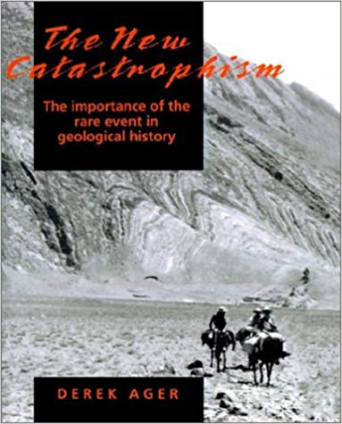
Derek Ager – “The hurricane, the flood or the tsunami may do more in an hour or a day than the ordinary processes of nature have achieved in a thousand years. Given all the millennia we have to play with in the stratigraphical record, we can expect our periodic catastrophes to do all the work we want of them.” (The Nature of the Stratigraphical Record, New York: John Wiley and Sons, 1993, pp. 68, 69)
Derek Ager –“To me, the whole record is catastrophic, not in the old-fashioned apocalyptic sense…but in the sense that only the episodic events – the occasional ones-are preserved for us.” (The Stratigraphic Code and What It implies” In Catastrophes and Earth History, p. 93, 1984).
Notes:
Derek Ager again – “The hurricane, the flood or the tsunami may do more in an hour or a day than the ordinary processes of nature have achieved in a thousand years. Given all the millennia we have to play with in the stratigraphical record, we can expect our periodic catastrophes to do all the work we want of them.”
This is an Evolutionist who has said some very sharp, hateful things about Creationists so he’s not on our side. But he has destroyed the possibility that the geological column is millions of years old by at the very least admitting catastrophism could very be behind some of what we see.
“To me, the whole record is catastrophic, not in the old-fashioned apocalyptic sense…but in the sense that only the episodic events – the occasional ones-are preserved for us.”

Slide 15
Dr. David Raup – “…contemporary geologists and paleontologists now generally accept catastrophe as a ‘way of life’ although they may avoid the word catastrophe.” (Geology and Creationism” Bulletin, Field Museum of Natural History, vol. 54:16-25)
R. H. Dott – “I hope I have convinced you that the sedimentary record is largely a record of episodic events rather than being uniformly continuous. My message is that episodicity is the rule, not the exception. ‘What do I mean by “episodic sedimentation”’ Episodic was chosen carefully over other possible terms. ‘Catastrophic’ has become popular recently because of its dramatic effect, but it should be purged from our vocabulary because it feeds the neo-catastrophist-creation cause.” (Episodic View Now Replacing Catastrophism, Geotimes, vol. 27:16-17, 1982)
Notes:
Dr. David Raup, who used to be Field director at the Museum of Natural History in Chicago – “…contemporary geologists and paleontologists now generally accept catastrophe as a ‘way of life’ although they may avoid the word catastrophe.”
Now why do you think they’d want to avoid the word “catastrophe”? Is there anything that might come to mind by using such a term? R. H. Dott helps us with this:
R. H. Dott – “I hope I have convinced you that the sedimentary record is largely a record of episodic events rather than being uniformly continuous. My message is that episodicity is the rule, not the exception. ‘What do I mean by “episodic sedimentation”’ Episodic was chosen carefully over other possible terms. ‘Catastrophic’ has become popular recently because of its dramatic effect, but it should be purged from our vocabulary because it feeds the neo-catastrophist-creation cause.”
In other words, we avoid it because we’d have to admit for the last 200 years the Creationists have been right and we’ve been wrong. So lest we give any credibility to creationists, let’s call it “episodic” rather than “catastrophic”. It would be funny if it wasn’t so sad!

Slide 16
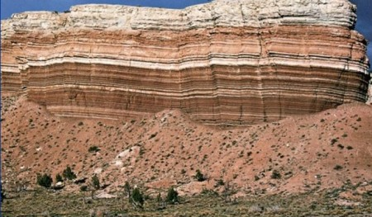
Notes:
For the last 200 years, Creationists have been trying to show people large formations like this that are several hundred meters high. Do you see all the horizontal, smooth, continuous and clean knife-edge layers? There is no erosion between these layers, no burling of animals, and no root formation. That means this had to have been created very rapidly. And now 200 years later, Evolutionists are finally admitting, “Yeah, ok, maybe it did happen this way” but they still won’t use the word “catastrophism”.
Think about how much Evolutionary stubbornness has set science back the last 200 years. That’s another topic for another day.

Slide 17
Stephen J. Gould – “Uniformitarianism is a dual concept. Substantive uniformitarianism (a testable theory of geologic change postulating uniformity of rates of material conditions) is false and stifling to hypothesis formation. Methodological uniformitarianism (a procedural principle asserting spatial and temporal invariance of natural laws) belongs to the definition of science and is not unique to geology.”
“Substantive uniformitarianism as a descriptive theory has not withstood the test of new data and can no longer be maintained in any strict manner.”
“As a special term, methodological uniformitarianism was useful only when science was debating the status of the supernatural in its realm; for if God intervenes, then laws are not invariant and induction becomes invalid…The term today is an anachronism: for we need no longer take special pains to affirm the scientific nature of our discipline.” (Is Uniformitarianism Necessary? American Journal of Science. 263:223-228, 1965)
Notes:
Now, let’s talk about what some Evolutionists are doing this counter this embarrassment. Since naturalistic geologists have found out that uniformitarianism is wrong, they are attempting to change the definition of it to try and save face. They’ll say, “You’ve got it all wrong, uniformitarianism isn’t slow gradual change” but in essence they’re really saying, “That’s just the old definition.” So what’s the issue here? Rather than admit fault, they’re redefining the word to save face.
Even Stephen J. Gould does this – “Uniformitarianism is a dual concept. Substantive uniformitarianism (a testable theory of geologic change postulating uniformity of rates of material conditions) is false and stifling to hypothesis formation. Methodological uniformitarianism (a procedural principle asserting spatial and temporal invariance of natural laws) belongs to the definition of science and is not unique to geology.”
So this is what he’s saying: the old uniformitarianism says that rates are the same in the past as they are today and he’s saying that’s wrong, calling is “substantive uniformitarianism”. But he says “methodological uniformitarianism” says that natural laws have always been the same.
“Substantive uniformitarianism as a descriptive theory has not withstood the test of new data and can no longer be maintained in any strict manner.”
Well, they didn’t get rid of it immediately because it wasn’t until the 1980s that they started admitting they had been wrong all these years.
“As a special term, methodological uniformitarianism was useful only when science was debating the status of the supernatural in its realm; for if God intervenes, then laws are not invariant and induction becomes invalid…The term today is an anachronism: for we need no longer take special pains to affirm the scientific nature of our discipline.”

Slide 18
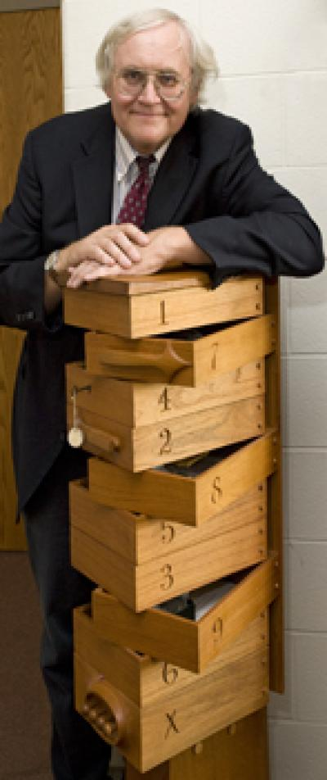
Digby McLaren – “A new uniformitarianism has moved to embrace at least a modified form of catastrophism.” (Bolides and Biostratigraphy, Presidential Address, Bulletin, Geological Society of America, 94:314, 1987)
U. B. Marvin – “But to regard the cataclysmic geologic effects of bolide impacts [meteors] as uniformitarian is an exercise in ‘new speak,’ whereby we would impose a 1980’s usage on an 1830’s term, which since the time it was coined, has donated the exact opposite of cataclysmic.”
“Rather than to invert the definition of the venerable word, it is time to recognize that bolide impact [meteors] is a geologic process of major importance, which by its very nature demolishes uniformitarianism itself as the
basic principle of geology.”
Notes:
Digby McLaren – “A new uniformitarianism has moved to embrace at least a modified form of catastrophism.”
Does that sound odd to you? Uniformitarianism is the opposite of catastrophism. Its very similar to the punctuated equilibrium theory. Evolution used to be defined by changes in the fossil record. But now they define it as lack of change in the fossil record which means evolution must have happened very quickly. That’s what they’re doing here with uniformitarianism. Lyell was the one who came up with the term, and he intended it to mean gradual, slow accumulation of the sediments. But its not defined that way anymore.
U. B. Marvin sees the logical fallacy happening:
“But to regard the cataclysmic geologic effects of bolide impacts as uniformitarian is an exercise in ‘new speak,’ whereby we would impose a 1980’s usage on an 1830’s term, which since the time it was coined, has donated the exact opposite of cataclysmic.”
In other words, even he recognizes that when the term “uniformitarianism” was invented, it meant the exact opposite of what evolutionists are trying to make it mean today.
“Rather than to invert the definition of the venerable word, it is time to recognize that bolide impact is a geologic process of major importance, which by its very nature demolishes uniformitarianism itself as the
basic principle of geology.”

Slide 19
Notes:
So what has happened? Evolutionists have admitted they are wrong about uniformitarianism. But instead of admitting it, they’ve redefined the word and therefore committed a logical fallacy called “Equivocation” – they shifted the meaning of a word during the course of their argument simply to win the debate rather than being truthful.
And if you try to force the original interpretation on them, they’ll pull the ole “bait and switch” and claim that you’re the one out of date and out of touch with current Evolutionary jargon. No, what they’ve done is rig the debate so that only they can win. Heads I win, tails you lose, right? Uniformitarianism, as Lyell defined it, was wrong. So Evolutionists simply change Lyell’s uniformitarianism to “substantive uniformitarianism” (even though he used that phrase) to “methodological uniformitarianism”.

Slide 20
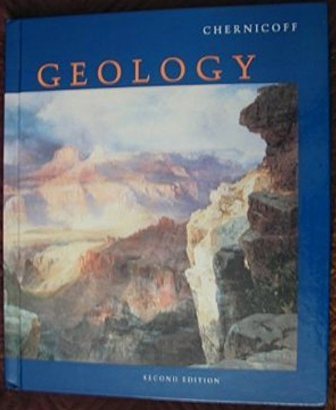
Stanley Chernicoff – “Over so vast a period of time, even processes that operate at imperceptibly slow rates have changed the earth's appearance dramatically. Fossil evidence of ancient marine creatures in some rocks of the Grand Canyon, for example, show that these rocks, today near the top of a hot, dry plateau 2300 meters (7500 feet) above sea level, once lay at the bottom of an ocean. Over millions of years, the mud at the bottom of this ocean – still containing the remains of sea creatures that died there – gradually solidified into rock, was uplifted to its present elevation, and was cut through and exposed by the Colorado River. As James Hutton knew, rocks, if we study them closely, can bear witness to an unimaginably long history.”
“There is no prescribed sequence to the rock cycle. A given rock’s evolution may be altered at any time by a change in the geological conditions around it.” (Geology: An Introduction to Physical Geology, Second Edition. Houghton Mifflin: Boston, MA. 1999. 596 pp. 14-15)
Notes:
Well, how do we defeat it if they’re just being dishonest? Most Darwinian Evolutionists are atheists, so you’re not going to push any buttons by appealing to ethics. So how do you defeat it?
One way is this: If “substantive uniformitarianism” is not true (slow and gradual), why is it still taught in public school textbooks?”
Stanley Chernicoff, who wrote the textbook Geology that is used in schools all over the nation, said this:
“Over so vast a period of time, even processes that operate at imperceptibly slow rates have changed the earth's appearance dramatically. Fossil evidence of ancient marine creatures in some rocks of the Grand Canyon, for example, show that these rocks, today near the top of a hot, dry plateau 2300 meters (7500 feet) above sea level, once lay at the bottom of an ocean. Over millions of years, the mud at the bottom of this ocean – still containing the remains of sea creatures that died there – gradually solidified into rock, was uplifted to its present elevation, and was cut through and exposed by the Colorado River. As James Hutton knew, rocks, if we study them closely, can bear witness to an unimaginably long history.”
But look what he then says:
“There is no prescribed sequence to the rock cycle. A given rock’s evolution may be altered at any time by a change in the geological conditions around it.”

Slide 21
Stanley Chernicoff – “The principle of uniformitarianism states that modern geological processes resemble those that operated in the past.” (p. 235)
“We must temper our acceptance of the principle of uniformitarianism, however, by realizing that the Earth has not always been the way we see it today. Early in its history, the Earth [1] lacked a well-developed atmosphere; the atmosphere it did have differed dramatically in composition, too. [2] The surface lacked its present-day vast ocean cover, [3] volcanic processes may have been more intense (the Earth’s interior was probably hotter), and [4] the planet rotated considerably faster (300 million years ago, for example, our Earth spun more quickly and our days were shorter, with 440 days in a year). Thus the rates of geological processes may have differed significantly, even though the basic forces that control those processes-such as gravity and heat flow– were essentially the same.” (pp. 209, 210)
Notes:
“The principle of uniformitarianism states that modern geological processes resemble those that operated in the past.”
But he admits that is wrong twenty-six pages earlier in saying:
“We must temper our acceptance of the principle of uniformitarianism, however, by realizing that the Earth has not always been the way we see it today.”
See, first he says uniformitarianism is an idea where the processes of today resemble what was in the past. But then 26 pages earlier he contradicts himself saying the Earth of today is not like it was in the past. But he’s going to list 4 ways why it was different in the past, though we know now there are at least a dozen reasons why.
“Early in its history, the Earth [1] lacked a well-developed atmosphere; the atmosphere it did have differed dramatically in composition, too. [2] The surface lacked its present-day vast ocean cover, [3] volcanic processes may have been more intense (the Earth’s interior was probably hotter), and [4] the planet rotated considerably faster (300 million years ago, for example, our Earth spun more quickly and our days were shorter, with 440 days in a year). Thus the rates of geological processes may have differed significantly, even though the basic forces that control those processes-such as gravity and heat flow– were essentially the same.”

Slide 22
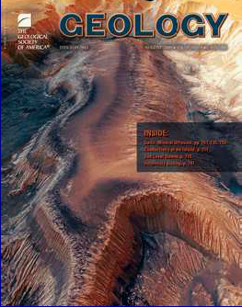
Bahngrell W. Brown – “Of late there has been a serious rejuvenation of catastrophism in geologic thought. This defies logic; there is no science of singularities. If catastrophe is not a uniform process, there is no rational basis for understanding the past.”
Notes:
Notice this quote from Bahngrell Brown. He is an Evolutionist. He admits that if uniformitarianism isn’t true, than there is no way we can judge the age of the Earth.
“Of late there has been a serious rejuvenation of catastrophism in geologic thought. This defies logic; there is no science of singularities. If catastrophe is not a uniform process, there is no rational basis for understanding the past.”
Why? Because we have to have a standard today by which we can judge the past. If the geologic column were created by a hurricane here, a tsunami there, or a meteor, or a flood, there is no way they can judge the earth through uniformitarian principles.

Slide 23
Rate of sedimentation
Rate of radioisotope decay
Speed of light
Notes:
If the age of the Earth can be determined by natural processes, there are only 3 ways it could be done:
Rate of sedimentation
Rate of radioisotope decay
Rate of light travel
But if rates are different in the past than they are in the present, how can we use those to judge the age of the earth today?

Slide 24
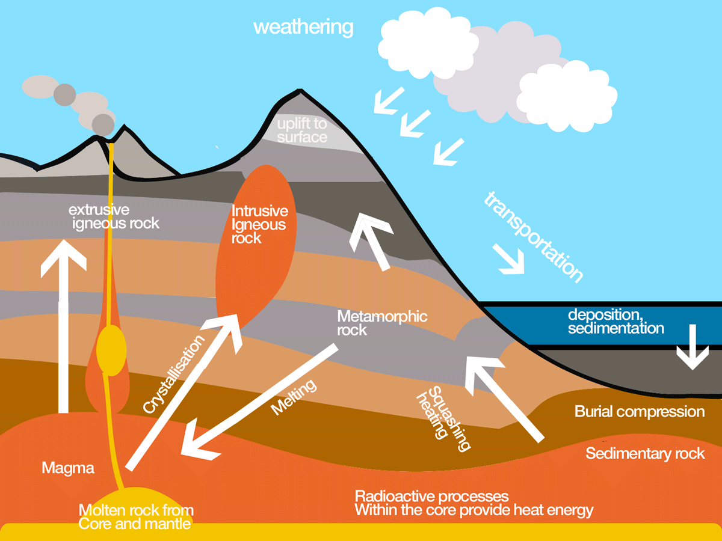
RATE OF SEDIMENTATION
Notes:
If catastrophism is true, there is no way we could measure the Earth by a constant rate of sedimentation build up. And with Evolutionists now changing the original definition of uniformitarianism to include catastrophic events, though they still don’t like to use that word, they have no choice but to admit that without direct knowledge of those catastrophic events, there is absolutely no way the earth’s age could ever be measured through sedimentation.
There are many examples of this, but here are three examples that disprove gradualism in sedimentation:

Slide 25
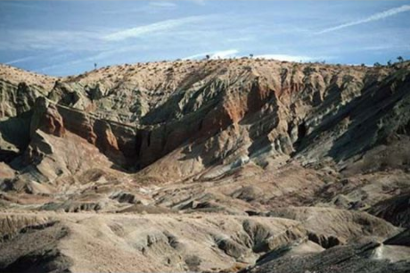
RATE OF SEDIMENTATION
Notes:
This is the Miocene Shales in the Mojave Desert in California. It is a fossil graveyard that does not conform to uniformitarian ideas at all. Because in just 1 4-square mile area, we find herring fossil bed of over 1 billion fish that suffocated to death. How did that happen? It couldn’t have happened by them being buried slowly over millions of years. They died rapidly. It was catastrophic, not gradual.

Slide 26
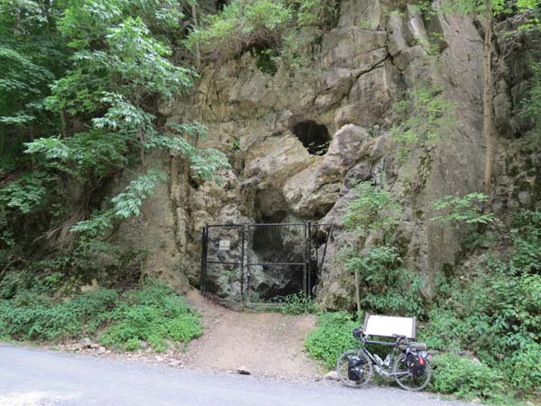
RATE OF SEDIMENTATION
Notes:
This is the Cumberland Bone Cave in Maryland. It contains fossilized remains of dozens of species of mammals, from bats to mastodons, along with the fossils of some reptiles and birds including animals which now have accommodated to different climates and habitats from the Arctic region to tropical zones. Uniformitarianism cannot explain this how this happened.

Slide 27
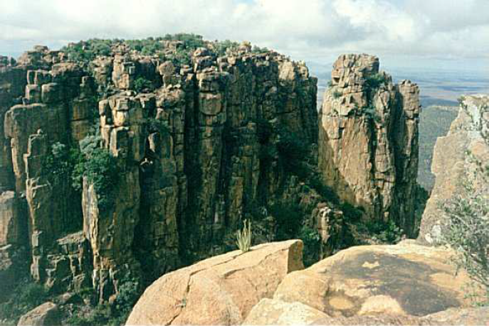
RATE OF SEDIMENTATION
Notes:
This is a series of mountain ranges called the Karoo Supergroup of Africa which contains 800 billion rapidly buried vertebrate animals. 800 billion. There are only 7 billion people in the world so there are over 100 times more animals buried in these layers than our world population. They’re all flood deposits, oceanic depositions, because all throughout these layers we find oceanic seashells buried with the vertebrates. They’re buried with the dinosaurs, the reptiles, the mammals, etc. This was not slow and gradual, but a great catastrophic event.

Slide 28
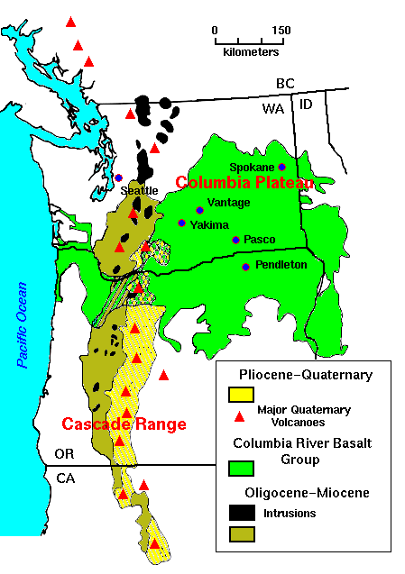
RATE OF SEDIMENTATION
Notes:
And then there is the Columbian Plateau Lava Beds in the NW US. Over 63,000 square-miles and it is 6,000 feet thick, over 1 mile deep, all developed by pure lava flow. This was a much bigger eruption than Mount St Helens. And it would have had to have been laid down fairly quickly to avoid other activity breaking up the consistency of the flow, making it several different beds
And as we’re going to see in a couple weeks, if there was a global flood, and the fountains of the deep burst open, there is evidence that the Pangea existed before the flood and that after the flood the continents divided during or after the flood. That would easily explain the great upsurge of volcanic activity and magma that could cause something like this to happen.

Slide 29
RADIOMETRIC DATING
Notes:
Now Evolutionists will claim they know the age of the Earth because of radiometric dating. But the truth is, they had it worked out long before that. What was considered the first accurate radiometric dating of rocks were not published until 1911 and they were predicting millions of years long before that.
Radiometric dating, or radioisotope dating, is the process of estimating the age of rocks by measuring the the decay of the rock’s radioactive elements. There are certain kinds of atoms in nature that are unstable and spontaneously change into other kinds of atoms (decay). For example, uranium, an unstable element, will radioactively decay through a series of steps until it becomes lead, a stable element. Potassium decays into argon. The original element is referred to as the parent element (in these cases uranium and potassium), and the end result is called the daughter element (lead and argon).
Carbon-14 dating has a half life of 5700 years, so they’ll often use it to attempt to measure rocks and fossils they believe are younger than 60,000 years. For those they think are older, they use a different radioactive isotope with a longer half-life.

Slide 30
RADIOMETRIC DATING
300 Million Years
Notes:
However, what if we were to take rocks and fossils whose date we knew, and run these tests against them, only for them to show vastly inflated radioisotope ages?
For example, here is coal formation with doorknobs embedded that radiometric dating tells us is 300 million years old. Does the guy who produced the patent for the door knob owe us an apology?

Slide 31
RADIOMETRIC DATING
Notes:
A 1971 article in Antarctic Journal, exposing the unreliability of carbon dating, claimed a freshly killed seal was carbon dated as having died 1300 years ago.

Slide 32
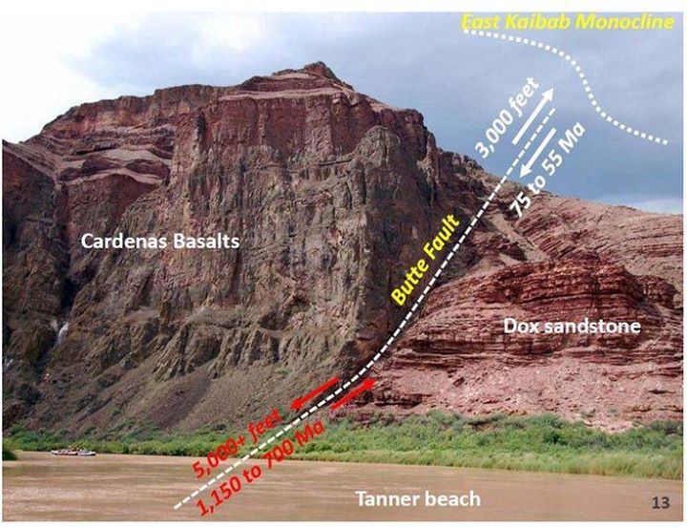
RADIOMETRIC DATING
Kaibab Plateau (top most strata) – 250 million yrs
Cardenas Basalt (Potassium-Argon) – 516 million yrs
Cardenas Basalt (Rubidium-Strontium) –1.1 billion yrs
Cardenas Basalt (Samarium-Neodymium – 1.6 billion yrs
Notes:
A basalt is a lava formed rock, and it is actually down in the basement layer of the Grand Canyon so it is considered by secular geologists to be some of the oldest rock. However, what they’ve found is that some of it, as a result of a volcanic eruption at the top, flowed out as magma and then over the side and covered every single layer all the way down to the basement rock in the Precambrian layer. So secular geologists would claim this rock is younger than all the layers since according to their uniformitarianism views would have been formed after all the other strata was laid in place.
But here is how messed up radiometric dating is: they say the very top strata called the Kaibab Plateau is only 250 million years old. But look at what all of these different radiometric dating methods say the age of the Cardenas Basalt is, how off they are not only with the Kaibab Plateau but even with each other.
Radiometric dating is not a measure of age. It is a measure of chemical composition

Slide 33
RADIOMETRIC DATING
Notes:
Here are some other examples of events whose dates we know whose radiometric dating grossly overestimated by just using Potassium to Argon dating. Mount St Helens is the most recent event, whose rock was formed in 1986; carbon dating shows it is 2.8 million years old.

Slide 34
RADIOMETRIC DATING
Changing Earth Conditions
Atmospheric Conditions
Redox Potential
Temperature
Pressure
Earth’s Magnetic Field
Earth’s Polarity
Notes:
What’s the issue? First, naturalistic geologists assume a constant isotope decay rate, though that is something that can never be known.
Second, they assume the initial isotope concentrations, which cannot be known. How could they possibly know how many parent elements there actually were? You can’t measure time without a definitive starting point.
And, third, they assume that the daughter atoms were all produced from radioactive decay, rather than admit the possibility that any of the daughter atoms were already present.
Consider this as well: if in the earth’s past, conditions were different, such as atmospheric conditions, redox potential, temperature, pressure, earth’s magnetic field (which has diminished 50% in just the last 1200 years), changes in the earth’s polarity (which has supposedly flipped multiple times), rates of radioactive decay would not have been uniform. They would have vastly changed.

Slide 35
RADIOMETRIC DATING
H. C. Dudley – “The observed variations in the decay rates (changes in the half life) were produced by changes in pressure, temperature, chemical state, electrical potential, stress of monomolecular layers, etc.”
“The decay ‘constant’ is now considered to be a variable. The value is dependent of the energy state of the entire atom as the basic unit system, not just on the energy state of the atomic nucleus.”
“Radioactivity is thus shown experimentally not to be, as described by Millikan, ‘an unalterable property of the atom.’ Half lives are NOT constant.” (“Is There an Ether?” Industrial Research. Nov 15, 1974, pp. 41-46)
Notes:
This was confirmed in an 11 year study which began in 2000, documented in a 2-volume, 1450 page report even though studies proving variation in radioactive decay had already been reported in the 1970s. What they did was take radioactive isotopes and put them in different conditions which represented Earth in the past. You know what they found? They found that it decayed differently.
H. C. Dudley, a radiation physicist who was apart of this experiment, said:
“The observed variations in the decay rates (changes in the half life) were produced by changes in pressure, temperature, chemical state, electrical potential, stress of monomolecular layers, etc.”
“The decay ‘constant’ is now considered to be a variable. The value is dependent of the energy state of the entire atom as the basic unit system, not just on the energy state of the atomic nucleus.”
“Radioactivity is thus shown experimentally not to be, as described by Millikan, ‘an unalterable property of the atom.’ Half lives are NOT constant.”
So here’s the question: can you think of a monumental, catastrophic event in the world which would have changed the Earth’s magnetic field, moved tectonic plates all over the place, and caused large volcanic eruptions? A global flood would have done this. Noah’s flood would have reset these clocks.

Slide 36
RADIOMETRIC DATING
Notes:
Here is the most important thing you need to know about radiometric dating. Age is not a substance that be measured with scientific equipment. The tools of science allow us to measure things like mass, volume, pressure, force, weight, and composition. There are quantities that can be directly measured using the right equipment. But age is not a physical property. Age is conceptual. Age is the concept of the amount of time an object has existed. It is the present time minus the time at which the object came into existence. The only way that this can be known scientifically is if a person observed the time of creation.
Radiometric dating is not a measure of age. It is a measure of chemical composition.

Slide 37
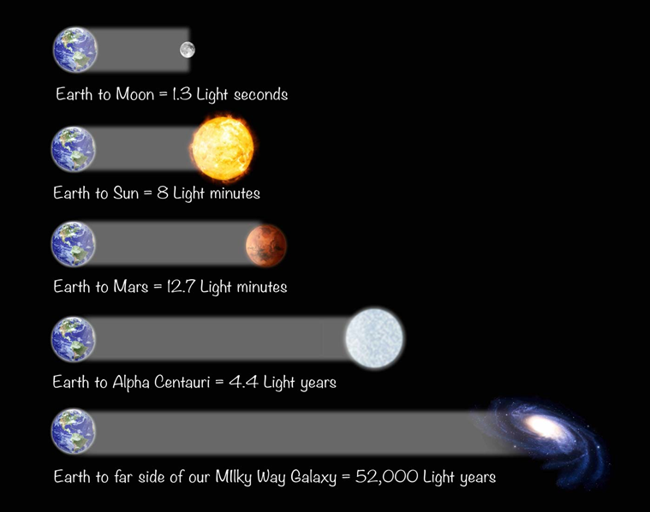
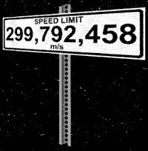
SPEED OF LIGHT
Gen 1:14-19 – “Then God said, ‘Let there be lights in the expanse of the heavens to separate the day from the night, and let them be for signs and for seasons and for days and years; and let them be for lights in the expanse of the heavens to give light on the earth’; and it was so. God made the two great lights, the greater light to govern the day, and the lesser light to govern the night; He made the stars also. God placed them in the expanse of the heavens to give light on the earth, and to govern the day and the night, and to separate the light from the darkness; and God saw that it was good. There was evening and there was morning, a fourth day.”
Notes:
In discussing the speed of light, here is what God said in Gen 1:14-19 – “Then God said, ‘Let there be lights in the expanse of the heavens to separate the day from the night, and let them be for signs and for seasons and for days and years; and let them be for lights in the expanse of the heavens to give light on the earth’; and it was so. God made the two great lights, the greater light to govern the day, and the lesser light to govern the night; He made the stars also. God placed them in the expanse of the heavens to give light on the earth, and to govern the day and the night, and to separate the light from the darkness; and God saw that it was good. There was evening and there was morning, a fourth day.”
But how do naturalistic scientists decide how many candles to put on the universe’s birthday cake? They study the oldest objects within the universe and measure how fast it is expanding. The speed of light is an important factor in how they make this determination. And so they determine that the universe is 13.8 billion years old. Here’s the Christians’ challenge: God said He made the stars on the 4th day and from the context, they would have been apparently seen from that day. So how can the universe be young if the stars are old? If a star is, say, a million light-years from Earth, wouldn't it take a million years for its light to reach us?

Slide 38
SPEED OF LIGHT
Notes:
Now there are various ways to deal with this issues. Here are some challenges to the skeptic:
1) Do you accept 13.8 billion years because you have personally studied this and sought out the evidence or do you accept because some scientist/textbook said so? This needs to be confronted, because as we have stressed over and over again, scientists bring their own biases into their discoveries and there are many physicists and astronomers who do not believe the Earth is that old, but in fact believe the evidence is there for a young earth. Therefore, challenge the skeptic for the source of his information.

Slide 39
SPEED OF LIGHT
David B. Cline – “We know little about that sea. The terms we use to describe its components, “dark matter” and “dark energy” serve mainly as expressions of our ignorance.” (David B. Cline, "The Search for Dark Matter," Scientific American (vol. 288. March 2003), p. 52.)
Notes:
2) Has scientific technology reached its zenith? Meaning, are we now able to see into the utter ends of the universe itself? And the answer is of course, “no”. Therefore we would have to conclude that additional evidence may present itself, as technology increases, that may increase or decrease this number. This is especially true because the stars and other measurable physical bodies of our universe are estimated by cosmologists themselves to only comprise ~5% of the “matter" in space. The remaining 95% has been coined "dark matter" or "dark energy," something which has never been observed, but which seems theoretically to be needed.
Cosmologist David Cline in his book “The Search for Dark Matter” admitted this about that unseen sea of unknown materials: “We know little about that sea. The terms we use to describe its components, "dark matter" and "dark energy" serve mainly as expressions of our ignorance.”
Well, the speed of light is a rate only measured within a vacuum. Do you see how further knowledge, which is what science is based on, may eventually alter these factors?

Slide 40
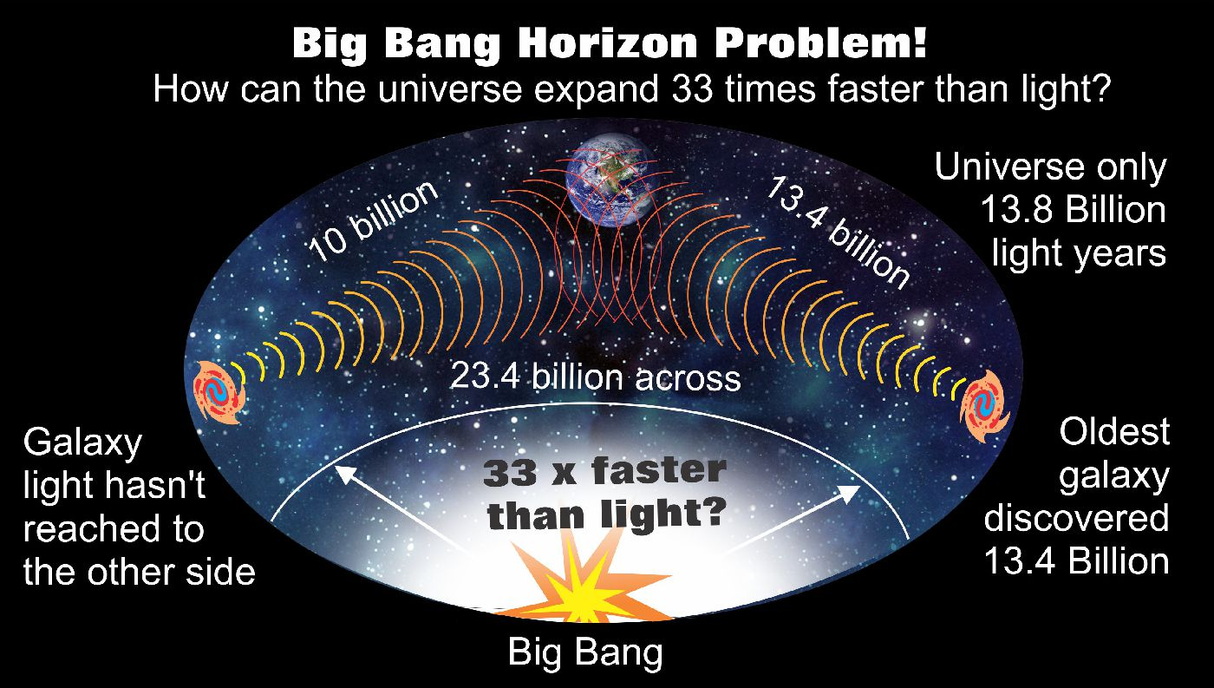
SPEED OF LIGHT
Notes:
3) This places the supposed “Big Bang” in big trouble. Folks, naturalistic cosmologist will make fun of Creationists for a young earth because of the alternate theories we’ll look at in just a moment, but they themselves make exceptions for the Big Bang. The light-travel–time argument cannot be used to reject the Bible in favor of the big bang, with its billions of years. This is because the big bang model also has a light-travel–time problem. We’re not going to get into details of this, but if you want to do your own research, its called “The Horizon Problem”, and in a nutshell, the guys who won the nobel prize in 1964 that discovered Cosmic Microwave Background (CMB), which was coined a successful prediction of the Big Bang model, is actually a problem for the Big Bang model because there hasn’t been enough time for it to get here according to their own theory. More in a bit on how they try to explain this away.

Slide 41
SPEED OF LIGHT
Gen 1:16c-17 – “He made the stars also. God placed them in the expanse of the heavens to give light on the earth”.
Gen 22:17b – “Indeed I will greatly bless you, and I will greatly multiply your seed as the stars of the heavens and as the sand which is on the seashore?”
Notes:
So what are the other alternatives to a 13.8 billion year old universe dictated by the speed of light? Here are other possibilities:
God could have created the light from the stars simultaneously with the stars themselves, so that Adam could have seen the stars as soon as they were created. Gen 1:16c-17 – “He made the stars also. God placed them in the expanse of the heavens to give light on the earth”. If there were no stars visible because the light hadn’t arrived, wouldn’t we have expected Moses to say, “Stars? What are stars?” Abraham was born about 2000 years after Creation, so were the only stars visible to him the ones who that were 2000 light years away? Gen 22:17b – “Indeed I will greatly bless you, and I will greatly multiply your seed as the stars of the heavens and as the sand which is on the seashore?” Well, which is it? The sand of the sea (trillions) or the stars (only few from what I can see)?
Now one difficulty with this assumption is how to deal with post-creation stellar events such as supernovas, which we have been able to sea with telescopes. So we would have to admit that these were events that God created to have the appearance of happening longer than the creation of the Earth. But if God created a grown-up Adam, He could certainly create a grown up universe.

Slide 42
SPEED OF LIGHT
Notes:
2) Some Creationist physicists have argued from Einstein's theory of relativity that, at great distances, six literal days on Earth could correspond to billions of years in distant space. The problem is that one would almost have to be a Ph.D. in theoretical physics even to comprehend the mathematics involved in this argument. Now God could have caused things to happen scientifically that even the greatest human mind would have trouble comprehending, but the real question is would God expect ordinary people to depend on theoretical physics to determine whether or not they could believe the Bible?

Slide 43
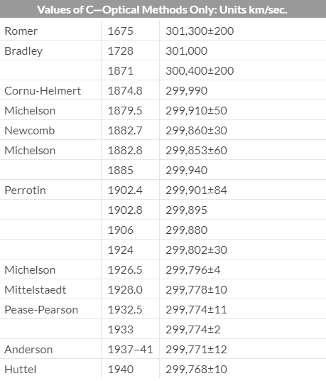
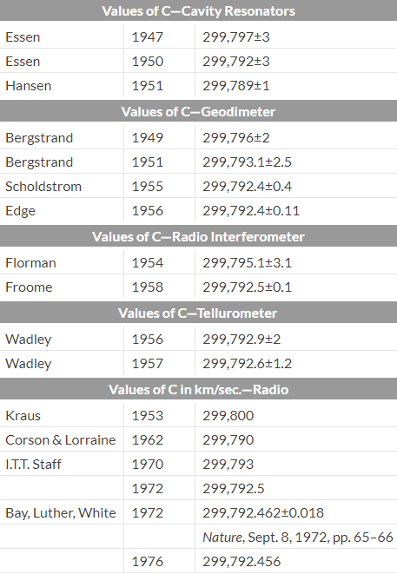
SPEED OF LIGHT
Notes:
3) Another theory is the idea that the speed of light has not always been uniform. There is evidence to suggest in fact that it used to be a lot faster. Now naturalistic cosmologists can’t laugh at this hypothesis and do you know why? Because its exactly how they attempt to explain “The Horizon Problem” for their precious Big Bang, what is called “variable speed of light”. VSL Cosmology teaches that the speed of light had to be faster in the past. But if it was faster in the past than in the present, what does that mean for what is taught in high schools today? It’s wrong. Because if it were faster, it got here faster and we can’t use that as a means to measure the age of the universe.
Measurements of light velocity, which we have records of since 1675, shows a slowing down of created light. These figures show a drop in the speed of light, and that is cool enough. But even cooler is when you measure the rapid rate at which it is dropping, the deceleration. The rate it is dropping between 1870 and 1920 is about 4 km/sec and then only about .3 km/sec before 1950. Also, the observed change in c over three centuries is far greater than the margins of error in the observations. In other words, from this data, ,the speed of light is decaying. But how fast is it decaying?

Slide 44
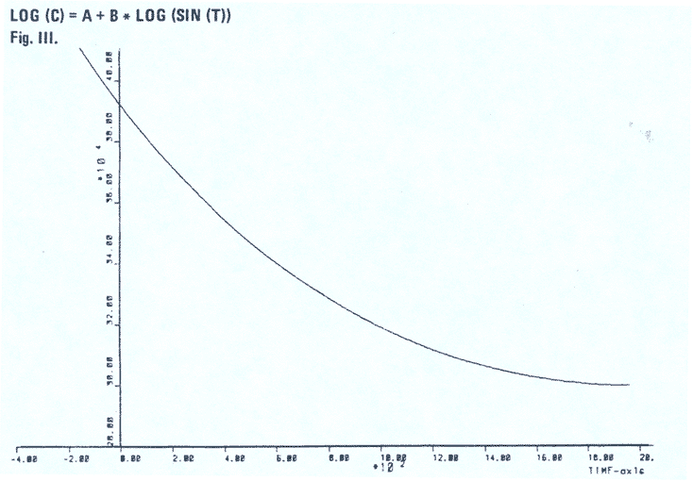
SPEED OF LIGHT
Notes:
Cosmologists who are creationists have tried to fit this data into a number of possible curves to try and determine the rate of decay, exponential curves, power curves, polynomials, logarithmic, hyperbolic functions, etc. There is only one curve that they tried which fitted the data points exactly. Its general form is a log sine curve, with a logarithmic vertical axis, and this is a typical curve of many energy functions, including the decay rate of super novae. Now, if you consider that beyond about 1960, the speed of light seems to have reached a uniform number, and you move the curve that the data points fit in to match that, guess what year the model predicts the beginning of the universe to be? 4040BC. +/- 20 years. This date of origin would refer to the time of Creation/Fall.
https://answersingenesis.org/astronomy/starlight/the-velocity-of-light-and-the-age-of-the-universe/

Slide 45
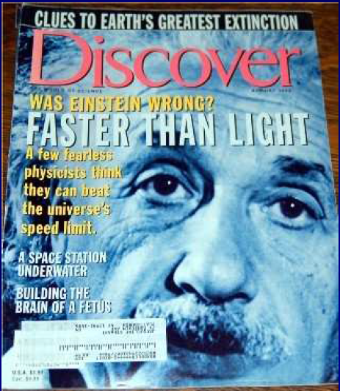
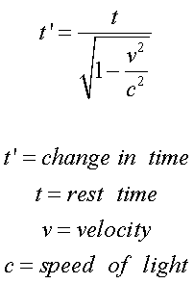
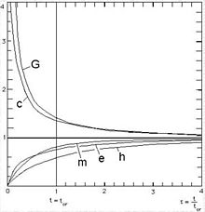
SPEED OF LIGHT
Notes:
“That’s crazy” – No, Einstein proved this years ago when he proved time dilation and even Evolutionary magazines admitted such. And again, “variable speed of light” is the only way Naturalists can make the Big Bang work, so why can’t Creationist scientists use it, with data we already have, to make our own predictions?

