Slide 1
Notes:
1 Kings 18:21 – “Elijah came near to all the people and said, “How long will you hesitate between two opinions? If the Lord is God, follow Him; but if Baal, follow him.”
Let’s look at what the alternative ideas for 24-hour Creation days, what Theistic Evolutionists believe and teach and why they teach it. These are ways in which they explain away Genesis 1, all of which do irreparable damage to the interpretation of the bible and the cause of Jesus Christ.
If we believe these principles, we have no basis upon believing any principle in the bible? Why? Because these interpretations do not come from any principles. Those who espouse make up anecdotes and stories and allegories to explain everything away.

Slide 2
Day/Age Theory
Notes:
The first one is called the “Day Age Theory”, and it was first suggested by an Anglican Bishop named George Stanley Faber in 1823. This views contends that each day in Gen 1 was not 24 hours, but:
1) Each day was a long period of indefinite time
2) God created certain animals millions of years ago and then they died out
3) God then created more animals and eventually He decided to create humans
4) There were millions of years of death, disease, and suffering before Adam and Eve’s sin and the subsequent curse on the earth.
The problem with this view, biblically speaking, is that the Hebrew word for day is “yom”. And with this Hebrew word in Gen 1 and 2 come qualifiers. These qualifiers include the words “morning”, “evening”, and then the number attached to the day. The Creation account documented in Genesis 1 specifically lists each day as follows: “And there was evening, and there was morning, the first day...second day... “ and so forth. These qualifiers are included rather redundantly, as if God wants to make it very clear what He means by the word day.
Another point that must be considered is the death and decay prior to Adam and Eve's sin that would have cast judgment on the earth. This would not have been consistent with God’s declaration after Day 6 of it being “very good”. (See also Romans 8:20-22)
Often times, Day/Age Theory proponents will refer to the verse in 2 Peter 3:8 – “One day is with the Lord as a thousand years.” First, we must consider the context the verse is located within. The third chapter of 2 Peter is specifically speaking about the second coming of Christ. Peter is conveying the patience of the Lord in Christ's second coming so that more people will be led to repentance and salvation. Next, Peter is conveying that the Lord is outside of time. He specifically uses a comparative article—as or like—which is not found in Genesis 1. This verse reiterates that God is outside of time or that time is nothing to God. It is not referring to the creation of time, space, and matter as Genesis 1 and 2 do.
There’s a good book that kicks this to the curb called “Old Earth Creationism On Trial”

Slide 3
Gap Theory
Gen 1:1-2 (NASB) – “In the beginning God created the heavens and the earth. ²The earth was formless and void, and darkness was over the surface of the deep, and the Spirit of God was moving over the surface of the waters.”
Gen 1:1-2 (NATEB) – “In the beginning God created the heavens and the earth. ²[The billions and billions of years pass] and] the earth was formless and void, and darkness was over the surface of the deep, and the Spirit of God was moving over the surface of the waters.”
Notes:
The 2nd theory is called the Gap Theory, and there are numerous types of this theory but we’ll consider the most prominent called The General Gap Theory. This theory is an “Evolution” (pun intended) of the Day/Age Theory suggesting that between Gen 1:1 and Gen 1:2 there were billions of years.
See, in Matt 1, when you look at the genealogy between Adam and Jesus, there is no way you can fit billions of years in that genealogy and scholars recognize that. So they then said, “We need to find another place to stock these billions of years so let’s do it between Gen 1:1 and Gen 1:2. So, the “New American Theistic Evolutionist Bible” would read, “In the beginning God created the heavens and the earth” but then billions of years later, “The Earth was without form and void.”
The problem with this theory, other than the fact it is not based on scripture, is that it undermines the gospel as it allows for death, bloodshed, disease, and suffering before Adam and Eve’s sin. All versions of the gap theory impose outside ideas on Scripture and thus open the door for further compromise.

Slide 4
Soft Gap Theory
Gen 1:2-3 (NASB) – “²The earth was formless and void, and darkness was over the surface of the deep, and the Spirit of God was moving over the surface of the waters. ³Then God said, ‘Let there be light’; and there was light.”
Gen 1:2-3 (NATEB) – “²The earth was formless and void, and darkness was over the surface of the deep, and the Spirit of God was moving over the surface of the waters. ³Then [billions and billions of years later,] God said, ‘Let there be light’; and there was light.”
Notes:
The 3rd theory is what is called the “Soft Gap Hypothesis”. This contends that there were billions of years between Gen 1:2 and 1:3, to allow for the long period of time it would take for light to get from the distant stars. One of the leading advocates for this movement, Gorman Gray, said, “Earth lay in total darkness … for an undefined length of time before the first day until God began to clear the envelope of thick darkness” (www.hal-pc.org/~tom/GGray.html)
First of all, God could have created the beams of light from distant stars already on their way to the earth. After all, Adam didn’t need any time to grow from a baby because he was made as an adult. Likewise, it can be argued that the universe and many of its aspects were made mature and that the light was created in-transit. Today, God sustains the universe in a different way than how He created it…by what we call natural law. However, the naturalist erroneously assumes that the universe was created by the same processes by which it operates today. Since the stars were created during Creation Week and since God made them to give light upon the earth, the way in which distant starlight arrived on earth may have been supernatural. We cannot assume that past acts of God are necessarily understandable in terms of a current scientific mechanism, because science can only probe the way in which God sustains the universe today. It is irrational to argue that a supernatural act cannot be true on the basis that it cannot be explained by natural processes observed today. It is perfectly acceptable for us to ask, “Did God use natural processes to get the starlight to earth in the biblical timescale? And if so, what is the mechanism?” But if no natural mechanism is apparent, this cannot be used as evidence against supernatural creation. So, the unbeliever is engaged in a subtle form of circular reasoning when he uses the assumption of naturalism to argue that distant starlight disproves the biblical timescale.
Secondly, any attempt to scientifically estimate the age of something will necessarily involve a number of assumptions. These can be assumptions about the starting conditions, constancy of rates, contamination of the system, and many others. If even one of these assumptions is wrong, so is the age estimate. What could be wrongly assumed related to light?
It is usually assumed that the speed of light is constant with time. At today’s rate, it takes light in a vacuum about one year to cover a distance of 6 trillion miles. But has this always been so? If we incorrectly assume that the rate has always been today’s rate, we would end up estimating an age that is much older than the true age. But some people have proposed that light was much quicker in the past. If so, light could traverse the universe in only a fraction of the time it would take today. Some creation scientists believe that this is the answer to the problem of distant starlight in a young universe.
Other theories such as Einstein’s “time-dilation” and “synchronization” are possible explanations, but beyond the scope of this class.
Ironically, the big bang theory has a light travel-time problem of its own. In the big bang model, light is required to travel a distance much greater than should be possible within the big bang’s own timeframe of about 14 billion years. This serious difficulty for the big bang is called the “horizon problem.”

Slide 5
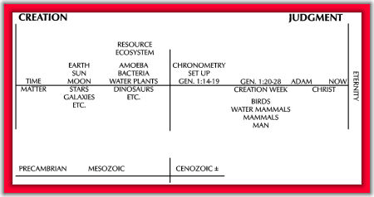
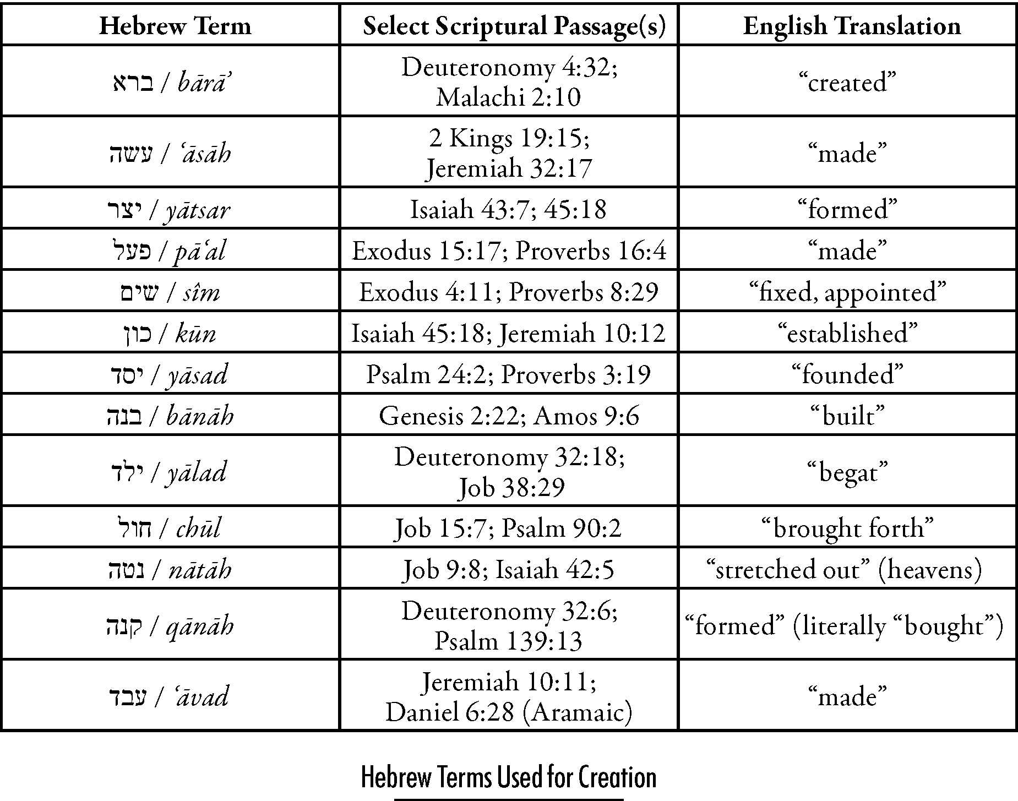
Modified Gap Theory
Notes:
The “Modified Gap Hypothesis” says that between Gen 1:2 and Gen 1:3, there were billions and billions of years. But what then they teach that during this time there were only amphibians, reptiles, fish, dinosaurs, but no warm blooded animals so that is why we have all these dinosaur bones. The guy that is the biggest proponent of this, John Clayton, a Christian, said that the reason God did this is because He knew when the Industrial Revolution came, we would need all this oil and gas and coal. And it is very probably he had that in mind, but that doesn’t mean he put it there over the course of millions and billions of years. Here’s what he said:
“Genesis 1:1 is an undated verse. No time element is given and no details of what the Earth looked like are included. It could have taken place in no time at all, or God may have used eons of time to accomplish his objectives. I suggest that all geological phenomena except the creation of warm-blooded life were accomplished during this time. There was no way God could have described amoebas, bacteria, viris [sic.], or dinosaurs to the ancient Hebrew, and yet these forms of life were vital to the coal, oil and gas God knew man would need. Thus God created these things but did not describe them just as He did not describe a majority of the million species of life on this planet. Changes took place in the Earth (but no gap destruction) until God began the formation of man's world with birds, whales, cattle and man in the literal days of Genesis (1976a, pp 147-148).”
The problem with this is that Moses very clearly stated that the fish (cold-blooded creatures) were created on the 5th day and that creeping things (including insects and reptiles) were created on the 6th day. Clayton place them on the first day, rearranging the Genesis record to fit his own evolutionary presuppositions—without any regard whatsoever for what God had to say on the matter.
The way Clayton attempts to make his interpretation the correct one is by coming up with new definitions of words, a common tactic of false teachers. For a more detailed critique of Clayton’s theory, see http://www.apologeticspress.org/APContent.aspx?category=9&article=569.

Slide 6
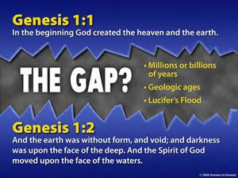
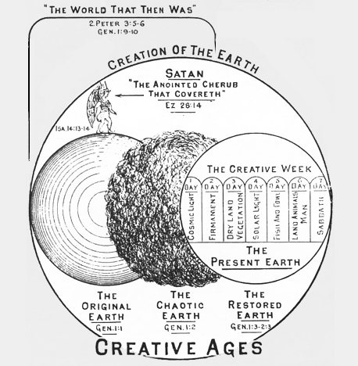
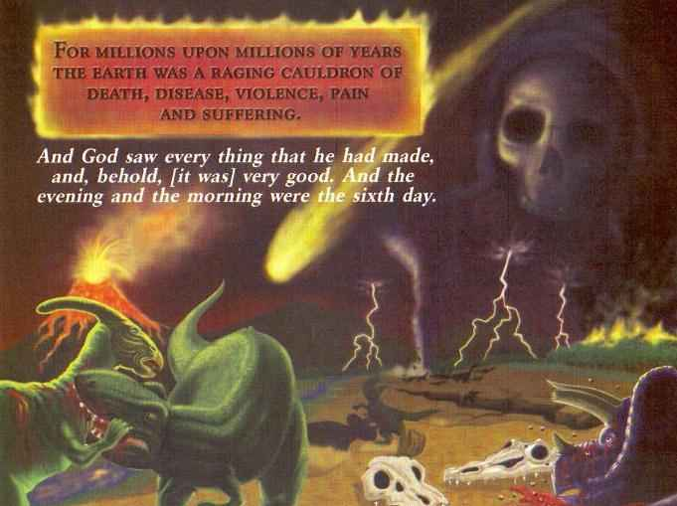
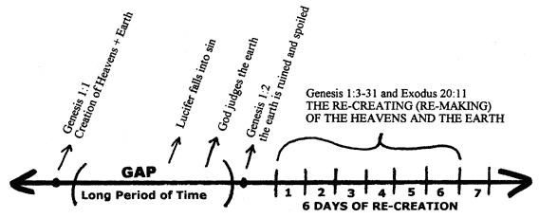
Ruin Reconstruction Theory
Notes:
Then there is what is called the “Ruin Reconstruction Hypothesis”. Thomas Chalmers came up with this idea in the 1800s. He taught that in Gen 1:1, God created the Earth and that it was beautiful and perfect. And during this time, he taught there was a pre-Adamic race where millions of people lived on the Earth. But during that time, Lucifer’s fall occurred (he believed Lucifer was Satan) and then the Earth was corrupted. He taught that God sent a flood (not Noah’s flood) to destroy the Earth, which is where we get all these dinosaur bones, and then he started over with Adam.
This was actually a very popular view during that time, and many conservative evangelicals actually believed it, the Scofield Reference Bible contained this theory in it.
The problems with this theory are the same as already discussed, but the following needs to be added:
This theory puts death, disease, and suffering before the Fall, contrary to Scripture. Rom 5:12 – “Therefore, just as through one man [Adam] sin entered the world, and death through sin, and thus death spread to all men, because all sinned.” From this we understand that there could not have been human sin or death before Adam. The Bible teaches in 1 Cor 15 that Adam was the first man, and as a result of his rebellion (sin), death and corruption (disease, bloodshed, and suffering) entered the universe. Before Adam sinned, there could not have been any animal or human death. Note also that there could not have been a race of men before Adam that died in Lucifer’s flood because 1 Cor 15:45 tells us that Adam was the first man.
Also, Gen 1:29-30 teaches us that animals and man were originally created to eat plants, which is consistent with God’s description of His creation as “very good.” But how could a fossil record, which gives evidence of disease, violence, death, and decay (fossils have been found of animals apparently fighting and certainly eating each other), be described as “very good”? For this to be true, the death of billions of animals (and many humans) as seen in the fossil record must have occurred after Adam’s sin. The historical event of the global Flood, recorded in Genesis, explains the presence of huge numbers of dead animals buried in rock layers, laid down by water all over the earth.
For more information refuting this theory, see https://answersingenesis.org/genesis/gap-theory/what-about-the-gap-and-ruin-reconstruction-theories/

Slide 7
Late Gap Theory
Notes:
The “Late Gap Hypothesis” teaches that God created Adam and Eve on day 6, but that they existed for millions or billions of years in the Garden of Eden. But after these millions and billions of years, Eve just gave in and ate the fruit.
The problem with this theory is that we have the genealogy of Adam in Gen 5:5 that claims he lived 930 years and then he died. This no longer becomes the Day-Age debate, not now the Year-Age debate.
Also, Adam and Eve were told in Gen 1:28 to be fruitful and multiply, and if they had waited millions and billions of years to do so they would have disobeyed and then that would have been the first sin. But the fact their first child happened after they were kicked out of the garden (Gen 4:1) suggests it was not long after their creation when they sinned. Gen 5:3 indicates that Adam had Seth when he was 130 and Gen 4:25 indicates this took place after Cain killed Abel. Thus the maximum time before the Fall would have much less than 130 years.

Slide 8
Literal w/Gaps Theory
Ex 20:11 – “For in six days the Lord made the heavens and the earth, the sea and all that is in them, and rested on the seventh day; therefore the Lord blessed the sabbath day and made it holy.”
Notes:
The Literal Day with Gaps Theory, sometimes called the “Multiple Gaps Theory” is where things are going to start getting crazier. This theory teaches that each of the Gen days were literal days, but that God put billions of year in between the days. Very inventive, right?
Dr. Donald England, a Christian and professor at Harding University, is one of its staunchest advocates. He writes, “The days could easily have been 24-hour days and the earth still date to great antiquity provided that indefinite periods of time separated six creation days.”
So in this theory God creates on a particular day, and the span between the days allows for various ages where development then takes place. It allows for things such as dinosaurs living and then becoming extinct for millions of years before man came on the 6th day. No matter what happens between the days of creation, the theory still attributes to the design of a sovereign creator.
This theory, as with all the others, attempts to reconcile the creation narrative with that of science. But from a hermeneutical point of view, the theory is lacking. The biblical text does not allow for multiple gaps between each day of Creation; rather it suggest continuity.
This theory also does not harmonize with orthodox geology. If the acts of creation are left on their respective days, then there is no possible way to make the Creation account agree with the geologic-age system—gaps or no gaps. The Genesis sequence and the alleged geologic sequence do not agree (see Thompson, 1995, p. 214). The Multiple Gap Theory does not alter that fact.
Finally, we shouldn’t overlook Ex 20:11 which specifically states that “in six days the Lord made the heaven and earth, the seas, and all that in them is, and rested on the seventh day.” Either God made what He made in six days or He made what He made in six days plus millions or billions of years.

Slide 9
Framework Hypothesis
Notes:
The “Framework Hypothesis” is even more out there. This theory teaches that Gen 1 is all symbolism and poetry – nothing by a framework. They teach it is like a parable, a story, and that there were no real days. They teach Gen 1 is just a literary device that we can make mean whatever we want it to mean. You know how in school you would discuss a poem and everyone got out of it and nothing was really right or wrong? This theory says you can just read Gen 1 and decide what you want it to mean.
It is currently one of the most popular views of Genesis 1 being taught in seminaries, where they are trying to reclassify the genre of Genesis 1 as being something other than historical narrative.
The leading promoter of the Framework Hypothesis, Meredith Kline, pulled no punches when explaining his goal in promoting it. “To rebut the literalist interpretation of the Genesis creation week propounded by the young-earth theorists is a central concern of this article. . . . The conclusion is that as far as the time frame is concerned, with respect to both the duration and sequence of events, the scientist is left free of biblical constraints in hypothesizing about cosmic origins.“
See https://answersingenesis.org/creationism/old-earth/whats-wrong-with-the-framework-hypothesis/

Slide 10
Revelatory Day Theory
Num 12:6-8 – “Hear now My words: if there is a prophet among you, I, the Lord, shall make Myself known to him in a vision. I shall speak with him in a dream. Not so, with My servant Moses, he is faithful in all My household; with him I speak mouth to mouth, even openly, and not in dark sayings, and he beholds the form of the Lord. Why then were you not afraid to speak against My servant, against Moses?”
Notes:
The “Revelatory Day View” is one of the more interesting ones. It is the idea that the 6 days in Gen 1 were 6 visions given by God to Moses on 6 days to show him how things were created over billions of years.
Bernard Ramm – “We believe…that creation was revealed in six days, not performed in six days. We believe that the six days are pictorial-revelatory days, not literal days nor age-days. The days are means of communicating to man the great fact that God is Creator, and that He is Creator of all” (Bernard Ramm, A Christian View Of Science And Scripture, Grand Rapids, Eerdmans, 1954, p. 151).
Consequently, each creative day recorded in Genesis would not constitute that which God created, but that which God revealed to Moses. Therefore there is no chronology of creation in the Genesis account.
This theory attempts to avoid all the controversy over whether the days of Genesis were literal or symbolic, but it is filled with issues.
First, the natural reading of this text would not make one think of these days as being revelatory, but rather of historical narrative. Nothing in the text even gives a hint that this theory is true.
Second, those who espouse this view try to take the Hebrew word “asah”, which is translated as “made”, and say that it should really mean “reveal” or “show”. Nowhere in Hebrew is this word translated as such. This is another attempt by another false teacher to change the meaning of a word to fit a theory rather than let the meaning of the word determine the meaning.
Third, God was specific with us on how He chose to communicate with Moses. Num 12:6-8 – “Hear now My words: if there is a prophet among you, I, the Lord, shall make Myself known to him in a vision. I shall speak with him in a dream. Not so, with My servant Moses, he is faithful in all My household; with him I speak mouth to mouth, even openly, and not in dark sayings, and he beholds the form of the Lord. Why then were you not afraid to speak against My servant, against Moses?”

Slide 11
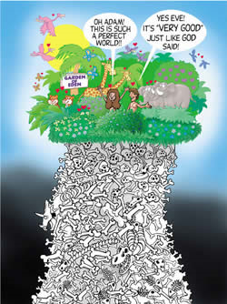
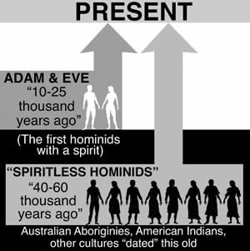
Progressive Creationism
Notes:
Finally, there is “Progressive Creationism”, which has also caught fire the last 20 – 30 years based on the teachings of astronomer Hugh Ross. He denies Evolution, but does claim that the Earth is 4.5 billion years old. He teaches that God successively created the animals. First He created algae and left the for a few million years, then He created some bacteria and left them for a few million years, and so on. About humans, he said for hundreds of thousands of years there were these pre-humans similar to cave men people, but they weren’t really human because they didn’t have souls. He calls them Spiritless Hominids. He teaches that 40,000 years ago, God took of one of these Neanderthal like pre-humans and put a soul in him and called him Adam. Then He put a soul in another one and called her Eve.
Four thousand years ago, God said to Job: "I will demand of thee, and answer thou me. Where wast thou when I laid the foundations of the earth? declare, if thou hast understanding" (Job 38:3-4). The stupendous impact of that question continues to the present hour.
The major problem with this view is that by its insistence that animals and pre-Adamic men died long before Adam sinned, the strong biblical connection between sin and death is broken. Rom 8:20-22 – “For the creation was subjected to futility, not willingly, but because of Him who subjected it, in hope that the creation itself also will be set free from its slavery to corruption into the freedom of the glory of the children of God. For we know that the whole creation groans and suffers the pains of childbirth together until now.” There could have been no death in the animal kingdom before the Fall and the curse. Progressive Creationism collapses under the weight of Romans 8

Slide 12
Conclusion
Notes:
And so what Theistic Evolution does is create a compromise between Evolutionists and Creationists by claiming that God allowed Evolution to occur. And many in the religious world are starting to accept this – Presbyterian, Nazarene, Anglican, Episcopalian, Methodist, Lutheran, United Church of Christ, and the Catholic Church since 1996. Abilene University, Pepperdine University, The Discovery Institute, etc.
First, the bible is clear that God spoke everything into existence.
Gen 1:3 – “Then God said, ‘Let there be light’; and there was light.”
Psa 33:6-9 – “By the word of the Lord the heavens were made, and by the breath of His mouth all their host. He gathers the waters of the sea together as a heap; He lays up the deeps in storehouses. Let all the earth fear the Lord; let all the inhabitants of the world stand in awe of Him. For He spoke, and it was done; He commanded, and it stood fast.”
Second, the bible is clear that the Earth was created on day 1 and the stars were created later on day 4. But Evolution teaches that the stars were created first up to 6 billion years before the Earth.
Third, although Gen 1:16-19 teaches that the sun and moon were created on the same day, Evolution teaches that the sun was created millions of years before the moon.
Fourth, the bible teaches that plant life and animal life were created on days 3 and 6 respectively. But Theistic Evolution teaches that plant life and animal life evolved side by side over a period of billions of years.
Fifth, the bible teaches that birds and fish were created on the same day, day 5. Theistic Evolution teaches that fish preceded birds by millions of years and that fish transformed into salamanders which transformed into reptiles which later transformed into birds.
Sixth, Gen 1 teaches that birds were created first and then reptiles. But Evolutionists teaches that reptiles evolved millions of years before birds.
Seventh, the bible teaches that woman was fashioned from man’s rib, but Evolution teaches that man and woman evolved together side by side over millions of years.
Ex 31:17b – “for in six days the Lord made heaven and earth, but on the seventh day He ceased from labor, and was refreshed”

