Slide 1
Notes:
This study will attempt to provide evidence for reliability of the NT documents as they exist today. It would logically follow that if we can prove the inspiration of our New Testament, this would prove its reliability. But rather than being caught in circular reasoning, we’ll approach each individually. This lesson will simply approach the New Testament as a document of antiquity and attempt to determine whether there is enough internal and external evidence to know beyond a reasonable doubt whether it is the same NT that was written in the first century.

Slide 2
Notes:
By the NT, we’re referring to 27 books. The first four books are biographical accounts of the life of Jesus Christ, what we also call the gospels. The fifth book, Acts, is a historical book recording the acts of the Apostles of Jesus Christ after they are commissioned by Jesus following His death, burial, and resurrection to go into all the world and preach the gospel to every creature.
Then there are the personal letters, of which the Apostle Paul wrote a majority. Six of these letters were written early in his ministry while on 3 separate missionary journeys chronicled in the book of Acts. At the end of Acts, he is imprisoned in Rome where he then writes four of his “prison epistles”. He is later released in which he writes personal letters to two of his young traveling companions and fellow ministers Timothy and Titus only to be imprisoned again, which ultimately led to his execution. Prior to his death, he wrote a final second epistle to Timothy.
Other apostles and prophets wrote epistles: James, Peter, John, and Jude as well as an unnamed author who penned Hebrews. And the NT is completed with the prophetic book of Revelation.

Slide 3
Outline
Bibliographical
Notes:
We’ll start by considering the bibliographical evidence.

Slide 4
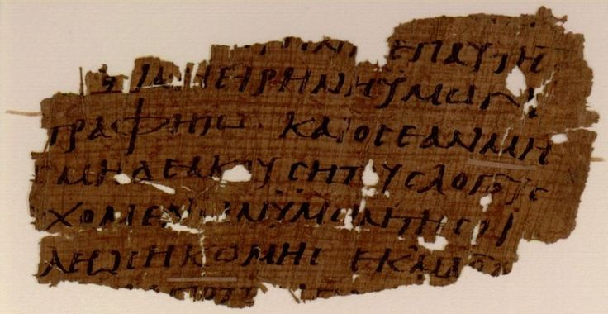
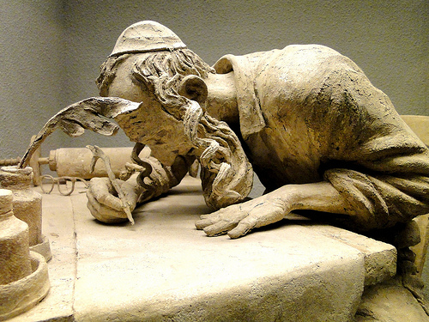
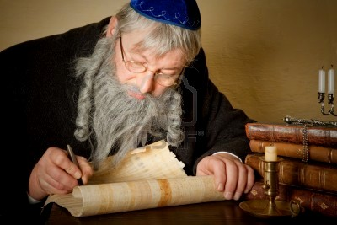
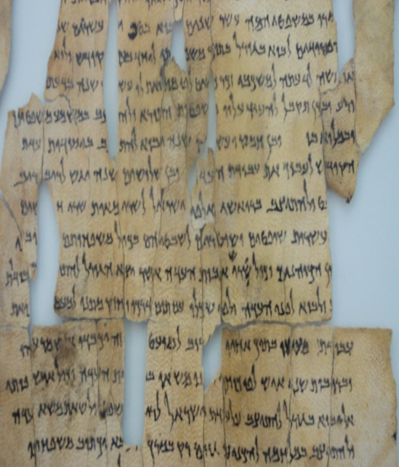
Bibliographical
Critics concern
We do not possess the original NT manuscripts
Papyrus it was written on quickly wore out
Had to be copied and recopied by hand
How do we know that the NT we have today is close enough to the original writings so as to be equally reliable?
Notes:
The first thing to note is that we do not have in our possession any of the original NT manuscripts. I mentioned this in passing in a sermon about 17 years ago and after the lesson I had a gentlemen pull me aside in the foyer and get on to me for stating this. He claimed I was going to lead people astray. So I understand that some are surprised by this because I have met Christians who just assume that all of the original copies are in a vault somewhere that no one is allowed to see. Well that’s just not the case at all. And just because we don’t have the original manuscripts in our possession does not mean we cannot trust the copies we do have.
The original NT manuscripts were written on a material called “papyrus”. Papyrus is a plant material people of the 1st century manufactured into a thin paper and it was the most common material to write on. But it was a material that wore out and disintegrated over a short period of time. And so the handwritten copies needed to be recopied over and over again in order to maintain it as well as distribute it to individual churches. And because of this, critics will ask the very reasonable question, “How can we be sure we have the same NT that was originally written?”

Slide 5
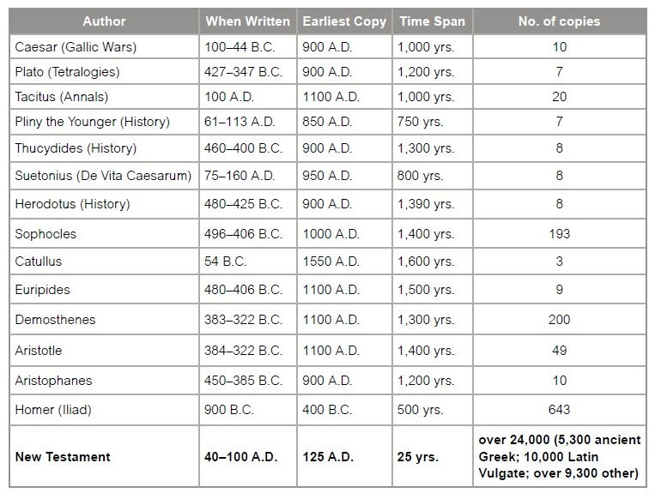
Bibliographical
Notes:
The reason we can know this is because of the number of hand-written copies we have in our possession. There are about 5600 complete hand-written copies of the NT that date from the beginning of the 4th century to the time of the invention of the printing press invented in 1440AD. And in addition to these, we have around 18000 partial copies that date to as early as the beginning of the 2nd century. Understand this: no document of antiquity rivals the NT in the number of copies. None. You know what comes in 2nd place to the NT? Homer’s Iliad. And we only have 643 copies of it. 643 vs. 5600? Homer’s Iliad isn’t just 2nd place, it is a distant 2nd place.

Slide 6
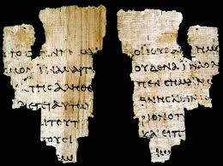
Bibliographical
John Ryland’s fragment of John’s Gospel dates at approximately 125 AD
John 18:31-33 – “³¹So Pilate said to them, ‘Take Him yourselves, and judge Him according to your law.’ The Jews said to him, ‘We are not permitted to put anyone to death,’ ³²to fulfill the word of Jesus which He spoke, signifying by what kind of death He was about to die. ³³Therefore Pilate entered again into the Praetorium, and summoned Jesus and said to Him, ‘Are You the King of the Jews?’”
John 18:37-38 – “³⁷Therefore Pilate said to Him, ‘So You are a king?’ Jesus answered, ‘You say correctly that I am a king. For this I have been born, and for this I have come into the world, to testify to the truth. Everyone who is of the truth hears My voice.’ ³⁸Pilate said to Him, ‘What is truth?’”
Notes:
The earliest fragment/partial copy we have is called the “John Ryland” fragment which paleographic evidence suggests was written between 100 – 150 AD. The first part of the fragment contains John 18:31-33 and the second part contains John 18:37-38.

Slide 7
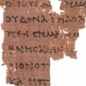
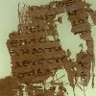
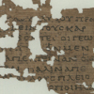
Bibliographical
2nd century AD
 | P52 (Rylands) | 100 – 150AD | Jn 18:31-33, 37-38
 | P90 (Oxyrhynchus) | 150 – 200AD | Jn 18:36-19:7
 | P104 (Oxyrhynchus) | 150 – 200AD | Matt 21:34-37,43,45
 | P98 (IFAO) | 150 – 200AD | Rev 1:13 - 2:1
Notes:
These are some of the more famous partial copies we have in existence.

Slide 8
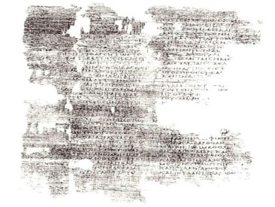
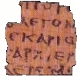
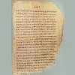
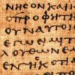
Bibliographical
Late 2nd and early 3rd century AD
 | P4 (Coptos) | 200AD | Luke 1-6
 | p64 & p67 (Magdalen) | 200AD | Matt 3, 5 & 26
 | P46 (Chester Beatty) | 200AD | Most of Paul’s epistles
 | P66 (Bodmer) | 200AD | most of John

Slide 9
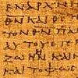
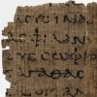
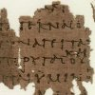
Bibliographical
Late 2nd and early 3rd century AD
 | P75 (Bodmer) | 200AD | most of Luke, half of John
 | P32 (Ryland’s) | 200AD | Tit 1:11-15; 2:3-8
 | p77 & 103 | 200AD | Matt 13:55-56, 14:3-5, 23:30-39
 | Uncial 0189 | 200AD | Acts 5:3-21 (oldest manuscript written on parchment)

Slide 10
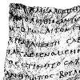
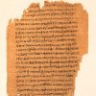
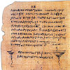
Bibliographical
3rd century AD
 | Uncial 0212 | 250AD | All 4 gospels
 | P45 (Chester Beatty) | 250AD | large portions of all 4 gospels and Acts
 | P47 (Chester Beatty) | 250AD | most of Rev 9:10-17:2
 | P72 (Bodmer) | 300AD | 1 & 2 Peter, Jude

Slide 11
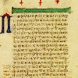
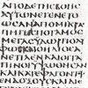
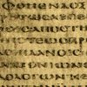
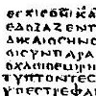
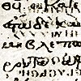
Bibliographical
3rd century AD
 | Codex Vaticanus | 325 – 350AD | most of the Septuagint (Greek OT/Apocrypha) and most of the NT
 | Codex Sinaiticus | 330 – 360AD | about half of the Septuagint and all of the NT
 | Codex Alexandrinus | 400 – 440AD | most of the Septuagint and all of the NT
 | Codex Bezae | 400AD | most of the Gospels & Acts
 | Codex Ephraemi | 450AD | some of the Septuagint and much of the NT
Notes:
These are manuscripts that contain the majority of the NT from as early as the 3rd century AD and our earliest complete NT manuscripts are dated to between 325AD – 350AD. Codex Sinaiticus is the earliest complete NT manuscript, and it can be seen today in the British Library.

Slide 12
Bibliographical
How accurate?
99.5%
Notes:
So how do we know we have the same NT as the original? Because when we compare all 24,000 partial and complete copies with one another, they are found to be 99.5% accurate with what we currently have. And given the propensity for mankind to make mistakes, quite frankly this is incredible.
However, some will not be satisfied with an error of 0.5%, despite the fact that this is far greater than any other document of antiquity for which there is no equal or greater criticism for its authenticity. So exactly what makes up this 0.5% variance?

Slide 13
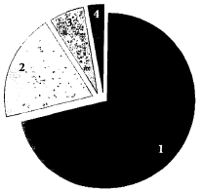
Bibliographical
Misspellings/Nonsense
1 Thes 2:7 – “We were gentle (Gk. ‘ēpioi’) among you” vs. “We were horses (Gk. ‘hippoi’) among you”
Minor Changes/Word Order
King Herod vs. Herod the King
“The Son of God” vs. “The only Son of God”
Notes:
Misspellings & Nonsense Words – These type of variants make up almost 75% of all the variants and are incredibly easy to detect even if you don’t know anything about Greek. One example of this is found in 1 Thes 2:7 – “But we proved to be gentle among you, as a nursing mother tenderly cares for her own children.” The Greek word for “gentle” in this verse is the word “ēpioi”. The majority of our handwritten copies contain this word. However, there are a few manuscripts (just a few) that instead have the Greek word “hippoi”. That is the Greek word for horses – in other words, a few of the translations read “But we proved to be horses among you…”. So in a situation like this, we know which translation is correct. No one to this day argues that the word “horses” is the correct word and none of our translations have that. We understand this was a slight of hand by a copyist who probably stayed up an hour past his bedtime. The most frequent example of variants in this category involves what is called the “moveable nu.” “Nu” is a Greek letter that has a sound like the English “N.” It serves a similar function to what our indefinite article “a” does in English. In English, if “a” comes before a consonant, there is no change; but before a word beginning with a vowel, the “a” becomes “an.” So we write “a potato,” but “an apple.” Greek does the same thing, but applies it to most instances in which a word ending in a vowel comes just before a word beginning with a vowel. Before a word beginning with a vowel, Greek would often insert a “nu” at the end of the word before the vowel to make it easier to pronounce. This was not always done, however, and different writers might or might not insert the “nu,” and this single practice is the most common cause of variant readings. But none of these types of variants change the meaning of the NT text, and again, this makes up the majority of variants amongst the NT copies.
Minor Changes & Word Orders – These type of variants make up roughly 20% of all variants and don’t amount to anything serious. For example, some manuscripts might say “King Herod” while others might say “Herod the King”. Some manuscripts might say “Jesus the Son of God” in one verse but in the same verse in another manuscript it might read “Jesus the only Son of God”. None of these variants are meaningful variants and none of them raise any doctrinal questions whatsoever.

Slide 14
Bibliographical
Meaningful changes not viable
1 Thes 2:9 – “The gospel of God” vs. “The gospel of Christ”
Meaningful & viable changes
Rom 5:1 – “We have peace” (Gk. ‘echomen’) vs. “Let us have peace” (Gk. ‘echōmen’)
Mark 16:9-20 & John 7:53-8:11
Notes:
3. Meaningful Changes Not Viable – These types of variants make up less than 10% of all known variants in the manuscripts. And though they are meaningful variants, they don’t cast doubt on any truths. One example of this error is found in 1 Thes 2:9 – “For you recall, brethren, our labor and hardship, how working night and day so as not to be a burden to any of you, we proclaimed to you the gospel of God.” The majority of versions say “the gospel of God” but there are a few handwritten copies that instead say “the gospel of Christ”. That is a meaningful difference. But it simply isn’t viable for the very reason that Christ is God and really either could have been used. “Gospel of God” is most commonly used because that is what is found in the overwhelming majority of the hand-written copies. Luke 6:22 – “Blessed are you when men hate you, and ostracize you, and insult you, and scorn your name as evil, for the sake of the Son of Man.” One late manuscript omits the last phrase “for the sake of the Son of Man.” That’s a meaningful variant since it could suggest that a person is blessed when he is persecuted regardless of his allegiance to Christ. Yet it is only in one manuscript, and a relatively late one at that. It has no chance of reflecting the wording of the original text, since all the other manuscripts are against it, including quite a few that are much, much earlier
4. Meaningful & Viable Changes – These are variants that actually do change the meaning of the text and they are viable in the sense that they cannot easily be explained away by looking at other manuscripts or external factors. But this is by far the smallest group of variants in the manuscripts, making up less than 1% of all variants. Let’s look at a couple of examples: Rom 5:1 – “Therefore, having been justified by faith, we have peace with God through our Lord Jesus Christ.” Some manuscripts have Rom 5:1 using a Greek letter called an omicron (lower case “o”) to create the word “echomen”; others use an omega resulting in the word “echōmen”. Thus the passage could be saying either “We have peace” or “Let us have peace” with God, depending on this single disputed letter. But how different are the two results? The bottom line is that neither usage contradicts the overall message of the New Testament. Another example is found in 1 John 1:4. Again, a single contested letter means the difference between the passage saying “Thus we are writing these things so that our joy may be complete,” or “Thus we are writing these things so that your joy may be complete.” The meaning is certainly affected by the change, but neither translation violates Christian doctrine. Whether the author is speaking of his personal joy or the readers’ joy, the obvious point of this verse is that the writing of this letter brings joy. I will tell you that the largest textual variant in the New Testament is found in the last chapter of Mark 16:9-20. Some early manuscripts end at verse eight. However, the vast majority of manuscripts add twelve more verses to the text. While scholars continue to debate where the actual ending is to the book of Mark, the point is that no doctrinal teaching or truth is affected by the dispute. In fact, one possibility for why this section is not included in some of the earlier manuscripts is that the last page of a manuscript would have naturally been the first to give in to deterioration as result of handling and touching. But here’s the thing: we know this about Mark 16:9-20. Most of our bibles have brackets around these verses with a note explaining at the bottom that it’s not found in some earlier manuscripts. And so we’re not trying to pull the wool over anyone’s eyes. In fact, even if Mark 16:9-20 was not in the original manuscript, which I believe it was, everything taught in Mark 16:9-20 is taught in other passages of the NT.
So these are the four categories of variants in the NT. And we clearly see that the overwhelming majority of them are minor variants that do not detract in the least from the message of the NT.

Slide 15
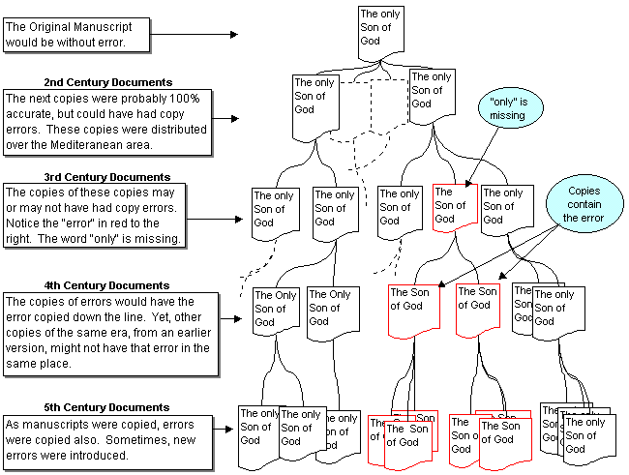
Bibliographical
Notes:
How might transmission errors occur? Very easily: through common scribal error. Then the manuscript in error gets copied and copied again while the correct ones also get copied. We would expect the manuscripts in error to be fewer in number than those which are correct so we tend to give those the benefit of the doubt, particularly if it does not lead to any significant doctrinal difference.

Slide 16
Bibliographical
Notes:
But let’s assume, hypothetically, that we cannot trust these copies. We have another bibliographical source in which we can depend to authenticate our NT.
We have an abundance of early writings from uninspired men that confirm the authenticity of the hand-written copies. These men were called the early church fathers, though I believe that title to be a misnomer. But these were men who knew the Apostles or knew the men who knew the Apostles, down to 4 generations or so. These were uninspired men, but they wrote commentary, gave suggestions on how to handle the apostasies of the early church, recorded early church service scripture readings, and other things. If we take all of the NT quotations from just these early Christian writers, there are enough of them to recreate well over 99% of the NT. One Apologist said that even without the hand-written copies, we could recreate the entire NT (7,957 verses) just from the early church fathers alone minus about 11 verses. And these were men who lived within 1 to 4 generations of the Apostles themselves.

Slide 17
Bibliographical
What can we conclude?
Not enough time elapsed between when Jesus spoke and when His words were recorded to allow misrepresentation or development of legendary material about Him
Not enough time has elapsed between the original and existing ancient manuscripts to allow significant transmission errors or tampering
Notes:
What can we conclude bibliographically about the NT?
Not enough time elapsed between when Jesus spoke and when His words were recorded to allow misrepresentation or development of legendary material about Him
Not enough time has elapsed between the original and existing ancient manuscripts to allow significant transmission errors or tampering

Slide 18
Outline
Bibliographical
Internal Evidence
Notes:
Now that we see how sir ethe bibliographical evidence is, we’ll consider the internal evidence and external evidence, in that order.

Slide 19
Internal Evidence
Four laws used in our legal system to determine a document’s acceptability
Ancient Document Rule
Parol Evidence Rule
Hearsay Rule
Cross-examination Rule
Notes:
In our legal system, sometimes there are disputes that arise over documents. It may be a legal contract that I have with another individual or it could be a will that a dead relative had written that children are bickering over. Whenever legal disputes arise over any document, there are four rules that are used to determine the validity of the document in question. These rules are called the Ancient Document Rule, the Parol Evidence Rule, the Hearsay Rule, and the Cross-Examination Rule. Instead of using a legal contract or a will, let’s take the New Testament and apply these same rules to it and determine whether it passes these tests.

Slide 20
Internal Evidence
Ancient Document Rule
Assumed truthful unless author contradicts himself by provable inaccuracies (except when internal evidence exists of textual tampering)
Burden of proof always on the accuser
Unsolved problems or unclear material do not automatically lend credence to the conclusion of error or unreliability
Notes:
The Ancient Document Rule is very similar to the idea that a person is assumed innocent until he is proven guilty. What I mean is that according to the Ancient Document Rule, the document in questions is always assumed to be true unless the author of that document contradicts himself by provable inconsistencies and inaccuracies. Now, obviously any so-called inconsistences would not be considered viable if it was proved they were the result of tampering. But using this rule, the burden of proof is always on the accuser and never on the document itself. Also, just because a document has unsolved problems or material that is unclear does not mean it is unreliable or given to error.

Slide 21
Internal Evidence
Ancient Document Rule
New Testament
27 books with one theme of different genres (historical, narrative, prophecy, wisdom, gospel, apocalyptic, and letters)
written over ~70 years
7/8 different authors of different backgrounds (fishermen, doctors, prophets, tax collectors, historians, etc)
2 different continents, different nations, different cultures
No ample evidence, other than biased skepticism, has been produced by accusers to disprove the accounts of Jesus
No unsolved problems/inconsistencies are evident within the bible
Notes:
So what about the New Testament? We are talking about a volume of 27 books with the exact same theme despite the fact that they contain different genres. There are histories, narratives, prophecies, wisdom literature, bibliographical gospel accounts, apocalyptic literature, and personal letters. All of these different genres were written over 70 years by 7, maybe 8, different authors of different backgrounds – some of these men were fishermen, doctors, prophets, tax collectors, and historians. The NT was written from 2 different continents, different nations, and different cultures. And yet the NT by itself is consistent in its message and its purpose throughout all 27 books.
And so if someone brings this book, our NT, before a judge and wants to claim that it is wrong, he is going to have to present greater evidence than biased skepticism or the judge will throw out his case. But no one has ever been able to provide real, objective evidence to prove tampering, inconsistencies, or unsolved problems within this document we call the NT, only biased skepticism and petty assumptions – the NT absolutely passes the Ancient Document Rule.

Slide 22
Internal Evidence
Parol Evidence Rule
External, oral testimony, or tradition will not be received in evidence to add to, subtract from, vary, or contradict an executed written instrument such as a will or contract
A written contract may not be modified, altered, or varied by parol (oral) evidence, provided that it has been legally executed by a person who intends for it to represent the final and complete expression of his or her understanding of the contract.
Notes:
The Parol Evidence Rule is very simple to understand. It merely means that when a document is being considered for its authenticity, no external testimony, oral testimony, or tradition will be allowed to add to, subtract from, vary, or contradict the document in question. For example, if a will that was written and legally executed by a deceased person is under trial, a family member can’t bring a post-it note to trial, written by the executer, that contradicts the will and assume that the post-it note will be given more stock.

Slide 23
Internal Evidence
Parol Evidence Rule
Insists Scripture be allowed to interpret itself, not twisted to external, extra-biblical data
Bible, claims to be “executed” and complete
Rev 22:18-19 – “I testify to everyone who hears the words of the prophecy of this book: if anyone adds to them, God will add to him the plagues which are written in this book; and if anyone takes away from the words of the book of this prophecy, God will take away his part from the tree of life and from the holy city, which are written in this book.”
Jude 3 – “Beloved, while I was making every effort to write you about our common salvation, I felt the necessity to write to you appealing that you contend earnestly for the faith which was once for all handed down to the saints.”
In other words, we give Scripture a fair hearing regardless of preconceived assumptions and biases
Notes:
Now, regarding the NT, this rule insists that Scripture be allowed to interpret itself and not be twisted to external or extra-biblical material that attempts to go against it. This is especially the case when we consider the fact that the NT claims for itself that it has been both executed and is complete in its revelation. Rev 22:18-18 – “I testify to everyone who hears the words of the prophecy of this book: if anyone adds to them, God will add to him the plagues which are written in this book; and if anyone takes away from the words of the book of this prophecy, God will take away his part from the tree of life and from the holy city, which are written in this book.” Jude 3 – “Beloved, while I was making every effort to write you about our common salvation, I felt the necessity to write to you appealing that you contend earnestly for the faith which was once for all handed down to the saints.”
In other words, we give Scripture a fair hearing regardless of preconceived assumptions and biases and despite the fact that so-called “new revelation” has been written that proposes to override our NT. In our court system, books like the Koran and the book of Mormon would never be allowed to override the message of the NT because they arrived hundreds of years after the NT was written and claimed for itself that it is executed and complete. The NT is the final written will and testament of Jesus Christ and therefore it never authorized another will and testament to be written.

Slide 24
Internal Evidence
Hearsay Rule
A witness must testify of his own knowledge, not on the basis of what has come to him indirectly from others (hearsay)
Testimony or documents which quote persons not in court are not admissible
Notes:
The Hearsay Rule simply means that a witness of a document must testify of his own knowledge and not on the basis of what has come to him indirectly from others. So any testimony or document which quote persons that are not in court are not permissible as evidence against the document in question.

Slide 25
Internal Evidence
Hearsay Rule
2 of the gospels were written by eye-witnesses (Matthew & John)
They made sure the reader was aware of this so as to confirm it’s authenticity - John 19:35; 20:30-31; 21:24; Acts 10:39-42; 1 Cor 15:6-8; 1 Pet 5:1
1 John 1:1 – “What was from the beginning, what we have heard, what we have seen with our eyes, what we have looked at and touched with our hands, concerning the Word of Life…”
2 Pet 1:16 – “For we did not follow cleverly devised tales when we made known to you the power and coming of our Lord Jesus Christ, but we were eyewitnesses of His majesty.”
Notes:
But in the case of the New Testament, 2 of the gospels were written by eye-witnesses to the event in question, Matthew and John. And what is interesting is that the writers of the NT always make sure that the reader is aware of this so as to confirm its authenticity.
John 19:35 – “And he who has seen has testified, and his testimony is true; and he knows that he is telling the truth, so that you also may believe.”
John 20:30-31 – “Therefore many other signs Jesus also performed in the presence of the disciples, which are not written in this book; but these have been written so that you may believe that Jesus is the Christ, the Son of God; and that believing you may have life in His name.”
John 21:24 – “This is the disciple who is testifying to these things and wrote these things, and we know that his testimony is true.”
Acts 10:39-42 – “We are witnesses of all the things He did both in the land of the Jews and in Jerusalem. They also put Him to death by hanging Him on a cross. God raised Him up on the third day and granted that He become visible, not to all the people, but to witnesses who were chosen beforehand by God, that is, to us who ate and drank with Him after He arose from the dead. And He ordered us to preach to the people, and solemnly to testify that this is the One who has been appointed by God as Judge of the living and the dead.”
1 Cor 15:6-8 – “After that He appeared to more than five hundred brethren at one time, most of whom remain until now, but some have fallen asleep; then He appeared to James, then to all the apostles; and last of all, as to one untimely born, He appeared to me also.”
1 Pet 5:1 – “Therefore, I exhort the elders among you, as your fellow elder and witness of the sufferings of Christ, and a partaker also of the glory that is to be revealed”
1 John 1:1 – “What was from the beginning, what we have heard, what we have seen with our eyes, what we have looked at and touched with our hands, concerning the Word of Life”
2 Pet 1:16 – “For we did not follow cleverly devised tales when we made known to you the power and coming of our Lord Jesus Christ, but we were eyewitnesses of His majesty.”
And so, if a skeptic comes along and claims that the NT is not accurate or authentic, he is going to have to present objective evidence that surpasses the evidence for the NT as well as aptly explain what puts him in a better position to know the series of events that occurred in the first century than those who were actually there.

Slide 26
Internal Evidence
Cross-Examination Rule
The more a witness is subjected to close and searching cross-examination, the more confidence we can place on his testimony
Notes:
And then fourth there is the Cross-Examination Rule. The more a witness is subjected to close and searching cross-examination, the more confidence we can place in his testimony.

Slide 27
Internal Evidence
Cross-Examination Rule
Eye-witnesses of Jesus’ resurrection testified in the very teeth of opposition (Acts 4, 5, 7, 23)
Acts 4:18-19 – “And when they had summoned them, they commanded them not to speak or teach at all in the name of Jesus. But Peter and John answered and said to them, ‘Whether it is right in the sight of God to give heed to you rather than to God, you be the judge; for we cannot stop speaking about what we have seen and heard.’”
Acts 5:28-29 – “‘We gave you strict orders not to continue teaching in this name, and yet, you have filled Jerusalem with your teaching and intend to bring this man’s blood upon us.’” But Peter and the apostles answered, ‘We must obey God rather than men.’”
Notes:
This was absolutely the case with the writers of our NT as countless texts show us the scathing threats and trials these men were subject to for preaching a resurrected Jesus. In Acts 4, the apostles Peter and John are dragged before the Sanhedrin for preaching Jesus. These are the very same men who had just killed Jesus and so this is a life and death situation for these men. So how did they respond? Acts 4:18-19 – In Acts 5, the apostles are dragged before the same court again because they would not stop proclaiming Jesus publically. How did they respond? Acts 5:28-29

Slide 28
Internal Evidence
Cross-Examination Rule
Appealed not only to their observations, but to the observations of the reader/listener, even when the witnesses were hostile
Acts 2:22 – “Men of Israel, listen to these words: Jesus the Nazarene, a man attested to you by God with miracles and wonders and signs which God performed through Him in your midst, just as you yourselves know…”
Acts 10:37 – “you yourselves know the thing which took place throughout all Judea, starting from Galilee, after the baptism which John proclaimed.”
Acts 26:24-28 – “While Paul was saying this in his defense, Festus said in a loud voice, ‘Paul, you are out of your mind! Your great learning is driving you mad.’ But Paul said, ‘I am not out of my mind, most excellent Festus, but I utter words of sober truth. For the king knows about these matters, and I speak to him also with confidence, since I am persuaded that none of these things escape his notice; for this has not been done in a corner.’”
Notes:
You’ve got to remember that these are the same men who fled from the Romans and denied the Lord. Prior to the resurrection, they were holed up in a house fearing the same punishment as their Master. And now they are boldly and unapologetically defending their preaching of Jesus and willing to take it to the grave if that be their lot. In fact, that is exactly what Stephen did in Acts 7 when he rebuked the Jews for their hardness of heart and they started stoning him to death. They didn’t break him as they were stoning him. He didn’t say “Just kidding” or “Ok, ok, you got me this is all a hoax.” He knew it to be true and was glad to die for Jesus. Men don’t die for something they believe to be false but they will die for what they believe to be true and many Christians in the 1st century gladly went to their graves preaching Jesus Christ. But not only, as they preached, they appealed to the fact that those whom they were preaching to already knew the story – Acts 2:22; 10:37; Acts 26:24-28 – In other words, the story of the death, burial, and resurrection of Christ was such a well-known event in the 1st century, no one in the ancient world at that time could say, “Well that’s news to me!”

Slide 29
Internal Evidence
Cross-Examination Rule
Those who knew Jesus and saw His miracles and yet were hostile to Him had every opportunity to refute the eye-witnesses
Not one, single piece of contrary historical evidence surfaced in the 1st century to claim these events were false
Matt 12:24 – “But when the Pharisees heard this, they said, ‘This man casts out demons only by Beelzebul the ruler of the demons.’”
Notes:
Also, those who knew Jesus and saw His miracles but were hostile to Him had every opportunity to refute the eye-witnesses. But not one single piece of contrary historical evidence surfaced in the 1st century to claim these events were false. The best that the enemies of Jesus could do was claim His miracles were done through the power of the devil. But everyone who knew Jesus’ character knew this not to be the case and the gospel writers had no concerns whatsoever in regarding this accusation for how ridicules it sounded.

Slide 30
Internal Evidence
Authors didn’t hesitate to report events that cast themselves in a negative light
Matt 9:9 – “As Jesus went on from there, He saw a man called Matthew, sitting in the tax collector’s booth; and He said to him, ‘Follow Me!’ And he got up and followed Him.”
Mark 14:66-72 – Peter’s Denial
Mark 8:31-33 – Peter rebuked
Notes:
The internal evidence for the authenticity of scripture is just amazing when you consider the nature of the stories themselves. For instance, the authors never hesitated to report events that case themselves in a negative light. If I’m fabricating a document that includes myself as a prominent character, wouldn’t I want to make myself look good? And yet Matthew, in his own gospel account, has no problem letting us know that his previous occupation was that of a tax collector, one of the most frowned upon careers a Jew could undertake. Mark, who wrote his gospel from Peter’s testimony, had no problem at all letting the reader know that He denied the Lord and cursed and swore in the process. Peter had no problem telling Mark to record the time that the Lord rebuked him for trying to prevent him from going to the cross. See, these men were not into made-up stories. They wanted to present the truth even when it cast themselves in negative lights.

Slide 31
Internal Evidence
Authors made no attempt to soften the “harsh” words of Jesus or to cover up any inflammatory accusations thrown at Him
Matt 23 – “Woe to you, scribes and Pharisees, hypocrites!”
Matt 15:25-26 – “But she came and began to bow down before Him, saying, ‘Lord, help me!’ And He answered and said, ‘It is not good to take the children’s bread and throw it to the dogs.’”
John 10:19-20 – “A division occurred again among the Jews because of these words. Many of them were saying, ‘He has a demon and is insane. Why do you listen to Him?’”
Notes:
What about the seemingly harsh words of Jesus? If I want to convince the whole world that Jesus Christ is the Son of God, wouldn’t I want to paint Him in the most positive light possible? Well, the NT writers had no intention at all of softening the harsh words of Jesus or covering up any inflammatory accusation thrown at Him. In Matt 23, Jesus just goes nuclear on the Pharisees, calling them hypocrites and a brood of vipers. In Matt 15:25-26, the story of what He said to the Syro-Phoenician woman sounds harsh on the surface. Even today, some will suggest Jesus shouldn’t have said that to the woman. But He did say it, and the writers wanted us to know that He said it and to think about why He would say what He did and choose the words that He did. The writers didn’t even cover up the slanderous remarks others would say about Jesus, all the name calling. It’s what they said about Him and the writers are challenging us to decide for ourselves whether or not those accusations had merit.

Slide 32
Internal Evidence
Authors recorded Jesus’ anger, His despair on the cross, and other less complimentary events
Mark 11:15-17 – “Then they came to Jerusalem. And He entered the temple and began to drive out those who were buying and selling in the temple, and overturned the tables of the money changers and the seats of those who were selling doves; and He would not permit anyone to carry merchandise through the temple. And He began to teach and say to them, ‘Is it not written, “My house shall be called a house of prayer for all the nations’? But you have made it a robbers’ den.”’”
Matt 27:46 – “About the ninth hour Jesus cried out with a loud voice, saying, “Eli, Eli, lama sabachthani?” that is, “My God, My God, why have You forsaken Me?””
Notes:
The gospel accounts record times when Jesus became angry. It records His anguish on the cross, less complimentary episodes in the life of our Lord.

Slide 33
Internal Evidence
Authors had nothing to gain and everything to lose if they were fabricating
To change the religion of Israel with all its observances would be to condemn your soul to Hades
Character/virtue of these men was not that of fabricators and liars
Notes:
The point is that these writers had nothing to gain by fabricating these stories but they had everything to lose. To change the religion of Israel with all of its observances would be to condemn your soul to hell. But the character of these men was not that of fabricators and liars because of the way they took this message to their death. This testifies to the accuracy and authenticity of the NT scriptures like no other document of antiquity could possibly rival.

Slide 34
Internal Evidence
Undesigned Coincidences
John 6:5-7 – “⁵So Jesus, after raising His eyes and seeing that a large crowd was coming to Him, said to Philip, ‘Where are we to buy bread so that these people may eat?’ ⁶But He was saying this only to test him, for He Himself knew what He intended to do. ⁷Philip answered Him, ‘Two hundred denarii worth of bread is not enough for them, for each to receive just a little!””
John 1:44a – “Now Philip was from Bethsaida…”
Luke 9:10-11 – “¹⁰When the apostles returned, they gave an account to Him of all that they had done. And taking them with Him, He withdrew privately to a city called Bethsaida. ¹¹But the crowds were aware of this and followed Him; and He welcomed them and began speaking to them about the kingdom of God, and curing those who had need of healing.”
Notes:
When we were considering the reliability of the OT has a document of antiquity, we looked at a couple of undesigned coincidences. To review, an undesigned coincidence is a notable connection between two or more accounts in scripture, but is very incidental. It doesn’t look planned. Yet one account helps to answer some natural questions raised by the first account, filling in the gaps of a puzzle. We not only find these in the OT, but many times in the NT as well, from gospel to gospel, from a gospel account to the book of Acts, and from the book of Acts to some of Paul’s epistles.
In John 6, we read the well-known story of Jesus feeding the 5000. And in vs. 6, as he begins testing the apostles, He specifically turns to Philip to ask where they should get bread for all the people. Now as far as Apostles were concerned, Philip would have been one of the minor ones. Why would Jesus turn to him rather than someone a little higher on his trust list such as Peter, John, or James? Well, we’re given a clue earlier on in the same gospel when we learn in John 1:44 that Philip was from the town of Bethsaida. And if you go to Luke 9, which is his account of the feeding of the 5000, we learn an additional detail that John’s account didn’t give us, that this took place in Bethsaida. So why did he turn and speak to Philip? Because they’re in Bethsaida and Philip would have been familiar with the area. So John’s account tells us he turns to Philip, but doesn’t tell us where they are at. Luke’s account tells us where they are at, but leaves out the detail that he spoke specifically to Philip. The only way we can figure it all out is knowing where Philip is from in John 1:44.

Slide 35
Internal Evidence
Undesigned Coincidences
Mark 6:30-32 – “³⁰The apostles gathered together with Jesus; and they reported to Him all that they had done and taught. ³¹And He said to them, ‘Come away by yourselves to a secluded place and rest a little while.’ (For there were many people coming and going, and they did not even have time to eat.) ³²And they went away in the boat to a secluded place by themselves.”
John 6:2-4 – “²A large crowd was following Him, because they were watching the signs which He was performing on those who were sick. ³But Jesus went up on the mountain, and there He sat with His disciples. ⁴Now the Passover, the feast of the Jews, was near.”
Notes:
Consider the exact same story, but from Mark’s account (all 4 gospels include the story of the feeding of the 5000). Mark 6:31 tells us that many people were coming and going, but doesn’t tell us why. But looking again in John 6, vs. 4 tells us it was the Passover. That explains the coming and going.
Point: these are not the kinds of coincidences you would find if the gospel writers simply copying from one another. They’re so incidental that they appear undesigned.

Slide 36
Internal Evidence
Undesigned Coincidences
Matt 14:1-2 – “¹At that time Herod the tetrarch heard the news about Jesus, ²and said to his servants, ‘This is John the Baptist; he himself has been raised from the dead, and that is why miraculous powers are at work in him.’”
Luke 8:1-3 – “¹Soon afterward, Jesus began going around from one city and village to another, proclaiming and preaching the kingdom of God. The twelve were with Him, ²and also some women who had been healed of evil spirits and sicknesses: Mary who was called Magdalene, from whom seven demons had gone out, ³and Joanna the wife of Chuza, Herod’s steward, and Susanna, and many others who were contributing to their support out of their private means.”
Notes:
One more example is in Matt 14:1-2. So this is Herod discussing it with his servants. It begs the question how Matthew knew this? Surely he wasn’t with Herod. And during this era, the difference in social standing between a king and his servants would be huge. It would be very unusual for a king like Herod to discuss matters of state with his servants. So how did Matthew know this? Well, if you’re a believer, one answer to this question is inspiration of the Holy Spirit. And as a fellow believer who is convinced of the inspiration of the NT, I have no problem w/that answer. But we’re considering the reliability of the NT as a document of antiquity, and it’s in that context I want to answer this.
In Luke 8, we learn of a connection between Jesus and some of Herod’s servants. Traveling w/Jesus were not only the Apostles, but also some women supporting Him, among whom was a woman name Joanna the wife of Chuza, Herod’s steward. And so Chuza would have been able to present an informed opinion of Jesus to Herod, which would explain why Herod discusses the matter with his servants. These two account are independent of one another, not even discussing the same matter, and seemingly trivial in detail. But it lends evidence to the authenticity of these accounts.
The existence of these and a considerable number of other undesigned coincidences in the NT doesn’t necessarily show that the NT is inspired. However, the coincidences do show that the Gospels contain an accurate and detailed record of the events that they describe.

Slide 37
Outline
Bibliographical
Internal Evidence
External Evidence

Slide 38
External Evidence
There are four significant areas of external evidence:
Christian sources
Non-Christian sources
Evidence from Martyrs
Archeology
Notes:
But then finally, there is the external evidence for the NT, which is considerable, and we’ll consider 4 areas: we’ll consider extra-biblical Christian source, extra-biblical non-Christian source, the evidence from martyrs, and then archeology.

Slide 39
External Evidence
Christian Sources
Corroborating information comes from Christians writers who lived around the time of the NT writers
Papias (Elder from Hieropolis) was John’s personal friend
“The Elder [apostle John] used to say this also: ‘Mark, having been the interpreter of Peter, wrote down accurately all that he [Peter] mentioned, whether sayings or doings of Christ, not however, in order. For he was neither a hearer nor a companion of the Lord; but afterwards, as I said, he accompanied Peter…So then Mark made no mistake…for he paid attention to this one thing, not to omit anything that he had heard, nor to include any false statements among them.’”
Notes:
First, we have a plethora of information from uninspired writers of the 1st century that corroborates the text of the NT. As I mentioned earlier, we have so many NT quotations in the writings of the early church fathers that we could put together virtually all of the NT even without the handwritten copies. But the early church writers also gave us some insight into bible stories and characters from the NT that at the very least gives us secondary corroboration.
For example, there was a man named Papias who was an elder from the city Hierapolis, which is mentioned in the NT, and he was a close personal friends of the Apostles John. He wrote the following – “The Elder [apostle John] used to say this also: ‘Mark, having been the interpreter of Peter, wrote down accurately all that he [Peter] mentioned, whether sayings or doings of Christ, not however, in order. For he was neither a hearer nor a companion of the Lord; but afterwards, as I said, he accompanied Peter…So then Mark made no mistake…for he paid attention to this one thing, not to omit anything that he had heard, nor to include any false statements among them.’”

Slide 40
External Evidence
Christian Sources
Corroborating information comes from Christians writers who lived around the time of the NT writers
Ireneous (Elder from Lyons) was a student of Polycarp who was a student of John’s
“Matthew published his gospel among the Hebrews [i.e. Jews] in their own tongue, when Peter and Paul were preaching the gospel in Rome and founding the church there. After their departure [i.e. death, which strong tradition places at the time of the Neronian persecution in 64], Mark, the disciple and interpreter of Peter, himself handed down to us in writing the substance of Peter’s preaching. Luke, the follower of Paul, set down in a book the gospel preached by his teacher. Then John, the disciple of the Lord, who also leaned on His breast [this is a reference to John 13:15 and 21:20], himself produced his gospel, while he was living at Ephesus in Asia.”
Notes:
Another man, by name of Irenaeus who was an elder from Lyons, was a student of Polycarp who In turn was a student of the Apostle John’s. He wrote the following – “Matthew published his gospel among the Hebrews [i.e. Jews] in their own tongue, when Peter and Paul were preaching the gospel in Rome and founding the church there. After their departure [i.e. death, which strong tradition places at the time of the Neronian persecution in 64], Mark, the disciple and interpreter of Peter, himself handed down to us in writing the substance of Peter’s preaching. Luke, the follower of Paul, set down in a book the gospel preached by his teacher. Then John, the disciple of the Lord, who also leaned on His breast [this is a reference to John 13:15 and 21:20], himself produced his gospel, while he was living at Ephesus in Asia.”

Slide 41
External Evidence
Non-Christian Sources
Jewish Historian, Josephus, wrote about John the Baptist and referred to James “the half brother of Jesus, the so-called Christ”
Roman Historian, Tacitus, alluded to Jesus’ death and the existence of Christians in Rome
Pliny the Younger wrote a letter to Emperor Trajon about A.D. 112 asking advice on how to deal with “the troublesome sect of Christians”
Suetonius, in his Lives of the 12 Caesers: Vita Claudius, mentioned the Jews being expelled from Rome because of disturbances over “Chrestus” (Christ)
Talmud & Mishnah made numerous references to Jesus of Nazereth, many of them written in the 1st century
Notes:
We also have non-Christian sources. These would be people who were not Christians and who did not believe that Jesus is the Son of God, but they at the very least wrote about occurrences that we find in the NT.
Josephus was one of the most famous Jewish historians who ever lived and he wrote about John the Baptist and referred to James “the half-brother of Jesus, the so-called Christ”. So while he was not a believer, he believed these men existed.
Tacitus was a famous Roman historian and he alluded both to the death of Jesus Christ as well as the existence of Christians in Rome.
Pliny the Younger wrote a letter to Emperor Trajan around 112AD asking advice on how to deal with “the troublesome sect of Christians”.
Suetonius, in his book “Lives of the 12 Caesars: Vita Claudius”, mentioned the expelling of the Jews from Rome because of the disturbances over a man names “Chrestus”, which is the same word for Christ. This is a known event in history as well as one mentioned in the book of Acts, chapter 18.
And then both the Talmud and the Mishnah make numerous references to Jesus of Nazareth and many of these references were written in the 1st century, though they did not believe Him to be the Messiah.

Slide 42
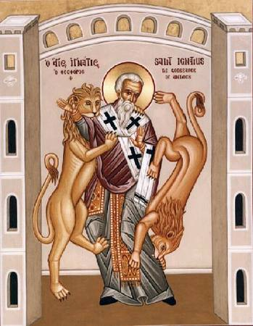
External Evidence
Evidence from Martyrs
Numerous examples of people who were prepared to die because of their faith in the reliability and trustworthiness of the NT accounts
Ignatius (AD 70-110)
Elder of Antioch
Knew all of the apostles and was a disciple of Polycarp
Thrown to the lions in the coliseum at Rome
Conclusion: Had ample material and witnesses to discover scriptural reliability; his death supports the reliability of the Scripture (the NT documents) on which his faith rested
Notes:
We also have evidence from martyrs of the 1st century, extra-biblical Christian characters from history who went to their death proclaiming the very truths recorded in the NT.
Ignatius, an elder in Antioch, was imprisoned for his faith by the Romans. He knew all of the apostles and was a disciple of Polycarp’s. Ignatius was thrown to the lions in the coliseum because his faith in the message of the NT was just so sure.

Slide 43
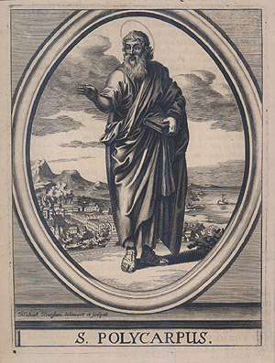
External Evidence
Evidence from Martyrs
Numerous examples of people who were prepared to die because of their faith in the reliability and trustworthiness of the NT accounts
Polycarp (AD 70-156)
Disciple of John and martyred at 86 years of age
He was burned at the stake
Conclusion: His death demonstrated his trust in the accuracy of the NT as he certainly had ample contacts to know the truth
Notes:
Polycarp, who we’ve mentioned a couple times already, was a disciple of John’s and they martyred him when he was 86 years old. Polycarp was burned at the stake, but before he was killed, it is said that his arrestors allowed him an hour to pray and were so touched by the fervency of which he prayed that many of them regretted arresting him and were converted to Christianity. As they were about to burn him alive, they asked him to recant his faith. He said, “86 years have I served Him and He has done me no wrong. How can I blaspheme my King and Savior?”

Slide 44
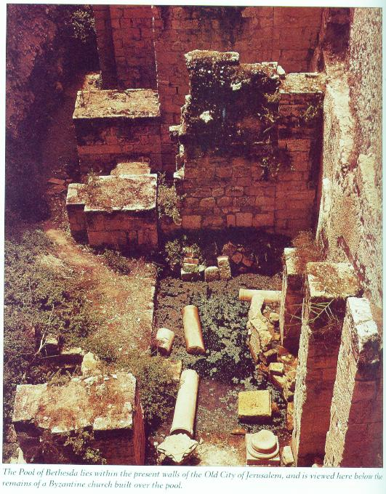
External Evidence
Archeology
Pool of Bethesda (John 5:1-15)
Found 40 feet underground
Archaeologists discovered a pool with five porticoes
Description of the surrounding area matches John's description.
Notes:
And the finally, there are numerous archeological discoveries that provide excellent secondary collaboration to the NT account.
The pool of Bethesda from John 5 has been uncovered in Jerusalem some 40 feet below the ground and you can visit it today as well as see the five porticoes that make it up

Slide 45
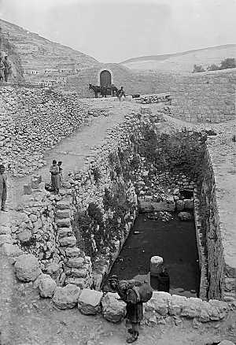
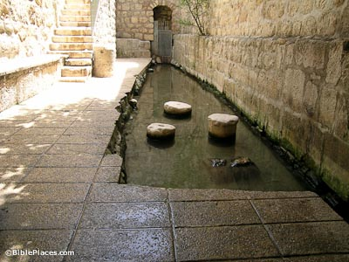
External Evidence
Archeology
Pool of Siloam (John 9:7)
Discovered in 1897
http://www.bibleplaces.com/poolofsiloam.htm
Notes:
The pool of Siloam of John 9 was uncovered in the late 19th century and while it was originally occupied by the Muslims has now been completely restored.

Slide 46
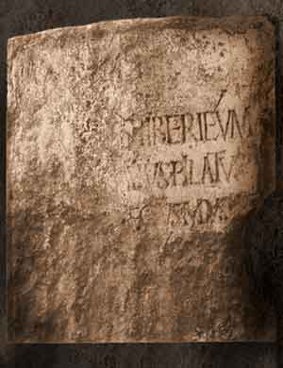
External Evidence
Archeology
Pontius Pilate
In 1961, an Italian archaeologist named Antonio Frova uncovered a fragment of a plaque that was used as a section of steps leading to the Caesarea Theater:
Line 1: TIBERIEUM
Line 2: (PON)TIUS PILATUS
Line 3: (PRAEF)ECTUS IUDA(EAE)
Translated: Joan E. Taylor translates the inscription as: “Pontius Pilate, Prefect of Judaea, [made and d]e[dicated] the Tiberieum for the (Augustan) gods”
Notes:
In 1961, an archeologist uncovered a fragment of a plaque that was used as a dedication to Caesar by none other the Pontius Pilate himself. The inscription reads, “Pontius Pilate, prefect of Judea, made and dedicated the Tiberium for the Augustan gods.” Before this discovery, many skeptics denied Pilate ever existed. Like many other times, this archeological find silenced them.

Slide 47
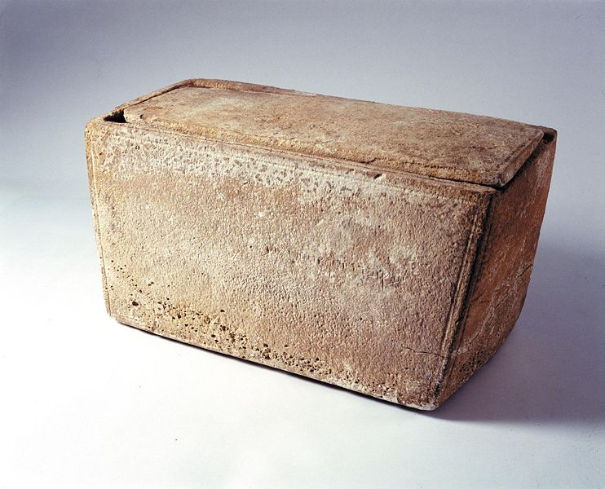
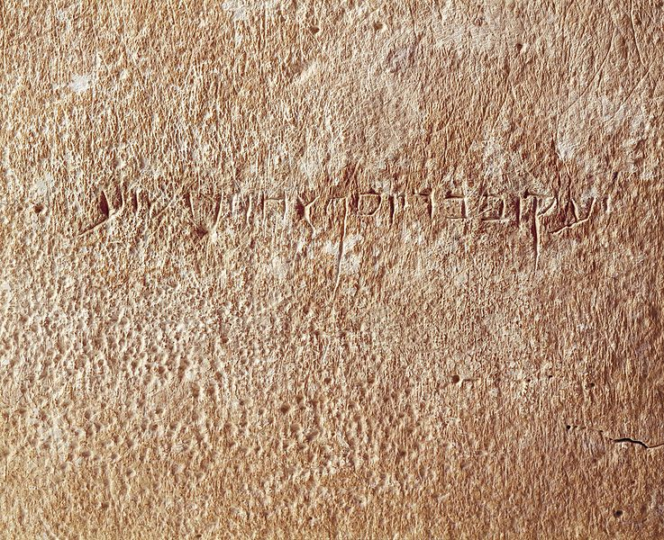
External Evidence
Archeology
James Ossuary
Existence of the ossuary was announced on October 21, 2002
Aramaic inscription “Ya'akov bar-Yosef akhui diYeshua” is cut into one side of the box
English translation: "James, son of Joseph, brother of Jesus"
Notes:
This is a picture of an ossuary that was discovered in 2002 with an inscription in the side when translated to English says, “James, son of Joseph, brother of Jesus”

Slide 48
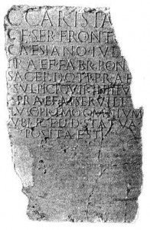
External Evidence
Archeology
Roman Census (Luke 2:1-3)
Papyrus found in Egypt
Translation: “Because of the approaching census it is necessary that all those residing for any cause away from their home should at once prepare to return to their own governments in order that they may complete the family registration of the enrollment…”
Notes:
This is a papyri was discovered in Egypt that proves the Roman census mentioned in Luke 2:1-3 that brought Mary and Joseph through Bethlehem where she would give birth to Jesus. Many skeptics argued no such census ever existed prior to this discovery and were once again proved wrong.

Slide 49
Notes:
We have nothing to fear from the charges of critics who deny its authenticity. The evidence is just too overwhelming, too incredible, too rock solid. And I hope for all of us believers here tonight, it has been enough to strengthen our faith.

