Slide 1
Notes:
The Old Testament was completed 400 years prior to the birth of Jesus Christ. The first 5 books are called the Torah, or in Greek, the Pentateuch, and it chronicles the Creation, how sin entered into the world, the global flood, the culmination of the seed of Abraham into the nation of Israel prior to their occupation of Canaan. Then there are 12 books of history that tell of Israel’s conquest of Canaan followed by a cycle apostasy, the reigns of its kings, its captivity, and her return from captivity. There are 5 books of wisdom written in Hebrew poetic form and 17 books of prophecy predicting judgment, urging repentance, and offering hope through the coming Messiah.
The entirety of our Old Testament scriptures, from Genesis to Malachi, consistently and unapologetically refers to itself as the word of God.

Slide 2
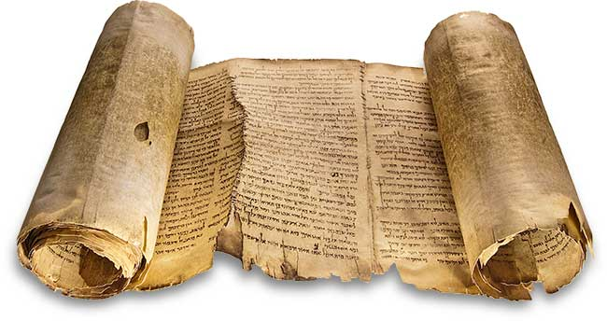
Reliability Of The
Old Testament
Notes:
But how do we know we can trust this document that makes up 73% of our bible? How do we know that this isn’t some made up story by a group of men with great imaginations who have nothing better to do than push their agenda upon the human race? How do we know that the text hasn’t been corrupted over time and that what we have in our hands is the actual inspired words of God as was originally recorded?
For tonight and next weeks study, we’ll look at both the reliability and the inspiration of the OT. By inspiration, we mean the fact that throughout the OT, we find the fingerprints of God. But this study will focus on the Old Testament as a reliable document of antiquity.

Slide 3
Testimony of Jesus
Confirmed arrangement
Luke 24:44 – “Now He said to them, ‘These are My words which I spoke to you while I was still with you, that all things which are written about Me in the Law of Moses and the Prophets and the Psalms must be fulfilled.’”
Confirmed Chronology
Luke 11:51a – “From the blood of Abel to the blood of Zechariah…”
Quoted From 24 of 39 Books
Confirmed Its Reliability
Matt 5:17-18 – “¹⁷Do not think that I came to abolish the Law or the Prophets; I did not come to abolish but to fulfill. ¹⁸For truly I say to you, until heaven and earth pass away, not the smallest letter or stroke shall pass from the Law until all is accomplished.”
John 10:35 – “…and the Scripture cannot be broken…”
Matt 4:4, 7, 9 – “It is written…”
Notes:
Jesus believed in the reliability of the OT documents. We haven’t yet considered whether or not Jesus Christ is someone whose testimony we can trust – that’s coming. But when we get to those lessons, it would be helpful for us to remember what He believed about the OT Scripture.
1) He confirmed the Jewish arrangement of the Old Testament scriptures – Luke 24:44 – What Jesus refers to are the 3 sections in which the Hebrew scriptures were ordered, the Law of Moses, which was called the “Torah”, the Prophets which they called the “Neviim”, and the Psalms/Writings which were called the “Kethubim”. Jesus confirms all 3 volumes and says everything within them must be fulfilled.
2) Jesus also confirmed the chronology of the Old Testament story – Luke 11:51a – Abel was the first martyr of the bible, killed by his brother Cain in Gen 4. Zechariah was murdered by Joash in the book of 2 Chron, the book which occupies the last place in the Jewish Canon. What Jesus is saying is from the “beginning to the end”. He is approving the chronology of the canon of the Jewish OT.
3) Jesus quoted from 24/39 books in the OT, whereas the NT as a whole quotes from 34/39 books. The books not quoted from were Ezra, Nehemiah, Esther, Ecclesiastes, and the Song of Solomon. But these books were part of “collections” of OT books which were quoted from. Someone might ask, “I’d feel better if He quoted from them all”, but we have to remember that there were a lot of things that Jesus did and said that are not recorded in the gospels. But by quoting from just one book in the collection, He verifies the entire collection.
4) Jesus declared the OT scriptures reliable – Matt 5:17-18 – In John 10:35, when Jesus contended with the Jews, he claimed the scriptures cannot be broken. In Matt 4, Jesus answered every temptation of Satan with the simple 3 words, “It is written”. If every single word was to come to pass in the OT, and if it could not be broken, and if He believed in the OT scriptures power to ward off the devil Himself, then Jesus believed the OT scriptures that existed during His time was authentic, reliable, and absolutely inspired. And anyone who comes along today and says differently is going to have to do so with evidence that is more compelling than the eyewitnesses who were there 2000 years ago

Slide 4
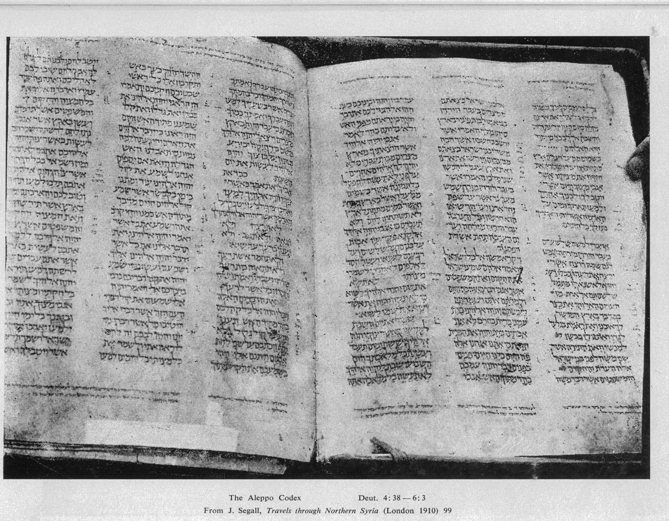
Textual Transmission
Notes:
Second, there is the transmission of the OT text. This picture is an OT manuscript called the Aleppo Codex, and prior to 1947, this was the oldest known OT manuscript we had in our possession. Now here’s what’s interesting – it’s from the 10th century AD. That was the oldest we had before 1947. So that is 900 years after Jesus was on Earth. Now, we can compare this text with our own and confirm it is the same. There’s no deviation other than the occasional scribal slip. But what about the 900 year gap between Jesus’ day and this copy here? How do we know that someone didn’t take it upon Himself to corrupt it or to change it? How do we know that during this 900 year gap, there weren’t so many scribal errors that it barely resembles what existed during the time our Lord? Let’s consider a couple reasons.

Slide 5
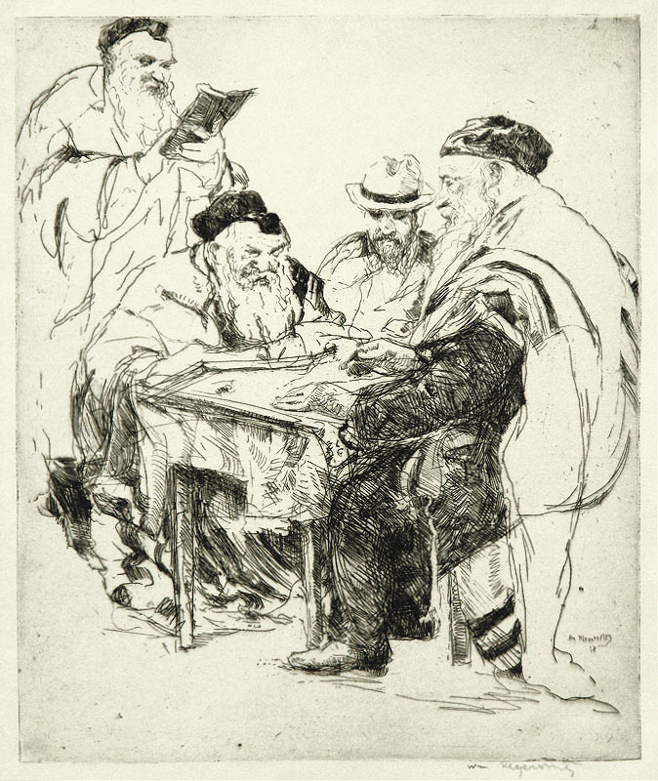
Textual Transmission
Talmudists (100–500AD)
Catalogued Hebrew civil & canonical law
Well known for their extraordinary discipline in transcribing Hebrew text
Notes:
Between 100 and 500 AD, there existed a group of Jewish Rabbis called the Talmudists. They were responsible for cataloging and transcribing Hebrew civil and canonical law. And they weren’t random individuals brought off the street; they were specialists and extraordinarily disciplined. To ensure the accuracy of their copies, the Talmudists concocted a list of rules to ensure that their copies of the OT scriptures were precise to the original.

Slide 6
Textual Transmission
Talmudist Rules:
A synagogue roll must be written on the skins of clean animals
It must be prepared for the particular use of the synagogue by a Jew
These must be fastened together with strings taken from clean animals
Every skin must contain a certain number of columns, equal throughout the entire codex
The length of each column must not extend over less than 48 or more than 60 lines; and the breadth must consist of thirty letters
The whole copy must be first-lined; and if three words be written without a line, it is worthless
Notes:
We won’t look at each rule in detail, so let’s just talk about a few that put in red Font – “Every skin must contain a certain number of columns, equal throughout the entire codex” – In other words, the same number of columns and the same number of rows on every page – a matrix. This would allow the copier to compare the first and last sentences and first and last letters of each sentence to ensure they were identical between copies

Slide 7
Textual Transmission
Talmudist Rules:
The ink should be black, neither red, green, nor any other color, and be prepared according to a definite recipe
An authentic copy must be the exemplar, from which the transcriber ought not in the least deviate
No word or letter, not even a yod, must be written from memory, the scribe not having looked at the codex before him
Between every consonant the space of a hair or thread must intervene
Between every new parashah (section) the breadth of nine consonants
Between every book three lines
Notes:
“No word or letter, not even a yod, must be written from memory, the scribe not having looked at the codex before him” – This would ensure that the copier would not rush the copy by assuming he knew it from memory, but would instead always rely on the previous copy.

Slide 8
Textual Transmission
Talmudist Rules:
The 5th book of Moses must terminate exactly with a line; the rest need not do so
The copyist must sit in full Jewish dress
He must wash his whole body
He must not begin to write the name of God ("YHWH") with a pen newly dipped in ink
Should a king address him while writing that name he must take no notice of him
Notes:
“The 5th book of Moses must terminate exactly with a line; the rest need not do so” – so based on the number of rows and columns they’d put on each page, by the time they finished copying the book of Deut, it would end exactly on a line, and in that way they would know that it was copied correctly
“The copyist must sit in full Jewish dress” – When I first started working from home a few years ago, I would typically get up in the morning and start working in my pajamas. But I found out it was harder to concentrate unless I took a shower, ate breakfast, and put on work clothes. This is the same idea. You’re copying holy scripture, get the mind ready by dressing the part.

Slide 9
Textual Transmission
Other notes:
Any roll in which these regulations were not observed were condemned to be buried in the ground, burned, or banished to schools to be used for reading books
When the Talmudist finished transcribing a manuscript, they were so convinced they had an exact duplicate that they would give the new copy equal authority
If both were equally correct, the older manuscript was at a disadvantage because it was more liable to become defaced or damaged in the lapse of time. A damaged or imperfect copy was at once condemned as unfit for use
Notes:
If any of these rules were not abided for any copy, the copy was discarded. But for all manuscripts where the rules were abided by, the new copies were actually given greater weight than the previous copy because it was less damaged.

Slide 10
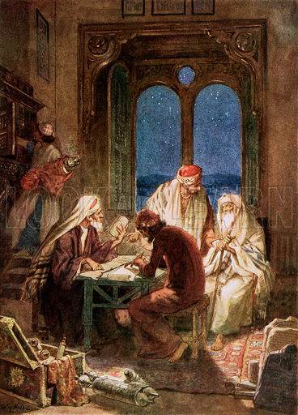
Textual Transmission
Massoretes (500–900AD)
Well-disciplined, treating the text with the greatest imaginable reverence
Devised a complicated system of safeguards against scribal slips
Notes:
Now after the Talmudists came the Massoretes, from 500 – 900 AD. The word “Massorete” comes from the word “tradition”, and these were scribes who accepted the job of copying the OT scriptures after the Talmudists. They even improved upon it in the sense that they added vowel points to the words in order to ensure proper pronunciation of the original text. And like the Talmudists, they treated the OT scriptures w/the greatest imaginable reverence by developing a system of safeguards to protect against slips of the pen.

Slide 11
Textual Transmission
Massoretes’ Rules:
Numbered verses, words, and letters of each individual book
Calculated the middle word and letter of each line
Enumerated verses which contained all the letters of the alphabet, or a certain number of them
Notes:
For example, they counted the number of times each Hebrew letter occurred in every book. They knew the middle Hebrew letter of the Torah as well as the middle Hebrew letter of the whole Hebrew bible. They knew the number of verses, the number of words, and the number of each letter in each individual book and would use this to compare to the previous copy as a sort of checksum. Now some might consider this overkill, but it shows the respect that they had for the scriptures and that like Jesus before them, they determined that not the smallest letter or stroke would be lost.
Point: If these scribes abided by their own rules, we can have confidence that the OT scriptures between the time of Jesus’ day and the Aleppo Codex of the 10th century are the same. But can we be sure?
Is there a way we can be sure? I mentioned earlier that the Aleppo Codex was the oldest OT manuscript we had prior to 1947. What happened after that?

Slide 12
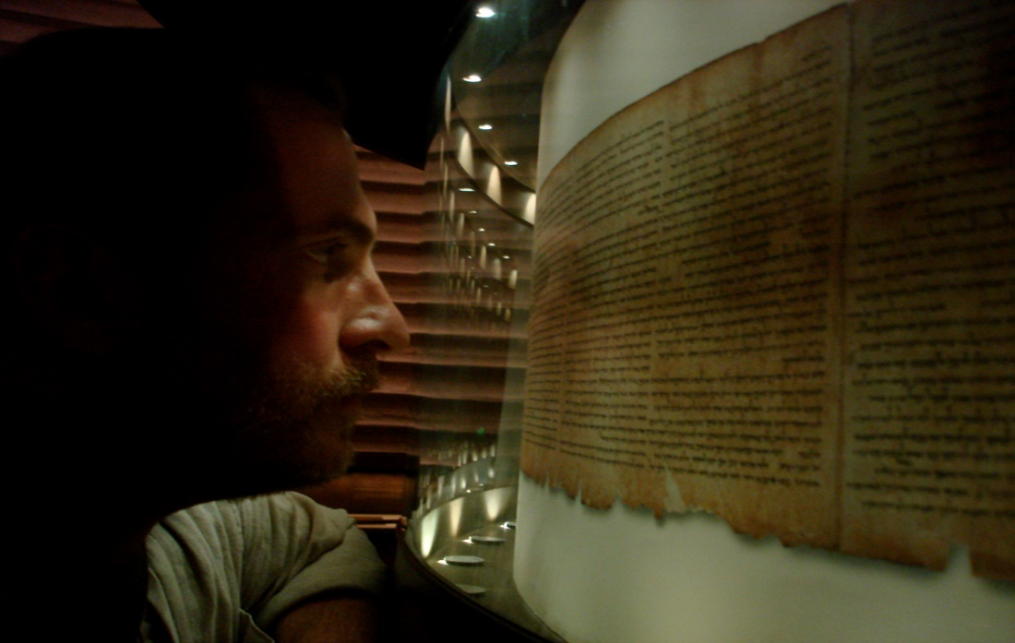
Archeology
Dead Sea Scrolls
Discovered OT manuscripts dating back to 400BC
1000 years older than previous known manuscripts
2 complete scrolls of Isaiah found (dated 125 BC)
Proved Jewish transcribers credibility
Notes:
In 1947, the Dead Sea scrolls were discovered. And without question, the Dead Sea scrolls was the greatest biblical, archeological discovery of the 20th century. They were first discovered by a young boy who was searching for a lost goat by the caves of Qumran on the West Bank of the Jordan River near the Dead Sea. But now, 73 years later, we have found over 40,000 inscribed fragments and from these fragments more than 500 books of the OT have been reconstructed. Not only were some of these scrolls dated 1000 years prior to the Aleppo Codex, there were some dated to around 400BC. But the most important ones found were two complete copies of the book of Isaiah that have been dated to about the year 125BC (palaeography is the study of old handwriting). This is significant because no book in the OT contains more prophecies about Jesus Christ than the book of Isaiah, and these two scrolls are dated to 125 years before His birth. So, guess what we found out when we compared the Dead Sea scrolls with the Aleppo Codex? They are 95% identical. The 5% error are made up of scribal slips of the pen and variations in spelling that are easy to distinguish and take nothing away from the meaning of the text. The Dead Sea Scrolls prove the credibility of the Jewish transcribers who copied these manuscripts during the first 1000 years after Christ. And this is exactly why we know we have the exact same OT that Jesus had during His time on Earth.

Slide 13
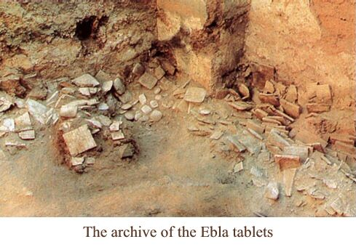
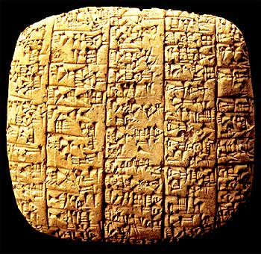
Archeology
Ebla Tablets
17,000 tablets discovered in 1974 in northern Syria
Recorded laws, customs, events from same era as Abraham and Moses
Proved written language existed at least a 1000 years before Moses
Mentions biblical cities: Sodom, Zeboim, Admah, Hazor, Megiddo, Salem (Jerusalem), and Gaza
Notes:
Archeology has become a seemingly never-ending witness to the reliability of the OT. For years, one of the skeptics’ biggest arguments was the claim that written language didn’t exist during the time of Moses. So they would say that that means the early books of the bible could not have been written by Moses, but would have been written hundreds of years later well after the time periods they record, which, according to them, should lead us to question their veracity. And I mean it when I tell you that this argument was the skeptics’ sacred cow for decades.
But, in 1974, over 17,000 clay tablets were discovered in Northern Syria in the ancient site that was known as Ebla – so these tablets are called the Ebla tablets. These tablets have been dated as far back as 2300BC – this is well before the time of Abraham, proving that there was written language of Mesopotamia in the 3rd millennia BC. They mention biblical names and places – Sodom and Gomorrah is mentioned. They speak of a priestly king ruling a city called Salem, which could be Melchizedek. It also possibly mentions the existence of the man Eber, from Gen 10, Noah’s great, great grandson and from where we believe the word “Hebrew” derives. This discovery was a deathblow to skeptics who for so long leaned on the “no written language” argument for decades.

Slide 14
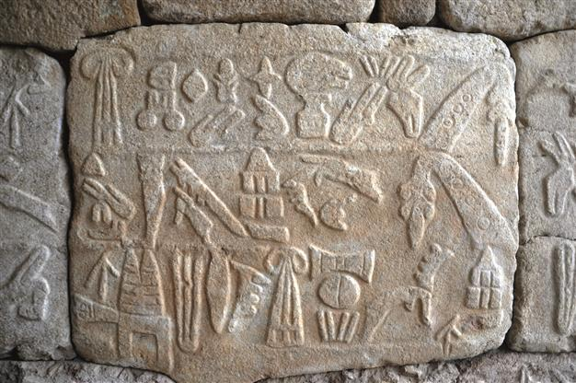
Archeology
Hittites
Once radically claimed by critics to be a myth and infallible proof for the inaccuracy of the OT
Archeology has now discovered over a 100 finds overlapping 1200 years of Hittite history
In some universities, you can get a degree in Hittite History
Notes:
In the OT, we read about a nation known as the Hittites. They played a major role in Israelite history and was one of the nations that God told Israel to conquer in Canaan. But before the 20th century, there was no secondary archeological evidence or historical writings outside of the OT proving this nation ever even existed. So, naturally, skeptics scorned the OT record and insisted that the absence of secondary evidence proved that the bible story was fabricated. However in 1906, an archeologist by the name of Hugo Winkler excavated an ancient site in Turkey and uncovered a bunch of Hittite artifacts – 5 temples, sculptures, and even a fortified castle. But the biggest discovery was a huge storeroom filled with over 10,000 clay tablets. Over time, they were able to decipher these tablets and confirm it was the Hittite capital of the ancient world. So abundant were these findings, you can actually get a graduate degree in Hittite studies at the University of Chicago.

Slide 15
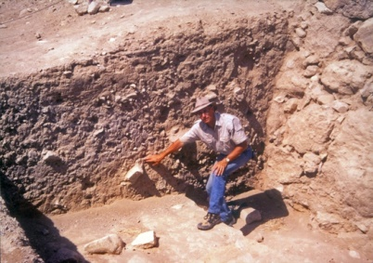
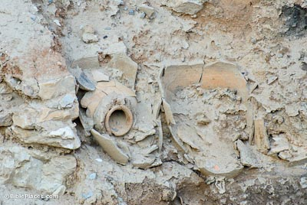
Archeology
Jericho
Excavation uncovered evidence that the walls fell outwardly
A thick layer of soot was discovered at the site indicating that the city was destroyed by fire (Josh 6:24)
Archaeologists found large amounts of grain. This is again consistent with the biblical account that the city was captured quickly
Notes:
And then there is the uncovering of the city of Jericho from Joshua 6. The story is epic. Joshua tells us that when Israel surrounded Jericho, they marched around it 13 times and, as we sing, the walls came tumbling down, at which point the Israelites went up into the city, killing every inhabitant and burning it to the ground. Excavations carried out at the sight have uncovered remarkable evidence that collaborates the biblical account.
They found that the walls had indeed fallen outwardly rather than inwardly as would have been the case had the city been taken by siege. But these walls fell outwardly and the excavations uncovered the fact that it created a ramp that the Israelites used to go straight up into the city.
They also uncovered large stores of carbonized grain within the pots found in the ruins. Why is this important? Because when a city was taken by siege, as was common in that time, the purpose was to starve out the inhabitants so that in their hunger they would surrender. So in a typical siege, there would be no food left by the time the enemy conquered the city. But they found an enormous amount of food at this site which proves that the city was taken quickly.
Also, the evidence was irrefutable that the city had been burned. They found walls and floors that had been blackened by fire and thick layers of soot.
We could spend an enormous amount of time simply looking at archeological discoveries that collaborate the OT record. The findings we do have continue to pile up and prove beyond a shadow of a doubt that the men who recorded these stories were doing so based on real events.

Slide 16
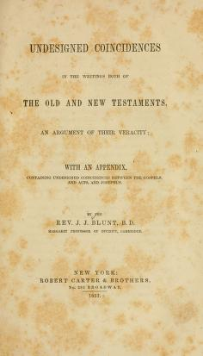
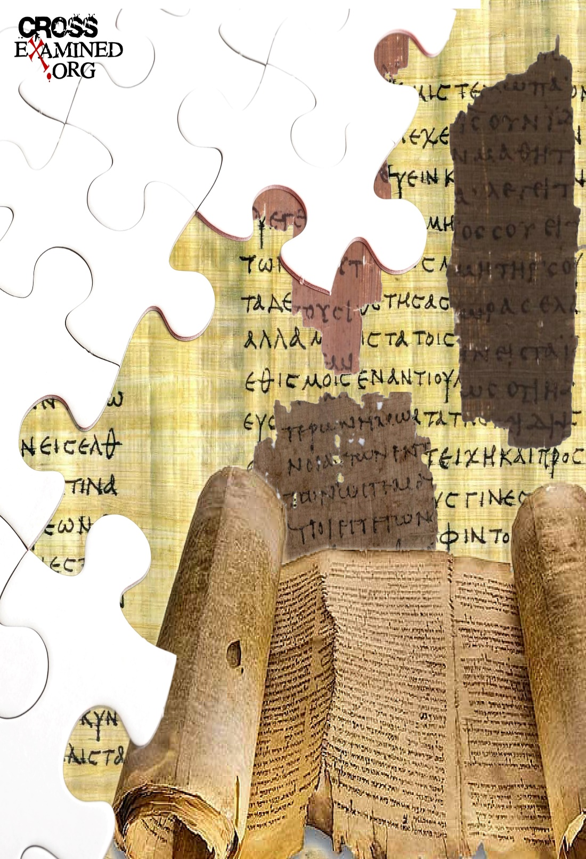
Undesigned Coincidences
Notes:
In 1869, author J. J. Blunt wrote a book entitled “Undesigned Coincidences” in which he attempted to provide credibility for the reliability of God’s word by alluding to evidence in the text that was hidden in plain view. An undesigned coincidence is when you have a notable connection between two or more accounts in scripture, that doesn’t look planned, and is usually very incidental. Yet one account helps to answer some natural questions raised by the first account, filling in the gaps of a puzzle.
See, when we read the bible, we’re introduced to a variety of historical, factual claims based on current events that the writer would have assumed their present-day readers knew about. So one writer may mention in passing a detail that then leaves some open-ended questions, but another writer comes along mentioning another detail just in passing that answers those questions. And that guy left out details too that was answered by the first guy.
These “undesigned coincidences” are exactly what we’d expect to find in accurate eye-witness testimony, and they support the reliability of both OT and NT. And it’s amazing just how widespread they really are.

Slide 17
Undesigned Coincidences
Ahithophel Betrays David:
1 Chron 27:33 – “Ahithophel was counselor to the king; and Hushai the Archite was the king’s friend.”
2 Sam 16:23 – “Now the advice of Ahithophel, which he gave in those days, was taken as though one inquired of the word of God; so was all the advice of Ahithophel regarded by both David and Absalom.”
2 Sam 15:12a – “And Absalom sent for Ahithophel the Gilonite, David’s counselor, from his city Giloh, while he was offering the sacrifices…”
2 Sam 23:34 – “Eliphelet the son of Ahasbai, the son of the Maacathite, Eliam the son of Ahithophel the Gilonite”
2 Sam 11:3 – “So David sent servants and inquired about the woman. And someone said, ‘Is this not Bathsheba, the daughter of Eliam, the wife of Uriah the Hittite?’”
Notes:
One the seemingly greatest mysteries in the OT was Ahithophel’s betrayal of David. 1 Chron 27:33 informs us that Ahithophel was David’s counselor and 2 Sam 16:23 tells us why – “the advice of Ahithophel…was taken as though one inquired of the word of God”. Ahithophel was a longtime counselor to David, which means he was a trusted friend. And yet, when Absalom begins to gather conspirators for usurping the throne, one of the men he approaches to help him is Ahithophel. And after they successfully oust David from the throne, Ahithophel is the one who gave Absalom advice to strengthen his cause by laying with all of David’s concubines. And he also gave great advice to Absalom that the best time to kill David is immediately, while he’s on the run and weary, though Absalom doesn’t take his advice. The text actually never explicitly tells us why one of David’s closest advisors turned on him so viciously, puzzling many bible students.
But then later on in 2 Sam 23, when all of David’s mighty men are being chronicled in a text completely unrelated to Absalom’s rebellion, we learn in 2 Sam 23:34 that one of David’s mighty men was named Eliam and he was Ahithophel’s son. Then 2 Sam 11:3, when David first spots Bathsheba and inquires who she is, we learn that Bathsheba was the daughter of Eliam. Think about this. David would later have Bathsheba’s husband killed, Ahithophel's granddaughter’s husband mercilessly killed, to cover his sin. When you put these pieces together, in starts to make sense why Ahithophel was so angry with David; he had likely been suppressing his anger for years, burning with resentment and bitterness at David for what he had done to his granddaughter and her husband Uriah. So from Ahithophel’s perspective, with the rebellion of Absalom comes an opportunity for revenge.
Only by putting together different, seemingly unrelated parts of the text are we then able to arrive at this explanation, because nowhere in scripture does it explicitly spell out that Ahithophel was the grandfather of Bathsheba.
Point: this is not the sort of thing one would expect in stories of myth and legend. Rather, it is the hallmark of truthful testimony.

Slide 18
Undesigned Coincidences
The Revolt of Libnah:
2 Kings 8:20-22 – “²⁰In his days Edom broke away from the rule of Judah, and appointed a king over themselves. ²¹Then Joram crossed over to Zair, and all his chariots with him. And he got up at night and struck the Edomites who had surrounded him and the captains of the chariots; but his army fled to their tents. ²²So Edom has broken away from Judah to this day. Then Libnah broke away at the same time.”
Josh 21:13 – “So to the sons of Aaron the priest they gave Hebron, the city of refuge for the one who commits manslaughter, with its pasture lands, Libnah with its pasture lands”
2 Chron 21:10 – “So Edom revolted against Judah to this day. Then Libnah revolted at the same time against his rule because he had abandoned the Lord God of his fathers.”
Notes:
Another example is given in a seemingly obscure text in 2 Kings 8. After the death of Jehoshaphat, his son Jehoram became king and despite Jehoshaphat’s faithfulness to God, Jehoram was one of the most wicked kings to ever reign. A large part of this wickedness had to do with the fact that Jehoram married Ahab and Jezebel’s daughter Athaliah. So when he became king, to ensure no uprisings and to cement his throne, he murdered every single one of his brothers and he also allowed Baal worship and all other kinds of idolatry to infiltrate Judah. And don’t you know that if Jehoshaphat had known Jehoram would one day kill all his sons, he would have never allowed the wickedness of Ahab and Jezebel to infiltrate his family. But God punished Jehoram all throughout his 8 year reign and one way he did it was by allowing Edom to break its subjection from the house of David. But an interesting little detail is given in 2 Kings 8 22 which tells us that while Edom broke away, so did Libnah. And it seems so incidental, such a random statement of fact with no context behind it.
So what was the city of Libnah and why should we care that they broke away too? Josh 21:13 tells us it was one of the cities for refugees that was given to the Levites. It was a priestly city just southwest of Jerusalem. And in 2 Chron 21:10, it gives us more context. Libnah revolted from Jehoram because Jehoram revolted against the Lord. And if you remember what happened later after Jehoram is dead and Athaliah usurps the throne, this fact about Libnah provides additional context as to how Jehoida the priest was able to rally the Levitical priests together to declare young Joash king and to kill Athaliah – because despite Jehoram turning Judah away from the Lord, much of the priesthood stayed true and were waiting for the opportunity to restore David’s seed to the throne.
We’ve noticed these kinds of things in the bible for years, but when you see it occurring in what appear to be very minor, parenthetical points, it speaks of consistency and reliability of testimony. We would not expect to find things such as this if this was fabricated material. Also, these kinds of details wouldn’t be expected if they were meant to be noticed. It would be difficult to prove that these passing comments are only coincidences.
So when the undesigned coincidences are all taken together as a cumulative argument, it builds a solid case for the bible’s reliability. Or as someone else put it, it’s the death of biblical skepticism by a thousand mosquito bites.

Slide 19
Notes:
The OT is no ordinary collection of books. It is historically accurate and after all these years that it has been around, isn’t it amazing that it has been preserved with the accuracy that it has? But this too was no accident. God had every intention of seeing to it that His word would always be available for mankind to have access – Isa 40:8
This lesson simply provides evidence for the OT’s reliability. What evidence do we have that it is inspired? This will be the subject of the next lesson.

