Slide 1
Notes:
Psa 19:1-4 – What David is saying is that Creation by itself points to a Creator. And not only that, it displays His glory and magnificence and tells us about His work. He says that despite the fact that Creation cannot speak with words, it still has a message for every person that walks this Earth, and that message is, “There is a God”.

Slide 2
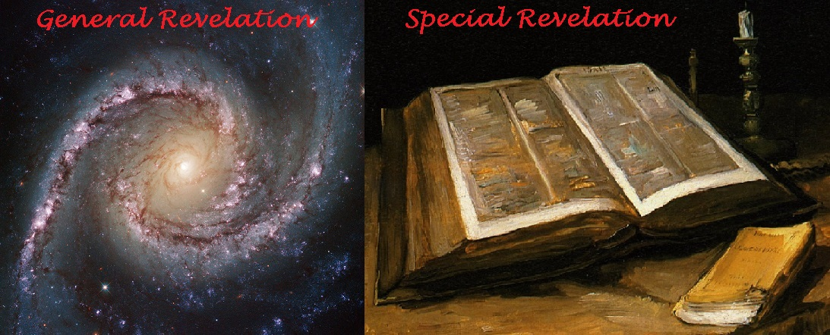
Notes:
This is what we call General Revelation. General Revelation is the knowledge we can gain about God merely by observing nature, existence and design, as well as observing ourselves, the moral law within us all.
Special Revelation is what has been recorded for us about God in words. And if God is behind a specific revelation about Himself, we would expect to find consistency between that which is written as well as that which we can observe in nature.

Slide 3
General Revelation
What does a house reveal about the owner?
Organized?
Clean?
Religious?
Favorite color?
Married?
We can learn general truths about God from the “house” he has built
Notes:
Reviewing General Revelation:
When we walk into a person’s house, someone whom we’ve never personally met, and we look around, what are the kinds of things we can learn? First of all, we can tell how clean the person is. Are they organized and neat or are they dirty and messy? We can generally tell if someone is religious or not just by walking in their house. Are there pictures hanging on the wall of bible verses or commentaries on their book shelves? How about their favorite color? Are they married? Are they animal lovers? And the list goes on and on. We make these judgments all of the time and they’re not far-fetched judgments.
And so here we are in God’s house/domain, having never met Him before. Being in His domain, are there not things we can know about Him?

Slide 4
General Revelation
Our Designer has a purpose
Every design has a reason
We don’t always know the purpose, just that there is a purpose
Part of the purpose has to do with us, God’s greatest design
Notes:
First, I believe we can logically and plausibly conclude that our creation was no accident and that we are in fact here for a purpose. That’s what design reflects – purpose. In other words, for our universe to contain the irreducibly complex structures and its vast amount of information to create and sustain life, we know from general revelation alone that our being here is no accident. We don’t necessarily know what that purpose is from general revelation alone, just that there is a purpose and we are a huge part of that purpose.

Slide 5
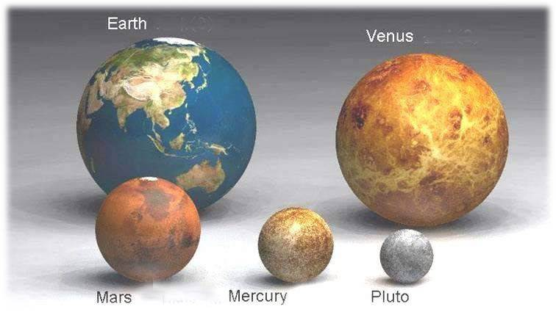
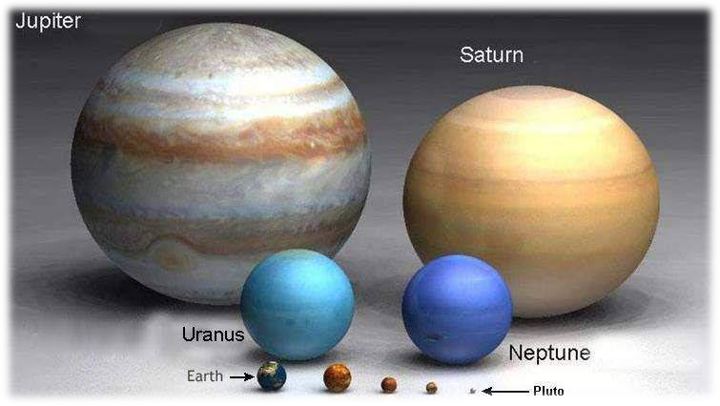
General Revelation
God is Powerful
Infinitely powerful
Hurricanes, tsunami’s, earthquakes, tornados, floods, wild fires, etc.
Power seen through what He created and also through what He sustains
This power is not inhibited by any of His creation
Notes:
Secondly, we can logically and plausibly conclude from existence that God is infinitely powerful beyond anything we can comprehend. Now this should be obvious just from what we see and experience from our planet as we experience such things as hurricanes, tornadoes, tsunamis, earthquakes, and floods. But also consider our planet Earth relative to other celestial bodies within our galaxy as well as our universe. Compared to other planets such as Venus, Mars, Mercury, and Pluto, our planet Earth is quite large. But then compare Earth to other planets in our solar system such as Jupiter, and we can see that we’re not as big as we think we are.

Slide 6
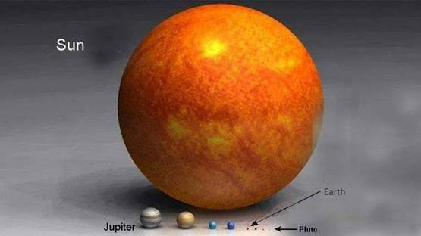
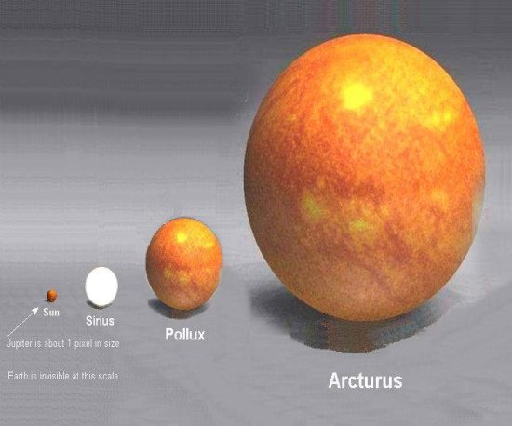
General Revelation
God is Powerful
Infinitely powerful
Hurricanes, tsunami’s, earthquakes, tornados, floods, wild fires, etc.
Power seen through what He created and also through what He sustains
This power is not inhibited by any of His creation
Notes:
But now look at how big our planet is compared to the sun. Look how small even Jupiter is to the sun. We look like just a speck, don’t we? Yet our sun is actually one of the smaller stars in our galaxy. Arcturus is much, much larger than our sun.

Slide 7
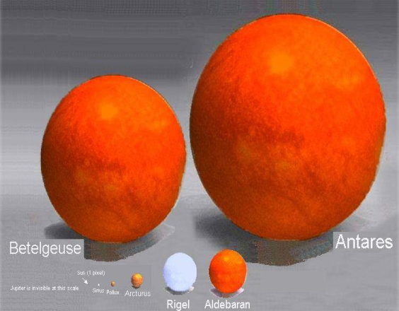
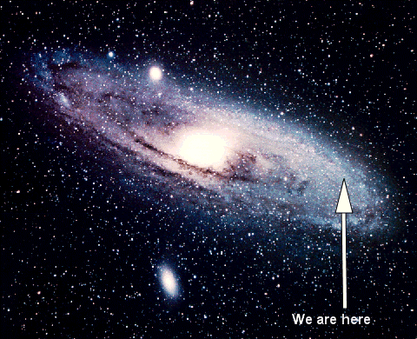
General Revelation
God is Powerful
Infinitely powerful
Hurricanes, tsunami’s, earthquakes, tornados, floods, wild fires, etc.
Power seen through what He created and also through what He sustains
This power is not inhibited by any of His creation
Notes:
And even Arcturus is but a speck compared to stars in our galaxy like Antares. And this is just our galaxy by itself. Astronomers claim there are more than a hundred billion galaxies in our universe. This means that the God who created us and sustains us, that singular uncaused Cause that led to this event we call our universe is infinitely powerful and it is not a power that can be inhibited by His creation. It is a power that demands the utmost humility and reverence on our part as we take it all in and see it for the marvelousness that it is.

Slide 8
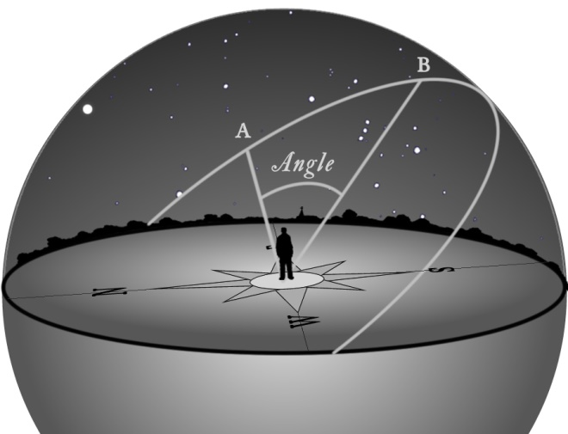
General Revelation
God is infinitely intelligent
The universe is the most advanced, complicated, and perfect system
Einstein - “…there is always some equation at the root of it all and if these equations did not work out as they do then the universe would not be able to function. Gravity is the weakest natural force in this universe and yet it holds this same universe together. What if it was stronger? Matter is able to contain an incredible amount of energy but what if it didn't? What use would the sun be then?”
This endless stream of perfectly coordinated laws convinced the best-known thinker of all time that the universe had to have been carefully composed by an intelligent God.
Notes:
Third, the great power behind our universe demands a great intelligence behind it all. We’ve discussed in prior lessons that our universe is balanced on a razor’s edge and that if some of these dimensionless constants were tweaked even just a little bit to the right or left, our universe could not sustain life.
Albert Einstein made a very acute observation about this – “There is always some equation at the root of it all and if these equations did not work out as they do then the universe would not be able to function. Gravity is the weakest natural force in this universe and yet it holds this same universe together. What if it was stronger? Matter is able to contain an incredible amount of energy but what if it didn't? What use would the sun be then?” It was this observation that led one of the greatest thinkers of our time to rationally conceive that our universe was carefully composed by an intelligent God.

Slide 9
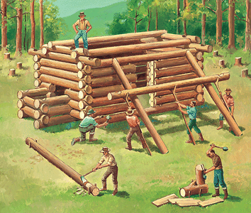
General Revelation
God is good
Rain and sunshine for food
Companionship
Shelter (wood and stone)
Seasons
Notes:
And then fourth, we can determine through General Revelation that our Creator is good to us. He gives us the sun, the rain, and the seasons, all perfectly coordinated to provide us with the food and substance we need to sustain our lives, along with a great variety of it. He gives us relationships with one another so that we can express His goodness towards others such as our family and our friends. He gives us all the building blocks we need for shelter in wood and stone and sand so that we can be comfortable. This is the short list.

Slide 10
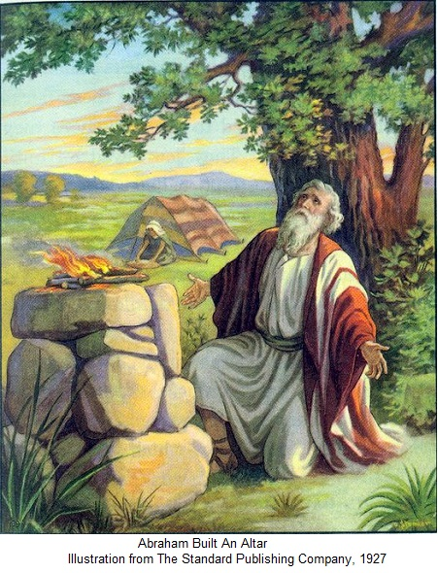
General Revelation
God is Good
Since He is good, He must detest what is not good
Else our conscious wouldn’t sting when we do wrong
Since we mostly find ourselves doing wrong, we have cause to fear God
Primitive cultures understood this (sacrifices)
Conclusion: God is the one Person we most need and the one Person we should be most afraid of
Notes:
But because He is good, as we have reasoned before, that means by definition that He must detest what is not good. Or else, why would our conscience sting so much when we go against what is wrong? And since we find ourselves doing so much wrong in this life as a result of our selfish choices, coming face to face with the goodness that is God should also be something in which we fear. Even primitive cultures understood this fear and this need to placate what they believed to be their creators even if they were off. Or else, why were there sacrifices offered in virtually every culture? And so because of the goodness of God, we can reason that our Creator, God, is the one Person we most need in our lives and yet the one Person we should fear above all else.

Slide 11
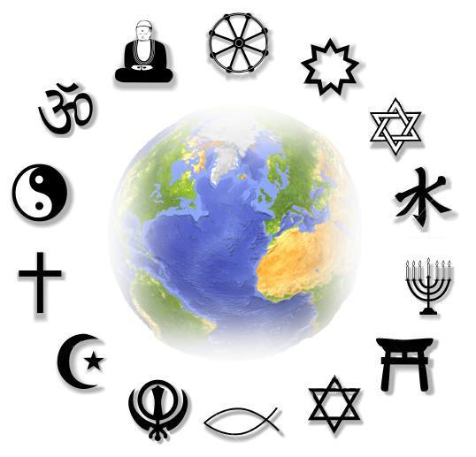
Specific Revelation
Where do we start?
Conflicting religions
Conflicting doctrines
Conflicting authorities
Conflicting literature
Conflicting popularities
Conflicting testimonies
Is it possible to weed through it all to find the truth?
Notes:
Now this leads to a turning point. While we can learn quite a bit about our Creator through General Revelation, we cannot learn everything we need to know from it alone. And that is why so many skeptics have objections to some of the things I’ve already even brought up. Objections such as, “If God is truly good, why is there is so much suffering?” We can’t answer that question from General Revelation. And while we can conclude from General Revelation that God put us here for a purpose, we can’t conclude precisely what that purpose is. In other words, we need something more than General Revelation. We need something more detailed, precise, and specific.
Now for the longest time, mankind has turned to and trusted in the bible as the source of Specific Revelation concerning our Creator and His purpose for mankind. But this is no longer the case, and I believe for two reasons.
First, there is conflicting literature and doctrine claiming to be what the bible, for the longest time has claimed to be, which has clouded the waters. And so with all of the competing religions and doctrines and authorities that are out there now, how do we weed through it all to find the truth? Or are they all the truth? That’s a fair question that deserves an answer.
Secondly, the last 100 – 200 years has seen the rise of secular humanism and critics who attempt to cast doubt on the authenticity and inspiration of the bible. And they use big words and philosophies that on the surface appear scholarly and intimidating, when in fact they’ve all been answered successfully in times past, because they’re the same recycled arguments we’ve been hearing for a hundred years.
But here’s the thing, despite all of this, there are plausible and rational reasons why the bible should be the very first place we turn to for more specific revelation. But let’s be clear: the purpose of this lesson is not to prove the authenticity and inspiration of scripture. Other lessons will prove this beyond a reasonable doubt. The purpose of this lesson is to show you why we should at the very least give the bible a fair hearing. So let’s start with the basics from which we’ll continue to peel back the onion.

Slide 12
Specific Revelation
#1 Best Seller
> 6 billion copies sold
2123 different languages
Perfect in Unity
66 Books: 39 OT + 27 NT
Written over 1500 years (1450 BC – AD 100)
40 different authors
From 3 different continents, different nations, and varying cultures
Contains 3 different languages (Hebrew, Aramaic, Greek)
No contradictions
Challenges us to test its message
Notes:
1) The bible is the number one best-selling book of all time, and I suspect it will stay that way for a long time. And a very probing question we need to ask ourselves is, “Why?” Why do so many people buy it and read it and memorize passages, and see the importance of applying its principles to their lives? We don’t do that with every day literature. Harper Lee wrote a great novel, “To Kill A Mocking Bird”; such a good story with a good message. But I don’t know a single passage from memory because as good as it is, it’s just never touched me in such a way that I’ve felt compelled to memorize it and meditate on it daily. I do have a couple Shakespeare passages memorized because I had to in school and some of them are quite catchy. But in the long run, I don’t care whether Hamlet is to be or not to be. There’s nothing about Hamlet’s conundrum that is going to change my life and make it better. But that isn’t the case with the bible. It has things to say that are rich and meaningful and vast, even as we recognize, while reading it, that it doesn’t pull punches when it comes to the mess that mankind has gotten themselves into regarding sin.
2) The bible is worth a serious hearing because of its extraordinary unity. It is not just one book, its 66 books gathered together into one volume. Now skeptics sometimes forget this when they accuse Christians of circular reasoning by using the bible to prove the bible. But it’s not one book. It’s a volume of 66 books. 39 books are in the OT and 27 books are in the NT. It was written over a period of 1500 years by more than 40 different authors from 3 different continents within a variety of cultures and in 3 different languages. And yet the overarching message and theme of all the books is consistent and thorough. Each book testifies to the legitimacy of the others. Suppose you had 40 scientists who over a long period of time, hundreds and hundreds of years, performed experiments and then when they were finished they compiled all of their results into one volume. We wouldn’t accuse them in their research of circular reasoning, they’re too disconnected from the other by separation of time and space. There is something about the utter unity and harmony of the bible that is so undeniable, that it depends ana thorough investigation.
3) The bible is unique in that it constantly calls on us to use our minds and reason objectively through its many truths while also constantly warning us to beware of the deceptiveness of our hearts. And this is what makes Christianity stand so different and so above other popular religions that employ more deceptive methods of conversion. For example, someone may ask, “Why should I consider the bible first and not the Koran? Both claim to be the word of God.” Now I could give you a plethora of reasons why the bible is far more superior than the Koran, and some of that will be evident in future lessons, because the evidence for the Koran is quite honestly embarrassing. But here’s one of the main reasons. Islam doesn’t convert through objectivity and never has. Islam converts people through intimidation and force and historically that has always been the case. Muhammed’s followers went throughout the fertile crescent like a wrecking ball of destruction and gave the people two options: convert to Islam or die. That’s all that Islam can do because its message and claims are fabricated nonsense. “Well than why don’t Muslims catch that?” Because they’re commanded by the Koran not to. “O ye who believe! Ask not questions about things which if made plain to you, may cause you trouble. Some people before you did ask such questions, and on that account lost their faith.” (Sur 5:101-102). There are several verses in the Koran just like that that want to deter Muslims from using the minds that God has given us to rationally and reasonably come to truth. Mormons do the same thing. A Mormon missionary will come to your house and when you ask for evidence on why they believe the Book of Mormon, they won’t give it. In fact, the more you study with Mormons, the more you realize that the concept of objective evidence is foreign to them. The book of Mormon says that if you want to know whether it is true or not, you need to put your hand on it and ask God and then He will send you a fire in your bosom. That’s not evidence-based faith that is reliable to confirm truth. It’s brainwashing. It’s a man-made feeling that you bring on yourself so you don’t have to feel left out when all your other Mormon friends claim to have experienced it. What I’m trying to say is that though Mormonism and Islam are the fastest growing religion in the world, neither bases its claims on objective evidence. But the bible does. It asks us to reason and to use our mind and to even test it. And those who have done this, sacrificing all biases and prejudices in the process, can testify that it’s worth giving a fair hearing.

Slide 13
Specific Revelation
Confirms truths we’ve already discovered
Confirms the 2nd law of thermodynamics
Psa 102:25-26 – “²⁵Of old You founded the earth, and the heavens are the work of Your hands. ²⁶Even they will perish, but You endure; and all of them will wear out like a garment; like clothing You will change them and they will be changed.”
God is a “someone” and not a “something”
Rom 4:17b – “God…who gives life to the dead and calls into being that which does not exist”
God is the one uncaused cause
Gen 1:1 – “In the beginning God created the heaven and the earth.”
Ex 20:11a – “For in six days the Lord made the heavens and the earth, the sea and all that is in them.”
Psa 90:2 – “Before the mountains were born or You gave birth to the earth and the world, even from everlasting to everlasting, You are God.”
Notes:
But here’s what’s really astonishing. The bible agrees with everything we talked about regarding existence, about intelligent design, and about the moral law. There are verses in the bible that confirms everything we derive from General Revelation just using logical deduction.
We’ve talked about the 2nd Law of Thermodynamics. A hot cup of coffee in a room is close system is always going to get cold. Available energy will always transfer to unavailable energy and not the other way around. And so in the universe we have all these hot cups of coffee called stars that are losing their available energy day by day and will eventually run out completely. And so we asked the question, “Who or what could have put this available energy in our universe in the first place? Who set the chain of events in motion where available energy is gradually becoming unavailable energy? Psa 102:25-26 – “Of old You founded the earth, and the heavens are the work of Your hands. Even they will perish, but You endure; and all of them will wear out like a garment; like clothing You will change them and they will be changed.” Now that verse may sound familiar because the Hebrew writer repeats it in Heb 1:10-11, as applied to our Creator Jesus Christ. Even the writers of scripture of 1000s of years ago understood what we call the 2nd Law of Thermodynamics, that though everything is winding down, Someone behind it is independent to its laws.
We also learned from General Revelation that in our physical, material world, there has never been something that has come from nothing – not in this universe. It has never been done in a laboratory and never can be done. Something always comes from something else. The bible teaches this, makes it very clear – Rom 4:17b – “God…who gives life to the dead and calls into being that which does not exist.” This verse isn’t saying that God is the nothing that brought this “something” called our universe into existence, it is saying that God is the something that brought about this physical world that once did not exist – in other words, something came from something.
We also learned from General Revelation about the Law of Cause and Effect and how every effect within our universe must have an adequate cause. Gen 1:1 – “In the beginning God created the heaven and the earth.” Ex 20:11a – “For in six days the Lord made the heavens and the earth, the sea and all that is in them.” And so the bible identifies God as the cause of this great effect we call the universe. But we also stressed that it has to be an adequate cause, a cause that is independent of the Law of Cause and Effect. Psa 90:2 – “Before the mountains were born or You gave birth to the earth and the world, even from everlasting to everlasting, You are God.”

Slide 14
Specific Revelation
Confirms truths we’ve already discovered
Intelligent Design
Psa 139:13-14a – “For You formed my inward parts; You covered me in my mother’s womb. I will praise You, for I am fearfully and wonderfully made”
Psa 104:24 – “O Lord, how many are Your works! In wisdom You have made them all; the earth is full of Your possessions.”
The Conscience
Gen 1:27a – “God created man in His own image.”
Rom 2:14-15 – “For when Gentiles who do not have the Law do instinctively the things of the Law, these, not having the Law, are a law to themselves, in that they show the work of the Law written in their hearts, their conscience bearing witness and their thoughts alternately accusing or else defending them.”
God Is Good
Acts 14:15-17 – “¹⁵Men, why are you doing these things? We are also men of the same nature as you, and preach the gospel to you that you should turn from these vain things to a living God, who made the heaven and the earth and the sea and all that is in them. ¹⁶In the generations gone by He permitted all the nations to go their own ways; ¹⁷and yet He did not leave Himself without witness, in that He did good and gave you rains from heaven and fruitful seasons, satisfying your hearts with food and gladness.”
Notes:
We also talked about the fact that there is so much complexity in the design of our universe that is so far above our intelligence, it screams of a Designer. There are things that occur on the biological level with such power and efficiency that we can’t replicate and produce no matter how hard we try. Psa 139:13-14a – “For You formed my inward parts; You covered me in my mother’s womb. I will praise You, for I am fearfully and wonderfully made”. Psa 104:24 – “O Lord, how many are Your works! In wisdom You have made them all; the earth is full of Your possessions.”
We also talked about our conscience, the fact that it seems like someone has put a standard of right and wrong within us and is trying to persuade us to act on what we know to be right. Gen 1:27a – “God created man in His own image”. Rom 2:14-15 – “For when Gentiles who do not have the Law do instinctively the things of the Law, these, not having the Law, are a law to themselves, in that they show the work of the Law written in their hearts, their conscience bearing witness and their thoughts alternately accusing or else defending them.”
We talked about how we can know from creation that God is good. This is the exact approach that Paul makes when evangelizing the idolaters of Athens to turn them away from their idols and to the true and living God. Acts 14:15-17 – “Men, why are you doing these things? We are also men of the same nature as you, and preach the gospel to you that you should turn from these vain things to a living God, who made the heaven and the earth and the sea and all that is in them. In the generations gone by He permitted all the nations to go their own ways; and yet He did not leave Himself without witness, in that He did good and gave you rains from heaven and fruitful seasons, satisfying your hearts with food and gladness.”

Slide 15
Specific Revelation
Confirms truths we’ve already discovered
The Bible & The Moral Law Agree
2 Cor 4:2 – “But we have renounced the things hidden because of shame, not walking in craftiness or adulterating the word of God, but by the manifestation of truth commending ourselves to every man’s conscience in the sight of God.”
Rom 3:23 – “ For all have sinned and fall short of the glory of God.”
Eccl 7:20 – “Indeed, there is not a righteous man on earth who continually does good and who never sins.”
Notes:
And then finally, we talked about the moral law. That within every single one of us there is a basic understanding of right and wrong. And this is a fact that is independent of all cultures and of all ages. The bible and the Moral Law are in complete agreement in all their moral teachings. “Can two walk together unless they be in agreement?” The Moral Law and the bible agree. And this fact conclusively proves that they both come from the same Author. 2 Cor 4:2 – “But we have renounced the things hidden because of shame, not walking in craftiness or adulterating the word of God, but by the manifestation of truth commending ourselves to every man’s conscience in the sight of God.” What does he mean by the second part of that verse? I think Paul means that when he revealed to mankind the great truths of the gospel, he made his appeal in such a way that it forced the approval of each man’s conscience. In other words, the truth commended itself as truth. And no person who hasn’t already seared his conscience can doubt its evidence. No person who understands the bible’s moral claims can dispute those claims. What truths are those? Supreme love toward God and equal love toward our neighbor. These are the two greatest commandments that Jesus tells us embody the entirety of scripture; and it is confirmed by our conscience.
In the bible, we have a book so perfectly in harmony with our conscience that it must come from the author of conscience. And so just as our conscience affirms we are often wrong, the bible teaches in Rom 3:23 that all have sinned and fallen short of the glory of God…Eccl 7:20 – “Indeed, there is not a righteous man on earth who continually does good and who never sins.”
If we have a document that goes as far back in history as the bible does and accurately confirms everything about God that I can already logically conclude from general revelation, why wouldn’t I give it a fair hearing? If it’s so popular as to be the #1 best seller of all time with no chance of losing this position, why would I not be curious about its message? And with the unmistakable unity and harmony that we find in this volume of work that is unlike any other, how can I not afford it a chance?

Slide 16
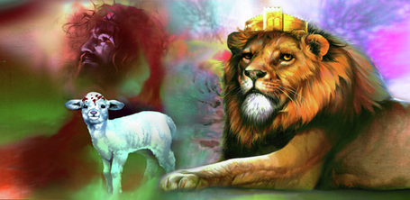
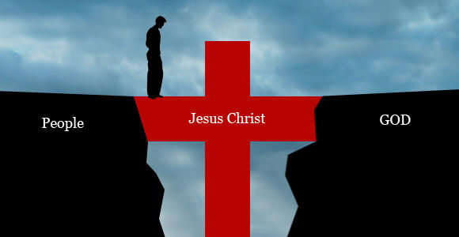
Specific Revelation
Notes:
See, the bible is an amazing book not just for what it confirms from general revelation, but because it answers all the questions I have about God as well as my purpose here on Earth. The bible answers the question of why there is so much suffering in this world. It describes for us God’s plan for how to deal with the sinfulness that we’ve brought up ourselves. Seeing the consistency between general revelation and the specific revelation that we call the bible is the key for us in coming to terms with who God is.

