Slide 1
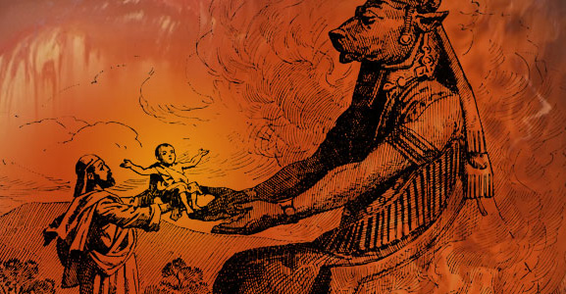
Is God Immoral For Killing
The Canaanites?
Notes:
Just prior to Israel’s occupation of the land of Canaan, God issues the following command relative to its current inhabitants. Deut 7:1-6 – Some of this had actually already taken place as Israel traveled north through the plains of Moab and into the Transjordanic region, and is recounted in Deut 2 & 3. Deut 2:32-34; Deut 3:3; Deut 3:6.
Was God immoral for killing the Canaanites? This is an older question and has been answered by many in bygone days, but modern day sensitivities brought on by, I believe, our present political climate has resurrected more interest in this topic. It’s difficult for some to wrap their mind around God’s actions in this story because they’re so used to hearing, “God is love”. And if that is the extent of your knowledge about God, to then read of Him commanding what looks like murder, that’s tough for some people. And it becomes more difficult when you consider the fact that God is commanding Israel, who are simply other sinful people, to perform this task. And if that isn’t difficult enough for you, we can make it tougher: why did He allow the killing of Canaanite women and children
This isn’t just a tough subject for skeptics; it’s tough for a lot of Christians. How could God command such a thing? Could there be more behind it? In answering this question, we’ll attempt to accomplish 3 things. We’ll be better prepared to answer the skeptic, perhaps clear up some areas of confusion for ourselves, and also inevitably glean additional insight into God and His character.

Slide 2
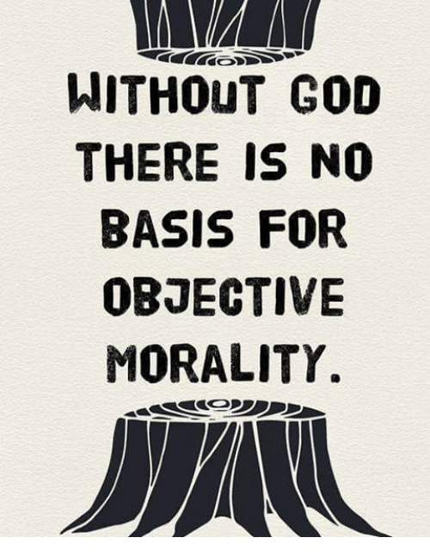
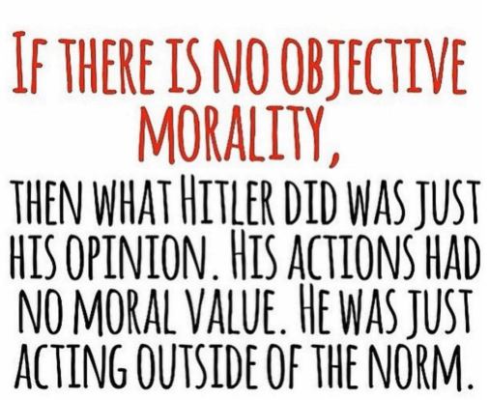
1) Where Do You Get Your Standard Of Morality?
Notes:
It is usually atheists who bring up this question as an attempt to not just discredit the bible, but to discredit the character of God. So when I’m dealing with an unbeliever, the first thing I find that is helpful is to kindly and humbly expose their fallacious reasoning. This isn’t to sidestep the question, it’s simply to first shed some light on how nonsensical their question really is because of the position they personally hold. Here’s what I mean: if what God commanded be done to the Canaanites is so immoral and so evil, by what standard are you, as an atheist, judging God? Because if there is no God, there is no objective morality and that means your disagreement over God’s handling of the Canaanites is simply just your opinion. “But he murdered people!” Well, why is murder so wrong? Who said it was wrong? Is that what you say? You’re the moral arbiter of the universe now?
You see the problem? This is a classic example of stealing from God in order to argue against God. More and more, you will find atheists stealing arguments from Christianity, attempting to make their case from a reality that only theism can explain. It’s contradictory. It’s an intellectual crime. You cannot steal what only theism can explain, such as an objective standard for morality, unless you believe there is a God.

Slide 3
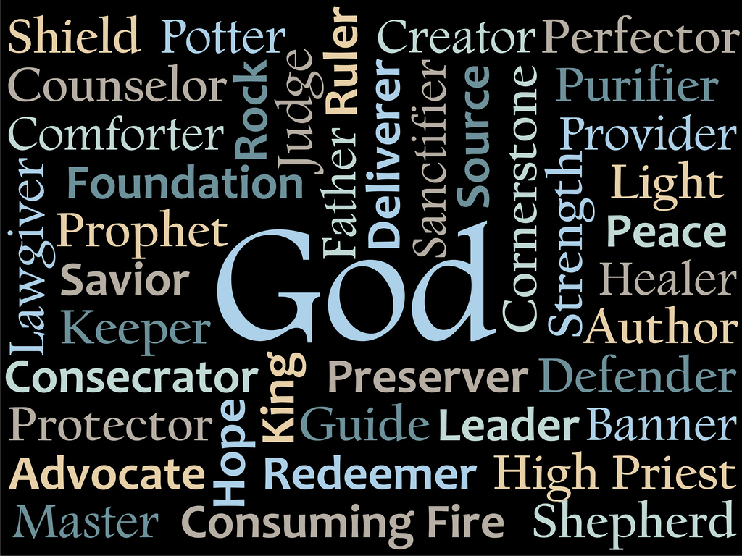
2) We Must Assume Everything We Know About God
Notes:
“Well, you believe God is a loving, moral God, so given that God exists, what then do you say about Him ordering the mass genocide of these people?” Ok, fair enough. But if we’re going to assume that God exists, we’re going to assume everything we know that has been revealed about Him rather than cherry picking specific attributes about God that I believe makes my case to the exclusion of other attributes. Because it is true that, “God is love”. But it is also true that He is a God of justice. “But God is peace.” Yes, but He is also a God of wrath. He is a God of patience and forbearance, a God of grace and mercy, He’s our shepherd and our shield, but He’s also a consuming fire, and the list goes on and on.
It’s a common tactic of the skeptic to try and take the idea of God and wrap Him up in a nice little subjective box of “love” and start cherry picking which of God’s decisions don’t appear to be loving enough. Nope, that’s not playing according to the rules. If we’re going to assume God, we’re going to assume everything we know about God, from the bible, not focusing simply on one attribute.

Slide 4
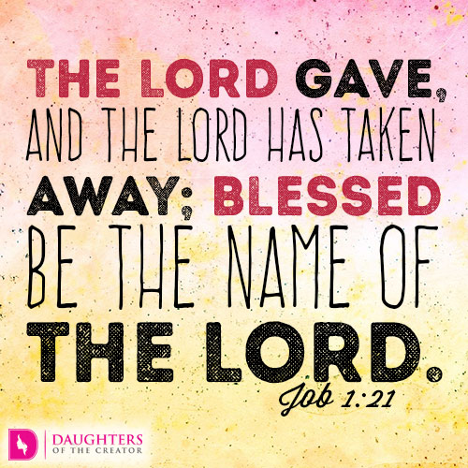
3) God Is Our Sovereign Creator
Isa 64:8 – “But now, O Lord, You are our Father, we are the clay, and You our potter; and all of us are the work of Your hand.”
Psa 24:1 – “The earth is the Lord’s, and all it contains, the world, and those who dwell in it.”
Psa 115:1-3 – “Not to us, O Lord, not to us, but to Your name give glory because of Your lovingkindness, because of Your truth. Why should the nations say, ‘Where, now, is their God?’ But our God is in the heavens; He does whatever He pleases.”
Notes:
So with that in mind, here is the first thing we need to understand about God, whether we like it or not, and it is this: God, as our Creator, has the sovereign right not only to freely give us life, but to take it whenever and however He chooses. And we could end the lesson right there with that one point, and God’s actions toward the Canaanites would be vindicated. “But that’s murder.” No, that’s not murder. Murder is the unjustified taking of life. God, as Sovereign Creator, is completely justified in taking lives that He has freely given whenever and however He chooses. He can give life whenever He chooses, He can take life whenever He chooses, and He can resurrect life whenever He chooses. He is God – Isa 64:8; Psa 24:1; Psa 115:1-3.
This is a difficult concept to grasp for a selfish, depraved world who has wholly given itself to self-indulgence. But it needs to be understood nonetheless. And so does the implication of this truth, and here it is: God owes us nothing. We owe Him everything, but He owes us nothing. If I were to drop dead right now, or if a gunman were to come into this building and light the place up and we lost men, women, and children, God has done us no wrong. Because God is not beholden to us or in debt to us. We’re sinners. We don’t deserve to die today, we deserved to die yesterday and go to hell. So the very fact that we are here and breathing is nothing more than absolute, wonderful, and indescribable grace. Because while God owes us nothing, He has given us everything. And should He decide to take away everything He has given us, He is still within His sovereign right to do so, and if He does, may our attitude be like Job’s – Job 1:21b
Bottom line is life is a gift, not a right, and its continuation ultimately depends on an appropriate relationship with its Creator whose nature is to our nature like fire is to stubble.

Slide 5
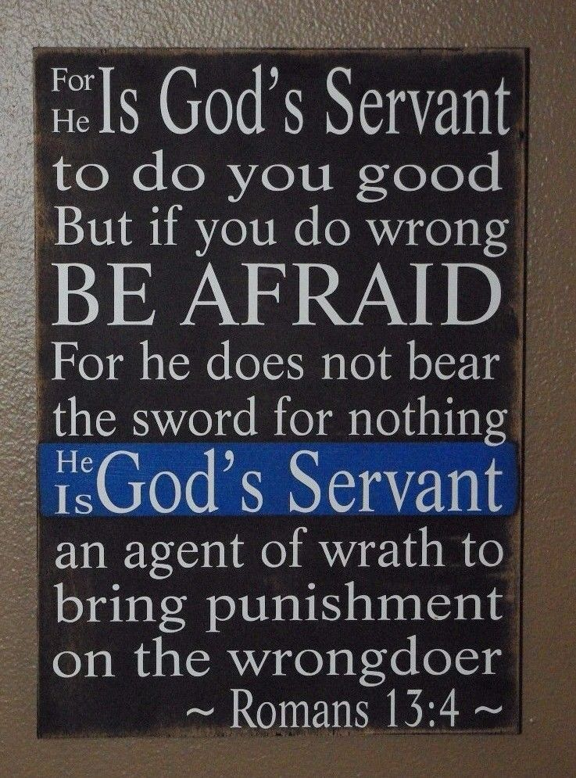
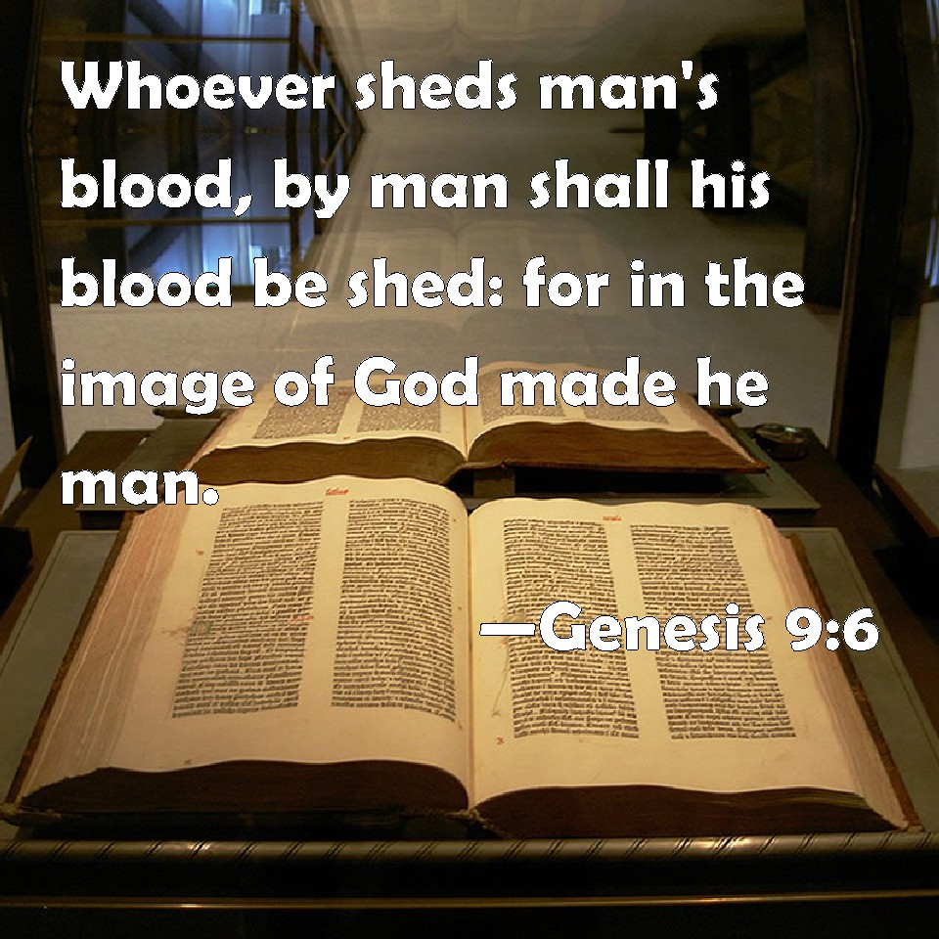
3) God Is Our Sovereign Creator
“Love your enemies…” – Matt 5:44a
“Pray for those who persecute you…” – Matt 5:44b
“Lord, do not hold this sin against them!” – Acts 7:60b
“Pursue peace with all men…” – Heb 12:14
Notes:
Now, God also, as Sovereign Creator, can command “the work of His hand”, someone like Joshua, to be the instrument of His judgment, which He did pertaining to Canaan’s descendants. At this time in the history of the OT, where Israel is His special chosen nation, He commands them to be instruments to execute judgment against blatant, long-lasting wickedness. This is similar to what we read in Rom 13, where we’re told in vs. 4 that the sword of justice has been given to government. Government has a right to take a murderer and either put him in jail or to kill him, and this idea, that we call capital punishment, is consistent with Gen 9 as well as with God’s character and His desire that we esteem so highly the sanctity of life.
But as the Lord’s church, we are not a political entity like Israel. The seed He was paving the way for at that time, Jesus Christ, has already come, died, been raised, and has ascended to God’s right hand where He rules. And so God has commanded us, under this new dispensation, to love our enemy, to pray for those who abuse us, not to kill to spread the gospel, but to be willing to die to spread the gospel, and to be peaceful toward all men.
Israel on the other hand was a political entity that God, as Sovereign Ruler of the Universe, chose to execute capital punishment during the days of the Old Testament, a different entity and a different dispensation from the NT church.

Slide 6
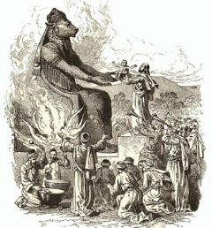
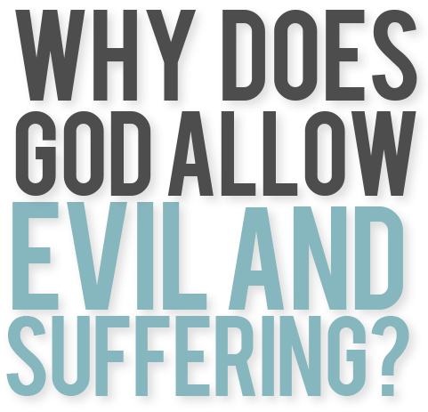
4) Does God Give Reasons For Killing People?
Gen 15:16b – “…the iniquity of the Amorite is not yet complete.”
Deut 9:5 – “It is not for your righteousness or for the uprightness of your heart that you are going to possess their land, but it is because of the wickedness of these nations that the Lord your God is driving them out before you, in order to confirm the oath which the Lord swore to your fathers, to Abraham, Isaac and Jacob.”
Notes:
Which leads to this question: in the bible, when God did choose to take lives, was He arbitrary and random about it or did He give a reason? We know the answer. There’s always a reason. What was the reason for the killing of the Canaanites? They were an evil and exceedingly immoral and idolatrous people. “Well, what’s the big deal about idolatry?” Let me tell you. One of the false gods they worshipped in Canaan was called Molech, and here is a picture constructed of what he looked like according to archeological findings. Molech had arms that came out, and the Canaanites would light a fire underneath these arms, getting that metal idol all nice and hot. Then they would take their firstborn children and lay them across the arms of this false idol and watch their child burn and sizzle to death. And while this was taking place, the Canaanites would play drums loudly in the background so that the parents wouldn’t have to hear the screams of their baby as he was being cooked to death. Archeologists have uncovered a numerous jars containing the remains of children that had been sacrificed to Canaanite gods, begging the question of why God didn’t destroy them sooner.
See, here’s some irony for you: just about every atheist I’ve ever talked to asks, “If God is so good, why doesn’t He do something about all the evil in the world?” Here is a perfect example of God doing something about evil in the world and atheists like to complain about it.
What did God tell Abraham more than 400 years before this happened? – Gen 15:16b; Deut 9:5 – He gave these guys over 400 years to get their act together. So why don’t you ever hear Atheists complain about why God took too long? I’ve never heard that objection from people who supposedly are so incensed at so much evil in our world. But there’s an answer to that as well. There is more to God than just His love, right? He’s also a God of justice. But He is also a long suffering God. Meaning, He is patient – 2 Pet 3:9 – Do you want to know why God doesn’t immediately do something about the evil in this world? Because then he’d have to do something about you, and me, and your loved ones. Because all have sinned and fallen short of the glory of God. God is patient and long suffering because He loves us. But when that patience expires and repentance cannot be found, His justice takes over and the evil has to be purged. See, there are a lot of atheists who aren’t asking this question because they want an answer. They just want a reason to be angry with God. If God waits too long to serve justice, they get mad. If He acts immediately to serve justice, they get mad. You can’t have your cake and eat it too. You’re judging God, but He is the source of all judgment. You’re judging the very standard of judgment itself, stealing from God in order to argue against Him, an intellectual crime.

Slide 7
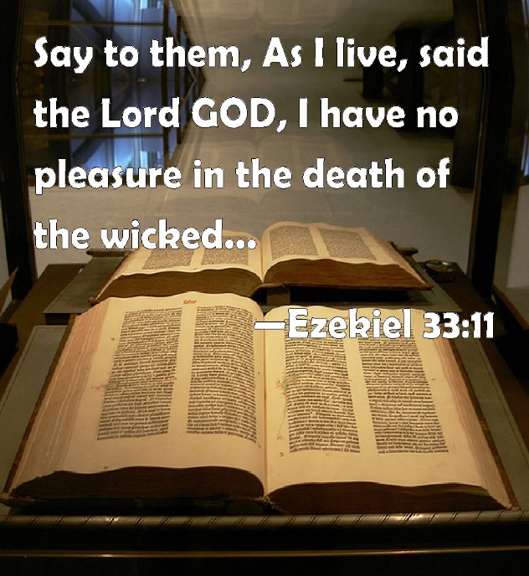
5) What If God Left Canaan To Dwell With Israel?
Ex 23:31-33 – “I will fix your boundary from the Red Sea to the sea of the Philistines, and from the wilderness to the River Euphrates; for I will deliver the inhabitants of the land into your hand, and you will drive them out before you. You shall make no covenant with them or with their gods. They shall not live in your land, because they will make you sin against Me; for if you serve their gods, it will surely be a snare to you.”
Judg 2:11-13 – “Then the sons of Israel did evil in the sight of the Lord and served the Baals, and they forsook the Lord, the God of their fathers, who had brought them out of the land of Egypt, and followed other gods from among the gods of the peoples who were around them, and bowed themselves down to them; thus they provoked the Lord to anger. So they forsook the Lord and served Baal and the Ashtaroth.”
2 Chron 33:9 – “Thus Manasseh misled Judah and the inhabitants of Jerusalem to do more evil than the nations whom the Lord destroyed before the sons of Israel.”
Notes:
“But He didn’t have to kill them.” Yes He did. And here’s why – Ex 23:31-33 – Understand this, that since the Fall in Gen 3, God had been trying to pave the way to bring His promised Messiah into the world to redeem mankind. And part of this process entailed getting a promised people into a promised land in order to bring about the promised Messiah. He wanted the nations destroyed to protect Israel, that same nation that would eventually produce the Messiah. And so God, as the Great Physician, had to take drastic measures.
What does that have to do with being a physician? Well, when a patient develops gangrene, doctors are usually left with no other choice but to amputate the infected limb. No doctor enjoys that, but they know should that infection not be kept in check, the infection would spread to the whole body and that is much worse. And so because God cares so much, because He is a God of love, He goes about this unpleasant task for the good of His patient, and this is not something He enjoys. – Ezek 33:11a
But what if they won’t turn from their way? Let them stay around so they can continue to harm others with their evil influence? What we do know from the beginning of the book of Judges is that after Israel settled in the land, they did not fully obey God and wipe out those nations (Judg 2). Israel left remnants of those nations around and this came back to bite them. At the beginning of Judges 2, we learn that Joshua and his generation as well as the generation that came after him were faithful to the Lord. But notice what happened when a new generation arose – Judg 2:11-13
This was the very thing God was trying to prevent. And this became Israel’s problem for its entire history until God had to use other nations as instruments of judgment against Israel. But skeptics don’t want to look at it from this perspective, that sometimes in order to save the body, you have no choice but to amputate a limb. The Canaanites were given hundreds of years to repent, and when they did not, God had no choice but to cut them off in order to prevent the spread of their disease. And the fact Israel did not obey God’s command to completely annihilate them, the disease spread, and Israel, as the prophets tell us, became just as evil as Canaan. In fact, notice in 2 Chron 33 just how bad Israel got during the days of King Manasseh, and this was hundreds of years later – 2 Chron 33:9 – The command to annihilate the Canaanites is not a flaw in God’s character. Rather, the spiritual fall of Israel vindicates God’s command to completely wipe them out, because in Manasseh’s days, they were burning babies again.

Slide 8
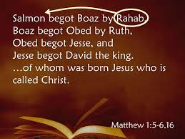
6) Did Everyone In Canaan Die?
Josh 2:9-13 – “I know that the Lord has given you the land, and that the terror of you has fallen on us, and that all the inhabitants of the land have melted away before you. For we have heard how the Lord dried up the water of the Red Sea before you when you came out of Egypt, and what you did to the two kings of the Amorites who were beyond the Jordan, to Sihon and Og, whom you utterly destroyed. When we heard it, our hearts melted and no courage remained in any man any longer because of you; for the Lord your God, He is God in heaven above and on earth beneath. Now therefore, please swear to me by the Lord, since I have dealt kindly with you, that you also will deal kindly with my father’s household, and give me a pledge of truth, and spare my father and my mother and my brothers and my sisters, with all who belong to them, and deliver our lives from death.”
Notes:
Well, here’s another question. After giving the Canaanites 400 years to get their act together, did He have Israel just blindly march in there and start destroying everybody? No He did not. Why? Because not every inhabitant in the land of Canaan were beyond reform, were they?
In Josh 2, when Joshua sends spies to Jericho, and the inhabitants of Jericho find out and seek them out to slay them, who hides the spies? A Canaanite harlot named Rahab – Josh 2:9-13 – In other words, everyone in Jericho knew what Israel was capable of and had heard about what God had done through them. Rahab puts her faith in God, but the rest of Jericho who had the same knowledge that she did, decided to take up arms. This shows that anyone, regardless of background, can put their faith in God and He will save them. He proved this with Rahab. And He also proved that He’s a rewarder of those who seek Him, as Heb 11:6 teaches us. Because when Israel conquered Jericho, Rahab was taken to live with the Israelites where she met and married a man named Salmon. Salmon and Rahab gave birth to Boaz who eventually married Ruth who gave birth to Obed. Obed and his wife gave birth to Jesse, and Jesse and his wife gave birth to King David. And so Rahab, a former harlot who put her trust and faith in God, was rewarded with being in the lineage of Jesus Christ Himself, and we’re told in Heb 11 that she had a faith worth mimicking.
God didn’t destroy people in Canaan who had faith. He destroyed wicked, abominable, baby killing pagans whose evil spread through that land like a cancer. The Gibeonites are another example, though they sought their salvation through stealth and deception. But regardless, they knew enough to know that the God of Israel was no one to trifle with, and so fearful were they that they went to some pretty dramatic lengths to save their own lives, preferring to be slaves to Israel than to take up arms.

Slide 9
7) Why Kill The Women?
Deut 7:3d-4a – “…nor shall you take their daughters for your sons. For they will turn your sons away from following Me to serve other gods…”
Judg 3:5-6 – “The sons of Israel lived among the Canaanites, the Hittites, the Amorites, the Perizzites, the Hivites, and the Jebusites; and they took their daughters for themselves as wives, and gave their own daughters to their sons, and served their gods.”
1 Kings 4:1-4a – “Now King Solomon loved many foreign women along with the daughter of Pharaoh: Moabite, Ammonite, Edomite, Sidonian, and Hittite women, from the nations concerning which the Lord had said to the sons of Israel, ‘You shall not associate with them, nor shall they associate with you, for they will surely turn your heart away after their gods.’ Solomon held fast to these in love. He had seven hundred wives, princesses, and three hundred concubines, and his wives turned his heart away. For when Solomon was old, his wives turned his heart away after other gods”
Neh 13:23-24 – “In those days I also saw that the Jews had married women from Ashdod, Ammon, and Moab. As for their children, half spoke in the language of Ashdod, and none of them was able to speak the language of Judah, but the language of his own people.”
Notes:
But why kill the women? That’s a fair question. Back in Deut 7, that we read at the beginning of the lesson, what did God say would happen if instead of killing the Canaanite women, they intermarried with them instead? Deut 7:3d-4a – Did this ever happen? – Judg 3:5-6; 1 Kings 4:1-4a; Neh 13:23-24
This is just the tip of the iceberg. Think about all the lives that were ruined as a result of their intermarrying. See, we’re so concerned about God killing children, which we’re going to deal in a moment, but how many children’s lives were ruined because of the Israelites intermarrying with these nations? Being a woman does not make one immune to evil, immune to an evil influence, or unaccountable to God for the life course you’ve chosen to take. They were women but they were not innocent women. And every person of accountable age is subject to God, regardless of gender. – 2 Cor 5:10

Slide 10
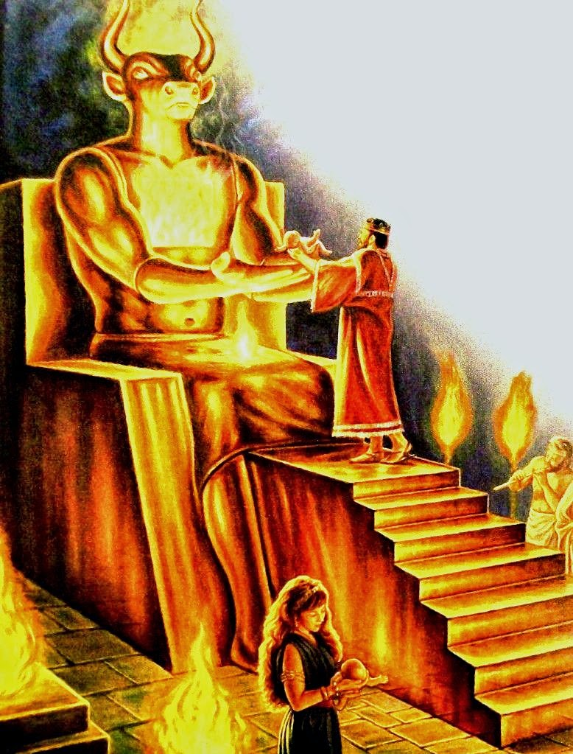
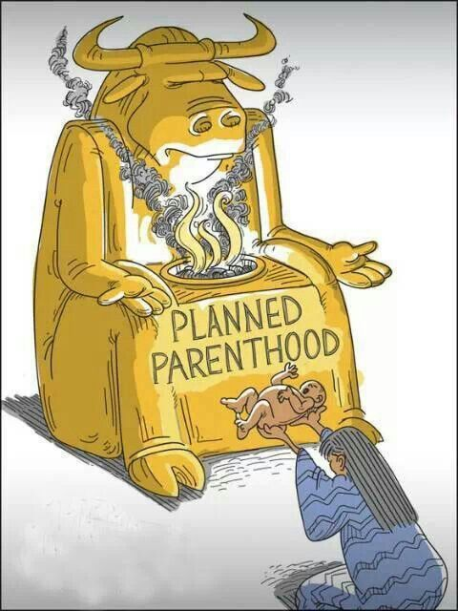
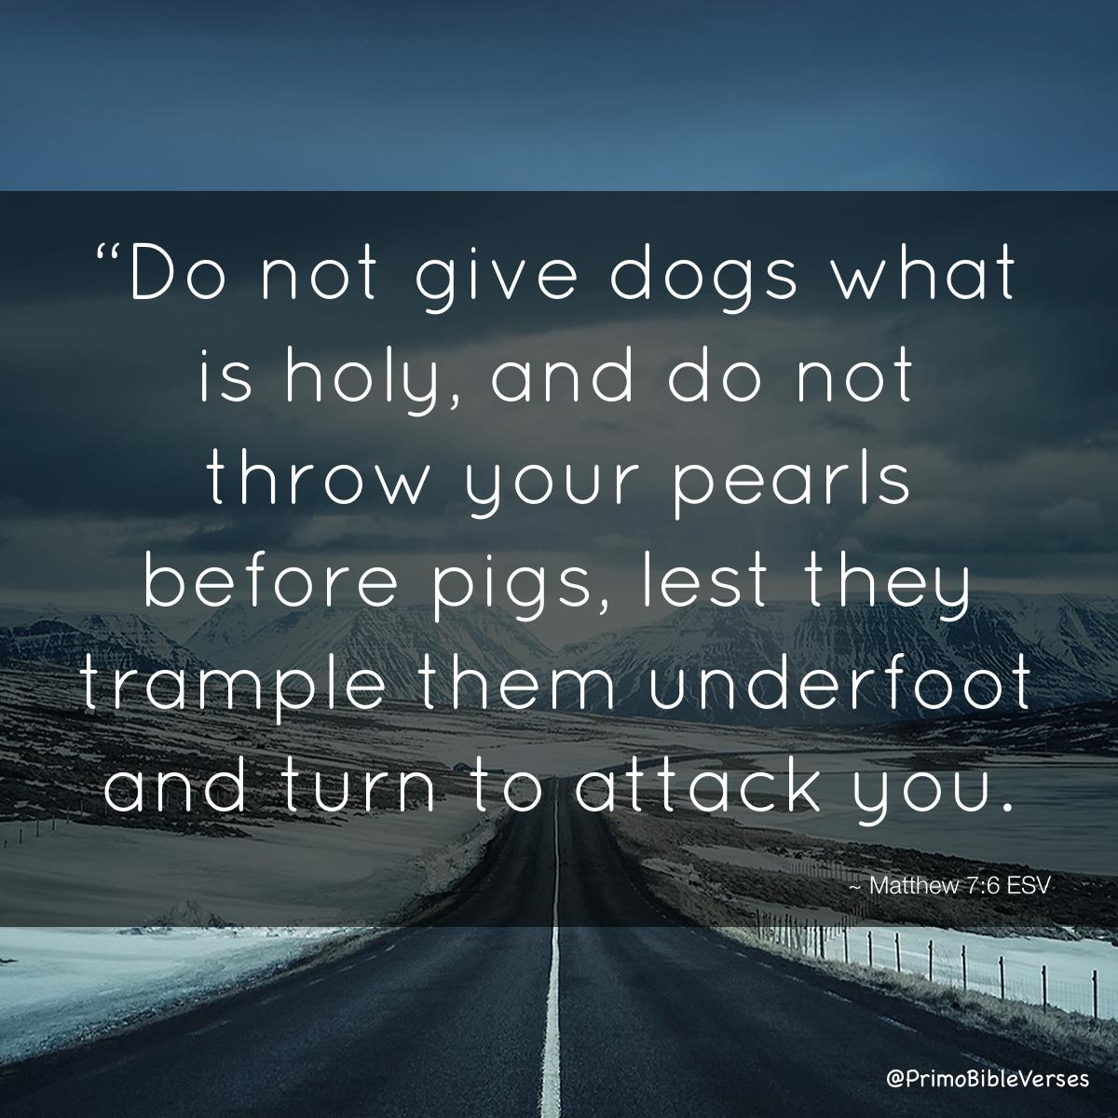
8) Why Kill The Children?
Notes:
What about the children? This one is a bit more difficult. We’re never explicitly told why, as we were told about the evil influence Canaanite women would have on Israel. But in addition to God being Sovereign Creator and therefore fully within His right to take life whenever and however He chooses, let me offer these thoughts.
I first think it’s important expose the double standard of many skeptics who question God’s credibility here. See, the Canaanites were already killing their babies. And they were doing so in an incredibly cruel way. Yet how ironic that when children become the center of the discussion in this story, it’s always what God did and not what the Canaanites were already doing. But to the skeptic who is so concerned about these children, I’d also ask this: does your filial sense of compassion extend to abortion clinics? Does your righteous indignation to spare the lives of children extend to Planned Parenthood and the 320k babies they murder every single year? Or, is this simply another example of selective moral outrage to push an anti-god agenda? I’m not pulling any punches here, because if we’re going to deal with this question fairly, I want to know the motive of the one questioning God. Is it someone genuinely interested in understanding or someone who is simply looking for a reason to discredit God? We need to remember that Jesus did not feel the need to answer every skeptic who attempted to undermine Him. And He encourages us likewise – Matt 7:6
But for those who are genuinely interested in a spiritual explanation, let me offer these possibilities:
First of all, death is not the end all of everything, it is simply a change in location. This is hard for an atheist to fathom when the extent of his existence only extends to the here and now. 2 Cor 2:14 – So an atheist who is not interested in spiritual truth isn’t going to get it, but, again, if we’re going to assume God, we must assume everything the bible reveals about Him including His promise of an infinitely better realm above and beyond this one. So the question we have to ask is, could God, in His wisdom, have determined that it be best for those children to die right then, when they would certainly go to heaven, rather than face a darker future in store for them should they be allowed to live?

Slide 11
8) Why Kill The Children?
Canaanite perversion left their children physically diseased
Lev 18:24 – “Do not defile yourselves by any of these things; for by all these the nations which I am casting out before you have become defiled.”
What if they grew up clinging to their “national pride”?
Heb 11:24-25 – “By faith Moses, when he had grown up, refused to be called the son of Pharaoh’s daughter, choosing rather to endure ill-treatment with the people of God than to enjoy the passing pleasures of sin”
To satisfy God’s wrath and justice toward Canaanite sin
Rom 1:18 – “ For the wrath of God is revealed from heaven against all ungodliness and unrighteousness of men who suppress the truth in unrighteousness”
God Is Holy
God Is Holy
JUSTICE
LOVE
JUSTICE
LOVE
Notes:
But you know, even then, it’s still such a shocking story isn’t it? I don’t deny it. I believe it’s shocking because it is God’s intention that we feel the weight of it, just how heinous, how destructive, and how influential evil can truly be. And however tough it may be for us to grasp emotionally, we need to understand that human sentimentality is not a qualified measuring stick for grasping divine truth and spiritual reality. So rather than questioning God’s motives, what we need to do is seek understanding of such events from a spiritual light and learn the appropriate lessons God would have us to learn.
In Luke 13, the Apostles are questioning Jesus about natural disasters and violent acts committed, wondering if it was because they were worse sinners than others. And Jesus’ reply in Luke 13:3-5, and I’m going to paraphrase it, is, “Don’t think you’re better than them because this hasn’t happened to you, because unless you repent, you’ll likewise perish.” These events, such as the slaughtering of the Canaanites, is not meant to be debated. It’s meant to serve as a warning to us.

