Slide 1
Notes:
Acts 14:15-17 – The Apostle Paul is saying something very similar to what David said in Psa 19, that we find God’s fingerprints everywhere within creation. Not only did He make the heavens and the earth, but He left us evidence of His presence, His providential care, inklings of His character, and His concern for that which is good. And if we’ll simply look around and about us and think about what we’re looking at, much of what we can learn about God from what we call “general revelation”, studying the Creation itself, is collaborated in what our specific revelation called “the bible” reveals about God.

Slide 2
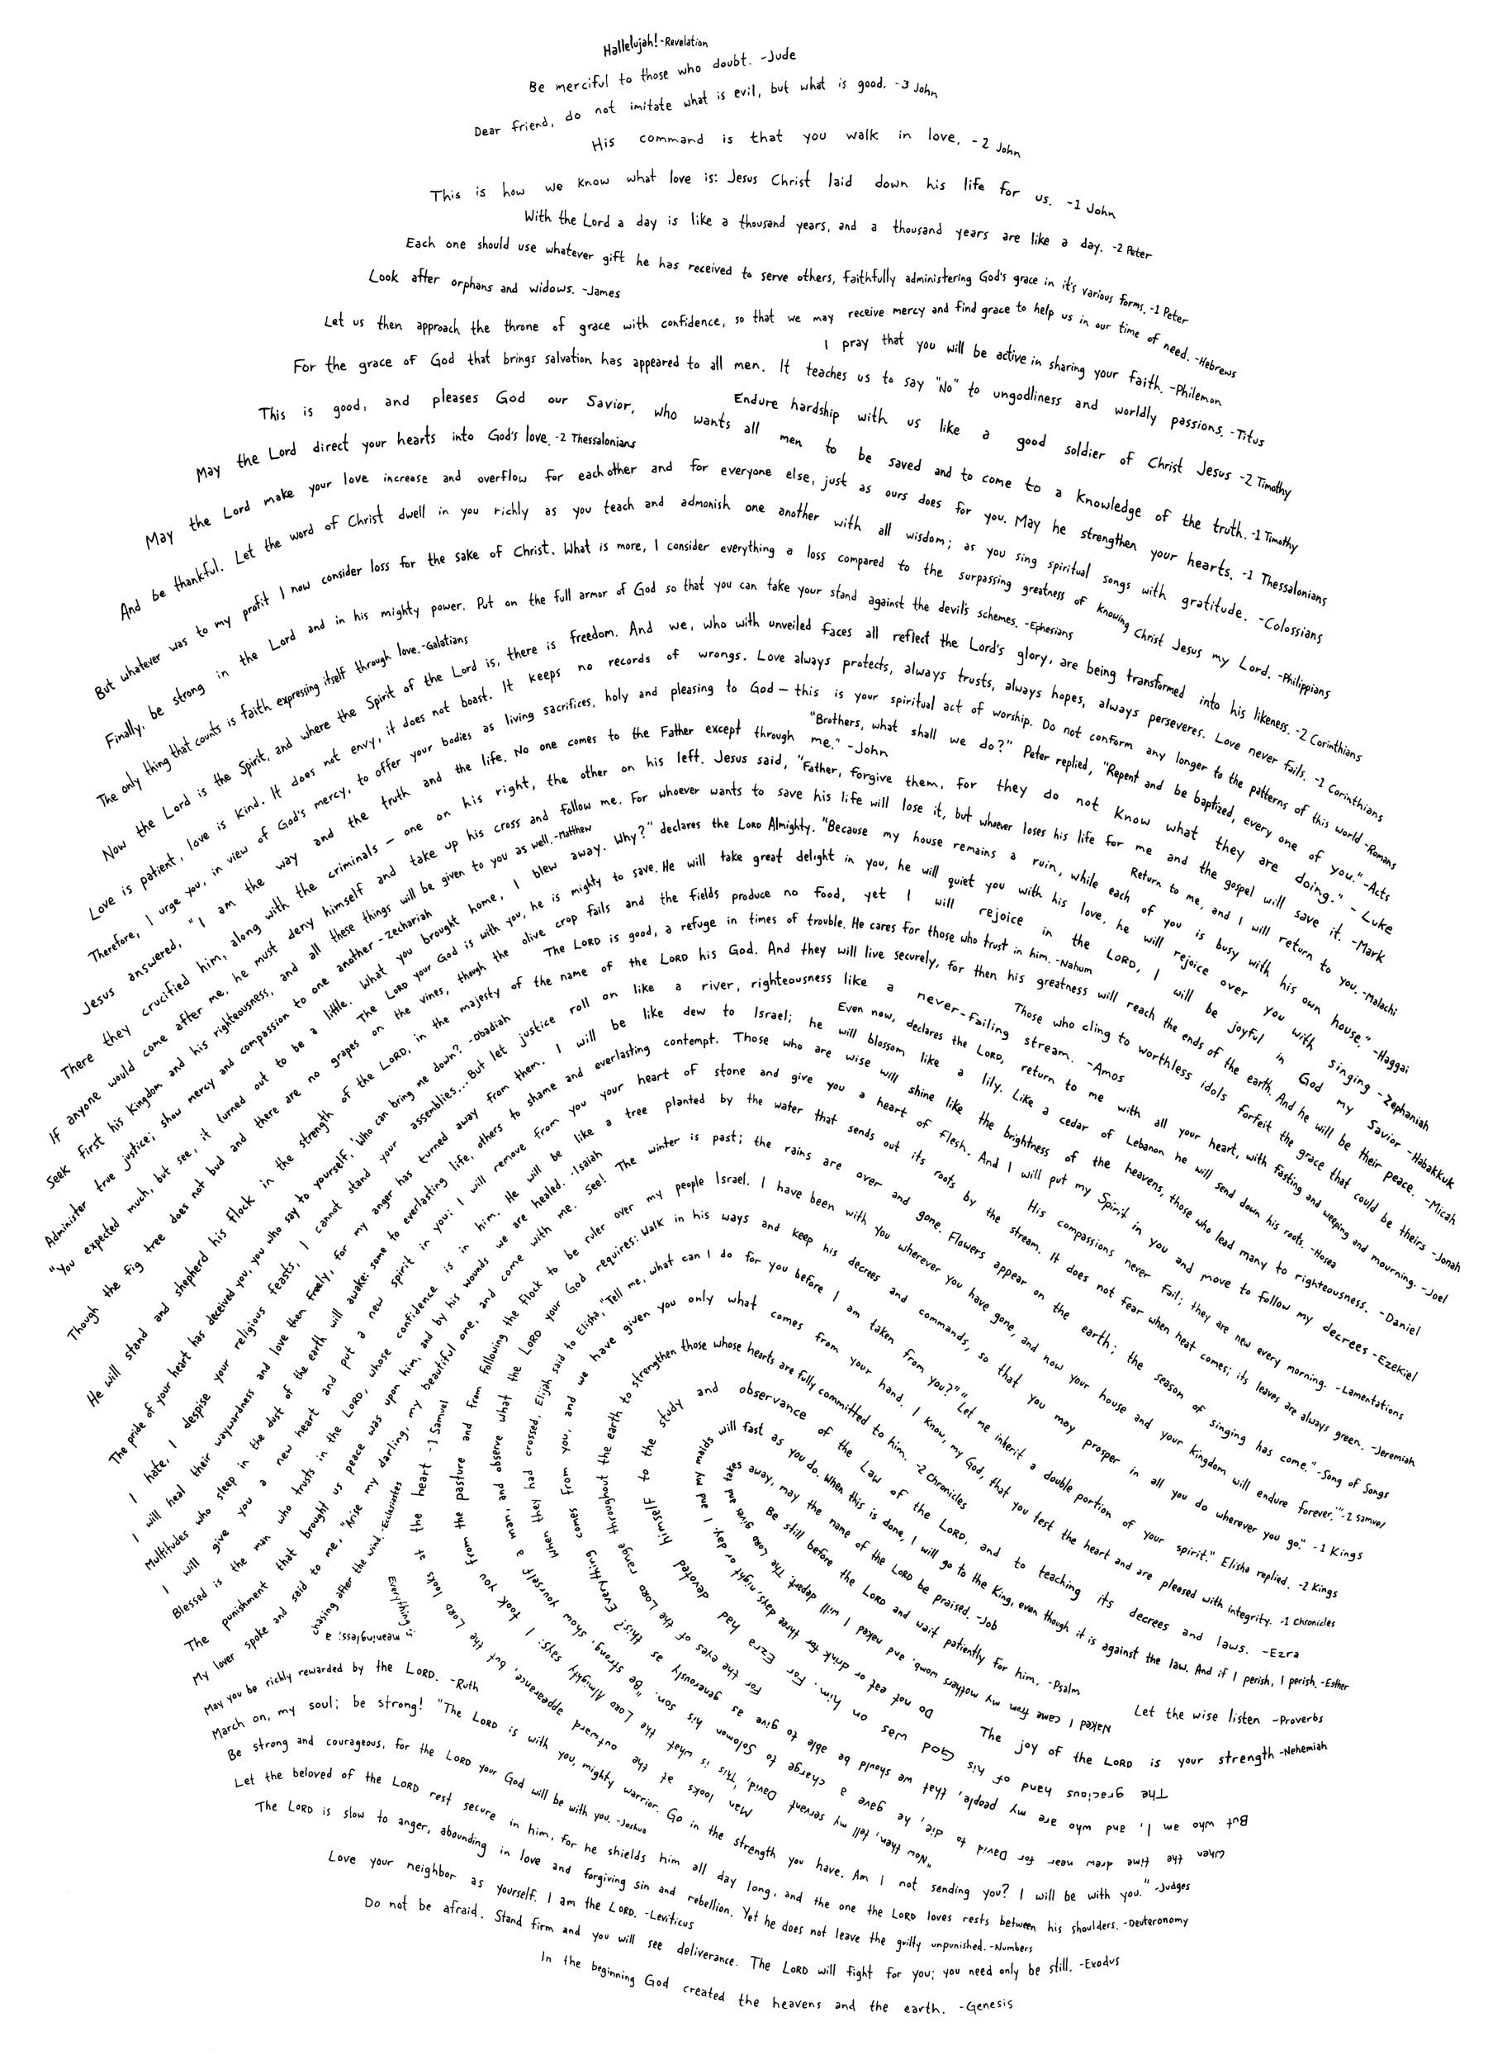
Genesis
Vs.
The
Chinese
Language
Notes:
One fingerprint God has left us, and that is what we find within the Chinese language. The Chinese language is considered to be the oldest written language the world. According to the Chinese themselves, it’s origin traces back before the year 2000 BC. Now that was a very interesting period of time in the history of our world because this would have been right after Noah’s flood when the descendants of Noah settled in the land of Shinar. It’s curious that these two things, the origin of the Chinese language and the settlement in Shinar, would coincide so closely together. Because Gen 11 tells us that when they settled in Shinar, they decided to build this massive tower, the tower of Babel, and God didn’t like that they were doing this and so here is what He did about it – Gen 11:7-9 – And so it is no surprise to us bible-believing Christians to accept that the Chinese language developed around this time because some of these people whom the Lord scattered would have made their way east and settled in what is now known as China. And from there, they would have taken what was only an aural language, given to them by God, and create from it the written language of Chinese.

Slide 3
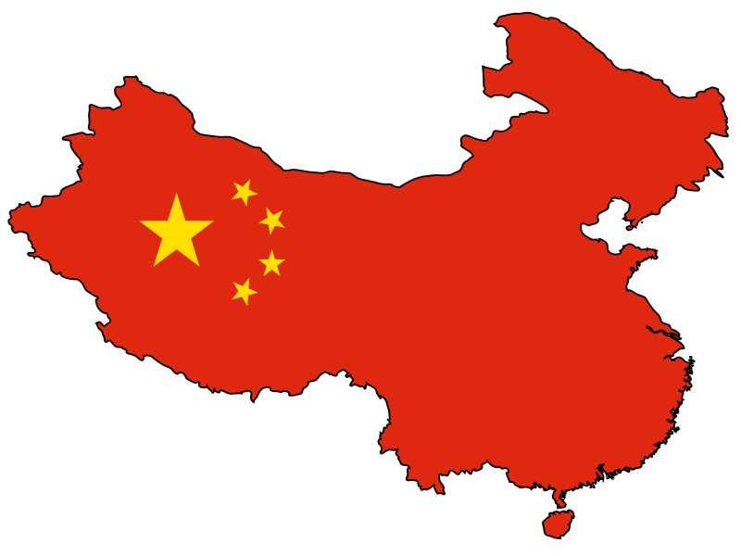
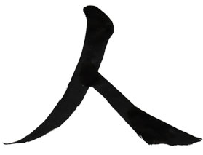
The Chinese Language
mouth/man
human
ruler
Notes:
Now the written language of Chinese is quite unique. Our written language of English is what is called a phonetic language; most languages in the world are this way. “Phonetic” means we use an alphabet where each letter has a sound and we use those sounds to construct the words. So even if you’ve never seen a word before, if you know how each letter is supposed to sound, you’ll be able to sound out most words. But the Chinese language is uniquely different. Whatever aural language they brought with them from Shinar to China, the ancient Chinese decided to construct their written language from images. Some of their images were primitive representations of the objects they were meant to express.
So, for example, this is the Chinese word for “tree”, which looks like a tree. Many simple Chinese words were designed to be simple representations of the object they were meant to express. But when they wanted to express more complicated words and ideas, they’d often combine the primitive symbols together. So, for example, when they wanted to talk about multiple trees, such as woods or a small forest, they placed the two words for tree side by side. The Chinese word for a large forest contains three of them, the word for tree on top and two words for tree on the bottom side by side. This is the word for mouth. When you think about it, that makes sense because it looks like a hole. But sometimes this word is used to refer to a man; it depends on the context. This is the word for human, and whether they were trying to be primitive by simply making a stick figure with two legs and no arms, I don’t know. But when the Chinese were coming up with the word for “ruler”, a person who rules, they constructed it by taking the word for mouth and putting it on top of the word for human, and that makes sense – a ruler is a “mouth man”. This is how a lot of the Chinese language works and some words are more intuitive than others, but this is the basic gist.
Now, if it is true that the ancient Chinese constructed their pictorial language from an aural language that they brought with them from Shinar, one might expect that we would find objects and concepts from pre-Babel history in the Chinese written language that correlates with the biblical record. And that is exactly what we do find. And so we’re going to look at some of these Chinese words and their constructions because this is a huge faith-building revelation.
I will tell you that there is more to do this than what I have time to present tonight and it would be well worth your time to investigate further. For example, some of the words we’re going to look at are the older versions of more modern replacements, yet they can still be found in a Chinese dictionary and the Chinese know these words even if they don’t use them. Some of the Chinese words are a bit of a stretch; I’ll avoid those. That doesn’t mean there isn’t something to them, I’m simply going to focus on the words that I believe contain the strongest evidence of the Genesis story.

Slide 4
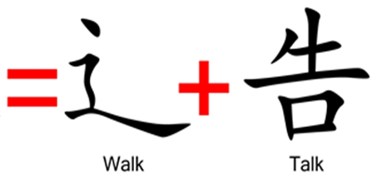
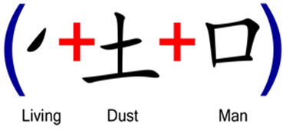
Gen 2:7 – “Then the Lord God formed man of dust from the ground, and breathed into his nostrils the breath of life; and man became a living being.”
Gen 2:8 – “Lord God planted a garden toward the east, in Eden; and there He placed the man whom He had formed.”
Notes:
(Gen 2) The Chinese word for “create” unmistakably reveals God’s creation of man. It is composed of two main symbols, the word “walk” (able to walk) and the word “talk”. This collaborates the Genesis record of the creation of Adam because since he was created a fully grown man, he was made a walking, talking man. But it gets better; the word “talk” is composed of three primitive Chinese symbols, the word “living” (life or movement), “dust”, and “man”. What’s the connection? Gen 2:7 – The Chinese word for “create” literally means a walking, living, dust man.
Then there is the Chinese word for “garden”. After God made man from dust, and breathed into him, what did He do? He placed man in a garden and eventually made woman to be his companion. And when you break down the Chinese word for “garden”, that’s exactly how they chose to construct this word. “Garden” is composed of the 5 primitive words for “dust”, “breath”, “enclosure”, “person”, and “person” – Gen 2:8

Slide 5
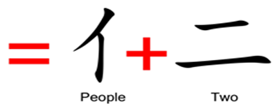
Gen 2:18 – “Then the Lord God said, ‘It is not good for the man to be alone; I will make him a helper suitable for him.’”
Gen 2:24-25 – “²⁴For this reason a man shall leave his father and his mother, and be joined to his wife; and they shall become one flesh. ²⁵And the man and his wife were both naked and were not ashamed.”
Notes:
The Chinese word for “necessary” also reveals some facts about God’s creation of mankind. It is composed of the words “one”, “man”, “enclosure”, and “woman”. Now, it’s curious why a generic word such as “necessary”, that can be used in so many contexts, would contain these specific primitives. That is until you know the Creation story which explains to us just how “necessary” it was that Adam not be alone in the garden, which was his enclosure – Gen 2:18 – And so God created one woman for this one man and placed both of them together in this enclosure called the Garden of Eden. Isn’t that neat? I like to imagine the ancient Chinese sitting down trying to come up with an appropriate symbol for the word “necessary”, and then they remember from their own oral history, how God made a woman for man because that is what he needed. It was necessary, and therefore they constructed their word from that story.
In fact, look at the Chinese word for “perfect”. It’s composed of the primitive word for “people” and the word for the number “two”. The image literally shows two people. Why? What does two people have to do with perfection from a biblical point of view? Gen 2:24-25 – In other words, this was a perfect, sinless, paradise of innocent man and innocent woman living together in perfect harmony with God; everything is perfect. In fact, there are a ton of Chinese symbols that make reference to two people where it doesn’t seem apparent why you would include two people, that is unless you know the Genesis story.

Slide 6
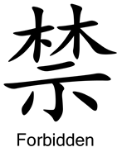
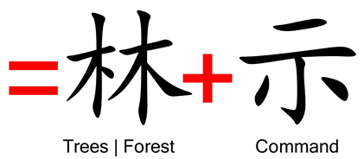
Gen 2:9 – “Out of the ground the Lord God caused to grow every tree that is pleasing to the sight and good for food; the tree of life also in the midst of the garden, and the tree of the knowledge of good and evil.”
Gen 2:16-17 – “¹⁶The Lord God commanded the man, saying, ‘From any tree of the garden you may eat freely; ¹⁷but from the tree of the knowledge of good and evil you shall not eat, for in the day that you eat from it you will surely die.’”
Notes:
This is the Chinese word for “forbidden”. Now look closely. Do you see any symbols we’ve already talked about, at the top? Those are the symbols for trees, right? Two trees. The bottom symbol is the Chinese word “command” and so the Chinese word “forbidden” is literally made up of two “trees” and the word “command”. Does that ring any bells? When God places Adam and Eve in the garden, what other significant things did He place there? Gen 2:9 – Two trees, and they’re set in the garden of Eden, and God gave a command concerning them. Gen 2:16-17 – The Chinese derived their word for “forbidden” from this account of the history of mankind as seen in the book of Genesis.

Slide 7
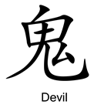
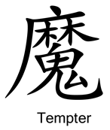
Gen 3:1 – “Now the serpent was more crafty than any beast of the field which the Lord God had made. And he said to the woman, ‘Indeed, has God said, “You shall not eat from any tree of the garden”?’”
Notes:
Well, Adam and Eve weren’t the only two living beings in the garden. In addition to the animals that Adam named, the devil was present. The Chinese word for devil is made up of four words, “secret”, “life”, “man”, and “garden”. The idea seems to be that though the devil took the form of a serpent, he was somewhat humanoid, given that he was able to speak with Eve, and he’s taking a very secretive, clandestine approach to Eve in the garden as he tempts her.
In fact, look at the Chinese word for “tempter”. You can see the word for “devil” in there at the bottom, but also the word we’ve seen a couple of times already, “forest”. Add the word for “cover” and that is how the Chinese developed their word for “tempter”. The idea here may be that as the serpent approached Eve in the Garden of Eden, he attempted to “cover up” his ulterior agenda, the whole truth about God’s law concerning the forbidden tree. He covers up the truth with half-truths and tempts Eve to eat of the fruit of the tree of the knowledge of good and evil because Satan is a crafty deceiver – Gen 3:1

Slide 8
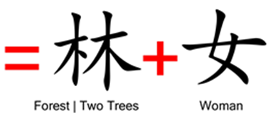
Gen 3:6 – “When the woman saw that the tree was good for food, and that it was a delight to the eyes, and that the tree was desirable to make one wise, she took from its fruit and ate; and she gave also to her husband with her, and he ate.”
1 Tim 2:14 – “And it was not Adam who was deceived, but the woman being deceived, fell into transgression.”
Notes:
And then we know what happens next. Satan succeeds in his temptation because Eve begins to doubt God’s beneficence. And so as she looks at the fruit from the tree of the knowledge of good and evil, what does she begin to do? She begins to desire it. Gen 3:6 – The Chinese word for “desire/covet” is made up of two words, and we’ve already seen them both. There’s the word “trees” again, and then we saw this word when we looked at the word “necessary”. It’s the word “woman”. The Chinese word for desire/covet is literally derived from the words “trees” and “woman”. It’s amazing how well it fits! 1 Tim 2:14

Slide 9
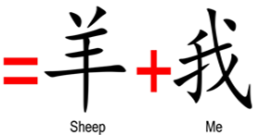
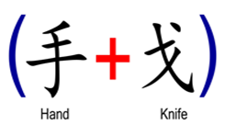
Gen 3:16 – “To the woman He said, ‘I will greatly multiply your pain in childbirth, in pain you will bring forth children; yet your desire will be for your husband, and he will rule over you.’”
Heb 9:22 – “And according to the Law, one may almost say, all things are cleansed with blood, and without shedding of blood there is no forgiveness.
Notes:
Then what happened? Their eyes, were open and they realized they were naked, they sewed figs together, and tried to hide from God, but you can’t hide from God and so He finds them. Then God rebukes them and they play the blame game. And so God curses the serpent, curses man, and then curses the woman and notice Gen 3:16 – Now the Chinese word for pain/sorrow is the following. Do you see anything familiar in there? We see the two trees, the symbol for “man” is in the bottom left corner, and then there is the word for “under”. See the significance? Woman was always designed to be man’s helper, his help-meet, but as a result of her sin she is now placed “under” man in that she is now to be in complete submission to man. She ate of the forbidden fruit because she wanted to be like God, and now God is saying that part of her pain and sorrow she would experience in life would be in a submissive role to man. This is no coincidence. The Chinese constructed their language from the oral traditions they brought with them from Shinar.
Now before God expelled them from the garden, he made garments of skin for them to cover their nakedness, which implies that the fig leaves they had made were not sufficient clothing. But where did the garments of skin come from? We’re not told, but they had to have come from an animal. And if the skin came from an animal, it means that animal died. Why did that animal die? Well, if we follow the bible plan for how OT atonement is accomplished, some animal died so Adam and Eve didn’t have to. The bible doesn’t tell us this explicitly, but I believe it can be strongly inferred that this happened. Because why didn’t Adam and Eve die? They were supposed to die if they ate from that tree, but they didn’t. An animal must have died in their place.
So now look at the Chinese word for “righteousness”. It’s made up of words we haven’t considered yet, the words “sheep” and “me”. And if you take the word for “me” and decipher it, we get the words “hand” and “knife”. So the Chinese word for “righteousness” comes from a sheep, which is a cover for me. See how it is on top of the “me”? And that only worked when you took a knife in your hand to the sheep. That’s how righteousness was obtained in the OT era. In other words, because of man’s sin, righteousness depends on a sacrifice and that is what is depicted in this word. It fits the bible story.

Slide 10
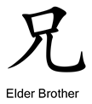
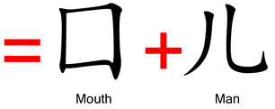
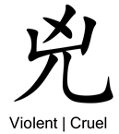
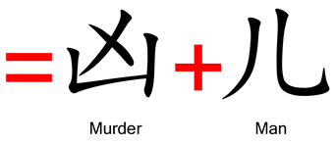
Gen 4:1-2a – “¹Now the man had relations with his wife Eve, and she conceived and gave birth to Cain, and she said, ‘I have gotten a man child with the help of the Lord.’ ²Again, she gave birth to his brother Abel.”
Gen 4:8 – “Cain told Abel his brother. And it came about when they were in the field, that Cain rose up against Abel his brother and killed him.”
Gen 4:13-15 – “¹³Cain said to the Lord, ‘My punishment is too great to bear! ¹⁴Behold, You have driven me this day from the face of the ground; and from Your face I will be hidden, and I will be a vagrant and a wanderer on the earth, and whoever finds me will kill me.’¹⁵So the Lord said to him, ‘Therefore whoever kills Cain, vengeance will be taken on him sevenfold.’ And the Lord appointed a sign for Cain, so that no one finding him would slay him.”
Notes:
Now when we get to Gen 4, we read about the offspring of Adam and Eve – Gen 4:1-2a – Now, Cain is the oldest and Abel is the youngest. And when you look at the Chinese word for “elder brother”, it is what we looked at in the beginning of the lesson, it’s the same word for ruler, made up of the words “mouth” and “man”. The reason is that the eldest brother was considered the spokesman for the family and this has been the case for a lot of cultures throughout history. So Cain would have held this role, right? At this point, he is the oldest and Abel is the youngest so Cain would have been the “ruler”, the “mouth man” so to speak. But then as the story goes, both the brothers offered sacrifices and God had respect for Abel’s offering but not for Cain’s – Gen 4:8 – Then God cursed Cain, determined that the fruit of the ground would no longer yield abundance to him, and then he cast him out as a vagrant and wanderer – Gen 4:13-15
So that brings us to this Chinese word, the word “violent/cruel”. Now before we break it down, do you see how similar it is to the word for elder brother? It’s almost exactly alike except the top part of the “mouth” is missing and there is something like an x going through where it should be. Well, that is the Chinese word for “murder”. And you know what that little x looking mark is? It’s the number seven, rotated about 140 degrees. What’s the significance? Gen 4:15 – When Cain murdered Abel, he lost his status as the ruler, and now he is no longer the “mouth man”; he is the “murder man”, who has been marked in a place where anyone who saw Cain could see it. And the bible doesn’t tell us what that mark was or where it was located, but when the Chinese were constructing their word “violent”, it seems they are borrowing from this story and perhaps thought it was located on his forehead

Slide 11
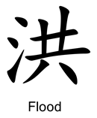
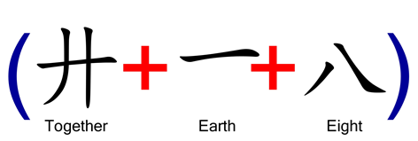
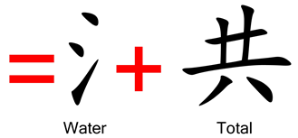
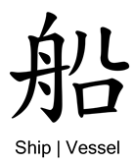
1 Pet 3:20 – “who once were disobedient, when the patience of God kept waiting in the days of Noah, during the construction of the ark, in which a few, that is, eight persons, were brought safely through the water.”
Notes:
As we continue walking through Genesis, we come to the story of Noah. The Chinese word for “flood” is made up of the words “water” and “total”. Then when you dissect the word “total”, you find that it is made up of the words “together”, “earth”, and the word for the number “eight”. It’s interesting that we find the number 8 there. After this total flood upon the earth, how many people were remaining? Noah, his wife, their three sons and their wives. Eight people.
The Chinese word for a large “ship/vessel” shows the same thing. The ship Noah constructed was massive, three stories with over 100k square feet of floor space. It is made up of the words . “ship/boat”, “eight”, and “people”. Now is this a coincidence? 1 Pet 3:20

Slide 12
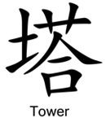
Gen 11:1-4 – “¹Now the whole earth used the same language and the same words. ²It came about as they journeyed east, that they found a plain in the land of Shinar and settled there. ³They said to one another, ‘Come, let us make bricks and burn them thoroughly.’ And they used brick for stone, and they used tar for mortar. ⁴They said, ‘Come, let us build for ourselves a city, and a tower whose top will reach into heaven, and let us make for ourselves a name, otherwise we will be scattered abroad over the face of the whole earth.’”
Notes:
Progressing further to Genesis 11, the Chinese word for “tower” is made up of the words “dust”, “grass”, “people”, “one”, and “mouth”. Now this word appears to be describing both the materials used to build a tower and the unity of the people who were building it. The components used are “dust” and “grass”, or to be more specific, mud and straw, because that is how you make brick. And the people involved in the construction are unified, one mouth and one language. Does that sound like a bible story we know? Gen 11:1-4

Slide 13
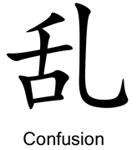
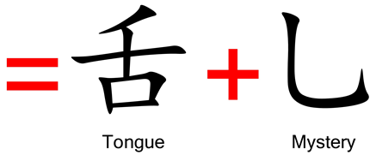
Gen 11:5-9 – “⁵The Lord came down to see the city and the tower which the sons of men had built. ⁶The Lord said, ‘Behold, they are one people, and they all have the same language. And this is what they began to do, and now nothing which they purpose to do will be impossible for them. ⁷Come, let Us go down and there confuse their language, so that they will not understand one another’s speech.’ ⁸So the Lord scattered them abroad from there over the face of the whole earth; and they stopped building the city. ⁹Therefore its name was called Babel, because there the Lord confused the language of the whole earth; and from there the Lord scattered them abroad over the face of the whole earth.”
Notes:
But then what did God do? Gen 11:5-9 –The Chinese word for “confusion” comes from the words “tongue” and “mystery”. Can you imagine waking up one morning and meeting with the foreman over what you’re going to try to accomplish that day and as he’s talking, it comes out as gibberish? Everything he’s saying might as well be Chinese to you! Well, that’s because some of it was Chinese. And they took their history with them as they migrated east and as their linguists sat down to construct a written language and tried to come up with the best representation for the concept that is “confusion”, they constructed it from their days in Shinar when God confused their languages and how their communication with one another became a mystery.

Slide 14
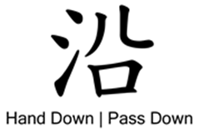
1 Pet 3:20 – “who once were disobedient, when the patience of God kept waiting in the days of Noah, during the construction of the ark, in which a few, that is, eight persons, were brought safely through the water.”
Notes:
How do we know that when the ancient Chinese sat down to write out their language that they did so from the details from Creation, the garden, Cain and Abel, and Noah and the flood? Well, look at the etymology of the Chinese word for “tell/speak/say”. It is derived from the Chinese symbols for “words”, “eight”, and “elders/rulers”.
So there again is that word eight, which would seem to be Noah, his wife, their three sons, and their wives since they would have been the oldest. But what if this was eight other people? That Chinese word doesn’t have to mean the eight members of Noah’s family, one might say. Well look at the Chinese word for “hand down/pass down”. It is also made up of the word “eight”, “water”, and “people”. These weren’t just any eight people; these were eight water people, eight people saved through water, Noah, his wife, their three sons, and their wives.

Slide 15
Notes:
Practical Application:
1. The Chinese themselves claim their written language was completed just before 2000 BC, and that would have been around the time the ancient Chinese migrated to China. 600 – 800 years later, another migration was happening, Israel’s exodus from Egypt, which occurred when Moses was 80 years old, and Moses would die 40 years after this. What this means is that the book of Genesis, which was written by Moses, between the time he was 80 and 120, was written as much as 800 years after the events of Babel, and likely 500 – 600 years after the development of the Chinese language. You know what this means? It means that the pre-Babel history of mankind was already recorded in the Chinese language before Moses received it from God and was inspired to pen it. Chinese culture and Hebrew culture had no connection to one another. Moses didn’t learn the Chinese language and turn into a story about Creation, and the Chinese didn’t learn Hebrew and turn it into a Creation story. And this is significant. Remember the concept of undesigned coincidences?
2. This is also significant because many times when you’re evangelizing to someone from China, they will denounce the biblical story simply on the basis that within it there can be found no record of Chinese history. They’ll claim “China was completely left out of the biblical story, so God obviously didn’t care about us, so why should we care about Him?” (Not all Chinese will say this) But this study shows us exactly what we established in the very beginning of this lesson – “God did not leave Himself without witness”. God’s fingerprints are all over Chinese history, within their own language even.
3. Genesis is pegged by skeptics as a fairy tale of false information and Christians are mocked as fools for believing the stories as factual. Well, look at all that we just studied. You may try to dismiss some, but you cannot dismiss them all. It’s too much evidence.
God’s fingerprints are all over His creation, found everywhere. And if you seek Him, He’ll be found.

