Slide 1
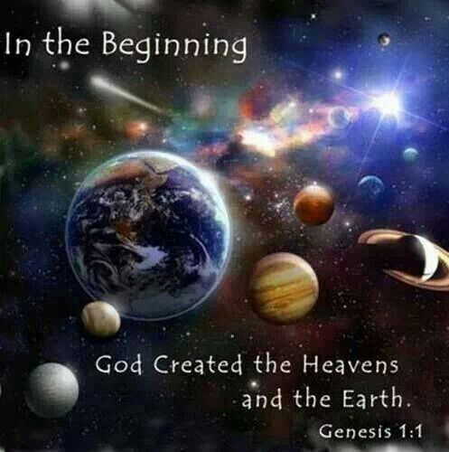
Notes:
Gen 1:1 – “In the beginning God created the heavens and the earth.”
As discussed in the prior study, there was a time not many years ago when virtually no one would have questioned such a statement in Genesis. That our universe was created, and that God was behind the creating was as sure in the mind of the greater populous as the rising and setting of the sun. But times have changed, and skepticism is on the rise. And for several reasons:

Slide 2
Skepticism On The Rise
Biased Educational System
Biased Media
Apathetic Christians
Unequipped Christians
Notes:
First, the educational system is flooded with teachers and professors who are skeptical and biased. And good Christian parents are turning their Christian children with their young, impressionable minds over to these educators where they are inundated and indoctrinated with anti-religious propaganda. And if they stand for the faith, they are ridiculed and ostracized for their so-called ignorance and stupidity. Our young people will have their faith tested in this regard if we choose to place them at the feet of such unbelievers.
Secondly, the media is becoming more anti-Christian, and this is evident as movies and YouTube mock religion and make mocking it sound like the cool thing to do.
Third, even Christians are falling off their spiritual duties because we’re becoming prisoners to our schedules; our jobs, our hobbies, our phones, anything and everything that keeps us from assemblies such as this where we can come and have our faith and our hearts strengthened with the truth.
But fourth, skepticism is increasing because more and more Christians are losing the knowledge and the tools to successfully answer the arguments skeptics place before us.

Slide 3
Notes:
So we Christians must be equipped with the knowledge and the means by to “give an account of that hope that is within you”. It is simply not enough to claim we believe in God without understanding why such a claim is reasonable and plausible in this cynical world.
Christianity is not a religion of brainwashed goody-two-shoes with nothing better to do than follow blindly – it’s never been that way. The basis of true, living faith will always lie in evidence – the bible testifies to this fact. And if we’re soldiers of the cross, we’ve got to know what the evidence is and why believing in God is the most intellectual, reasonable, and only plausible conclusion to derive. And the more evidence we can learn, the more convicted we’ll be, and the more willing we’ll be to take the fight to those who would say otherwise.

Slide 4
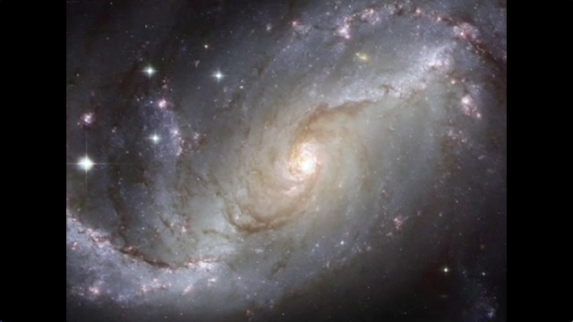
What We Will Not Do:
Attack Atheists
Account For God’s Existence
Confront “Evolution”
Talk About “Possibilities”
Notes:
This study is going to look at existence itself as evidence for the existence of God. There are things we will not do:
First, we’re not going to attack atheists. You don’t prove a position simply by demeaning a person who holds that point. You prove your position w/evidence, and then show why the evidence does not lean toward their position. We are going to be looking at a couple statements made by leading atheists, but we’ll address the statement and not the person.
Secondly, as we account for the evidence that is “existence”, I’m not talking about the existence of God, though I hope at the end of this study that will become evident. But before we account for God’s existence, we first need to work out existence itself, the fact that we exist and that the earth itself exists along with all of its billions of features, and that it is only a tiny speck in a much larger universe.
Third, we’re not going to talk about evolution. Whether or not a person believes he can plausibly conclude that mankind evolved from lesser creatures does not answer the question of how everything we see and experience around us came into existence in the first place. The question we’re trying to answer is, “What caused the universe and everything in it to come into existence? Why is there this thing we call “reality”? Why do we have “something” rather than “nothing”?
But then fourth, as we discuss issues pertaining to evidence, we need to be sure we’re focusing on that which is plausible, and not merely possible. There are as many possible conclusions as our imagination allows us. If I want to imagine that the moon is made of green cheese, I might be able to make some arguments to support that position. But in a study of evidences, I’m interested in what are reasonable and rational conclusions. We need to discover the most rational and reasonable explanation for why we have this thing we call “existence”, the universe in which we live.

Slide 5
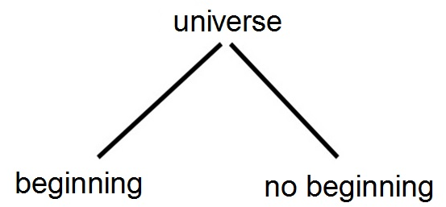
Notes:
So we’ve got this thing we live in that’s called a universe. It either had a beginning or it didn’t. Meaning, either something or someone began the universe, or the universe has just always, infinitely existed.

Slide 6
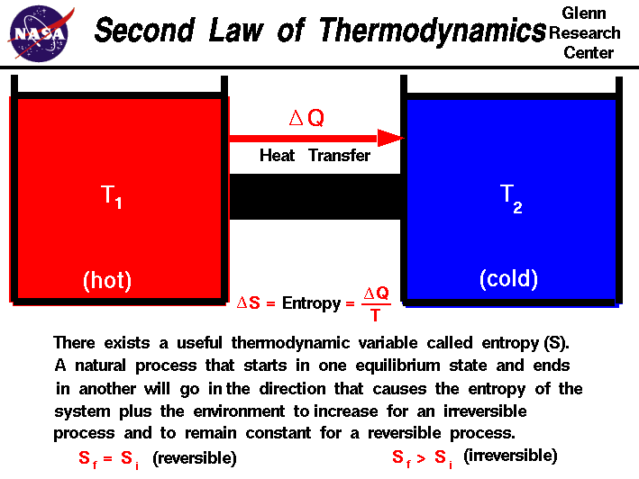
Notes:
Now this is a diagram of what we call the 2nd Law of Thermodynamics: in any closed system, a process will always proceed toward a direction in which unavailable energy increases; this is called “entropy”. In other words, in any closed system, the amount of disorder always increases with time; things within our universe naturally progress from order to disorder, from a state of available energy to a state of unavailable energy. I know all this sounds very technical and begs the question, “Do I have to be a scientist to understand all this?” Absolutely not, and we easily simplify this into something we can understand.

Slide 7
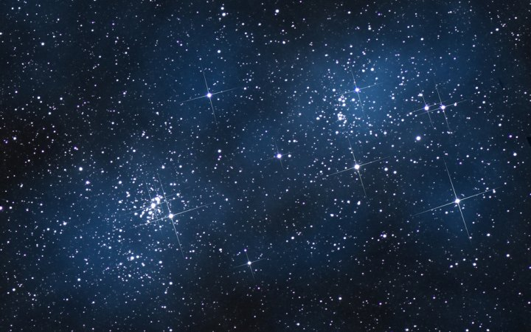
Notes:
Imagine you have a hot cup of coffee siting in a perfectly insulated room (that’s our closed system) and it’s doing what every cup of hot coffee does – it’s cooling off. Now the total amount of energy in that room will remain the same – that’s the 1st law of thermodynamics. A perfectly insulated room guarantees no increase/decrease in energy. So when that hot cup of coffee is cooling down in that room, you’re not losing energy, it is simply being transformed from the coffee’s heat to the cool air. When the coffee is hot, there is available energy because of the temperature difference between the coffee and the air. But as the coffee cools down, the available energy is becoming unavailable energy until it eventually becomes room temperature. At some point in time, probably just a matter of hours, there will be no temperature difference between the coffee and the air, and all that energy will be in an unavailable state.
In Thermodynamics, this is what is called a “heat death”. The system is dead because all the available energy is gone, and no further work can be done. There is just no way in this closed system that the cup of coffee will get hot again all by itself because in our universe, it is scientifically impossible to turn unavailable energy into available energy because we are bound by the 2nd law of thermodynamics and if we could figure out a way around that, we’d be trillionaires.
Now let’s expand this coffee analogy: think about the entire universe as one giant closed system where we have billions of hot cups of coffee which we call stars. And these stars, just like that hot cup of coffee, are cooling down, losing energy into space; available energy is becoming unavailable energy even as I speak. Our entire universe is winding down like a giant clock, ticking down and losing available energy; and one day, a long time from now, our universe will undergo a heat death.
And if this is the case, someone or something had to place all this available energy into existence in the beginning! Someone had to wind up that clock that is currently ticking down. Who or what could have produced this colossal amount of energy in an available state in the first place? It could only be someone or something not bound by the second law of thermodynamics. Only the Creator of the second law of thermodynamics could create energy in a state of availability in the first place.
So using the clock analogy again, the further back in time we could go, the more wound up the clock would be. Far enough back in time, the clock was completely wound up. And so the universe cannot be infinitely old. The only plausible conclusion is that the universe had a beginning, and that beginning was caused by someone or something operating outside of the laws of thermodynamics.

Slide 8
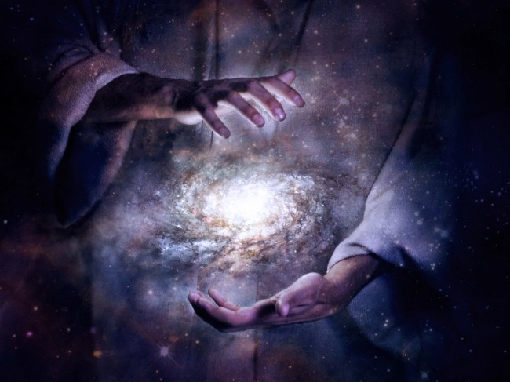
Psa 102:25-26 – “²⁵Of old You founded the earth, and the heavens are the work of Your hands. ²⁶Even they will perish, but You endure; and all of them will wear out like a garment; like clothing You will change them and they will be changed.”
Notes:
Now, this is evidence for God. That doesn’t mean its proof yet. Proof is when there is so much evidence pointing toward a position, you really have no choice to believe beyond a reasonable doubt not to. And we still have a lot of evidence to continue looking at that when we do take it all together, I believe is going to demonstrate proof of God’s existence. So far, though, its just evidence. And you be the judge whether this is good or bad evidence.
But evolutionary theories of the universe cannot counteract the above arguments. Pointing to a Big Bang can’t account for the chemical properties and processes that would bring about such a large explosion with all of our elements and the massive amount of available energy that occupies our universe. The further back we attempt to go in finding a source for the available energy that exists in our universe, the more plausible it becomes that we hit a singular point, a something or someone not bound by these laws.
But did you know that even the bible teaches the 2nd Law of Thermodynamics? Not in those words of course – Psa 102:25-26 – “Of old You founded the earth, and the heavens are the work of Your hands. Even they will perish, but You endure; and all of them will wear out like a garment; like clothing You will change them and they will be changed.” Now that verse will sound familiar because the Hebrew writer repeats it in Heb 1:10-11. So even the inspired writers of scripture from thousands of years ago understood the concept behind the Second Law of Thermodynamics, that though everything is winding down, they believed someone w/immense power was behind the immutable laws of existence.

Slide 9
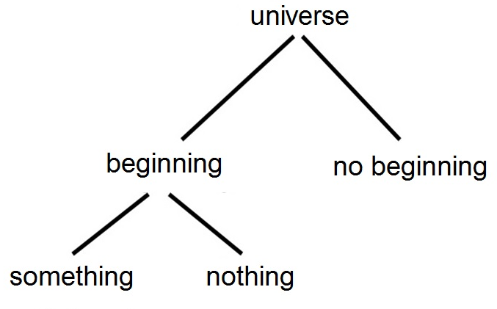
Notes:
Now, not surprisingly, most skeptics and atheists today agree with what we’ve just stated, though they would say it is a “something” rather than a “someone”. Science is confirming more and more that our universe has not always existed and that it in fact has a beginning. So for the last few decades, scientists have been attempting to explain that beginning, and so the issue now becomes whether or not something or someone created the universe or whether the universe came from nothing.

Slide 10
Stephen Hawking – “Because there is a law like gravity, the universe can and will create itself from nothing.” (Page 180)
Notes:
This is the late Stephen Hawking, who suffered from Lou Gehrig's disease. He was considered by many to be one of the smartest men alive. His research in theoretical physics and cosmology is certainly unparalleled. He’s written tons of books, published papers, and won mounds of awards for his research. He was also an atheist. In 2010, he wrote a book called “The Grand Design”. To his credit, he believed what we have already established, that within the confines of our laws, the universe cannot be infinitely old. He believed something had to have created it. So in this book, he attempted to describe how our universe came into existence.
“Because there is a law like gravity, the universe can and will create itself from nothing.” – Now, read that again and see if you can find the inconsistencies, there are at least 2. The first is that Hawking believes the universe brought itself into existence from nothing, but he calls that “nothing” “gravity”.

Slide 11
Hijacking words
something = nothing?
Scientific laws don’t make things happen. They describe what happens
Nothing creates nothing
Notes:
That doesn’t make much sense does it? Well this is a very common strategy of skeptics in the scientific community. They attempt to hijack words and change their definitions. Virtually every scientist sees the evidence that the universe has not always existed and that it had a beginning. But then when it comes to identifying whether something or nothing caused it to come into existence, they play verbal gymnastics by claiming something is equal to nothing.
Science is another word that is hijacked unfortunately. But here’s the 2nd issue with Hawking’s statement: scientific laws don’t make things happen. Scientific laws, such as gravity, describe what happens. There’s a difference.
When you truly have nothing, it creates nothing. When you have something, something else created it

Slide 12
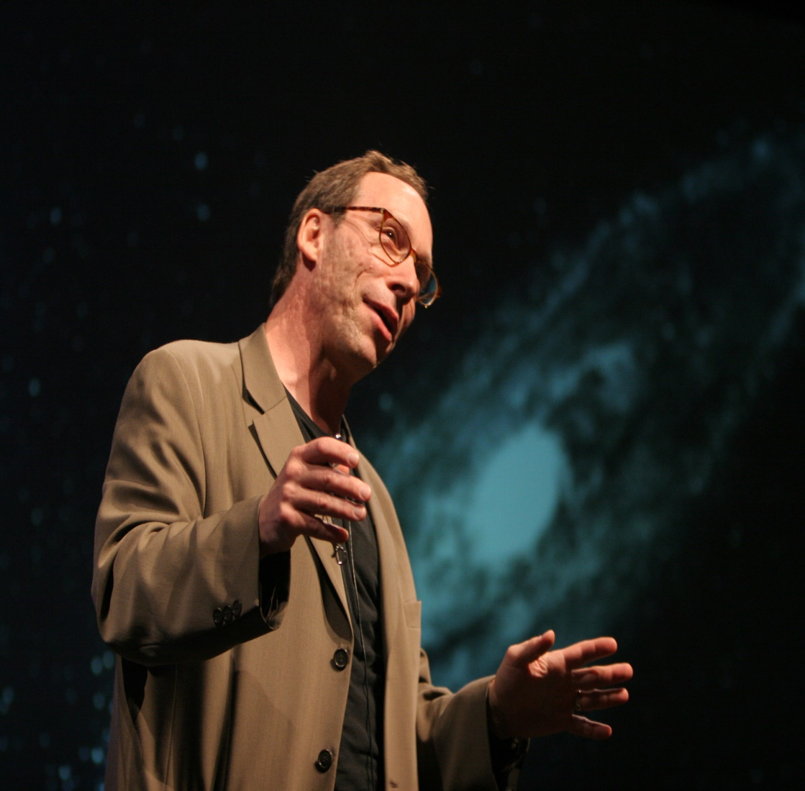
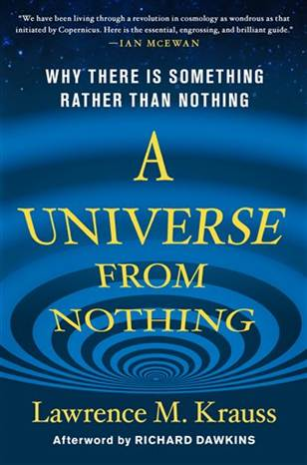
Lawrence Krauss – “One of the things about quantum mechanics is not only can nothing become something, nothing always becomes something. Nothing is unstable. Nothing will always produce something in quantum mechanics.” (Chapter 10)
Notes:
Lawrence Krauss is another noted physicist and atheist who wrote a book called “A Universe From Nothing”. In this book, Krauss attempts to answer the question of why there is something rather than nothing. In other words, why is there such a thing as “existence”? He boldly claims that the cause of the universe is not God, but rather “nothing”, citing that there are things happening at the quantum level that dispense the need for God.
“One of the things about quantum mechanics is not only can nothing become something, nothing always becomes something. Nothing is unstable. Nothing will always produce something in quantum mechanics.” But, again, this begs the question: what does he mean by “nothing”? I’ll tell you what he means; he means “something” and he defines that something as occurring at the quantum level. I don’t understand the complexities of quantum physics. But I know there are properties and laws. And I don’t have to understand quantum physics to know that it is something. But he calls it nothing. And this is the game that some of the skeptics of our scientific community like to play, and its an irrational, logical fallacy.

Slide 13
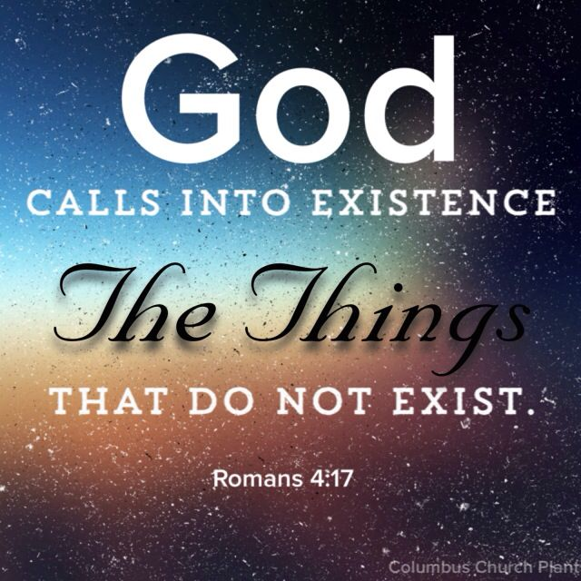
Notes:
There has never been something that has come from nothing, not in this universe. It has never been done in a laboratory and never can be done. Something always comes from something else. Interestingly, the bible makes this assertion also – Rom 4:17b – “God…who gives life to the dead and calls into being that which does not exist.” In other, we’re not suggesting that outside our universe there was “nothing”, we’re just saying that what brought it into existence is most definitely something, at the very least, and Christians will even go so far as to say it is “Someone”, which we’ll get more into in just a moment.

Slide 14
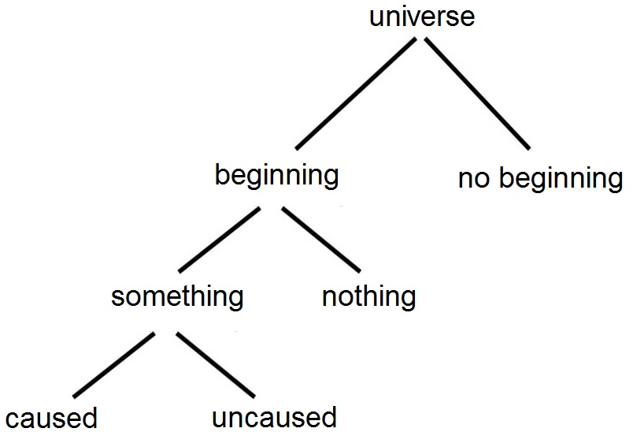
Notes:
So if the universe has a beginning and something or someone brought it into existence, the next logical question to ask is whether the universe was caused or uncaused. In other words, could the universe have brought itself into existence or did something or someone cause the universe to come into existence? The natural laws of our universe have no exceptions. In other words, the Second Law of Thermodynamics is a sure thing within the bounds of existence. This is also true of the Law of Cause and Effect, which is the most universal and certain of all physical laws.

Slide 15
Law of Causality (Cause & Effect) – “The relation between an event (the cause) and a second event (the effect), where the second event is understood as a consequence of the first.”
Notes:
Simply put, the Law of Cause and Effect states that for every material effect, there must be an adequate cause that existed before that effect. Material effects without an adequate cause simply do not exist in our universe and never will exist. Also, no effect is ever greater than the cause; that’s why scientists state that every effect must have an adequate cause. For example, a river does not become muddy because a frog jumps in it. A book doesn’t fall off the table because a single fly lands on it. These are not adequate causes for the resulting effect. For whatever effects we see, there is adequate causes that preceded them.
Even children understand the Law of Cause and Effect. “Dad, where do apples come from?” And dad will respond, “Why son, they come from an apple tree.” “Then where do apple trees come from?” And dad will respond, “Well, it comes from an apple.” That child will hardly be satisfied, will he? The child wants to know how the first apple tree got here because even small children can see that there was a cause, and they want to know what that cause was.
What if dad says, “Well, the apple tree just brought itself into existence.”? You think a child will buy that? Not likely. From the time we are young, we know intuitively that nothing happens in isolation. Every event can be traced to one or more events which preceded it and that, in fact, caused it. We ask: ‘How did this happen?” “What caused this?” “Where did this come from?” “When did it start?” Or, more incisively, “Why did this happen?” When we try to trace an event to its cause, or causes, we find that we never seem to reach a stopping point. The cause of the event was itself caused by a prior cause, which was affected by a previous cause, and so on. Police investigators on an accident scene use the principles of cause and effect every day to determine who was ultimately responsible and how it happened.

Slide 16
Notes:
And one thing we know for sure is that the cause cannot be equal to the effect. That’s why few people buy into the fact that the universe brought itself into existence because matter can’t create matter. I could take a rock weighing 1 pound and perform a thousand different experiments on that bad boy and short of changing its state, I‘m never going to produce anything new. In the same way, whatever was the cause of this “effect” we call existence, the universe in which we live, it cannot be material but something much, much more.

Slide 17
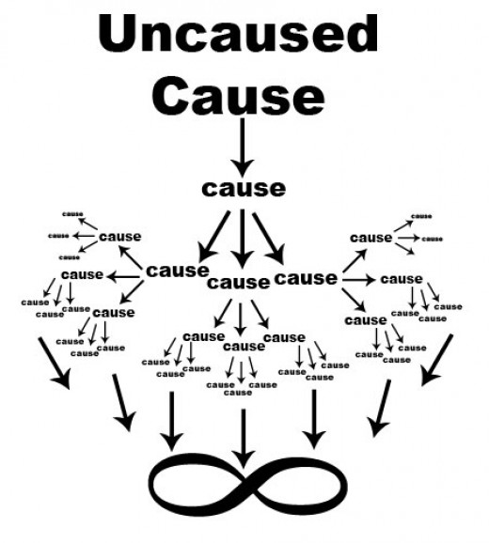
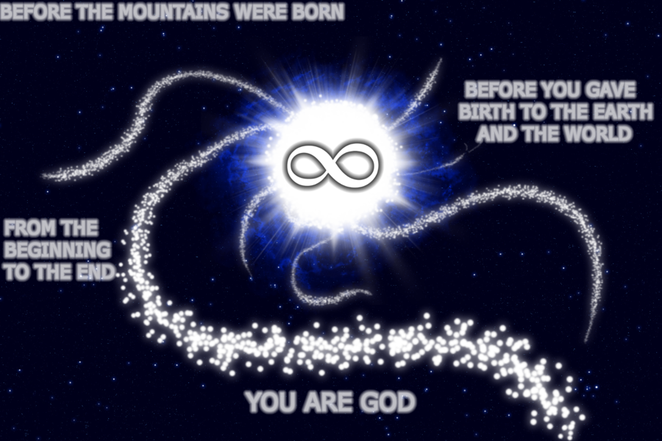
Gen 1:1 – “In the beginning, God created the heavens and the earth.”
Acts 17:28-29 – “For in Him we live and move and exist, as even some of your own poets have said, ‘For we also are His children.’ Being then the children of God, we ought not to think that the Divine Nature is like gold or silver or stone, an image formed by the art and thought of man.”
Notes:
Now someone is thinking, “Ok, then who/what created God?” The very question itself is a nonsensical; we’re thinking of the wrong God, because the God of the bible is not effected by time, space and matter. If He’s effected by time, space, and matter, He’s not God. Time, space, and matter are what we call a continuum and they all had to come into existence together. Because if there was matter but no space, where would you put it? If there was matter and space but no time, when would you put it? These 3 things had to come into existence simultaneously and the bible declares how this happened 10 short words – Gen 1:1 – “In the beginning (time), God created the heavens (space) and the earth (matter).” This is a trinity of trinities, because time is composed of past, present, and future; space is composed of height, width, and depth; and matter is composed of solid, liquid, and gas. That’s a trinity of trinities created instantaneously and the God who created them must be above them and outside of them, making Him the first uncaused cause, independent and not subject to the demands of those laws. He is the one uncaused cause from which every effect we see and experience in this material world derives.
Acts 17:28-29 – “For in Him we live and move and exist, as even some of your own poets have said, ‘For we also are His children.’ Being then the children of God, we ought not to think that the Divine Nature is like gold or silver or stone, an image formed by the art and thought of man.” If He’s limited by any of these, He’s not God. So the question, “Who/what created God” limits God, and if you could fit God in my 3 lb brain, He certainly wouldn’t be worth worshipping.
Psa 90:2 – “Before the mountains were born or You gave birth to the earth and the world, even from everlasting to everlasting, You are God.” He is everlasting from everlasting. And that’s how He introduces Himself to Moses at the burning bush in Exodus 3; the great I AM. Not the “I WAS”, the “I WILL BE”, or the” I AM FOR NOW”; He’s not limited by the past, present, or future of time. He is the “I AM”, the eternal God. He is the uncaused cause from which every effect in existence derives and finds its being

Slide 18
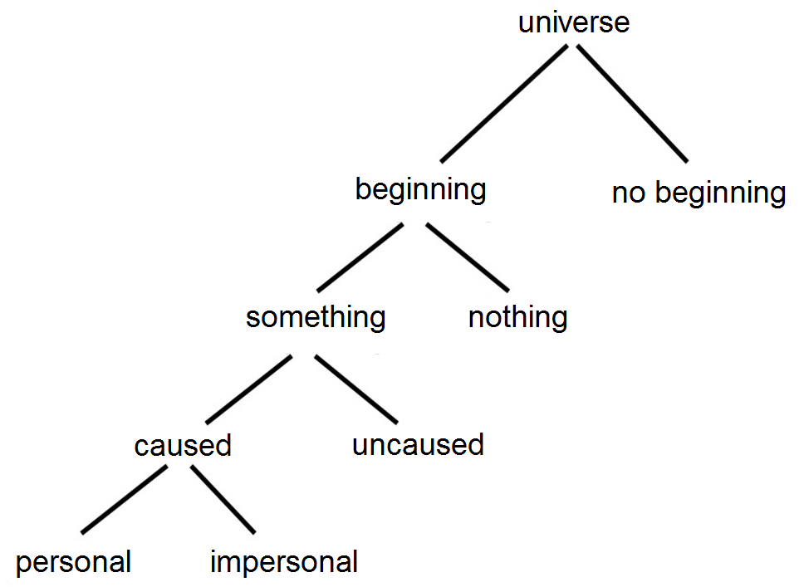
Notes:
That’s what the bible says. But is there evidence in existence, in the universe for there being a personal God behind existence, a “someone”, rather than an impersonal “something”? Is there evidence in the universe that an adequate mind was behind this great effect we call existence? We know that matter and energy cannot spontaneously arrange itself and we’ve already proven that the most plausible conclusion based on the physical laws of our universe is that our universe had a beginning. If those things are the case, then the beginning of our universe was the result of a decision. And decisions are made when there is a mind involved. And a mind belongs to a personal being. And so our universe was the result of a decision by someone, someone GREAT, to act w/specificity, to bring into existence everything it is that we experience.

Slide 19
Notes:
I cannot easily illustrate this: suppose you are in a forest hundreds of miles from civilization, and you come across a stack of rocks. There are two conclusions you can draw about how this stack of rocks appeared in this specific arrangement. First, you can conclude that nature itself, as the result of spontaneous causes such as wind, water, or a shift in the magnetic field, somehow brought all these rocks into alignment. Secondly, you can conclude that as far away from civilization as you may be, someone else had been here and had made a decision to stack these rocks.
Now, both of these conclusions are possible. But which is more reasonable? Which is more plausible? And we all know the answer. Every single one of us knows the conclusion we would draw, that it is much more likely that someone had been there. Someone w/a “will” decided to leave evidence of the fact that they had been there in hopes that a faraway traveler would stumble upon that evidence.

Slide 20
Notes:
And if we would naturally conclude this about a simple design such as a stack of rocks, how could we not conclude the same about this infinitely more complex design we call our universe? I do believe the most plausible evidence points to a personal being who made a decision to bring our universe into existence, and there was a purpose behind that. And He has also left us evidence to have plausible cause to believe in His existence, and that is what we call general revelation.
Psa 19:1-4 – “The heavens are telling of the glory of God; and their expanse is declaring the work of His hands. Day to day pours forth speech, and night to night reveals knowledge. There is no speech, nor are there words; their voice is not heard. Their line has gone out through all the earth, and their utterances to the end of the world. In them He has placed a tent for the sun.”
You know, if God has left us evidence of His existence, it means He wants to be found, and He wants us to find Him. This means we are not insignificant blobs of flesh created spontaneously to merely live a meaningless life only to die without any hope of something else past this life.

