Slide 1
Notes:
In the last couple decades, there has been a torrent of material in the media suggesting that the bible we have in our possession is not complete. This has been circulating for a number of years, but it really got reignited w/the 2006 release of that movie called “The Da Vinci Code” along w/the unveiling of the so-called “Gospel of Judas” which was introduced that same year. TV channels such as National Geographic, The Discovery Channel, and the History Channel seized on the popularity of the topic by airing stories that included interviews from professors who are so-called bible “authorities”, and as you could guess, the ones they interviewed pretty much all called into question how valid our current bible really is.
Now, as w/the subject of the canonization of scripture, which is more about why we can trust what we do have, it’s important that we not allow people to incorrectly frame the situation according to a false narrative. Meaning, when shows about this topic are being broadcast or you’re reading an article about it, they throw out certain words about these books, saying they have been “banned” or “taken out” or “missing” or “lost”, some even blaming the Catholics for doing so in the 4th century. And the problem w/this is that those words are highly misleading. They are painting a false narrative to suggest that there are books that do belong in our bible but that some man or institution interfered w/God’s divine will, and that for hundreds of years we’ve been cheated out of His word by not including these other books.

Slide 2
Isa 40:6-8 – “⁶A voice says, “Call out.” Then he answered, “What shall I call out?” All flesh is grass, and all its loveliness is like the flower of the field. ⁷The grass withers, the flower fades, when the breath of the Lord blows upon it; surely the people are grass. ⁸The grass withers, the flower fades but the word of our God stands forever.”
Notes:
But we need to keep in mind that in order for 2000 years to go by w/o certain books in the canon, that would call into question Isa 40:6-8 which declares that the word of the Lord stand forever. And if it is God’s will that His word stand forever, that would involve it being readily available to mankind so that could know what His will is, and knowing who God is, one would expect that He would see to it in His divine providence that nothing man could do would thwart this purpose. This is logically reasonable. God can achieve whatever He sets out to achieve. So, if Isa 40:6-8 is actually God’s word, I can be reasonably certain His entire word and will is available today to even the common man.

Slide 3
Notes:
What we need to understand from the very beginning is that these so-called “missing” books were never really missing. We’ve known about their existence for a long time because we have early Christian writings from the 2nd century onward that opposed these books being included in the canon because they knew they were either written by uninspired men or that they were outright forgeries by heretics seeking for their doctrines to get a foot hold in the church.
Now, last I saw, there are over 600 so-called lost books. But in this study, we’re going to divide the so-called “lost books” into 2 categories: the Apocrypha and the Gnostic gospels. This is not necessarily a fair way to divide them, because there are some that may not fall into either class and some of the apocryphal writings were definitely gnostic in nature. Also the apocrypha are OT in origin whereas the gnostic texts are primarily NT in origin. And then there are other random forgeries that don’t really fall in either category, so understand that I’m trying to be accommodative in categorizing it this way, but for the purposes of our study, this categorization should suffice.

Slide 4
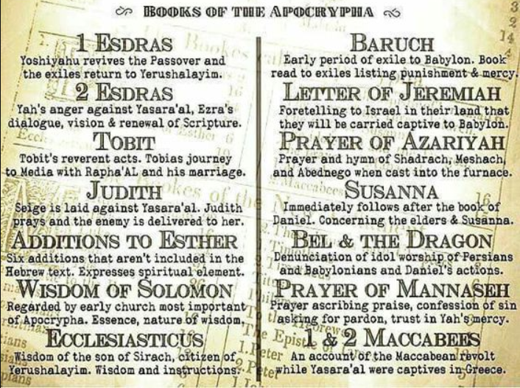
Notes:
Let’s begin w/the Apocrypha, which is a word translated from the Hebrew word for “hidden”, and it refers to the 14 or 15 books of doubtful authenticity and authority that the Catholic church now includes as an addition in their OT. These writings were never found in the Jewish canon of the Hebrew bible, which was universally received, but was rather added to the Greek version of the OT called the Septuagint that was completed around 250BC in Alexandria, Egypt. So, again, these books were never lost, they’ve been around for over 2200 years and we’ve known about them for that amount of time.
Now, some of these books have great historical value, especially 1 & 2 Maccabees, because it gives us details about the Maccabean revolt that occurred during the 400 years of silence. The early church father writings from the 2nd century onward have great historical value. But there is a difference between something having historical value, and something being inspired by God that is authoritative for our life.

Slide 5
The Apocrypha
Not inspired
No “Thus says the Lord…”
No “The word of the Lord came unto me saying…”
Prologue to Ecclesiasticus – “Ye are intreated therefore to read with favour and attention, and to pardon us, if in any parts of what we have laboured to interpret, we may seem to fail in some of the phrases.”
Not written in Hebrew or Aramaic
Earliest copies in Greek
Never quoted in the NT
~263 OT quotations in the NT
~370 OT allusions in the NT
Notes:
And that’s the first thing we want to note about the Apocrypha, is that none of these books ever alluded to any kind of inspiration. Our bible has the fingerprints of inspiration all over them. In Genesis, we see that phrase “these are the records of the generations of…” all over the book, because in Genesis we have a family album of God’s dealings w/the Patriarchs. In Exodus, Leviticus, Numbers, and Deuteronomy, God speaks and Moses writes the very words given to him and we see the same thing in Joshua. In Judges, the angel of God speaks and appears throughout the book. We see this kind of pattern in the entirety of the OT canon, but you never see that in the Apocrypha. Not once is there a, “thus says the Lord,” or language like, “the word of the Lord came unto me, saying ...” In fact, some of the documents actually confess non-inspiration! In the prologue of Ecclesiasticus, the writer states – “Ye are intreated therefore to read with favour and attention, and to pardon us, if in any parts of what we have laboured to interpret, we may seem to fail in some of the phrases.” You never find anything like that in the OT.
Second, none of them were written in Hebrew or Aramaic which are the predominant languages of the inspired OT, especially Hebrew. Rather, the earliest manuscripts we have show it was written in Greek. And when did the Greek language become prominent? During the 400 years of silence…more on that in a bit.
Third, there are ~263 quotations and ~370 allusions to the OT in the NT and not one of them refers to the Apocryphal books. Catholics claim there are some allusions, but that’s debatable. The fact is, Paul quoted from various Grecian poets to make certain points, and we don’t claim those poets were inspired. Yet the NT never quotes from the Apocrypha and Catholics consider them inspired? See the issue?

Slide 6
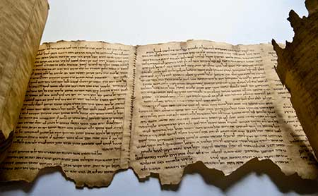
The Apocrypha
Dead Sea Scrolls claim uninspired
Notes:
Fourth, in the Dead Sea Scrolls, a scroll was discovered called “The Manual of Discipline” and it rejected the Apocrypha as inspired. “But why would you believe it over the Apocrypha?” I’m not claiming “The Manual of Discipline” was inspired, simply that the OT Jews never accepted it as such, and that document was written in the 400 years of silence. Also, some of the apocrypha books were found amongst the Dead Sea Scrolls, and yet w/them was a document explicating denying their inspiration. That’s pretty telling.

Slide 7
The Apocrypha
Originated during 400 years of silence
Mal 4:4 – “Remember the law of Moses My servant, even the statutes and ordinances which I commanded him in Horeb for all Israel.”
Mal 4:5 – “Behold, I am going to send you Elijah the prophet before the coming of the great and terrible day of the Lord.”
“It is true, our history has been written since Artaxerxes very particularly, but has not been esteemed of the like authority with the former by our forefathers, because there has not been an exact succession of prophets since that time…[no one] has been so bold as either to add any thing to them, to take any thing from them, or to make any change in them.” (Against Apion 1.8)
1 Maccabees 4:46 – “And they laid up the stones in the mountain of the temple in a convenient place, till there should come a prophet, and give answer concerning them.”
1 Maccabees 9:27 – “And there was a great tribulation in Israel, such as was not since the day, that there was no prophet seen in Israel.”
1 Maccabees 14:41 – “And that the Jews, and their priests, had consented that he should be their prince, and high priest for ever, till there should arise a faithful prophet.”
Notes:
Fifth, these books originated during the 400 years of silence, an era where there was no inspired prophet. Malachi concluded his book in this way – Mal 4:4. He then projects 4 centuries into the future saying in Mal 4:5. The implication is that no prophet would arise until John the Baptist’s coming, and this would exclude the Apocrypha.
Even Josephus acknowledges this: “It is true, our history has been written since Artaxerxes very particularly, but has not been esteemed of the like authority with the former by our forefathers, because there has not been an exact succession of prophets since that time……[no one] has been so bold as either to add any thing to them, to take any thing from them, or to make any change in them.”
And the Apocrypha itself acknowledges no prophet of God in that period. 1 Maccabees 4:46; 9:27; 14:41.

Slide 8
The Apocrypha
Historical Inaccuracies
1 & 2 Maccabees: death(s) of Antiochus Epiphanes
Geographical Inaccuracies
Where was Baruch? (Jer 52:12-13; 43:6-7 vs. Baruch 1:1-2)
Chronological Inaccuracies
Tobit’s age (Tobit 14:11)
Doctrinal inaccuracies
Wisdom of Solomon 11:17: God created world out of “formless matter”
Wisdom of Solomon 8:19-20: preexistence of soul
2 Maccabees 12:45: praying for the dead
Tobit 12:9: alms for sins
Notes:
They abound in historical inaccuracies. For example, in 1 & 2 Maccabees, Antiochus Epiphanes, who was the Grecian ruler giving the Jews so much trouble during that time, he is made to die three different deaths in as many different places.
They abound in geographic inaccuracies. In the book of Jeremiah, we’re told Nebuchadnezzar burned down Jerusalem on the tenth day, fifth month, of the nineteenth year of his reign (Jer. 52:12-13). After this occurred, the remaining Jews took both Jeremiah and his scribe Baruch to Egypt (Jer. 43:6-7). Yet, the book of Baruch claims he was in Babylon at that very same time.
They abound in chronological inaccuracies. Tobit 14:11 claims he lived for 158 years. Yet, he was supposedly alive back when Jeroboam revolted against Jerusalem in 931 B.C., and then still around when the Assyrians invaded Israel, which was in 722-721BC. That’s a span of some 210 years!
And they abound in doctrinal inaccuracies. In Wisdom of Solomon 11:17, it claims God created the world out of “formless matter”, contradicting Gen 1:1 and other texts which plainly teach God spoke creation into existence from nothing.
The Wisdom of Solomon 8:19-20 also teaches the preexistence of the soul, suggesting that the kind of body one now has is determined by the character of his soul in a previous life. This was a common belief among pagans, but it is contrary to the biblical teaching that the soul of man is formed with him at conception (Psa. 139:13-16; Zech. 12:1).
2 Maccabees 12:45 allows for prayer to be made for the dead. Now Roman Catholics love this text, because it supports their view that praying for the dead can release their loved ones from purgatory, but the effort is vain. This is foreign to the NT, and flies in the face of the many texts. Heb 9:27 – “And inasmuch as it is appointed for men to die once and after this comes judgment”. Abraham told Lazarus in Luke 16:26 – “Between us and you there is a great chasm fixed, so that those who wish to come over from here to you will not be able, and that none may cross over from there to us.”
And then Tobit 12:9 teaches the giving of alms will accomplish atonement for one’s sins.

Slide 9
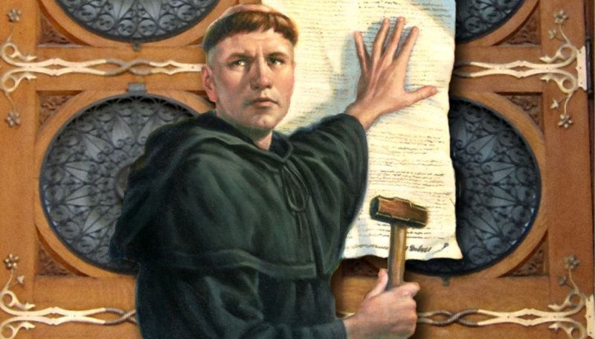
The Apocrypha
Canonized by Catholics in 1546AD
People were wising up to Catholic false teaching
Canonized to legitimize:
Purgatory
2 Maccabees 12:43-45 – “2,000 pieces of silver were sent to Jerusalem for a sin-offering … whereupon he made reconciliation for the dead, that they might be delivered from sin.”
Indulgences
Ecclesiasticus 3:30 – “Water will quench a flaming fire, and alms maketh atonement for sin.”
Earning salvation
Tobit 12:9 – “For almsgiving delivers from death, and it will purge away every sin. Those who perform deeds of charity and of righteousness will have fullness of life.”
Notes:
Now, who do some of these doctrinal inaccuracies benefit? Catholics. Yet the Roman Catholic church did not officially declare these books Holy Scripture until 1546AD at the Council of Trent. Now, what other major event was occurring in world history that not so coincidentally aligns w/the Catholic church waiting hundreds of years before deciding, “We need to listen to these books.”?
The Protestant Reformation. With the invention of the printing press and the translation of the bible into languages that could be understood by everyone, people could read for themselves that Catholicism taught doctrine that was in opposition to scripture. It didn’t take a rocket scientist to see this. And men like Martin Luthor and other reformers were diligently pointing this out to the masses. And so by canonizing these books, they legitimized certain false doctrines that they teach such as purgatory, indulgences, and earning your way into heaven. In other words, rather than reforming the church to the bible, the Roman Catholic church decided to reform the bible to the church’s teachings. And even to this day, the Catholic bible contains these additional books despite them not being there for the first 1500 years of the church’s existence.

Slide 10
The Apocrypha
Suspect & offensive morality
Ecclesiasticus 22:3 – “It is a disgrace to be the father of an undisciplined, and the birth of a daughter is a loss.”
Ecclesiasticus 25:19 – “Any iniquity is insignificant compared to a wife's iniquity.”
Tobit 6:5-8 – “If the Devil, or an evil spirit troubles anyone, they can be driven away by making a smoke of the heart, liver, and gall of a fish...and the Devil will smell it, and flee away, and never come again anymore.”
2 Maccabees 14:41-43 – “When the troops were about to capture the tower and were forcing the door of the courtyard, they ordered that fire be brought and the doors burned. Being surrounded, Razis fell upon his own sword, preferring to die nobly rather than to fall into the hands of sinners and suffer outrages unworthy of his noble birth. But in the heat of the struggle he did not hit exactly, and the crowd was now rushing in through the doors. He courageously ran up on the wall, and bravely threw himself down into the crowd.”
Judith 9:2-9 applauds murder
Notes:
And finally, there are just so many verses that are either suspect or just downright offensive when compared to the biblical text. Here are a couplethe ladies will not appreciate – Eccl 22:3; 25:19
Tobit 6:5-8 describes the making of magic potions which allegedly drive away demons, even the devil.
In 2 Maccabees 14:41-43, suicide is applauded as a noble, brave act. 2 Maccabees tells of a man named Razis who, being surrounded by the enemy, fell upon his sword, choosing “to die nobly” than to fall into the hands of his enemy. But it did not mortally wound him, so he threw himself down from a wall and “bravely/manfully” died among the crowds
And in Judith 9:2-9, she utters this prayer to God applauding the murder of the men of Shechem from Gen 34, where Dinah was raped and Simeon and Levi took revenge by killing all the men of the city. It makes this out to be God’s will that they did this. However, this is contrary to Gen 49 where Jacob, through the Spirit, cursed his two sons for what they had done.
In summary, there is no valid reason to assume these books are missing from the canon. And they were never considered inspired until the Catholic church tried to force them in.

Slide 11
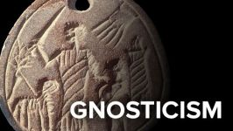
Greek word “gnosis” = “knowledge”
Believed they had secret knowledge
Pandered to spiritual pride
Hellenistically influenced
Leaders: Marcion, Basilides, Valentinus
Dualism (OT God evil, NT God good)
The body and physical world are evil
Rejected Christ’s Humanity
Rejected Christ’s physical death
Rejected Christ’s resurrection
Wrote false gospels
Notes:
And then there are the gnostic gospels. Before looking at the writings themselves, it’s helpful to remember who the Gnostics were.
The Judaizers were those Christians who could not break away from certain tenants of OT law like circumcision, and so they demanded that any Gentile who obeyed the gospel must complete their conversion by being circumcised, else they are not truly Christians. The Gnostics were exactly the same as the Judaizers, except they were influenced by Hellenistic teaching and attempted to hybridize Christianity w/various Grecian philosophies.
The term “gnostic” comes from the Greek word “gnosis” , which means “knowledge”. These Christians were a bit of a secret society who believed they were more enlightened than other Christians. They considered the God of the OT to be an inferior, ignorant god who made an evil creation, and so they believed that all physical matter, including the body, was evil, though they disagreed among themselves whether the body’s desires should be met. And this led them to rejecting some of the most essential and fundamental Christian doctrines. See, the Gnostics believed in Christ, but because they believed all matter was evil, they could not accept that Jesus came to earth in the flesh, insisting He was merely an apparition. And since they denied His humanity, they also denied His physical death, claiming that Simon died on the cross instead. And since they did not believe that Christ died, they did not believe in His resurrection from the dead.
And they were so bold in spreading their false teaching, they actually wrote false gospels, under pseudonyms, because who is going to receive a teaching from a man known to be a false teacher? Contrast that w/the Apostles and prophets who in almost every case wrote their names as the writer of their epistles.

Slide 12
The Gospel of Thomas
The Gospel of Judas
The Gospel of Mary
The Gospel of Philip
The Gospel of the Egyptians
The Acts of John
The Apocryphon of John
The Apocalypse of Paul
The Wisdom of Jesus Christ
The Secret Gospel of Mark
The Hermetica
Notes:
This is a short list of what we consider to be the gnostic gospels…we believe there are ~52 of them in all. As you can see, many of them consider themselves to be actual gospel accounts whereas others not so much.
So, while the Catholic church tried to include books in the Canon that didn’t belong in order to get its way, the Gnostics went further by simply writing their own material in an attempt to get their theories to stick. But they were universally rejected from the canon. Like the Apocrypha, these writings were never lost; they were well known in their time and the early church fathers mention them repeatedly in their writings, but they were widely condemned because they’re not supplements to what we know to be truly inspired writings; they wholly contradict them.
So, a simple study of the canonization of scripture, why the inspired books we have belong in the bible, vs. what is written in these gnostic texts is enough to show why they should be completely discounted. However, but let’s look at 3 other reasons in more detail.

Slide 13
The Gnostic Gospels
Secretive
John 18:20 – “Jesus answered him, ‘I have spoken openly to the world; I always taught in synagogues and in the temple, where all the Jews come together; and I spoke nothing in secret.’”
2 Cor 4:2 – “but we have renounced the things hidden because of shame, not walking in craftiness or adulterating the word of God, but by the manifestation of truth commending ourselves to every man’s conscience in the sight of God.”
1 Cor 1:26 – “For consider your calling, brethren, that there were not many wise according to the flesh, not many mighty, not many noble”
Notes:
1. Secretive – As mentioned earlier, the Gospel of Judas is the most recent gnostic text to make serious headlines, published by National Geographic in 2006. Here are the opening words to the Gospel of Judas – “The secret account of the revelation Jesus spoke. . . to Judas Iscariot”. These words, and terms like them, are extremely common among the Gnostic literature. Compare this to texts we have in the NT – John 18:20; 2 Cor 4:2 – However, the Gnostics, they claim secret knowledge, and would assure its adherents that they were specially enlightened people. And so the biggest thing Gnosticism did was pander to human pride. The human appeal to be a part of an elite group of people can’t be underestimated. After all, who didn’t want to be part of the cool club in school? Gnosticism, with its teaching of salvation by secret knowledge, appealed to the same desires as flying saucer cults. The Gnostic could look down his nose at mere ordinary Christians around him and think, ‘if you only knew what I knew.’ But is that the kind of Christian Paul said would be in the kingdom? – 1 Cor 1:26.

Slide 14
The Gnostic Gospels
Secretive
Blatantly Contradicts Bible
1 Tim 6:20-21 – “O Timothy, guard what has been entrusted to you, avoiding worldly and empty chatter and the opposing arguments of what is falsely called ‘knowledge’— which some have professed and thus gone astray from the faith.”
1 John 1:1 – “What was from the beginning, what we have heard, what we have seen with our eyes, what we have looked at and touched with our hands, concerning the Word of Life”
1 John 4:1-2 – “Beloved, do not believe every spirit, but test the spirits to see whether they are from God, because many false prophets have gone out into the world. By this you know the Spirit of God: every spirit that confesses that Jesus Christ has come in the flesh is from God”
Notes:
2. Blatantly contradicts the bible – See, the gnostic gospels attempted to do the same thing the Latter-Day movements do, to suggest that our bible has been corrupted and that we need their literature to know the true story of Jesus of Nazareth. But as we’ve observed, the bible that we have is bullet proof, and what does it say contrary to gnostic teaching?
1 Tim 6:20-21 – Was he talking about the Gnostics? Who knows, but he is certainly rebuking those who falsely think they have knowledge, yet whose knowledge goes against apostolic teaching.
1 John 1:1 – If Jesus was an apparition, it begs the question how John and the other Apostles could have touched Him and confirmed Him to be flesh.
1 John 4:1-2 – The point of Jesus coming in the flesh is an important one. Heb 2 teaches us that He did this so He could relate to us and our suffering. He humbled Himself in order to fully partake of the human experience, such that every trial, every pain/suffering we experience, He knows it – He understands by virtue of His humanity. That draws me closer to Jesus. The Gnostics saying that He never came in the flesh, but was merely an apparition, that takes away all the power from the gospel. That’s why it’s important to believe that He came in the flesh. Any other coming was pointless.
Consider again the Gospel of Judas. This so-called gospel actually portrays Judas Iscariot as a hero, an Apostle who was given more revelation and played a more significant part than any of the other apostles. In the text, Judas hands Jesus over to the Jewish authorities only because Jesus personally instructed him to do so, rather than because of his greed as portrayed in the actual gospel accounts. So, if this text is true, the gospel accounts are wrong, and so were the Apostles in Acts 1 when they recognized him as a betrayer and quoted the psalm that they did giving them authority to replace him. Who can believe it?
Such sensational theories is a big reason behind Premillennialism today. The outlandish, sensational ideas about Revelation and the rapture and the 7-year tribulation, is popular not because it can be found in scripture, but because of sensationalism. And many of the biggest proponents of Premillennialism, when challenged from scripture, take a Gnostic, elitist view towards their critics as if they have a more enlightened understanding behind the signs and symbols of the bible than we do. It reeks of pride.

Slide 15
The Gnostic Gospels
Secretive
Blatantly Contradicts Bible
Not “lost”, but shunned
Irenaeus:183 – 186AD
Justin Martyr:155AD
Tertullian: 210AD
Eusebius: 323AD
Notes:
3. Again, these Gnostic gospels were never “lost”, they were universally shunned by the early Christians. We’ve always known about these books, but practically every early church father that we give any credibility to today rejected them. The early church rejected them. Some of the writers were definitely forging this material and were caught, which we know from 2 Thes 2 was certainly happening. Irenaeus was one of its biggest critics, and he wrote extensively against it in his writing called “Against Heresies”. Justin Martyr also mentioned in his writings that he and other Christians were persecuted more heavily than the Gnostics were, presumably because Gnostic teaching aligned better w/Roman paganism and Hellenistic philosophy. Tertullian called them liars. Eusebius even wrote about its entrance in the church of Jerusalem by one of it’s elders after the martyrdom of James, the Lord’s brother.

