Slide 1
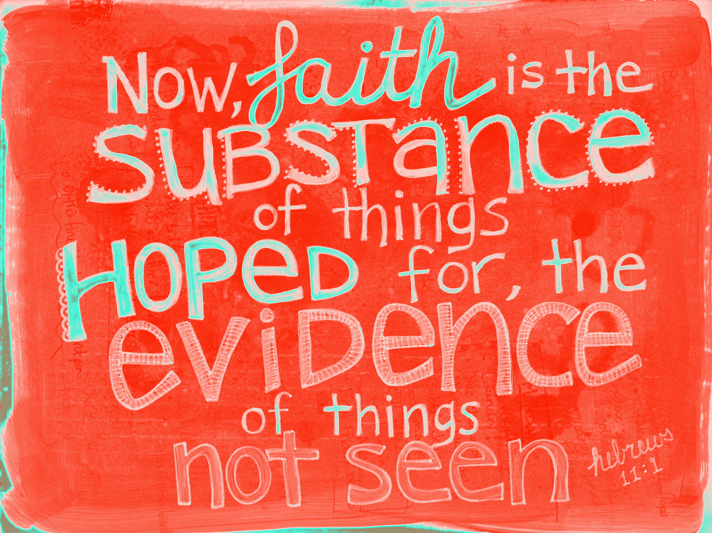
Notes:
Heb 11:1 – “Now faith is the substance of things hoped for, the evidence of things not seen.”
It wasn’t that long ago that adhering to a faith that rested outside of scripture would cause others to look at you with wonder and bewilderment. But times have certainly changed and we are no longer living in a society where faith in Jesus Christ is the prevailing perspective within our nation. Christians of today are the ones viewed as out of touch. We scorned and mocked because we place our trust and faith in the invisible rather than in carnal pursuits. Skepticism and postmodernism are now the dominant dogmas of this degrading society and Islam, which is now being pandered to and pampered by our pompous politicians is fiercely attacking the bible with no mercy. And so what do we do about that? Do we run away from the challenge or do we face it head on? Do we stay home at the base or do we put on the armor of God and join in on the front lines?
If we’re to be true soldiers of Christ, we need to be armed and equipped with the tools to accomplish what Peter talked about in 1 Pet 3:15, and that is to “give an account of the hope that is in you”. Because, truthfully, the objective evidence for Christianity is so abundant, so vast, and so unparalleled that we should have nothing to fear from the critics of our day. On the surface, some of the arguments that these skeptics make can seem intimidating because they bring their big words and their so-called science. And if we’re not familiar with the argument or the logical fallacy being employed, we can come away from such conversations intimidated, thinking that their arguments are out of our league. But that is just not the case.

Slide 2
Why Is Skepticism On The Rise?
We Are Broken People
Notes:
But why is skepticism on the rise?
First, in my experience, the majority of skeptics are broken people, just like us. They’re wrestling w/bitterness, some negative experience, or some unanswered question from years ago that they were never able to answer and its cultivated not only into unbelief, but an antagonistic skepticism. Broken people need Christians who love them enough to talk through the difficult issues openly and honestly, the willingness to address tough topics and provide honest answers.
We can help skeptics overcome the problems that they are hiding within themselves by simply loving them, showing genuine interest in them, and studying with them to uncover what is the real reason they’re denying God.

Slide 3
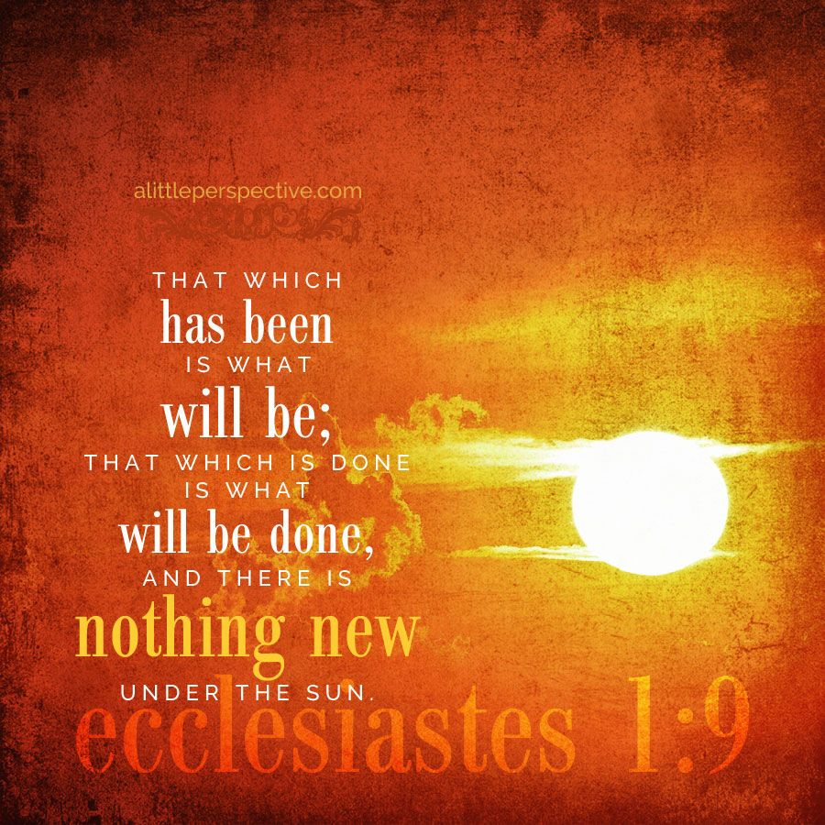
Why Is Skepticism On The Rise?
Bitterness, Negativity, Unanswered Questions
Repeating Old, Recycled Arguments
Notes:
Secondly, most skeptics you’ll talk to are just repeating old, recycled arguments that have already been answered by Christians for years, while never truly considering the abundance of objective evidence that Christianity brings with it. Solomon said in Eccl 1:9 that “there is nothing new under the sun”, and that absolutely applies to discussions with skeptics. Now it may be that it’s the first time you’ve heard a particular argument. That’s ok. Note it, think about it, research it, ask others more experienced for a suggestion on how to answer it, and now you have an extra tool for your spiritual tool belt. But don’t fear the argument.

Slide 4
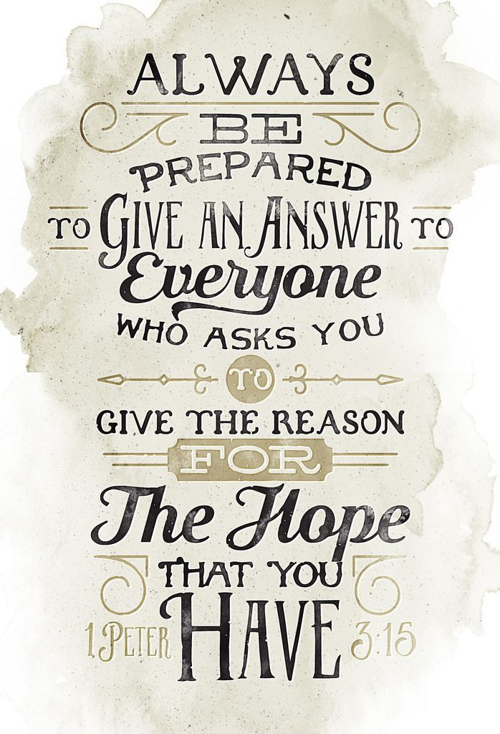
Why Is Skepticism On The Rise?
Bitterness, Negativity, Unanswered Questions
Repeating Old, Recycled Arguments
Christians Are Not Taking The Fight Head On
Notes:
Thirdly, many skeptics are becoming increasingly emboldened towards Christians simply because we’ve lost either the ability or the willingness to take the fight head on. Many Christians are just not making the sacrifice of engaging unbelievers that we see patterned in the NT. We’re becoming lazy, apathetic, or we’re pushing it on the Preachers because, after all, that’s what we pay them for. And yet the preachers don’t have the open doors that you do. They don’t see your coworkers and school mates every day. But you do. And if we are going to boast about being Christians patterned after the NT, then we’re going to have to get out there and get our hands dirty by being evangelistic because that’s what first century Christians did.
Skeptics are doing it. And they’re doing it better than us, winning converts to their cause, with an inferior message. Imagine that. We have the truth, the irrefutable gospel of Jesus Christ, God’s ultimate drawing power to save man, and we don’t use it. The skeptic has clever fallacies, lies, and hot air, and they win more disciples. We need to stand up to skeptics, in the spirit of Christ, and not only show them the answers, but prove we have nothing to fear. Because the evidence for Christianity is so undeniable and so irrefutable, we can be absolutely sure that our faith is not in vain and that it rests on solid ground – true faith, that is.

Slide 5
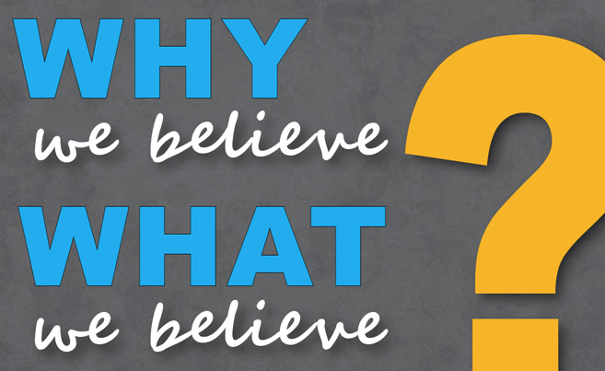
Notes:
And that really begs the following question. And I want everyone here to answer this question for themselves. Why do you believe what you believe? Whether you are a Christian, a Muslim, an Agnostic, or an Atheist, in your mind, go back to the time in your life when you first became convinced of whatever faith you currently hold, and ask yourself, “What is that faith based on?” “What facts, opinions, teachings, influences or led me to where I am today to believe what believe right now?” If we’re completely honest about that, we might actually surprise ourselves with the answer. We might actually find that our faith doesn’t rest on as solid of a basis as it should.

Slide 6
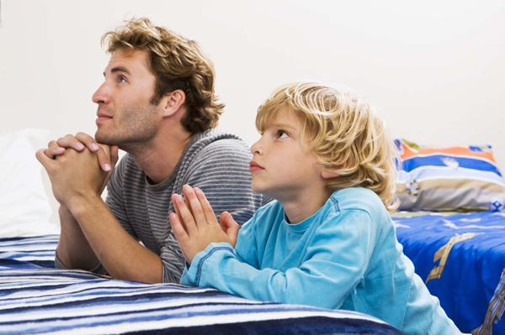
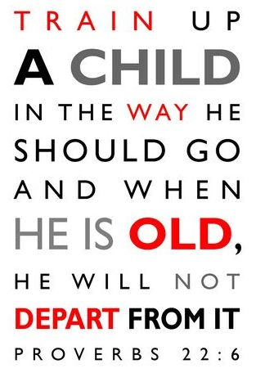
Many Religious Because…
Raised To Believe
Parents
Government
Whose parents are right?
Notes:
Here’s what I mean:
Many in the world believe what they believe simply because it’s what their parents taught them. From the time we were young, our parents, according to what they thought was right, had a significant control over our influences and behavior. So suppose a Christian and a Muslim are engaged in conversation and the Muslim asks the Christian, “Why are you a Christian?” And the Christian answers, “Because that’s how I was raised. My mom and dad took me to church from the time that I was young, taught me the bible, we prayed before every meal and going to bed, and all my friends were Christians.” Does that prove Christianity is right? Could not the Muslim answer in the same way as that Christian? Muslims, from the time they are young, are taken to Mosque, taught to prayer a certain way, taught the Koran from their childhood, and typically make friends with other Muslims. Now it’s true that parents should try to raise their children in a faith that they deem to be the truth – Prov 22:6 – “Train up a child in the way he should go: and when he is old, he will not depart from it.” But, being raised with a particular faith does not prove that that faith is the correct faith. So, if that is the only answer we can give for why we believe what we believe, what makes him wrong and you right? We might answer, “Well, his parents brought him up with the wrong faith.” But, see, that is what he would say about you.

Slide 7
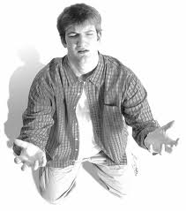
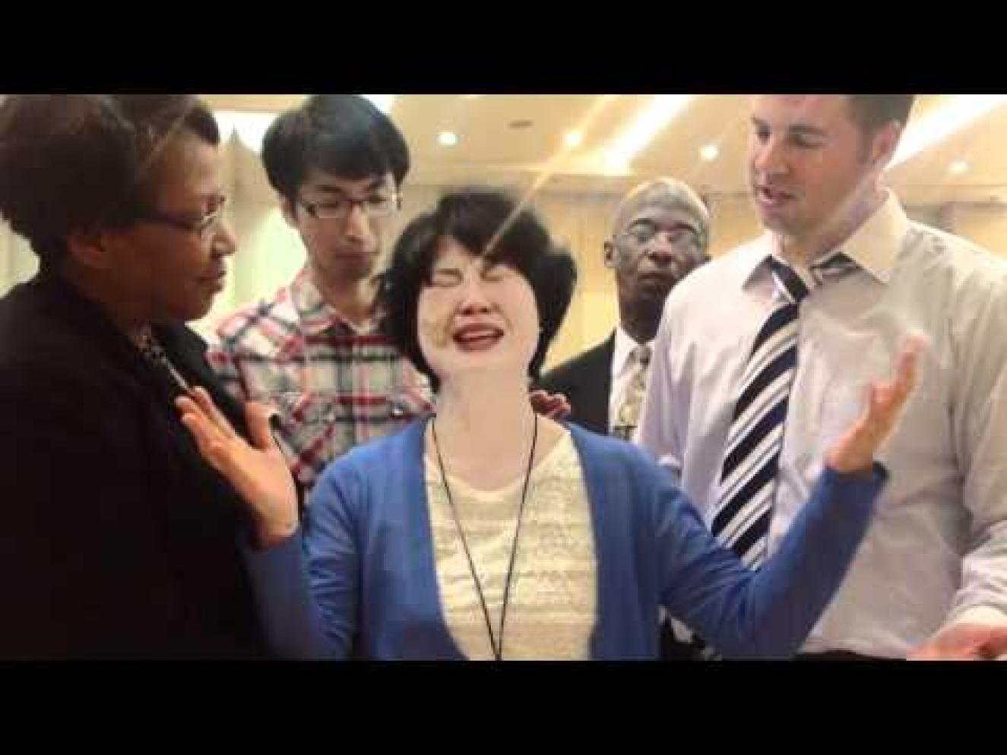
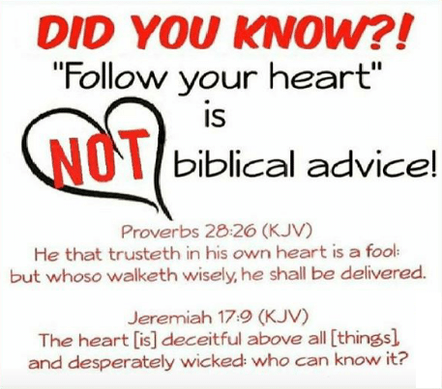
Many Religious Because…
Religious Experience
“Holy Spirit…”
“Feels right…”
“My Heart says…”
Whose feeling is right?
Notes:
Let’s take another example:
A Christian and a Mormon are talking about their individual beliefs and the Christian says, “I know Christianity is right because I’ve had experiences occur in my faith that cannot be otherwise explained. I’ve experienced the power of prayer in my life. I’ve been involved in pray services for those that are sick and I’ve seen them recover. I’ve seen the power of the Holy Spirit at work. Even when I became a Christian, I felt the weight of sin lift from my shoulders so I know Christianity is the right religion because of all of these experiences I have had.”
But couldn’t the Mormon say the same thing? He would say, “I know the book of Mormon is correct and I know Joseph Smith is a prophet because I felt the effects of that in my life. And I’ve seen God answer my prayers. And when I held the Book of Mormon for the first time and asked God if it were true, I felt that burning in my bosom.” Now the Christian would say that the Mormon experience is wrong and the Mormon would say the Christian experience is wrong. So who is right?

Slide 8
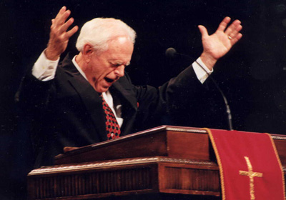
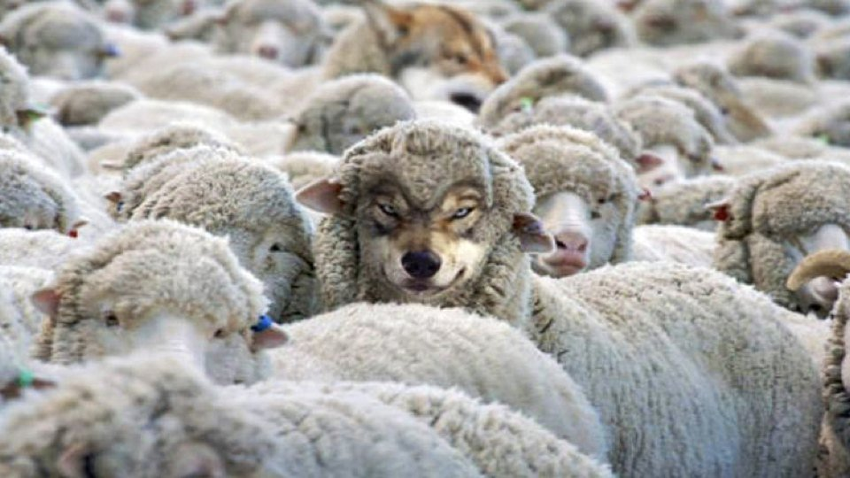
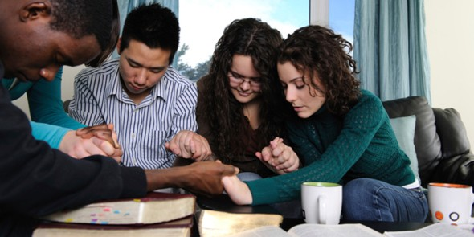
Many Religious Because…
Taught By Someone
Preacher/Pastor
A Friend
Which teacher is right?
Notes:
Another example: Suppose a Christian and a Buddhist are engaged in discussion about their respective beliefs. The Christian says, “I was taught the bible by so and so preacher, perhaps you’ve heard of him, and he is so smart and so eloquent and so kind a person that there is no way what he taught me could be wrong.” Add to that the fact that he perhaps has the title of “reverend” or “father” or “pastor” that precedes his first name and even a PHD that follows. But the Buddhist could say the exact same thing. The Buddhist is well acquainted with intellectuals within his scope of faith who are not only scholars of his faith but appear to bear the fruit of what he teaches as a Buddhist. Well, who is right? And if this is our best and most convincing argumentation, why is one more right than the other?

Slide 9
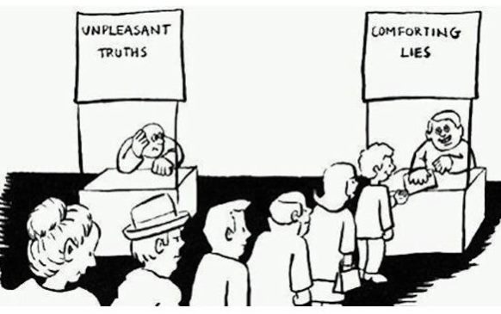
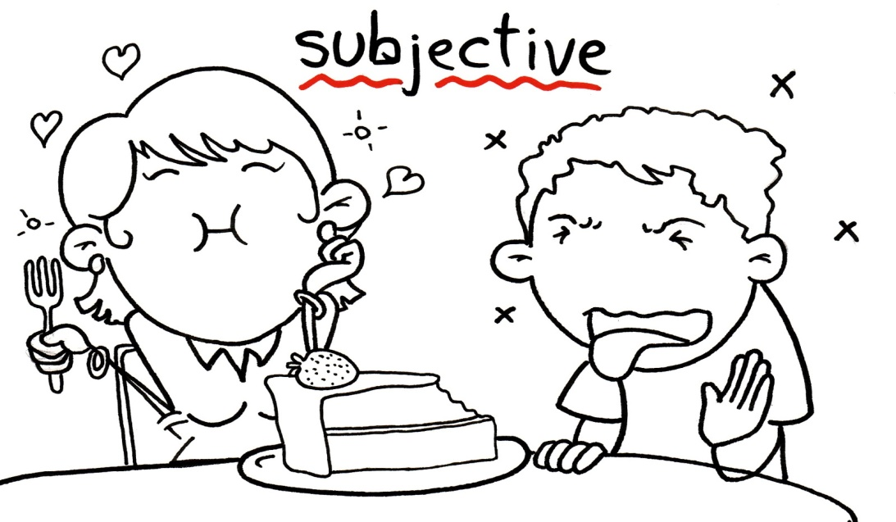
Notes:
Here’s the point, presuppositions, emotional subjectivity, and our relationships w/other people, those things do not validate truth. And when discussing differences, if answers such as these are the best that we can come up with, we’re never going to know whether or not we are truly on the right path

Slide 10
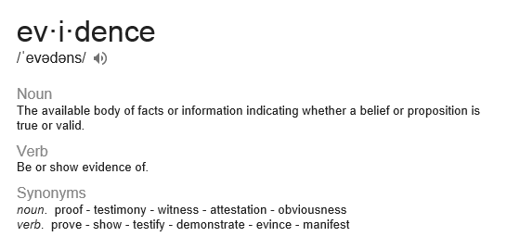
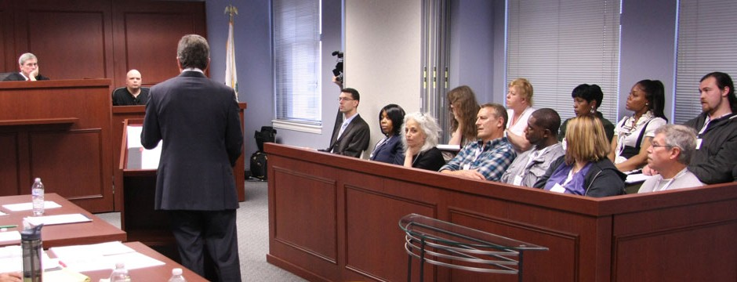
Notes:
The key to actually knowing the truth is evidence. And whatever it is that we believe, that faith we have must find its foundation in evidence. That is, confirmation, proof, facts, verification. Evidence is the means by which all truths are discovered, and in which true faith is produced.
Our entire judicial system is based upon evidence, to such a degree that men and women are tried on capital charges based on evidence even if there were no eye witnesses present at the crime in question. Science makes its astounding discoveries based on evidence. How we make pretty much all of our decisions is based upon evidence. Which car do I buy? Where do I go on vacation next year? Should I marry this person? It may be good evidence or poor evidence. Our analysis of the evidence may be good or bad. But we need to gather the evidence in order to make truly intelligent decisions.
Matt 22:37 – “And He said to him, ‘You shall love the Lord your God with all your heart, and with all your soul, and with all your mind.’”
Now using our mind to logically think through something and uncover the facats is unfortunately easier said than done isn’t it? Too often we allow other things to override rational, thought-out conclusions, and these other things will hinder our search for truth. So let’s consider just a few ways in which we do this

Slide 11
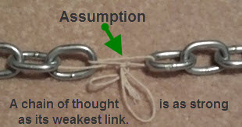
What Hinders Our Search?
Presuppositions & Biases
Notes:
First, as we’ve briefly hit on, the temptation will always exist to cling to some presupposition or bias. Now I want to say this. There’s a sense in which our presuppositions make it possible for us to survive and not go crazy in a world that barrages us with millions of impressions each day. What I mean is that we can’t possibly deal with every stimulus that comes our way. We have to be selective so that we can concentrate on what we perceive to be important at the moment. That is human nature.
But where we can get in trouble is when valid information and evidence comes our way and then we inappropriately screen out that information. Our theories can become so ingrained within us that we don’t recognize those theories as presuppositions and so we just assume that because I feel this way, I must be right. And so it’s when we inspect evidence without awareness of our presuppositions that we can end up not treating that evidence as objectively as we need to.

Slide 12
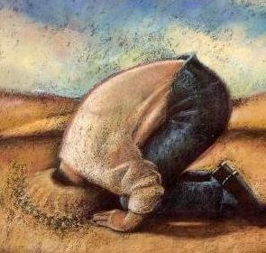
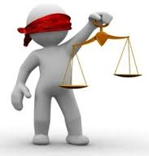
What Hinders Our Search?
Presuppositions & Biases
Intellectual Dishonesty
Notes:
Now, when we allow our presuppositions and biases to hold us back, the 2nd thing it can lead to is intellectual dishonesty. Rom 1:18 – “For the wrath of God is revealed from heaven against all ungodliness and unrighteousness of men who suppress the truth in unrighteousness.” And so when evidence is put before us that’s worth considering and it happens to be strong evidence, but because of where I happen to be in life it is starting to make me feel a little uncomfortable for how true it could be, a common tactic of intellectual dishonesty is to attempt to suppress it or to stonewall and avoid it. We can refuse to answer penetrating questions or try to change the subject or we can resort to name-calling. There was one guy that I would debate with and anytime I backed him in a corner with a solid argument, he would laugh at me and mock me. These are versions of the proverbial ostrich in that I try to stick my head in the sand and just hope the evidence goes away. But none of these things help us find the truth, all they do is make me feel better about myself at the expense of having rational and reasonable discussions based on the actual evidence.

Slide 13
What Hinders Our Search?
Presuppositions & Biases
Intellectual Dishonesty
Apathy
Notes:
But then third, learning the truth will absolutely be hindered when we decide to be apathetic toward the evidence; we just don’t care. We’re set in our ways, it’ll cost me too much to change my view, and so I’d just rather be blissfully ignorant and not deal with it. Sometimes our apathy can actually be disguised by the humanistic belief that there really is no right or wrong answer to begin with. Some skeptics that I’ve talked to have become rather comfortable with what they believe to be the “unknowable”. And so they’ll argue that the very fact people don’t agree on everything is itself evidence that no one can ever know whether there is a God or Who He is for that matter.
Now there are some things in life that I might apply that reasoning to. For example, should I eat whey protein or soy protein? Some have said babies should sleep on their backs, some say on their side. There are a lot of things like this that come and go in cycles and so some people just throw up their hands and quit and don’t bother trying to figure out for themselves what is right or wrong. The problem with this type of apathy toward spiritual things is that if that is your view toward Christianity, you are potentially dealing with a life or death scenario. If Christianity is correct, as I believe it is based on the evidence, this kind of apathy will be infinitely more hazardous to your spiritual health than anything else. And because of the richness of evidence for Christianity, I really can’t afford to at least give all this evidence an honest and thorough glance before I decide that I’m going to stop caring

Slide 14
Notes:
And so the point is, whatever happens to be my belief, whether it’s a faith in God and the bible or a faith that denies His existence, can I personally point to objective evidence for that faith to prove that my faith stands on solid ground? Because if you do have faith in God and in the bible, which is the case for the overwhelming majority of us here, and for good reason, here’s the thing: the bible itself teaches us that evidence must be the basis of our faith. And this can be one of the most common misconceptions about Christianity, that we’re just a bunch of people who don’t think, who stick our fingers in our ear going “Na na na” and that we don’t care what science says. That’s bologna. The bible does not teach that kind of faith.

Slide 15
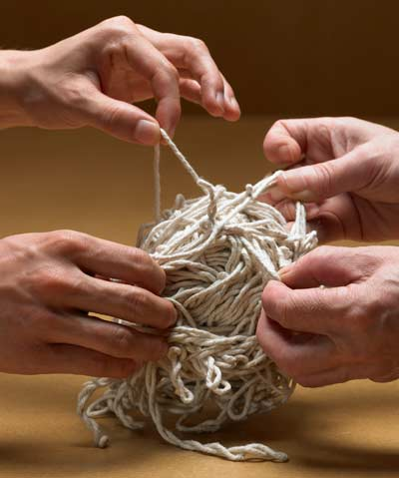
What Is True Faith?
Wrong definitions:
“Faith begins where reason ends”
“Faith is believing what you know can’t be true”
“Faith is believing when common sense tells you not to
“Faith is unquestionable belief that doesn’t require proof/evidence”
Bible teaches evidence is the basis of faith
Notes:
For example, some will say, “Faith begins where reason ends” – Meaning, if I choose to believe in God and believe in the bible, I must do so in an absence of reason. That is not what the bible teaches. And therefore that cannot be our reason to have faith – Heb 11:1 – “Now faith is the substance of things hoped for, the evidence of things not seen.” The “hope” in this verse is not wishful thinking. It’s not the idea of, “I hope the weather is nice again this week”. The Greek word used for “hope” indicates a confident expectation in that we have good reason to hope in something In other words, while faith is believing in the unseen, its believing in the unseen because we have good reason, valid evidence, to do so. When Isaiah contends with the Jews in Isa 1:18, He says, “Come and let us reason together.” And therefore, its God who wants our faith to be based on reason, and if that is the case we can have confident expectation that He has provided us with that evidence.
“Faith is believing what you know can’t be true” – This is what Mark Twain once said about faith. And I’ve met some Christians who seem to take pride in the fact they believe things that are irrational and then thinking that that type of faith is pious. But that is not what Jesus taught – John 8:31-32 – “So Jesus was saying to those Jews who had believed Him, ‘If you continue in My word, then you are truly disciples of Mine; and you will know the truth, and the truth will make you free.’” So in the bible, there is a relationship between believing, that is “faith”, and then truth. Faith is believing things we know are true because the objective evidence for that faith is undeniable.
“Faith is believing when common sense tells you not to”. This takes rationality completely out of the equation, doesn’t it? As if God wants us to completely separate our minds from our faith. 1 John 1:1-3a – “What was from the beginning, what we have heard, what we have seen with our eyes, what we have looked at and touched with our hands, concerning the Word of Life—and the life was manifested, and we have seen and testify and proclaim to you the eternal life, which was with the Father and was manifested to us—what we have seen and heard we proclaim to you also…”. So why did John believe? Because He saw, He heard, and He touched. He used 3 of his 5 senses to make His decision just as every other eye-witness did. And then those who were in the best possible position to know then reported it back to us and led lives of virtue and sacrifice that gives credence to their claim. That isn’t believing in something when common sense tells you not to, it’s the exact opposite. It’s being so impressed by the strength of the evidence, that you have no choice but to believe.
“Faith is unquestionable belief that doesn’t require proof/evidence”. I’m going to show you in the following verses that the bible teaches the exact opposite of that view, that evidence is the basis of true faith

Slide 16
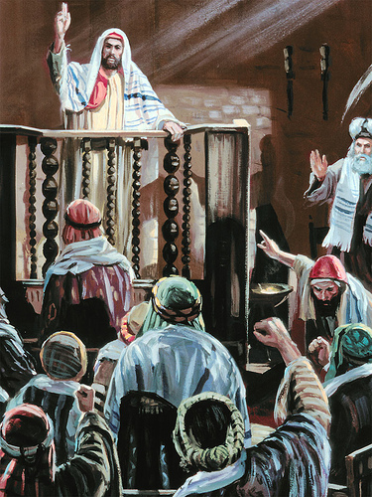
Evidence: The Basis For Faith
Acts 17:2-4b - ²And according to Paul's custom, he went to them, and for three Sabbaths reasoned with them from the Scriptures, ³explaining and giving evidence that the Christ had to suffer and rise again from the dead, and saying, “This Jesus whom I am proclaiming to you is the Christ.” ⁴And some of them were persuaded and joined Paul and Silas, along with a large number of the God-fearing Greeks and a number of the leading women.
Notes:
When the Apostle Paul traveled the world preaching Jesus Christ, one of the first places He would do so was in the synagogue of the Jews. He would go in there on the Sabbath Day, and use the Old Testament scriptures to proclaim the gospel of Jesus Christ.
Acts 17:2-4 – “And according to Paul’s custom, he went to them, and for three Sabbaths reasoned with them from the Scriptures, explaining and giving evidence that the Christ had to suffer and rise again from the dead, and saying, ‘This Jesus whom I am proclaiming to you is the Christ.’ And some of them were persuaded and joined Paul and Silas, along with a large number of the God-fearing Greeks and a number of the leading women.”
In other words, Paul didn’t teach a Christianity devoid of common sense and objectivity. Paul reasoned with them from scripture by explaining the passages and giving evidence, and it was on that basis that some were persuaded and for no other reason. And so when those persuaded went out persuading others, they could likewise point to the same evidence that Paul did for why they believed what they believe because that is what their faith was based upon: evidence.

Slide 17
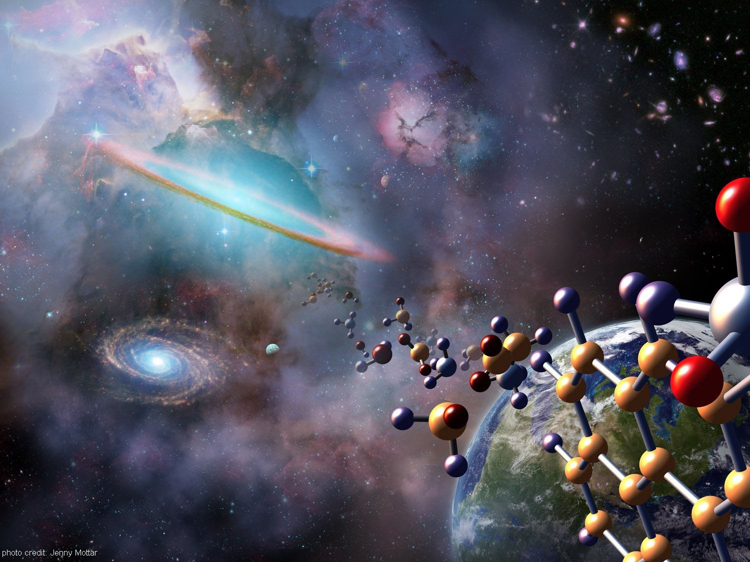
Evidence: The Basis For Faith
Rom 1:18-20 – “¹⁸For the wrath of God is revealed from heaven against all ungodliness and unrighteousness of men who suppress the truth in unrighteousness, ¹⁹because that which is known about God is evident within them; for God made it evident to them. ²⁰For since the creation of the world His invisible attributes, His eternal power and divine nature, have been clearly seen, being understood through what has been made, so that they are without excuse.”
Heb 11:3 – “By faith we understand that the worlds were prepared by the word of God, so that what is seen was not made out of things which are visible.”
Notes:
In the first chapter of Romans, Paul is discussing the accountability toward God of the Gentiles, that though they were a people without the Mosaic law, there was sufficient, general revelation for them to believe in God.
Rom 1:18-20 – “For the wrath of God is revealed from heaven against all ungodliness and unrighteousness of men who suppress the truth in unrighteousness, because that which is known about God is evident within them; for God made it evident to them. For since the creation of the world His invisible attributes, His eternal power and divine nature, have been clearly seen, being understood through what has been made, so that they are without excuse.”
The key is God made His existence evident within us as well as throughout the creation so that by merely looking at existence itself, we all can see the abundant evidence for God’s presence. This isn’t blind faith in the invisible, it’s understanding that there are visible signs within existence that point to the invisible, those things we cannot see. Going back to an illustration that I used earlier, isn’t this how our judicial system works? A person in our society can be convicted of murder even if there were no eye-witnesses to see him commit the murder in question. How is that fair? Because a jury of his peers examines the evidence, the things they can see, evaluate it with their senses, and try to decide whether those visible things are convincing enough to prove beyond a shadow of a doubt a capital crime was committed that was in fact invisible to their eyes. That’s exactly how faith in God works. We may not see God with our eyes, but we do see other pieces of visible evidence that points to the invisible.
Heb 11:3 – “By faith we understand that the worlds were prepared by the word of God, so that what is seen was not made out of things which are visible.”
So when a skeptic says, “I refuse to believe in God unless He shows Himself to me in Person.” Well, first of all, if the bible is true, you don’t want that, because the day that happens is called Judgment Day, that’s going to be it for you. You’re done. On judgment day, there is no more atonement available for your sins. But, secondly, ask the skeptic, “Is that how the judicial system works? Don’t we make life and death decisions based on evidence even if we couldn’t see the act itself with our own eyes?” Likewise, spiritual life and death decisions are made on the basis of visible facts that point to invisible truths.

Slide 18
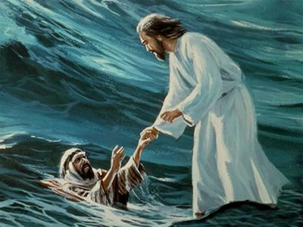
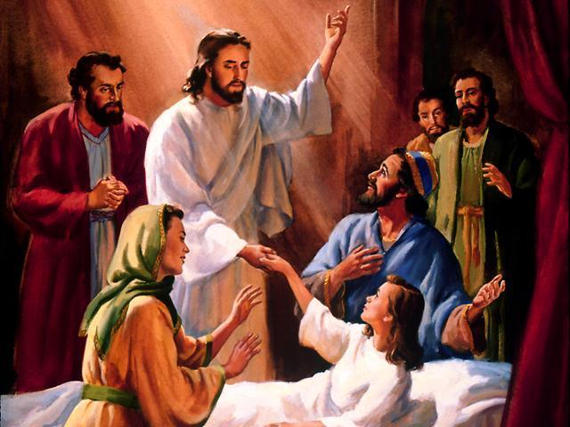
Evidence: The Basis For Faith
John 5:31 - “If I alone testify about Myself, My testimony is not true.”
John 5:36 – “But the testimony which I have is greater than the testimony of John; for the works which the Father has given Me to accomplish--the very works that I do--testify about Me, that the Father has sent Me.”
Notes:
This is the exact reasoning that Jesus used when He was here on Earth.
John 5:31 – “If I alone testify about Myself, My testimony is not true.” In other words, Jesus didn’t come on the scene claiming these grandiose things and then following it up with, “You just have to take my word for it.”
Jesus knew a person’s testimony in and of itself is not sufficient evidence and He applied that same reasoning to Himself. You know, our friends from the Holiness movements, Charismatics, Pentecostals, and the like, will make claims to miracles and expect that the claim alone should prove the validity of their claim. And the moment we ask for evidence they will say, “Oh ye of little faith”. Jesus Himself said the testimony of a person alone does not substantiate his claim. So what did Jesus say did substantiate His claims?
John 5:36 – “But the testimony which I have is greater than the testimony of John; for the works which the Father has given Me to accomplish—the very works that I do—testify about Me, that the Father has sent Me.”
In other words, the miracles He performed confirmed His testimony because no one could do the things that Jesus did unless God had given Him that ability. They were too incredible. They were greater than the testimony of John the Baptist, and also included the testimony of the Father, and the testimony of scripture. All these things were the evidence that pointed to Jesus as the Messiah

Slide 19
Evidence: The Basis For Faith
John 10:37-38 – “³⁷If I do not do the works of My Father, do not believe Me; ³⁸but if I do them, though you do not believe Me, believe the works, so that you may know and understand that the Father is in Me, and I in the Father.”
Notes:
John 10:37-38 – “If I do not do the works of My Father, do not believe Me; but if I do them, though you do not believe Me, believe the works, so that you may know and understand that the Father is in Me, and I in the Father.”
Jesus has already answered their false charges of blasphemy, but now He is taking it to another level. Whether He is a blasphemer or not ultimately depends upon whether or not He represents God, and to prove this He appeals again to His works. Are they or are they not the works of the Father? They had their Old Testaments and saw the works of the Father from those time periods and they could make a comparison.
In the upcoming studies, we’re going to be looking at “works” within Creation that point to God’s existence as well as His character.

Slide 20
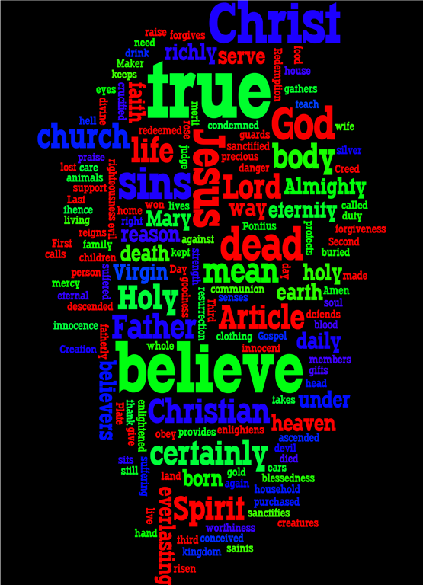
Evidence: The Basis For Faith
John 20:30-31 – ³⁰Therefore many other signs Jesus also performed in the presence of the disciples, which are not written in this book; ³¹but these have been written so that you may believe that Jesus is the Christ, the Son of God; and that believing you may have life in His name.
Notes:
John 20:30-31 – “Therefore many other signs Jesus also performed in the presence of the disciples, which are not written in this book; but these have been written so that you may believe that Jesus is the Christ, the Son of God; and that believing you may have life in His name.”
John says, “I’m writing about this so you will believe, and the signs present in this letter are the evidence upon which you can measure your faith.” Biblical faith, in fact, all true faith, must be based on evidence or else it cannot truly be faith, at least not faith that rests on a solid foundation.

Slide 21
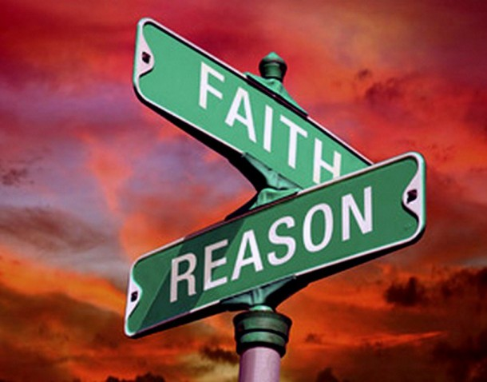
Notes:
The point of this lesson is that if you do not believe in God, the goal is not to trick you into doing so, or to fill your mind with silliness or subjective arguments based on feeling. That’s not the way faith works and its never been the way it works – not in the 1st century or any other century that came later. Faith in God is about submitting to objective truths that cannot be denied and that cannot be successfully countered.

